Slide 1
Computationally binding quantum commitments
Dominique Unruh
University of Tartu
v2

Slide 2
Scope of this talk: Commitments
Hiding and binding
Hiding seems well understood
Statistically vs. computationally binding
Weaker assms, everlasting security
Interactive vs. non-interactive
For now
Secure against quantum attacks
Classical protocols

Slide 3
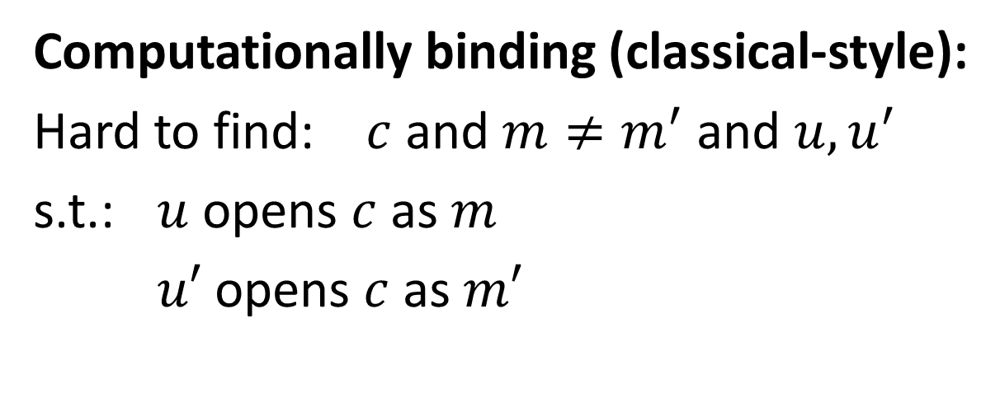
Classical definitions
$$c$$
Commit:
S
R
$$m, u$$
Open:
Computationally binding (classical-style):
Hard to find: $c$ and $m≠m^{′}$ and $u,u^{′}$
s.t.: $u$ opens $c$ as $m$
$u′$ opens $c$ as $m′$
$⟹$ Adv. cannot change his mind

Slide 4
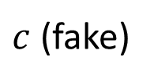
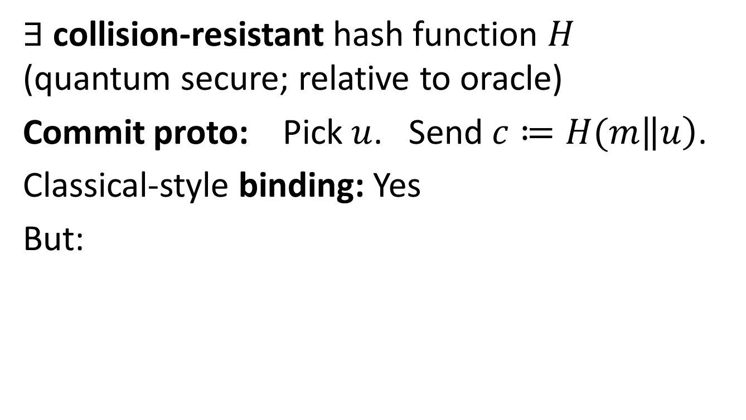

Classical-style binding: no good
$∃$ collision-resistant hash function $H$ (quantum secure; relative to oracle)
Commit proto: Pick $u$. Send $c≔H(m\left\|u\right)$.
Classical-style binding: Yes
But:
Adv
$c$ (fake)
$$m (random)$$
$$u$$
with $H(m\left\|u\right)=c$

Slide 5
New definitions needed
Classical def of computationally binding:
Not useful for post-quantum crypto
Collision-resistance
Weaker than expected
Stronger def? (NIST post-quantum competition?)
Our proposal: “Collapse-binding” commitments
Our proposal: “Collapsing” hash functions

Slide 6
Existing defs (binding)
Various prior def’s
Brassard, Crépeau, Damgård, Dumais, Fehr, Jozsa, Langlois, Lunemann, Mayers, Salvail, Schaffner
Various problems:
Need trapdoors (or even UC)
Rewinding proofs difficult
No parallel composition
Do not imply knowledge of message

Slide 7

Collapse-binding commitments
Adv. A outputs commitment $c$ (classically), and valid openings $m,u$ (in superposition)
Def: Collapse-binding = A cannot distinguish
$$|m〉$$
$$|m〉$$
A
A
A
measure
A
or
$$|u〉$$
$$|u〉$$
$$c$$
$$c$$

Slide 8
Why this def?
Intuition:
Adversary cannot produce several openings in superposition
If he could, he’d notice measurement
Formally:
Weaker than “non-existence of two openings” (perfect)
Stronger than “hard to find two openings” (class.-style)
kind of…
$$|m〉$$
$$|m〉$$
measure
A
A
A
A
$$|u〉$$
or
$$|u〉$$
$$c$$
$$c$$

Slide 9
Properties
Perfect binding $⟹$ collapse-binding $⟹$ classical-style binding
Avoids “change of mind”
Composes in parallel
Rewinding friendly
gives ZK arguments of knowledge
Simple constructions from “collapsing” hashes
✔
✔
✔
✔
✔

Slide 10
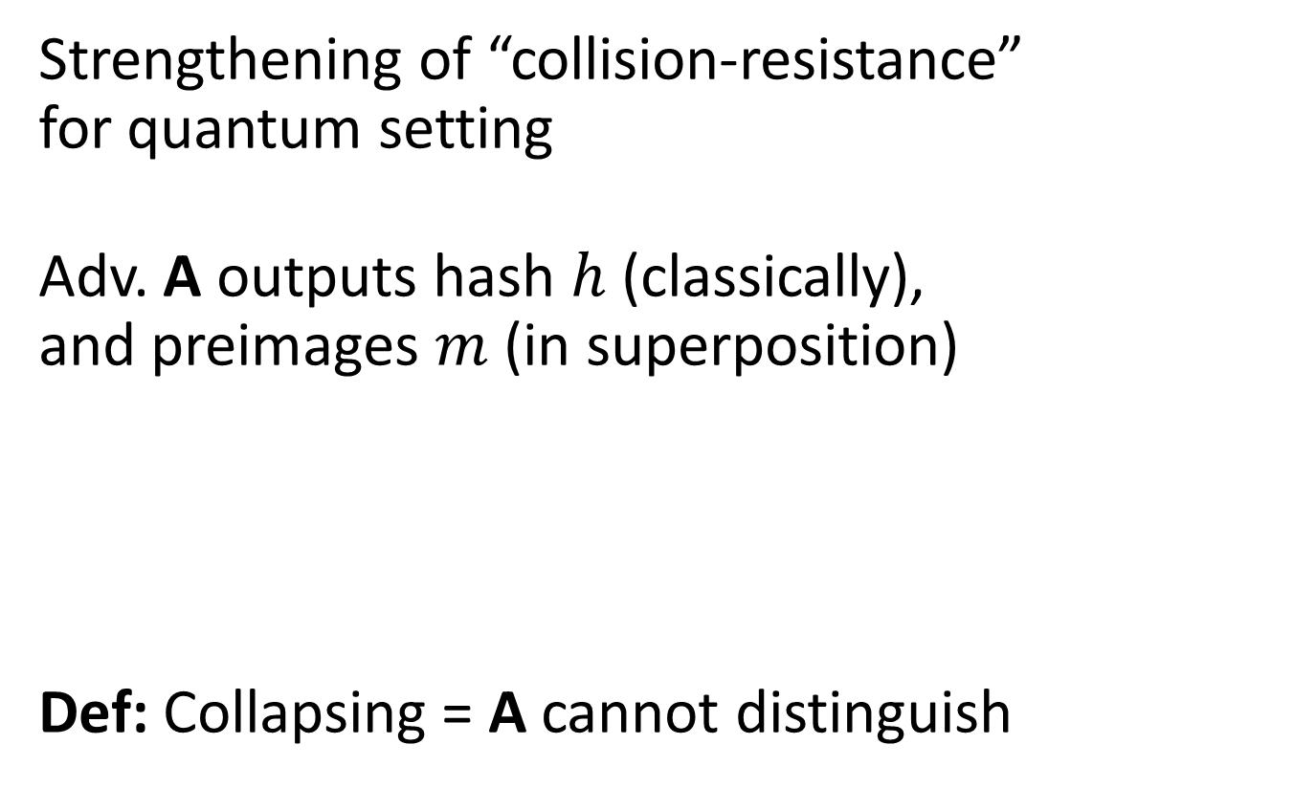
Collapsing hash functions
Strengthening of “collision-resistance” for quantum setting
Adv. A outputs hash $h$ (classically), and preimages $m$ (in superposition)
Def: Collapsing = A cannot distinguish
$$|m〉$$
$$|m〉$$
A
A
A
measure
A
or
$$h$$
$$c$$

Slide 11
Collapsing hash functions (ctd.)
Simple “collapse-binding” commitments
Statistically hiding
Using collapsing hashes in existing constructions
Drop in replacement for “collision-resistance”?
Random oracle is collapsing hash
Suggestion: “Collapsing” required property for hashes
e.g., NIST post-quantum crypto competition

Slide 12
Open questions
Collapse-binding com’s based on OWFs?
Implications between defs?
(partially done)
Are SHA-2, SHA-3, … collapsing?
(partially done)
Protocols using collapse-binding com’s

Slide 13
I thank for your attention
This research was supported by European Social Fund’s Doctoral Studies and Internationalisation Programme DoRa

