Slide 1
IACR Financial Report
Eurocrypt 2026
Brian LaMacchia
treasurer@iacr.org

Slide 2
Financial Highlights
The IACR continues to maintain a good financial position
  Our total assets are ~1.8-1.9x annual expenses
Comparing FY23 vs FY24 vs FY25:
  YoY revenue growth FY24/FY23: -4.40%, FY25/FY24: 9.53%
  YoY expense growth FY24/FY23: -7.58%, FY25/FY24: 0.81%
  Cryptography Research Fund for Student Speakers:
  ~41.5% increase FY23→FY24, 26.96% FY24 → FY25.
  For FY25, operating expenses were ~5.8% on top of conference expenses
Credit card fees for FY25 averaged 3.13% (up from FY24 3.07%)

Slide 3
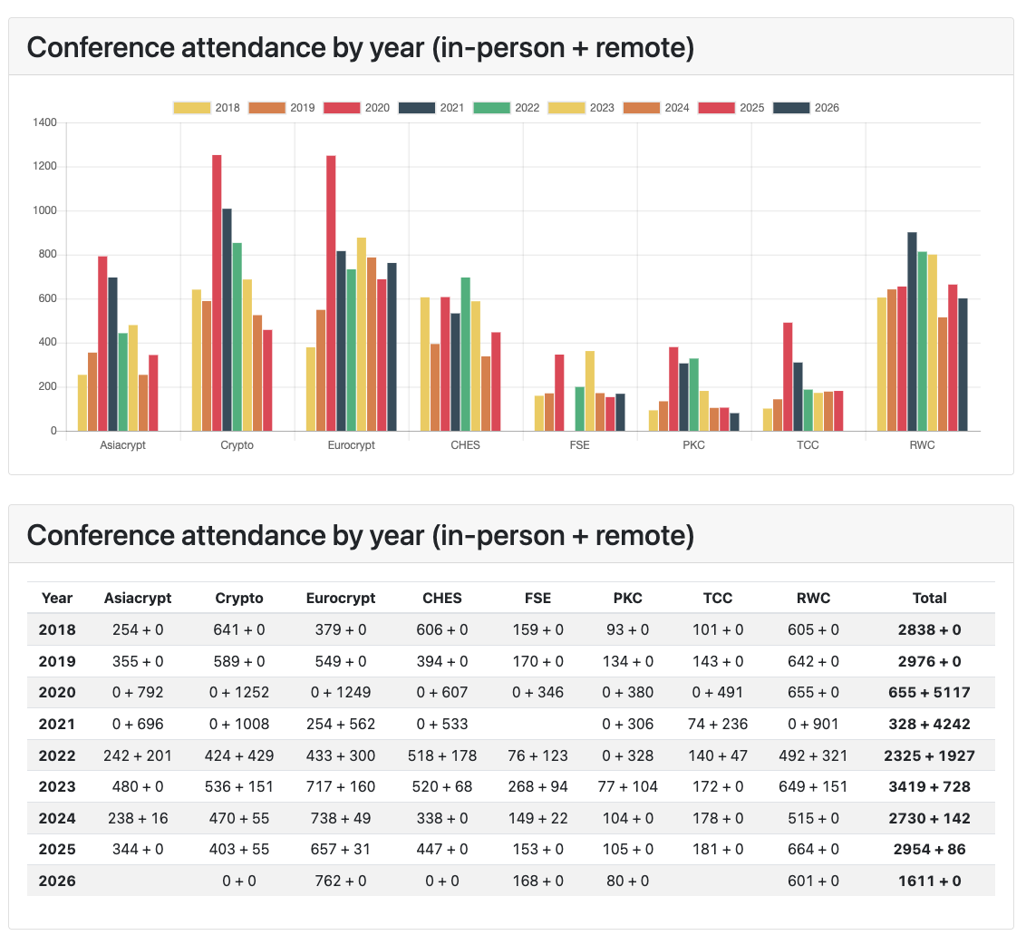

Slide 4
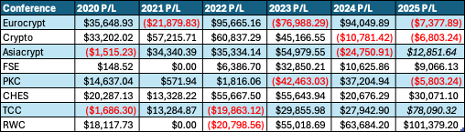
Conference Performance 2020-2025

Slide 5
IACR’s Investment Philosophy
(in response to a question asked last year at EC’25)

Slide 6
IACR’s Investment Policy and Strategy
In 2019, the Board adopted an Investment Policy & Procedures document together with an Investment Strategy. Together these govern how the IACR’s unrestricted funds are managed and invested.
The Investment Strategy allocates unrestricted funds to
Operating Fund: assets for day-to-day operations (checking accounts, money-market funds, 3-month T-Bills, etc.)
Investment Fund: assets allocated to long-term investments (e.g., our “endowment” investments)

Slide 7
IACR’s Investment Fund Strategy (2)
The Investment Fund is sub-divided between a Mid-term Fund and a Long-term fund
Mid-term fund: Investment horizon >2 years
  100% Short Term US Bonds
Long-term fund: Investment horizon >= 3 years. Target allocations:
  45% Total U.S. Stock Market
  25% Total International Stock Market
  30% Total Intermediate-Term Bonds

Slide 8
Long-Term Fund Components
Target % of Fund | Investment Class | Mutual Fund | Expense Ratio
45% | Total U.S. Stock Market | FIDELITY TOTAL MARKET INDEX FUND (FSKAX) | 0.015%
25% | Total International Stock Market | FIDELITY INTERNATL INDEX FUND (FSPSX) | 0.035%
30% | Total Intermediate-Term Bonds | FIDELITY U.S. BOND INDEX FUND (FXNAX) | 0.025%
*Note: The IACR uses Fidelity index funds for its portfolio, but you could also build a similar portfolio using other mutual fund or ETF families. For example, here are similar proposals using Vanguard funds/ETFs:
Vanguard Total Stock Market Index Fund (VTSAX)
Vanguard Total International Stock Index Fund (VTIAX)
Vanguard Total Bond Market Fund (VBTLX)
Vanguard Total Stock Market Index Fund ETF (VTI)
Vanguard Total International Stock Index Fund ETF (VXUS)
Vanguard Total Bond Market ETF (BND)

Slide 9
Current Long-Term Fund Allocation
(as of Monday, 11-May-2026)

Slide 10
Additional resources:
If you’re interested in reading more about this style of investing (sometimes called the “three-fund portfolio”):
r/bogleheads on Reddit (“Passive Indexing Community for Long-Term Lazy Investors”)
https://www.bogleheads.org/wiki/
  https://www.bogleheads.org/wiki/Bogleheads%C2%AE_investment_philosophy
  https://www.bogleheads.org/wiki/Three-fund_portfolio

Slide 11
Questions for IACR Treasury?

