Slide 1



Methodology for Efficient CNN Architectures in Profiling Attacks
Gabriel ZAID, Lilian BOSSUET, Amaury HABRARD, Alexandre VENELLI
Univ Lyon, UJM-Saint-Etienne, CNRS Laboratoire Hubert Curien UMR 5516 F-42023, Saint-Etienne, France
Thales ITSEF, Toulouse, France
TCHES 20 – Virtual Conference

Slide 2
What is a Side-Channel Attack?

Slide 3

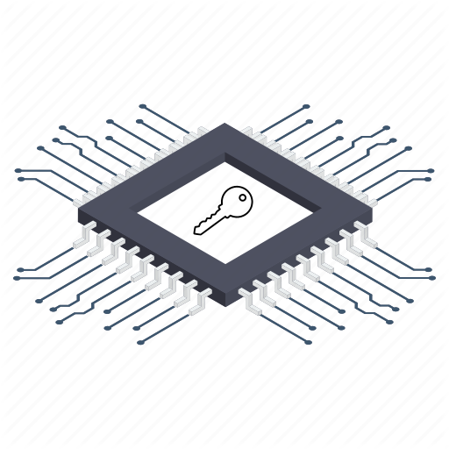



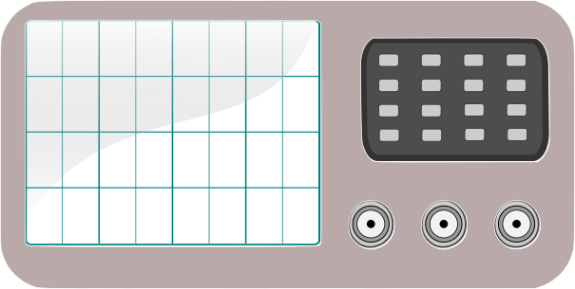
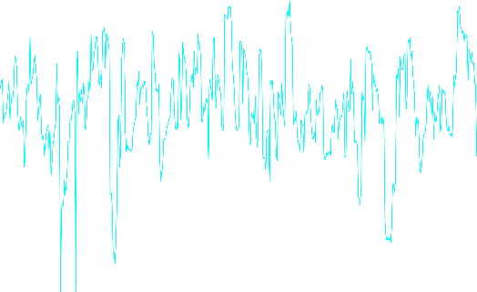
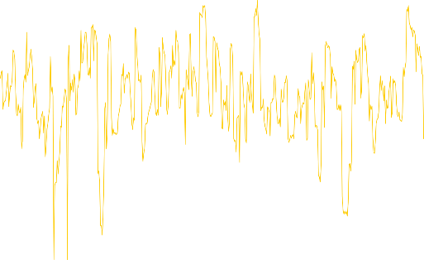


Plaintext = 0x17130198f8adb9ab
Secret Key = 0x25404f9d6bcc3c68
Plaintext = 0xda1294ddc28b466b
Secret Key = 0x89e8f11831b71a05

Slide 4




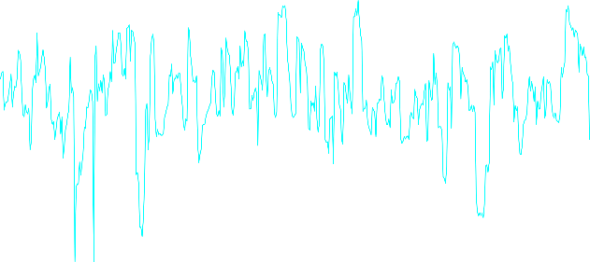



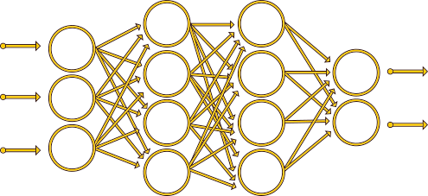
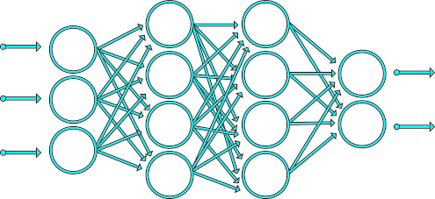
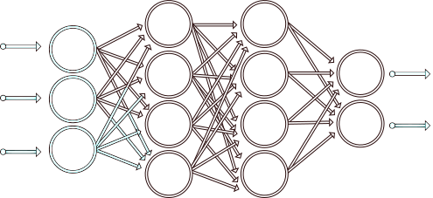
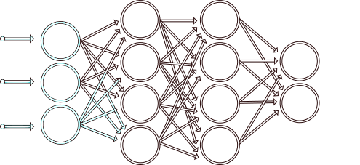
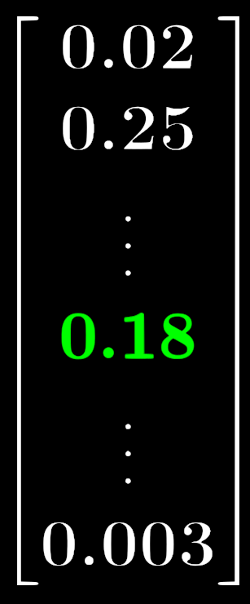




Profiling phase
Plaintext = 0x5e44a0b8cd0e4c5f
Secret Key =
Plaintext = 0x13c635b1ab74bab0
Secret Key = ?
Plaintext = 0x17130198f8adb9ab
Secret Key = 0x25404f9d6bcc3c68
Plaintext = 0x5e44a0b8cd0e4c5f
Secret Key = ?
Plaintext = 0xda1294ddc28b466b
Secret Key = 0x89e8f11831b71a05
Attack phase
Model Trained !

Slide 5


Why is DL interesting for performing SCA?
Pros:
Reduces the preprocessing
Efficient against classical countermeasures (e.g. desynchronization [CDP17, MDP20], dummy operations [LH20], …)
Wide range of applications (noise reduction [WP20], multiple inputs [GGH20], probe repositioning [RWM19], leakage detector tool [BP20], …)
Cons:
DL vs SCA metrics
Black box tool (explainability)
Generation of suitable models for SCA
Good understanding of DL-SCA is crucial to evaluate its limitation

Slide 6
How to select model hyperparameters for efficient CNN architectures in Profiling Attacks?

Slide 7

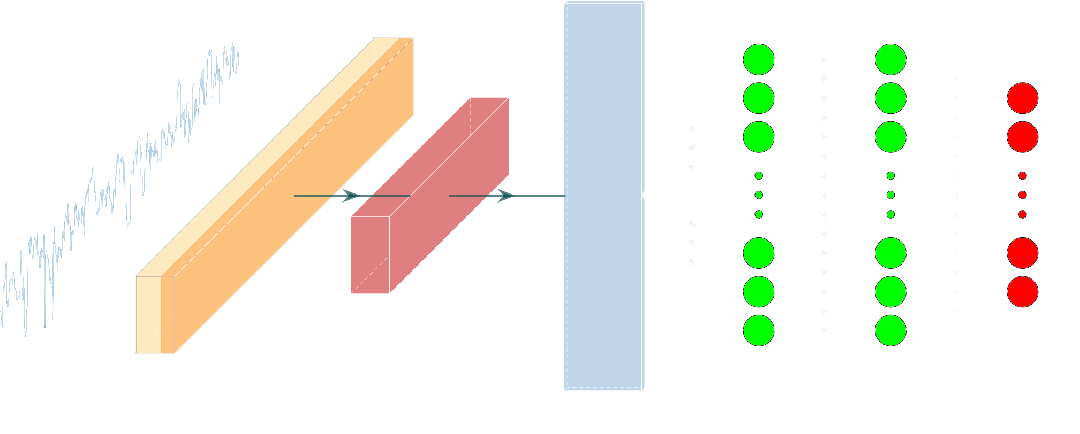
Convolutional Neural Networks (CNN)
How can we construct an efficient convolutional part ?

Slide 8

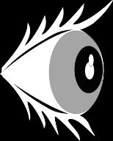







Global Network Evaluation [MDP19]:
Convolutional Part Evaluation:
- Weight Visualization (more details [ZBHVb])
- HeatMaps
8

Slide 9

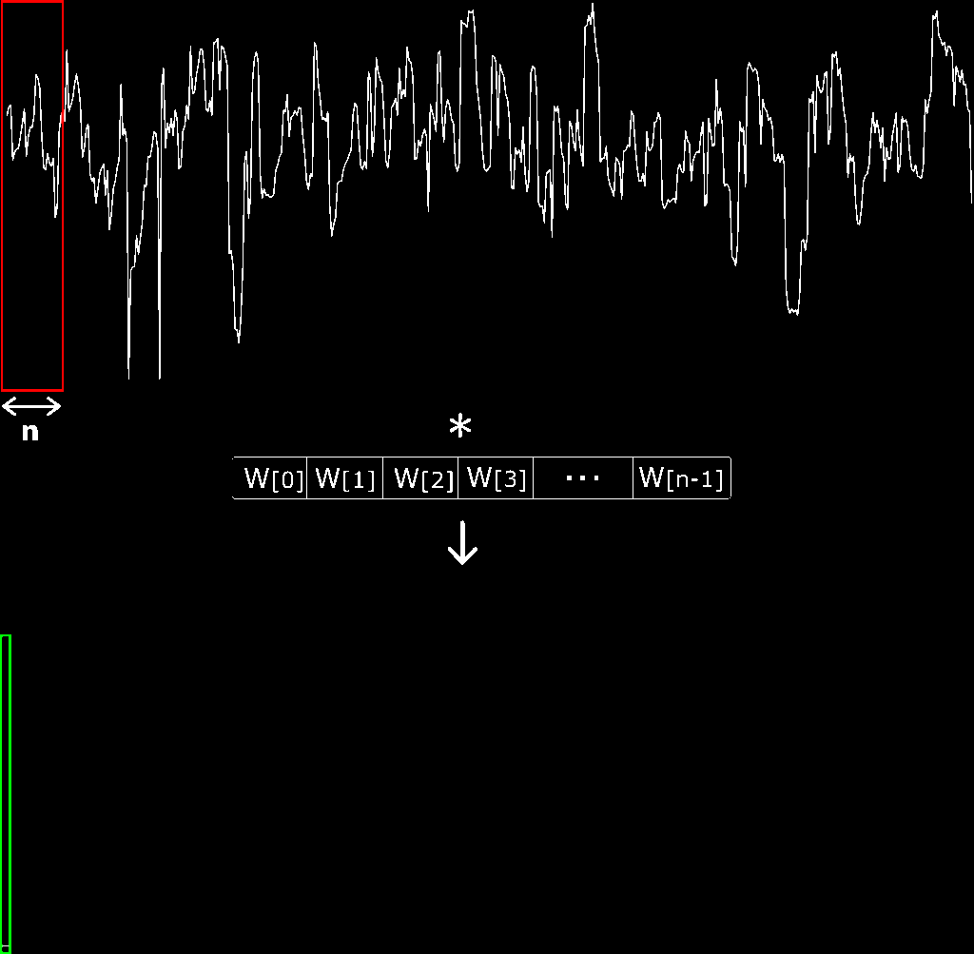




Composed by $n_{f}$ filters of size $n$:
Features extraction through a series of convolutional operations:
(Non-linear function)

Slide 10



How does the filter size impact the PoIs’ selection?
Weight Visualization
Low noise dataset – Chipwhisperer (8-bit XMEGA Target, unprotected AES-128)
Take-away message: The filter size impacts the precision of the features detection

Slide 11


Divides the dimension of the trace such that most of the relevant information is preserved
Average Pooling:
Max Pooling:
  Unshared information is preserved
  The same most sensitive information is spread

Slide 12
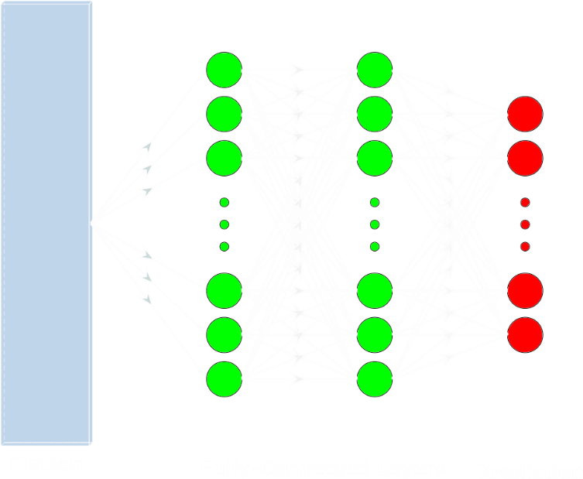
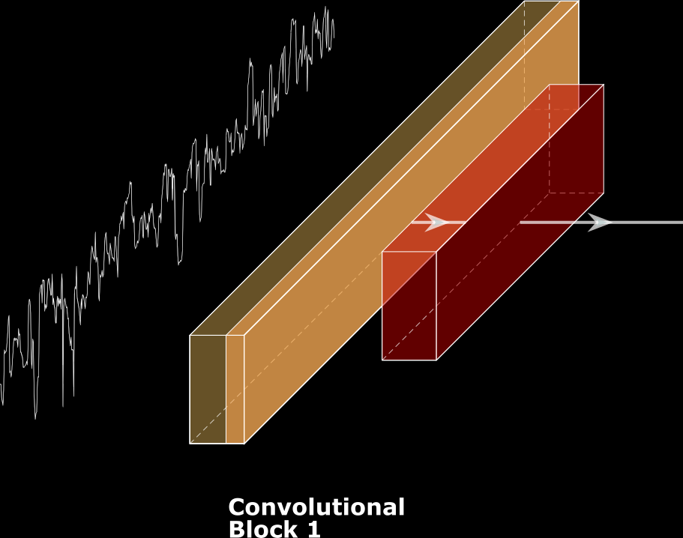
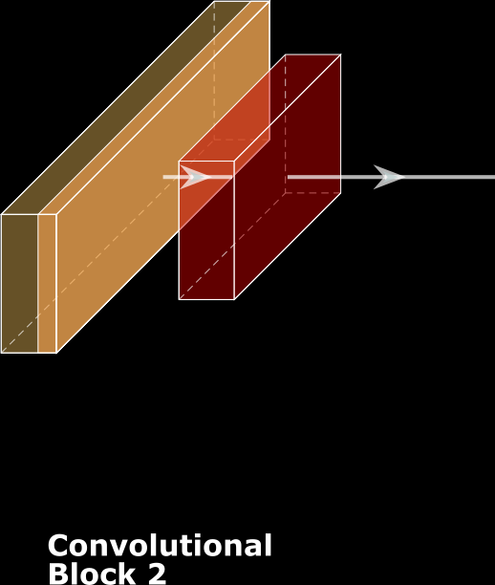
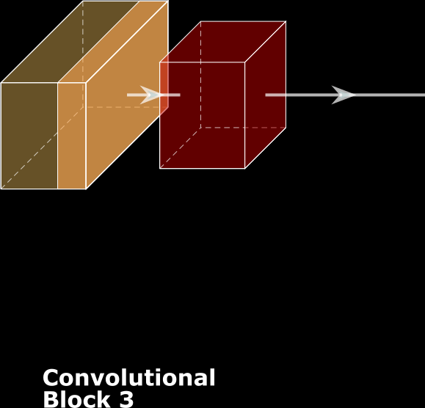
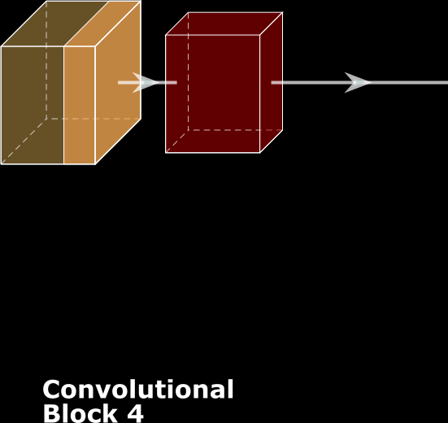


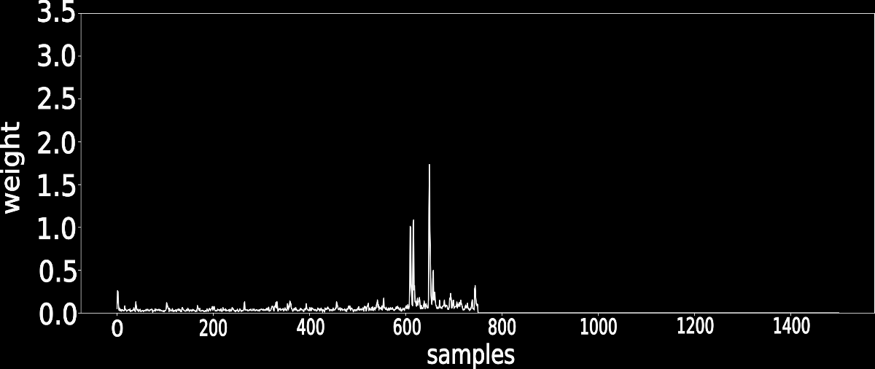

How does the number of convolutional blocks impact the PoIs’ selection?
Weight Visualization
Weight Visualization
Take-away message: Increasing the number of convolutional blocks reduces the desynchonization effect

Slide 13
Methodology for efficient CNN architectures with known desynchronization

Slide 14
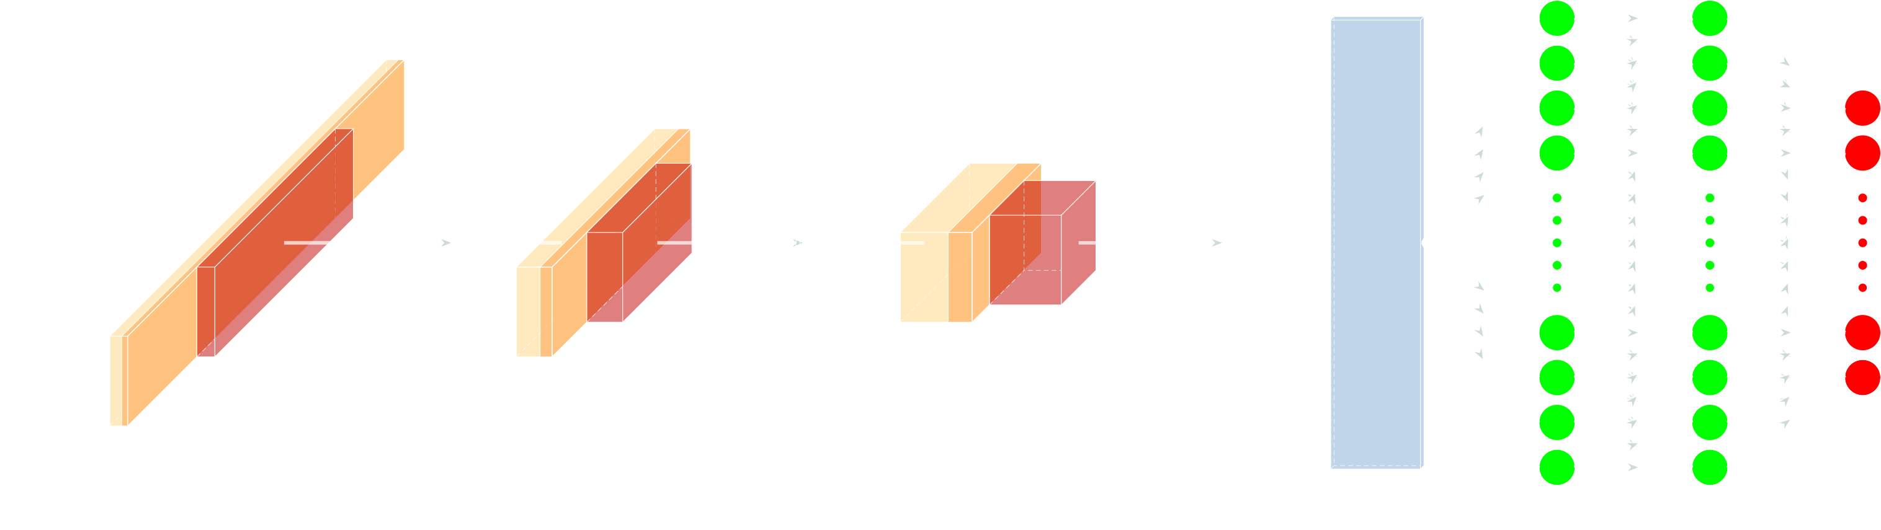





Heatmap

Slide 15
Experimental Results

Slide 16




Datasets
AES_RD (AES-128) [CK09]
  8-bit AVR microcontroller
  Sensitive variable:
  $$Z=Sbox[P_{0} ⊕ k^{∗}]$$
  - Countermeasure: Random delay
ASCAD-v1 (AES-128) [BPS+20]
  8-bit AVR microcontroller
  Sensitive variable:
  $$Z=Sbox[P_{3} ⊕ k^{∗}]$$
  - Countermeasure: Random delay + 1st order masking

Slide 17

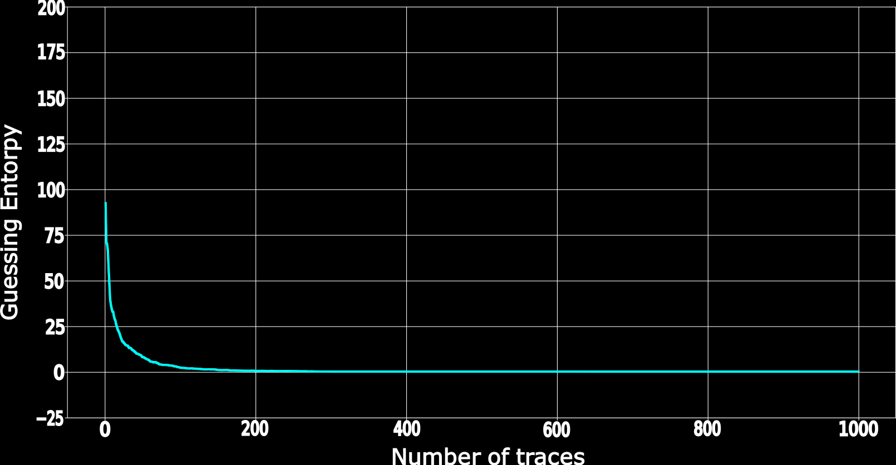

We compute ${Nt}_{GE}$ over 100 tests and denote the final result as ${\overline{Nt}}_{GE}$
$${\overline{Nt}}_{GE}$$

Slide 18
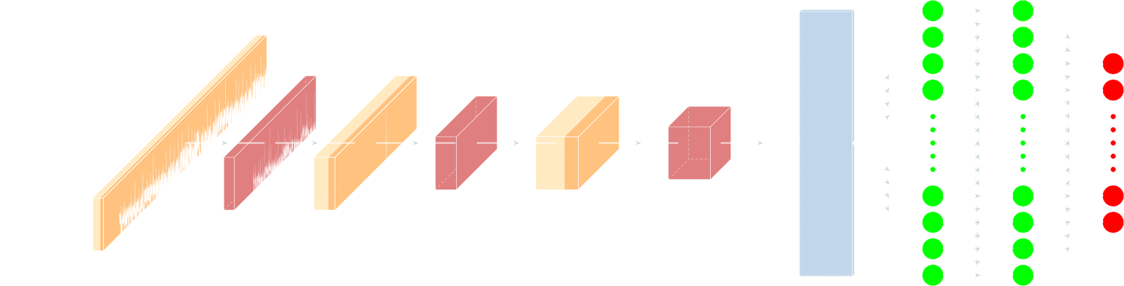
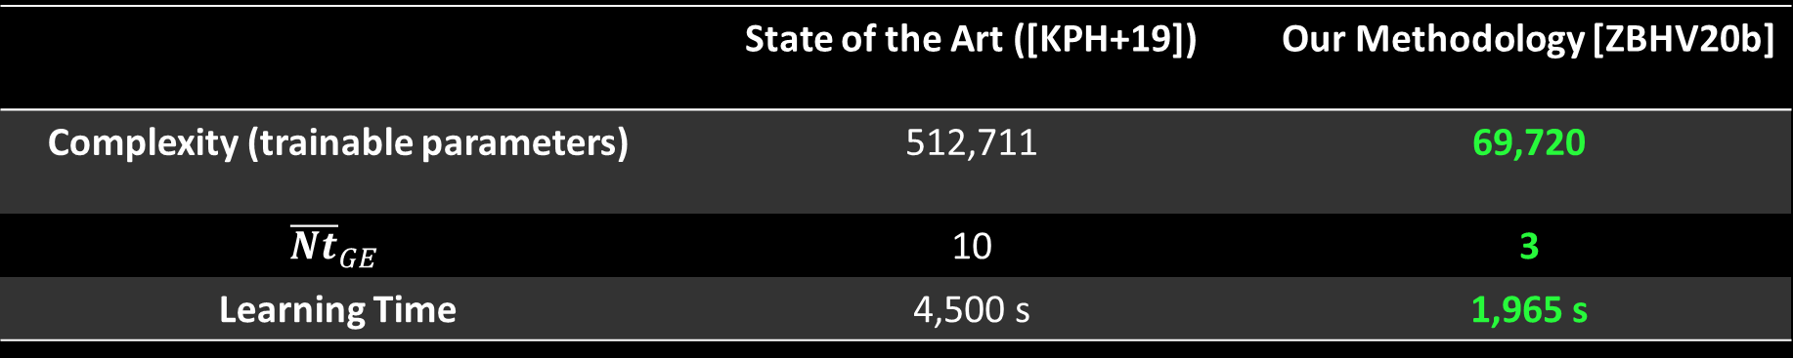
AES_RD
 | State of the Art ([KPH+19]) | Our Methodology [ZBHV20b]
Complexity (trainable parameters) | 512,711 | 69,720
$${\overline{Nt}}_{GE}$$ | 10 | 3
Learning Time | 4,500 s | 1,965 s

Slide 19
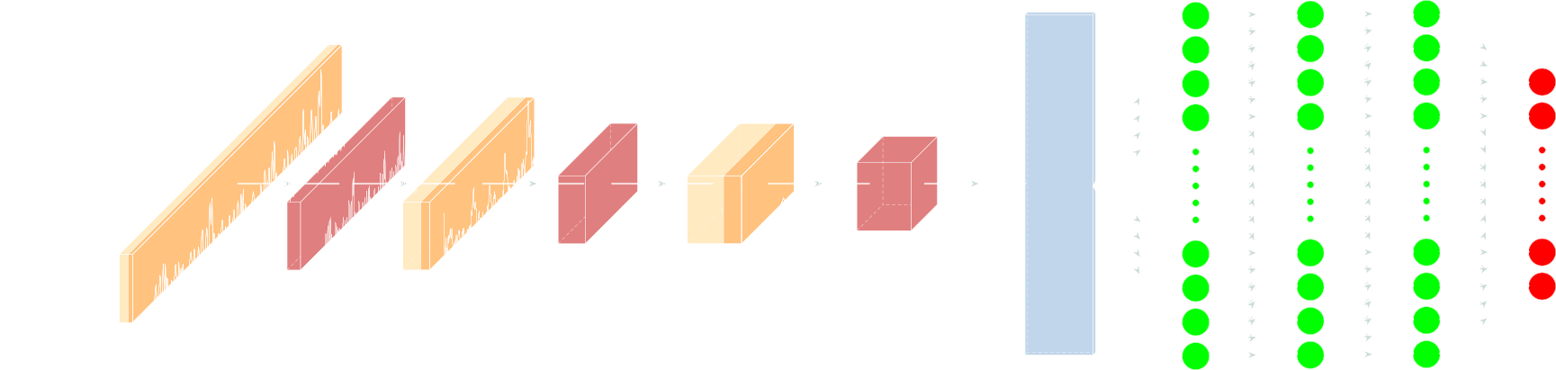
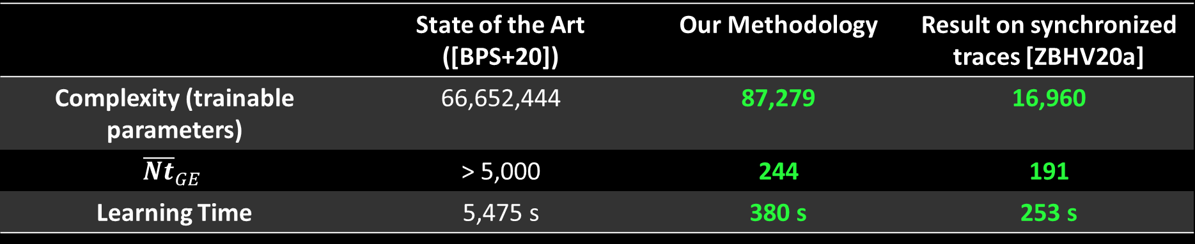
ASCAD: Random Delay 50
 | State of the Art ([BPS+20]) | Our Methodology | Result on synchronized traces [ZBHV20a]
Complexity (trainable parameters) | 66,652,444 | 87,279 | 16,960
$${\overline{Nt}}_{GE}$$ | > 5,000 | 244 | 191
Learning Time | 5,475 s | 380 s | 253 s

Slide 20
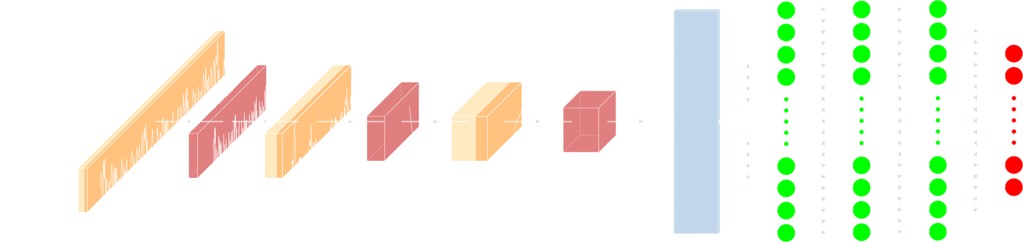
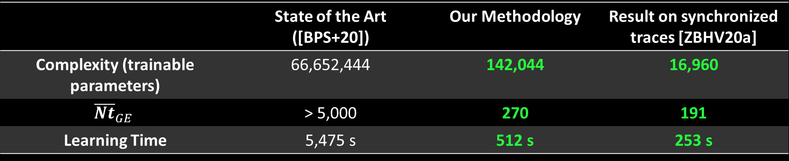
ASCAD: Random Delay 100
 | State of the Art ([BPS+20]) | Our Methodology | Result on synchronized traces [ZBHV20a]
Complexity (trainable parameters) | 66,652,444 | 142,044 | 16,960
$${\overline{Nt}}_{GE}$$ | > 5,000 | 270 | 191
Learning Time | 5,475 s | 512 s | 253 s

Slide 21



How can we reproduce these results?
GitHub repository:
> 500 unique visitors
> 100 unique downloads
- Source code: github.com/gabzai/Methodology-for-efficient-CNN-architectures-in-SCA
Since 2018, less than 10 % of the research papers (in DL-SCA) can be reproduced with an open-source code
Make DL-SCA great!
Source: Cryptology ePrint Archive and arXiv.org (August 2020)

Slide 22
MERCI !
Take-Away Messages
Classical architectures in SCA context seem too complex when small traces are considered. Recently validated on larger traces (ie. traces of dimensionality 160,000 [MBC+20])
Random desynchronization does not protect against side-channel attacks ([CDP17])
Our methodology can be improved by using additional techniques (ie. SMOTE [WJB20], adding noise on irrelevant information [KPH+18], …)
We encourage all the researchers to promote the open source approach and encourage the collaborations
Contact: gabriel.zaid@univ-st-etienne.fr / GitHub: github.com/gabzai/Methodology-for-efficient-CNN-architectures-in-SCA

Slide 23
Bibliography (1):
[BP20] Elie Bursztein and Jean-Michel Picod. A Hacker’s guide to reducing side-channel attack surfaces using deep-learning. Defcon 28 & Black Hat USA 2020.
[BPS+20] Ryad Benadjila, Emmanuel Prouff, Rémi Strullu, Eleonora Cagli and Cecile Dumas. Deep learning for side-channel analysis and introduction to ASCAD database. J Cryptogr Eng 10, 163–188 (2020). https://doi.org/10.1007/s13389-019-00220-8.
[CDP17] Eleonora Cagli, Cécile Dumas, and Emmanuel Prouff. Convolutional neural networks with data augmentation against jitter-based countermeasures - profiling attacks without pre-processing. In Wieland Fischer and Naofumi Homma, editors, Cryptographic Hardware and Embedded Systems - CHES 2017 - 19th International Conference, Taipei, Taiwan, September 25-28, 2017, Proceedings,volume 10529 of Lecture Notes in Computer Science, pages 45–68. Springer,2017.
[CK09] Jean-Sébastien Coron and Ilya Kizhvatov. An efficient method for random delay generation in embedded software. In Christophe Clavier and Kris Gaj, editors, Cryptographic Hardware and Embedded Systems - CHES 2009, pages 156–170, Berlin, Heidelberg, 2009. Springer Berlin Heidelberg.
[GGH20] Christophe Genevey-Metat, Benoît Gérard and Annelie Heuser. On What to Learn: Train or Adapt a Deeply Learned Profile? Cryptology ePrint Archive, Report 2020/952, 2020. https://eprint.iacr.org/2020/952.
[KPH+19] Jaehun Kim, Stjepan Picek, Annelie Heuser, Shivam Bhasin and Alan Hanjalic. Make some noise. unleashing the power of convolutional neural networks for profiled side-channel analysis. IACR Transactions on Cryptographic Hardware and Embedded Systems, 2019(3):148–179, 2019.

Slide 24
Bibliography (2):
[LH20] JongHyeok Lee and Dong-Guk Han. DLDDO: Deep Learning to Detect Dummy Operations. Cryptology ePrint Archive, Report 2020/939, 2020. https://eprint.iacr.org/2020/939.
[MDP19] Loïc Masure, Cécile Dumas, and Emmanuel Prouff. Gradient visualization for general characterization in profiling attacks. In Ilia Polian and Marc Stöttinger, editors, Constructive Side-Channel Analysis and Secure Design, pages 145–167, Cham, 2019. Springer International Publishing.
[MDP20] Loïc Masure, Cécile Dumas, and Emmanuel Prouff. A comprehensive study of deep learning for side-channel analysis. IACR Transactions on Cryptographic Hardware and Embedded Systems, 2020(1):348–375, Nov. 2019.
[MBC+20] Loïc Masure, Nicolas Belleville, Eleonora Cagli, Marie-Angela Cornelie, Damien Couroussé, Cécile Dumas and Laurent Maingault. Deep Learning Side-Channel Analysis on Large-Scale Traces - A Case Study on a Polymorphic AES. Cryptology ePrint Archive, Report 2020/881, 2020. https://eprint.iacr.org/2020/881.
[RWM19] Bastian Richter, Alexander Wild and Amir Moradi. Automated Probe Repositioning for On-Die EM Measurements. 2019 IEEE/ACM International Conference on Computer-Aided Design (ICCAD), Westminster, CO, USA, 2019, pp. 1-6, doi: 10.1109/ICCAD45719.2019.8942157.
[WJB20] Yoo-Seung Won, Dirmanto Jap and Shivam Bhasin. Push For More: On Comparison of Data Augmentation and SMOTE With Optimised Deep Learning Architecture For Side-Channel. Cryptology ePrint Archive, Report 2020/665, 2020. https://eprint.iacr.org/2020/665.
[WP20] Lichao Wu and Stjepan Picek. Remove Some Noise: On Pre-processing of Side-channel Measurements with Autoencoders. IACR Transactions on Cryptographic Hardware and Embedded Systems, 2020(4), Aug. 2020.

Slide 25
Bibliography (3):
[ZBHV20a] Gabriel Zaid, Lilian Bossuet, Amaury Habrard, and Alexandre Venelli. Methodology for efficient cnn architectures in profiling attacks. IACR Transactions on Cryptographic Hardware and Embedded Systems, 2020(1):1–36, Nov. 2019.
[ZBHV20b] Gabriel Zaid, Lilian Bossuet, Amaury Habrard, and Alexandre Venelli. Understanding Methodology for efficient cnn architectures in profiling attacks. Cryptology ePrint Archive, Report 2020/757, 2020. https://eprint.iacr.org/2020/757.

Slide 26
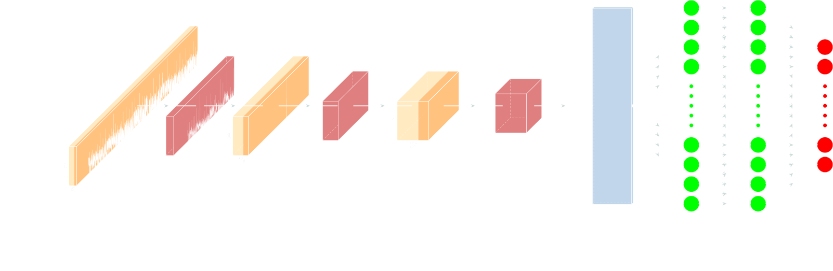
Appendix
AES_RD

Slide 27
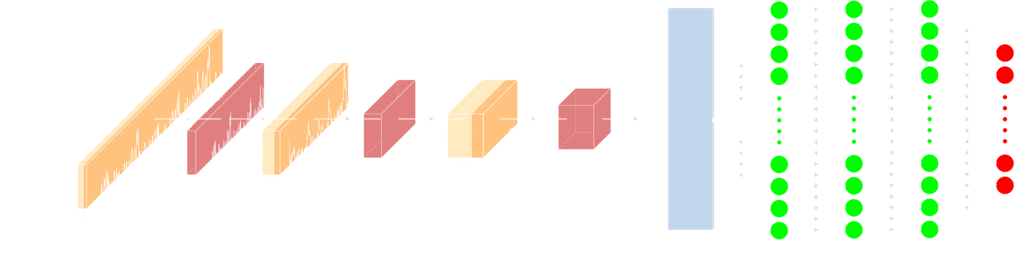
Appendix
ASCAD desync. 50

Slide 28
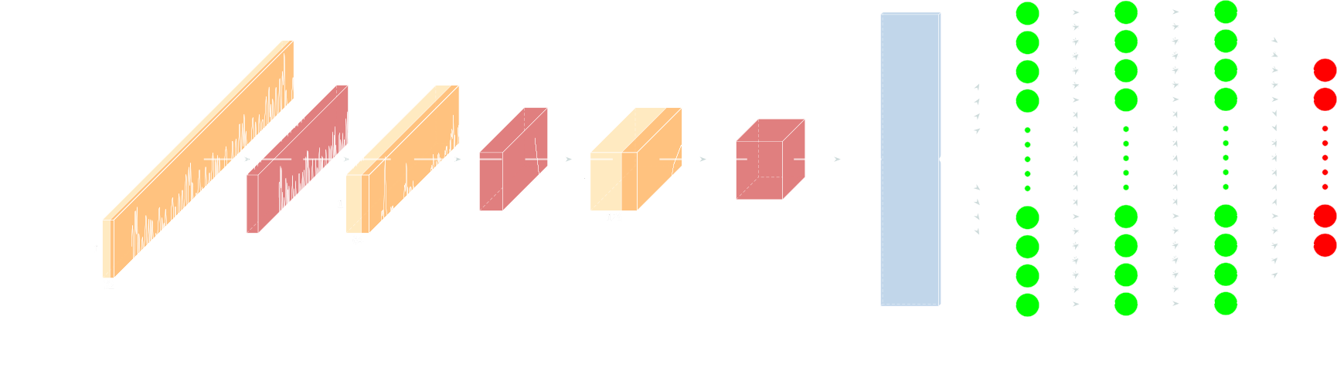
Appendix
ASCAD desync. 100

