Slide 1
Cache vs. Key-Dependency
Daniel Genkin, Romain Poussier, Rui Qi Sim, Yuval Yarom, and Yuanjing Zhao

Slide 2
Introduction
Ciphers
Vulnerable to cache attacks
Recover secret information knowing the internal structure of cipher and victim cache accesses
Show that secret (key-dependent) transformations do NOT guarantee additional protection against cache attacks

Slide 3
Pilsung
Part of Red-Star OS 3.0
Based on AES, with:
Key-dependent S-Boxes
Key-dependent “Shift-Rows” permutations
AES: Secret information can be recovered with cache attacks and knowing the internal structure of the cipher
Secret transformations do not make Pilsung secure against cache attacks used for AES

Slide 4
AES Refresher
ADD-ROUND-KEY
🔑 | 🔑 | 🔑 | 🔑
🔑 | 🔑 | 🔑 | 🔑
🔑 | 🔑 | 🔑 | 🔑
🔑 | 🔑 | 🔑 | 🔑
🔑 | 🔑 | 🔑 | 🔑
🔑 | 🔑 | 🔑 | 🔑
🔑 | 🔑 | 🔑 | 🔑
🔑 | 🔑 | 🔑 | 🔑
repeat
$$⊕$$
$$=$$
Plaintext, $P$
$$S^{0}=P$$
Round-key, $K$
$$S^{1}$$
SUB-BYTES
SHIFT-ROWS
MIX-COLUMNS
Notes:
1 min

Slide 5
Attacking AES
Input
$$S^{0}=P$$
$P⊕K$ is the index to the S-Box.
$$index =P⊕K$$
$$⇒ K=index⊕P$$
If we can find index, we get the key.
🔑 | 🔑 | 🔑 | 🔑
🔑 | 🔑 | 🔑 | 🔑
🔑 | 🔑 | 🔑 | 🔑
🔑 | 🔑 | 🔑 | 🔑
Add-Round-Key
$$S_{ARK}^{0}=P⊕K$$
Sub-Bytes
$$S_{SB}^{0}=SB\left[S_{ARK}^{0}\right]= SB[P⊕K]$$
Notes:
30 sec

Slide 6
Cache Attacks: Theory
Obtain S-Box accesses by observing memory accesses to the cache
PRIME+PROBE uses timing information to infer victim’s cache accesses over a period of time
Notes:
1.5 min

Slide 7
Attack on AES
ADD-ROUND-KEY
Idea: Fix one plaintext byte
🔑 | 🔑 | 🔑 | 🔑
🔑 | 🔑 | 🔑 | 🔑
🔑 | 🔑 | 🔑 | 🔑
🔑 | 🔑 | 🔑 | 🔑
🔑 | 🔑 | 🔑 | 🔑
🔑 | 🔑 | 🔑 | 🔑
🔑 | 🔑 | 🔑 | 🔑
🔑 | 🔑 | 🔑 | 🔑
$$⊕$$
$$=$$
Fix S-Box access (observe in memory)
Get key byte using: $K=index⊕P$
Plaintext, $P$
Round-key, $K$
SUB-BYTES
Notes:
1 min

Slide 8
Cache Attacks: Practical Challenges
Limited temporal resolution
Sample cache at regular intervals
Many accesses happen between samples
Solution: average over multiple encryptions
$K=index⊕P$
…
Notes:
2 minss

Slide 9
Cache Attacks: Practical Challenges
Limited spatial resolution
Can’t distinguish between accesses to the same cache line
Multiple S-Box entries are present in the same cache line
See S-Box accesses to the resolution of the cache line
First round attack can only recover two to four bits of each key byte
Solution: second round attack
… | … | … | …
S-Box (256 entries)
Cache
Notes:
2 minss

Slide 10
Attack on AES
ADD-ROUND-KEY
Idea: Fix one plaintext byte
🔑 | 🔑 | 🔑 | 🔑
🔑 | 🔑 | 🔑 | 🔑
🔑 | 🔑 | 🔑 | 🔑
🔑 | 🔑 | 🔑 | 🔑
🔑 | 🔑 | 🔑 | 🔑
🔑 | 🔑 | 🔑 | 🔑
🔑 | 🔑 | 🔑 | 🔑
🔑 | 🔑 | 🔑 | 🔑
Fix S-Box access (observe in memory)
Get key byte using: $K=index⊕P$
Limited spatial resolution: recover two to four bits
$$⊕$$
$$=$$
Plaintext, $P$
Round-key, $K$
Access to part of the S-Box
SUB-BYTES
…
Cache
SHIFT-ROWS
MIX-COLUMNS
Notes:
1 min

Slide 11
Second Round Attack
ADD-ROUND-KEY
Idea: Fix four plaintext bytes
that map to the same column after Shift-Rows
Idea: Fix four plaintext bytes
🔑
 | 🔑
 |  | 🔑
 |  |  | 🔑
🔑 | 🔑 | 🔑 | 🔑
🔑 | 🔑 | 🔑 | 🔑
🔑 | 🔑 | 🔑 | 🔑
🔑 | 🔑 | 🔑 | 🔑
🔑
🔑
🔑
🔑
$$⊕$$
$$=$$
Need to know transformations
plaintext
$$S^{1}$$
Result: four state bytes fixed at the end of the first round
SUB-BYTES
SHIFT-ROWS
MIX-COLUMNS

Slide 12
Pilsung vs. AES
Based on AES with key-dependent transformations
Key schedule
Master key is passed through a SHA1-based function to generating $K$
Uses AES key schedule with $K$ to generate eleven 128-bit round keys

Slide 13
Pilsung vs. AES
S-Boxes
Different S-Boxes are used for each state byte at each round
16 different S-Boxes at each round
The S-Boxes depend on the corresponding key byte of the next round
🔑 | 🔑 | 🔑 | 🔑
🔑 | 🔑 | 🔑 | 🔑
🔑 | 🔑 | 🔑 | 🔑
🔑 | 🔑 | 🔑 | 🔑
* patterns represent an S-Box
SUB-BYTES
Pilsung
AES

Slide 14
Pilsung vs. AES
Shift-Rows
Uses a pseudo-random permutation
The permutation depends on the key of the next round
Next round key
SHIFT-ROWS
Pilsung
AES

Slide 15
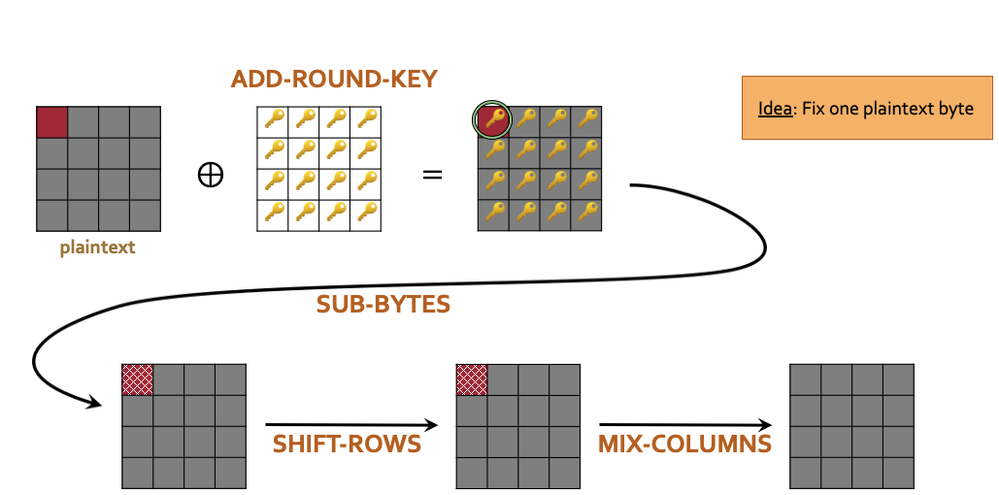
First Round Attack on Pilsung
Provides the two MSBs of each key byte
Use cache access patterns to infer S-Box access indices
Reduce search space for second round attack

Slide 16
First Round Attack: Getting MSBs
Idea: S-Box index$=P⨁K$
Observe:
S-Box entries 0 – 63
two MSBs: 00
Byte plaintext 64 – 127
two MSBs: 01
$K =P ⨁ \text{S}\text{−}\text{Box} \text{index}$
Key byte’s two MSBs = 01
…
…
…
…
Entries 0-63 (00xx xxxx₂)
Byte’s S-Box (256 entries)

Slide 17
First Round Attack: Getting MSBs
Idea: S-Box index$=P⨁K$
Observe:
S-Box entries 64 – 127
two MSBs: 01
Byte plaintext 0 – 63
two MSBs: 00
$K =P ⨁ \text{S}\text{−}\text{Box} \text{index}$
Key byte’s two MSBs = 01
…
…
…
…
Key byte’s two MSBs: 01
Key byte’s two MSBs: 01
Entries 64-127 (01xx xxxx₂)
Byte’s S-Box (256 entries)

Slide 18
Preparing Second Round Attack: Reversing Shift-Rows
0 | 4 | 8 | 12
1 | 5 | 9 | 13
2 | 6 | 10 | 14
3 | 7 | 11 | 15
0 | 4 | 8 | 12
1 | 5 | 9 | 13
2 | 6 | 10 | 14
3 | 7 | 11 | 15
0 | 4 | 8 | 12
1 | 5 | 9 | 13
2 | 6 | 10 | 14
3 | 7 | 11 | 15
0 | 4 | 8 | 12
1 | 5 | 9 | 13
2 | 6 | 10 | 14
3 | 7 | 11 | 15
0 | 4 | 8 | 12
1 | 5 | 9 | 13
2 | 6 | 10 | 14
3 | 7 | 11 | 15
0 | 4 | 8 | 12
1 | 5 | 9 | 13
2 | 6 | 10 | 14
3 | 7 | 11 | 15
0 | 4 | 8 | 12
1 | 5 | 9 | 13
2 | 6 | 10 | 14
3 | 7 | 11 | 15
0 | 4 | 8 | 12
1 | 5 | 9 | 13
2 | 6 | 10 | 14
3 | 7 | 11 | 15
0 | 4 | 8 | 12
1 | 5 | 9 | 13
2 | 6 | 10 | 14
3 | 7 | 11 | 15
0 | 4 | 8 | 12
1 | 5 | 9 | 13
2 | 6 | 10 | 14
3 | 7 | 11 | 15
0 | 4 | 8 | 12
1 | 5 | 9 | 13
2 | 6 | 10 | 14
3 | 7 | 11 | 15
Shift-Rows permutation is key-dependent
Two steps for reversing Shift-Rows:
Column mapping:
Finding the group of four bytes that map to the same column in Shift-Rows
Identify which column the group maps to
Column ordering:
Finding which row each byte goes to
SHIFT-
ROWS
? | ? | ? | ?
? | ? | ? | ?
? | ? | ? | ?
? | ? | ? | ?
? | ? | ? | ?
? | ? | ? | ?
? | ? | ? | ?
? | ? | ? | ?
15 | 12 | 13 | ?
10 | 8 | 9 | ?
4 | 2 | 5 | ?
0 | 6 | 3 | ?
15 | 12 | 13 | 1
10 | 8 | 9 | 7
4 | 2 | 5 | 11
0 | 6 | 3 | 14
15 | 12 | 13 | 1
10 | 8 | 9 | 7
4 | 2 | 5 | 11
0 | 6 | 3 | 14
15 | 12 | ? | ?
10 | 8 | ? | ?
4 | 2 | ? | ?
0 | 6 | ? | ?
15 | ? | ? | ?
10 | ? | ? | ?
4 | ? | ? | ?
0 | ? | ? | ?
? | ? | ? | ?
? | ? | ? | ?
? | ? | ? | ?
? | ? | ? | ?
? | ? | ? | ?
? | ? | ? | ?
? | ? | ? | ?
? | ? | ? | ?
? | ? | ? | ?
? | ? | ? | ?
? | ? | ? | ?
? | ? | ? | ?
? | ? | ? | ?
? | ? | ? | ?
? | ? | ? | ?
? | ? | ? | ?
? | ? | ? | ?
? | ? | ? | ?
? | ? | ? | ?
? | ? | ? | ?
15 | 12 | ? | ?
10 | 8 | ? | ?
4 | 2 | ? | ?
0 | 6 | ? | ?
15 | 12 | 13 | ?
10 | 8 | 9 | ?
4 | 2 | 5 | ?
0 | 6 | 3 | ?
15 | ? | ? | ?
10 | ? | ? | ?
4 | ? | ? | ?
0 | ? | ? | ?

Slide 19
Reversing Shift-Rows: Column Mapping
Idea:
Fix four bytes
Check if they map to the same column after Shift-Rows
Observation: Fixing four bytes that map to the same column in Shift-Rows fixes the S-Box accesses at the second round
SHIFT-ROWS
MIX-COLUMNS
SHIFT-ROWS
MIX-COLUMNS

Slide 20
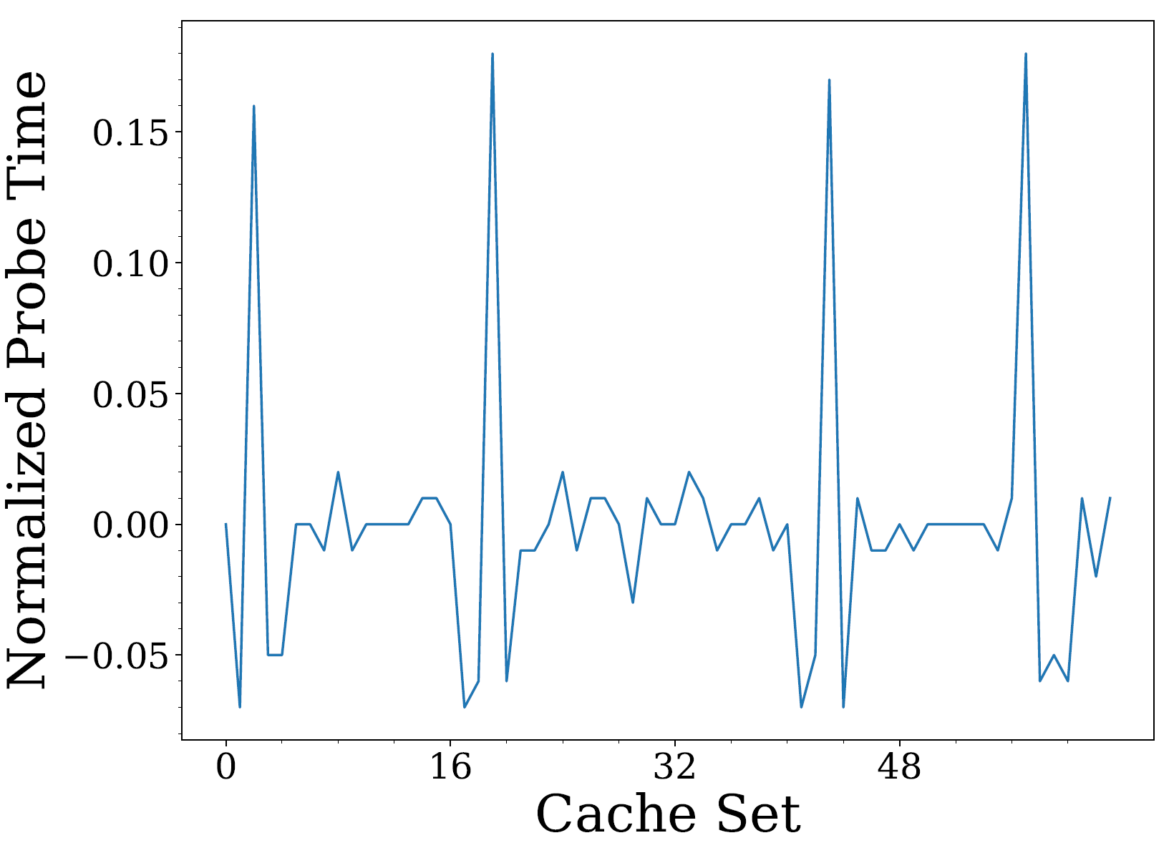
Column Mapping: Wrong Guess
SHIFT-ROWS
MIX-COLUMNS
First round S-Box accesses of the four fixed plaintext bytes

Slide 21
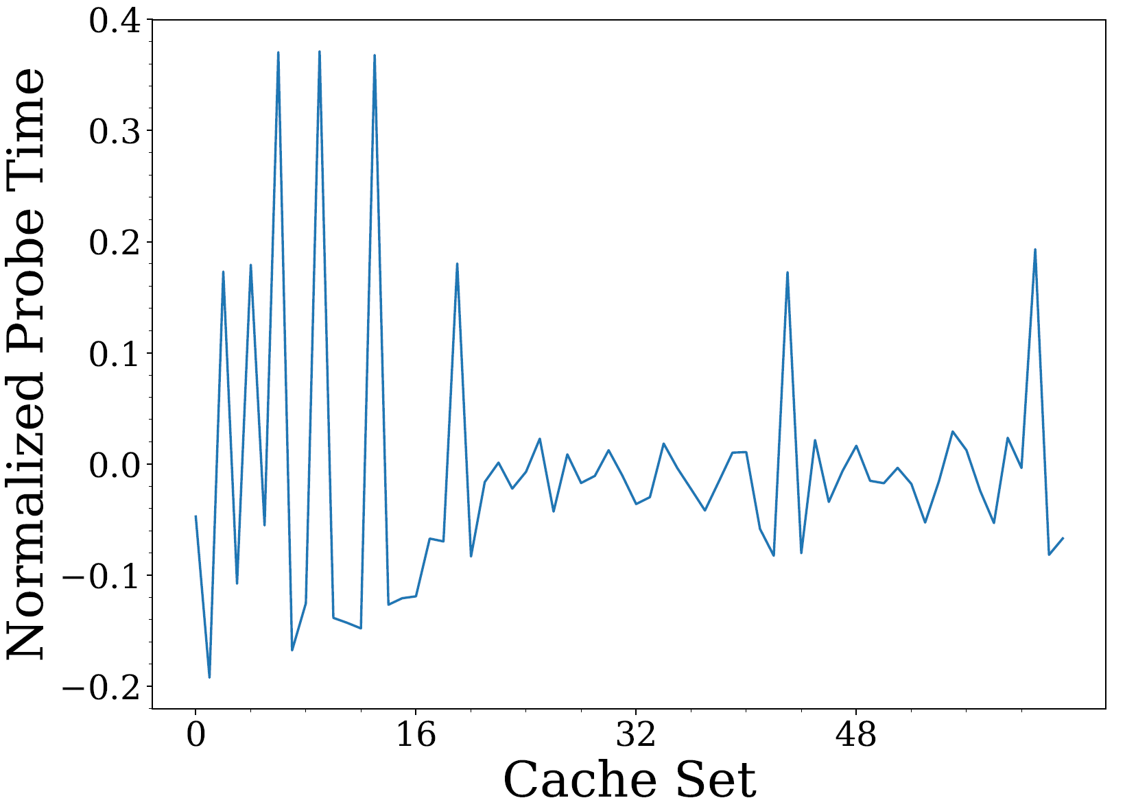
Column Mapping: Correct Guess
ADD-
ROUND-KEY
SHIFT-ROWS
MIX-COLUMNS
SUB-BYTES
First round S-Box accesses of the four fixed plaintext bytes
Second round S-Box accesses of the four fixed plaintext bytes (mapped to the same column at the end of the first round)
Cache accesses here corresponds to the first column of bytes after first round Shift-Rows

Slide 22
Reversing Shift-Rows: Column Ordering
Mix-Columns is a matrix multiplication
2 | 3 | 1 | 1
1 | 2 | 3 | 1
1 | 1 | 2 | 3
3 | 1 | 1 | 2
$$×$$
$$=$$
Idea: Fixing three bytes in a column and varying the other results in a predictable behaviour dependent on the varying byte
2 | 3 | 1 | 1
1 | 2 | 3 | 1
1 | 1 | 2 | 3
3 | 1 | 1 | 2
$$×$$
$$=$$
Result: Knowing how the second round S-Box accesses change as the varying plaintext byte changes identifies its row in the column

Slide 23
Column Ordering: Example
?
?
?
?
ADD-
ROUND-KEY
SHIFT-ROWS
MIX-COLUMNS
SUB-BYTES
First round S-Box accesses of the four fixed plaintext bytes
Second round S-Box accesses of the four fixed plaintext bytes
Observe: second round S-Box accesses change when changing the plaintext byte

Slide 24
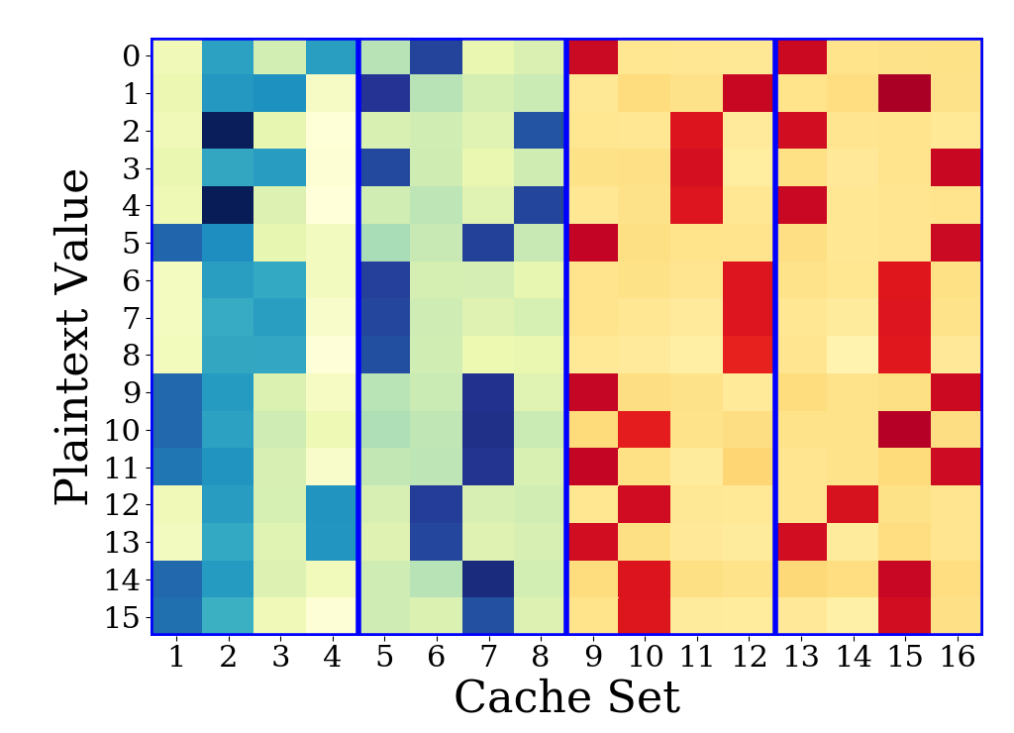
Column Ordering: Example
Fixing three bytes and varying the other (in the same column):
There will be two second round S-Box accesses that are identical up to XOR with a constant
Identifying them gives us the row of the varying plaintext byte
11
01
10
10
00
00
01
01
11
11
00
00
00
00
10
10
10
10
00
00
00
10
10
10
Accesses in first and second S-Boxes are identical up to XOR with constant 10₂
Varying byte in last row of column
11
11
01
01
00
00
10
10

Slide 25
So far …
First Round Attack: gets 2 MSBs of the first round key
Prepared the second round attack by reversing the first round of the key-dependent transformation Shift-Rows

Slide 26
Second Round Attack
Shift-Rows of first round
Second round S-Box access
$${SB}^{1}[2 {SB}^{0}\left[ P ⨁{ RK}^{0}\right]⨁constant]$$
Observe this in cache
Depends on next${ RK}^{1}$
Guess ${RK}^{1}$
Calculate ${SB}^{0}\left[ P ⨁{ RK}^{0}\right]$
Calculate this.
It will match what we observe in the cache up to a constant.
Guess ${RK}^{0}$ and ${RK}^{1}$
Calculate ${2SB}^{0}\left[ P ⨁{ RK}^{0}\right]$
It will match what we observe in the cache up to a constant if we guess the correct key.

Slide 27
Second Round Attack
For each key byte, guess 6 unknown bits of the first round key and the 8 bits of the second round key
Total $2^{14}$ possible guesses to test for each key byte
On average, observing S-Box accesses for around $30$ different plaintext byte values for each key byte is sufficient

Slide 28
Summary
Secret-dependent transformations can be reversed by observing cache accesses
To fully break cipher:
35 million encryptions
19,472 queries of S-Box accesses
Average 8 minutes on a typical laptop
Constant-time implementation as a defence for side-channel attacks

