Slide 1
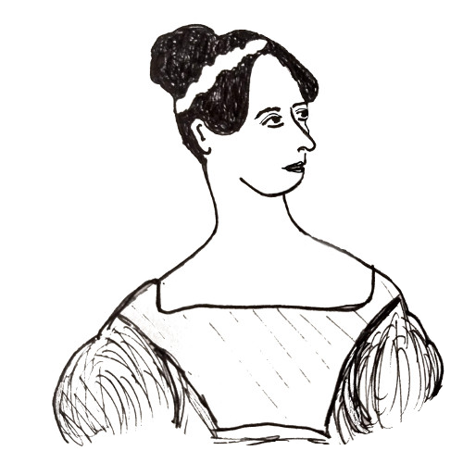
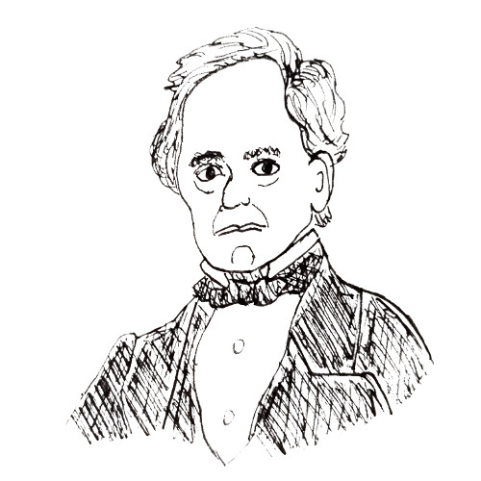
Universally Composable Relaxed
Password Authenticated Key Exchange
Michel Abdalla
École normale supérieure
INRIA
Manuel Barbosa
FCUP
INESC TEC
Tatiana Bradley*
UC Irvine
Stanisław Jarecki
UC Irvine
Jonathan Katz
George Mason
University
Jiayu Xu
George Mason
University
guest stars:
Ada Lovelace and Charles Babbage
* Thanks to Tatiana for help with the slides!

Slide 2


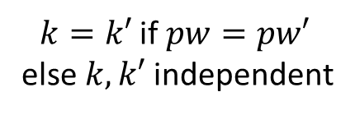


Password Authenticated Key Exchange (PAKE)
Goal: Establish shared key in the password-only setting
$$pw$$
$$pw′$$
Ada
PAKE
Charles
$k=k′$if $pw=pw′$
else $k,k′$ independent
$$k$$
$$k′$$

Slide 3
(Brief and partial) Overview of PAKE results
Two prominent PAKE construction paradigms
  Password-Blinded Diffie-Hellman protocols [BM92, BMP00, .........]
    Most efficient PAKEs in ROM: SPEKE [Jab96], SPAKE2 [AP05], TBPEKE [PW17], CPace [HL19]
  Encrypt + SPHF [KOY01, GL03, JG04, CHK+05, GK10, KV10, ………]
    Standard model (no ROM), but less efficient
Implication in practice
  No adoption for the longest time
    internet needs asymmetric (client-server) PAKEs
  2019 - 2020: IETF CRFG competition on PAKEs
    Symmetric PAKE finalists: SPAKE2 and CPace (winner: CPace)
    Asymmetric PAKE finalists: OPAQUE and AuCPace (winner: OPAQUE)
    Active efforts on security validation, prototyping, testing, integration

Slide 4
PAKE security models
Game-based [BPR00, …] vs. Universally Composable (UC) [CHK+05]
  UC PAKE model is stronger
    Allows arbitrary protocol composition
    Naturally models arbitrary password distributions
    Models password reuse, password mistypes, partial password information disclosure, & more
  UC viewed as gold standard for analysis, including in the IETF CFRG competition
Utility of protocol composition: PAKE → aPAKE compiler results
  UC PAKE → UC aPAKE [GMR06, HJK+18]
  UC aPAKE → UC strong aPAKE [JKX18]
The most efficient PAKEs (SPEKE, SPAKE2, TBPEKE) only proven game-based secure
  …yet no explicit attacks on any of them were shown
Our Question: Is there a gap between these efficient PAKEs and the UC model?

Slide 5
Our results:
We define two relaxations of UC PAKE functionality of [CHK+05]
  lazy-extraction UC PAKE (lePAKE)
  stronger variant: relaxed UC PAKE (rPAKE)
SPAKE2, TBPEKE, SPEKE, CPace all realize UC lePAKE in ROM
  SPAKE2 with tight^{(*)} relation to Gap DH assumption
  TBPEKE under Gap DH & Gap Simultaneous DH assumptions [PW17]
    implies same level of security for SPEKE and CPace
Standard key confirmation converts UC lePAKE to UC rPAKE
  in addition to providing explicit entity authentication
Sanity check: any UC rPAKE is game-based secure with PFS
  bonus: any UC lePAKE is game-based secure with weak PFS
(*) : Simulator’s work ≈ Protocol’s cost + O(q_{RO}) group operations

Slide 6
Key observation:
UC PAKE functionality of [CHK+05] requires the simulator to
  extract a password which the adversary effectively uses in its PAKE messages
  before session completes, i.e., before attacked party outputs a key
  the simulator then learns a bit (= correct guess / wrong guess)

Slide 7
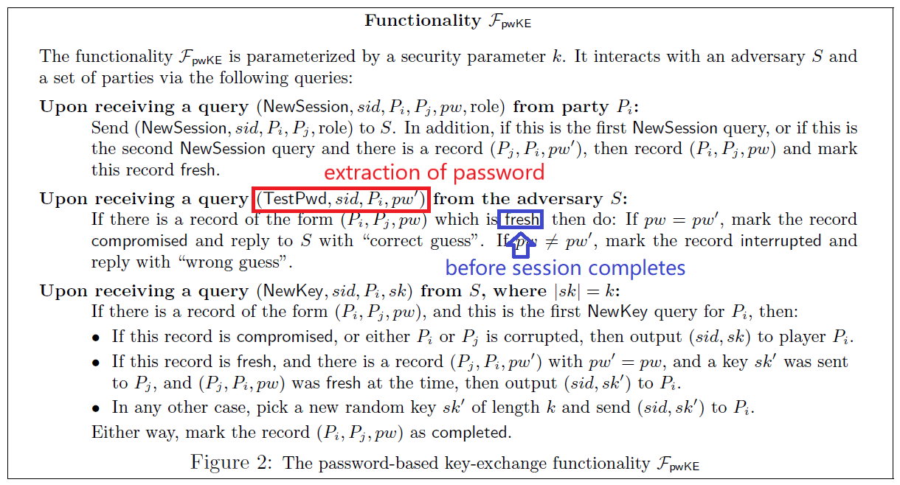

Slide 8


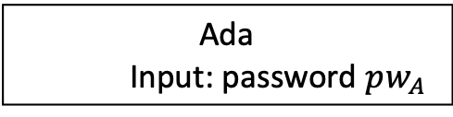







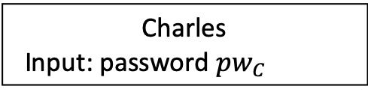

SPAKE2
Ada
Input: password $pw_{A}$
g: group generator
M,N: random group elements
H: hash function (= RO)
Charles
Input: password $pw_{C}$
$$x ←Z_{p}$$
$$X$$
$$Y$$
$$y←Z_{p}$$
$X=g^{x}⋅M^{pw_{A}}$
$Y=g^{y}⋅N^{pw_{C}}$
Pedersen commitment
to password
(IT hiding, no extraction)
$\hat{Y}=Y/N^{pw_{A}}$
$\hat{X}=X/M^{pw_{C}}$
$k_{A}=H(sid, Ada, Charles, X, Y, pw_{A},{\hat{Y}}^{x})$
$k_{C}=H\left(sid, Ada, Charles, X, Y, pw_{c},{\hat{X}}^{y}\right)$
Can extract password here?
Notes:
Thanks to this remark in slides #19 and afterwards you can replace
z=f_s(pw) with z=s^{H(pw)}, which will make it easier to see how it
works, I think...
OK, so back to slide #19:
First of all, I think you should add one more slide here which would
go something like this:
Slide #19A (similar to slide #21 but simplified and two-directional):
Title: Building saPAKE from STOWF
Subtitle: We will use the "CPA Enc + SPHF" paradigm to PAKE [KOY01,GL03,...]
The picture explains this paradigm using the Ada & Charles and
protocol like in #21 but simplifed and two-directional, i.e.:
Ada -> Charles: cA=Enc(pwA;rA)
Chalres -> Ada: cC=Enc(pwC;rC)
Ada defines statement xA = "cC encrypts pwA" and computes
SPHF.Hash(xA)->(vA,hpA)
Ada -> Charles: hpA
Charles defines statement xC = "cA encrypts pwC" and computes
SPHF.Hash(xC)->(vC,hpC)
Charles -> Ada: hpC
Ada recovers vC'=SPHF.PHash(hpC,wA) for wA=(pwA,rA)
Charles recovers vA'=SPHF.PHash(hpC,wA) for wA=(pwA,rA)
Ada's key is k = vA xor vC'
Carles key is k = vA' xor vC
And you explain two points:
#1: explain SPHF but just verbally (you will have slide #22 on CKEM,
which will mention that this is a generalization of SPHF): An SPHF
for some NP language s.t. given statement x the sender can "Hash" it
to generate a hash value v and "hash projection" hp s.t. if receiver
has witness w that statement x is in the language, then using the
"Projection Hashing" procedure PHash it can derive the hash value v
and otherwise this value will be random to the receiver. And say that
this design intuitively works because if A's password matches C's then
she can recover C's hash value, and if C's password matches A's then
he can recover A's hash value, and otherwise one party's key is random
to the other.
#2: say that there has been lot of work on this paradigm, that it can
be very efficient, that it can be done in the standard model, i.e.
without RO, it can be done even in non-interactive way, and under
various assumptions

Slide 9
Proposed relaxation of UC PAKE model: allow “Post-Execution Input Extraction”
Allow password extraction after session completes
  after honest session key is computed ⇒ no more protocol messages…
  yet extraction possible from adversary’s local computation!
    requires idealized computation models: e.g. Random Oracle or Ideal Cipher
Allows only one post-execution password test query per session
  as in UC PAKE, the adversary cannot test >1 passwords on an attacked session
Two relaxation flavors:
  “lazy-extraction” PAKE : the adversary learns a session key (= real / random)
  “relaxed” PAKE : the adversary learns a bit (= correct guess / wrong guess)

Slide 10
Active Attack w/o on-line password extraction
Post-execution password extraction here
“Lazy-Extraction” PAKE: adversary gets real/random key
“Relaxed” PAKE: adversary gets only correct/wrong bit

Slide 11
Thm 1: SPAKE2 realizes UC lePAKE in ROM under Gap DH (with tight reduction)
Ada
Input: password $pw_{A}$
g: group generator
M,N: random group elements
H: hash function (= RO)
Charles
Input: password $pw_{C}$
$$x ←Z_{p}$$
$$X$$
$$Y$$
$$y←Z_{p}$$
$X=g^{x}⋅M^{pw_{A}}$
$Y=g^{y}⋅N^{pw_{C}}$
$\hat{Y}=Y/N^{pw_{A}}$
$\hat{X}=X/M^{pw_{C}}$
$k_{A}=H(sid, Ada, Charles, X, Y, pw_{A},{\hat{Y}}^{x})$
$k_{C}=H\left(sid, Ada, Charles, X, Y, pw_{c},{\hat{X}}^{y}\right)$
Notes:
Thanks to this remark in slides #19 and afterwards you can replace
z=f_s(pw) with z=s^{H(pw)}, which will make it easier to see how it
works, I think...
OK, so back to slide #19:
First of all, I think you should add one more slide here which would
go something like this:
Slide #19A (similar to slide #21 but simplified and two-directional):
Title: Building saPAKE from STOWF
Subtitle: We will use the "CPA Enc + SPHF" paradigm to PAKE [KOY01,GL03,...]
The picture explains this paradigm using the Ada & Charles and
protocol like in #21 but simplifed and two-directional, i.e.:
Ada -> Charles: cA=Enc(pwA;rA)
Chalres -> Ada: cC=Enc(pwC;rC)
Ada defines statement xA = "cC encrypts pwA" and computes
SPHF.Hash(xA)->(vA,hpA)
Ada -> Charles: hpA
Charles defines statement xC = "cA encrypts pwC" and computes
SPHF.Hash(xC)->(vC,hpC)
Charles -> Ada: hpC
Ada recovers vC'=SPHF.PHash(hpC,wA) for wA=(pwA,rA)
Charles recovers vA'=SPHF.PHash(hpC,wA) for wA=(pwA,rA)
Ada's key is k = vA xor vC'
Carles key is k = vA' xor vC
And you explain two points:
#1: explain SPHF but just verbally (you will have slide #22 on CKEM,
which will mention that this is a generalization of SPHF): An SPHF
for some NP language s.t. given statement x the sender can "Hash" it
to generate a hash value v and "hash projection" hp s.t. if receiver
has witness w that statement x is in the language, then using the
"Projection Hashing" procedure PHash it can derive the hash value v
and otherwise this value will be random to the receiver. And say that
this design intuitively works because if A's password matches C's then
she can recover C's hash value, and if C's password matches A's then
he can recover A's hash value, and otherwise one party's key is random
to the other.
#2: say that there has been lot of work on this paradigm, that it can
be very efficient, that it can be done in the standard model, i.e.
without RO, it can be done even in non-interactive way, and under
various assumptions

Slide 12




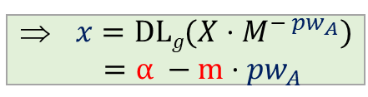
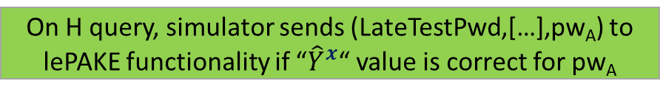


Thm 1: SPAKE2 realizes UC lePAKE in ROM under Gap DH (with tight reduction)
Ada
Input: password $pw_{A}$
g: group generator
M,N: random group elements
H: hash function (= RO)
Charles
Input: password $pw_{C}$
Ada
(simulated) ~~~~~
Charles
(adversary)
$←g^{m},g^{n}$ (trapdoors)
$$x ←Z_{p}$$
$$X$$
$$y←Z_{p}$$
$$←g^{α}$$
$$Y$$
$X=g^{x}⋅M^{pw_{A}}$
$Y=g^{y}⋅N^{pw_{C}}$
⇒ $x=DLg(X⋅M^{− pw_{A}})$ $=α −m⋅pw_{A}$
$\hat{Y}=Y/N^{pw_{A}}$
$\hat{X}=X/M^{pw_{C}}$
Why Gap DH assumption?
Note: ${\hat{Y}}^{x}$has component $g^{m⋅n}$= CDH(M,N)
Reduction solves CDH(M,N) if >1 password tested
Needs DDH oracle to verify H query correctness without trapdoors m,n
$k_{A}=H(sid, Ada, Charles, X, Y, pw_{A},{\hat{Y}}^{x})$
$k_{C}=H\left(sid, Ada, Charles, X, Y, pw_{c},{\hat{X}}^{y}\right)$
⇒ ${\hat{Y}}^{x}$= ${(Y/N^{pw_{A}})}^{x}$ = $(Y/{g^{n⋅pw_{A}})}^{(α−m⋅pw_{A})}$
On H query, simulator sends (LateTestPwd,[…],pw_{A}) to lePAKE functionality if “${\hat{Y}}^{x}$“ value is correct for pw_{A}
Notes:
Thanks to this remark in slides #19 and afterwards you can replace
z=f_s(pw) with z=s^{H(pw)}, which will make it easier to see how it
works, I think...
OK, so back to slide #19:
First of all, I think you should add one more slide here which would
go something like this:
Slide #19A (similar to slide #21 but simplified and two-directional):
Title: Building saPAKE from STOWF
Subtitle: We will use the "CPA Enc + SPHF" paradigm to PAKE [KOY01,GL03,...]
The picture explains this paradigm using the Ada & Charles and
protocol like in #21 but simplifed and two-directional, i.e.:
Ada -> Charles: cA=Enc(pwA;rA)
Chalres -> Ada: cC=Enc(pwC;rC)
Ada defines statement xA = "cC encrypts pwA" and computes
SPHF.Hash(xA)->(vA,hpA)
Ada -> Charles: hpA
Charles defines statement xC = "cA encrypts pwC" and computes
SPHF.Hash(xC)->(vC,hpC)
Charles -> Ada: hpC
Ada recovers vC'=SPHF.PHash(hpC,wA) for wA=(pwA,rA)
Charles recovers vA'=SPHF.PHash(hpC,wA) for wA=(pwA,rA)
Ada's key is k = vA xor vC'
Carles key is k = vA' xor vC
And you explain two points:
#1: explain SPHF but just verbally (you will have slide #22 on CKEM,
which will mention that this is a generalization of SPHF): An SPHF
for some NP language s.t. given statement x the sender can "Hash" it
to generate a hash value v and "hash projection" hp s.t. if receiver
has witness w that statement x is in the language, then using the
"Projection Hashing" procedure PHash it can derive the hash value v
and otherwise this value will be random to the receiver. And say that
this design intuitively works because if A's password matches C's then
she can recover C's hash value, and if C's password matches A's then
he can recover A's hash value, and otherwise one party's key is random
to the other.
#2: say that there has been lot of work on this paradigm, that it can
be very efficient, that it can be done in the standard model, i.e.
without RO, it can be done even in non-interactive way, and under
various assumptions

Slide 13
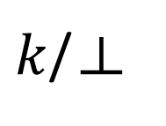

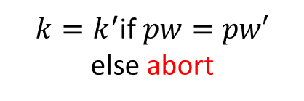

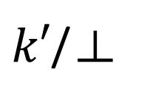
Adding explicit authentication
$$pw$$
$$pw′$$
Ada
PAKE
Charles
$k=k^{′}$if $pw=pw′$
else abort
$k$/⊥
$k′$/⊥

Slide 14


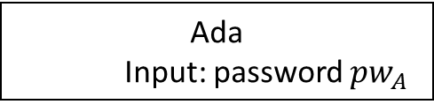




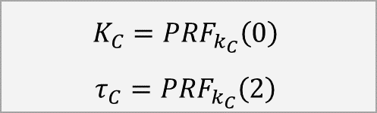
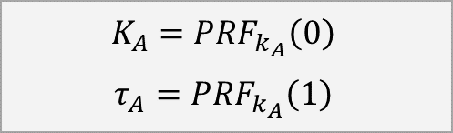
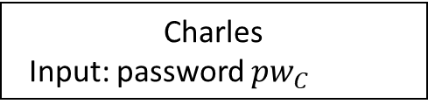


Thm 2: UC lePAKE + Key Conf. ⇒
UC rPAKE with Explicit Authentication
Ada
Input: password $pw_{A}$
Charles
Input: password $pw_{C}$
Lazy-Extraction
PAKE
$$pw_{A}$$
$$pw_{C}$$
$$k_{A}$$
$$k_{C}$$
$$K_{A}=PRF_{k_{A}}\left(0\right)$$
$$τ_{A}=PRF_{k_{A}}\left(1\right)$$
$$K_{C}=PRF_{k_{C}}\left(0\right)$$
$$τ_{C}=PRF_{k_{C}}\left(2\right)$$
$$τ_{A}$$
$$τ_{C}$$
abort if $τ_{C}≠PRF_{k_{A}}\left(2\right)$
abort if $τ_{A}≠PRF_{k_{C}}\left(1\right)$
Notes:
Thanks to this remark in slides #19 and afterwards you can replace
z=f_s(pw) with z=s^{H(pw)}, which will make it easier to see how it
works, I think...
OK, so back to slide #19:
First of all, I think you should add one more slide here which would
go something like this:
Slide #19A (similar to slide #21 but simplified and two-directional):
Title: Building saPAKE from STOWF
Subtitle: We will use the "CPA Enc + SPHF" paradigm to PAKE [KOY01,GL03,...]
The picture explains this paradigm using the Ada & Charles and
protocol like in #21 but simplifed and two-directional, i.e.:
Ada -> Charles: cA=Enc(pwA;rA)
Chalres -> Ada: cC=Enc(pwC;rC)
Ada defines statement xA = "cC encrypts pwA" and computes
SPHF.Hash(xA)->(vA,hpA)
Ada -> Charles: hpA
Charles defines statement xC = "cA encrypts pwC" and computes
SPHF.Hash(xC)->(vC,hpC)
Charles -> Ada: hpC
Ada recovers vC'=SPHF.PHash(hpC,wA) for wA=(pwA,rA)
Charles recovers vA'=SPHF.PHash(hpC,wA) for wA=(pwA,rA)
Ada's key is k = vA xor vC'
Carles key is k = vA' xor vC
And you explain two points:
#1: explain SPHF but just verbally (you will have slide #22 on CKEM,
which will mention that this is a generalization of SPHF): An SPHF
for some NP language s.t. given statement x the sender can "Hash" it
to generate a hash value v and "hash projection" hp s.t. if receiver
has witness w that statement x is in the language, then using the
"Projection Hashing" procedure PHash it can derive the hash value v
and otherwise this value will be random to the receiver. And say that
this design intuitively works because if A's password matches C's then
she can recover C's hash value, and if C's password matches A's then
he can recover A's hash value, and otherwise one party's key is random
to the other.
#2: say that there has been lot of work on this paradigm, that it can
be very efficient, that it can be done in the standard model, i.e.
without RO, it can be done even in non-interactive way, and under
various assumptions

Slide 15


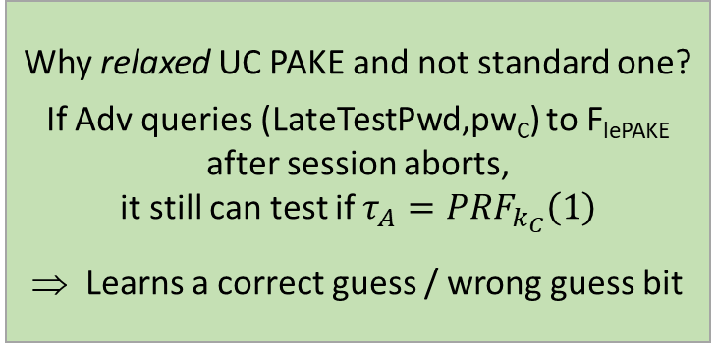
Thm 2: UC lePAKE + Key Conf. ⇒
UC rPAKE with Explicit Authentication
Ada
Input: password $pw_{A}$
Charles
Input: password $pw_{C}$
Ada
(simulated) ~~~~~
Charles
(adversary)
Lazy-Extraction
PAKE
Lazy-Extraction
PAKE Functionality
$$pw_{A}$$
$$pw_{C}$$
$$(LateTestPwd,pw_{C})$$
$$k_{A}$$
$$k_{C}$$
$$k_{C}$$
$$K_{A}=PRF_{k_{A}}\left(0\right)$$
$$τ_{A}=PRF_{k_{A}}\left(1\right)$$
$$K_{C}=PRF_{k_{C}}\left(0\right)$$
$$τ_{C}=PRF_{k_{C}}\left(2\right)$$
$$τ_{A}$$
$$τ_{C}$$
Why relaxed UC PAKE and not standard one?
If Adv queries (LateTestPwd,pw_{C}) to F_{lePAKE} after session aborts,
it still can test if $τ_{A}=PRF_{k_{C}}\left(1\right)$
⇒ Learns a correct guess / wrong guess bit
abort if $τ_{C}≠PRF_{k_{A}}\left(2\right)$
abort if $τ_{A}≠PRF_{k_{C}}\left(1\right)$
If Adv doesn’t query (LateTestPwd,pw_{C}) to F_{lePAKE}
s.t. pw_{C}=pw_{A} then k_{A} is hidden and attacked session aborts
Notes:
Thanks to this remark in slides #19 and afterwards you can replace
z=f_s(pw) with z=s^{H(pw)}, which will make it easier to see how it
works, I think...
OK, so back to slide #19:
First of all, I think you should add one more slide here which would
go something like this:
Slide #19A (similar to slide #21 but simplified and two-directional):
Title: Building saPAKE from STOWF
Subtitle: We will use the "CPA Enc + SPHF" paradigm to PAKE [KOY01,GL03,...]
The picture explains this paradigm using the Ada & Charles and
protocol like in #21 but simplifed and two-directional, i.e.:
Ada -> Charles: cA=Enc(pwA;rA)
Chalres -> Ada: cC=Enc(pwC;rC)
Ada defines statement xA = "cC encrypts pwA" and computes
SPHF.Hash(xA)->(vA,hpA)
Ada -> Charles: hpA
Charles defines statement xC = "cA encrypts pwC" and computes
SPHF.Hash(xC)->(vC,hpC)
Charles -> Ada: hpC
Ada recovers vC'=SPHF.PHash(hpC,wA) for wA=(pwA,rA)
Charles recovers vA'=SPHF.PHash(hpC,wA) for wA=(pwA,rA)
Ada's key is k = vA xor vC'
Carles key is k = vA' xor vC
And you explain two points:
#1: explain SPHF but just verbally (you will have slide #22 on CKEM,
which will mention that this is a generalization of SPHF): An SPHF
for some NP language s.t. given statement x the sender can "Hash" it
to generate a hash value v and "hash projection" hp s.t. if receiver
has witness w that statement x is in the language, then using the
"Projection Hashing" procedure PHash it can derive the hash value v
and otherwise this value will be random to the receiver. And say that
this design intuitively works because if A's password matches C's then
she can recover C's hash value, and if C's password matches A's then
he can recover A's hash value, and otherwise one party's key is random
to the other.
#2: say that there has been lot of work on this paradigm, that it can
be very efficient, that it can be done in the standard model, i.e.
without RO, it can be done even in non-interactive way, and under
various assumptions

Slide 16
Model Validation: Perfect Forward Secrecy (PFS)
PFS security: After party corruption, previous sessions are still secure
PFS security for PAKEs:
Future revealing of password does not endanger security of past sessions
Thm 3: UC rPAKE ⇒ game-based PAKE with PFS
  Proof analogous to UC PAKE ⇒ game-based PAKE with PFS in [CHK+05]
Also: UC lePAKE ⇒ game-based PAKE with weak PFS

Slide 17
Related Results
Some prior appearances of “lazy input extraction” UC models
  UC Oblivious PRF [JKK14]: unbinds online/offline evaluation → allows post-execution extraction
  relaxed asymmetric UC PAKE in OPAQUE [JKX18, ePrint] (post-execution extraction due to UC OPRF!)
Concurrent result by Victor Shoup [ePrint 2020/313]
  UC security of SPAKE2 and asymmetric SPAKE2 extension using equivalent UC PAKE model relaxation
    non-modular analysis (requires key confirmation)
    uses weaker version of Gap DH: DDH oracle with fixed DH exponent
Recent result by Ian McQuoid, Mike Rosulek, and Lance Roy
  2-round Feistel realizes “one-time Ideal Cipher” in ROM, suffices for EKE to realize (standard) UC PAKE
    bandwidth increase, 2 hash-onto-curve ops (none in SPAKE2), 1 fixed-based exp (vs. 3 in SPAKE2)
    non-tight security reduction to DDH (vs. tight relation to Gap DH in SPAKE2)

Slide 18
Conclusions
Main Result: Practical PAKEs realize lazy extraction UC PAKE functionality
  Including SPAKE2, TBPAKE, SPEKE, CPace (all in ROM)
  SPAKE2 and CPace finalists in IETF CFRG PAKE competition
Adding key confirmation adds explicit authentication
  and strengthens the model to relaxed UC PAKE
  (= post-execution extraction attack only reveals a correct guess / wrong guess bit)
Model validation: Every UC rPAKE is game-based PFS-secure
One open question: Is UC lazy-extraction PAKE weaker than UC PAKE ?
  We have some preliminary results but no general answer

Slide 19
THANK YOU!
Universally Composable Relaxed
Password Authenticated Key Exchange
https://eprint.iacr.org/2020/320

