Slide 1
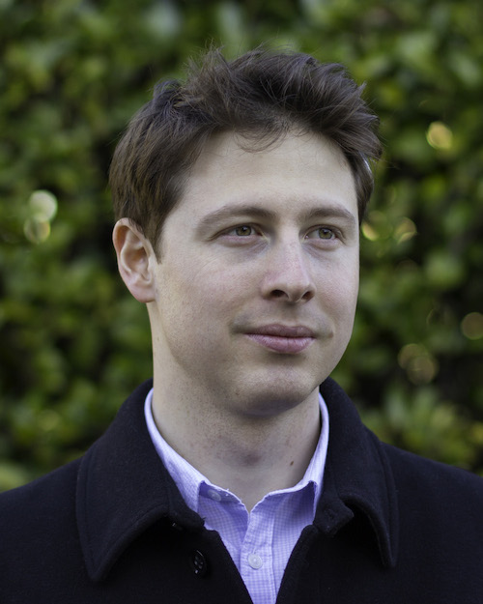
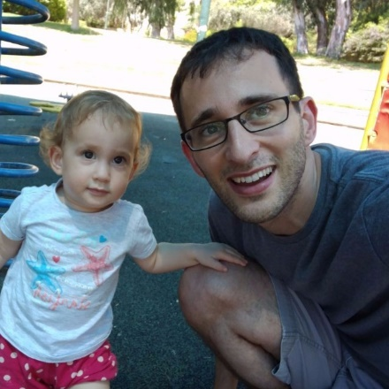
Barriers for Succinct Arguments in the Random Oracle Model
TCC 2020
Alessandro Chiesa
Eylon Yogev
UC Berkeley
Boston University
& Tel Aviv University

Slide 2
Succinct Arguments in the Random Oracle Model

Slide 3
Succinct arguments in the ROM
$$ζ:{\left\{0,1\right\}}^{∗}→{\left\{0,1\right\}}^{λ}$$
$$?$$
$$x∈L$$
Prover
Verifier
$$π$$
An interactive protocol for a language $L$ (i.e., 3-SAT)
The communication complexity is “succinct”
Soundness is computational

Slide 4
Succinct arguments in the ROM
$$ζ:{\left\{0,1\right\}}^{∗}→{\left\{0,1\right\}}^{λ}$$
$$?$$
$$x∈L$$
Prover
Verifier
$$π$$
Completeness: $\operatorname{Pr}\left[V\left(x,π\right)=1 :π←P\right]=1$
Soundness: for any $t$-query adversary $\tilde{P}$: $\operatorname{Pr}\left[V\left(x,π\right)=1 :π←\tilde{P} \right]≤ε$
This talk: non-interactive (SNARGs)

Slide 5
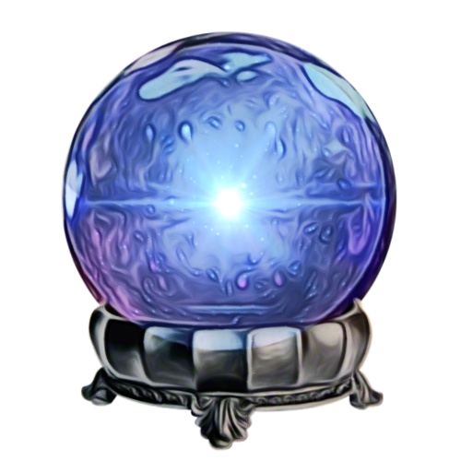
The random oracle model (ROM)
An elegant information-theoretic model
Can prove lower bounds
Supports several well-known constructions of succinct arguments
Heuristically instantiated via lightweight crypto
Plausibly post-quantum secure
$$ζ:{\left\{0,1\right\}}^{∗}→{\left\{0,1\right\}}^{λ}$$

Slide 6
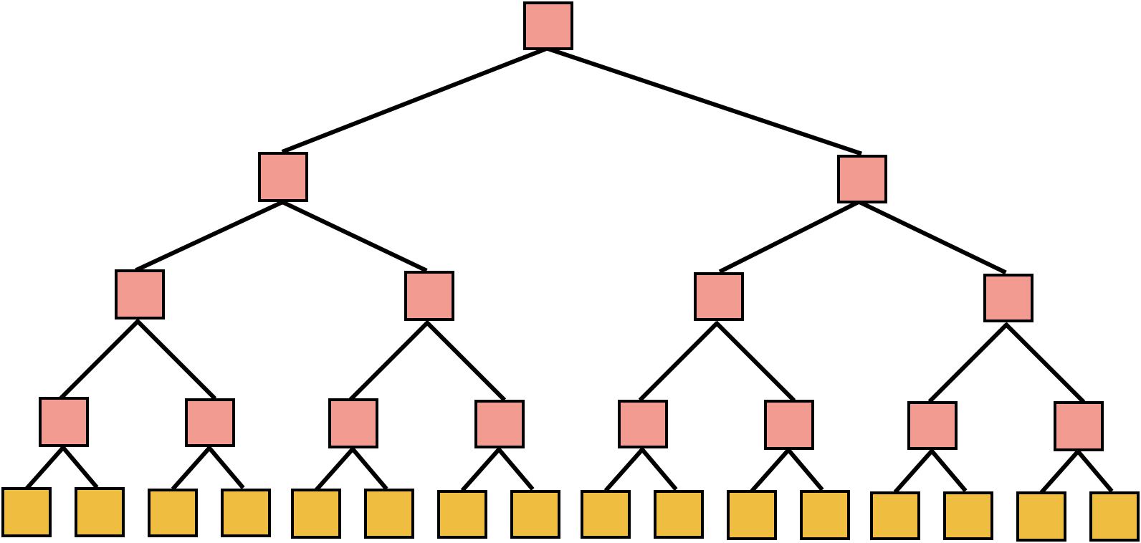
Known SNARG Constructions [Micali94,BCS16]
Information theoretic proof (PCP or IOP)
Cryptographic commitment (with local opening)
+
=
(non-interactive) succinct argument
Why aren’t there other constructions?

Slide 7
Our Results

Slide 8
Our results
succinct argument
in the ROM (for 3-SAT)
$$⇒$$
Interactive oracle proof (for 3-SAT)
$$⇒$$
Fast algorithm (for 3-SAT)
$$⇒$$
Boom!
result 1
result 2
$$⇒$$
ETH

Slide 9
Result 1
Theorem: IOPs are inherent for succinct argument in the ROM
$$⇒$$
Interactive oracle proof (IOP)
succinct argument in the ROM
+ preprocessing
+ salted soundness
+ holography
+ state restoration soundness

Slide 10
Prover Adaptivity
We consider prover adaptivity: The number of query rounds to the random oracle.
$$x_{1}^{1},x_{2}^{1},…,x_{m}^{1}$$
$$y_{1}^{1},y_{2}^{1},…,y_{m}^{1}$$
$$x_{1}^{2},x_{2}^{2},…,x_{m}^{2}$$
$$y_{1}^{2},y_{2}^{2},…,y_{m}^{2}$$

Slide 11
Prover Adaptivity
We define a parameter of prover adaptivity: The number of query rounds to the random oracle.
In known constructions, adaptivity $a=O(log n)$

Slide 12
Result 1 – with parameters
Rothblum Vadhan 09:
PCPs are inherent for succinct arguments obtained via blackbox reductions to falsifiable assumptions
Theorem:
succinct non-interactive argument
$$⇒$$
Interactive oracle proof (IOP)
argument size: $as$
verifier queries: $vq$
prover queries: $pq$ prover adaptivity: $a$
proof length: $pq+as$
query complexity: $as+vq⋅a$

Slide 13
Result 2: Limits on IOPs/PCPs
How high can the soundness of an IOP be?
Theorem: Suppose 3-SAT over $n$ variables has a IOP with: soundness error: $ε$, rounds: $k$, proof: $l$ (over alphabet $Σ$), query complexity $q$, such that $q⋅(\log\left|Σ\right|+k)=o(n)$ Then, if $ε=o(2^{−qlog l})$ then ETH is false.
Analogous result for deterministic languages (DTIME[T])
Matches the Sliding Scale Conjecutre, even for IOPs: Rules out constant query PCP/IOPs with $2^{−s}$ soundness over alphanet of size $2^{O\left(s\right)}$

Slide 14
Verifier Query Complexity
How small can verifier query complexity be?
It would be wonderful to have SNARGs that make 10 queries to the ROM
Queries become costly in non-black-box use of the verifier (e.g., recursive composition)
Corollary: Barriers for SNARGs with small verifier query complexity

Slide 15
Corollary
succinct argument for 3SAT
$$⇒$$
Interactive oracle proof (IOP)
$$⇒$$
Fast algorithm for 3SAT
$s$ bits of security
verifier queries: $vq$
prover adaptivity: $a$
$$vq⋅a= o(s)$$
$$⇒$$
Boom!
Breaking news: $vq= o(s)$
$$⇒$$
$s$-bits of sercurity:
Any $2^{s}$-query adversary wins with probability $2^{−s}$.
$λ=O(s)$
ETH

Slide 16
Proof Overview SNARG $⇒$ IOP

Slide 17
SNARG $⇒$ IOP
Prover
Verifier
$$π$$
$$⇒$$

Slide 18
Strawman proof
Prover
Verifier
$$π$$

Slide 19
Strawman proof
Prover
Verifier
$$π$$
The verifier simulates the random oracle

Slide 20
Strawman proof
$$x_{1}$$
$$y_{1}$$
$$x_{2}$$
Verifier simulates the argument verifier on $π$
How to simulate verifier queries?
$$y_{2}$$
$$…$$
$$π$$

Slide 21
Strawman proof
$$x_{1}$$
How to simulate verifier queries?
For any query $x$: find round $i s.t. x_{i}=x$ Use $y_{i}$ as the response
Problem: must make sure $x$ was not issued twice
Solution: for any $j≠i$ verify that $x_{j}≠x_{i}$
Query complexity: entire transcript
Round complexity: huge
$$y_{1}$$
$$x_{2}$$
$$y_{2}$$
$$…$$
$$π$$

Slide 22
Strawman proof
$$x_{1}^{1},x_{2}^{1},…,x_{m}^{1}$$
How to simulate verifier queries?
For any query $x$: find round $i s.t. x_{i}=x$ Use $y_{i}$ as the response
Problem: must make sure $x$ was not issued twice
Solution: for any $j≠i$ verify that $x_{j}≠x_{i}$
Query complexity: entire transcript
Round complexity: prover adaptivity
$$y_{1}^{1},y_{2}^{1},…,y_{m}^{1}$$
$$x_{1}^{2},x_{2}^{2},…,x_{m}^{2}$$
$$y_{1}^{2},y_{2}^{2},…,y_{m}^{2}$$
$$…$$
$$π$$

Slide 23
Challenge for small query complexity: Given $x$, and $j$ we need to verify that $x$ was not issued in round $j$
$$x_{1},x_{2},…,x_{m}$$

Slide 24
Perfect Hash Functions
A family of hash function $H:U→[O(m)]$ is perfect if: For every $S⊂U$ of size $m$ there is $h∈H$ s.t. $h$ is one-to-one on $S$
Famous construction: Fredman, Komlós, and Szemerédi [FKS84]
Used two levels of hashing.
This construction has an additional locality property: To eval $h$ on a specific $x$ one needs to read only a few bits from $h$

Slide 25
Challenge for small query complexity: Given $x$, and $j$ we need to verify that $x$ was not issued in round $j$
$$h_{1}(x_{1})$$
$$h_{1},$$
$$x_{3}$$
$$x_{1}$$
$$x_{2}$$
$${=T}_{j}$$

Slide 26
Full proof
$$h_{1},$$
$$x_{3}^{1}$$
$$x_{1}^{1}$$
$$x_{2}^{1}$$
$${=T}_{1}$$
How to simulate verifier queries?
For any query $x$: find $i s.t. T_{i}\left[h\left(x\right)\right]=x$ Use $y=T_{i}^{′}[h\left(x\right)]$ as the response.
Verify: $∀j≠i:T_{j}\left[h\left(x\right)\right]≠x$
Query complexity: O(1) per round
Round complexity: prover adaptivity
$$y_{1}^{1}$$
$$y_{2}^{1}$$
$$y_{3}^{1}$$
$$y_{4}^{1}$$
$$y_{5}^{1}$$
$$y_{6}^{1}$$
$$y_{7}^{1}$$
$$y_{8}^{1}$$
$$y_{9}^{1}$$
$${=T′}_{1}$$
$$h_{2},$$
$$x_{1}^{2}$$
$$x_{3}^{2}$$
$$x_{2}^{2}$$
$${=T}_{2}$$
$$y_{1}^{2}$$
$$y_{2}^{2}$$
$$y_{3}^{2}$$
$$y_{4}^{2}$$
$$y_{5}^{2}$$
$$y_{6}^{2}$$
$$y_{7}^{2}$$
$$y_{8}^{2}$$
$$y_{9}^{2}$$
$${=T′}_{2}$$
$$π$$

Slide 27
Summary
succinct argument for 3SAT
$$⇒$$
Interactive oracle proof (IOP)
$$⇒$$
Fast algorithm for 3SAT
We gave barriers for the query complexity of a SNARG in the ROM
Another important complexity measure: argument size.
Open problem: can our techniques be used to lower bound the argument size?

