Slide 1

Generic Side-channel attacks on CCA-secure lattice-based PKE and KEMs
Prasanna Ravi^{1,2}
Sujoy Sinha Roy³
Anupam Chattopadhyay^{1,2}
Shivam Bhasin¹
1. Temasek Labs, NTU Singapore
2. SCSE, NTU Singapore
3. SCSE, University of Birmingham
18th Sep, 2020

Slide 2
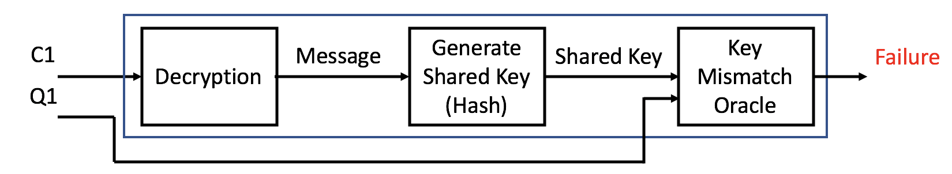
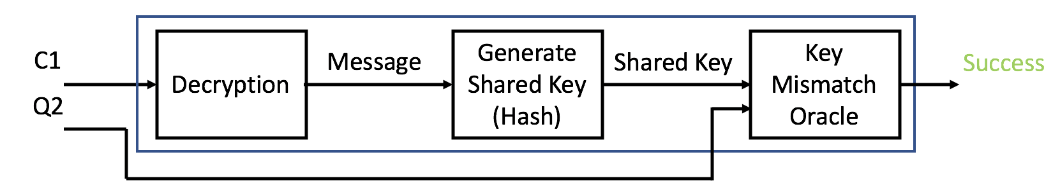
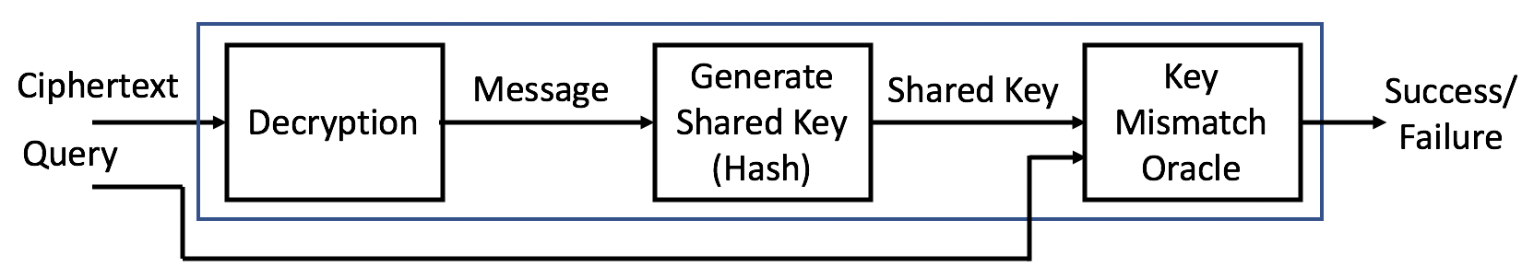
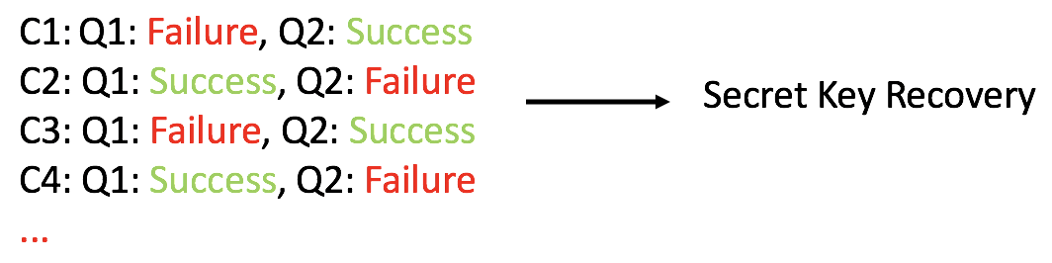
Motivation
Caching encryption keys is a very common technique used in several protocols such as the TLS and IKE.
Security of several public-key encryption schemes in a key-reuse scenario has been studied for a very long period of time... dating back to the million message attack of Bleichenbacher reported in 1996.
These attacks craft malicious ciphertexts and use the decryption device to instantiate a plaintext-checking or key-mismatch oracle.

Slide 3
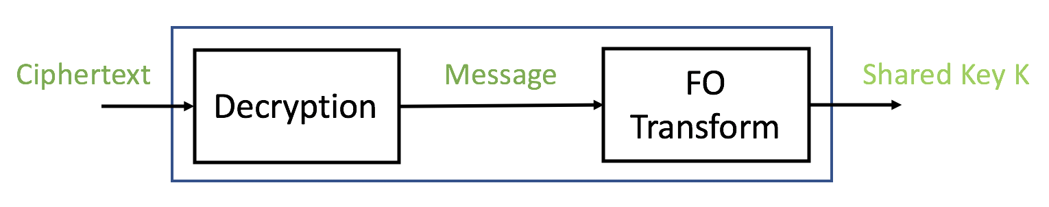
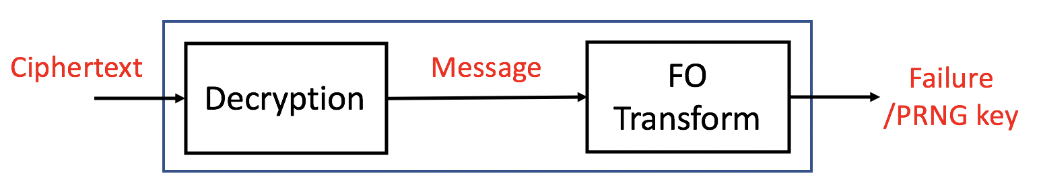
Motivation
Lattice-based PKEs are also known to be susceptible to such chosen-ciphertext attacks in a key-reuse scenario.
How do you protect against such attacks?
  No Key Caching – Using ephemeral keys has a considerable impact on performance.
  Chosen Ciphertext Security - Removes the presence of a key-mismatch oracle.
The Fujisaki-Okamoto transform is a well known technique which has been used to provide chosen-ciphertext security (CCA) to several lattice-based PKEs.
Thus, the attacker cannot gain any information about the decrypted message for an invalid ciphertext thereby preventing such chosen-ciphertext attacks.
Is it possible to gain information about the decrypted message through side-channels???
Along the same lines, D’Anvers et al.[1] demonstrated a timing attack on error correcting codes used in LAC and RAMSTAKE to recover information about the decrypted message leading to full key recovery.
Checks for the validity of
ciphertext through
re-encryption

Slide 4
Our Contribution
In this work, we extend and generalize side-channel assisted chosen ciphertext attacks applicable to about six lattice-based PKE/KEMs all of which were second round candidates in the NIST call.
  Kyber (Third Round - Main)
  Saber (Third Round - Main)
  Frodo KEM (Third Round - Alternative)
  Round5
  NewHope
  LAC
We identified two types of EM-based side-channel vulnerabilities that can be used to instantiate an efficient a plaintext-checking oracle in chosen ciphertext secure schemes which can be used to perform secret key recovery.
We perform experimental validation of our EM-based side-channel attacks on implementations from the public pqm4 library, a benchmarking framework for PQC schemes on the ARM Cortex-M4 microcontroller.
All our demonstrate attacks can be practically performed in a matter of minutes only using a few thousand traces for full key recovery.

Slide 5
Lattice-based PKEs
All the schemes targeted in this work are based on the well known Learning With Errors (LWE) and Learning With Rounding (LWR) problem.
6 out of the 26 schemes in the second round were based different variants of the LWE/LWR problem:
  Standard LWE (Frodo) – computation over matrices/vectors
  Ring LWE/LWR (NewHope, LAC, Round5) – computation over polynomials in polynomial rings
  Module LWE/LWR (Kyber, Saber) – computation over matrices and vectors of polynomials in rings
All the aforementioned CCA secure PKE/KEMs contain in their core an encryption scheme based on a generic paradigm of the well known Lyubsashevsky-Peikert-Regev (LPR) Encryption scheme [2].
We will briefly explain the LPR encryption scheme when operating over the Ring-LWE problem for the sake of illustration.
We assume all operations are performed over the polynomial ring

Slide 6
Lattice-based PKEs
Key-Generation:
Encryption:
Decryption:
All CPA secure LWE/LWR-based schemes suffer from a certain decryption failure rate.
Key Criterion for CCA security: Negligible decryption failure rate
Two routes taken to satisfy this criterion:
  1. Design Parameters with negligible failure rate
    Kyber, Saber, NewHope, Frodo
  2. Utilize error correcting codes (ECC) to decrease failure rate
    Round5, LAC

Slide 7
Chosen Ciphertext Security
Most LWE/LWR-based schemes utilize the well known Fujisaki-Okamoto (FO) transform for CCA security.
IND-CPA secure PKE (Encrypt, Decrypt) -> IND-CCA secure KEM (Enapsulation, Decapsulation)
It forms a wrapper around the encryption and decryption procedure using one way functions (hash).
Checks validity of ciphertext after decryption through re-encryption.
Encapsulation:
Decapsulation:
Re-encryption
Correct Key
Random Key

Slide 8
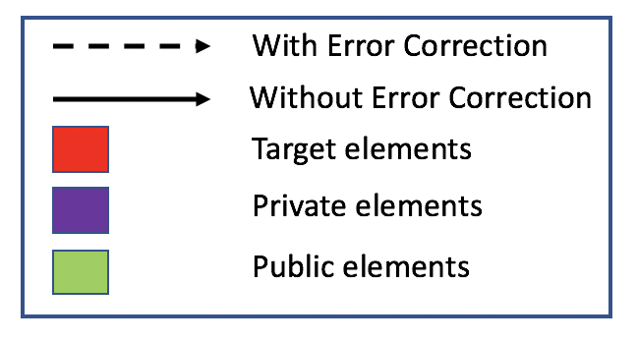
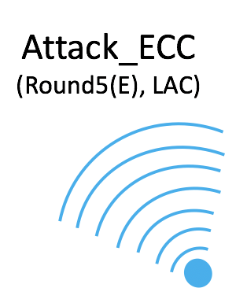
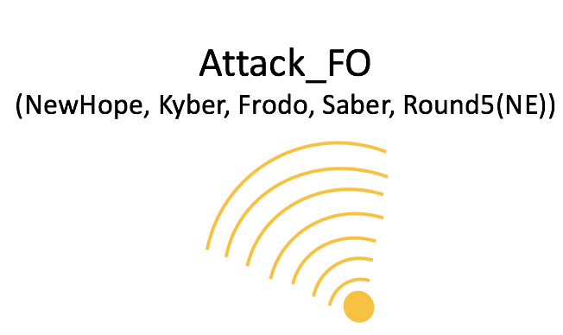
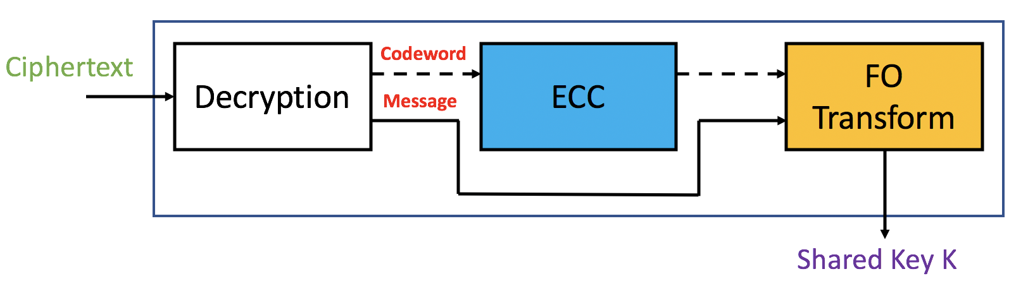
Attacking CCA secure Decapsulation:
Two main questions:
  How to utilize side-channels to efficiently instantiate a plaintext-checking oracle?
  How to craft chosen ciphertexts such that outputs of the plaintext-checking oracle can be used to recover the secret key?

Slide 9
Part I:
Using side-channels to efficiently instantiate a plaintext-checking oracle.

Slide 10
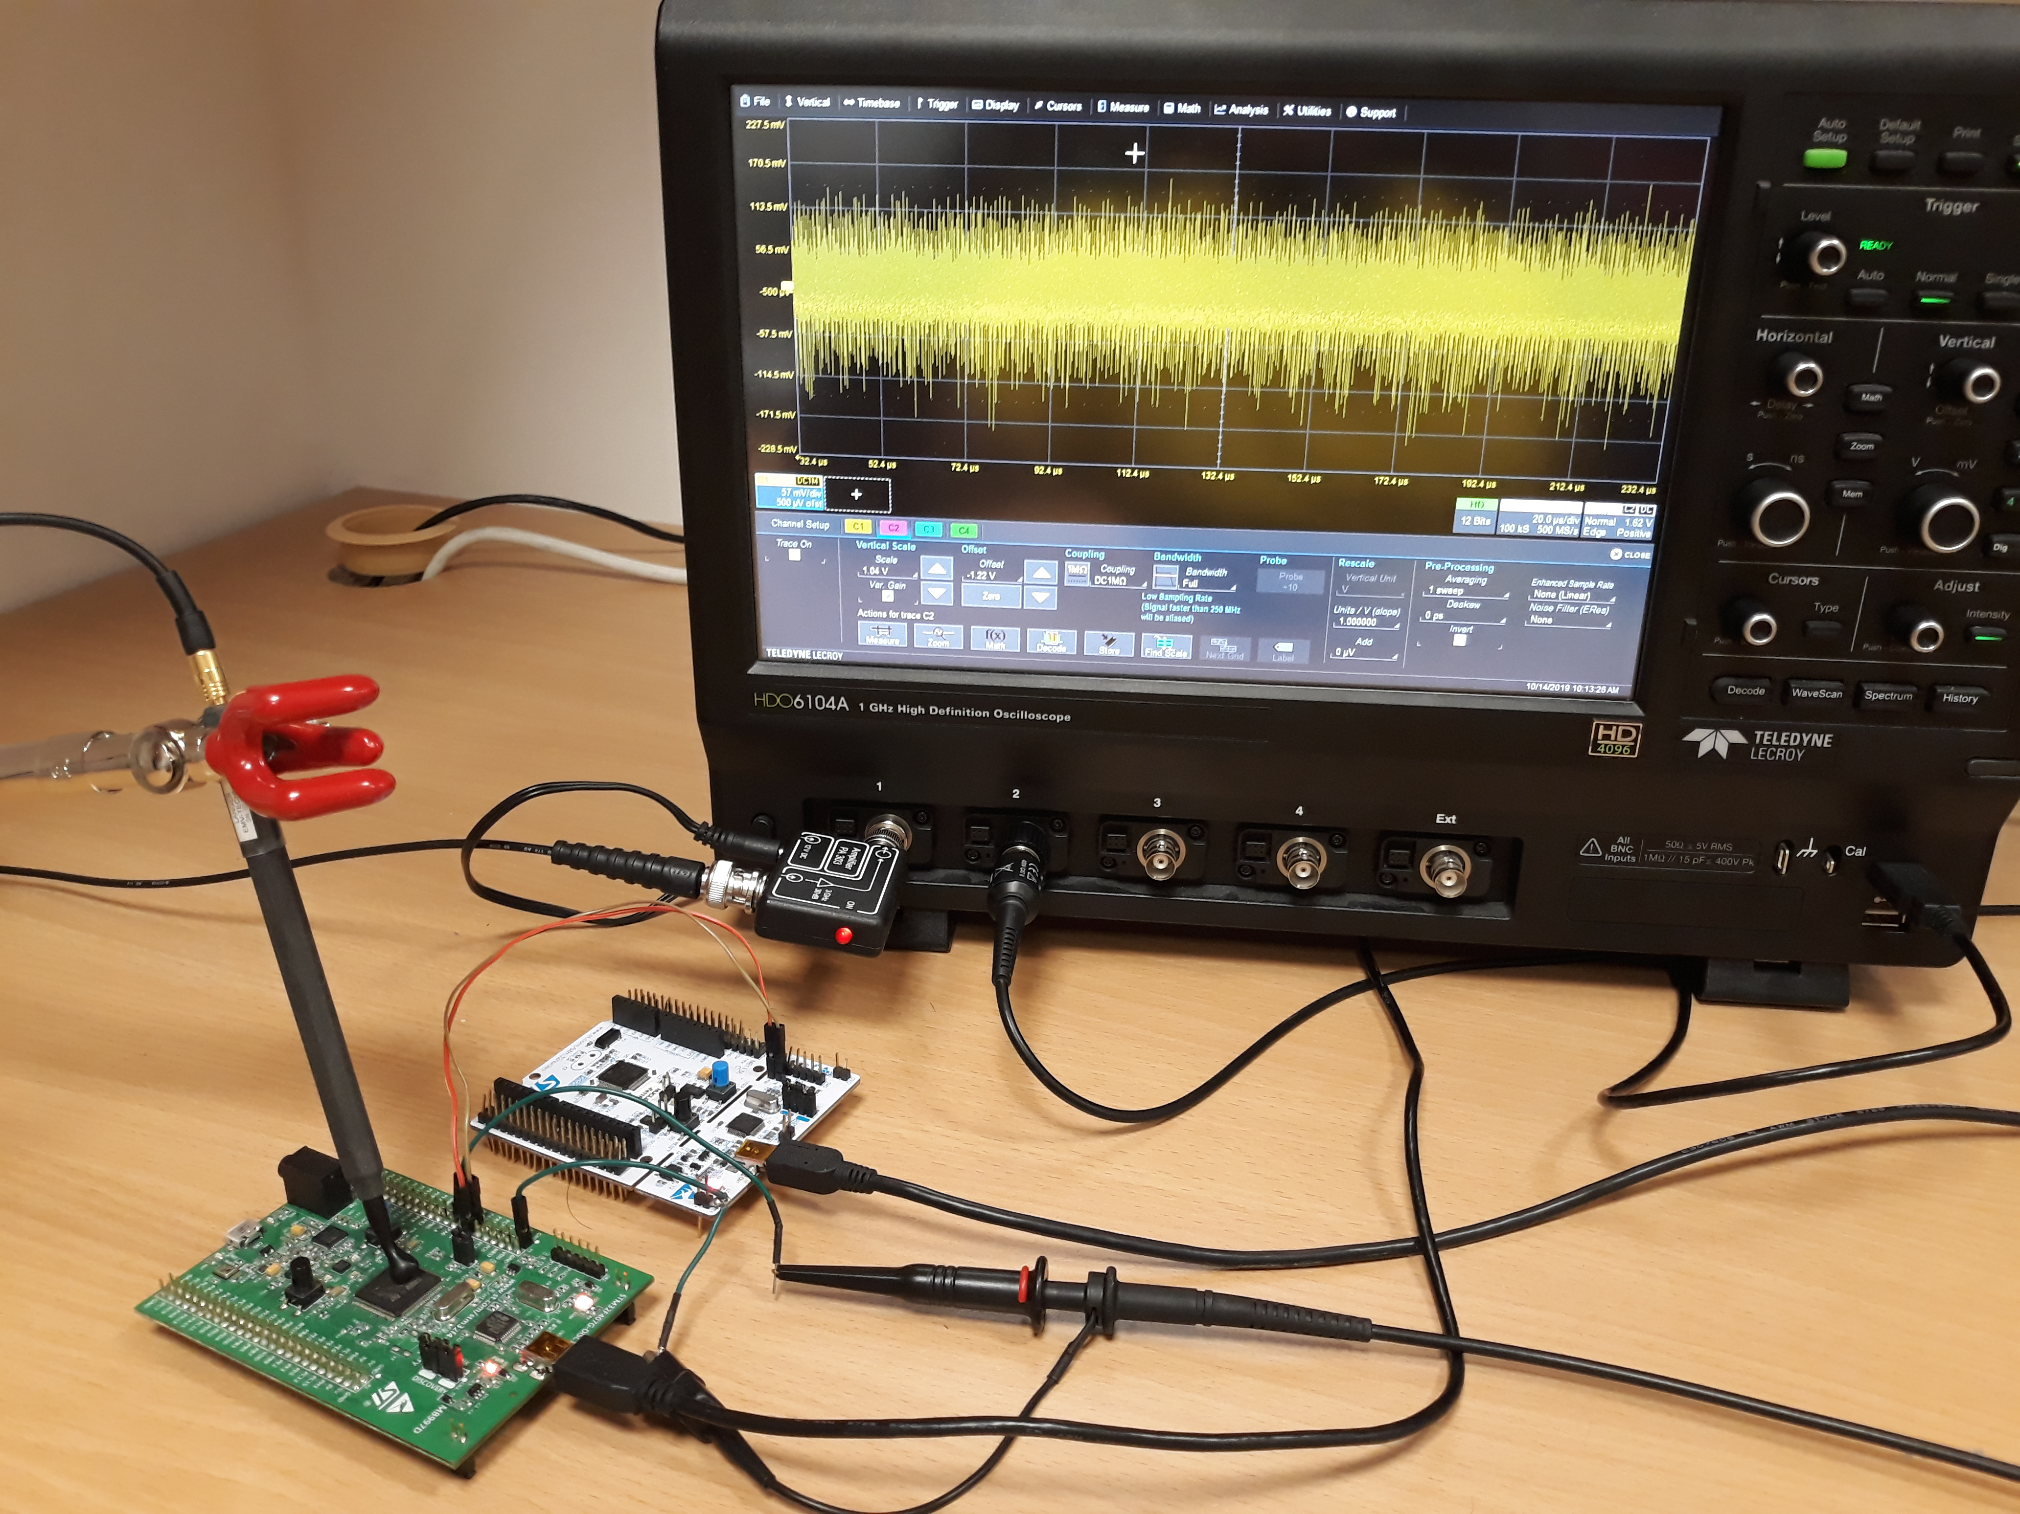
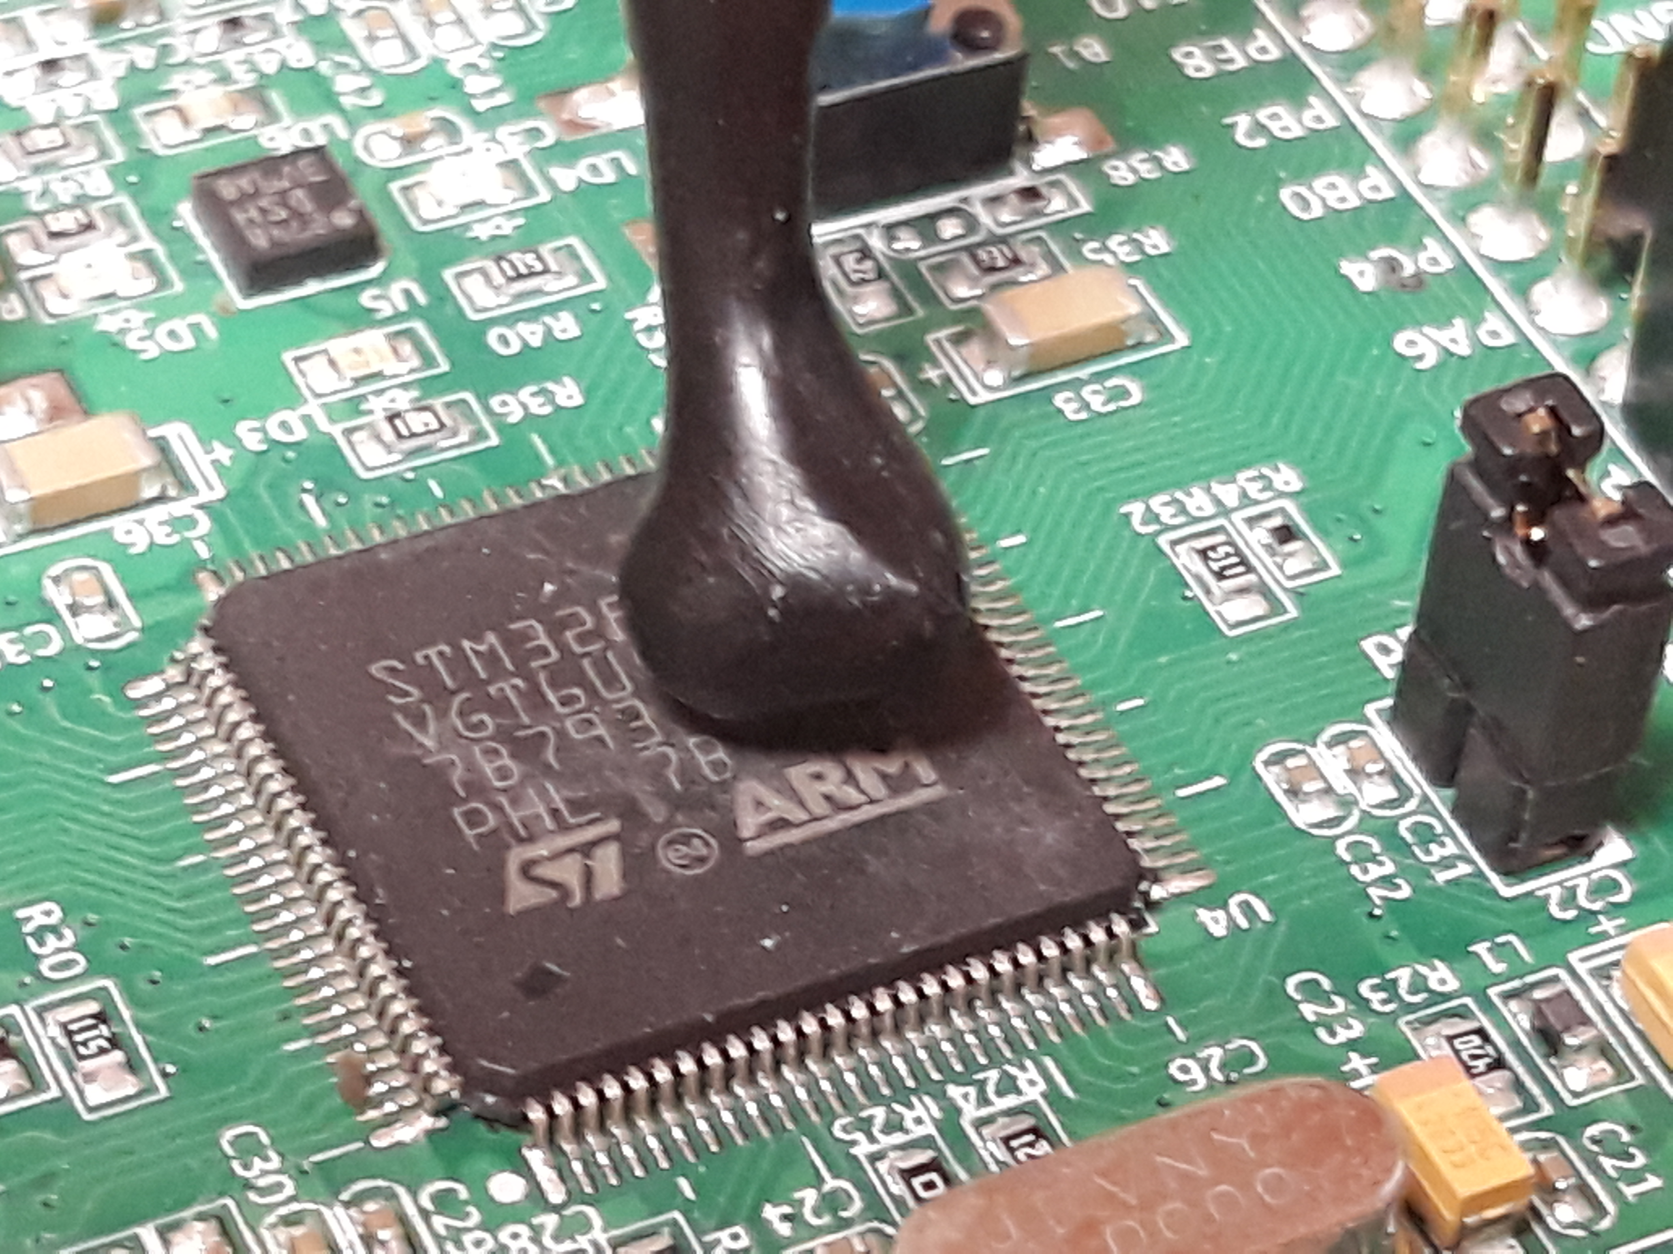
Experimental Setup:
We perform all our experiments on the most optimized implementations of the targeted schemes present in the pqm4 library, a benchmarking and testing framework for PQC schemes on the ARM Cortex-M4 microcontroller.
Target Platform: STM32F407VG based on the ARM Cortex-M4 (24 MHz).
We utilize the near field EM probe and record measurements on the Lecroy 610Zi oscilloscope at a sampling rate of 500 Msam/s.

Slide 11
SCA over Error Correcting Codes : Round5
We first consider Round5 based on RLWR, which utilizes the XEf error correction scheme, an f-bit linear parity code capable of correcting upto “f” errors per codeword.
Encoding:
Decoding:

Slide 12
SCA over Error Correcting Codes : Round5
The decision making operation to flip a bit or not is implemented as a majority logic operation using bitwise operators.
If codeword is valid, all inputs to this majority logic operation are zeros.
If codeword is invalid, one or more inputs are non-zero.
This differential behaviour based on the validity of the codeword can be easily distinguishable through side-channels.
We also observe that an all zero codeword (i.e) c = 0 is valid, while c = 1 is invalid.
We utilize a t-test based reduced template approach to distinguish between c = 0 and c = 1.

Slide 13
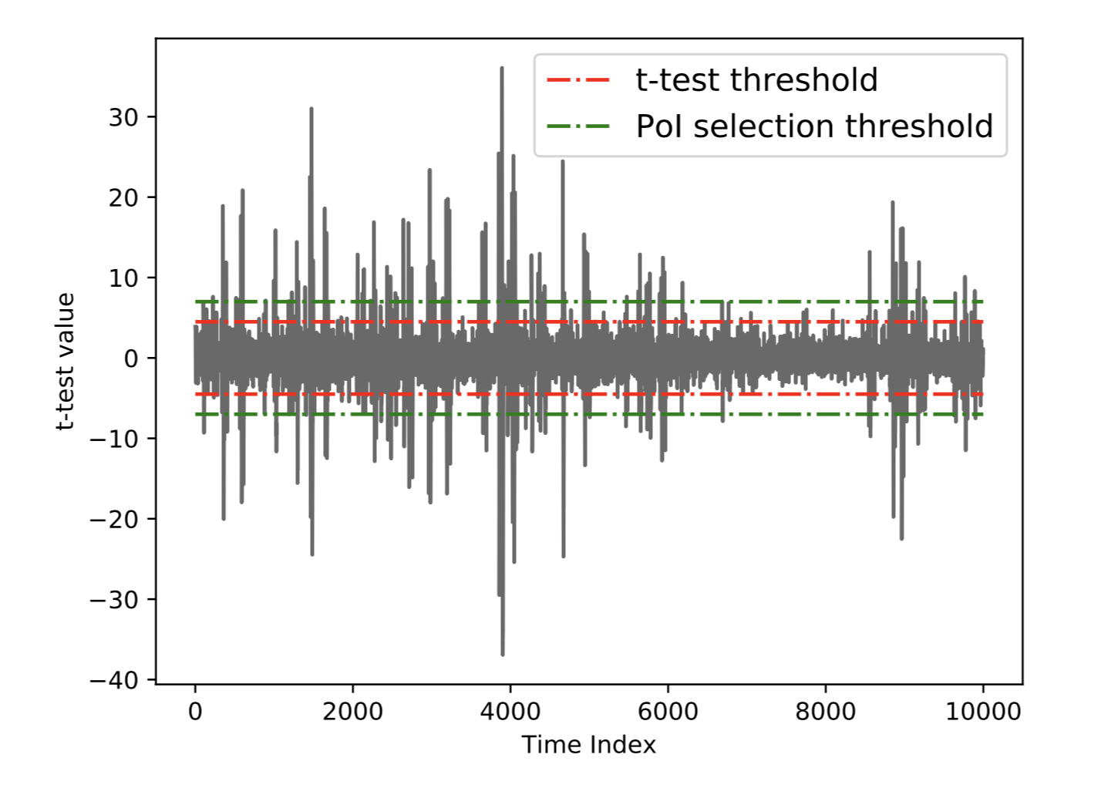
SCA over Error Correcting Codes : Round5
t-test based reduced template attack:
  Construct ciphertexts for codewords c = 0 and c = 1
  Collect n traces corresponding to decryption of c = 0 (T0) and c = 1 (T1)
  Normalize the traces and compute the t-test between the two traces sets.
  Construct a reduced trace set with points of interest (PoIs) above a certain threshold for both sets.
  The mean of the reduced trace sets T0 and T1 are the reduced templates for c = 0 and c = 1.
  In the attack phase, a simple template matching can be performed to determine the class.
Encryption:
can choose any value for c
t-test plot for Round5 (R5ND_1KEM_5d) between decoding of c= 0 and c = 1

Slide 14
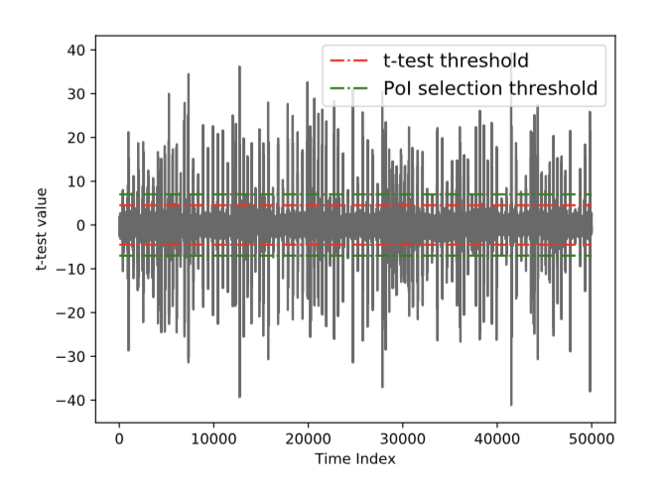
SCA over Error Correcting Codes : LAC
LAC is another scheme (RLWE) that utilizes the BCH code for heavy error correction.
D’Anvers et al.[1] demonstrated a timing attack on a non-constant time decoding procedure of BCH, whose runtime varies depending upon the validity of the codeword.
The decoding procedure of BCH works by computing a syndrome S for the received codeword.
It is well known that the syndrome is zero for a correct codeword and non-zero for an invalid codeword.
We hypothesize that the syndrome computation can probably be targeted through side-channels to distinguish between valid and invalid codewords.
Similar to XEf, the all zero codeword (c = 0) is valid for BCH while c = 1 is an invalid codeword with a single bit error.
We follow the same t-test based reduced template appraoach to distinguish between c = 0 and c = 1.
t-test plot for LAC (LAC128) between decoding of c= 0 and c = 1

Slide 15
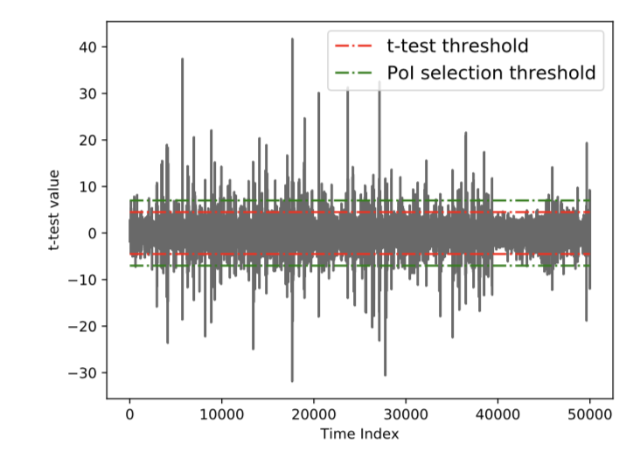
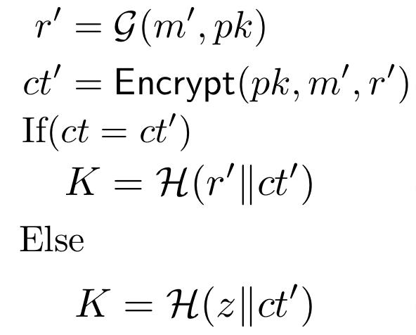
SCA over FO Transform: Kyber
Kyber, based on the MLWE does not utilize error correcting codes to reduce decryption failure.
SCA over the hash function can help provide us information about the decrypted message.
Here again, we would like to differentiate between the two cases m = 0 and m = 1.
The diffusion property of the hash function ensures that the computations corresponding to the two cases are observably different over the EM side-channel.
We capture EM traces from operations towards the end of the hash computation and utilize the same t-test based reduced template approach to distinguish between the two values of the message.
Decapsulation:
Directly operates over the decrypted message
t-test plot for Kyber (KYBER512) between decoding hashing of m= 0 and m = 1

Slide 16
Part II:
Efficiently using the instantiated plaintext-checking oracle for secret key recovery

Slide 17
Crafting Malicious Ciphertexts
We assume all operations are performed over the polynomial ring
Every coefficient of the product “r” depend upon all the coefficients of the secret polynomial s
Subsequent operations are all coefficient wise operations and thus
Decryption (ct = (u,v)):

Slide 18
Crafting Malicious Ciphertexts
We assume all operations are performed over the polynomial ring
Decryption (ct = (u,v)):
To break this dependency, we choose:

Slide 19
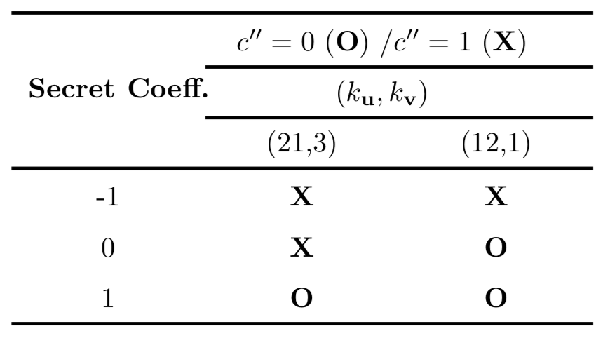
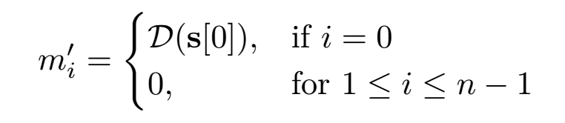
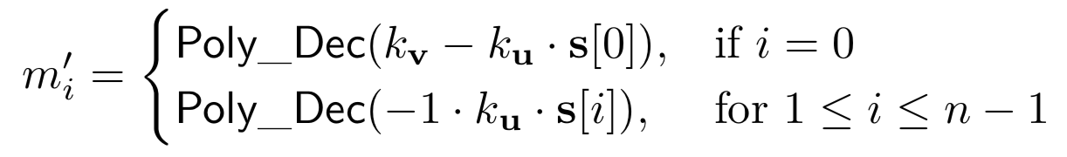
Crafting Malicious Ciphertexts
We assume all operations are performed over the polynomial ring
Decryption (ct = (u,v)):
Distinguisher for secret coefficient in Round5 (R5ND_1KEM_5d)
Now, we need to choose values for and based on certain conditions:
This ensures that the decryption output can only take two values possible values (i.e) 0 or 1.
Moroever, the decryption output’s value only depends upon s[0].
Choose values for and such that the corresponding decryption outputs should uniquely identify s[0].

Slide 20
Full Secret Key Recovery
We can adapt the same technique to recover the complete secret key one at a time.
We exploit efficient properties of multiplication in the ring
If we choose
By, simply changing the non-zero coefficient of u and v, we can recover the full secret key.
We exploit the efficient rotation property to restrict the number of possible values of the decryption output to just two (i.e) and .

Slide 21
Experimental Results:
We performed practical experiments over three schemes: Round5, LAC and Kyber.
Scheme | # Coeffs | # Pre-Processing traces | # Attack traces (3 iterations) | Time (Minutes) (3 iterations)
Round5 (R5ND_1KEM_5d) | 490 | 2 x 50 = 100 | 2 x 489 x 3 = 2.9k | 4.5
LAC (LAC128) | 512 | 2 x 50 = 100 | 2 x 512 x 3 = 3.0k | 25
Kyber (KYBER512) | 512 | 2 x 50 = 100 | 5 x 512 x 3 = 7.7k | 10.8

Slide 22
Adapting our Attack to other schemes:
The rotation property of polynomial multiplication does not hold for FrodoKEM as it operates over matrices and vectors.
The position of the dependent bit in the decryption output changes based on the position of the secret coefficient to be recovered (i.e) to recover the secret coefficient s[i], one has to distinguish between (1) and (2)
This increases the number of possible templates to be built in the pre-processing phase.
  Frodo640: 129 templates.
  Frodo976: 193 templates.
  Frodo1344: 257 templates.

Slide 23
Adapting our Attack to other schemes:
NewHope utilizes a redundancy approach in its encoding and decoding procedures by encoding a single bit into multiple coefficients.
In case of NewHope512, two coefficients of m’ are used to decode to a corresponding bit m’ and this increases to four coefficients in the case of NewHope1024.
Each coefficient of s can take 17 possible values (i.e) [-8,8] and this amounts to distinguishing between:
  NewHope512: 289 candidate pairs
  NewHope1024: 85321 candidate quadruples
We propose a two staged randomized approach to search for the required ciphertexts.
We performed attack simulations and could perform full key recovery using an ideal plaintext checking oracle.
  NewHope512: 6495 queries
  NewHope1024: 26624 queries

Slide 24
Countermeasures
Masking serves as a concrete countermeasure against our attacks targeting both the error correcting procedures and the FO transform.
However to the best of our knowledge, masking schemes for error correcting codes has not been studied yet.
For schemes that do not use error correcting codes, masking can concretely protect against our attack.
Our attacks thus reiterate the need for evaluating concrete masking style countermeasures to protect lattice-based schemes against side-channel attacks.

Slide 25
Conclusion
We proposed generic approaches for side-channel assisted chosen ciphertext attacks applicable to about six lattice-based schemes that participated in the second round of the NIST standardization process.
We identify vulnerabilities within the error correcting procedures and the FO transform to efficiently instantiate a plaintext-checking oracle to perform full key recovery.
We evaluate all our attacks on optimized implementations of the targeted schemes on publicly available implementations from the pqm4 library on the ARM Cortex-M4 microcontroller.
All the demonstrated attacks can be performed in a matter of minutes using only a few thousand traces for full key recovery.
Our attacks thus reiterate the need for evaluating concrete masking style countermeasures to protect lattice-based schemes against side-channel attacks.

