Slide 1
Adaptive Extractors and their
Application to Leakage Resilient Secret Sharing
Nishanth Chandran¹, Bhavana Kanukurthi², Sai Lakshmi Bhavana Obbattu¹ and Sruthi Sekar²
¹Microsoft Research, India
²Indian Institute of Science, India

Slide 2
Talk Outline

Slide 3
Randomness Extractors [Nissan and Zuckerman, 96]

Slide 4
Adaptive Extractors

Slide 5
Output-adaptivity of Extractors

Slide 6
Secret Sharing Schemes [Sha79, Bla79]

Slide 7
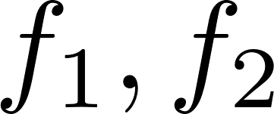
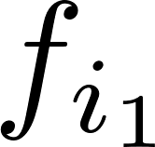
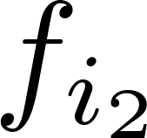
Leakage Models

Slide 8
Parameters

Slide 9
Relevant Prior Work

Slide 10
Our Result

Slide 11
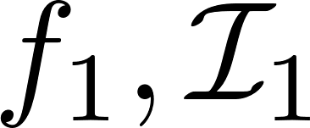
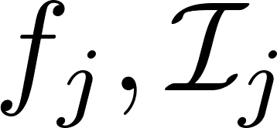
Our Result: Leakage Model

Slide 12
Construction: Building Blocks

Slide 13
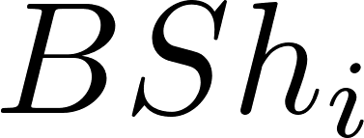
Base Construction

Slide 14
Base Construction: Security

Slide 15
Extending the Base Construction

Slide 16
Towards Final Construction

Slide 17
Towards Final Construction: Security

Slide 18
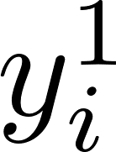
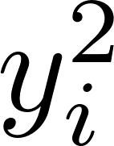
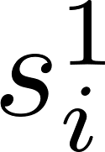
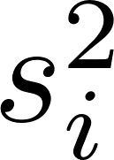
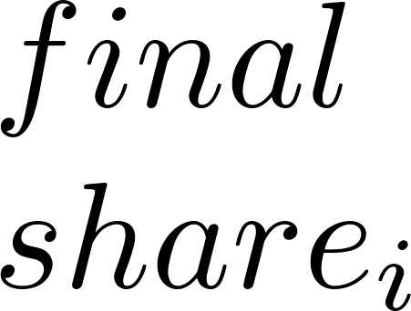
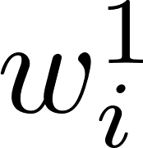
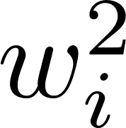
Final Construction

Slide 19
Instantiation

Slide 20
Applications of LRSS

Slide 21
Thank You

