Slide 1

Compact Ring Signatures from LWE
Rohit Chatterjee¹, Sanjam Garg^{2,3}, Mohammad Hajiabadi⁴, Dakshita Khurana⁵, Xiao Liang¹, Giulio Malavolta⁶, Omkant Pandey¹, Sina Shiehian^{1,2}
CRYPTO 2021
¹ Stony Brook University
² UC Berkeley
³ NTT Research
⁴ University of Waterloo
⁵ U. of Illinois Urbana-Champaign
⁶ Max Planck Institute for Security & Privacy
Notes:
Hello, I am RC, and I will present our work in CRYPTO, titled ...
Introduce coauthors by name

Slide 2

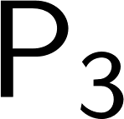
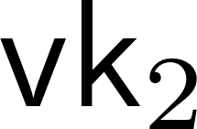
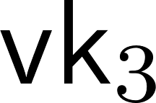

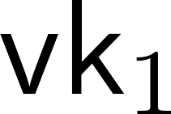
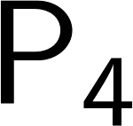

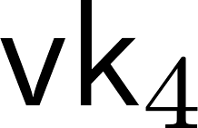
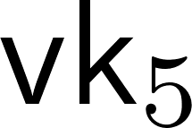
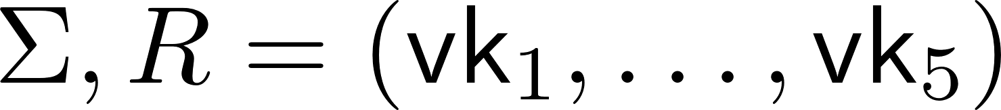

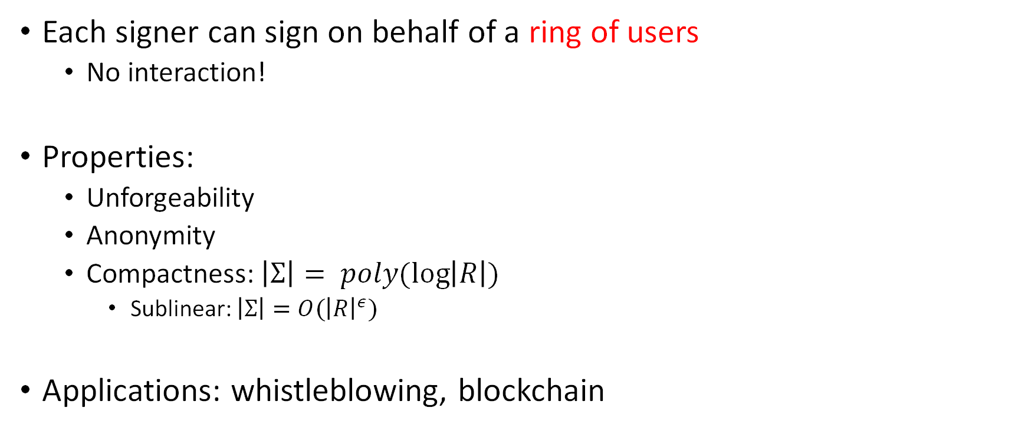
Compact Ring Signatures
Each signer can sign on behalf of a ring of users
  No interaction!
Properties:
  Unforgeability
  Anonymity
  Compactness: $\left|Σ\right|= poly(\log\left|R\right|)$
    Sublinear: $\left|Σ\right|=O({\left|R\right|}^{ε})$
Applications: whistleblowing, blockchain
Notes:
First, let us discuss what compact ring signatures are
We have a scenario where there are multiple users each with their own public and signing keys, and one would like to sign on behalf of a ring with multiple users
Crucially, we require the signature be generated without any prior setup or interaction with other users in the ring
We expect the signature to have unforgeability just as standard signatures, and anonymity meaning that signatures should not reveal which user in the ring created them. We also want compactness, that is, that the signature have at most polylogarithmic size with respect to the quantity of users in the ring
There are the related notions of sublinear and linear ring signatures which grow sublinearly and linearly in the ring size respectively
Final: Ring signatures have been studied for a while and they have myriad applications such as authenticating data for whistleblowers, which was the original motivation, as well as more recent ones such as usage in cryptocurrencies to authenticate transactions.

Slide 3
Previous Sublinear/Compact Ring Signatures
ROM
CRS
Plain
[DKNS’04], [GK’15], [LLNW’16], [LPQ’18], [EZS+19], [BKP20], [LNS’21], …
[CGS’07], [Gha’13], [Gon’17], [LPNY’20], …
 | Size | Assumption
[MS’17] | Compact | Non-falsifiable
[BHKS’18] | Sublinear | Pairings
[BDHKS’19] | Compact | Pairings
No plain model construction from LWE!
Notes:
Ring signatures have been studied in the random oracle model, the CRS model, and in the plain model i.e., without any modelling assumptions
All works mentioned here are compact or sublinear ring signatures, there are earlier initial works that were linear
Recall that compact signatures grow polylogarithmically in ring size, while sublinear signatures grow sublinearly
Of note are the works by Malavolta and Schroder who build a compact ring signature using a knowledge of exponent assumption
Backes, Hanzlik and others who build a sublinear ring signature based on pairings,
And finally Backes, Doettling and others who give a compact ring signature based on pairings which is of closest interest to us
However, in works so far there is no compact ring signature construction in the plain model instantiable solely from LWE

Slide 4
Key Question
Q:Can we build compact ring signatures from (poly-hard) LWE?
[This work]: YES!
Compact ring signature scheme using components instantiable from (poly-hard) LWE.
Notes:
This brings us to the key question we address in this work, namely: ...
And in this work, we show how to construct a ...

Slide 5

[BDHKS’19]
Can be based on: derandomization assumption [BOV’03],
bilinear maps [GOS’12],
or iO [BO’15]
Strengthening of Merkle tree, can be based on FHE
PKE
Sign
SPB-Hash
NIWI
Our Task:
Getting rid of NIWI
Standard (Generic)
Post-Quantum
Quantum-breakable
Notes:
Our construction builds upon the BDHKS framework, so we briefly describe their construction next
We start by describing the components used in their construction
This uses a public key encryption with additional properties, a standard signature scheme,
An SPB-hash which can be thought of as a variant of a Merkle tree hash with stronger statistical properties that can be instantiated from FHE schemes,
And a noninteractive witness indistinguishable argument system, which …
We can note here that the first two components can be obtained from a variety of standard assumptions including LWE
Similarly, SPB schemes can also be instantiated based on LWE via FHE schemes
NIWI proofs however are instantiated in most cases from pairing based assumptions, which are known to be broken by efficient quantum attacks
So for our purposes, we are looking to replace the usage of NIWI proofs in the BDHKS construction

Slide 6

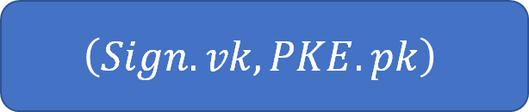



[BDHKS’19]: Construction
PKE
Sign
SPB-Hash
NIWI
Signing/Verification Keys:
  $\left(Sign.sk,Sign.vk\right)←Sign.Gen\left(\right)$
  Random $PKE.pk$
$$VK$$
$$SK$$
$$\left(Sign.vk, PKE.pk\right)$$
$$\left(Sign.sk \right)$$
Notes:
Let us take a closer look at the actual construction
For Setup, we pick signing and verification keys as follows:
We sample a signing and verification key for the standard signature scheme
We also sample a public key for encryption, i.e., sample it without a corresponding secret key
The encryption scheme allows this to be done indistinguishably. We will see why this is necessary soon
Finally, the overall verification key consists of the verification key for the signature scheme along with the encryption public key
The corresponding signing key just has the ordinary signing key

Slide 7
















[BDHKS’19]: Construction
PKE
Sign
SPB-Hash
NIWI
Sign $m$ on behalf of ring $R=(VK_{1}, …, VK_{ℓ})$ using key-pair (SK,VK) :
  $hk←SPB−Hash.Gen()$
  Compress the ring $R$ into a short-digest $h$using SPB-Hash
  $σ←Sign.sign(Sign.sk,m)$
$$VK$$
$$SK$$
$$\left(Sign.vk, PKE.pk\right)$$
$$\left(Sign.sk \right)$$
$π:$ NIWI proof that
$ct$ encrypts a valid signature under some $vk$ and
$∃$ an SPB opening showing $vk$ is consistent with $h$
$$h$$
$$Σ$$
….
SPB-Hash.Hash($hk$,…)
$$ct$$
$$PKE.Enc_{pk}(σ)$$
$$hk$$
$$π$$
$$VK_{1}$$
$$VK_{2}$$
….
$$VK_{ℓ}$$
Notes:
The actual signature is created as follows (this is a simplified construction)
To sign a message m with respect to a ring R, which contains our ring verification key VK
first generate hash key for SPB hash
Compress…
Next, generate a signature using the signing key
Finally, encrypt the signature under the chosen public key
The ring signature consists of the encrypted signature, the hash key, and a NIWI proof proving …..

Slide 8









[BDHKS’19]: Compactness
PKE
Sign
SPB-Hash
NIWI
$$VK$$
$$SK$$
Statement: is small because $h$ is compact
Witness: is small because SPB opening is compact
=> π is compact
$$\left(Sign.vk, PKE.pk\right)$$
$$\left(Sign.sk \right)$$
$π:$ NIWI proof that
$ct$ encrypts a valid signature under some $vk$ and
$∃$ an SPB opening showing $vk$ is consistent with $h$
$$Σ$$
$$h$$
$$ct$$
$$PKE.Enc_{pk}(σ)$$
$$hk$$
$$π$$
….
SPB-Hash.Hash($hk$,…)
Small
Small
$$VK_{1}$$
$$VK_{2}$$
….
$$VK_{ℓ}$$
Notes:
We turn to the properties of this construction, starting with the signature size
The encrypted signature and hash key are unrelated to the ring size by default
Turning to the proof, we note that firstly, the statement…
Taken together, this implies that the ring signature itself is compact

Slide 9


[BDHKS’19]: Unforgeability
PKE
Sign
SPB-Hash
NIWI
$$VK$$
$$SK$$
$$\left(Sign.vk, PKE.pk\right)$$
$$\left(Sign.sk \right)$$
$π:$ NIWI proof that
$ct$ encrypts a valid signature under some $vk$ and
$∃$ an SPB opening showing $vk$ is consistent with $h$
$$Σ$$
$$ct$$
$$PKE.Enc_{pk}(σ)$$
$$hk$$
$$π$$
Forger has to either forge $σ$ or violate soundness of $π$
Notes:
Consider a successful ring signature forger
The crucial thing to note is that this forger is forced to either …….
Given this, it is easy to reduce to either the soundness of the NIWI or unforgeability of the signature scheme
The latter is done as follows:
The reduction switches to a hybrid where it now has the secret keys for every encryption pk it generates
Now it can extract such a signature by decrypting by trying out each secret key in turn

Slide 10
[BDHKS’19]: Anonymity
PKE
Sign
SPB-Hash
NIWI
$$VK$$
$$SK$$
$$\left(Sign.vk, PKE.pk\right)$$
$$\left(Sign.sk \right)$$
$π:$ NIWI proof that
$ct$ encrypts a valid signature under some $vk$ and
$∃$ an SPB opening showing $vk$ is consistent with $h$
VK₀
VK₁
$$Σ$$
$$ct$$
$$PKE.Enc_{pk}(σ)$$
$$hk$$
$$π$$
Anonymity follows from a [NY’90] style argument (uses a ‘dummy block’)
Notes:
To show anonymity, we rely on the WI property
Recall that anonymity requires that we cannot tell which user in a ring actually created a particular signature
This is done by gradually modifying the signature using a sequence of hybrids, moving from a signature signed under one particular key say VK0, to another say VK1 (where both are in the ring)
Basically, the signature includes another ‘dummy block’, or another encrypted signature and hash key pair
To show anonymity, we ‘switch’ gradually the dummy block to one using VK1
Then we switch the proof to using this block, and next switch out the original block to also use VK1
Finally switch back to the original block for the proof
As a side note, We use a strong security notion for anonymity, where the randomness for key generation is provided to adversary for every party in the ring
This is the reason we normally generate public keys without a corresponding secret key

Slide 11




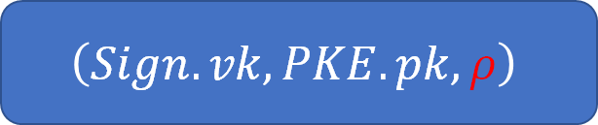





Getting Rid of NIWI
Observation: can use ZAPs instead of NIWI [BKM’06].
  ZAP: 2-round public-coin witness-indistinguishable arguments
$$VK$$
$$SK$$
$$\left(Sign.vk, PKE.pk,ρ\right)$$
$$\left(Sign.sk \right)$$
ZAP first message
ZAP response generated using the $ρ$ from the lexicographically smallest $VK$ in the ring.
$$Σ$$
$$ct$$
$$PKE.Enc_{pk}(σ)$$
$$hk$$
$$π$$
Notes:
Now that we have summarized the BDHKS construction, let us see how we can replace the NIWI proof
We begin by using an observation from Bender, Katz, Morselli:
Instead of using a NIWI, we can use a specific 2-round WI argument or a ZAP, which has a public coin first message
We place the ZAP first round message in the public key VK, and use the second round response in place of the NIWI proof in the ring signature
Using the first message from the Signer’s own VK may violate anonymity, so we use the first message from the lexicographically smallest VK in the ring

Slide 12
ZAPs: Status
Want: ZAPs from LWE
Several previous works: [LVW’19], [GJJM’20], [BFJ+’20]
Drawback: All need subexponential hardness of LWE
(Necessitated by complexity leveraging)
No constructions (that can establish soundness) from (poly-hard) LWE
Notes:
It seems we would essentially be done if we could build ZAPs from LWE
And in fact, there is a rich recent line of works that construct ZAPs just from LWE
However, all of these works crucially require subexponential hardness from the LWE assumption
This is specifically to show soundness, where these works all utilize some form of complexity leveraging type techniques
We have in fact no ZAP constructions that can be instantiated from just polynomially hard LWE

Slide 13
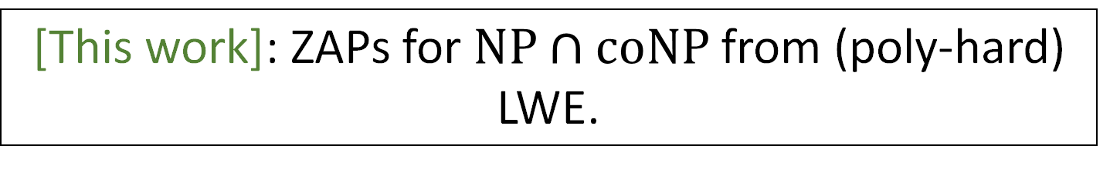

ZAPs for$NP∩coNP$
Might not need soundness for all NP languages!
  Unforgeability game: only 2 ways of beating soundness
  Either provide an invalid encryption (assume can be detected)
  Or encrypt a signature that is a valid forgery
  Defines a `non-witness’ for such forgeries
[This work]: ZAPs for $NP∩coNP$from (poly-hard) LWE.
Notes:
The key observation for our construction is that we only really need a ZAP that captures NP int coNP languages
This is due to the nature of the unforgeability reduction, which we show allows some extra leverage for proving soundness
Basically, the prover can only cheat in one of two ways, use a malformed encryption, or encrypt an actual forgery
We show that in either case, we can construct a short non-witness, or proof of the forger’s cheating, and use it as leverage while proving soundness
We will not discuss this further in this presentation but rather focus on describing how to construct our new ZAP scheme for NP int coNP, from LWE based components

Slide 14




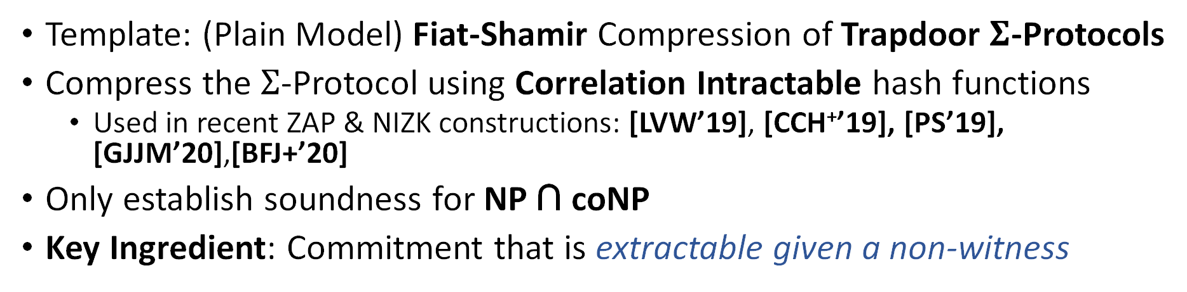
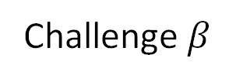




ZAPs for$NP∩coNP$: Ingredients
Template: (Plain Model) Fiat-Shamir Compression of Trapdoor $Σ$-Protocols
Compress the $Σ$-Protocol using Correlation Intractable hash functions
  Used in recent ZAP & NIZK constructions: [LVW’19], [CCH⁺’19], [PS’19], [GJJM’20],[BFJ+’20]
Only establish soundness for NP ∩ coNP
Key Ingredient: Commitment that is extractable given a non-witness
P
$$α$$
P
V
V
Challenge $β$
Fiat-Shamir
$α , \left[β= h\left(α\right)\right] , γ$
$$γ$$
Witness: $w$
Witness: $w$
Notes:
To construct our ZAP, we will employ the recently popular framework of using correlation intractable hash functions to compress sigma protocols in the plain model
This just takes a sigma protocol and creates a noninteractive proof where the verifiers response is simply the output of a randomly chosen hash function on the first message
CI Hash functions can be constructed from LWE and this approach has helped construct both ZAPs and NIZKs from LWE
In our case, we will only show soundness of our construction for languages in NP int coNP
Our key ingredient ….

Slide 15
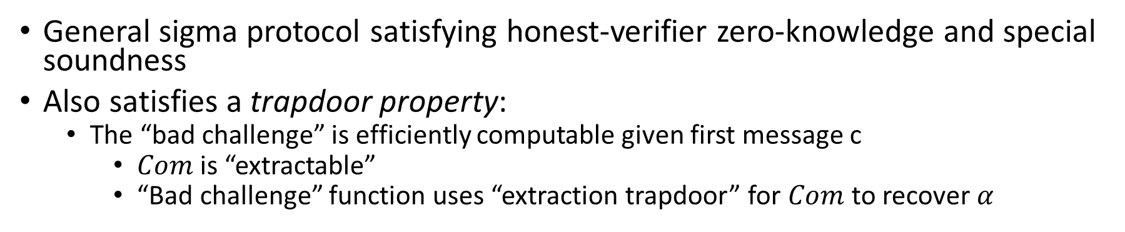
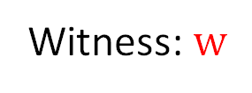

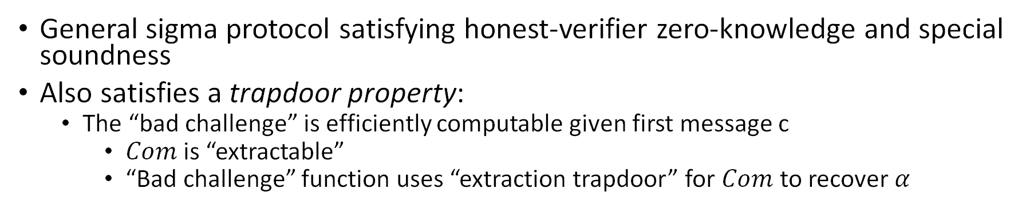

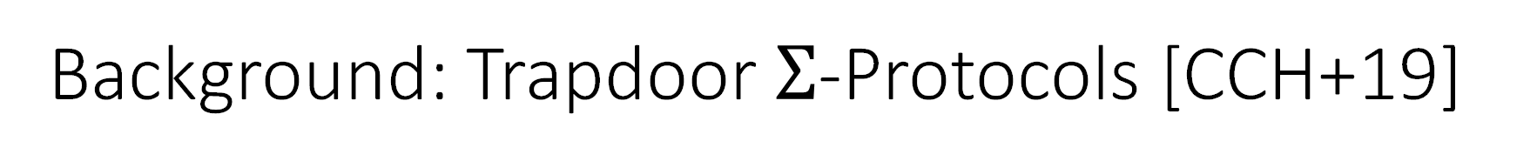

Background: Trapdoor $Σ$-Protocols [CCH+19]
General sigma protocol satisfying honest-verifier zero-knowledge and special soundness
Also satisfies a trapdoor property:
  The “bad challenge” is efficiently computable given first message c
    $Com$ is “extractable”
    “Bad challenge” function uses “extraction trapdoor” for $Com$ to recover $α$
P
V
$$c←Com(α)$$
$β$
$$γ$$
Witness: $w$
Notes:
We now describe these components in a little more detail
Trapdoor sigma protocols are also general sigma protocols, satisfying both honest verifier zero knowledge and special soundness
Further, they also satisfy the following trapdoor property, relating to the bad challenge function for the protocol
Recall that the bad challenge function is defined by the unique verifier response, given a provers first message, that allows the prover to provide a successful proof for a false statement
The trapdoor property is as follows:

Slide 16





Background: Correlation-intractable hashing for circuits
For any $C∈ 𝒞$, given a hash key $k←K$, an efficient adversary cannot find an $x$ such that $h_{k}\left(x\right)=C\left(x\right)$.
$𝒜$ wins if $h_{k}\left(x\right)=C\left(x\right)$
$$𝒜$$
$$k←K$$
$$x$$
Notes:
Correlation intractable hash functions are used to instantiate the Fiat-Shamir transform
Essentially, this disallows any efficient adversary to plant precomputed correlations between the input output pairs for the hash function
In more detail, for a given circuit class, a hash family H is Correlation intractable w.r.t. this class if for any circuit C from this class, given an uniformly chosen hash key, an efficient adversary cannot find an input x such that the hash on x outputs C(x).

Slide 17
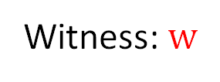
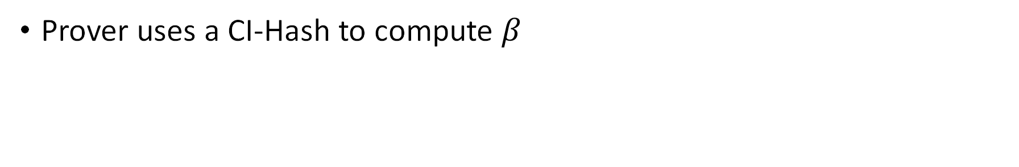


Background: Compressing Trapdoor $Σ$-Protocols
Prover uses a CI-Hash to compute $β$
P
V
$$c←Com\left(α\right),\left[β=h(c)\right], γ$$
Witness: $w$
Notes:
We briefly discuss how the CI hash helps with Fiat-Shamir compression
Any cheating prover that wants to break soundness has to find a first message such that the hash of it evaluates to the bad challenge
However if we pick the hash function from a family that is correlation intractable against this bad challenge function, this is not possible, and we obtain a contradiction
This implies that our compressed protocol must be sound

Slide 18
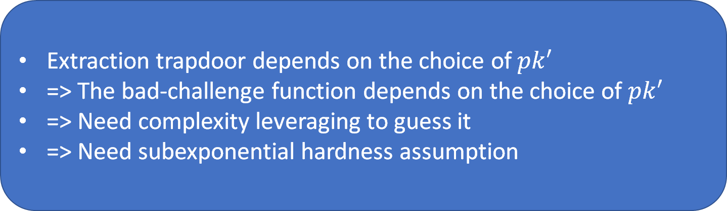
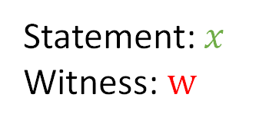



Background: ZAPs for$NP$ from subexponentially hard LWE [LVW’19]
Extraction trapdoor depends on the choice of $pk′$
=> The bad-challenge function depends on the choice of $pk′$
=> Need complexity leveraging to guess it
=> Need subexponential hardness assumption
Use a PKE scheme as the commitment
$pk, pk^{′}$ chosen uniformly by
V and P respectively
P
V
$pk,h$
$c←PKE.Enc(pk⊕pk^{′},α),\left[β=h\left(c\right)\right], γ$
Statement: $x$
Witness: $w$
h: CI hash function
Notes:
We briefly discuss why previous ZAP schemes required subexponential hardness from LWE.
For concreteness, we use the construction by Lombardi, Vaikuntanathan and Wichs from 2019
Here the verifier and prover each pick a public key pk and pk’ respectively
The verifier sends its public key along with an honestly chosen hash function in the ZAP first message
The prover uses the encryption scheme in lieu of the first round commitment in the compressed sigma protocol
With the encryption key set to pk xored with pk’
The extraction trapdoor is just the corresponding secret key for this public key, and so it depends on ….

Slide 19
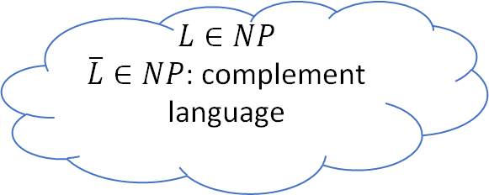
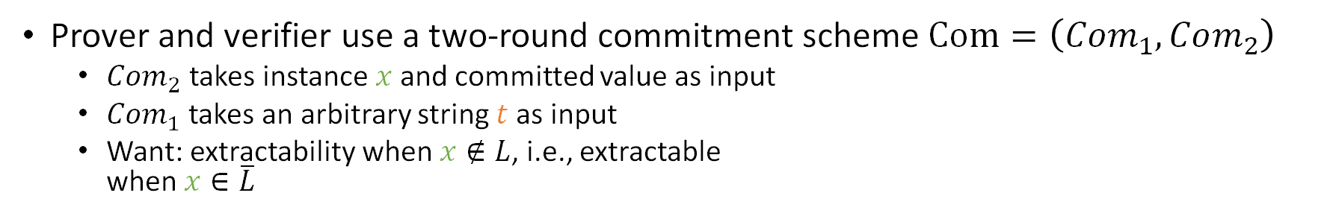


ZAPs for$NP∩coNP$: Template
Prover and verifier use a two-round commitment scheme $Com=\left(Com_{1},Com_{2}\right)$
  $Com_{2}$ takes instance $x$ and committed value as input
  $Com_{1}$ takes an arbitrary string $t$ as input
  Want: extractability when $x∉L$, i.e., extractable
  when $x∈\overline{L}$
$$L∈NP$$
$\overline{L}∈NP$: complement language
P
V
$Com1(t), h$
${c←Com}_{2}(x,α),\left[β=h\left(c\right)\right], γ$
Statement: $x$
Witness: $w$
h: CI hash function
Notes:
We now come to our ZAP construction for NP int coNP
Our construction uses a special 2 round commitment scheme with the following properties
Crucially, we use the commitment scheme for the complement language L bar which is also an NP language
The verifier’s message consists of the first commitment message w.r.t a random string t
It also has a hash function h that is CI against the bad challenge function, as mentioned before
The Prover’s message has the second commitment message which uses alpha as the committed value and x as the associated instance, as well as the sigma protocol transcript compressed with h
Next, we describe our special commitment scheme

Slide 20
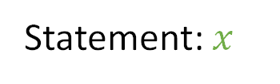
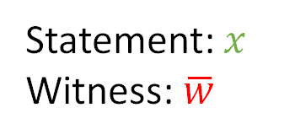
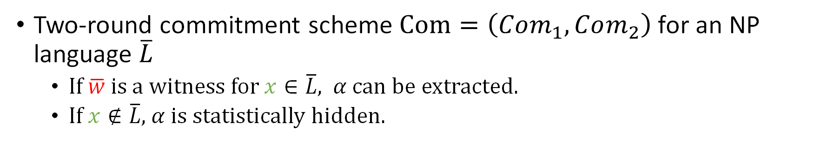


Witness Extractable Commitments
Two-round commitment scheme $Com=\left(Com_{1},Com_{2}\right)$ for an NP language $\overline{L}$
  If $\overline{w}$ is a witness for $x∈\overline{L}$, $α$ can be extracted.
  If $x∉\overline{L}$, $α$ is statistically hidden.
C
R
${Com}_{1}(\overline{w})$
${Com}_{2}(x,α)$
Statement: $x$
Statement: $x$
Witness: $\overline{w}$
Notes:
We call our commitments witness extractable commitments
As discussed, this has two rounds, and is defined with respect to an NP language
Here we use L complement for the sake of continuity
The commitment has the following properties: If the encoded string in the first round is a witness for x being in L complement, then the receiver can extract the committed value alpha
Conversely, if this is not the case, then alpha is in fact statistically hidden from the receiver.

Slide 21
Witness Extractable Commitments
We build “compact” witness-extractable commitments from LWE.
  Uses malicious circuit-private FHE [OPP’14] – provides `compactness’
  Non-compact from OT+Garbling.
C
R
${Com}_{1}(\overline{w})$
${Com}_{2}(x,α)$
Statement: $x$
Statement: $x$
Witness: $\overline{w}$
Notes:
We build this commitment scheme by using malicious circuit private FHE (known from polynomially hard LWE )
This construction has the property that the commitment size is decoupled from the size of the related NP verifier circuit for the associated language and depends only on its depth
This property turns out to help us with the compactness of our ring signature construction
We also construct a witness extractable commitment without this property using OT and garbled circuits

Slide 22



Witness Extractable Commitments: Construction
$G_{x,b}$($\overline{w}$):
  If $\overline{w}$ is a witness for $x∈\overline{L}:$
    output b
  Otherwise:
    output 0
C wants to commit
to b.
C
R
$$ct←FHE.Enc(FHE.pk,\overline{w})$$
$ct_{eval}←FHE.Eval(G_{x,b},ct)$
Statement: $x$
Notes:
These commitments are constructed as follows:
The reciever encrypts its input, which is a potential non-witness, using the FHE scheme and sends this as the first message
The committer now evaluates a circuit G homomorphically over this ciphertext, where G has the instance and committed value hardwired
And simply computes our desired functionality – it outputs the committed bit if the receivers ciphertext is indeed an encrypted nonwitness, and zero otherwise.

Slide 23



Witness Extractable Commitments: Construction
$G_{x,b}$($\overline{w}$):
  If $\overline{w}$ is a witness for $x∈\overline{L}:$
    output b
  Otherwise:
    output 0
Compactness: $FHE$ is compact
Extractable: $x∈\overline{L}⇒FHE.Dec\left(ct_{eval},FHE.sk\right)=b$
Hiding: follows from malicious
circuit-privacy of $FHE$:
  $∀ct$ (even malicious), $∃t$: nothing is revealed beyond $G_{x,b}$($t$).
    => If $x∉\overline{L},$ nothing is revealed!
C
R
$$ct←FHE.Enc(FHE.pk,\overline{w})$$
$ct_{eval}←FHE.Eval(G_{x,b},ct)$
Statement: $x$
Notes:
We quickly go over how this construction satisfies all the stated properties
Compactness follows from that of the FHE scheme: the evaluated ciphertext depends only on the depth of G, not its size
Extractability follows simply by the correctness of the evaluation procedure
Finally, hiding follows from the malicious circuit privacy of the FHE scheme: note that the receiver has full control over the generation of the encryption keys and ciphertext
Malicious circuit privacy provides the guarantee that even in this case, the evaluated ciphertext computing G homomorphically reveals nothing beyond the correct output
In particular, if x is not in L bar, nothing is revealed!

Slide 24


ZAPs for$NP∩coNP$
Prover and verifier use a two-round commitment scheme $Com=\left(Com_{1},Com_{2}\right)$
  $Com_{2}$ takes instance $x$ and committed value as input
  $Com_{1}$ takes an arbitrary string $t$ as input
  Want: extractability when $x∉L$, i.e., extractable
  when $x∈\overline{L}$
P
P
V
V
$Com1(t), h$
$Com1(\overline{w}), h$
${c←Com}_{2}(x,α),\left[β=h\left(c\right)\right], γ$
${c←Com}_{2}(x,α),\left[β=h\left(c\right)\right], γ$
Statement: $x$
Witness: $w$
h: CI hash function
Notes:
Finally we briefly discuss how the properties of the commitment are used in our ZAP protocol
To show witness indistinguishability, we note that there is no non-witness for the verifier to use in the commitment
Thus no matter what string t the verifier may use in the first round commitment message, alpha is statistically hidden
This allows us to then use the honest verifier zero knowledge simulator for the sigma protocol
In turn, consider a cheating prover trying to violate soundness
We can build a soundness reduction that works as follows
This first switches the first commitment message to an encoding of a non-witness for the prover’s statement and this will allow it to extract alpha
This can be then used to break the CI property

Slide 25
Thank You!
eprint: https://eprint.iacr.org/2021/942.pdf

