Slide 1
Improved cryptanalysis of UOV and Rainbow
Ward Beullens imec-COSIC, KU Leuven, Belgium

Slide 2
Two multivariate signature algorithms:
Oil & Vinegar
1997, Patarin
Cryptanalysis in 1998/1999, no real improvements since then. (until now)
E.g., 89 byte signatures, 60 KB public keys.
Rainbow
2005, Ding and Schmidt
Based on Oil and vinegar, multiple layers of OV stacked together.
More complicated cryptanalysis.
E.g., 71 byte signatures, 60 KB public key.
NIST PQC finalist
Two Contributions:
Simplified exposition of Oil & Vinegar and Rainbow
New key recovery attacks.

Slide 3
Oil and Vinegar & Rainbow
Trapdoor-based signatures using multivariate quadratic maps:
Public key: $P\left(x\right):𝔽_{q}^{n}→𝔽_{q}^{m}$ looks random.
Secret key: some information that allows to compute preimages for $P$.
Signature: $s$ such that $P\left(s\right)=H(m)$, where $H\left(m\right)∈$ $𝔽_{q}^{m}$ is hash digest.
How to trapdoor $P$ ?

Slide 4
Rainbow structure?

Slide 5
Definition: (Differential, Polar form) Let $P\left(x\right):𝔽_{q}^{n}→𝔽_{q}^{m}$, be a homogenous multivariate quadratic map. Then we define the polar form of $P$ as:
$P^{′}\left(x,y\right):=P\left(x+y\right)−P\left(x\right)−P\left(y\right)$
Easy exercise: $P′\left(x,y\right)$ is symmetric and bi-linear.

Slide 6
The Oil and Vinegar Trapdoor
Trapdoor is a linear subspace $O⊂𝔽_{q}^{n}$ of dimension $m$ such that
$$∀o∈O :P\left(o\right)=0$$
$$𝔽_{q}^{n}$$
$$𝔽_{q}^{m}$$
$$O$$
$$P$$
.
0

Slide 7
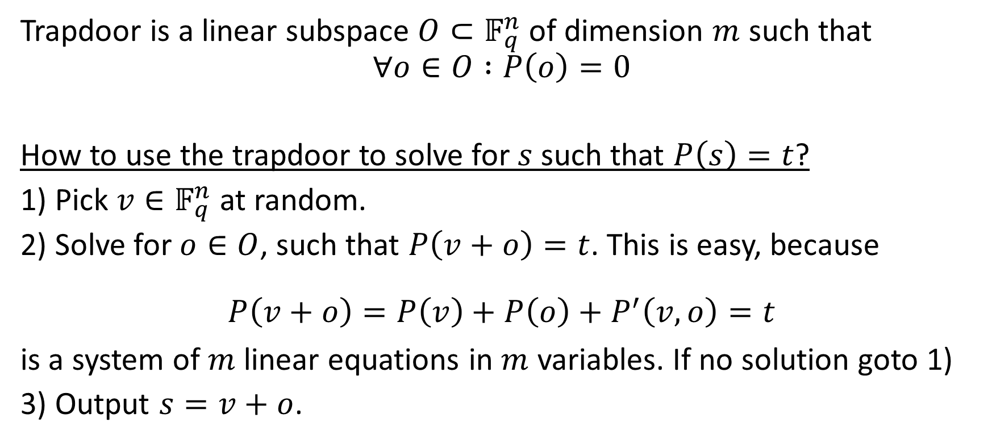
The Oil and Vinegar Trapdoor
Trapdoor is a linear subspace $O⊂𝔽_{q}^{n}$ of dimension $m$ such that
$$∀o∈O :P\left(o\right)=0$$
How to use the trapdoor to solve for $s$ such that $P\left(s\right)=t$?
1) Pick $v∈𝔽_{q}^{n}$ at random.
2) Solve for $o∈O$, such that $P\left(v+o\right)=t$. This is easy, because
$$P\left(v+o\right)=P\left(v\right)+P\left(o\right)+P^{′}\left(v,o\right)=t$$ is a system of $m$ linear equations in $m$ variables. If no solution goto 1)
3) Output $s=v+o$.

Slide 8
The Rainbow Trapdoor
Trapdoor is a chain of subspaces $O_{i}⊂𝔽_{q}^{n}$ and subspaces $W_{i}⊂𝔽_{q}^{m}$ of dimension $m$ such that
$$∀i,∀o∈O_{i} :P\left(o\right)∈W_{i} \\ ∀i, ∀x ∀o∈O_{i}:P^{′}\left(x,o\right)∈W_{i+1}$$
$$𝔽_{q}^{n}$$
$$𝔽_{q}^{n}$$
$$O_{1}$$
$$P$$
$$W_{1}$$
…
…
$$O_{k}$$
.
0

Slide 9
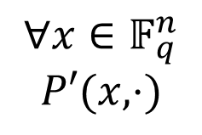
The Rainbow Trapdoor
Trapdoor is a chain of subspaces $O_{i}⊂𝔽_{q}^{n}$ and subspaces $W_{i}⊂𝔽_{q}^{m}$ of dimension $m$ such that
$$∀i,∀o∈O_{i} :P\left(o\right)∈W_{i} \\ ∀i, ∀x ∀o∈O_{i}:P^{′}\left(x,o\right)∈W_{i−1}$$
$$𝔽_{q}^{n}$$
$∀x∈𝔽_{q}^{n}$ $$P′(x,⋅)$$
$$𝔽_{q}^{n}$$
$$O_{1}$$
$$W_{1}$$
…
…
$$O_{k}$$
.
0

Slide 10
Intersection Attack
New attack against UOV and Rainbow
Attack against Rainbow (See video/paper)
Rectangular MinRank Attack

Slide 11
Rectangular Minrank attack
$$𝔽_{q}^{n}$$
$$𝔽_{q}^{m}$$
$$O_{1}$$
$$P′(x,⋅)$$
$$W_{1}$$
…
…
$$O_{k}$$
.
0

Slide 12
Rectangular Minrank attack
$$𝔽_{q}^{n}$$
$$𝔽_{q}^{m}$$
$$W_{1}$$
$$O_{2}$$
$$∀ x:P′(x,⋅)$$
.
0

Slide 13
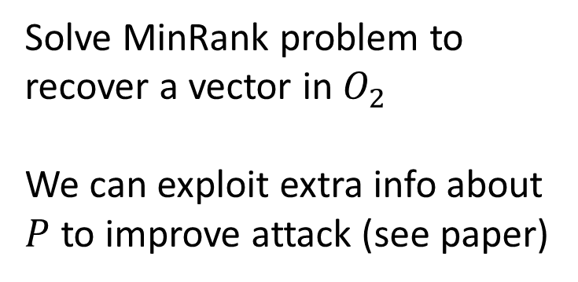
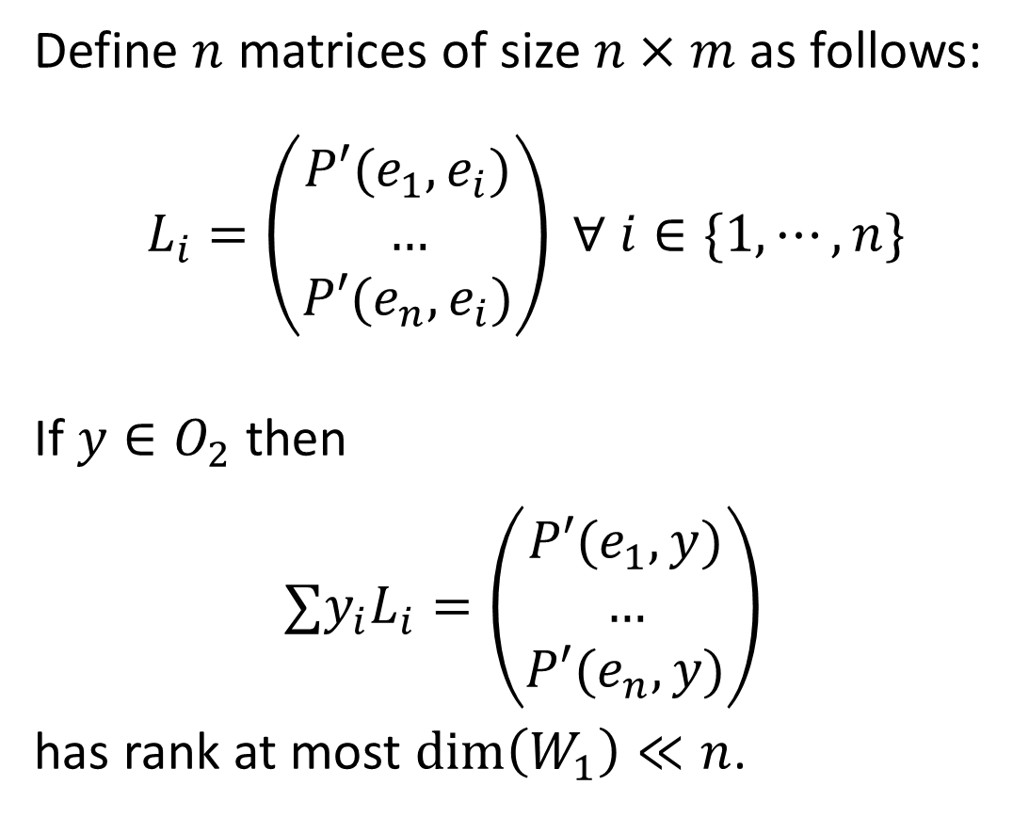
Rectangular MinRank Attack
$$𝔽_{q}^{n}$$
$$𝔽_{q}^{m}$$
Define $n$ matrices of size $n×m$ as follows: $L_{i}=\left(\begin{matrix}P′(e_{1},e_{i}) \\ … \\ P′(e_{n},e_{i})\end{matrix}\right) ∀ i∈\{1,⋯, n\}$
If $y∈O_{2}$ then
$$∑y_{i}L_{i}=\left(\begin{matrix}P′(e_{1},y) \\ … \\ P′(e_{n},y)\end{matrix}\right)$$
has rank at most $\dim\left(W_{1}\right)≪n$.
$$O_{2}$$
$$W_{1}$$
$$∀ x:P′(x,⋅)$$
Solve MinRank problem to recover a vector in $O_{2 }$ We can exploit extra info about $P$ to improve attack (see paper)

Slide 14
Application to NIST parameters
More efficient attacks for all the parameter sets submitted to NIST PQC.
Security of NIST submission reduced by:
20 bits for SL I
40 bits for SL III
55 bits for SL V

Slide 15
Conclusion
1) New exposition of Oil and Vinegar and Rainbow
2) Two new attacks
‘Intersection attack’ on O&V and Rainbow (See video or paper)
New Minrank attack on Rainbow
Reduces security of NIST parameters by 20 bits (SL 1), 40 bits (SL 3) and 55 bits (SL 5)
Questions?

