Slide 1
Instantiability of Classical Random-Oracle-Model Encryption Transforms
Asiacrypt 2022
ia.cr/2022/1584
Alice Murphy, Adam O’Neill, Mohammad Zaheri

Slide 2
Outline
Background
OAEP result preview
Tools
OAEP
FO

Slide 3
The Random Oracle Model [Bellare & Rogaway ‘93]
A Random Oracle:
Returns a random value when queried
Consistent outputs for the same inputs
Can only be evaluated in a black-box way
Does not exist in the real world
Proving a scheme secure in the ROM shows security against black-box attacks
R. Anderson ’08
Notes:
Some means of producing random values, like the die.
Some means of storage, like the scroll, so that it can answer consistently if queried with the same input more than once

Slide 4
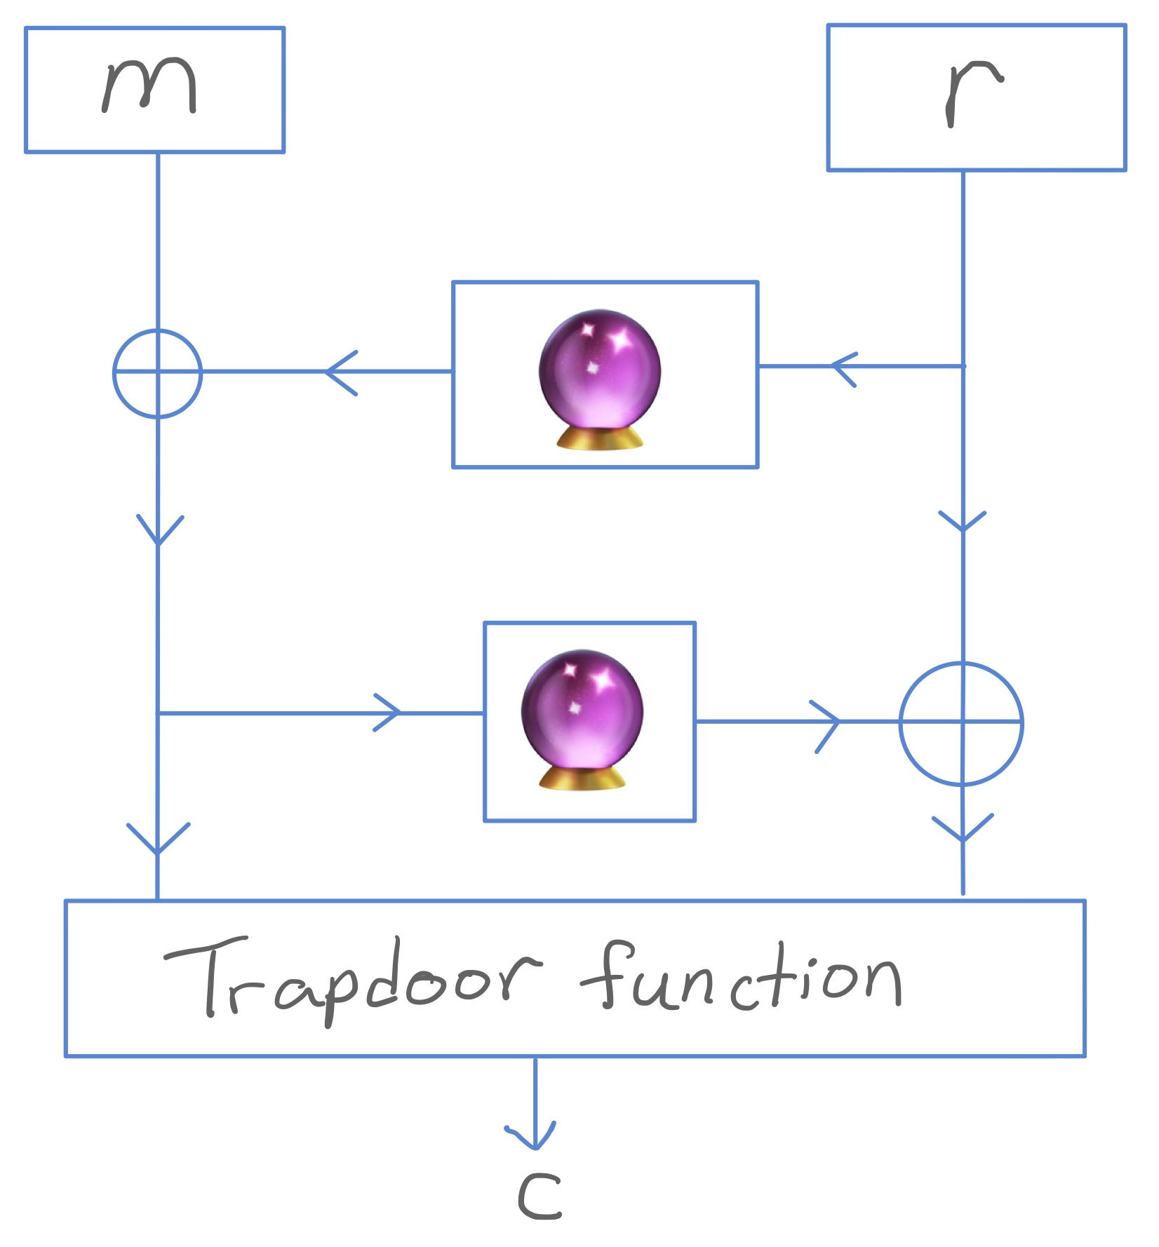
Background – Instantiation of ROs
Instantiating ROs:
replacing them with real functions that maintain security of the scheme
In practice ROs are instantiated with hash functions like SHA256
Uninstantiability results exist in general [Canetti, Goldreich, Halevi ‘98]:
Schemes that are secure in the ROM but insecure for any instantiation

Slide 5
ROM Encryption Transforms
We provide instantiations for celebrated two ROM encryption transforms:
Low exponent RSA-OAEP [BR’94]
Trapdoor function + 2 ROs upgraded into→ an IND-CCA2 public-key encryption (PKE) scheme
Standardized in RSA PKCS v2.1 (2002)
Fujisaki-Okamoto transform [FO’99]
OW-CPA PKE + private-key encryption scheme + 2 ROs upgraded into→ an IND-CCA2 PKE
Used (with modification) in NIST’s selection for post-quantum KEMs

Slide 6
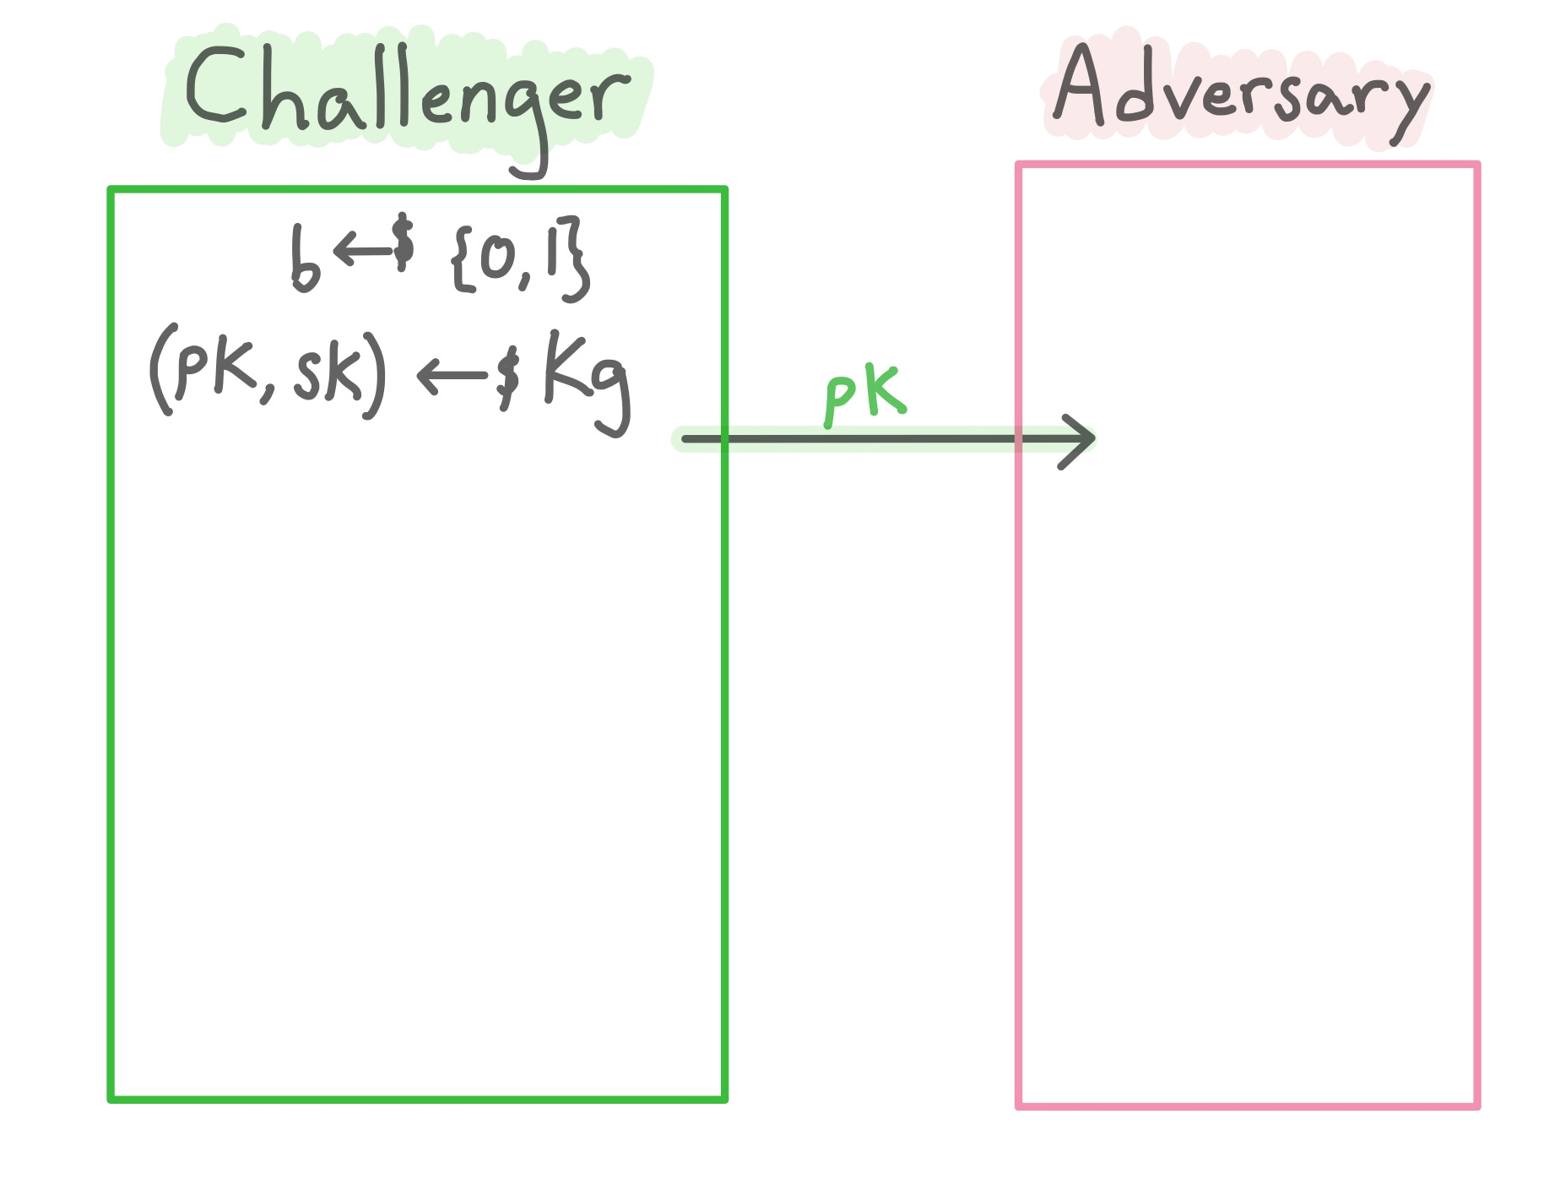
Indistinguishability under adaptive Chosen Ciphertext Attack (IND-CCA2) [Rackoff & Simon‘93]
The result of both RSA-OAEP and FO is an IND-CCA2 secure PKE.
A scheme is IND-CCA2 secure if all PPT adversaries $𝒜$ have negligible advantage, where
$Adv=2⋅Pr\left[b^{′}=b\right]−1$.
Notes:
Both OAEP and FO schemes upgrade to a public key encryption scheme that is IND-CCA2 secure.
I’m sure everyone is familiar with this but since it’s our main goal, I wanted to include it

Slide 7
Outline
Background
OAEP result preview
Tools
OAEP
FO

Slide 8
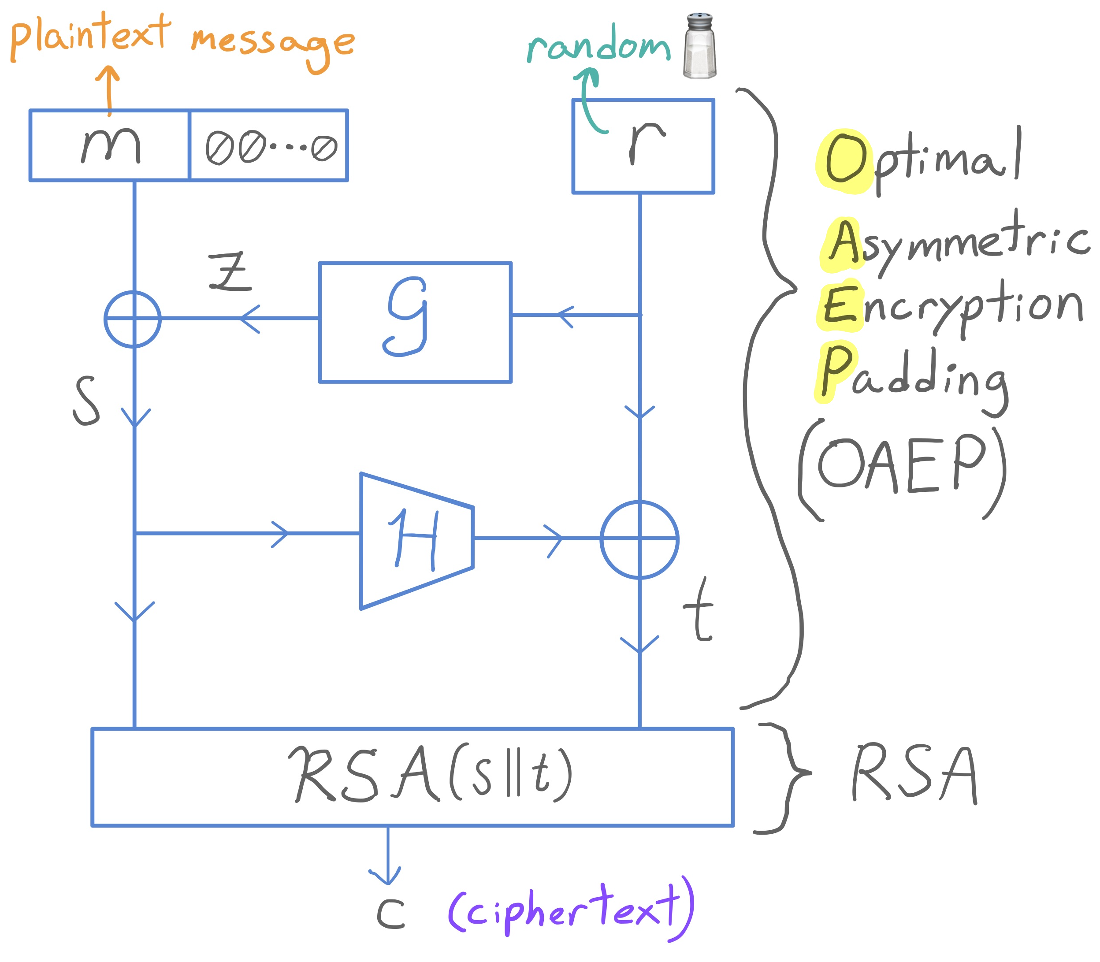
RSA-OAEP encryption transform [Bellare & Rogaway ’94]
Ingredients: trapdoor function (RSA), 2 random oracles ($𝒢$ and $ℋ$)
Result: IND-CCA2 secure public-key encryption scheme

Slide 9
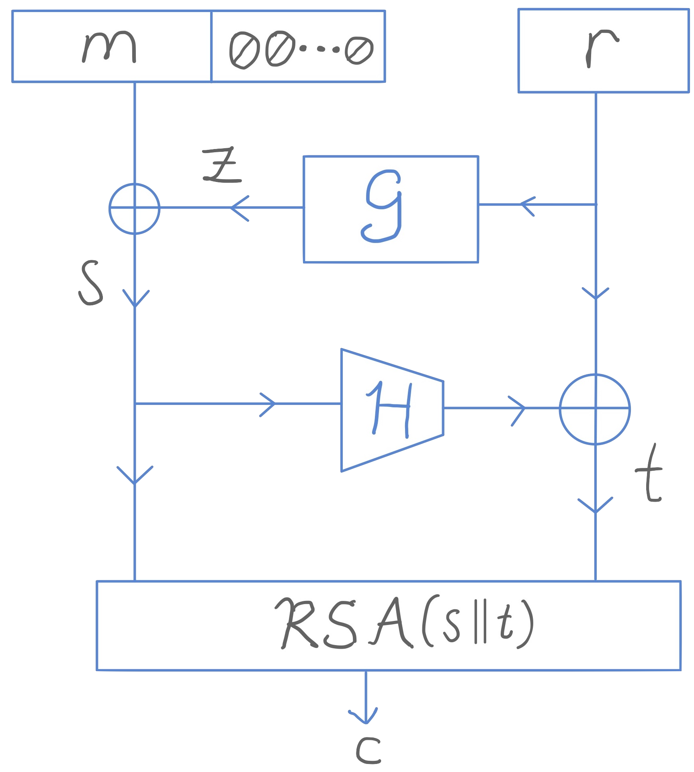
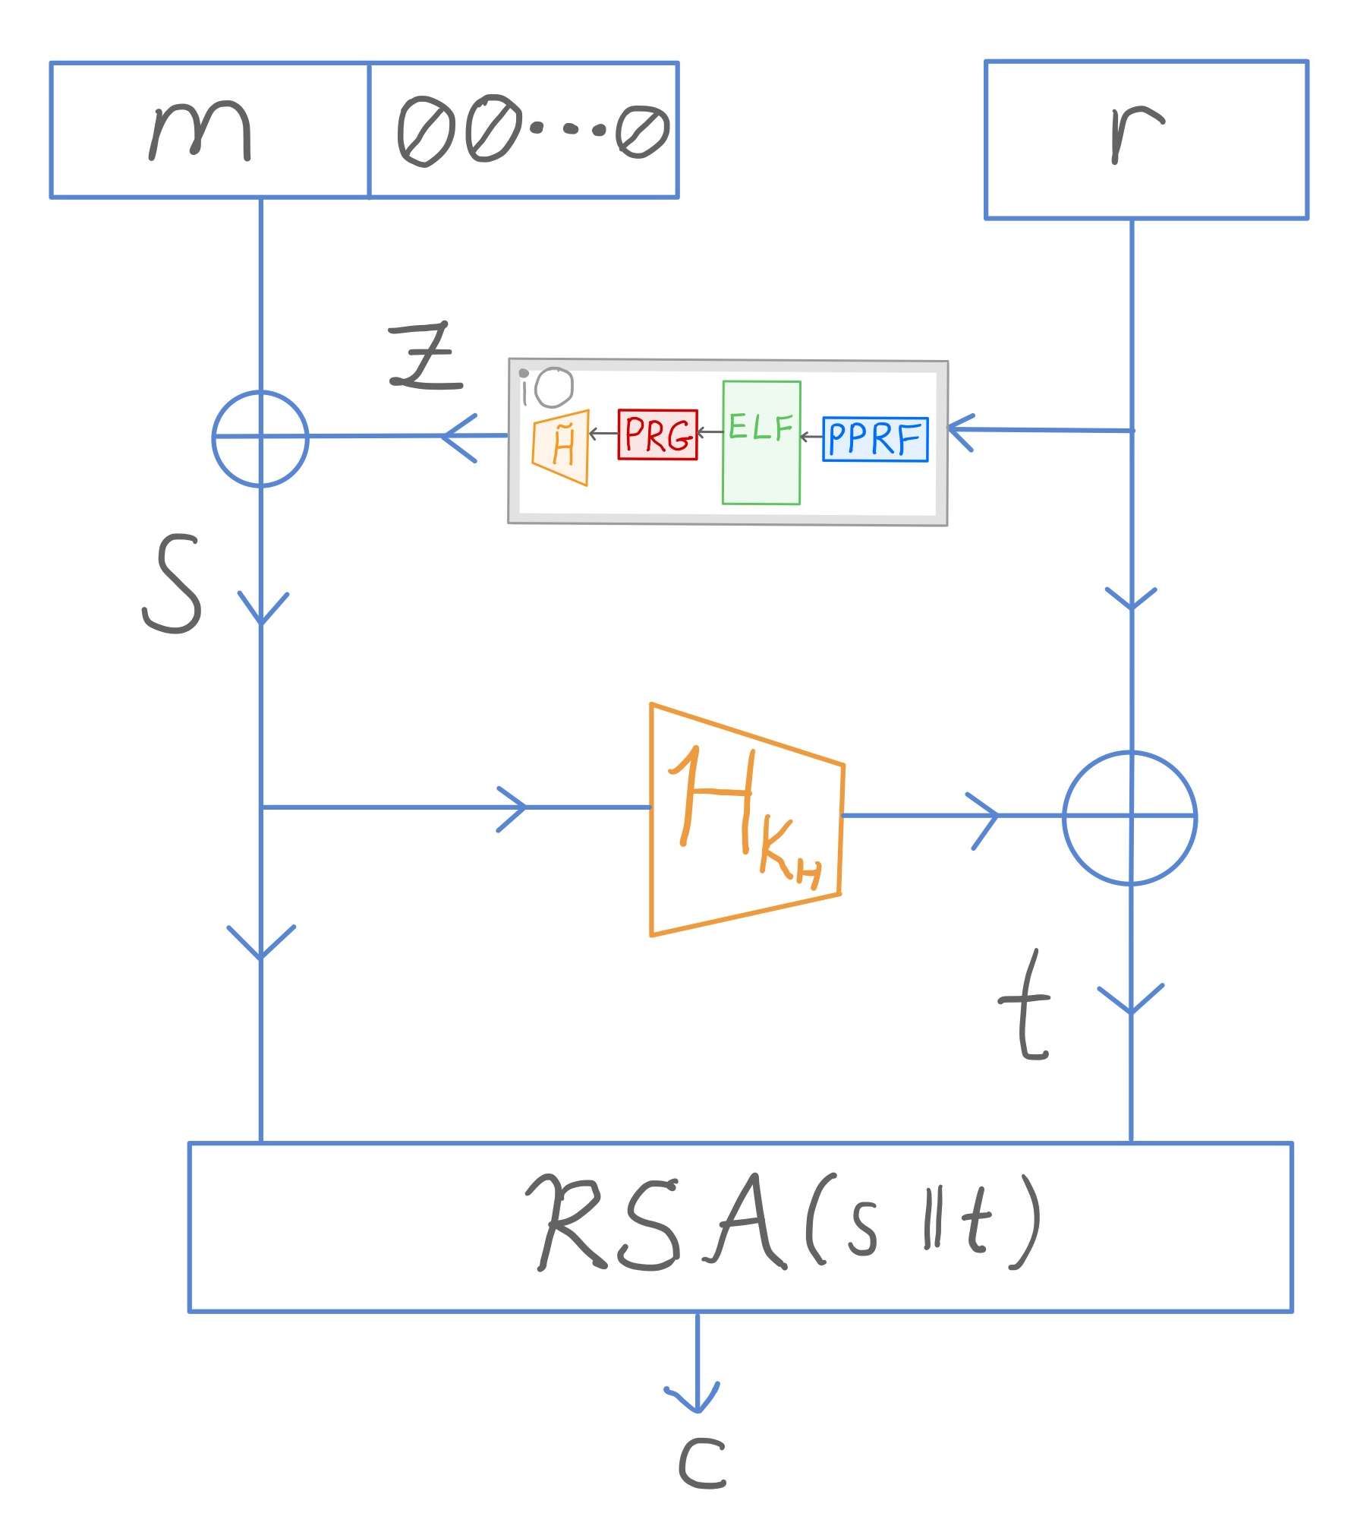
Informal results: RSA-OAEP
The low-exponent RSA-OAEP encryption transform is IND-CCA2 in the standard model when:
$𝒢$ is instantiated as the composition of:
indistinguishability obfuscation
puncturable pseudorandom function
extremely lossy function
pseudorandom generator
pairwise independent hash
$ℋ$ is instantiated as a universal hardcore function
RSA is sub-exponentially one-way

Slide 10
Outline
Background
OAEP result preview
Tools
OAEP
FO

Slide 11
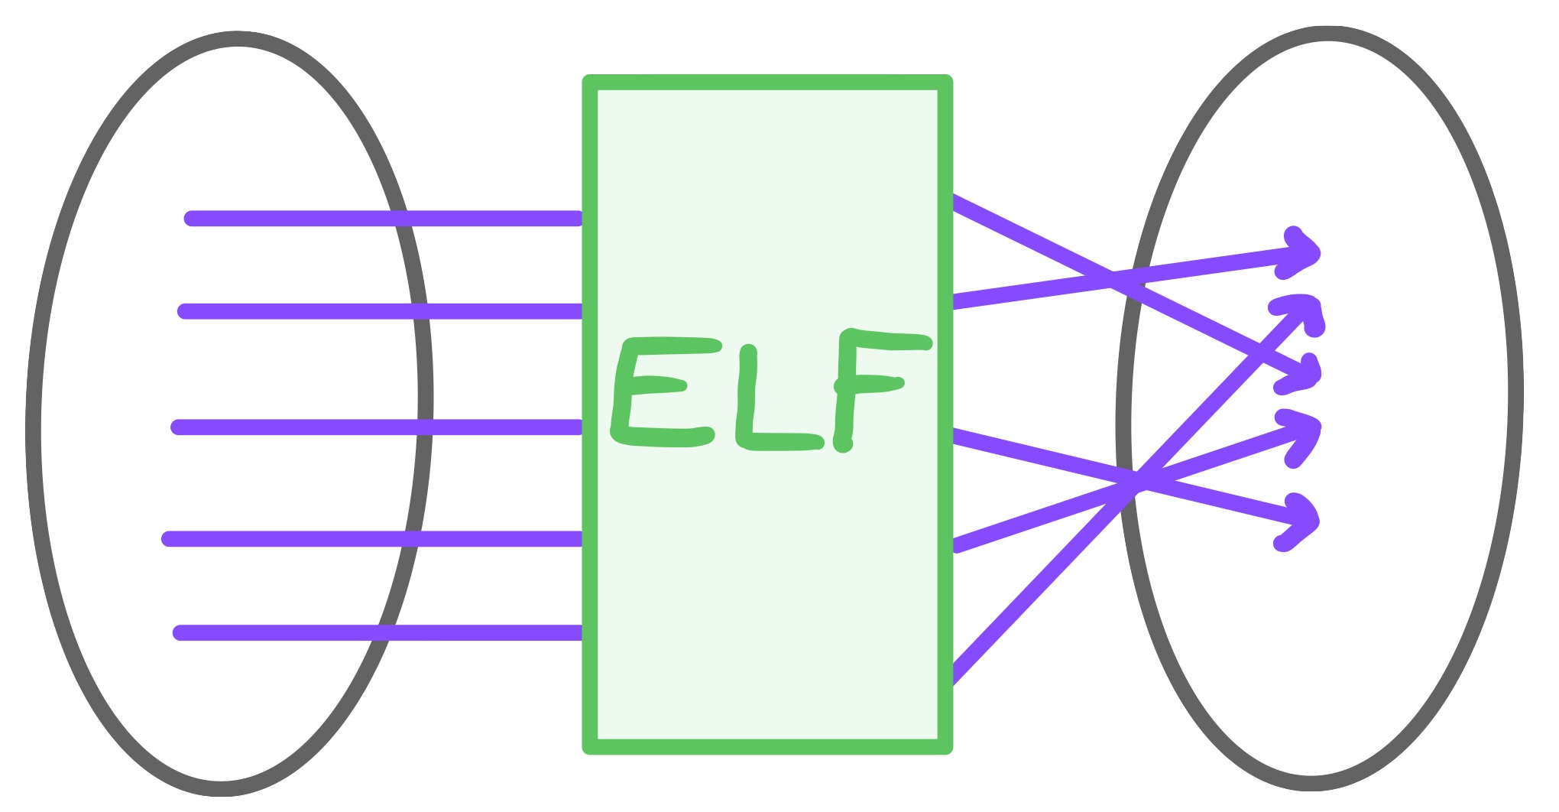
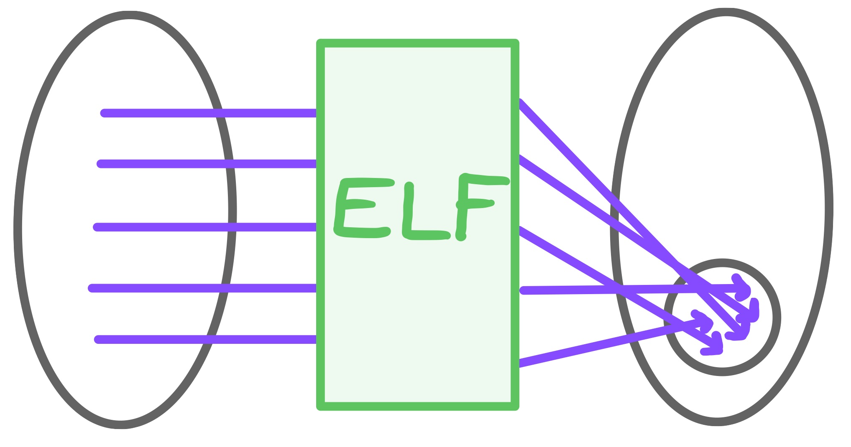
Extremely Lossy Functions (ELFs) [Zhandry’16]
Tools
Injective mode
Lossy mode
$$≈_{c}$$
Polynomial
image size
Key generation algorithm for injective keys
Key generation algorithm for adversary-dependent (extremely) lossy keys
If PPT $𝒜$ runs in time $t$, then the lossy key is generated s.t. it takes time $t+1$ to find a collision in the ELF image $⟹$ lossy ELF has polynomial image size
Standard model construction from the exponential DDH assumption

Slide 12
Indistinguishability Obfuscation (iO) [BGIRSVY’01]
Tools
If two circuits $C_{1}$ and $C_{2}$ have the same input-output behaviour and $\left|C_{1}\right|=|C_{2}|$, then iO($C_{1}$) and iO$(C_{2})$are computationally indistinguishable
There exist standard model constructions [Jain, Lin, Sahai ’21]
Notes:
$$2^{−k^{α}}$$

Slide 13
Auxiliary-input point function obfuscation (AIPO)
Tools
Point function:
Auxiliary-information $z$ is jointly sampled with $x$ from some unpredictable distribution: $\left(z,x\right)←𝒟$
Security goal of an obfuscation of $p_{x}$: Given $z$, a PPT adversary can’t distinguish between $𝒪\left(p_{x}\right)$ and $𝒪(p_{u})$ for random $u$ with advantage $> negl$.
$$Pr⁡[A\left(1^{k},z\right)⇒x : \left(z,x\right)←^{\$}D_{k}]≤negl(k)$$
real vs. random input point

Slide 14
Auxiliary-input multi-bit point function obfuscation (MB-AIPO)
Tools
Multi-bit point function:
Auxiliary-information $z$ is jointly sampled with $x$ and $y$ from some unpredictable distribution: $\left(z,x,y\right)←𝒟$
Security goal of an obfuscation of $p_{x,y}$: Given $z$, a PPT adversary can’t distinguish between $𝒪(p_{x,y})$ and $𝒪(p_{x,u})$ for random $u$ with advantage $> negl$.
$$Pr⁡[A\left(1^{k},z\right)⇒x : \left(z,x,y\right)←^{\$}D_{k}]≤negl(k)$$
real vs. random output point

Slide 15
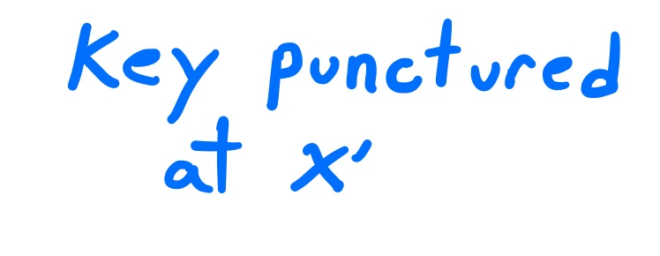
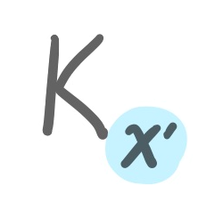
Puncturable pseudorandom functions (PPRF)
Tools

Slide 16
Puncturable pseudorandom functions (PPRF)
Tools
Security guarantee: Given $x′$ and $K_{x^{′}}$, a PPT adversary can’t distinguish between $y←PPRF(K, x^{′})$ and a random point with advantage $> negl$
Can be constructed from one-way functions [KPTZ’13, BW’13, BGI’15]

Slide 17
Outline
Background
OAEP result preview
Tools
OAEP
FO

Slide 18
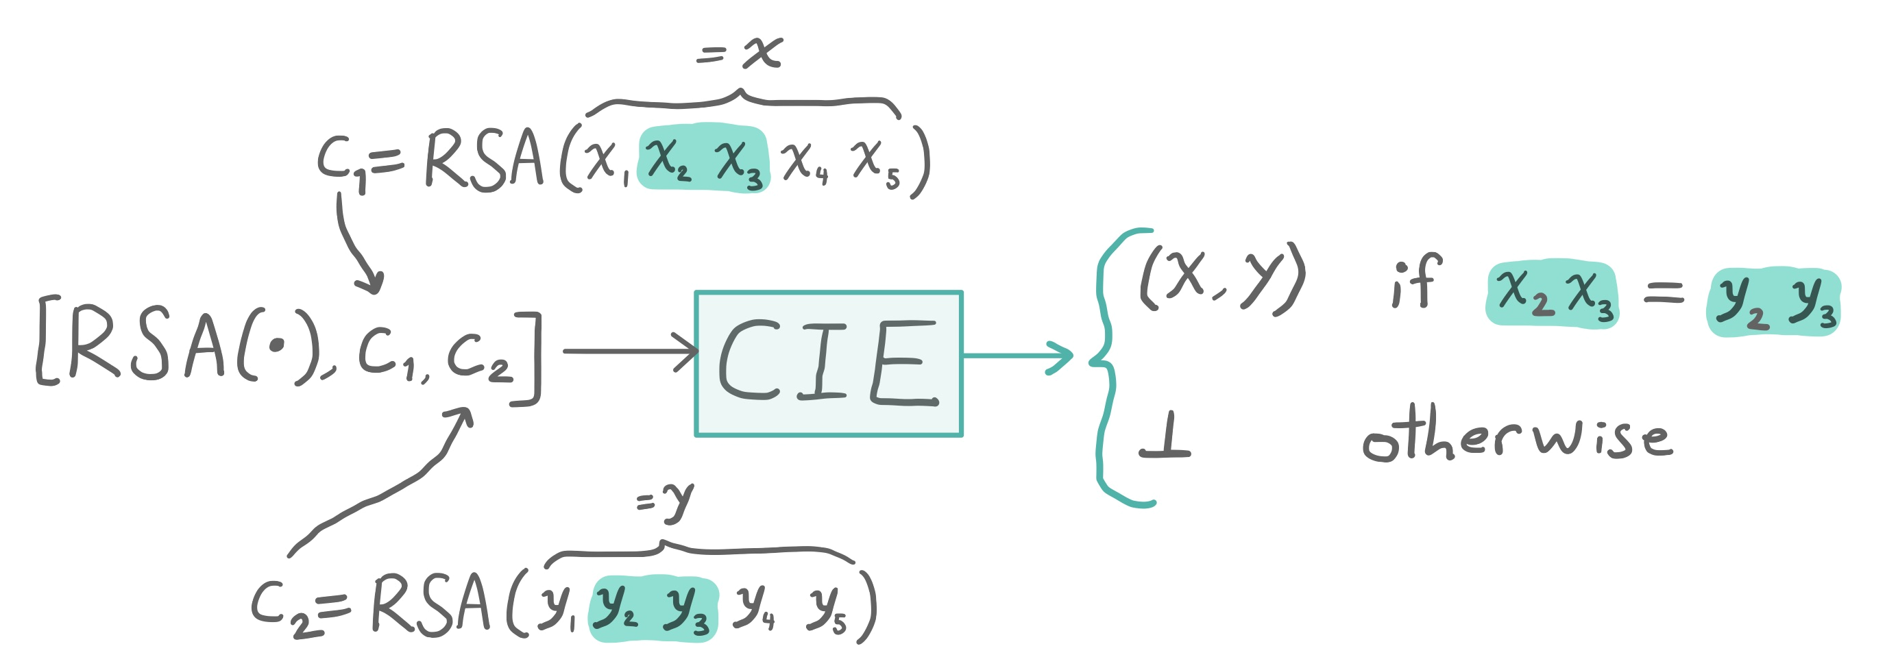
Properties needed for low-exponent RSA-OAEP
Tools/OAEP
Second inputs extractability (SIE): Given the function $\text{RSA}(⋅)$, an output $c=\text{RSA}(x)$, and a portion of $x$, you can recover $x$
Common inputs extractability (CIE): Given $\text{RSA}(⋅)$, image points $c_{1}=\text{RSA}(x)$ and $c_{2}=\text{RSA}(y)$, you can recover $x$ and $y$ if some portion of both preimages are equal
Sub-exponentially one-way: Given $\text{RSA}(⋅)$, and $c=\text{RSA}\left(x\right)$ for random $x$, the probability of finding $x$ is sub-exponentially small
Notes:
First 2 not assumptions

Slide 19
RSA-OAEP encryption transform [Bellare & Rogaway ’94]
Ingredients: trapdoor function (RSA), 2 random oracles ($𝒢$ and $ℋ$)
Result: IND-CCA2 secure public-key encryption scheme
Notes:
Blackbox impossibility for OAEP E. Kiltz and K. Pietrzak.
Blackbox impossibility for FDH

Slide 20
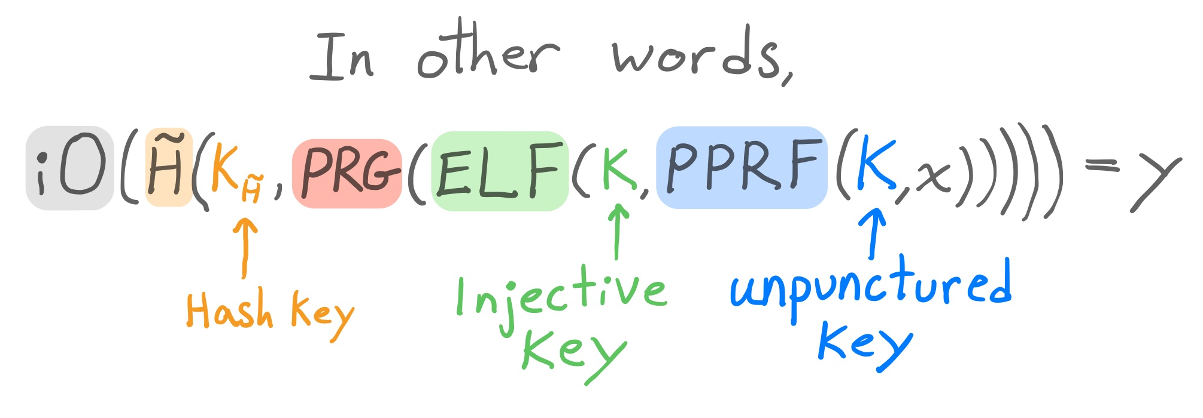
Instantiating the RO $𝒢$
iO → Indistinguishability obfuscator
PPRF → Puncturable pseudorandom function
ELF → Extremely lossy function
PRG → pseudorandom generator
$\tilde{H}$ → Pairwise independent hash
Notes:
Output of the elf in hash value used in the decryption query is easy to guess. For the simulated decryption oracle
Adv guessing the output point can run longer than the ELF so that’s why mb-aipo

Slide 21
RSA-OAEP instantiation
$𝒢$ is instantiated as iO($\tilde{H}$(PRG(ELF(PPRF(•)))))
$ℋ$ is instantiated as a sub-exponentially secure universal hardcore function
Can be constructed from differing-input obfuscation (diO) with PPRFs with short aux input [Bellare, Stepanovs, Tessaro ‘14]
Notes:
To construct a sub-exponential one-wayness extractor with polynomial output length, we can use diO with short auxiliary input as per [13], which is stronger than iO but is plausibly satisfied by the same constructions.1 (diO with short auxiliary input is weaker than full-fledged diO, which is implausible [43].)

Slide 22
OAEP Result
Low-exponent RSA-OAEP is IND-CCA2 secure in the
standard model if:
$ℋ$ is a sub-exponentially secure universal hardcore function
$𝒢$ is iO($\tilde{H}$(PRG(ELF(PPRF(•)))))
RSA is sub-exponentially one-way
$∃$ MB-AIPO for specific sub-exponentially unpredictable distributions

Slide 23
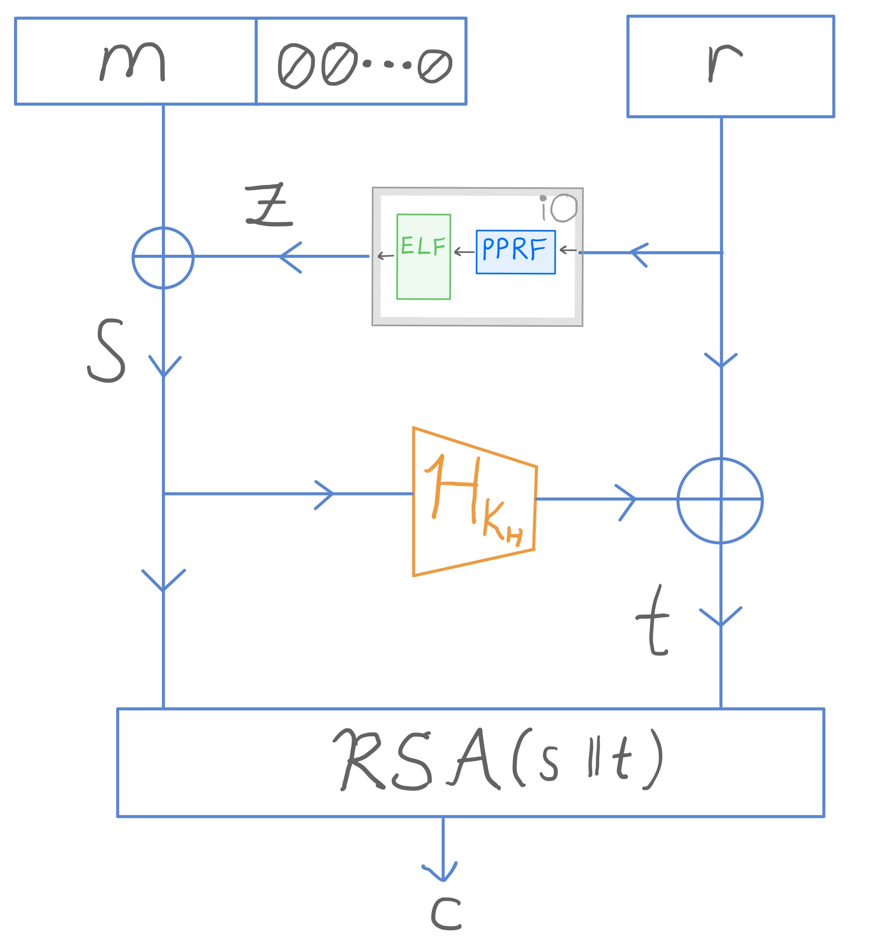
OAEP Proof Idea – starting point
Hash $𝒢$ construction given to $𝒜$ as part of $pk$
(PRG and $\tilde{H}$ omitted)

Slide 24
OAEP Proof Idea – 1st change
MB-AIPO hides the punctured point $r^{∗}$, which is in $c^{∗}$

Slide 25
OAEP Proof Idea – 2nd change
Hash $𝒢$ construction given to $𝒜$ is unchanged:

Slide 26
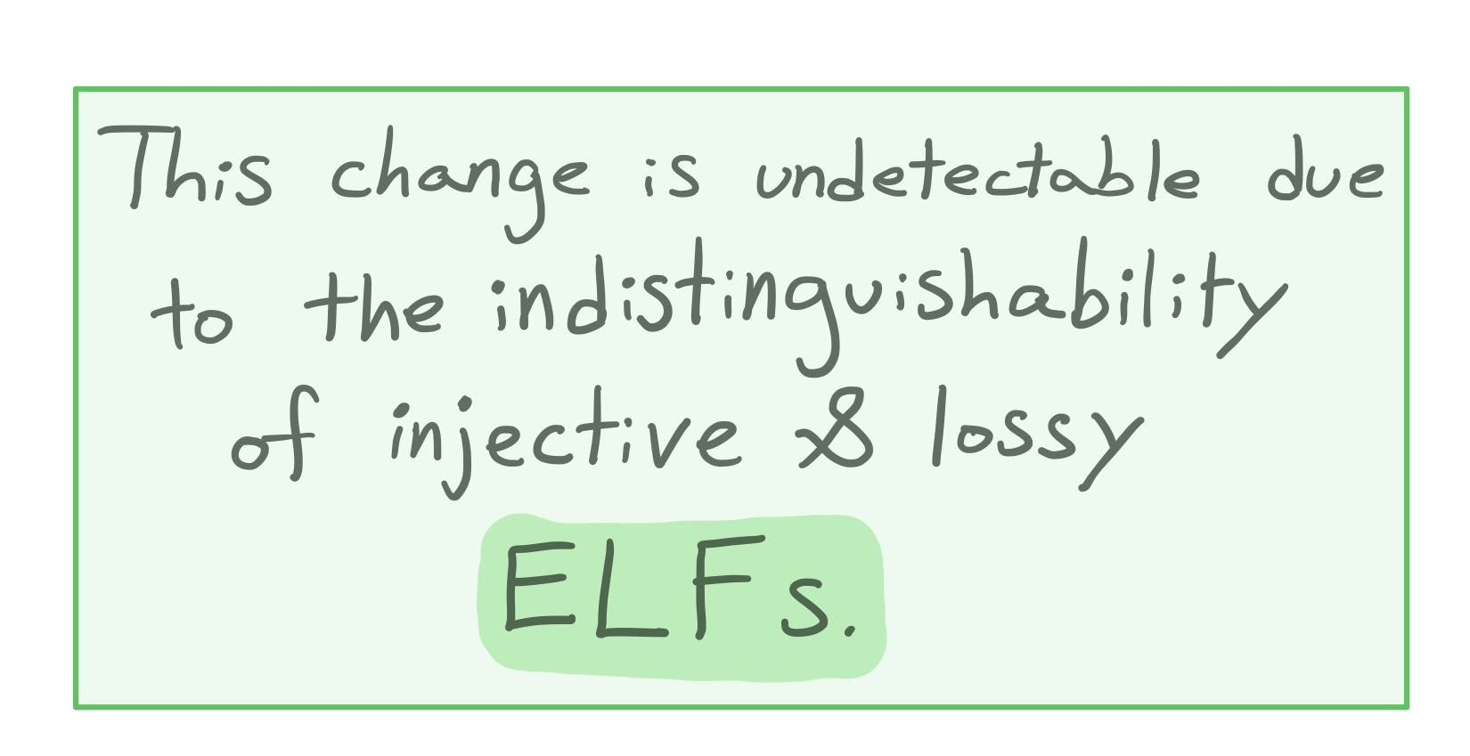
OAEP Proof Idea – 3rd change

Slide 27
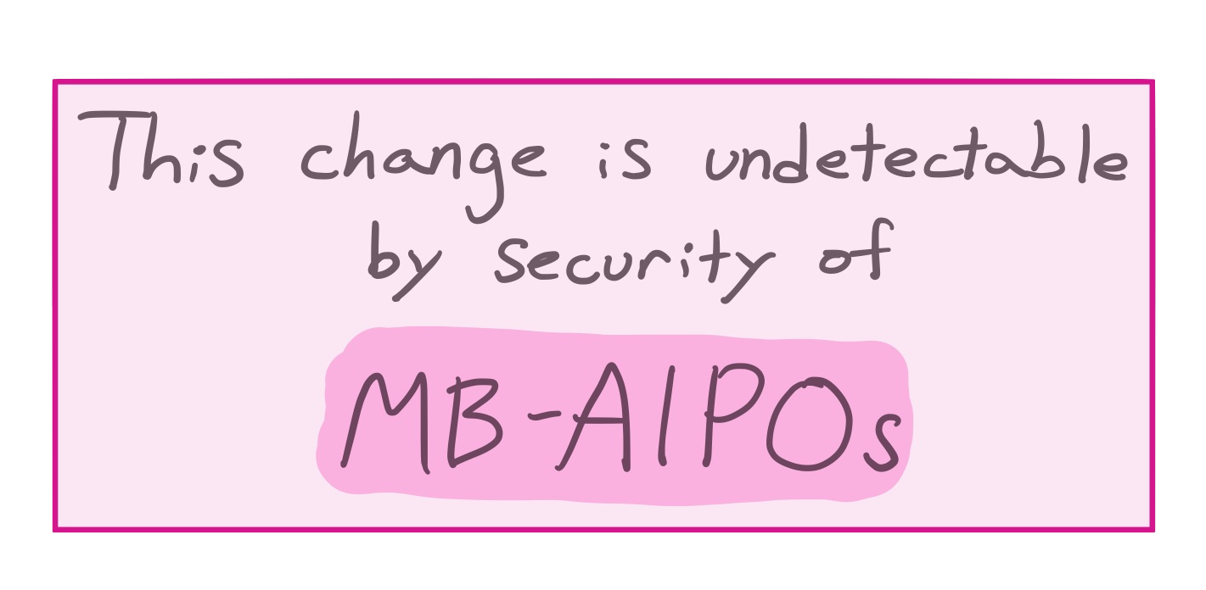
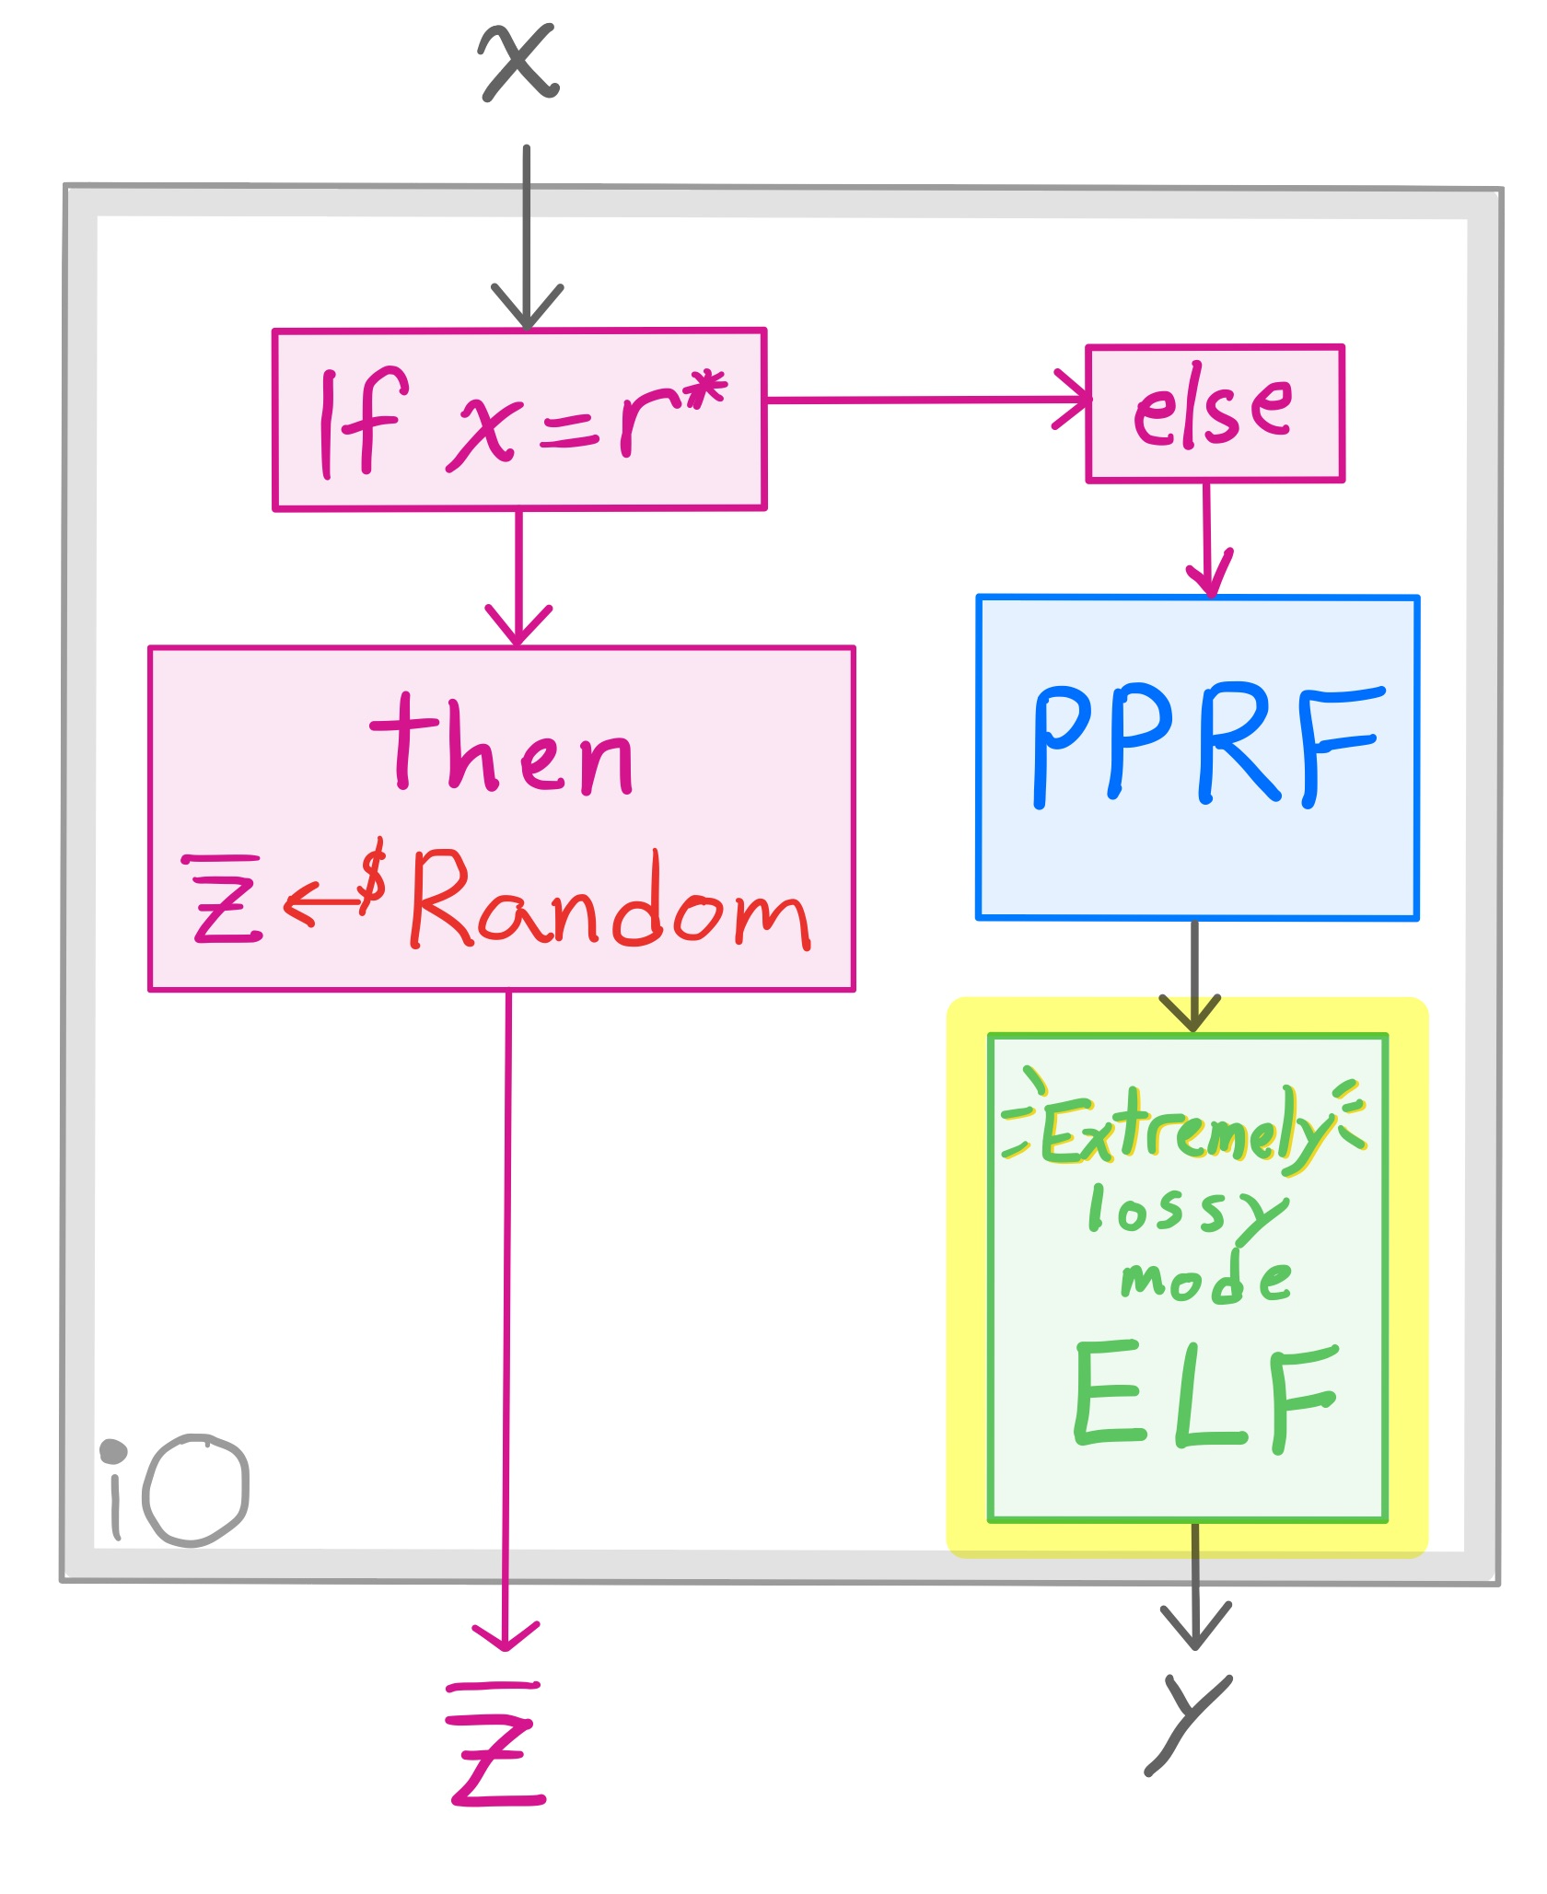
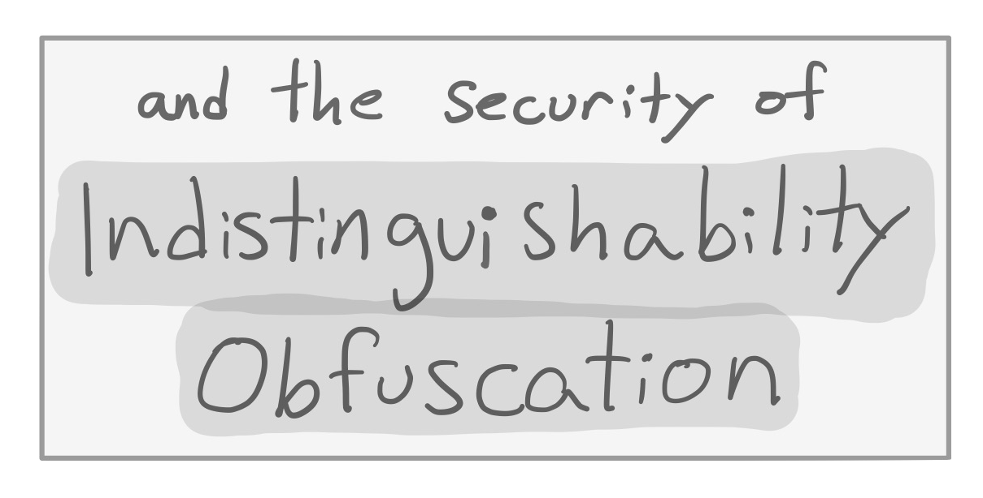
OAEP Proof Idea – 4th change

Slide 28
OAEP Proof Idea – 4th change

Slide 29
Outline
Background
OAEP result preview
Tools
OAEP
FO

Slide 30
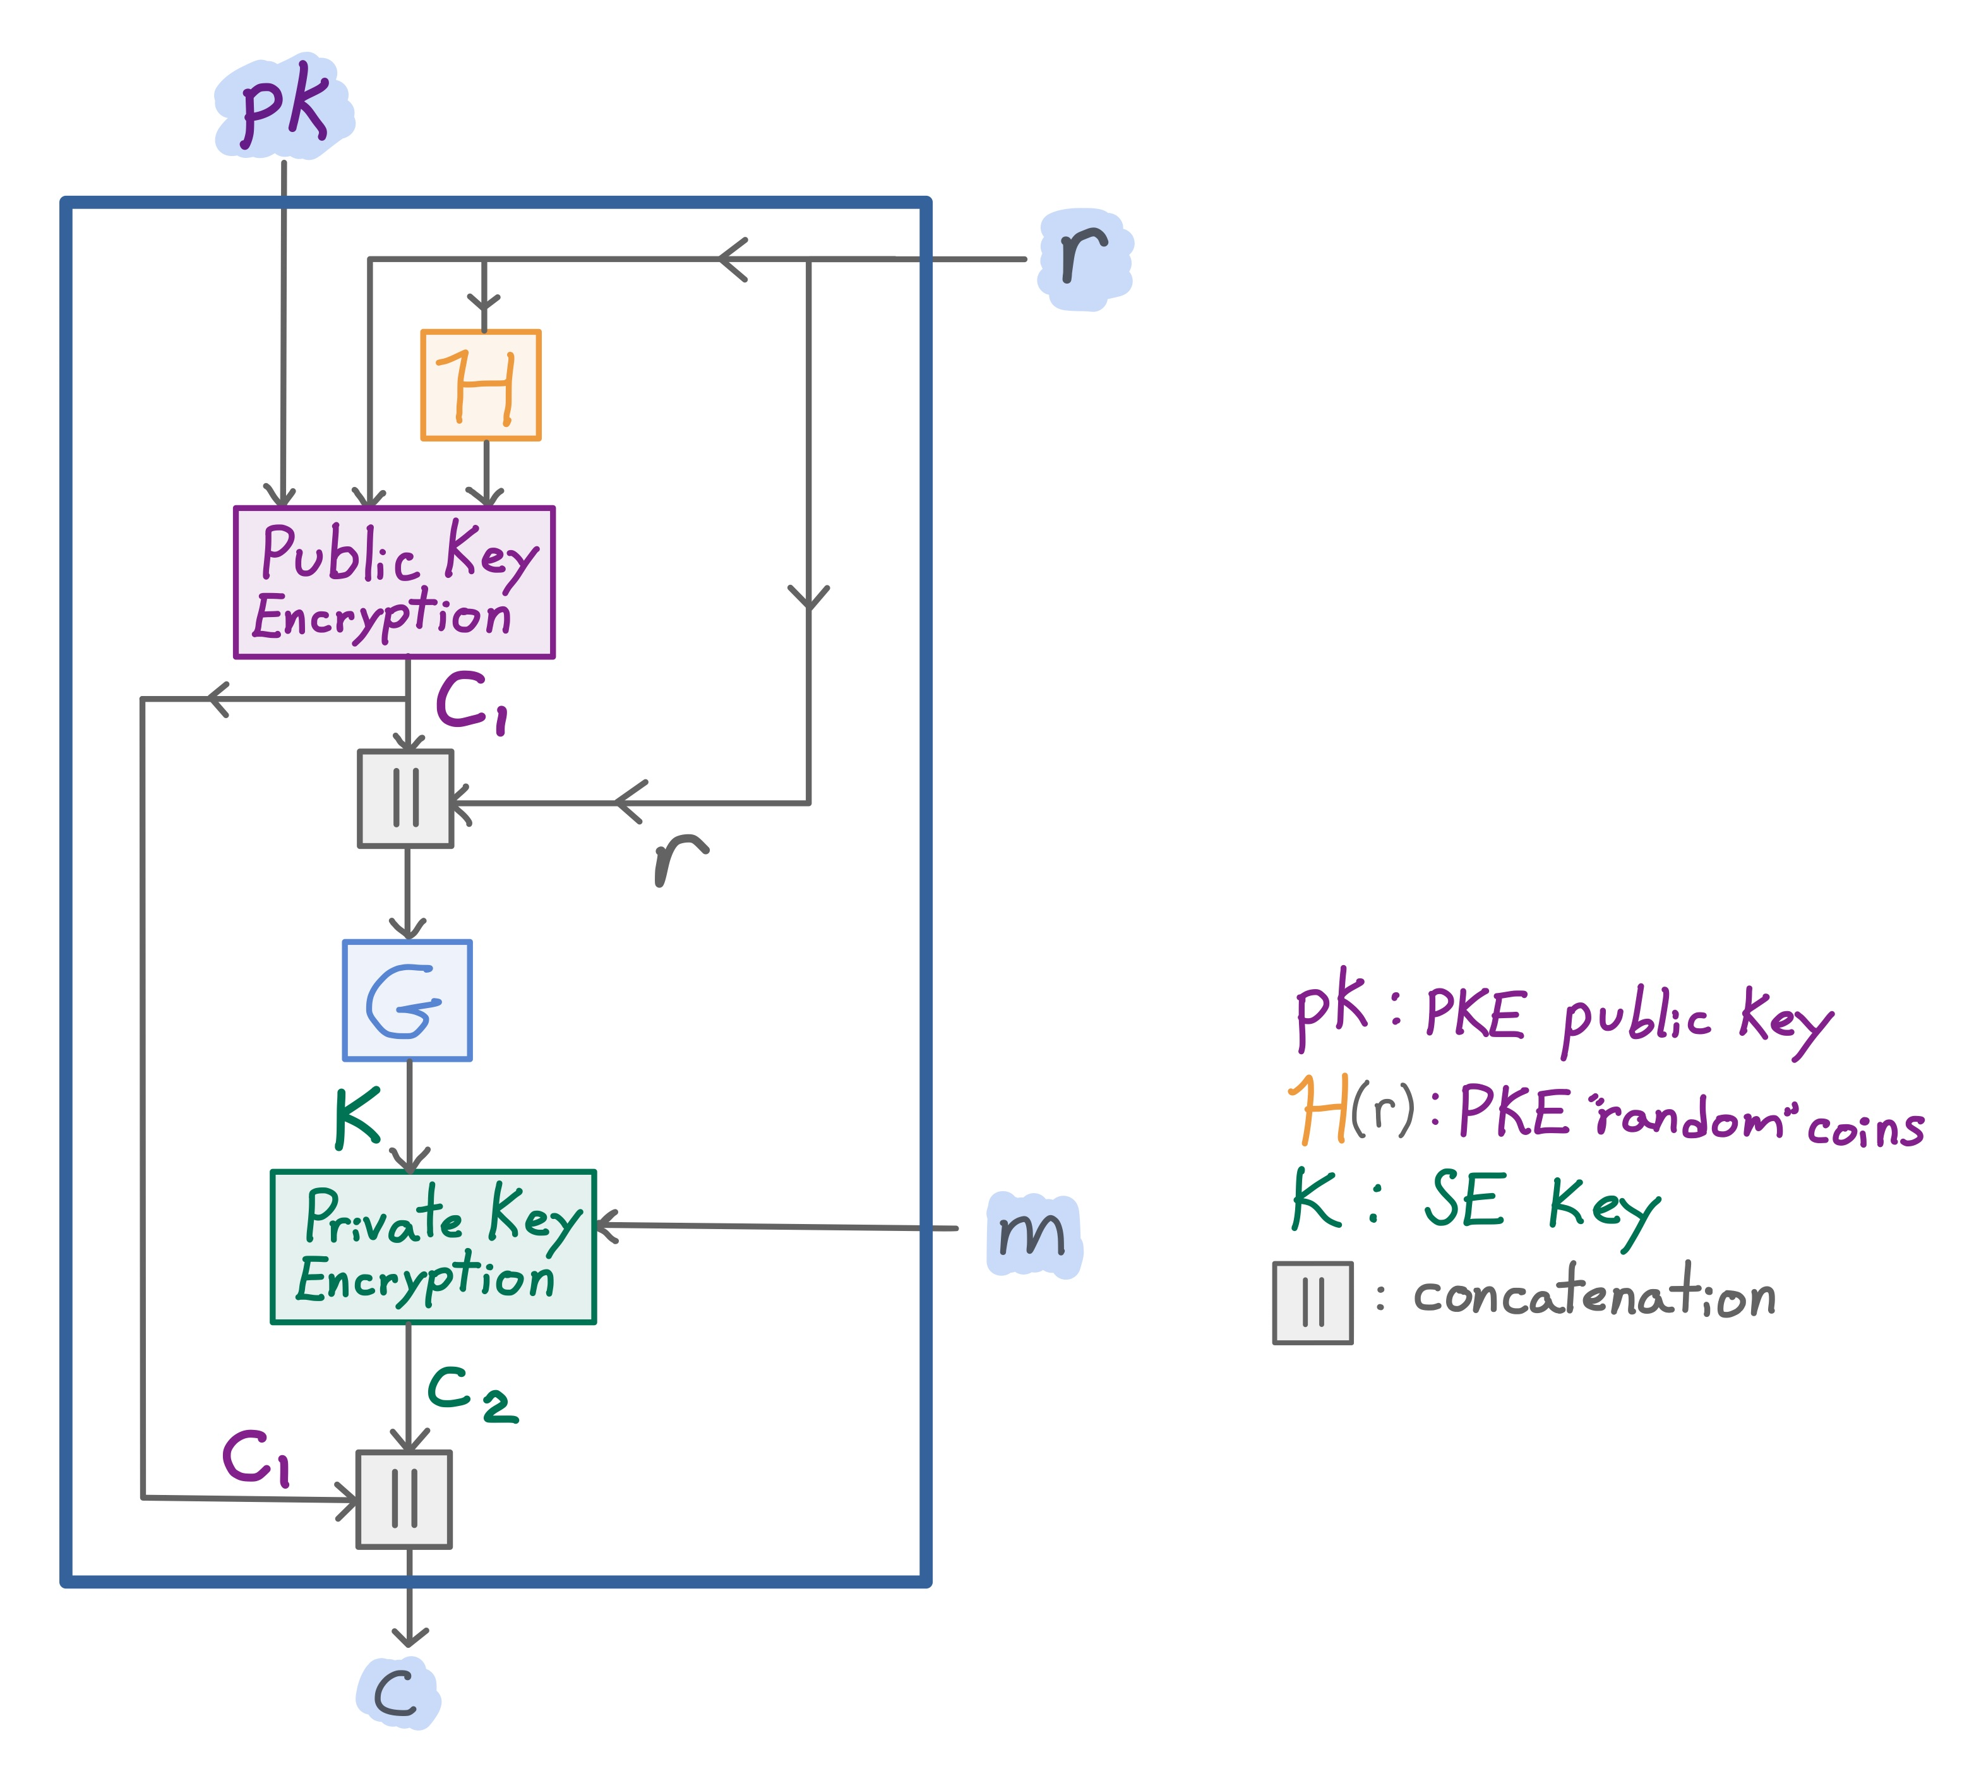
Fujisaki-Okamoto Encryption Transform [FO’99]
Encrypt-with-Hash (EwH)
The random coins of the encryption are the hash of the plaintext:
PKE.Enc($pk, r ; ℋ_{K_{H}}(r)$)
Ingredients:
1 OW-CPA public key encryption (PKE) scheme
1 symmetric key (SE) (aka private-key) encryption scheme
2 random oracles ($𝒢$ and $ℋ$)
Result: IND-CCA2 public-key encryption scheme
Used by CRYSTALS-Kyber, NIST’s post-quantum standardization selection for Public-key Encryption and Key-establishment Algorithms
But our instantiation is not post-quantum secure (ELF construction uses DDH)
random
coins
plaintext
message
Notes:
Uninstan for ow-cpa

Slide 31
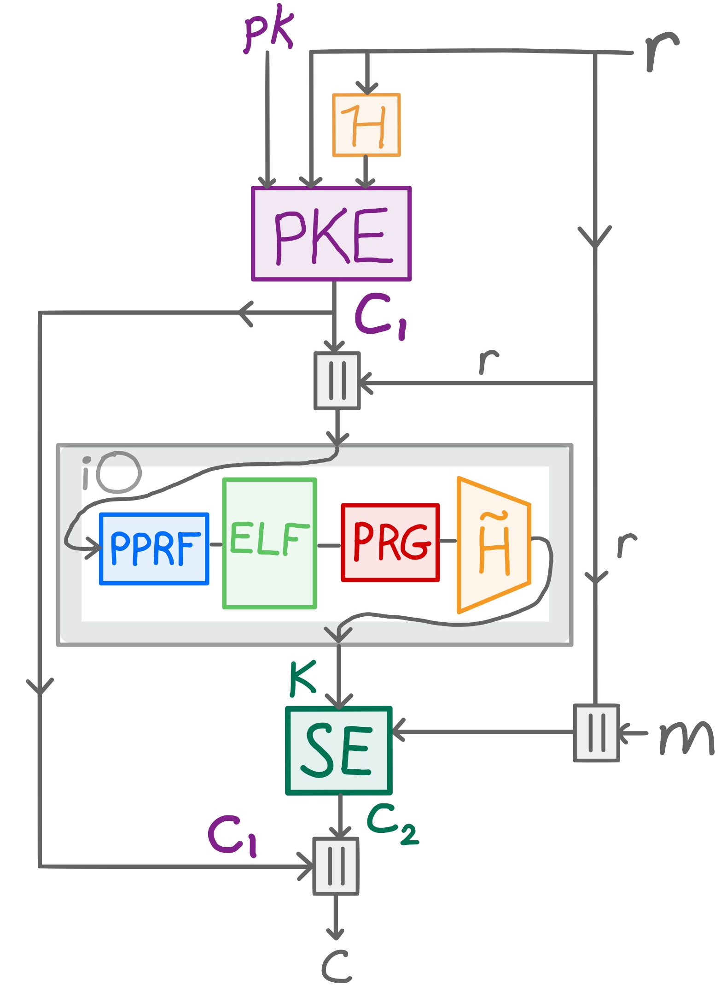
Informal results: FO
(Tweaked) FO transform is IND-CCA2 in the standard model if:
$𝒢$ is instantiated as the composition of:
indistinguishability obfuscation
puncturable pseudorandom function
extremely lossy function
pseudorandom generator
pairwise independent hash
$ℋ$ is instantiated as a pairwise independent hash
Base PKE is lossy encryption
Base SE is authenticated encryption

Slide 32
Informal results: FO
(Tweaked) FO transform is IND-CCA2 in the standard model if:
$𝒢$ is instantiated as the composition of:
indistinguishability obfuscation
puncturable pseudorandom function
extremely lossy function
pseudorandom generator
pairwise independent hash
$ℋ$ is instantiated as a pairwise independent hash
Base PKE is lossy encryption
Base SE is authenticated encryption

Slide 33
Informal results: FO
(Tweaked) FO transform is IND-CCA2 in the standard model if:
$𝒢$ is instantiated as the composition of:
indistinguishability obfuscation
puncturable pseudorandom function
extremely lossy function
pseudorandom generator
pairwise independent hash
$ℋ$ is instantiated as a pairwise independent hash
Base PKE is lossy encryption
Base SE is authenticated encryption

Slide 34
Informal results: FO
(Tweaked) FO transform is IND-CCA2 in the standard model if:
$𝒢$ is instantiated as the composition of:
indistinguishability obfuscation
puncturable pseudorandom function
extremely lossy function
pseudorandom generator
pairwise independent hash
$ℋ$ is instantiated as a pairwise independent hash
Base PKE is lossy encryption
Base SE is authenticated encryption

Slide 35
Informal results: FO
(Tweaked) FO transform is IND-CCA2 in the standard model if:
$𝒢$ is instantiated as the composition of:
indistinguishability obfuscation
puncturable pseudorandom function
extremely lossy function
pseudorandom generator
pairwise independent hash
$ℋ$ is instantiated as a pairwise independent hash
Base PKE is lossy encryption
Base SE is authenticated encryption

Slide 36
Informal results: FO
(Tweaked) FO transform is IND-CCA2 in the standard model if:
$𝒢$ is instantiated as the composition of:
indistinguishability obfuscation
puncturable pseudorandom function
extremely lossy function
pseudorandom generator
pairwise independent hash
$ℋ$ is instantiated as a pairwise independent hash
Base PKE is lossy encryption
Base SE is authenticated encryption

Slide 37
Informal results: FO
(Tweaked) FO transform is IND-CCA2 in the standard model if:
$𝒢$ is instantiated as the composition of:
indistinguishability obfuscation
puncturable pseudorandom function
extremely lossy function
pseudorandom generator
pairwise independent hash
$ℋ$ is instantiated as a pairwise independent hash
Base PKE is lossy encryption
Base SE is authenticated encryption

Slide 38
Informal results: FO
(Tweaked) FO transform is IND-CCA2 in the standard model if:
$𝒢$ is instantiated as the composition of:
indistinguishability obfuscation
puncturable pseudorandom function
extremely lossy function
pseudorandom generator
pairwise independent hash
$ℋ$ is instantiated as a pairwise independent hash
Base PKE is lossy encryption
Base SE is authenticated encryption

Slide 39
Informal results: FO
(Tweaked) FO transform is IND-CCA2 in the standard model if:
$𝒢$ is instantiated as the composition of:
indistinguishability obfuscation
puncturable pseudorandom function
extremely lossy function
pseudorandom generator
pairwise independent hash
$ℋ$ is instantiated as a pairwise independent hash
Base PKE is lossy encryption
Base SE is authenticated encryption

Slide 40
FO viewed as 2 transformations [Hofheinz et al ‘21]
FO upgrades a base OW-CPA PKE into an IND-CCA2 PKE
This can be broken into 2 steps:
Transform a OW-CPA PKE $⟹$ OW-PCA PKE
Transform a OW-PCA PKE $⟹$IND-CCA2 PKE
- OW-CPA: one-way chosen plaintext attack
- OW-PCA: one-way plaintext checking attack [Okamoto & Pointcheval ‘01]
- IND-CCA2: indistinguishability under adaptive chosen ciphertext attack
Notes:
2 avoids uninstan results
(ow-pca defined later)

Slide 41
Summary
ia.cr/2022/1584
We provide full IND-CCA2 standard-model instantiations for
low-exponent RSA-OAEP and
the (tweaked) Fujisaki-Okamoto encryption transform
RO instantiations use the construction iO($\tilde{H}$(PRG(ELF(PPRF(•)))))
Standard-model MB-AIPO constructions are provided based on RSA and ELFs
Notes:
Open problems
post-quantum secure ELF
Eliminating sub-expo assumptions (and add slide explaining that it’s needed to go from messaging depending on pk to not depending)
eliminating need for iO

