Slide 1
Oblivious Message Retrieval
Zeyu Liu
Eran Tromer
Columbia University
CRYPTO 2022

Slide 2
Motivation - anonymous message delivery systems
Bulletin
Sender
?
?
?
?
?
Generate
Text message, coin transfer, etc.
Recipient
Retrieve
Sending privacy
Riposte [CGBM15]
Dandelion [VFV17]
Dandelion++ [FVBDBMV18]
Signal’s Sealed Sender [Lun18]
+ improvement [MKARW21]
Bulletin board privacy
Zerocash [BSCGMTV14,...]
Monero [Noe15,...]
...
Recipient privacy How to receive pertinent messages without leaking identity or metadata?
Alpenhorn [LZ16]
Notes:
conceptually put into a centralized bulletin board

Slide 3
Message retrieval via full scan
Bulletin
Retrieve
Sender
?
?
?
?
?
Generate
Recipient
Too expensive in bandwidth, computation
Notes:
MSGs are for multiple recipients

Slide 4
Message retrieval using a detector
Bulletin
Sender
?
?
?
?
?
Generate
Retrieve
Detector
Text message, coin transfer, etc.
Recipient
Digest
Digest
Digest
Notes:
[BLMG21] Gabrielle Beck, Julia Len, Ian Miers, and Matthew Green. Fuzzy message detection, CCS 2021
[MSSSV21] Varun Madathil, Alessandra Scafuro, Istv´an Andr´as Seres, Omer Shlomovits, and Denis Varlakov. Private signaling. Cryptology ePrint Archive, Report 2021/853 (20210624:145011), 2021.
Another solution is to introduce a third party

Slide 5
Message retrieval using a detector - prior work
Distilled full scan [ZIP-307]
Digest size linear to N
Sender
Bulletin
Detector
Recipient
Digest
Fuzzy Message Detection [BLMG21]
Decoy-based →weak privacy [Lew21][SPB21]
Honest senders & recipients
Bulletin
Sender
Detector
Recipient
Digest
Notes:
[ZIP-307] Jack Grigg and Daira Hopwood. Zcash improvement proposal 307: Light client protocol for payment detection. https://zips.z.cash/zip-0307, September 2018
[BLMG21] Gabrielle Beck, Julia Len, Ian Miers, and Matthew Green. Fuzzy message detection, CCS 2021
[SPB21] Istv ́an Andr ́as Seres, Bal ́azs Pej ́o, and P ́eter Burcsi. The effect of false positives: Why fuzzy message detection leads to fuzzy privacy guarantees? https://ia.cr/2021/1180
[Lew21] Sarah Jamie Lewis. Discreet log #1: Anonymity, bandwidth and Fuzzytags, Feb 2021. URL: https://openprivacy.ca/discreet-log/01-anonymity-bandwidth-and-fuzzytags/.

Slide 6
Message retrieval using a detector - prior work (cont.)
Private Signaling 1 [MSSSV21]
Trusted hardware (e.g., Intel SGX)
Honest senders & recipients
Sender
Bulletin
Recipient
Digest
Private Signaling 2 [MSSSV21]
Two communicating but non-colluding servers
Honest senders & recipients
Bulletin
Sender
Detector
Recipient
Digest
Notes:
[LZ16] David Lazar and Nickolai Zeldovich. Alpenhorn: Bootstrapping secure communication without leaking metadata. In 12th USENIX Symposium on Operating Systems Design and Implementation (OSDI 16), pages 571–586. USENIX Association, November 2016.
[MSSSV21] Varun Madathil, Alessandra Scafuro, Istv´an Andr´as Seres, Omer Shlomovits, and Denis Varlakov. Private signaling. Cryptology ePrint Archive, Report 2021/853 (20210624:145011), 2021.

Slide 7
Our results
Oblivious Message Retrieval (and Detection) that is
fully private
under strong, hitherto-unachieved security notions
based on Fully Homomorphic Encryption
+ bespoke application-driven optimizations
practical for Bitcoin-scale applications

Slide 8
Clue-based Model
Recipient
Bulletin
Detector
Secret keys
Sender
Payload 1
Payload 2
Payload 3
...
…
Clue 1
Clue 2
Clue 3
...
…
Clues
Streaming
Public Keys
GenClue
detection key
Clue Key
Payloads
Payloads
Payloads
Detection
Key
Accumulate
Payload
Clue
Message
Payload N
Clue N
Digest
Process
Digest
Plaintext
payloads
clue key
Functionality: Oblivious Message Detection (OMD)
Oblivious Message Retrieval (OMR)
Goals:
Detector learns nothing about a recipient
Which messages are pertinent
Who is doing the retrieval with what keys
Digest size is much smaller than the bulletin size
Notes:
Add the payload afterwards

Slide 9
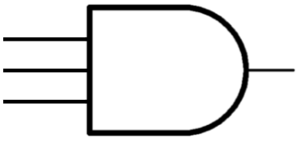
Detection using generic Fully Homomorphic Encryption
Sender:
Use recipient’s clue key
Generate ℓ FHE.Enc(1)
Detector:
Recrypt all ℓ ciphertexts for each clue (totally N clues)
Use AND gate to compress ℓ ciphertexts into one ciphertext
➔ |PV| linear in N
Sender
Bulletin
Detector
Recipient
Payload 1
Payload 2
Payload 3
... | ...
…
Payload N
a
a
1
a
Pertinency Vector (PV)
a
1
1, 1, …, 1
FHE
Recrypt
a
a
1
1
FHE.SK
1
1
a
1
a
FHE.
Enc
1
FHE.PK
FHE.PK
a
Recipient:
Generate keys
a
1
FHE
Recrypt
...
0
a
1
0
Decrypt digest
a
1
0
FHE.PK
FHE.
Dec
PV
ℓ encryptions of 1
...
...
...
Notes:
align wires and the circles and align the circles

Slide 10
Compressing the Pertivency Vector to o(N) a la Private Stream Search [OS05]
Detector
Initialize m accumulator+counter ciphertexts to 0 (m > k)
For each message i ∈ [N] and its PV_{i} (encrypting 0 or 1)
Add PV_{i} i to a pseudorandomly-chosen accumulator
Increment the corresponding counter by PV_{i}
Send the accumulators and counters to the recipient
i
PV
Accumulator
Counter
1
0
0
2
0
0
1
2
1
2
0
0
3
1
3
3
1
4
0
0
0
0
Collisions (counter>1) possible, handled by repetitions and deduction
...
...
...
N
0
0
Notes:
[OS05] Rafail Ostrovsky and William E. Skeith. Private searching on streaming data. CRYPTO 2005

Slide 11
From detection to retrieval
Detector
Compute (PV_{i} Payload_{i})
Multiply it by a pseudorandom weights matrix of width m
Yields m encrypted linear combinations of the pertinent payloads. If at least k are linearly independent, recipient can solve and obtain all pertinent payloads
Combination
Payload
PV
Weights
P1
1
P1
C1
w(1,1) | w(1,2) | w(1,3) | ... | w(1,m)
w(2,1) | w(2,2) | w(2,3) | ... | w(2,m)
w(3,1) | w(3,2) | w(3,3) | ... | w(3,m)
... | ... | ... | ... | w(4,m)
w(N,1) | w(N,2) | w(N,2) | ... | w(N,m)
P2
0
0
C2
P3
1
P3
C3
...
...
...
PN
0
0
Cm
Using suitable Sparse Random Linear Coding Cost message is Õ(1)
Notes:
Add a slide saying what we have achieved so far

Slide 12
Thus far
Generic FHE-based
Oblivious Message Detection
Oblivious Message Retrieval
Asymptotically efficient and succinct
o(N) communication cost
Õ(N) computational cost
Impractical
FHE has high computational cost and communication cost
Take milliseconds to do an AND gate (TFHE [CGGI20])
One ciphertext can be kilobytes (TFHE [CGGI20]) or more

Slide 13
Key optimization: reduce clue size, lightweight recryption
PVW Encryption for ℓ bits [PVW07]
BFV Homomorphic Encryption [Bra12][FV12] supports packed SIMD field operations
PVW ciphertext
BFV ciphertext
a₁ | a₂ | a₃ | ... | a_{n}
b₁ | ... | b_{ℓ}
a
b
c
...
z
s1₁ | s1₂ | s1₃ | ... | s1_{n}
}
...
PVW secret key
sℓ₁ | sℓ₂ | sℓ₃ | ... | sℓ_{n}
SIMD PVW decryption under BFV
PVW decryption:
PVW decryption:
a₁ | a₂ | a₃ | ... | a_{n}
a₁ | a₂ | a₃ | ... | a_{n}
a₁ | a₂ | a₃ | ... | a_{n}
a₁ | a₂ | a₃ | ... | a_{n}
a₁ | a₂ | a₃ | ... | a_{n}
a₁ | a₂ | a₃ | ... | a_{n}
b₁
b₁
b₁
+
b₁
b₁
inner product
b₁
b₁
b₁
Inner Prod
b₁
b₁
s1₁ | s1₂ | s1₃ | ... | s1_{n}
...
s1₁ | s1₂ | s1₃ | ... | s1_{n}
sℓ₁ | sℓ₂ | sℓ₃ | ... | sℓ_{n}
Range
Check
Range
Check
via
[LCZ21]
0/1
0/1
0/1
0/1
…
0/1

Slide 14
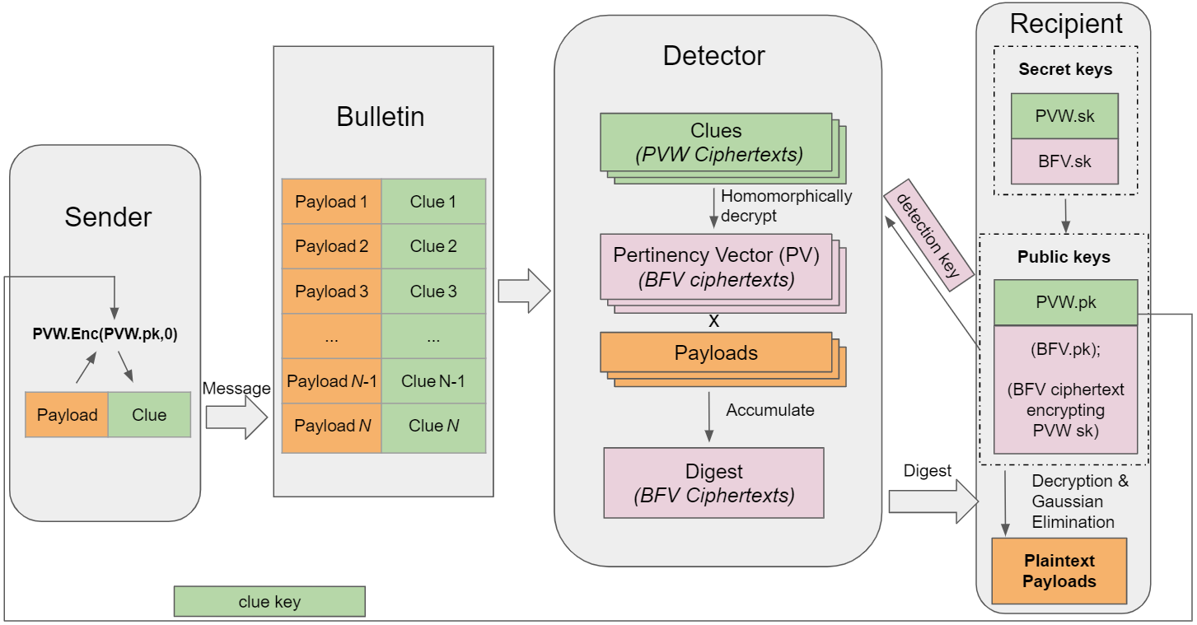
Putting it together: hybrid PVW+BFV OMR/OMD

Slide 15
Additional techniques
FHE tailoring
Optimized ladder of moduli
Homomorphic operation scheduling (e.g., multiplication vs. rotation)
Symmetric BFV encryption
Level-specific homomorphic rotation keys
Scheme optimizations
Tailored range check
Deterministic bitwise index retrieval
Application tailoring
Memory footprint reduction
Streaming updates with low-latency finalization

Slide 16
Denial of Service Attacks
Detector
Recipient
Payload
Clue
Sender
Bulletin
1
2
3
...
N-1
N
Detector
Recipient
Payload
Clue
Payload
Generate
Payload
Clue
Payload
Clue
Detector
Recipient
clue key
Notes:
adjust distance

Slide 17
Denial of Service Attacks (mitigated)
Detector
Recipient
Payload
Clue
Payload
Bulletin
1
2
3
...
N-1
N
Detector
Recipient
Payload
Clue
Payload
Generate
Payload
Clue
Payload
Clue
Detector
Recipient
Payload
FMD and PS are vulnerable.
Notes:
adjust distance

Slide 18
Snake-eye Conjecture for LWE encryption
sk₁
Regev05.KeyGen
Regev05.Dec
0
pk₁
→
ct = (a,b)
with nontrivial probability
> ½ + nonnegl
→
→
a ≠ 0
pk₂
sk₂
Regev05.KeyGen
Regev05.Dec
0
Conjecture: this is infeasible
Not directly implied standard notions like semantic security or key privacy.
For PKE schemes like El Gamal, it’s trivially impossible for nontrivial probabilities.
Provable under SIS + generalization of the knowledge of Knapsack of Noisy Inner Products [BCCT12]
Notes:
adjust distance

Slide 19
Key unlinkability (defined and attained)
FMD and PS are vulnerable.
Recipient
Recipient
Detection
Key 1
Recipient
Clue Key 1
Clue Key 1
Detector
Detector
Recipient
Recipient
Detector
~
Clue Key 2
~
Detection
Key 2
~
~
~
~
Detection
Key 1
Detection
Key 1
Detector
Detector
Recipient
Clue Key 1
Recipient
Recipient
Clue Key 2
Clue Key 2
Detection
Key 2
Detection-key to detection-key unlinkability
Clue-key to clue-key unlinkability
Clue-key to detection-key unlinkability
Notes:
shrink detectors and recipients

Slide 20
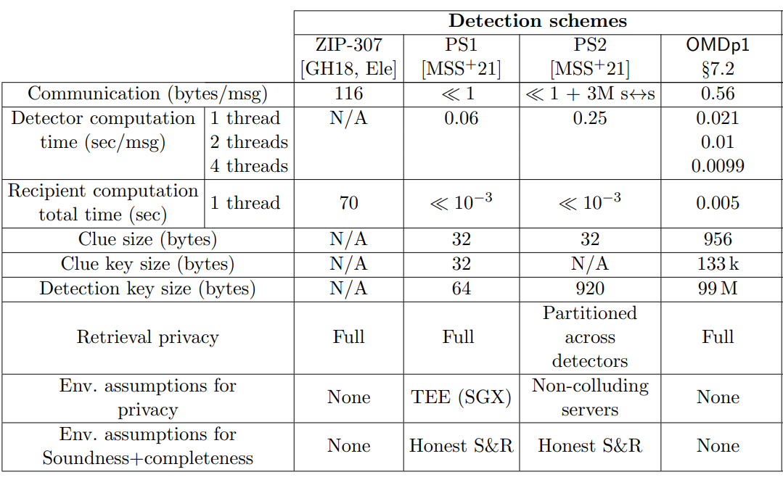
Detection benchmarks (N = 500,000, k = 50)

Slide 21
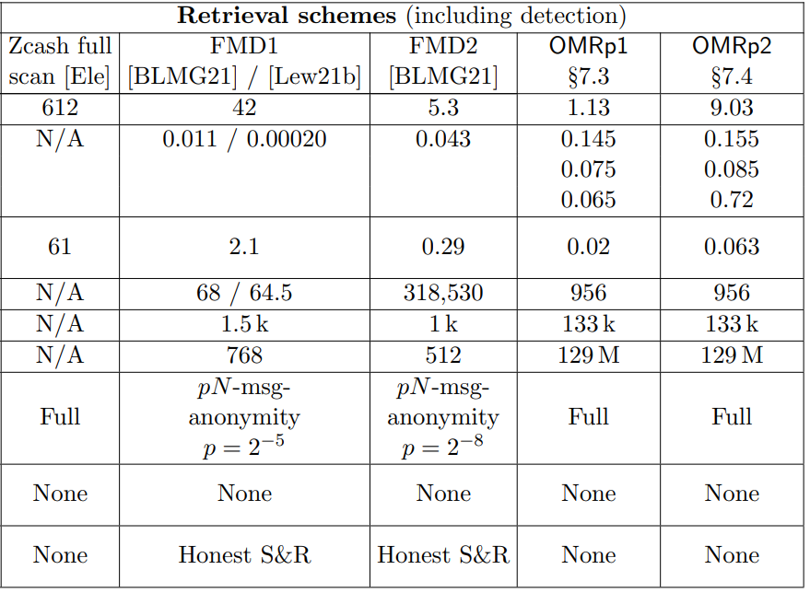
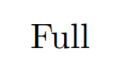
Retrieval benchmarks (N = 500,000, k = 50)
Notes:
Add three bullets:
fastest retrieval

Slide 22
Scaling of recipient costs
Digest size vs. number of messages
For N>300,000 messages, our OMR1p has the lowest costs for the recipients
Recipient computation time vs. number of messages
For N>10,000,000 messages, our OMR2p has the lowest costs for the recipients
… while attaining the strongest privacy guarantees and under minimal environmental/trust assumptions
Notes:
Add things to brag about arrow

Slide 23
Real-world prospects
Concrete retrieval costs
$1.02 per million payments scanned (based on GCP cost)
$0.02/month for Zcash, $1.66/month for Monero
Integration considerations
Payload Size: for Zcash, 612 bytes sizes
Clue Key Distribution
embedded in the recipient’s public address
short URL from which the clue key can be fetched (senders using Tor or IPFS)
Clue Embedding
956 bytes, close to a Zcash shielded transaction (which is 1.3kB)
extend the transaction format with a dedicated clue field
other ways like OP_RETURN field in Zcash transactions
Detection Latency
Streaming updates reduces latency to 0.0005 core-seconds/msg

Slide 24
Future works
Paper
Code
Ongoing
Reducing detector cost (~2.5x faster)
Group messaging (one msg, multiple recipients)
Integrations
Future directions
Reducing size of clue, clue key, detection key
DoS-Resistance from standard assumptions
Integrity against fully-malicious detectors
ia.cr/2021/1256
github.com/ZeyuThomasLiu/ObliviousMessageRetrival

