Slide 1
Constructive Post-quantum Reductions
Nir Bitansky
TAU
Zvika Brakerski
Weizmann
Yael Kalai
MSR/MIT
*Some slides inspired by Zvika

Slide 2
Post-quantum Cryptography
classical protocol/scheme
$$P_{1}$$
$P_{2}$
A
quantum adversary
Notes:
So we’re still in the context of pq crypto, where we want to design classical protocols that can withstand quantum attackers

Slide 3
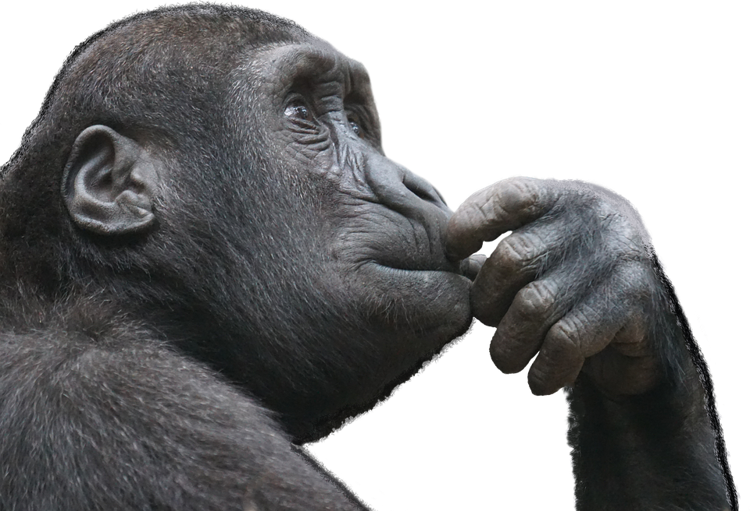
Rethinking Cryptography
Assumptions
lattice instead of Factoring…
Adversary interface
quantum vs classical signing oracle?
Reductions
OWFs still imply all symmetric key crypto?
Notes:
And our community has been thinking about pq for some time now, and it required that we reconsider different aspects of crypto.
One obvious thing is assumptions, we can no longer use assumptions that are quantumly broken like factoring, and have to turn for new sources of hardness like lattices,
But there are also other aspects, for instance how does the quantum adversary interact with our classical protocol, can they say query a signature oracle in superposition and so on…
And there’s another even more basic aspect which is reductions. Do the reductions we have in the classical setting carry over. For instance do OWFs still imply all symmetric-key crypto?
And this is going to be our focus today.

Slide 4
(Security) Reductions
P
e.g. PRG
A
breaks P
Q
e.g. OWF/LWE
R
breaks Q
“Breaking P (e.g. PRG) is no easier than breaking Q (e.g. OWF)”
Notes:
So more explicitly, we’re concerned with security reductions, so let recall what those are.
Say we’ve constructed some primitive P from some assumption Q, and now we wanna prove that breaking P is no easier than breaking Q.
So the way we do it is by giving a reduction algorithm that can use an adversary that breaks P in order to break Q.
And such reductions are the bread and butter of crypto, and we’ve coming up with such classical reductions for decades, it would be a shame if we have to redo everything in the quantum setting.

Slide 5
Can classical reductions be lifted to post-quantum regime?
Most classical reductions treat A as a black box….
Notes:
And this brings us to the basic question of whether we can lift our classical reductions to the post-quantum regime.
And there’s seems to be a good reason we can hope to do that --- and the reason is that almost all of our reductions are black box. They don’t really care how the attacker is implemented, so who cares if its quantum.

Slide 6
Problematic in Interactive Setting
P
A
$$\left| ψ \right\rangle$$
rewind
disturbed
Q
R
$∃$interactive P BB-reducible to LWE, but quantumly broken [BCMVV18]
Notes:
But this intuition is generally not true, and in particular if we think about interactive protocols, it is known to be quite problematic.
The reason is that a basic thing that classical reductions do in the interactive setting is rewind the adversary at some intermediate point in the protocol. And in the quantum setting this doesn’t work due to the observer effect. Whenever the reduction observes the adversary’s messages in the protocol, it disturbs its intermediate quantum state.
And as a matter of fact, you can come up with interactive protocols whose security classically reduces to LWE, which is allegedly quantum hard, yet you can break these protocols quantumly. In particular, we don’t expect that a post-quantum reduction exists.

Slide 7
Our Focus: Non-interactive Primitives/Assumptions
A
A
A
A
reduction execution
R
Notes:
So let’s focus on the more basic setting of non-interactive primitives, like say pseudorandom generators, or public key encryption, there are still plenty of reductions here that we would like to carry them to the post-quantum world.
Here the adversary has no intermediate state, it gets a challenge and spits out a solution, so it looks like everything should work.

Slide 8
Quantum Auxiliary Input
A
A
A
A
$$\left| ψ \right\rangle$$
$$\left| φ \right\rangle$$
$$\left| ρ \right\rangle$$
$$\left| ζ \right\rangle$$
$$?$$
$$?$$
$$?$$
Auxiliary input state disturbed
Where does $\left| ψ \right\rangle$ come from?
Expensive preprocessing
Intermediate state in a protocol
Friendly advice from aliens…
R
Notes:
But actually things are a bit more subtle than that.
Specifically, we want our reductions to also work when the adversary has an auxiliary quantum input.
Such an auxiliary input may come from different sources:
It can be the result of some expensive preprocessing,
It can be an intermediate state in some larger protocol,
And so on….
Now, whereas a classical auxiliary input is typically not an issue for black-box reductions, a quantum auxiliary input is again problematic due to the same observer we’ve just discussed. Because every time the reduction queries the adversary and observes the result the auxiliary quantum state is disturbed, and we have no guarantee on what’s going to happen next, as far as we know the adversary will stop working and the reduction won’t be able to perform its next queries.

Slide 9
Just Copy the State?
A
A
A
A
$$\left| ψ \right\rangle$$
$$\left| ψ \right\rangle$$
$$\left| ψ \right\rangle$$
$$\left| ψ \right\rangle$$
R
Non-constructive
Quantum cloning impossible!
Notes:
But perhaps this has an easy solution which is just to provide the reduction with many copies of this auxiliary state. So what’s the problem?
This would work, but it is non-constructive. Indeed, it is generally impossible to copy quantum states let alone, do it efficiently.
Now, sometimes this may be fine, e.g., if we only care about the underlying assumption Q and are willing to assume it holds in the presence of arbitrary auxiliary input, we might be satisfied with this solution, but we argue that in general we want more.

Slide 10
Goal: Constructive Reductions
A
A
R
$$\left| ψ \right\rangle$$
$$\left| ψ \right\rangle$$
breaks P
breaks Q
Win-Win: broken scheme $⇒$ explicit algorithmic advance
Targeted also classically (uniform reductions) [Bellare, Rogaway]
Goal II: Durability, new algorithm should work forever.
Notes:
We want constructive reductions. Formally, this means that the reduction should work given the algorithm and its auxiliary input, without requiring further resources that it cannot really generate.
Because reduction-based crypto is much about win-win: if we come up with a concrete way of breaking a cryptographic scheme then we should be able to use it right here and now to achieve algorithmic advance.
And we’re not the first to argue this, this is something that is also targeted in the classical setting and is why we usually insist on uniform reductions.
Another thing to consider here, which doesn’t come up classically, is durability. We want our reduction to keep working forever, whenever we choose to run it, we don’t want it to work only once.

Slide 11
Results
Lifting large class of classical reductions
Any R from breaking Q to breaking P such that:
R is black box
R is non-adaptive
P is a decision assumption (e.g. PRG) or has few solutions (e.g Injective OWF)
Resulting post-quantum reduction is constructive and durable.
Intermediate models of stateful adversaries, also of interest classically
Negative result
Restriction on P is somewhat inherent.
Notes:
Say what’s non adaptive.

Slide 12
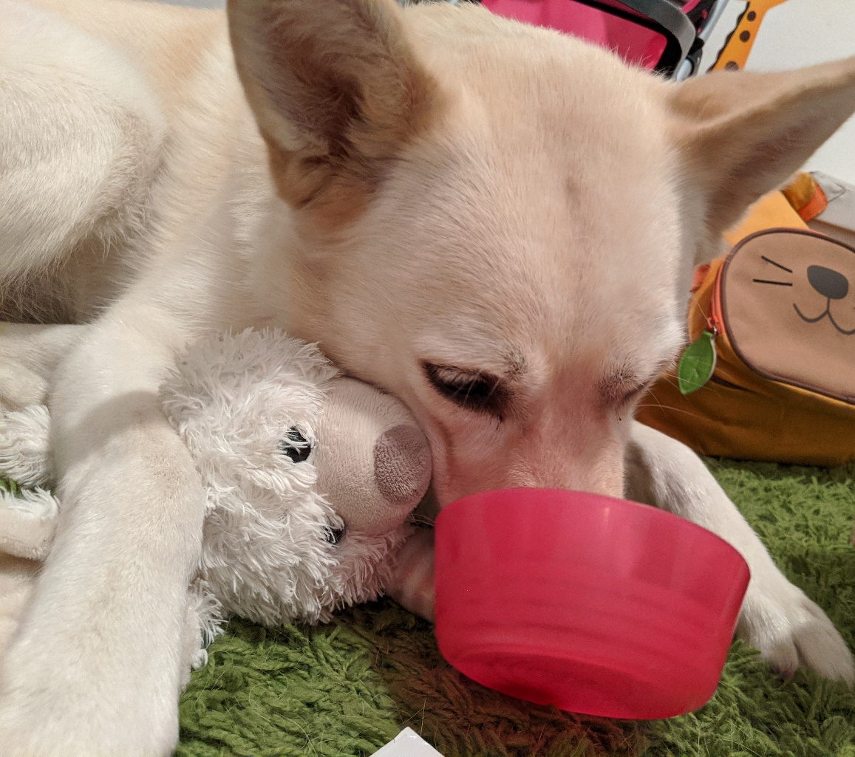
A taste of the techniques
Notes:
In the remaining time I would like to give you a taste of the techniques.
And perhaps some of you already recognize this dog…

Slide 13
Bridge Between Stateful and Stateless Adversaries
A
A
A
A
One-shot
$$\left| ψ \right\rangle$$
$$\left| φ \right\rangle$$
$$\left| ρ \right\rangle$$
$$\left| ζ \right\rangle$$
$$?$$
$$?$$
$$?$$
Gap
A
A
A
A
Stateless
classical reduction applicable
Notes:
So what we basically wanna do is build a bridge between two adversarial models.
Our finish line is the model where classical reductions work, and we call this the stateless model. Here every query the reduction makes is answered by the same function.
And our starting point seems quite far, here we have a one-shot stateful adversary, we know that it works if we run it once, but then its quantum state changes, and we lose any guarantee.
So this is the gap we want to bridge, and we do it in several steps.

Slide 14
Bridge 1: One-Shot to Persistent
A
A
A
A
One-shot
$$\left| ψ \right\rangle$$
$$\left| φ \right\rangle$$
$$\left| ρ \right\rangle$$
$$\left| ζ \right\rangle$$
$$?$$
$$?$$
$$?$$
quantum rewinding
[Chiesa-Ma-Spooner-Zhandry]
Gap 1
restriction to decision etc.
A
A
A
A
Persistent
$$\left| ψ \right\rangle$$
$$\left| φ \right\rangle$$
$$\left| ρ \right\rangle$$
$$\left| ζ \right\rangle$$
keeps solving, without losing steam
Notes:
In the first step, we’ll transition from one-shot adversaries to what we call persistent adversaries. These are adversaries that never lose steam, even after we run them, and despite the fact that their state may change, they will keep breaking the corresponding primitive with almost the same probability.
And the way we do this is by leveraging recent quantum rewinding techniques, and this is the step that introduces the restriction to decision problems etc, which as I told you turns out to be somewhat inherent.

Slide 15
Isn’t Persistent Enough?
A
A
A
A
Persistent
$$\left| ψ \right\rangle$$
$$\left| φ \right\rangle$$
$$\left| ρ \right\rangle$$
$$\left| ζ \right\rangle$$
keeps solving, without losing steam
Solvable set drifts
reduction queries may be correlated (e.g., Goldreich-Levin)
Notes:
So before proceeding to the next step, we should ask ourselves why persistent adversaries aren’t enough, they never lose steam so what can go wrong.
So it is enough if we consider for say reductions that make a single query, but if our reductions makes multiple queries we might run into trouble, and the reason is that the adversary state still changes and while the set of instances that it solves, remains of roughly the same size, it can wonder around.
And this is going to be a problem for reductions that make multiple correlated queries (like say GL), in the extreme case it could be that after the first query, the solution space changes in a way such that all other queries won’t be answered correctly.
*Maybe enough in some cases, e.g. if there’s some form of random self-reducibility.

Slide 16
Bridge 2: Persistent to Memoryless
A
A
A
A
Persistent
$$\left| ψ \right\rangle$$
$$\left| φ \right\rangle$$
$$\left| ρ \right\rangle$$
$$\left| ζ \right\rangle$$
simulation argument
restriction to non-adaptive
main tech contribution
Gap 2
A
A
A
A
Memoryless
(& persistent)
$$1$$
$$2$$
$$3$$
$$4$$
keeps clock, strategy fixed ahead
Notes:
So this brings us to the next step, where we basically want to make sure that the state forgets the previous queries.
Specifically, we’re going to transition from the model of persistent adversaries to a model of memoryless adversaries. In this model, every query may be answered by a different function, but these functions are fixed ahead of time, independently of the queries made.
And we bridge this gap by showing how to simulate such memoryless behavior, in the case that the underlying reduction is non adaptive. And this step is perhaps the main technical contribution, so I’ll say a few words on how we do this.

Slide 17
Simulating Memoryless Behavior
Idea: adversary state poly-bounded, limited memory of past queries
To make $i$-th query $q_{i}$:
${\tilde{q}}_{i1},…,{\tilde{q}}_{it}←Q_{i}$ marginal of $i$-th query
plant “real” $q_{i}$ in random location
A
A
A
A
$$\left| ψ \right\rangle$$
$$\left| φ \right\rangle$$
$$\left| ρ \right\rangle$$
$$\left| ζ \right\rangle$$
$${\tilde{q}}_{i1}$$
$${\tilde{q}}_{i2}$$
$$q_{i}$$
$${\tilde{q}}_{it}$$
$$⋯$$
#state-qubits
$δ$-close to execution with predetermined oracles for $t≈ \frac{ℓ}{δ^{2}}$
(quantum mutual information argument)
Notes:
The basic idea is to leverage the fact that the adversary’s quantum state is polynomially bounded, so there’s only so much that it can remember about past queries.
In more detail, when we want to get an answer for the i-th query of our reduction, we’ll first sample many dummy queries from the marginal of the ith query, then we’re going to plant our real query somewhere at random among these dummy queries, and then we’re going to make all of these queries to the adversary, use the answer we got to the real query and discard the rest.
The intuition is that the attacker can’t tell the real query from the
dummy ones, and doesn’t have a large enough state to store them all.
And we prove that the query-answer distribution we get is actually close to an execution with some predetermined oracles, that basically depend only on dummy queries, but are completely independent of the real queries.
And to get this closeness we naturally need to make sure that we’re flooding the adversdary with enough dummy queries, more than the length of its quantum state.
The formal proof relies on basic quantum information theory.
Where did we use non-adaptivity?
the marginals Q_i are well defined independently of the adversary’s answers.

Slide 18
Bridge 3: Memoryless to Stateless
A
A
A
A
Memoryless
$$1$$
$$2$$
$$3$$
$$4$$
keeps clock, strategy fixed ahead
simulation argument
restriction to non-adaptive
(shuffle queries…)
Gap 3
A
A
A
A
Stateless
classical reduction applicable
Notes:
The last step

Slide 19
Bridge Between Stateful and Stateless Adversaries
A
A
A
A
One-shot
$$\left| ψ \right\rangle$$
$$\left| φ \right\rangle$$
$$\left| ρ \right\rangle$$
$$\left| ζ \right\rangle$$
$$?$$
$$?$$
$$?$$
Gap
Persistent
main tech contribution
Memoryless
also in cosmic [CFP22]
A
A
A
A
Stateless
classical reduction applicable
Notes:
So we combine all of these steps and we get the bridge we wanted between one shot adversaries and stateless adversaries.
As I mentioned before we think that these interemediate models of stateful adversaries are also interesting beyond the context of quantum, you could ask what can be done in a model where the adversary somehow adapts over time.
And indeed this question is also explored in a concurrent work of Chen-Freitag-Pass on cosmic security where they consider a similar model of memoryless adversaries and give a similar shuffling transformation to stateless adversaries.

Slide 20
Food for Thought
What about adaptive reductions?
(PRGs from OWFs [HILL])
Thanks!
Notes:
Let me conclude with some food for thought.
So we showed how to deal with non-adaptive reductions, and perhaps most reductions are non-adaptive, and yet there are some important examples of adaptive reductions, and the most notorious example is PRGs from general OWFs. So we still don’t know how to deal with those, and whether it’s even possible.

Slide 21
A Counterexample for Search Assumptions
Non-interactive problems P,Q with classical reduction, but no constructive post-quantum reduction
P: Given vk for digital signature scheme, and a random message m, output s which is a valid signature for m.
Q: Given vk for digital signature scheme, and random messages (m₁, m₂), output (s₁, s₂) which are valid signature for (m₁, m₂).
Classically: P-Solver $⇒$ Q-Solver
Quantumly: tokenized signature schemes [BS18,CLLZ21] allow to generate a quantum state that can be used to generate exactly one valid signature.

Slide 22
P
A
Q
R

