Slide 1
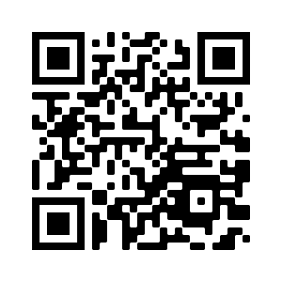
Orion: Zero Knowledge Proof with Linear Prover Time
Tiancheng Xie, Yupeng Zhang, Dawn Song

Slide 2
What is ZKP? [GMR85]
Verification: ✓ or ✗
$F(w) = y$+
Witness: $w$
Completeness: Pr[ honest prover and verification is ✓ ] = 1
Soundness: Pr[$y≠F(w)$ and verification is ✓ ] $≤2^{−100}$
Zero knowledge: proof leaks no information about $w$
Notes:
Add note: we are technically zk arguments, but for simplicity we still call it zk proof

Slide 3
History of efficient instantiations
GMR85/Kilian-Micali92
Start Point of ZK
20 Years
GGPR13/BCGTV13/PGHR13
BCTV14a/GROTH16
10 Years
Ligero/Stark/Aurora/Spartan/Libra
Virgo/Marlin/Fractal/Brakedown
Notes:
直接列list
强调第二个是efficient system

Slide 4
History of efficient instantiations
GMR85/Kilian-Micali92
Start Point of ZK
20 Years
GGPR13/BCGTV13/PGHR13
BCTV14a/GROTH16
Efficient Instantiations
10 Years
Ligero/Stark/Aurora/Spartan/Libra
Virgo/Marlin/Fractal/Brakedown

Slide 5
History of efficient instantiations
GMR85/Kilian-Micali92
Start Point of ZK
20 Years
GGPR13/BCGTV13/PGHR13
BCTV14a/GROTH16
Efficient Instantiations
10 Years
Ligero/Stark/Aurora/Spartan/Libra
Virgo/Marlin/Fractal/Brakedown
Recent developments

Slide 6
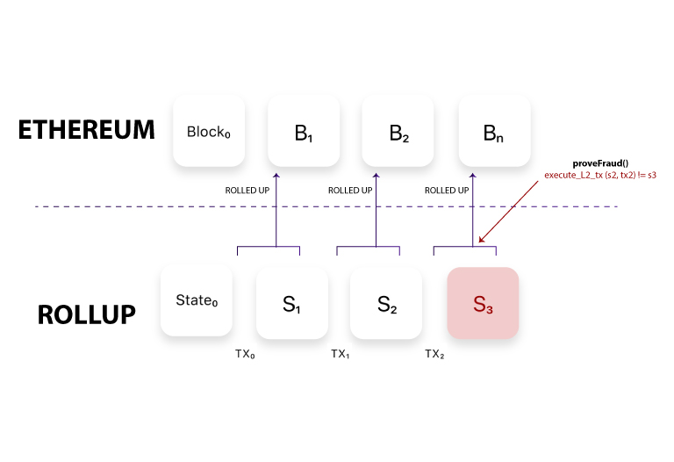
Applications of ZK
Blockchain
Notes:
Change applications to suit CRYPTO

Slide 7
Applications of ZK
Blockchain
Notes:
Change applications to suit CRYPTO

Slide 8
Applications of ZK
Machine Learning
Program Analysis
[FDNZ21]
And more
zkMiddlebox[GAZBW21]
DECO [ZMMGJ20]
zkDT [ZFZS20]
…
Mystique [WYXKW21]
zkCNN [LXZ21]
Notes:
Change applications to suit CRYPTO

Slide 9
Existing challenges
Ligero
Aurora
Virgo
Fractal
Stark
FFT
Groth16
Bulletproof
Plonk
GGPR13
PGHR13
BCGTV13
Exponentiations
Wolverin
QuickSilver
Linear proof size
Not public verifiable

Slide 10
Road to linear time succinct proofs
[Bootle17, BCG20]
$O(N^{c})$ Proof size
[Bootle17, BCG20]
𝑂(𝑁^𝑐) Proof size
[BCL22]
$O(\log^{2}{N})$
Proof size
[BCL22]
𝑂(log^2⁡𝑁)
Proof size
[GLS+]
$O(\sqrt{N})$ Proof size
[GLS+]
𝑂(√𝑁) Proof size
Boolean circuits:
[RR22], [HR22], [BCGL22]…
Notes:
Mostly theoretical results
And soundness problem

Slide 11
Our results
 | [Bootle17] | TensorIOP [BCL22] | [GLS+] | Orion
P time | $$O\left(C\right)$$ | $$O(C)$$ | $$O(C)$$ | $$O(C)$$
V time | $$O(\sqrt{C})$$ | $$O(polylog C)$$ | $$O(\sqrt{C})$$ | $$O(\log^{2}{C})$$
Soundness | $$Negl$$ | $$Negl$$ | $$\frac{1}{poly}$$ | $$Negl$$
Efficient instantiation | Unknown | Unknown | $\frac{1}{poly(C)}$ soundness | New sampling algorithm

Slide 12
Our contributions
New construction of expander code
Previous constructions are either not practical or has non-negligible failure probability
Achieves cryptographic level successful probability 1 – negl(n)
Efficient proof from expander code
Further reduce the verification cost (and proof size) from $\sqrt{N}$ to $\log{N}$
Notes:
Make it simpler and highlevel to understand

Slide 13
Previous works
 | libSNARK | Ligero | [Bootle17] | Hyrax | STARK | TensorIOP [BCL21] | Libra | Virgo
P time | $$O(C\log^{2}{C})$$ | $$O(C\log{C})$$ | $$O\left(C\right)$$ | $$O(C\log{C})$$ | $$O(C\log^{2}{C})$$ | $$O(C)$$ | $$O(C+n log n)$$ | $$O(C+n\log{n})$$
V time | $$O(1)$$ | $$O(C)$$ | $$O(\sqrt{C})$$ | $$O(\sqrt{n}+d\log{C})$$ | $$O(\log^{2}{C})$$ | $$O(polylog C)$$ | $$O(d\log{C})$$ | $$O(d\log{C}+\log^{2}{n})$$
Proof size | $$O(1)$$ | $$O(\sqrt{C})$$ | $$O(\sqrt{C})$$ | $$O(\sqrt{n}+d\log{C})$$ | $$O(\log^{2}{C})$$ | $$O(polylog C)$$ | $$O(d\log{C})$$ | $$O(d\log{C}+\log^{2}{n})$$
Trusted setup | Each statement | No | No | No | No | No | Universal | No

Slide 14
Our contribution
 | libSNARK | Ligero | [Bootle17] | Hyrax | STARK | TensorIOP [BCL21] | Libra | Virgo | Orion
P time | $$O(C\log^{2}{C})$$ | $$O(C\log{C})$$ | $$O\left(C\right)$$ | $$O(C\log{C})$$ | $$O(C\log^{2}{C})$$ | $$O(C)$$ | $$O(C+n log n)$$ | $$O(C+n\log{n})$$ | $$O(C)$$
V time | $$O(1)$$ | $$O(C)$$ | $$O(\sqrt{C})$$ | $$O(\sqrt{n}+d\log{C})$$ | $$O(\log^{2}{C})$$ | $$O(polylog C)$$ | $$O(d\log{C})$$ | $$O(d\log{C}+\log^{2}{n})$$ | $$O(\log^{2}{C})$$
Proof size | $$O(1)$$ | $$O(\sqrt{C})$$ | $$O(\sqrt{C})$$ | $$O(\sqrt{n}+d\log{C})$$ | $$O(\log^{2}{C})$$ | $$O(polylog C)$$ | $$O(d\log{C})$$ | $$O(d\log{C}+\log^{2}{n})$$ | $$O(\log^{2}{C})$$
Trusted setup | Each statement | No | No | No | No | No | Universal | No | No

Slide 15
Technical

Slide 16
Technical Outline
Linear time encodable error-correction code
Efficient ZKP from:
Expander code + Non-black-box proof composition: code-switching [RR19]

Slide 17
Technical Outline
Linear time encodable error-correction code
Efficient ZKP from:
Expander code + Non-black-box proof composition: code-switching [RR19]

Slide 18
Why do we need error-correction code?
Step 1: parse witness into a matrix

Slide 19
Why do we need error-correction code?
$$E_{C}(col_{i}= )$$
Step 2: encode coefficient matrix row-wise and column-wise using error-correction code
Step 3: Hash the matrix using Merkle tree
$$E_{C}(row_{i})$$

Slide 20
Why do we need error-correction code?
Interleaved code check
Random linear combination
Check valid codeword

Slide 21
Why do we need error-correction code?
Interleaved code check

Slide 22
Why do we need error-correction code?
Interleaved code check
Reed-Solomon code
Requires FFT

Slide 23
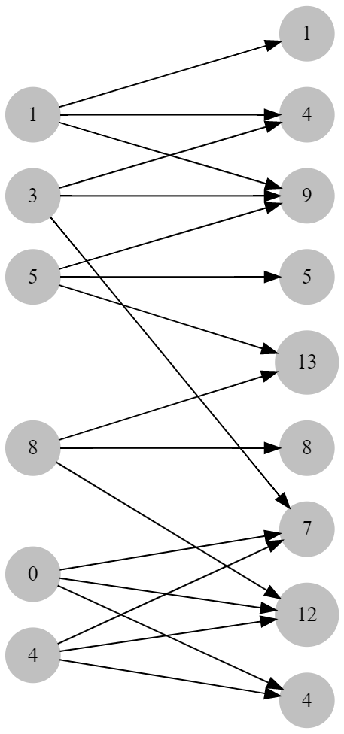
Error-correction code from expanders
[Spi96, DI14,GLS+21] Proposed ECC from expanders
$$Output[i]=\sum_{\left(i,j\right)∈E}{Input[j]}$$

Slide 24
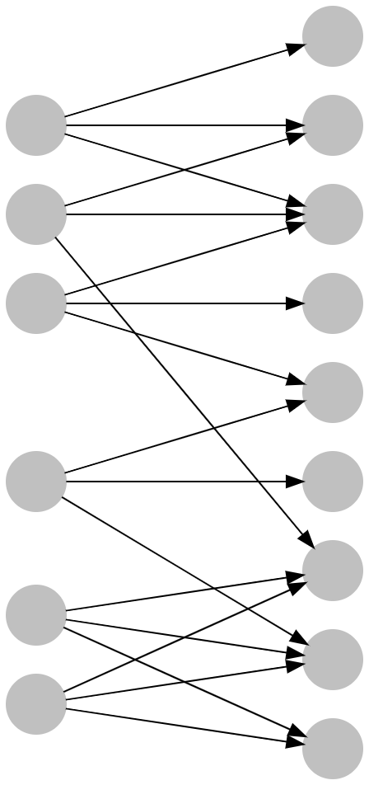
What is expander
Bipartite Graph

Slide 25
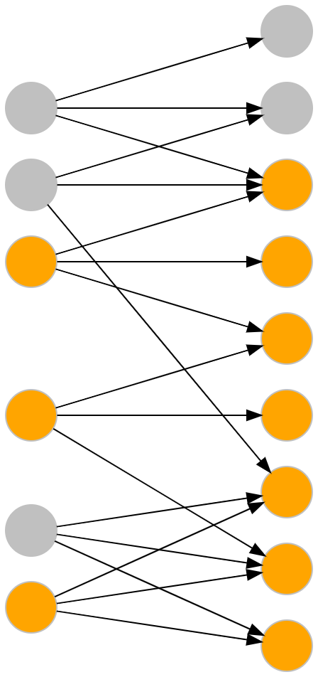
What is expander
Bipartite Graph
Expansion

Slide 26
Explicit construction?
Explicit algorithm [CRVW02]:
Large constants
Parameters are not practical

Slide 27
Random expander generation [HLW06]
A expander graph can be generated via random bipartite graph
Uniformly at random sample a bipartite graph
The probability of being a lossless expander is $\frac{1}{poly(N)}$

Slide 28
Our technique
Testing algorithm for random graph
based on Densest-subgraph algorithm
HLW06
Soundness: $\frac{1}{poly(N)}$
Ours
Soundness: $Negl$

Slide 29
Examples
Correct expander
Incorrect expander
Notes:
Mention densest sub-graph algorithm here

Slide 30
Examples
Correct expander
Incorrect expander
Density: 9/(3+8)
Density: 6/(2+3)
Notes:
Mention densest sub-graph algorithm here

Slide 31
Expander distinguisher
What does “expansion” imply for left-regular bipartite graph?
Edge-vertex ratio is LOW: $ratio=\frac{g|G′|}{\left|G^{′}\right|+Γ(|G′|)}≤\frac{g}{1+\left(1−ε\right)g}$
We can use max-density sub-graph algorithm to test expander graph!

Slide 32
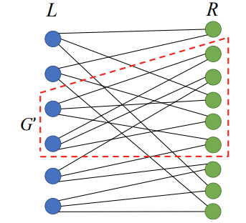
Expander graph
[Lossless expander] A bipartite graph $G=\left(L, R, E\right)$ with following properties:
Degree: The degree of every vertex is a constant $g$
Expansion: for every $G^{′}⊆L, \left|G^{′}\right|<c|L|$, the neighbor set $Γ(G′)$ must be large enough: $\left|Γ\left(G^{′}\right)\right|≥\left(1−ε\right)g|G′|$

Slide 33
Our testing algorithm
Due to special requirement of our expander graph
Sub-sample a subset of $L^{′}⊂L$ , $\left|L^{′}\right|=c|L|$
Test if there is a dense graph on the induced graph of $L′$
Repeat process above for sufficiently times

Slide 34
Sample a lossless expander
Randomly generate a bipartite graph
Run our tester to check if it’s a lossless expander
If Yes, great! We are done.
If No, try a new random graph and repeat

Slide 35
Technical Outline
Expander sampling/testing algorithm
Efficient ZKP from:
Expander code + Non-black-box proof composition: code-switching [RR19]

Slide 36
Polynomial commitment
A polynomial commitment consists three algorithms:
$Commit\left(f\left(∗\right)\right)→R$: the algorithm outputs a digest of polynomial $f\left(∗\right)$
$Prove\left(f, x,R\right)→π,y:$ given query $x$, it will output an evaluation result $y$ and the corresponding proof $π$
$Verify\left(π, x, y,R\right)→0/1$: Given the proof $π$ and the commitment $R$, verify $y=f(x)$, where $f(∗)$ is consistent with $R$
Notes:
Do not mention pc
Mention only the check need to open one row/several columns
Then use CW to recursively open rows/cols

Slide 37
ZKP from (multi-variate) polynomial commitment
“Efficient” polynomial commitment is sufficient to construct “efficient” ZKP
Ligero
Stark
Virgo
Spartan
etc.

Slide 38
Encode phase
Step 1: parse witness into a matrix

Slide 39
Encode phase
$$E_{C}(col_{i}= )$$
Step 2: encode coefficient matrix row-wise and column-wise using expander code
Step 3: Hash the matrix using Merkle tree
$$E_{C}(row_{i})$$

Slide 40
Prove the query $x=(x_{0},x_{1})$
$$E_{C}(col_{i}= )$$
$$E_{C}(row_{i})$$
Query $f\left(x\right)=⟨c,x_{0}⊗x_{1}⟩$
Fold $w$ into
Fold
$$E_{C}(y_{1}= )$$
$$=⟨x_{0},\vec{}⟩$$

Slide 41
Prove the query $x=(x_{0},x_{1})$
$$E_{C}(col_{i}= )$$
$$E_{C}(row_{i})$$
$y=⟨y_{1},x_{1}⟩$
Fold
$$E_{C}(y_{1}= )$$
$$=⟨x_{0},\vec{}⟩$$

Slide 42
Verify the query $r=r_{0}⊗r_{1}$
$$E_{C}(col_{i}= )$$
$$E_{C}(row_{i})$$
Fold
$$E_{C}(y_{1}= )$$
$$=⟨r_{0},\vec{}⟩$$
Check 1:
Check 2: $\vec{}=E_{C}(\vec{})$
Check 3: $y=⟨y_{1},r_{1}⟩$
Check 4: ${=E}_{C}\left(\vec{}\right)$

Slide 43
Cost of the verification
$$E_{C}(col_{i}= )$$
$$E_{C}(row_{i})$$
Fold
$$E_{C}(y_{1}= )$$
$$=⟨r_{0},\vec{}⟩$$
Check 1: $O(\sqrt{N})$
Check 2: $\vec{}=E_{C}(\vec{})$ $O(\sqrt{N})$
Check 3: $y=⟨y_{1},r_{1}⟩$ $O(\sqrt{N})$
Check 4: ${=E}_{C}\left(\vec{}\right)$ $O(\sqrt{N})$

Slide 44
Code-Switching
$$E_{C}(col_{i}= )$$
$$E_{C}(row_{i})$$
Input:
Encoding Circuit
$$E_{C}$$
Inner product circuit
Fold
$$E_{C}(y_{1}= )$$
Codeword
$$=⟨r_{0},\vec{}⟩$$
Code-Switch
Check 1: $O(\sqrt{N})$
Check 2: $\vec{}=E_{C}(\vec{})$ $O(\sqrt{N})$
Check 3: $y=⟨y_{1},r_{1}⟩$ $O(\sqrt{N})$
Check 4: ${=E}_{C}\left(\vec{}\right)$ $O(\sqrt{N})$

Slide 45
Code-Switching
$$E_{C}(col_{i}= )$$
$$E_{C}(row_{i})$$
Input:
Encoding Circuit
$$E_{C}$$
Inner product circuit
Check consistency on few outputs
Fold
$$E_{C}(y_{1}= )$$
Codeword
$$=⟨r_{0},\vec{}⟩$$
Code-Switch
Check 1:
Check 2: $\vec{}=E_{C}(\vec{})$
Check 3: $y=⟨y_{1},r_{1}⟩$
Check 4: ${=E}_{C}\left(\vec{}\right)$
Random selector $I$
Final output
Size $O(λ)$:

Slide 46
Experiments

Slide 47
Experimental results
$$10x$$
Notes:
Hightlight comparison with Brakedown
Comparable prover time
Much smaller proof size
Negl probability
ADD More than 10x

Slide 48
Experimental results
Notes:
IOP systems
Plausibly Post Quantum secure
No trusted setup
Proof size is ok

Slide 49
Summary
Linear time encodable linear code
From secure expander sampling
Non-black-box proof composition
From code-switching [RR19]
Code: https://github.com/sunblaze-ucb/Orion
Paper: https://eprint.iacr.org/2022/1010
49

Slide 50
Comparison across different schemes
BCGTV13/PGHR13/GROTH16
Early ZKP with trusted setups

Slide 51
Comparison across different schemes
BCGTV13/PGHR13/GROTH16
Early ZKP with trusted setups
STARK/Ligero/Hyrax/Virgo
ZKP without trusted setups

Slide 52
Our contribution
BCGTV13/PGHR13/GROTH16
Early ZKP with trusted setups
STARK/Ligero/Hyrax/Virgo
ZKP without trusted setups
Quasi-Linear proof generation
Orion
Linear time proof generation
$O(\log^{2}{N})$ proof size
Secure error-correction code instantiation

