Slide 1
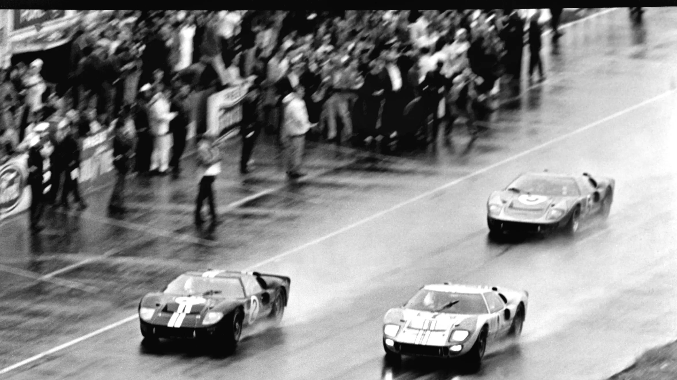
Le Mans: Dynamic and Fluid MPC for Dishonest Majority
CRYPTO 2022
Rahul Rachuri
Peter Scholl

Slide 2
Secure Multi-Party Computation
a
b
c
d
Goal: Securely compute $f(a,b,c,d)$
$f :Z_{p}^{n}×…Z_{p}^{n} → Z_{p}$, large $p$

Slide 3
MPC with Dynamic Participants: Why?
Flexibility
Hard to be online for long computations
Drop outs
Security
Moving target
E.g. YOSO model [GHHMNRY 21]
(“you only speak once”)

Slide 4
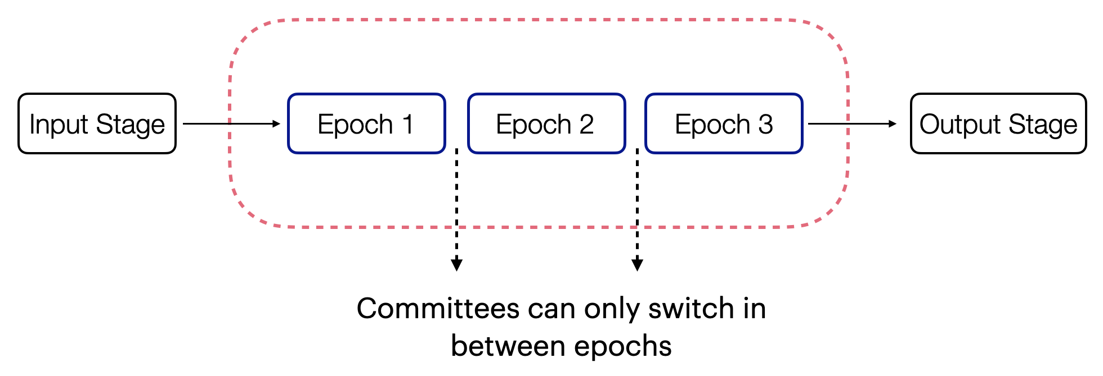
Fluid MPC Model [CGG+ 20]
Computation proceeds in epochs
Honest majority in every committee

Slide 5
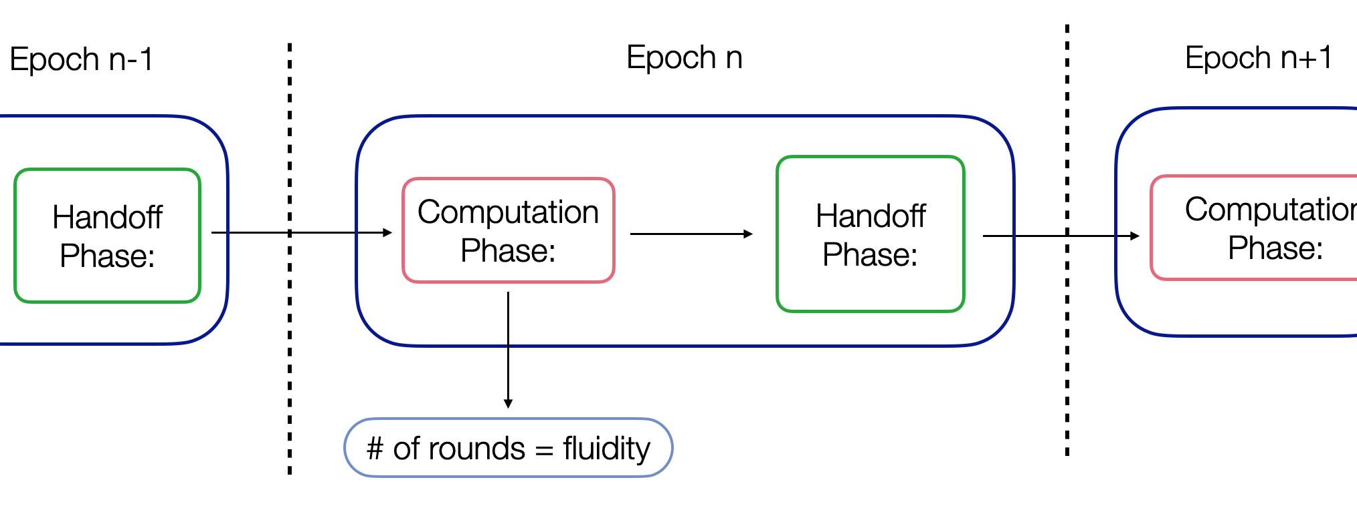
Fluid MPC Model [CGG+ 20]
One epoch: computation phase and handoff phase

Slide 6
Highlights of Fluid MPC [CGG+ 20]
Active security (w/ abort) if every committee has an honest majority
Small state complexity
Maximally fluid:
no restriction in # rounds of participation

Slide 7
Le Mans: Fluid MPC for Dishonest Majority
Preprocessing phase
(all parties)
Epoch 1
Epoch 2
Epoch 3
Online phase
(evolving committees)
Committee in epoch $i$ must be fixed before end of $i−1$
Security: at least one honest party in every committee

Slide 8
Le Mans: Fluid MPC for Dishonest Majority
Epoch 1
Epoch 2
Epoch 3
Preprocessing
(all parties)
Online phase
Committee in epoch $i$ must be fixed before end of $i−1$
Security: at least one honest party in every committee

Slide 9
Le Mans: Two Variants of SPDZ [DPSZ12]
[RS 22]
Dynamic SPDZ
One online committee
Any subset from preprocessing
More practical
Fluid SPDZ
Evolving online committees
Maximally fluid (epoch can be one round)
Lowest communication of any SPDZ-like preprocessing
Even without dynamicity!
Silent, universal preprocessing
Using PCGs [BCGIKS 20]

Slide 10
MPC with Preprocessing
[Beaver ’91]
Preprocessing
Correlated randomness
$$x$$
$$y$$
Online phase
$$f(x,y)$$

Slide 11
MPC with Silent Preprocessing
[BCGI 18, BCGIKS 19]
Preprocessing
Correlated, short seeds
Using pseudorandom
correlation generators
Silent
expansion
Correlated pseudorandomness
Online phase
$$x$$
$$y$$
$$f(x,y)$$

Slide 12
Universal Preprocessing in Le Mans
Goal: $n$-party preprocessing $⇒$ $m$-party preprocessing for any $m<n$
without interaction
Challenge:
Triples are tied to a fixed set of parties
[SSW17]: reshare triples between committees
$O(N)$ communication for $N$ triples ☹

Slide 13
Universal Preprocessing: Passive Security
$n$-party Beaver triples $\left[a\right],\left[b\right],[c]$
$$\sum_{i}{c_{i}=}c=a⋅b=\left(\sum_{i}{a_{i}}\right)⋅\left(\sum_{j}{b_{j}}\right)$$
$=\sum_{i}{\sum_{j}{a_{i}⋅b_{j}}}$
Store shares $[a_{i}b_{j}]$ for all $i,j$
Allows computing triple for any subset of $m<n$ parties
Make silent: gen. $[a_{i}b_{j}]$ pseudorandomly with 2-party PCG [BCGIKS 20]
Needs to be consistent with $\left[a_{i}b_{k}\right]…$

Slide 14
Universal Preprocessing: Active Security
Authenticated triples $\left[a\right],\left[b\right],\left[c\right],\left[Δa\right],\left[Δb\right],[Δc]$
$Δ$: secret-shared MAC key [DPSZ 12]
Problem:
$Δc=\sum_{i}{Δ_{i}}\sum_{j}{a_{j}}\sum_{k}{b_{k}}$
$n^{3}$ cross-terms $α_{i}a_{j}b_{k}$: expensive
Solution:
Forget about $[Δc]$!
Partially authenticated triples

Slide 15
Dynamic SPDZ: Overview
Sample $a_{i},b_{i}$
Share $\left[a_{i}b_{j}\right],\left[Δ_{i}a_{j}\right], [Δ_{i}b_{j}]$
$$\left[a\right]$$
$$\left[b\right]$$
$$[c]$$
$$\left[Δa\right]$$
$$\left[Δb\right]$$
$$\left[a\right]$$
$$\left[b\right]$$
$$[c]$$
$$\left[Δa\right]$$
$$\left[Δb\right]$$
$$\left[Δc\right]$$
Eval circuit
+ check
Correctness check:
Randomized evaluation [CGH+ 18]
Cost: $≈3×$ standard SPDZ online protocol

Slide 16
Fluid SPDZ: Changing Committees in the Online Phase
Challenges:
Small state
Consistency of MAC keys
Ingredients:
Incremental MAC check and circuit verification
MAC key switching protocol
Maximally fluid
multiplication protocol

Slide 17
MAC key switching in Fluid SPDZ
With one message?
$$\left[x\right], [Δ_{A}x]$$
$$\left[x\right], [Δ_{B}x]$$
Preprocessing:
$$[Δ_{A}]$$
$[r]$ +
MAC* wrt $Δ_{B}$
$$[Δ_{B}]$$
Online:
Reshare $[x]$
Send $x+r$
(+ MACs)
$$\left[x\right], [Δ_{B}x]$$

Slide 18
Efficiency Comparison ($n$ parties, circuit $C$)
Protocol | Online comm. | Prep. Comm. | Storage
SPDZ [KPR 18] | 2$|C|$ | $$O(n\left|C\right|)$$ | $$O(\left|C\right|)$$
SPDZ/Le Mans hybrid [RS 22] | 2$|C|$ | $$O(\left|C\right|+n log\left|C\right|)$$ | $$O(\left|C\right|)$$
[BGIN 22] | 2$|C|$ | $$O(n√|C)|$$ | $$O(n√|C)|$$
Dynamic SPDZ [RS 22] | $$6|C|$$ | $$O(n log \left|C\right|)$$ | $$O(n log \left|C\right|)$$
Costs are field elements per-party

Slide 19
Efficiency Comparison ($n$ parties, circuit $C$)
Protocol | Online comm. | Prep. Comm. | Storage
SPDZ [KPR 18] | 2$|C|$ | $$O(n\left|C\right|)$$ | $$O(\left|C\right|)$$
Costs are field elements per-party

Slide 20
Efficiency Comparison ($n$ parties, circuit $C$)
Protocol | Online comm. | Prep. Comm. | Storage
SPDZ [KPR 18] | 2$|C|$ | $$O(n\left|C\right|)$$ | $$O(\left|C\right|)$$
Dynamic SPDZ [RS 22] | $$6|C|$$ | $$O(n log \left|C\right|)$$ | $$O(n log \left|C\right|)$$
Costs are field elements per-party

Slide 21
Efficiency Comparison ($n$ parties, circuit $C$)
Protocol | Online comm. | Prep. Comm. | Storage
SPDZ [KPR 18] | 2$|C|$ | $$O(n\left|C\right|)$$ | $$O(\left|C\right|)$$
Dynamic SPDZ [RS 22] | $$6|C|$$ | $$O(n log \left|C\right|)$$ | $$O(n log \left|C\right|)$$
Fluid SPDZ [RS 22] | $$O(\left|C\right|)$$ | $$O(n log \left|C\right|)$$ | $$O(n log \left|C\right|)$$
Costs are field elements per-party

Slide 22
Le Mans: Dynamic and Fluid MPC for Dishonest Majority
https://eprint.iacr.org/2021/1579
Thank you!
Dynamic SPDZ
One online committee
Any subset from preprocessing
More practical
Fluid SPDZ
Evolving online committees
Maximally fluid (epoch can be one round)

