Slide 1



Authentication in the Bounded Storage Model
Yevgeniy Dodis Willy Quach Daniel Wichs
New York University
Northeastern University
Northeastern University
NTT Reseach
EUROCRYPT 2022

Slide 2



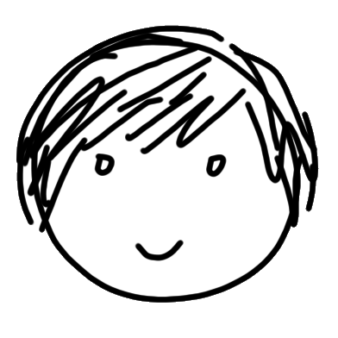


Cryptography 101: Secure Communication
Without restriction on adversaries, $\left|key\right|≥|message|$ [Shannon49]
  Key can only be reused a few times
  Public-key setting impossible
Secrecy: message is hidden from Eve
Eve
Alice
Bob
Authenticity: Bob is convinced message comes from Alice (and not from Eve)
Hello!

Slide 3
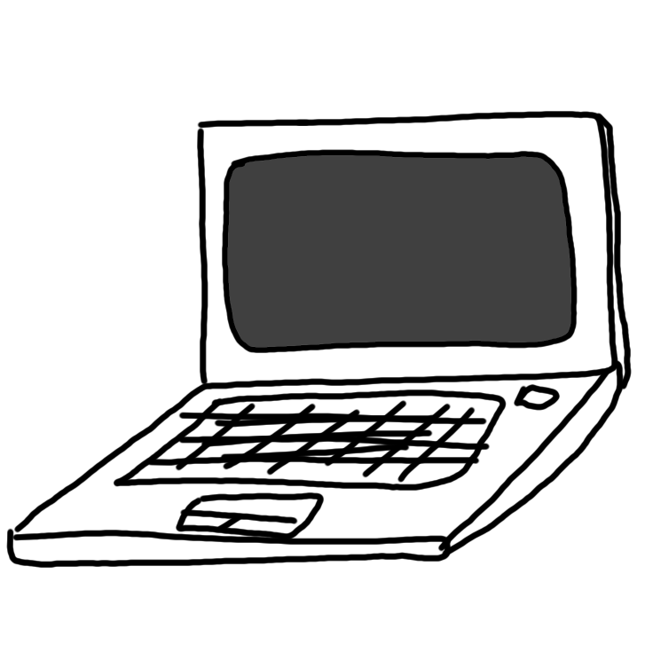

Cryptography 101: Secure Communication
Without restriction on adversaries, $\left|key\right|≥|message|$ [Shannon49]
Restrict to efficient adversaries: typically polynomial run-time
Requires computational assumptions: at least $P≠NP$
Secrecy: message is hidden from Eve
Eve
Alice
Bob
Authenticity: Bob is convinced message comes from Alice (and not from Eve)
Hello!
« Cryptographers seldom sleep well »

Slide 4
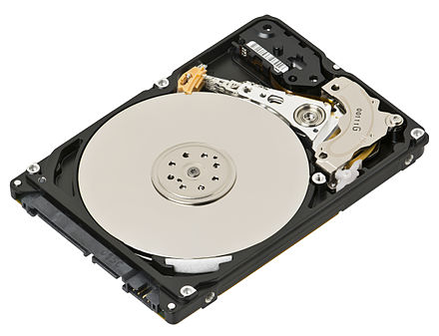

The Bounded Storage Model (BSM) [Maurer92]
Alternative assumption on adversaries: limited memory
  No restriction on runtime of adversaries
  Honest users use much less memory than the adversary $≪$
Surprisingly, unconditional security for many primitives in that model!
Secrecy: message is hidden from Eve
Eve
Alice
Bob
Authenticity: Bob is convinced message comes from Alice (and not from Eve)
Hello!

Slide 5
The Bounded Storage Model (BSM) [Maurer92]
Blah
Alternative assumption on adversaries: limited memory
  No restriction on runtime of adversaries
  Honest users use much less memory than the adversary $≪$
Surprisingly, unconditional security for many primitives in that model!
Blah
Secrecy: message is hidden from Eve
Blah
Eve
Alice
Bob
Authenticity: Bob is convinced message comes from Alice (and not from Eve)
Blah
Blah
Blah

Slide 6

The Bounded Storage Model (BSM) [Maurer92]
???
Blah
Alternative assumption on adversaries: limited memory
  No restriction on runtime of adversaries
  Honest users use much less memory than the adversary $≪$
Surprisingly, unconditional security for many primitives in that model!
Blah
Secrecy: message is hidden from Eve
Blah
Eve
Alice
Bob
Authenticity: Bob is convinced message comes from Alice (and not from Eve)
Blah
Blah
Blah
Blah
Blah
Blah
Blah
Blah
Blah

Slide 7

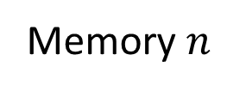
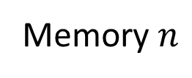
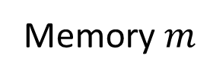
The (Streaming) BSM [Raz16,GuanZhandry19,DodisQuachWichs21]
Memory $m$
Users stream their messages
  Messages are possibly long, of size $≫n$
  Generated and processed using memory $n$
Adversary has memory $m≫n$, and unbounded runtime
Memory $n$
Memory $n$
Blah…Blah…Blah…Blah…

Slide 8
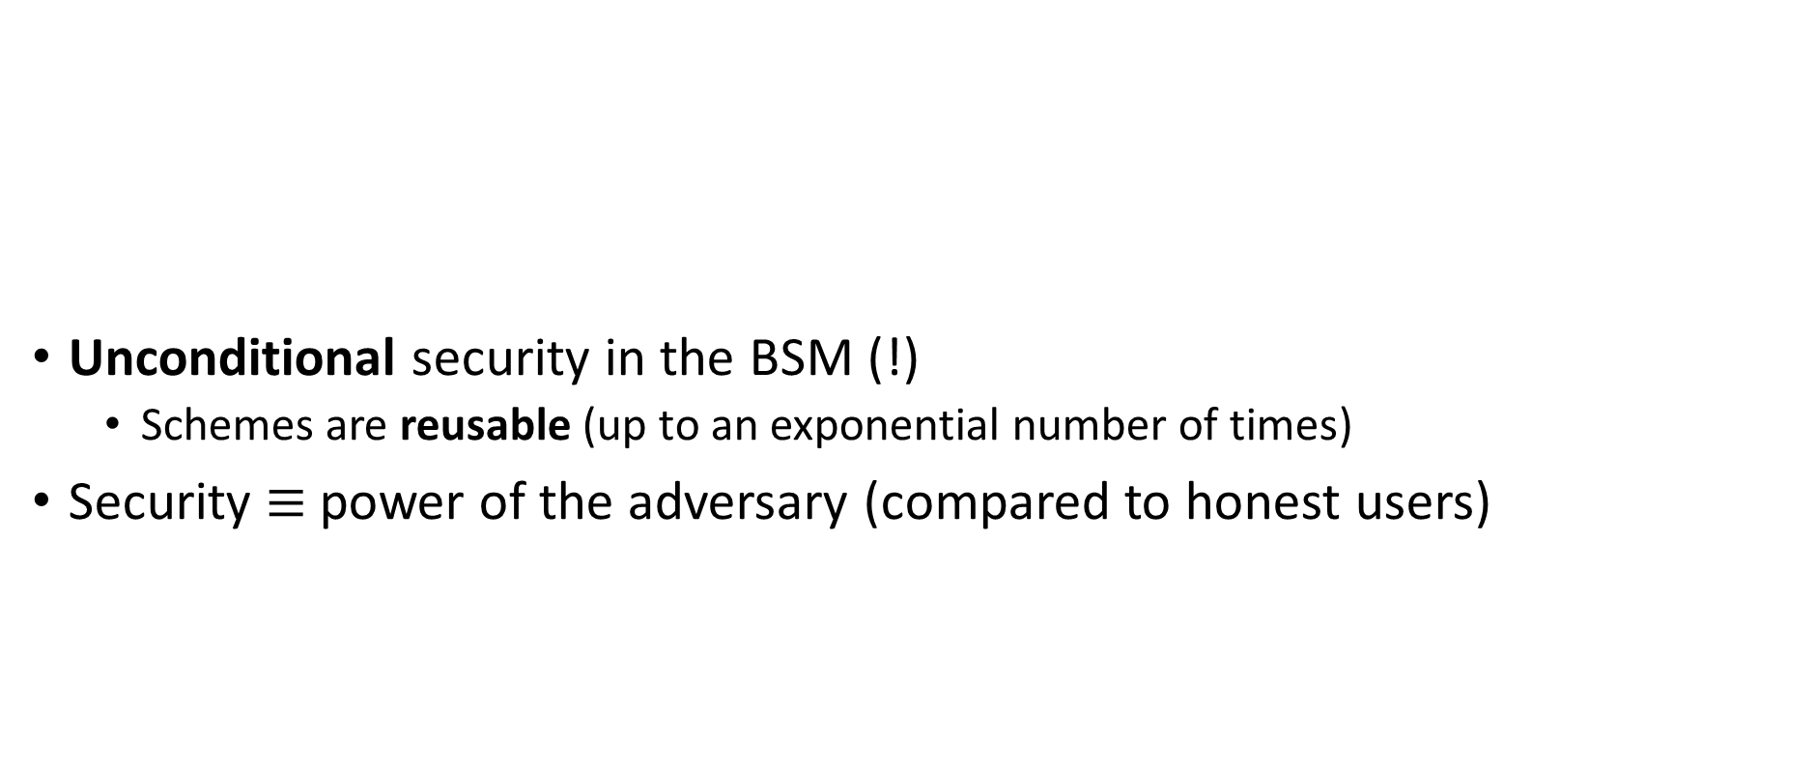
Prior Work in the BSM
 | Adversary/Honest Memory Gap
Symmetric-Key Encryption
Key Agreement (!)
Oblivious Transfer, MPC
Unconditional security in the BSM (!)
  Schemes are reusable (up to an exponential number of times)
Security $≡$ power of the adversary (compared to honest users)
✓
[Maurer92,…,Vadhan04,Raz16]
✓
[Cachin-Maurer97,…,
Guan-Zhandry19]
✓

Slide 9
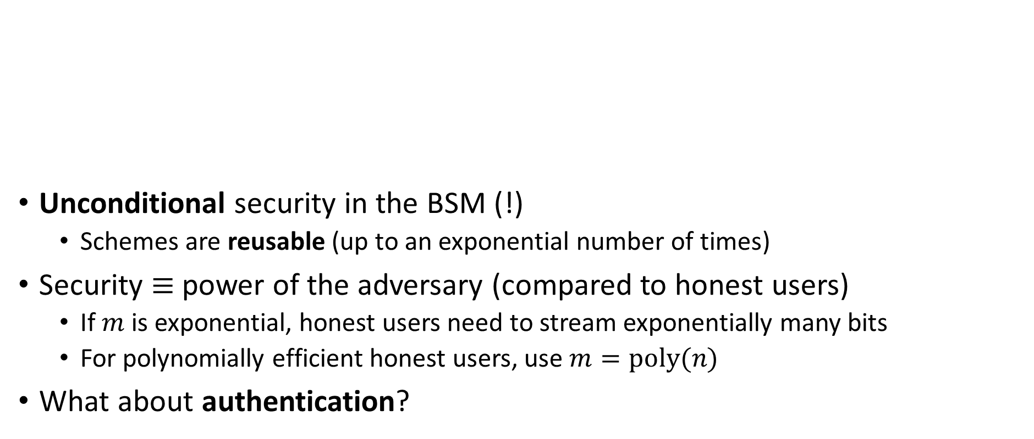
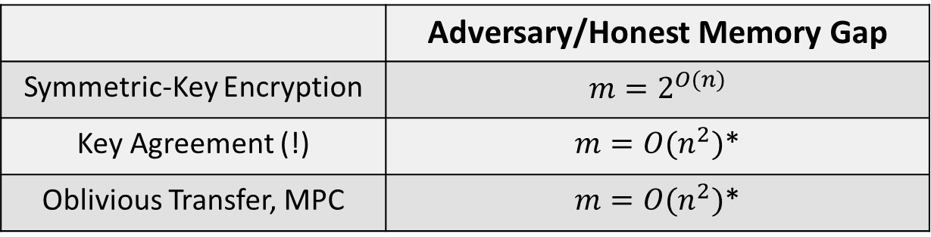
Prior Work in the BSM
 | Adversary/Honest Memory Gap
Symmetric-Key Encryption | $m=2^{O(n)}$
Key Agreement (!) | $m={O(n}^{2})$*
Oblivious Transfer, MPC | $m={O(n}^{2})$*
Unconditional security in the BSM (!)
  Schemes are reusable (up to an exponential number of times)
Security $≡$ power of the adversary (compared to honest users)
  If $m$ is exponential, honest users need to stream exponentially many bits
  For polynomially efficient honest users, use $m=poly(n)$
What about authentication?
[Maurer92,…,Vadhan04,Raz16]
[Cachin-Maurer97,…,
Guan-Zhandry19]
*Can make gap exponential at the cost of much larger communication and interaction [DQW21]

Slide 10
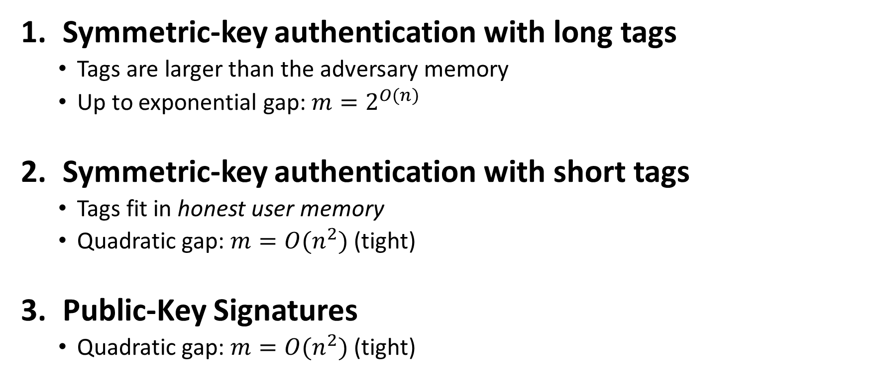
Our Results: Authentication in the BSM
Symmetric-key authentication with long tags
  Tags are larger than the adversary memory
  Up to exponential gap: $m=2^{O(n)}$
Symmetric-key authentication with short tags
  Tags fit in honest user memory
  Quadratic gap: $m=O(n^{2})$ (tight)
Public-Key Signatures
  Quadratic gap: $m=O(n^{2})$ (tight)
All schemes have unconditional security
and are reusable

Slide 11
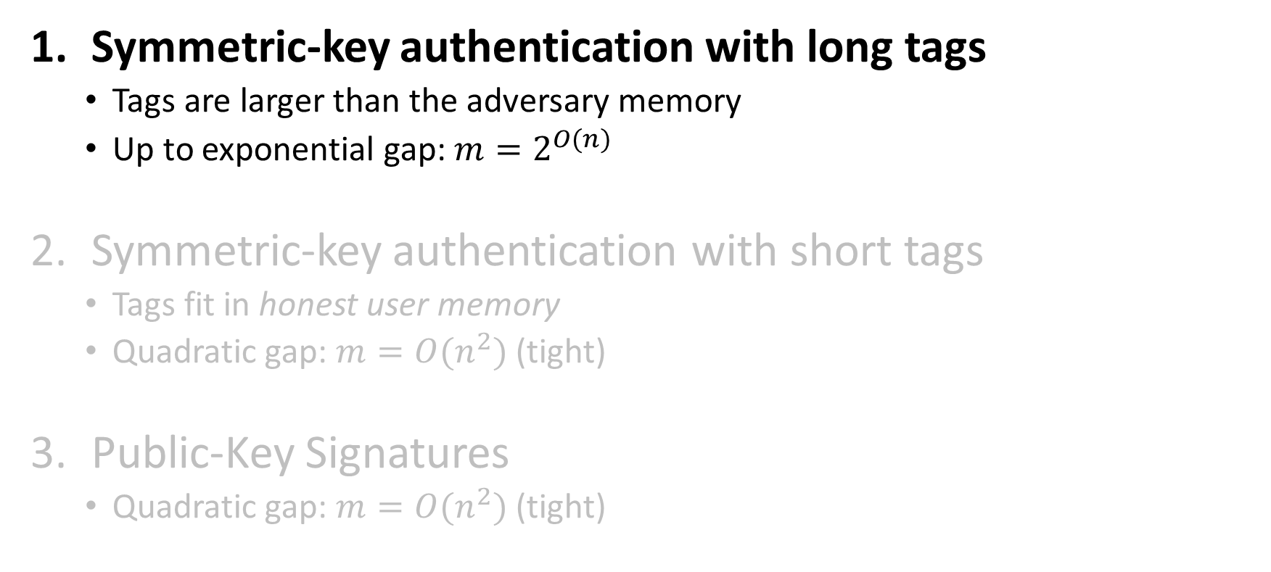
Our Results: Authentication in the BSM
Symmetric-key authentication with long tags
  Tags are larger than the adversary memory
  Up to exponential gap: $m=2^{O(n)}$
Symmetric-key authentication with short tags
  Tags fit in honest user memory
  Quadratic gap: $m=O(n^{2})$ (tight)
Public-Key Signatures
  Quadratic gap: $m=O(n^{2})$ (tight)
All schemes have unconditional security
and are reusable

Slide 12


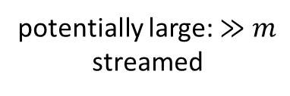


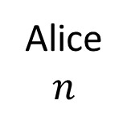
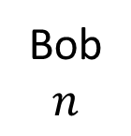
Symmetric-Key Authentication (MACs) in the BSM
Correctness: Bob accepts messages authenticated by Alice
Alice
$$n$$
Bob
$$n$$
✓
potentially large: $≫m$
streamed
$$sk$$
$$sk$$

Slide 13
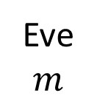
Symmetric-Key Authentication (MACs) in the BSM
Eve
$$m$$
Correctness: Bob accepts messages authenticated by Alice
Unforgeability:
Alice
$$n$$
Bob
$$n$$
✓
potentially large: $≫m$
streamed
$$sk$$
$$sk$$

Slide 14
Symmetric-Key Authentication (MACs) in the BSM
Eve
$$m$$
Correctness: Bob accepts messages authenticated by Alice
Unforgeability:
  Reusability: Eve can see arbitrarily many authentications
Alice
$$n$$
Bob
$$n$$
✓
potentially large: $≫m$
streamed
$$sk$$
$$sk$$

Slide 15
Symmetric-Key Authentication (MACs) in the BSM
Eve
$$m$$
Correctness: Bob accepts messages authenticated by Alice
Unforgeability:
  Reusability: Eve can see arbitrarily many authentications
Alice
$$n$$
Bob
$$n$$
✓
potentially large: $≫m$
streamed
$$sk$$
$$sk$$

Slide 16
Symmetric-Key Authentication (MACs) in the BSM
Eve
$$m$$
Correctness: Bob accepts messages authenticated by Alice
Unforgeability:
  Reusability: Eve can see arbitrarily many authentications
Alice
$$n$$
Bob
$$n$$
✓
potentially large: $≫m$
streamed
$$sk$$
$$sk$$

Slide 17

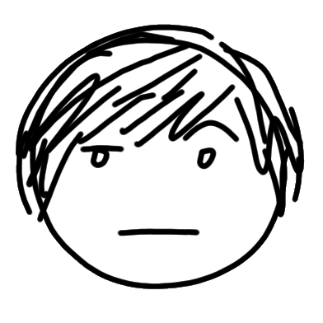
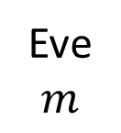
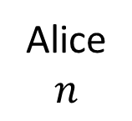
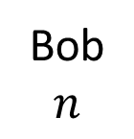
Symmetric-Key Authentication (MACs) in the BSM
Eve
$$m$$
Correctness: Bob accepts messages authenticated by Alice
Unforgeability: Eve cannot make Bob accept fake authentications
  Reusability: Eve can see arbitrarily many authentications
Alice
$$n$$
Bob
$$n$$
✗
$$sk$$
$$sk$$

Slide 18


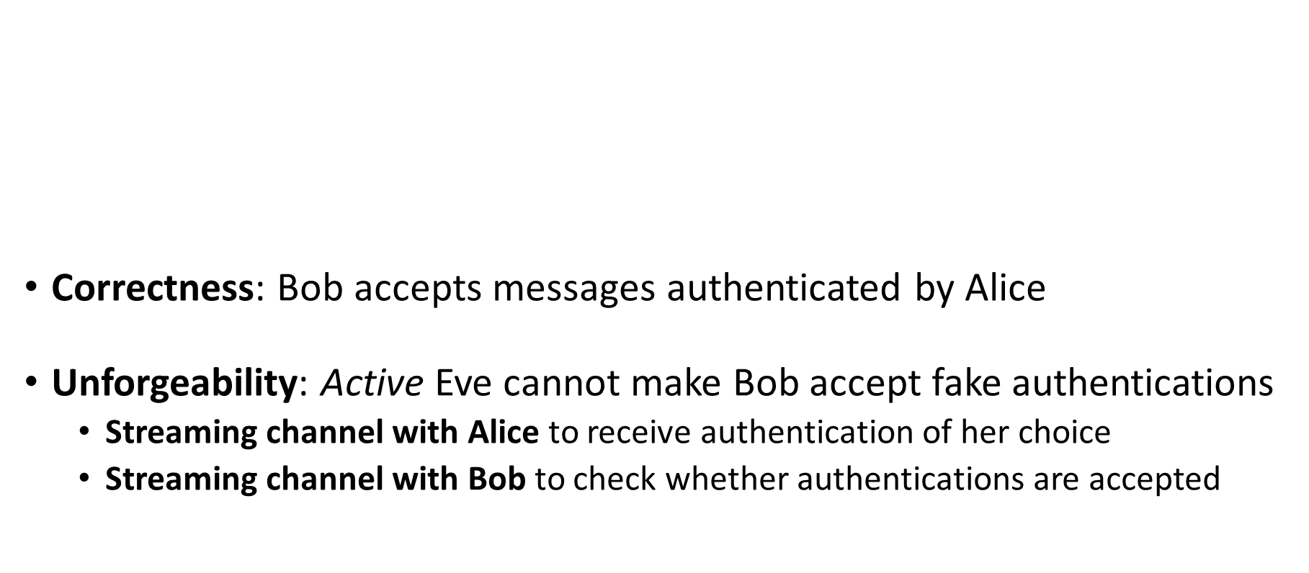
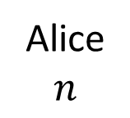
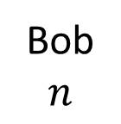
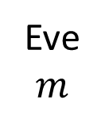
Symmetric-Key Authentication (MACs) in the BSM
Eve
$$m$$
Correctness: Bob accepts messages authenticated by Alice
Unforgeability: Active Eve cannot make Bob accept fake authentications
  Streaming channel with Alice to receive authentication of her choice
  Streaming channel with Bob to check whether authentications are accepted
  Can modify authentications on the fly (in a streaming manner, using memory $m$)
Alice
$$n$$
Bob
$$n$$
$$sk$$
$$sk$$

Slide 19
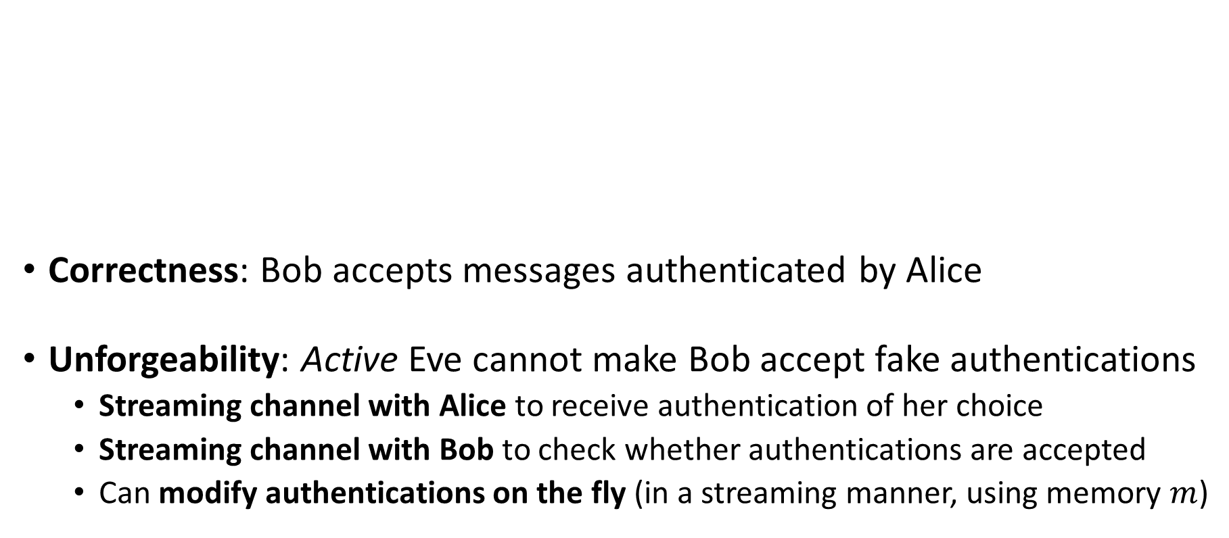
Symmetric-Key Authentication (MACs) in the BSM
Eve
$$m$$
Correctness: Bob accepts messages authenticated by Alice
Unforgeability: Active Eve cannot make Bob accept fake authentications
  Streaming channel with Alice to receive authentication of her choice
  Streaming channel with Bob to check whether authentications are accepted
  Can modify authentications on the fly (in a streaming manner, using memory $m$)
Alice
$$n$$
Bob
$$n$$
$$sk$$
$$sk$$

Slide 20
Symmetric-Key Authentication (MACs) in the BSM
Eve
$$m$$
Correctness: Bob accepts messages authenticated by Alice
Unforgeability: Active Eve cannot make Bob accept fake authentications
  Streaming channel with Alice to receive authentication of her choice
  Streaming channel with Bob to check whether authentications are accepted
  Can modify authentications on the fly (in a streaming manner, using memory $m$)
Alice
$$n$$
Bob
$$n$$
$$sk$$
$$sk$$

Slide 21

Constructing MACs with Long Tags
Eve
$$m$$
Main idea: encrypt tags of an information-theoretic one-time MAC
  Symmetric-key encryption in the BSM
Intuition for security:
Alice
$$n$$
Bob
$$n$$
$$sk$$
$$sk$$

Slide 22
Constructing MACs with Long Tags
Eve
$$m$$
Main idea: encrypt tags of an information-theoretic one-time MAC
  Symmetric-key encryption in the BSM
Intuition for security:
  If Eve passively observes authentications, security of applies
Alice
$$n$$
Bob
$$n$$
$$sk$$
$$sk$$

Slide 23
Constructing MACs with Long Tags
Eve
$$m$$
Main idea: encrypt tags of an information-theoretic one-time MAC
  Symmetric-key encryption in the BSM
Intuition for security:
  If Eve passively observes authentications, security of applies
  If Eve tries to relay one authentication to Bob, one-time MAC security applies…
    Can still hurt security of … MAC needs to authenticate the encryption too
Alice
$$n$$
Bob
$$n$$
$$sk$$
$$sk$$

Slide 24
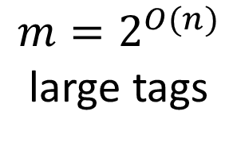
Constructing MACs with Long Tags
Eve
$$m$$
Main idea: encrypt tags of an information-theoretic one-time MAC
  Symmetric-key encryption in the BSM
Intuition for security:
  If Eve passively observes authentications, security of applies
  If Eve tries to relay one authentication to Bob, one-time MAC security applies…
    Can still hurt security of … MAC needs to authenticate the encryption too
In general Eve can delay/mix her input/output streams… Still works
Alice
$$n$$
Bob
$$n$$
$$m=2^{O(n)}$$
large tags
$$sk$$
$$sk$$

Slide 25
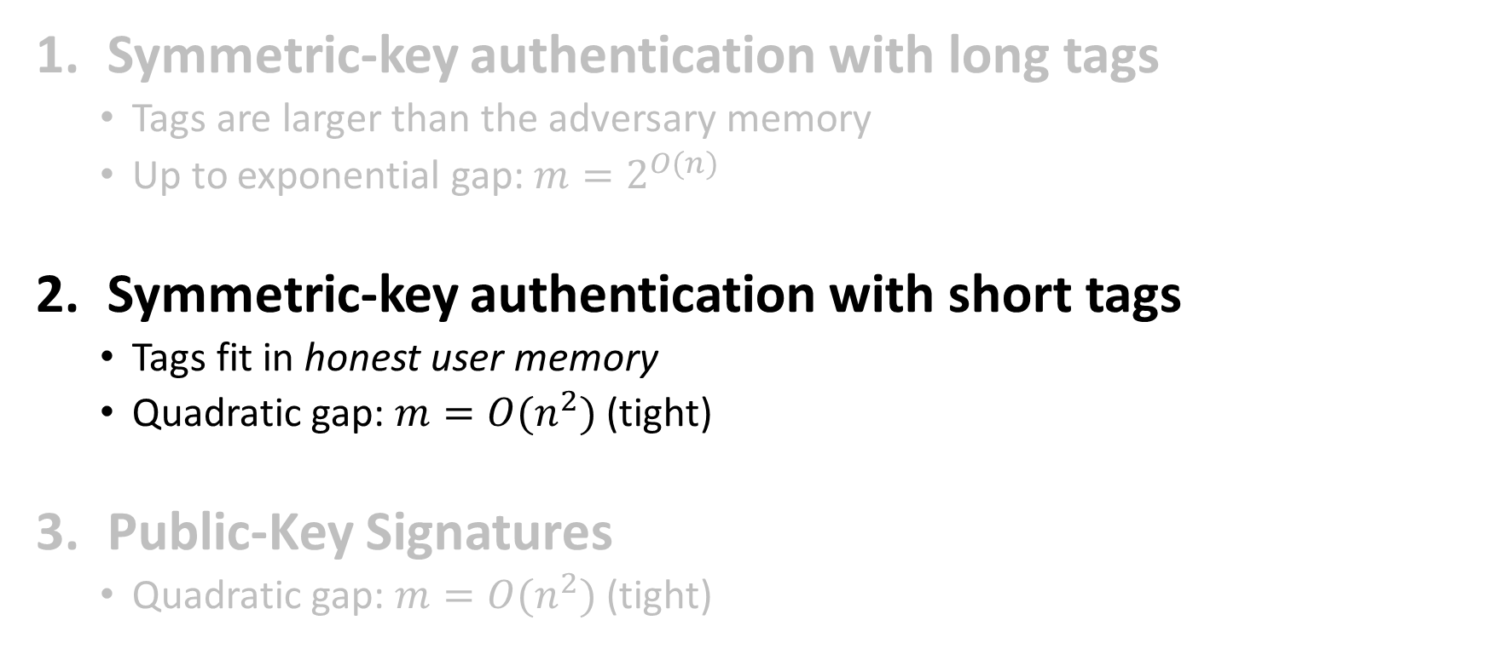
Our Results: Authentication in the BSM
Symmetric-key authentication with long tags
  Tags are larger than the adversary memory
  Up to exponential gap: $m=2^{O(n)}$
Symmetric-key authentication with short tags
  Tags fit in honest user memory
  Quadratic gap: $m=O(n^{2})$ (tight)
Public-Key Signatures
  Quadratic gap: $m=O(n^{2})$ (tight)
All schemes have unconditional security
and are reusable

Slide 26


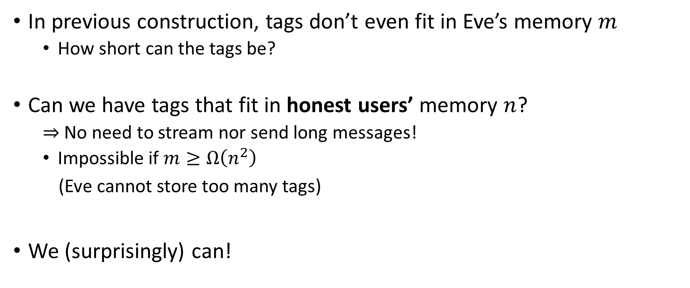
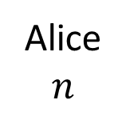

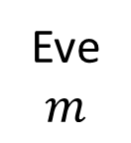

MAC with Short Tags
In previous construction, tags don’t even fit in Eve’s memory $m$
  How short can the tags be?
Can we have tags that fit in honest users’ memory $n$?
  $⇒$ No need to stream nor send long messages!
  Impossible if $m≥Ω\left(n^{2}\right)$
  (Eve cannot store too many tags)
We (surprisingly) can!
Eve
$$m$$
Alice
$$n$$
Bob
$$n$$
Small: $≤n$?
$$sk$$
$$sk$$

Slide 27

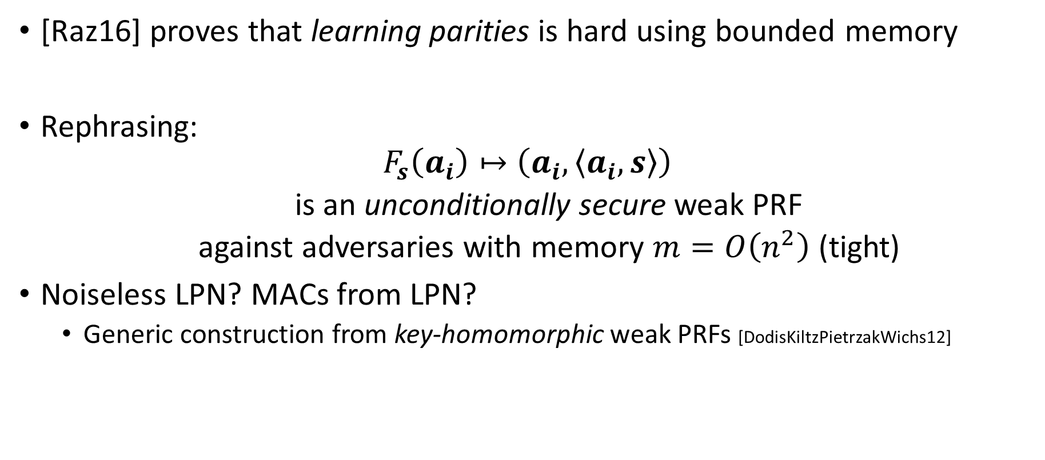
MAC with Short Tags from Raz’s Lower Bound
[Raz16] proves that learning parities is hard using bounded memory
Rephrasing:
$$F_{s}\left(a_{i}\right)↦\left(a_{i},\left\langle a_{i},s\right\rangle \right)$$
  is an unconditionally secure weak PRF
  against adversaries with memory $m=O\left(n^{2}\right)$ (tight)
Noiseless LPN? MACs from LPN?
  Generic construction from key-homomorphic weak PRFs [DodisKiltzPietrzakWichs12]
  … in the standard sense. More work required in the bounded memory setting
Gives a MAC in the BSM with short tags, where $m={O(n}^{2})$ (tight)
$${∈\left\{0,1\right\}}^{n}$$

Slide 28
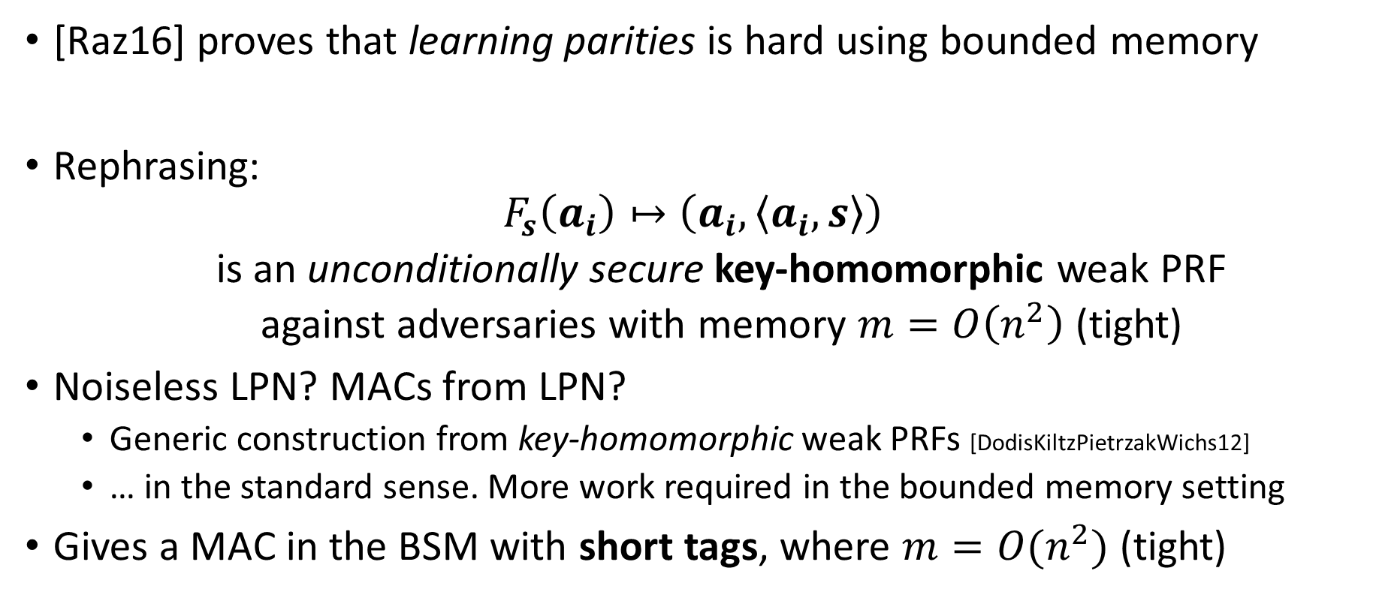
MAC with Short Tags from Raz’s Lower Bound
[Raz16] proves that learning parities is hard using bounded memory
Rephrasing:
$$F_{s}\left(a_{i}\right)↦\left(a_{i},\left\langle a_{i},s\right\rangle \right)$$
  is an unconditionally secure key-homomorphic weak PRF
  against adversaries with memory $m=O\left(n^{2}\right)$ (tight)
Noiseless LPN? MACs from LPN?
  Generic construction from key-homomorphic weak PRFs [DodisKiltzPietrzakWichs12]
  … in the standard sense. More work required in the bounded memory setting
Gives a MAC in the BSM with short tags, where $m={O(n}^{2})$ (tight)
$${∈\left\{0,1\right\}}^{n}$$

Slide 29
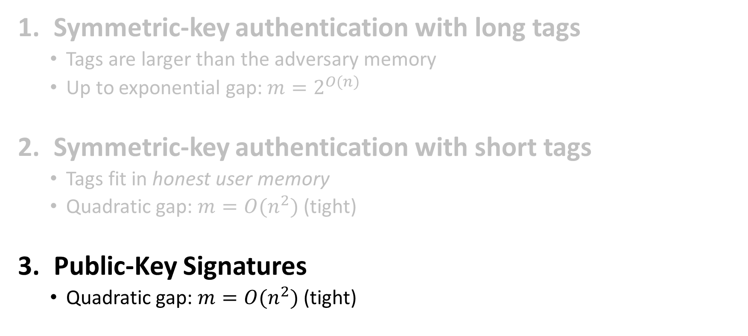
Our Results: Authentication in the BSM
Symmetric-key authentication with long tags
  Tags are larger than the adversary memory
  Up to exponential gap: $m=2^{O(n)}$
Symmetric-key authentication with short tags
  Tags fit in honest user memory
  Quadratic gap: $m=O(n^{2})$ (tight)
Public-Key Signatures
  Quadratic gap: $m=O(n^{2})$ (tight)
All schemes have unconditional security
and are reusable

Slide 30



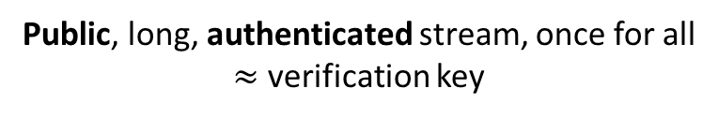




Signatures in the (Streaming) BSM
Public, long, authenticated stream, once for all
$≈$ verification key
Alice
$$n$$
Bob
$$n$$
potentially large: $≫m$
Small signing key
$$sk$$
$$vd$$
Small verification digest
✓
$$Verify\left(vd,μ, σ\right)=$$
$$Sign(sk,μ)$$
Potentially long, streamed

Slide 31
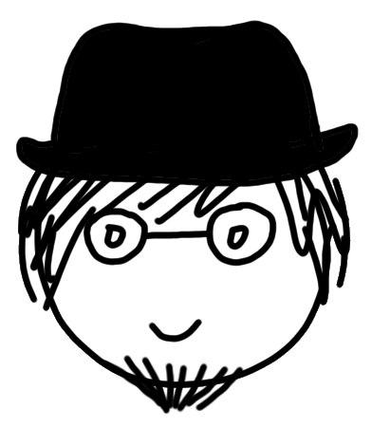
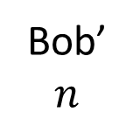


Signatures in the (Streaming) BSM
Public, long, authenticated stream, once for all
$≈$ verification key
Alice
$$n$$
Bob’
$$n$$
potentially large: $≫m$
Small signing key
$$sk$$
$$vd′$$
Small verification digest
✓
$$Verify\left(vd′,μ, σ\right)=$$
$$Sign(sk,μ)$$
Potentially long, streamed

Slide 32
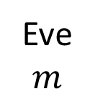
Signatures in the (Streaming) BSM
Public, long, authenticated stream, once for all
$≈$ verification key
Alice
$$n$$
Bob
$$n$$
potentially large: $≫m$
Small signing key
$$sk$$
$$vd$$
Small verification digest
Eve
$$m$$

Slide 33


Signatures in the (Streaming) BSM
Public, long, authenticated stream, once for all
$≈$ verification key
Alice
$$n$$
Bob
$$n$$
potentially large: $≫m$
Small signing key
$$sk$$
$$vd$$
Small verification digest
✗
$$Verify\left(vd,μ, σ\right)=$$
$$Sign(sk,μ)$$
Eve
$$m$$

Slide 34


Constructing Signatures (1)
Public, long, authenticated stream, once for all
$≈$ verification key
Alice
$$n$$
Bob
$$n$$
Key agreement
potentially large: $≫m$
Small signing key
$$sk$$
$$sk$$
$$MAC(sk,μ)$$
BSM MAC
Potentially long, streamed

Slide 35
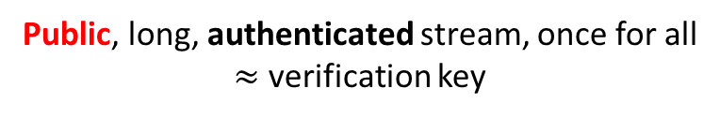
Constructing Signatures (1)
Public, long, authenticated stream, once for all
$≈$ verification key
Alice
$$n$$
Bob’
$$n$$
Key agreement
potentially large: $≫m$
Small signing key
$$sk$$
$$sk$$
$$MAC(sk,μ)$$
BSM MAC
Potentially long, streamed

Slide 36
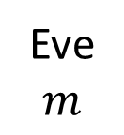

Constructing Signatures (1)
Public, long, authenticated stream, once for all
$≈$ verification key
Alice
$$n$$
Eve
$$m$$
Key agreement
potentially large: $≫m$
Small signing key
$$sk$$
$$sk$$
$$MAC(sk,μ)$$
BSM MAC
Potentially long, streamed

Slide 37
Constructing Signatures (1)
Public, long, authenticated stream, once for all
$≈$ verification key
How to agree on a key using a single broadcast message…?
Alice
$$n$$
Eve
$$m$$
Key agreement
potentially large: $≫m$
Small signing key
$$sk$$
$$sk$$

Slide 38
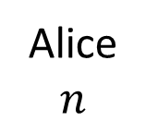





Set Key Agreement
Public, long, authenticated stream
Alice and Bob share $|T|$ keys
Alice
$$n$$
Bob
$$n$$
potentially large: $≫m$
$$\vec{sk}={sk}_{1},…,{sk}_{q}$$
$${{\vec{sk}}_{T}=\left\{sk_{i}\right\}}_{i∈T}, T⊆[q]$$

Slide 39
Set Key Agreement
Public, long, authenticated stream
Alice and Bob share $|T|$ keys
Alice
$$n$$
Bob
$$n$$
potentially large: $≫m$
$$\vec{sk}={sk}_{1},…,{sk}_{q}$$
$${{\vec{sk}}_{T}=\left\{sk_{i}\right\}}_{i∈T}, T⊆[q]$$

Slide 40



Set Key Agreement
Public, long, authenticated stream
Alice and Bob share $|T|$ keys
Some ${sk}_{t}, t∈T$ looks uniform to Eve even given all the other keys
  The index $t$ depends on Eve… $⇒$ Alice and Bob don’t know $t$
Alice
$$n$$
Bob
$$n$$
potentially large: $≫m$
$$\vec{sk}={sk}_{1},…,{sk}_{q}$$
$${{\vec{sk}}_{T}=\left\{sk_{i}\right\}}_{i∈T}, T⊆[q]$$
$${sk}_{t}$$
$${sk}_{t}$$

Slide 41



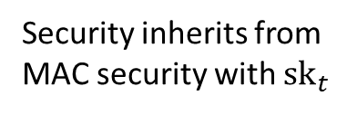
Constructing Signatures (2)
Public, long, authenticated stream, once for all
$≈$ verification key
Alice
$$n$$
Bob
$$n$$
Set key
agreement
potentially large: $≫m$
Small signing key
$$\vec{sk}$$
$${\vec{sk}}_{T}$$
$${\left\{MAC\left({sk}_{i},μ\right)\right\}}_{i∈[q]}$$
BSM MAC
Potentially long, streamed
Security inherits from
MAC security with ${sk}_{t}$

Slide 42


Summary
We study authentication in the (streaming) bounded storage model
  Adversaries have unlimited computational power, but limited memory
  Enables unconditional security and reusability (!)
We give three constructions:
  A MAC with long tags
    Adversaries have exponentially large memory $m=2^{O(n)}$, but tags are even larger
  A MAC with short tags: tags fit in honest users’ memory (!), no need to stream
    Adversaries have quadratic memory $m=O(n^{2})$ (tight)
  A signature scheme
    Adversaries have quadratic memory $m=O(n^{2})$ (tight)
    Both verification keys and signatures are longer than $m$
Thanks for listening!
https://ia.cr/2022/690
Thanks Eysa Lee for the drawings!

