Slide 1
Incompressible Cryptography
Jiaxin Guan¹, Daniel Wichs^{2,3}, and Mark Zhandry^{1,2}
1 Princeton University
2 NTT Research, Inc.
3 Northeastern University

Slide 2
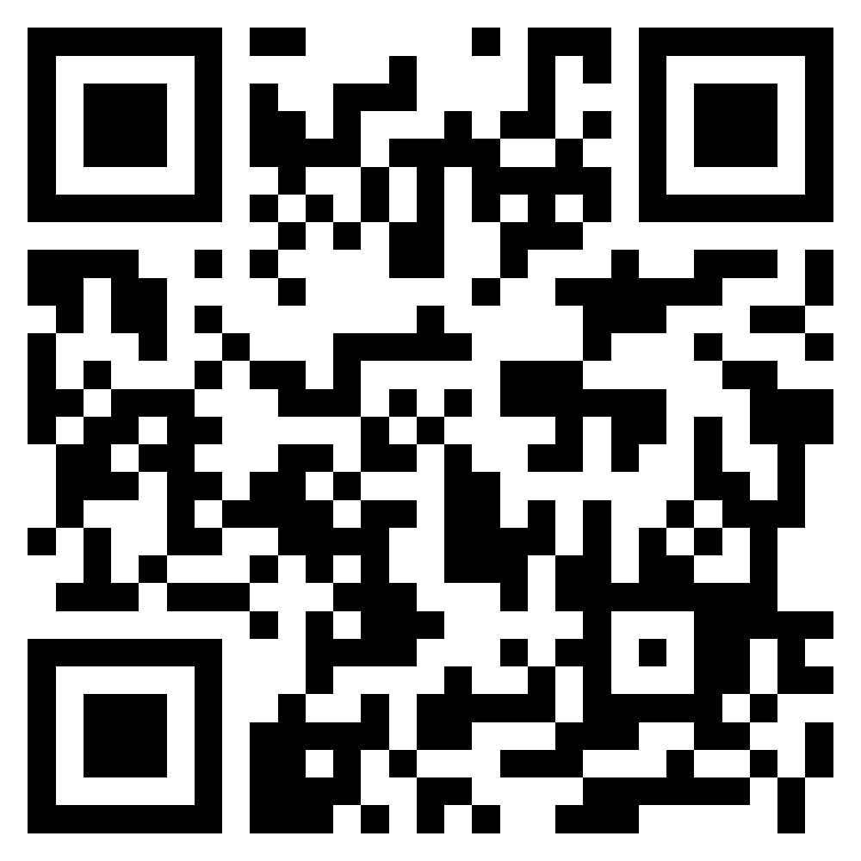
Forward Secrecy
Hi, Bob! Here is a super secret QR code. For your eyes only!!!
Multi-Round Protocols
Key Updates

Slide 3
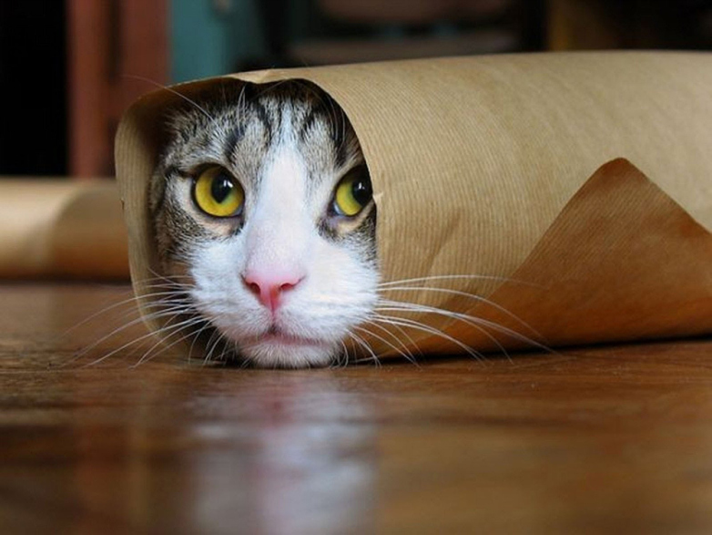
Receiver-Deniable Encryption [CDNO97]
Impossible in the standard model! [BNNO11]

Slide 4
Replay Attack
“Party Tonight”
Multi-Round Protocols
Synchronized Clocks
Stateful Verifier
“Party Tonight”

Slide 5
What if the adversary cannot store the ciphertext / signature?

Slide 7
“Party Tonight”
“Party Tonight”

Slide 8
Key Idea: Manually blow up the ciphertext / signature size

Slide 9
Disappearing Cryptography in the Bounded Storage Model [GZ21]

Slide 10
Bounded Storage Model [Mau92]

Slide 11
Traditionally
Bounded Storage Model [Mau92]
= poly($n$)
= $p(n)$
fixed poly. $p$

Slide 12
Disappearing PKE [GZ21]
$$\left(pk,sk\right), b$$
$$≤S$$
$$pk$$
$$m_{0},m_{1}$$
$$Enc(pk, m_{b})$$
$$sk$$
$$b′$$

Slide 13
Key Difference: Memory Bound

Slide 14
Memory Bound for Adv.
$$S$$

Slide 15
Incompressible Cryptography

Slide 16
Incompressible PKE Security
$$\left(pk,sk\right), b$$
$$≤S$$
$$pk$$
$$m_{0},m_{1}$$
$$, aux$$
$$Enc(pk, m_{b})$$
$$st s.t. \left|st\right|≤S$$
$$sk$$
$$b′$$
$$,pk,aux,st$$
Implies Disappearing PKE Security!

Slide 17
Feature: Low Space Streaming
BSM requires honest parties run protocol with lower storage bound
Enc, Dec, Sig, Ver runs in low space
Incompressible PKE + Low Space Streaming -> Disappearing PKE

Slide 18
Feature: Rate 1
Low Rate PKE:
Rate-1 PKE:
$$m$$
$$m$$
ct
ct

Slide 19
Key Idea: Manually blow up the ciphertext / signature size
Entropy

Slide 20
This Work: Incompressible Cryptography
Incompressible PKE (low rate)
Incompressible PKE (rate 1)
Incompressible Signatures (low rate)
Incompressible Signatures (rate 1)
>>
>>
Standard Model PKE
Indistinguishability Obfuscation (iO)
One Way Functions
Incompressible Encodings [MW20]

Slide 21
Thank you!
eprint.iacr.org/2021/1679
jiaxin@guan.io

