Slide 1
Lightweight Maliciously Secure
Verifiable Function Secret Sharing
Leo de Castro
MIT CSAIL
Antigoni Polychroniadou
J.P. Morgan AI Research

Slide 2
This Talk
Two-Party Function Secret Sharing for Distributed Point Functions
Verifiable
Maliciously Secure
Unconstrained: supports any output group, any set of evaluation points.
Concretely Efficient:
Only symmetric key operations
Similar performance as non verifiable DPFs
+ Distributed Multi-Point Functions
Prior constructions [BGI18, BBCGI21] are constrained and are based on public key operations/MPC

Slide 3
The Two Server Model: Introduction
All protocols in this talk are in the two server model.
The two servers are allowed to communicate with each other.
The two servers are assumed to not collude.
Server 0
Server 1
Client

Slide 4
The Two Server Model: Corruptions
We will be secure against any one corruption.
If the client deviates from the protocol, the semi-honest servers will detect the misbehavior.
The client’s privacy is maintained even if one of the servers is corrupted.
Server 0
Server 1
Client

Slide 5
The Two Server Model: Corruptions
We will be secure against any one corruption.
If the client deviates from the protocol, the semi-honest servers will detect the misbehavior.
The client’s privacy is maintained even if one of the servers is corrupted.
Server 0
Server 1
Corrupted Client

Slide 6
The Two Server Model: Corruptions
We will be secure against any one corruption.
If the client deviates from the protocol, the semi-honest servers will detect the misbehavior.
The client’s privacy is maintained even if one of the servers is corrupted.
Corrupted
Server 0
Server 1
Client

Slide 7
Two Server Model: Applications
Many larger protocols:
Private Information Retrieval
Private Set Intersection
ORAM
Apple & Google
Covid Data Collection
Mozilla + Prio Private data collection [BC17]

Slide 8
Introduction: Function Secret Sharing
A secret sharing scheme for functions.
Supported function class $F ≔\left\{f \right| f:D →R\}$.
Consider a function $f$ in $F$.
$Share\left(f\right)→k\left\{0\right\}, k\left\{1\right\}$
Hiding: $k\{b\}$ alone hides $f$. (Doesn’t necessarily hide that $f∈F$).
$Eval\left(k\left\{b\right\}, x\right) →[y]_{b}$
Correctness: $[y]_{0}$ + $[y]_{1}=y=f(x)$

Slide 9
Function Class: Point Functions
Parameters of F (class of point functions): Domain D, Range R
For $α∈D,β∈R$, consider $f ≔ f\{α,β\}$in F.
$f\left(x\right)=β$ if $x =α$
$f\left(x\right)=0$ otherwise
Distributed Point Functions (DPF): FSS for point functions
A DPF scheme hides the non-zero point ($α,β$).
The shares don’t hide the fact that $f$ is a point function.

Slide 10
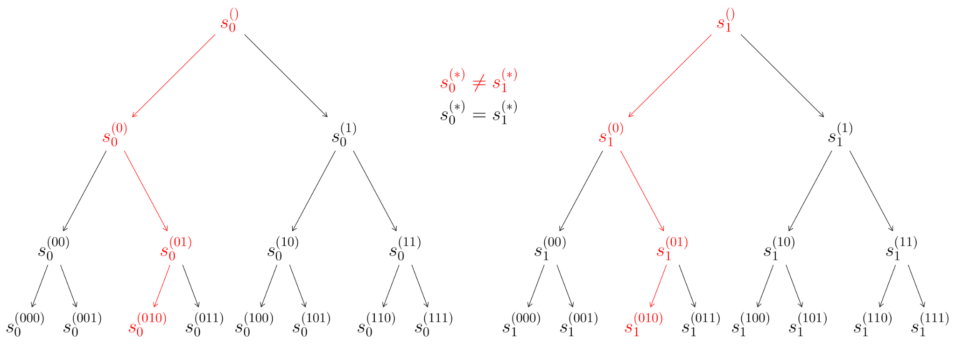
Prior Work: Distributed Point Functions
Boyle, Gilboa, Ishai introduced FSS for point functions.
Key Idea:
Point functions are very close to the zero function.
Sharing the zero function is very easy via PRFs.
Server 0
Server 1

Slide 11
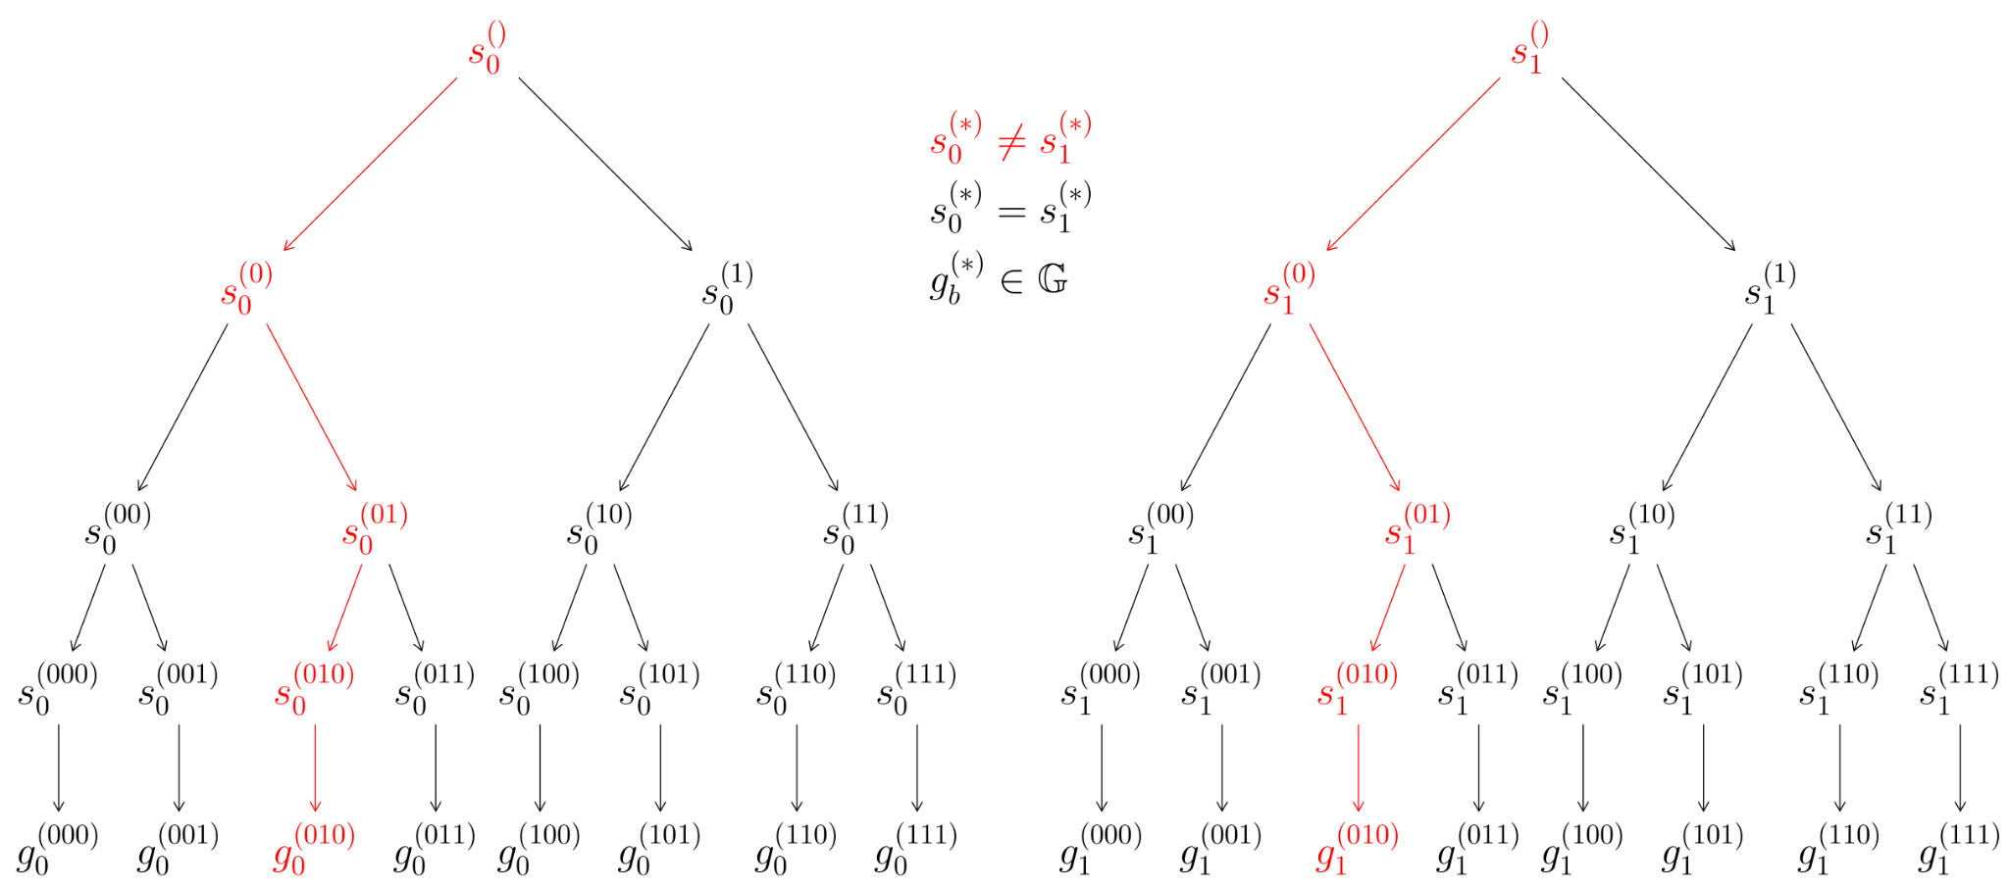
Prior Work: Distributed Point Functions
Server 0
Server 1
GGM Tree: Children are PRG expansions of the parent.
convert(s) → g Random seed maps to pseudorandom group element
Complexity: For an output space of size $2^{n}$ and security parameter $λ$, this construction has $O(λn)$ key size and evaluation time

Slide 12
Verifying Point Functions
Servers evaluate the point function on a set $S$.
Servers hold secret-sharings of a vector $\overset{⃑}{y}$.
$\overset{⃑}{y}$ is the output of the point function on the elements in $S$.
Recall:
$Share\left(f\right)→k\left\{0\right\}, k\left\{1\right\}$
$Eval\left(k\left\{b\right\}, x\right) →[y]_{b}$
$$[\overset{⃑}{y}]_{0}$$
$$[\overset{⃑}{y}]_{1}$$
GOAL: check that $\overset{⃑}{y}$is non-zero in at most one location.
Server 0
Server 1

Slide 13
Verifying Point Functions: Prior Work
Prior work relies on a combination of
Linear Sketching + MPC
Security relies on the Schwartz-Zippel Lemma.
Main Drawbacks
Requires a large output field $ℱ$, since Schwartz-Zippel gives $\sim \frac{1}{ℱ}$ security.
Only semi-honest security for general output space.
Malicious security for outpus in $β∈\{0,1\}$, but $ℱ$ must still be large and MPC is still requried. [BBCGI21]
Notes:
lightweight techniques for private heavy hitters,
dan boneh, elette boyle, henry Corrigan-gibbs, niv Gilboa, yuval ishai

Slide 14
Starting Point: Verifying the Zero Function
Server 1 negates their vector. Now, both servers should have identical vectors.
To check, hash down the vectors to $2λ$ bits and exchange the bits.
All honest shares will pass this test.
$$[\overset{⃑}{y}]_{0}$$
$$[\overset{⃑}{y}]_{1}=−[\overset{⃑}{y}]_{0}$$
Server 0
Server 1
Observe: A point function is very close to the zero function.
$$H([\overset{⃑}{y}]_{0})$$

Slide 15
From Zero Points to One Point: Correction Operation
Toy Version (Central idea to [BGI18])
Client computes the shares of the non-zero point $[β]_{0}$ and $[β]_{1}$
Client includes correction word $ω=[β]_{0} ⨁{ }[β]_{1}$ with the key.
$$[0]_{0}$$
$[0]_{0}$
$$[β]_{0}$$
$$[0]_{0}$$
$$⋮$$
$$[0]_{0}$$
$$[0]_{1}$$
$$[0]_{1}$$
$$[β]_{1}$$
$$[0]_{1}$$
$$⋮$$
$$[0]_{1}$$
Server 0
Server 1
$[\overset{⃑}{y}]_{0}=$
$= [\overset{⃑}{y}]_{1}$

Slide 16
From Zero Points to One Point: Correction Operation
Toy Version (Central idea to [BGI18])
Client computes the shares of the non-zero point $[β]_{0}$ and $[β]_{1}$
Client includes correction word $ω=[β]_{0} ⨁{ }[β]_{1}$ with the key.
$$[0]_{0}$$
$[0]_{0}$
$$[β]_{0}$$
$$[0]_{0}$$
$$⋮$$
$$[0]_{0}$$
$$[0]_{1}$$
$$[0]_{1}$$
$$[β]_{1}$$
$$[0]_{1}$$
$$⋮$$
$$[0]_{1}$$
Server 0
Server 1
$[\overset{⃑}{y}]_{0}=$
$= [\overset{⃑}{y}]_{1}$
Deterministic Correction Operation: $correct\left({[μ]}_{b}, ω\right)$
$$correct\left({[0]}_{0}, ω\right)=correct\left({[0]}_{1}, ω\right)$$
$$correct\left({[β]}_{0}, ω\right)=correct\left({[β]}_{1}, ω\right)$$
$correct\left({[\tilde{β}]}_{0}, ω\right)≠correct\left({[\tilde{β}]}_{1}, ω\right)$ where $β≠\tilde{β}≠0$

Slide 17
From Zero Points to One Point: Correction Operation
Toy Version (Central idea to [BGI18])
Client computes the shares of the non-zero point $[β]_{0}$ and $[β]_{1}$
Client includes correction word $ω=[β]_{0} ⨁{ }[β]_{1}$ with the key.
Server 0
Server 1
$[0]_{0}$ $⨁{ \left(t_{0}^{\left(i\right)}∙ω\right)= }$ $v_{i}$
$[β]_{0}$ $⨁{ \left(t_{0}^{\left(∗\right)}∙ω\right)= }$ $v_{∗}$
$[0]_{1}$ $⨁{ \left(t_{1}^{\left(i\right)}∙ω\right)= }$ $v_{i}$
$[β]_{1}$ $⨁{ \left(t_{1}^{\left(∗\right)}∙ω\right)= }$ $v_{∗}$
All $t_{b}^{(∙)}$ are bits.
$$t_{0}^{(∗)}≠t_{1}^{(∗)}$$
$$t_{0}^{(i)}=t_{1}^{(i)}$$

Slide 18
From Zero Points to One Point: Correction Operation
$[0]_{0}$ $⨁{ \left(t_{0}^{\left(1\right)}∙ω\right)= }$ $v_{1}$
$[0]_{0}$ $⨁{ \left(t_{0}^{\left(2\right)}∙ω\right)= }$ $v_{2}$
$[β]_{0}$ $⨁{ \left(t_{0}^{\left(∗\right)}∙ω\right)= }$ $v_{∗}$
$[0]_{0}$ $⨁{ \left(t_{0}^{\left(4\right)}∙ω\right)= }$ $v_{4}$
$$⋮$$
$[0]_{0}$ $⨁{ \left(t_{0}^{\left(k\right)}∙ω\right)= }$ $v_{k}$
$[0]_{1}$ $⨁{ \left(t_{1}^{\left(1\right)}∙ω\right)= }$ $v_{1}$
$[0]_{1}$ $⨁{ \left(t_{1}^{\left(2\right)}∙ω\right)= }$ $v_{2}$
$[β]_{1}$ $⨁{ \left(t_{1}^{\left(∗\right)}∙ω\right)= }$ $v_{∗}$
$[0]_{1}$ $⨁{ \left(t_{1}^{\left(4\right)}∙ω\right)= }$ $v_{4}$
$$⋮$$
$[0]_{1}$ $⨁{ \left(t_{1}^{\left(k\right)}∙ω\right)= }$ $v_{k}$
Server 0
Server 1
$$t_{0}^{(∗)}≠t_{1}^{(∗)}$$
$$t_{0}^{(i)}=t_{1}^{(i)}$$
Observe: ${[0]}_{0}={[0]}_{1}$ and ${[β]}_{0}≠{\left[β\right]}_{1}$, since $β≠0$
$t_{b}^{(∙)}=LSB({[0]}_{b})$ and $t_{0}^{(∗)}=LSB({\left[β\right]}_{b})$
Define $correct\left({[μ]}_{b}, ω\right) :={[μ]}_{b} ⨁{ \left(LSB({[μ]}_{b})∙ω\right) }$

Slide 19
From Zero Points to One Point
Idea: Allow the client to correct at most one non-zero point.
Let $y_{i}=f(x_{i})$ where $f$ is a point function defined by $f\left(α\right)=β$.
Let $Share\left(f\right)→k\left\{0\right\}, k\left\{1\right\}$, and let $Eval\left(k\left\{b\right\},β\right) →[β]_{b}$.
Client appends a correction word $ω$ = $H(\left[β]_{0}\right) ⨁{ }H([β]_{1})$.
Correction operation
Input is a share $u :=[y]_{b}$. If $b=1$, set $u ←−u$.
Hash $u$ to get $v ≔H(u)$.
If the LSB of $v$ is 1, output, $v⨁{ω}$. Otherwise, output $v$.

Slide 20
From Zero Points to One Point
Correction operation
Input is a share $u :=[y]_{b}$. If $b=1$, set $u ←−u$.
Hash $u$ to get $v ≔H(u)$.
If the LSB of $v$ is 1, output, $v⨁{ω}$. Otherwise, output $v$.
Deterministic: If the inputs are shares of zero, the outputs are equal.
Client samples the keys until $LSB\left(H\left([β]_{0}\right)\right)≠LSB\left(H\left([β]_{1}\right)\right)$.
This occurs with probability ½ in the BGI construction.
Correction: If the inputs are shares of $β$, outputs will also be equal.
If a malicious client corrects more than one error, then they’ve found inputs
$u_{1}≠u_{2}$ and $u_{3}≠u_{4}$
$$ω=H\left(u_{1}\right)⨁H\left(u_{2}\right)=H\left(u_{3}\right)⨁H(u_{4})$$

Slide 21
XOR-Collision Resistance
We say a function family F is XOR-collision resistant
if for a randomly sampled $f$ in F
it is hard to find four inputs $x_{1},x_{2},x_{3},x_{4}$ such that the following holds.
$$\left(x_{1},x_{2}\right) ≠\left(x_{3},x_{4}\right) \& \left(x_{1},x_{2}\right)≠\left(x_{4},x_{3}\right)$$
$$f\left(x_{1}\right)⨁f\left(x_{2}\right)=f\left(x_{3}\right)⨁f\left(x_{4}\right) ≠0$$
This is a sparse correlation → Random Oracle Model gives security.
In practice, we have a hash function output of $4λ$ bits.

Slide 22
Verifying Point Functions: Our Approach
Server 0 begins with $[\overset{⃑}{y}]_{0}$ and $ω$. Server 1 begins with $[\overset{⃑}{y}]_{1}$ and $ω$.
Servers apply the correction operation to each element in the vectors.
Servers hash the resulting vectors to check if they are equal.
$[\overset{⃑}{y}]_{0}$ and $ω$
$[\overset{⃑}{v}]_{0} ←correct([\overset{⃑}{y}]_{0}, ω)$
$π_{0} ←H([\overset{⃑}{v}]_{0})$
$[\overset{⃑}{y}]_{1}$ and $ω$
$[\overset{⃑}{v}]_{1} ←correct([\overset{⃑}{y}]_{1}, ω)$
$π_{1}←H([\overset{⃑}{v}]_{1})$
Server 0
Accept if
$$π_{0 }=π_{1}$$
Server 1
Notes:
Only exchange 2*lambda bits.
Works for any non-zero output and any output group.

Slide 23
Verifying Point Functions: Our Approach
Server 0 begins with $[\overset{⃑}{y}]_{0}$ and $ω$. Server 1 begins with $[\overset{⃑}{y}]_{1}$ and $ω$.
Servers apply the correction operation to each element in the vectors.
Servers hash the resulting vectors to check if they are equal.
Security
Secure against a malicious client because of the XOR-collision resistance of the hash function.
Secure against malicious server because the server’s do not exchange any new information when the shares are honestly generated.
Notes:
Only exchange 2*lambda bits.
Works for any non-zero output and any output group.

Slide 24
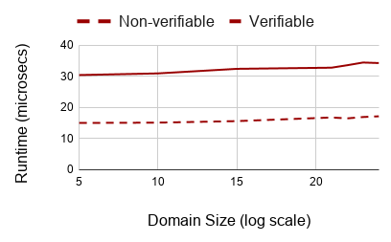
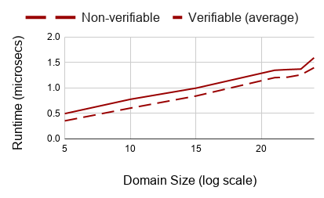
Verifiable DPF Performance
Share Generation
$\sim 2×$ overhead
Share Evaluation
Verification overhead
is very low

Slide 25
Efficient, Verifiable Multi-Point Functions

Slide 26
Function Class: Multi-point Functions
Function class with small number of non-zero points.
Non-zero points are explicitly defined.
Parameters of F: Domain D, Range R, number of non-zero points t
For $S≔\left\{\left(α_{i}, β_{i}\right)\right\} ∈ {(D × R )}^{t}$, consider $f ≔f\{S\}$
Observe: Multi-point functions can be viewed as the sum of t point functions.
$f\left(x\right)=β_{i}$ if $x =α_{i}$
$f\left(x\right)=0$ otherwise

Slide 27
FSS for Multi-Point Functions (DMPF)
The Naive Approach: Just concatenate t point functions.
For $S≔\left\{\left(α_{i}, β_{i}\right)\right\} ∈ {(D × R)}^{t}$, consider $f ≔f\{S\}$
$DMPF.Share\left(f\right)→k\left\{0\right\}, k\left\{1\right\}$
$k\left\{b\right\}=DPF.Share\left(g\left\{α_{1}, β_{1}\right\}\right), …, DPF.Share\left(g\left\{α_{t}, β_{t}\right\}\right)$
$DMPF.Eval\left(k\left\{b\right\}, x\right) →[y]_{b}$
Parse $k\left\{b\right\}= k_{1}, …, k_{t}$
Output $\sum_{i=1}^{t}{DPF.Eval(k_{i}, x)}$
$DMPF.Eval$ must evaluate t DPF shares for each input, even though only one share will evaluate to a non-zero value.
Question: Can we reduce this work?

Slide 28
Background: Cuckoo Hashing
Packs t elements into a table of size m.
Uses $κ=O(1)$ hash functions $h_{i}:D →\left\{1, …, m\right\}, 1≤i ≤κ$ to build the table.
After the table is built, an element $x$ is at exactly one of the indices $h_{1}\left(x\right), …,h_{κ}\left(x\right)$
A table can fail to be built, but when $30 ≤t ≤2^{37}$ and $κ=3$ this failure occurs with probability $2^{−80}$ while still keeping $m ≤2t$. [DRRT18]
We focus on the parameter regime:
$30 ≤t ≤2^{37}$ $m ≤2t$ $κ=3$
Notes:
Daniel Demmler, Peter Rindal, Mike Rosulek, and Ni Trieu. Pir-psi: Scaling private contact discovery.

Slide 29
DMPF: Our Construction
Client begins with multi-point function $f ≔f\{S\}$
defined by $S≔\left\{\left(α_{i}, β_{i}\right)\right\}∈{\left(D × R\right)}^{t}$
$$DMPF.Share\left(f\right)→k\left\{0\right\}, k\left\{1\right\}$$
Client inserts $α_{1}, …,α_{t}$ into a Cuckoo-hash table with $m$ buckets.
For each bucket $i$, if the bucket holds $α_{j}$ then define the point function $g_{i}\{α_{j},β_{j}\}$. If the bucket is empty, define the point function $g_{i}\{0, 0\}$.
For each bucket $i$, run $DPF.Share\left(g_{i}\right)→k_{i}\left\{0\right\}, k_{i}\left\{1\right\}$
Send $k\left\{0\right\}=k_{1}\left\{0\right\},k_{2}\left\{0\right\}, …,k_{m}\left\{0\right\}$ to Server 0 and $k\left\{1\right\}=k_{1}\left\{1\right\},k_{2}\left\{1\right\}, …,k_{m}\left\{1\right\}$ to Server 1. Send the hash functions to both servers.

Slide 30
DMPF: Our Construction
Client begins with multi-point function $f ≔f\{S\}$
defined by $S≔\left\{\left(α_{i}, β_{i}\right)\right\}∈{\left(D × R\right)}^{t}$
$$DMPF.Eval\left(k\left\{b\right\}, x\right)→ {[y]}_{b}$$
Parse the key $k\left\{b\right\}=k_{1}\left\{b\right\},k_{2}\left\{b\right\}, …,k_{m}\left\{b\right\}$, $h_{1}, …,h_{κ}$
Compute the indices $i_{1}, …,i_{κ}=h_{1}\left(x\right), …,h_{κ}\left(x\right)$
Output $\sum_{j=1}^{κ}{DPF.Eval(k_{i_{j}}\left\{b\right\}, x)}$
Correctness: The element $x$ can only be in one of the $κ$ locations specified by the hash functions $h_{1}, …,h_{κ}$. All other DPF shares will evaluate to zero.
Performance: Only need to evaluate $κ=O(1)$ DPF shares instead of $t$ DPF shares.

Slide 31
Verifying DMPFs
Using verifiable DPFs results in a verifiable DMPF.
Optimal Verification
Verify that the shared function has at most $t$ non-zero points.
Relaxed Verification
Cuckoo-hashing allows us to verify that there are at most $m ≤2t$ non-zero points.
Efficiency: Verification communication never grows beyond $2λ$ bits.

Slide 32
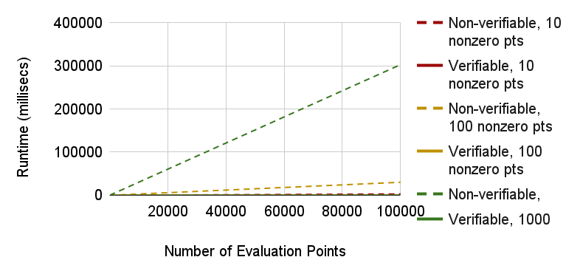
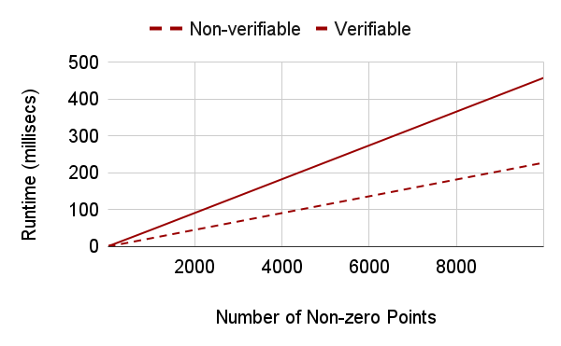
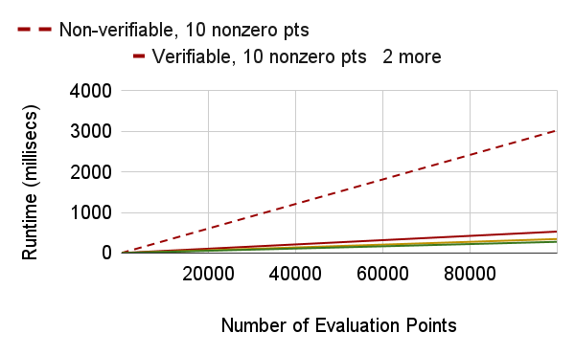
Verifiable DMPF Performance
Share Evaluation
Share Generation
$\sim 2x$ overhead

Slide 33
Future Directions
Immediate Applications
Two-server Malicious PIR & Two-Server Malicious PSI
Likely extensions to two-server ORAM
Next Steps: Malicious MPC for set membership.
One valid $β$ is trivial (e.g. $β$ can only be 1).
Achieved by [BBCGI21] for $β∈\{0,1\}$, although still requires large output field.
Need to defend against additive attacks from a malicious server.

Slide 34
Thank you! eprint.iacr.org/2021/580 ldec@mit.edu

Slide 35
Thank you!
Verifying DPFs
Server 0 begins with $[y]_{0}$ and $ω$. Server 1 begins with $[y]_{1}$ and $ω$.
Servers apply the correction operation to each element in the vectors.
Servers hash the resulting vectors to check if they are equal.
$$DMPF.Share\left(f\right)→k\left\{0\right\}, k\left\{1\right\}$$
Client inserts $α_{1}, …,α_{t}$ into a Cuckoo-hash table with $m$ buckets.
For each bucket $i$, if the bucket holds $α_{j}$ then define the point function $g_{i}\{α_{j},β_{j}\}$. If the bucket is empty, define the point function $g_{i}\{0, 0\}$.
For each bucket $i$, run $DPF.Share\left(g_{i}\right)→k_{i}\left\{0\right\}, k_{i}\left\{1\right\}$
Output $k\left\{0\right\}=k_{1}\left\{0\right\},k_{2}\left\{0\right\}, …,k_{t}\left\{0\right\}$ and $k\left\{1\right\}=k_{1}\left\{1\right\},k_{2}\left\{1\right\}, …,k_{t}\left\{1\right\}$
$$DMPF.Eval\left(k\left\{b\right\}, x\right)→ {[y]}_{b}$$
Parse the key $k\left\{b\right\}=k_{1}\left\{b\right\},k_{2}\left\{b\right\}, …,k_{t}\left\{b\right\}$
Compute the indices $i_{1}, …,i_{κ}=h_{1}\left(x\right), …,h_{κ}\left(x\right)$
Output $\sum_{j=1}^{κ}{DPF.Eval(k_{i_{j}}\left\{b\right\}, x)}$

