Slide 1
Sine Series Approximation of the Mod Function for Bootstrapping of Approximate HE
Charanjit S. Jutla and Nathan Manohar
IBM T.J. Watson Research Center
Notes:
Hi, I’m Nathan Manohar and I’ll be presenting Sine Series Approximation of the Mod Function for Bootstrapping of Approximate HE. This is joint work with Charanjit Jutla. I hope you enjoy this presentation.

Slide 2
CKKS HE Scheme (2017)
Supports arithmetic circuits over the reals/complex numbers
Only for approximate arithmetic
Scheme | Circuit Type | Plaintext Type
BGV | Arithmetic | Mod $p$
BFV | Arithmetic | Mod $p$
GSW | Boolean | Bits
FHEW | Boolean | Bits
TFHE | Boolean | Bits
CKKS | Arithmetic | Real/Complex
Notes:
In this work, we focus on the CKKS homomorphic encryption scheme. The CKKS HE scheme is unique among FHE schemes since it natively supports approximate arithmetic over real numbers.

Slide 3
CKKS HE Scheme (2017)
Ideal for privacy-preserving machine learning
Scheme | Circuit Type | Plaintext Type
BGV | Arithmetic | Mod $p$
BFV | Arithmetic | Mod $p$
GSW | Boolean | Bits
FHEW | Boolean | Bits
TFHE | Boolean | Bits
CKKS | Arithmetic | Real/Complex
Notes:
The upshot of CKKS is that it is ideal for applications such as privacy-preserving machine learning that naturally lend themselves to computation over real numbers. For these kinds of applications, using CKKS is much more efficient because one doesn’t have to first try to represent computation over real numbers via mod p arithmetic or a Boolean circuit over bits.

Slide 4
CKKS HE Scheme (2017)
Main insight: Treat error as part of approximate computation error
Allows for much more efficient constructions!
Dec:
m
SK
m + error
Notes:
CKKS homomorphic encryption inherits many of the properties of BGV, but has the clever idea of mimicking fixed point arithmetic directly. Since fixed point arithmetic is inherently noisy, the LWE error present in FHE schemes can be added to the approximate arithmetic error and only affects the least significant bits of the message.
It can be shown that CKKS can perform approximate arithmetic homomorphically with only 1 additional bit of precision loss over plaintext fixed point arithmetic.

Slide 5
$$Q$$
Fresh Ciphertext
$$0$$
$$0$$
$$m$$
$$e$$
$$q$$
$$Q′$$
After 1 Multiplication
$$0$$
$$0$$
$$m′$$
$$e′$$
$$q$$
After Several Multiplications
$$0$$
$$m′′$$
$$e′′$$
$$q$$
Notes:
Let’s review the structure of a CKKS ciphertext.

Slide 6
Can we increase $Q$ to support the depth of computation?
Increasing$Q$ decreases security!
Need to increase ring dimension $N$ to compensate

Slide 7
$$Q$$
Fresh Ciphertext
$$0$$
$$0$$
$$m′′$$
$$e′′$$
$$q$$
Bootstrapping “refreshes” ciphertext
After Several Multiplications
$$0$$
$$m′′$$
$$e′′$$
$$q$$
Notes:
Because of the nature of approximate arithmetic, the data loses precision every multiplication. Bootstrapping will not be able to bring back precision, so for large depth circuits, it is necessary to operate at a high precision including bootstrapping at high precision. This have proven to be challenging as we will see.

Slide 8
This Work
Can we support high precision bootstrapping?

Slide 9
This Work
Can we support high precision bootstrapping?
Yes, up to arbitrary precision!
Our Implementation: 100 bits

Slide 10
Before Bootstrapping
$$0$$
$$m$$
$$e$$
$$q$$
$$Q$$
After Modulus Raising
$$0$$
$$I$$
$$0$$
$$m$$
$$e$$
$$q$$
$$Q′$$
After Bootstrapping
$$0$$
$$0$$
$$0$$
$$m$$
$$e′$$
$$q$$

Slide 11
Bootstrapping for CKKS
Coefficient rounding modulo $q$
Operations on coefficients not “slots’’
Mod function not easily represented by a polynomial
Handled by applying homomorphic linear transforms
Our focus

Slide 12
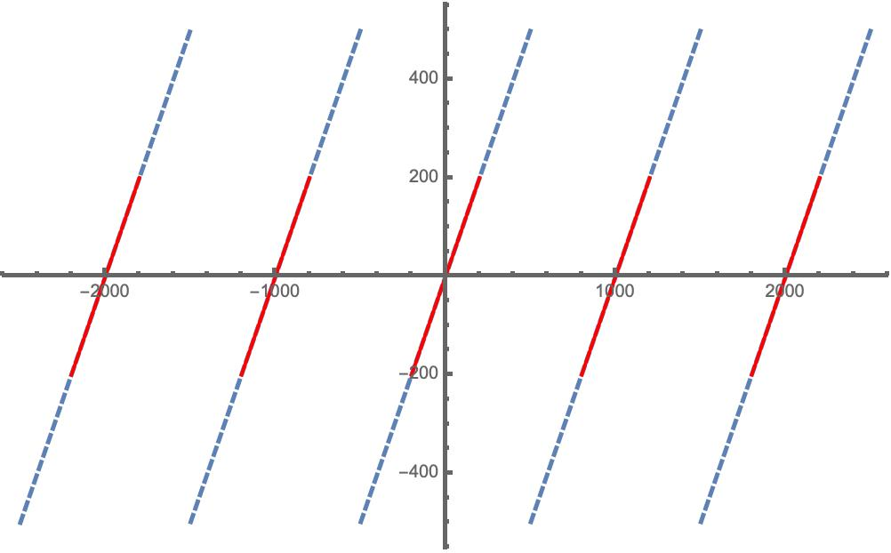
Approximating the Mod Function
poly(·)
$$qI + m$$
$$m$$
Can assume $m << q$
Mod Function
Approximation Region
Mod Function for $q = 1000$

Slide 13
Main Challenges
Approximation Error: Large error will destroy message precision
$$Q$$
After Modulus Raising
$$0$$
$$I$$
$$0$$
$$m$$
$$e$$
$$q$$
$$Q′$$
After Bootstrapping
$$0$$
$$0$$
$$0$$
$$m$$
$$e′$$
$$q$$

Slide 14
Main Challenges
Approximation Error: Large error will destroy message precision
$$Q$$
After Modulus Raising
$$0$$
$$I$$
$$0$$
$$m$$
$$e$$
$$q$$
$$Q′$$
After Bootstrapping
$$0$$
$$0$$
$$0$$
$$m$$
$$e′$$
$$q$$

Slide 15
Main Challenges
Polynomial Degree: Larger degree => larger multiplicative depth => more ciphertext modulus consumed to evaluate
$$Q$$
After Modulus Raising
$$0$$
$$I$$
$$0$$
$$m$$
$$e$$
$$q$$
$$Q′$$
After Bootstrapping
$$0$$
$$0$$
$$0$$
$$m$$
$$e′$$
$$q$$

Slide 16
Main Challenges
Polynomial Degree: Larger degree => larger multiplicative depth => more ciphertext modulus consumed to evaluate
$$Q$$
After Modulus Raising
$$0$$
$$I$$
$$0$$
$$m$$
$$e$$
$$q$$
$$Q′$$
After Bootstrapping
$$0$$
$$0$$
$$m$$
$$e′$$
$$q$$

Slide 17
Main Challenges
Coefficient Magnitude: Larger coefficients => larger “evaluation precision” => more ciphertext modulus consumed to evaluate
$$Q$$
After Modulus Raising
$$0$$
$$I$$
$$0$$
$$m$$
$$e$$
$$q$$
Small evaluation precision
$$Q′$$
After Bootstrapping
$$0$$
$$0$$
$$0$$
$$m$$
$$e′$$
$$q$$

Slide 18
Main Challenges
Coefficient Magnitude: Larger coefficients => larger “evaluation precision” => more ciphertext modulus consumed to evaluate
$$Q$$
After Modulus Raising
$$0$$
$$I$$
$$0$$
$$m$$
$$e$$
$$q$$
Large evaluation precision
$$Q′$$
After Bootstrapping
$$0$$
$$0$$
$$m$$
$$e′$$
$$q$$

Slide 19
Approximating the Mod Function
poly(·)
$$qI + m$$
$$m$$
Can assume $m << q$
1) Small Approximation Error
2) Low Degree
3) Small Coefficients

Slide 20
Prior Approaches to Mod Approximation
Scaled sine approximation of mod function [CHK+18, CCS19, HHC19, HK20]
Can only achieve low precision as sine approximation has fundamental cubic error.
Other Approaches [JM20, LLL+21]
[LLL+21] – Algorithmic search on a composition of functions
[JM20] – Explicit formulas for direct polynomial approximation
Coefficients of polynomials can be too large

Slide 21
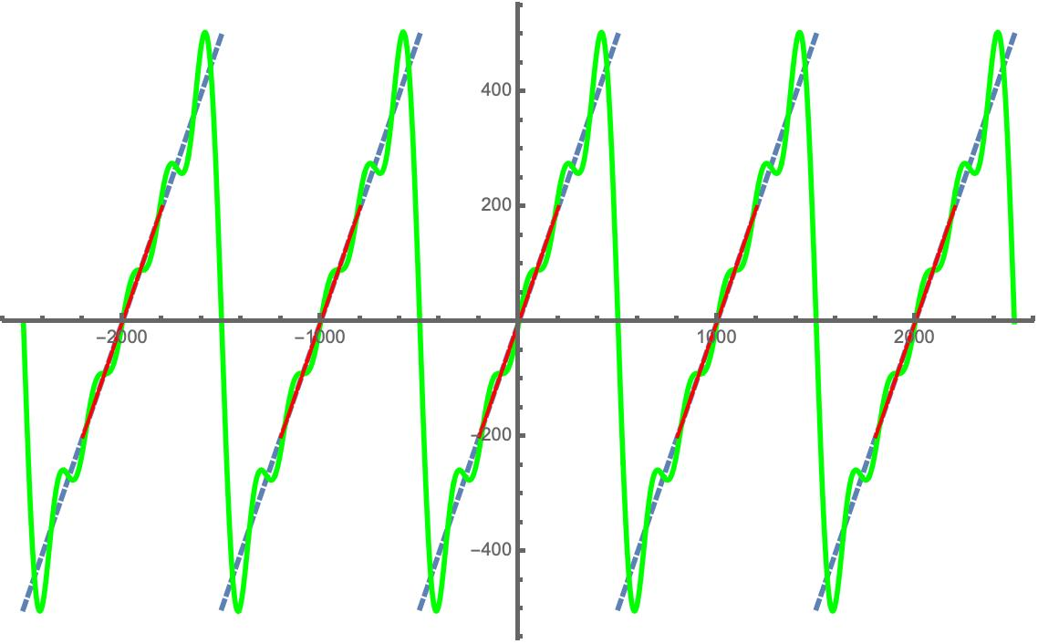
Fourier Series Approximation
Mod Function
Approximation Region
Fourier Series
Fourier Series Approximation of Order 5
Notes:
There is a well known technique to approximate periodic functions called the Fourier series.

Slide 22
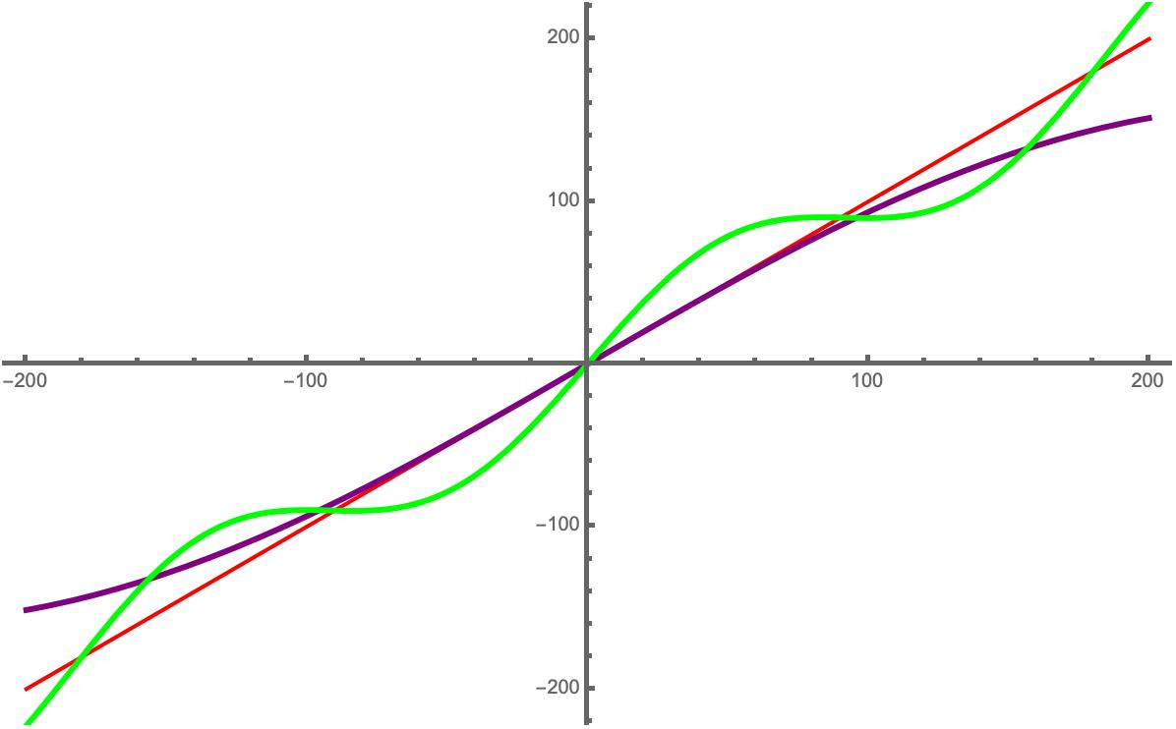
Fourier Series Approximation
Approximation Region
Sine
Fourier Series
Fourier Series Approximation of Order 5

Slide 23
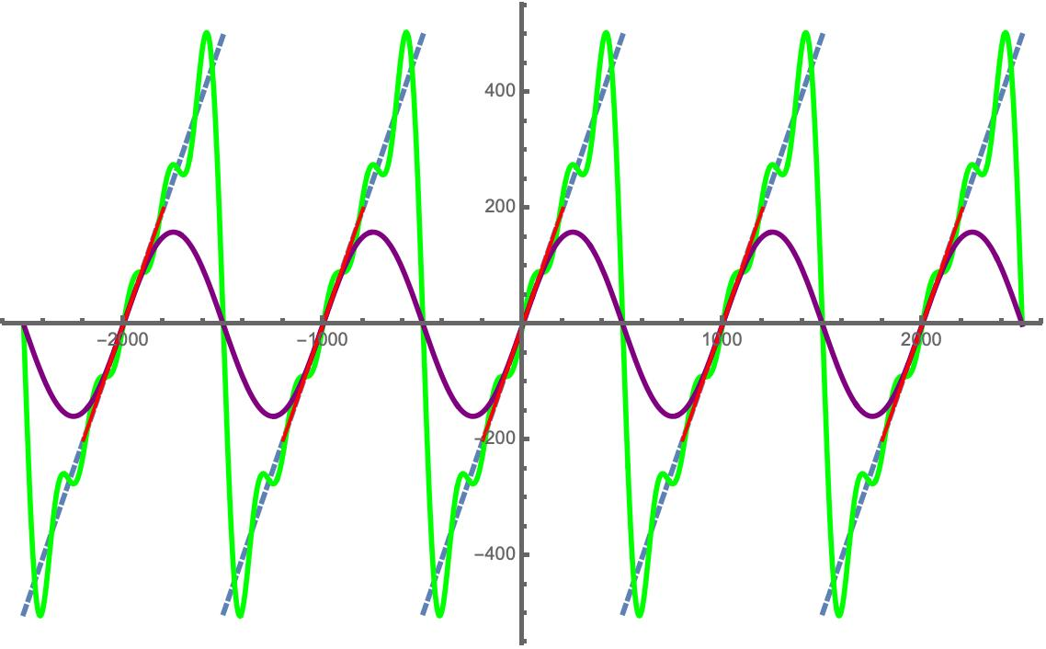
Fourier Series Approximation
Mod Function
Approximation Region
Sine
Fourier Series
Fourier Series Approximation and Sine Approximation

Slide 24
Fourier Series: The Bad
Approximation Region
Sine
Fourier Series
Fourier Series Approximation of Order 5
Performs poorly in approximation region!

Slide 25
Fourier Series: The Bad
Approximation Region
Sine
Fourier Series
Fourier Series Approximation of Order 5
Performs poorly in approximation region!
Cannot be used for bootstrapping

Slide 26
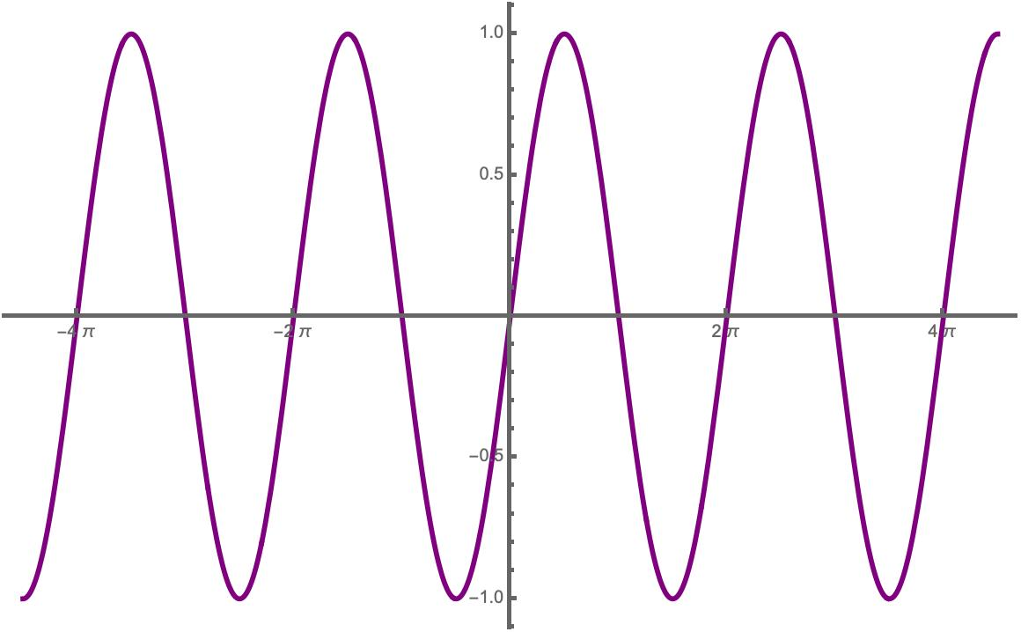
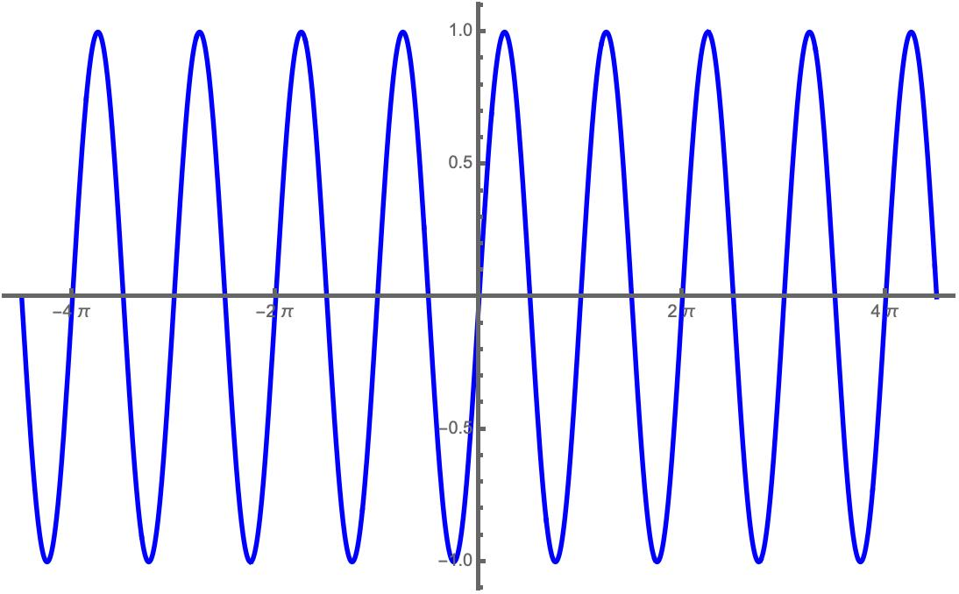
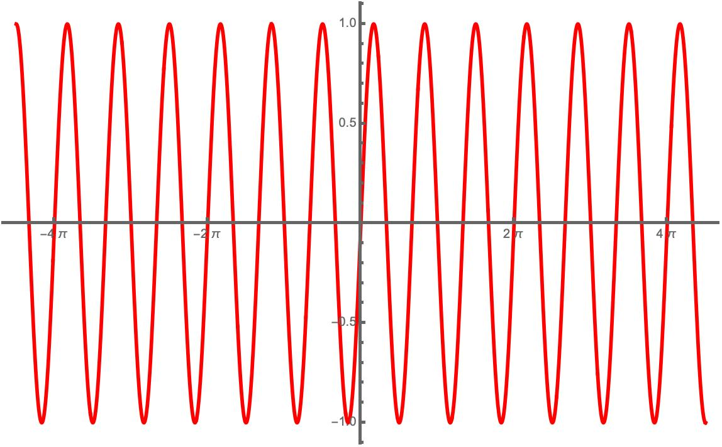
Stepping Away From Fourier Series
Suppose we want to approximate ${\left[⋅\right]}_{2π}$
Fourier series is linear combination of $\sin{x,\sin{2x,\sin{3x, …}}}$
$$\sin{x }$$
$$\sin{2x }$$
$$\sin{3x }$$
Notes:
So what did we learn by considering the Fourier series? For simplicity, suppose that we want to approximate modding down by 2pi, so we don't have to worry about any scaling factors. Now, the Fourier series was a linear combination of sinx sin2x sin3x etc. Observe that all of these sin terms all have periods that divide 2Pi. This means that any linear combination will automatically mod down by 2 Pi, as desired, and perform the same in all approximation regions.

Slide 27
This Work
Can we use a different linear combination to approximate the mod function?

Slide 28
This Work
Can we use a different linear combination to approximate the mod function?
Only focus on approximation region!

Slide 29
This Work: Sine Series Approximation
Want to approximate ${\left[⋅\right]}_{2π}$ on inputs $2πI+x$ for small $x$
$\sin\left(k(2πI+ x)\right)=\sin{kx}$
Enough to consider behavior for small $x$
Want $x≈$ $\sum_{k=1}^{n}{β_{k}sin⁡(kx)}$ for small $x$
Easy to find such a linear combination
Hard Part: Prove it gives exponentially good approximation

Slide 30
Order 2 Approximation
$$\sin{x }$$
$$\sin{2x }$$
$$\frac{4}{3}\sin{x −\frac{1}{6}\sin{2x}}$$

Slide 31
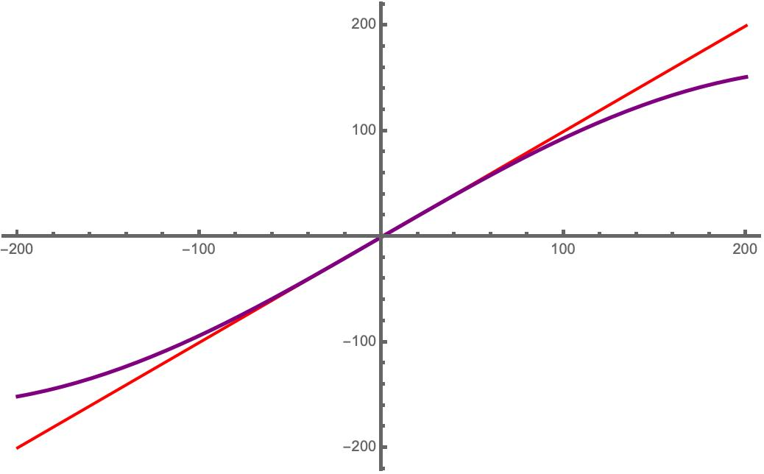
Our Approximation
Approximation Region
Sine
Mod Function for $q = 1000$ with Scaled Sine Approximation

Slide 32
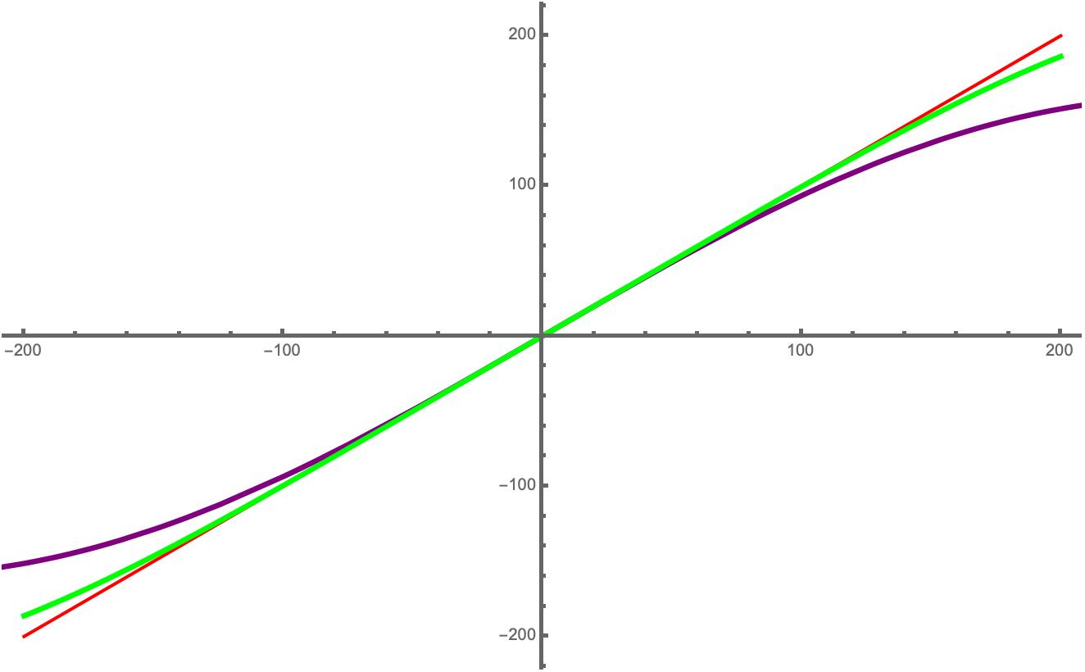
Our Approximation
Approximation Region
Sine
Sine Series
Sine Series Approximation of Order 2

Slide 33
Our Approximation
Want to approximate ${\left[⋅\right]}_{2π}$ on inputs $2πI+x$ for small $x$
Enough to consider behavior for small $x$
$$\sin{x=x −\frac{x^{3}}{3!}+\frac{x^{5}}{5!}−\frac{x^{7}}{7!}+ …}$$
Error

Slide 34
Our Approximation
$$\sin{x=x −\frac{x^{3}}{3!}+\frac{x^{5}}{5!}−\frac{x^{7}}{7!}+ …}$$
$$\sin{2x=2x −\frac{(2{x)}^{3}}{3!}+\frac{(2{x)}^{5}}{5!}−\frac{(2{x)}^{7}}{7!}+ …}$$

Slide 35
Our Approximation
$$\frac{4}{3}\sin{x=\frac{4}{3}x −\frac{2}{9}x^{3}+\frac{1}{90}x^{5}−\frac{1}{3780}x^{7}+… }$$
$$−\frac{1}{6}\sin{2x=−\frac{1}{3}x+\frac{2}{9}x^{3}−\frac{2}{45}x^{5}+\frac{4}{945}x^{7} −…}$$

Slide 36
Our Approximation
$$\frac{4}{3}\sin{x=\frac{4}{3}x −\frac{2}{9}x^{3}+\frac{1}{90}x^{5}−\frac{1}{3780}x^{7}+… }$$
+
$$−\frac{1}{6}\sin{2x=−\frac{1}{3}x+\frac{2}{9}x^{3}−\frac{2}{45}x^{5}+\frac{4}{945}x^{7} −…}$$
$$=x−\frac{1}{30}x^{5}+\frac{1}{252}x^{7}−…$$
Error

Slide 37
Our Approximation
$$\frac{4}{3}\sin{x=\frac{4}{3}x −\frac{2}{9}x^{3}+\frac{1}{90}x^{5}−\frac{1}{3780}x^{7}+… }$$
+
$$−\frac{1}{6}\sin{2x=−\frac{1}{3}x+\frac{2}{9}x^{3}−\frac{2}{45}x^{5}+\frac{4}{945}x^{7} −…}$$
$$=x−\frac{1}{30}x^{5}+\frac{1}{252}x^{7}−…$$

Slide 38
Our Approximation
$$\frac{4}{3}\sin{x=\frac{4}{3}x −\frac{2}{9}x^{3}+\frac{1}{90}x^{5}−\frac{1}{3780}x^{7}+… }$$
+
$$−\frac{1}{6}\sin{2x=−\frac{1}{3}x+\frac{2}{9}x^{3}−\frac{2}{45}x^{5}+\frac{4}{945}x^{7} −…}$$
$$=x−\frac{1}{30}x^{5}+\frac{1}{252}x^{7}−…$$

Slide 39
Our Approximation
$$\frac{4}{3}\sin{x −\frac{1}{6}\sin{2x}}=x−\frac{1}{30}x^{5}+\frac{1}{252}x^{7}−…$$
Can we cancel higher order terms?
Yes!

Slide 40
Our Approximation
Approximation Region
Sine
Sine Series
Sine Series Approximation of Order 2

Slide 41
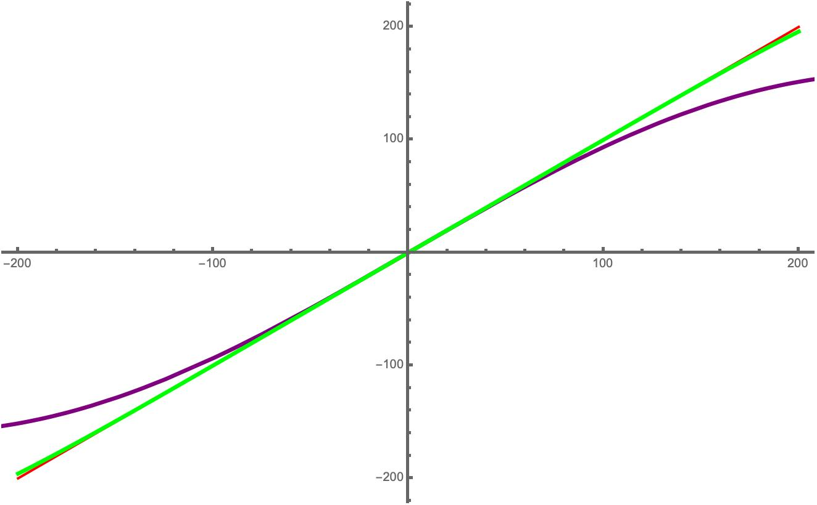
Our Approximation
Approximation Region
Sine
Sine Series
Sine Series Approximation of Order 3

Slide 42
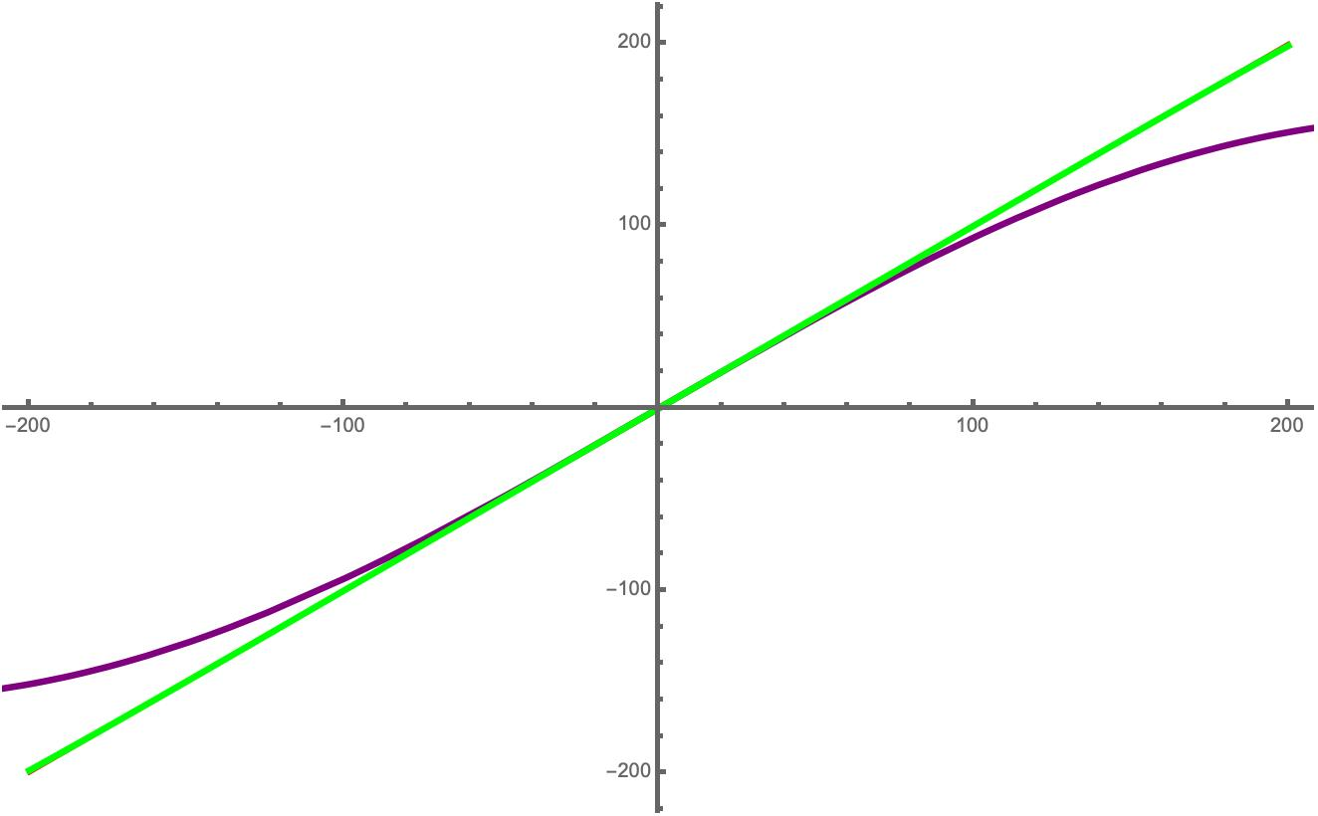
Our Approximation
Approximation Region
Sine
Sine Series
Sine Series Approximation of Order 4

Slide 43
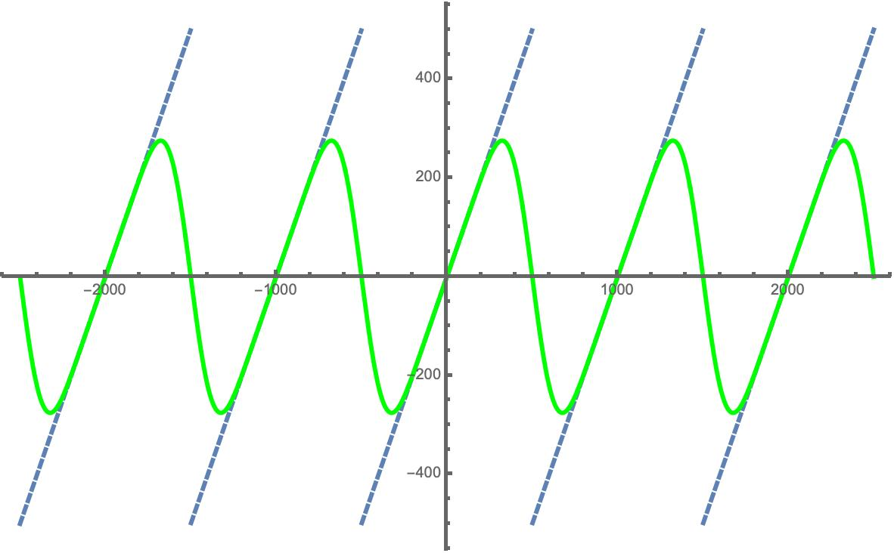
Our Approximation
Mod Function
Approximation Region
Sine Series
Sine Series Approximation of Order 4

Slide 44
Proof Challenges
Taylor series error bound is not good!
Need more advanced proof techniques
Calculate determinants of generalized Vandermonde matrices
Use well-known generating series of the complete homogeneous symmetric polynomials
Notes:
So what are some of the challenges to formally proving strong error bounds for our sine series approximation of the mod function? A first attempt would be to simply use the Lagrange remainder term of the Taylor series expansion of our approximation to bound the error. Unfortunately, this gives a poor error bound. We are able to exponentially improve on this error bound using more sophisticated techniques. We show a stronger error bound using Leibniz’s alternating series test. However, proving that our approximation satisfies the alternating series test is not immediate, and in order to do so, we have to calculate the determinants of generalized Vandermonde matrices. These are Vandermonde matrices where the last column is replaced with much higher powers. To calculate the determinants of generalized Vandermonde matrices, we use the well-known generating series of the complete homogeneous symmetric polynomials.

Slide 45
Our Approximation
Error of approximation is $O(qε^{2n+1})$where $ε=\frac{m}{q}$
Mod Function
Approximation Region
Sine Series
Sine Series Approximation of Order 4

Slide 46
Our Approximation
Error of approximation is $O(qε^{2n+1})$where $ε=\frac{m}{q}$
Mod Function
Approximation Region
Sine Series
Sine Series Approximation of Order 4

Slide 47
Our Approximation
Error of approximation is $O(qε^{2n+1})$where $ε=\frac{m}{q}$
Sine was $O(qε^{3})$
Mod Function
Approximation Region
Sine Series
Sine Series Approximation of Order 4

Slide 48
Our Approximation
Error of approximation is $O(qε^{2n+1})$where $ε=\frac{m}{q}$
We also show
|$β_{1}|<2$ and ${|β}_{k}|<1$
with $β_{k}$’s alternating sign
Sine was $O(qε^{3})$
Mod Function
Approximation Region
Sine Series
Sine Series Approximation of Order 4

Slide 49
Our Approximation
Error of approximation is $O(qε^{2n+1})$where $ε=\frac{m}{q}$
We also show
|$β_{1}|<2$ and ${|β}_{k}|<1$
with $β_{k}$’s alternating sign
Sine was $O(qε^{3})$
Small Coefficients
Mod Function
Approximation Region
Sine Series
Sine Series Approximation of Order 4

Slide 50
Homomorphically Computing Sine Series
Can use Taylor series approximation of $e^{ix}$ to determine $\sin{x}$
$e^{ix}=\cos{x+i\sin{x}}$
Can compute $e^{2ix}$ from $e^{ix}$
$e^{2ix}=\cos{2x+i\sin{2x}}$

Slide 51
Homomorphically Computing Sine Series
Can use Taylor series approximation of $e^{ix}$ to determine $\sin{x}$
$e^{ix}=\cos{x+i\sin{x}}$
Can compute $e^{2ix}$ from $e^{ix}$
$e^{2ix}=\cos{2x+i\sin{2x}}$
Can compute $\sum_{k=1}^{n}{β_{k}sin⁡(kx)}$ with low degree polynomial

Slide 52
Approximating the Mod Function
poly(·)
$$qI + m$$
$$m$$
Can assume $m << q$
1) Small Approximation Error
2) Low Degree
3) Small Coefficients

Slide 53
Evaluation
Implemented on top of the HEAAN library
Obtained 100 bit precision bootstrapping
Obtained using sine series of order 6
High precision computations supported!

Slide 54
Thank You!
https://eprint.iacr.org/2021/572

