Slide 1
SNARGs for P from Sub-exponential DDH and QR
James Hulett¹ Ruta Jawale¹
Dakshita Khurana¹ Akshayaram Srinivasan²
¹ University of Illinois Urbana-Champaign ² Tata Institute of Fundamental Research

Slide 2
Main Result
For any language decidable in time $T=T(n)$, we give a non-interactive argument system with
Proof size $n⋅T^{o(1)}$
Verifier time $n⋅T^{o(1)}$
Security against adversaries running in time $\text{poly}(T)$
assuming the sub-exponential hardness of DDH and QR with security parameter $λ=T^{o\left(1\right)}$

Slide 3
This Talk
For any language decidable in time $T=T(n)$ and space $S=S(n)$, we give a non-interactive argument system with
Proof size $(n+S)⋅T^{o(1)}$
Verifier time $(n+S)⋅T^{o(1)}$
Security against adversaries running in time $\text{poly}(T)$
assuming the sub-exponential hardness of DDH and QR with security parameter $λ=T^{o\left(1\right)}$
Known techniques [BKKSW18, KVZ21] give us main result

Slide 4
Prior Work on SNARGs
[Kil92, Mic94, BGLPT15, CHJV15, CH16, CCHR15, KLW15, CCCLLZ16, ACCLL16, PR17, KRR17, CCRR18, HL18, CCHLRRW18]: Assuming random oracles / obfuscation / optimally secure FHE / etc for NP
[KPY19]: Assuming new pairing-based falsifiable assumption for P
[JKKZ21]: Assuming sub-exponential LWE for bounded-depth P
[CJJ21a]: Assuming sub-exponential DDH and QR for batch-NP
[CJJ21b]: Assuming polynomial LWE for batch-NP
[CJJ21b, KVZ21]: Assuming polynomial LWE for P (compiler from batch-NP)
This work [HJKS21]: Assuming sub-exponential DDH and QR for P

Slide 5
Overview of Techniques
Extend notion of Fiat-Shamir compatibility [JKKZ21] to work for argument systems instead of only proof systems
Introduce a new interactive argument system for any language decidable in time $T$ and space $S$
Show that this new interactive argument satisfies the expanded definition of Fiat-Shamir compatibility, and so can be compressed to a non-interactive argument

Slide 6
Summary: Fiat-Shamir Compatibility [JKKZ21]
Proof system is Fiat-Shamir compatible if
It is round-by-round sound [CCHLRRW18]
The “bad challenges” can be (non-uniformly) efficiently enumerated
How do we generalize this notion to also apply to arguments?

Slide 7
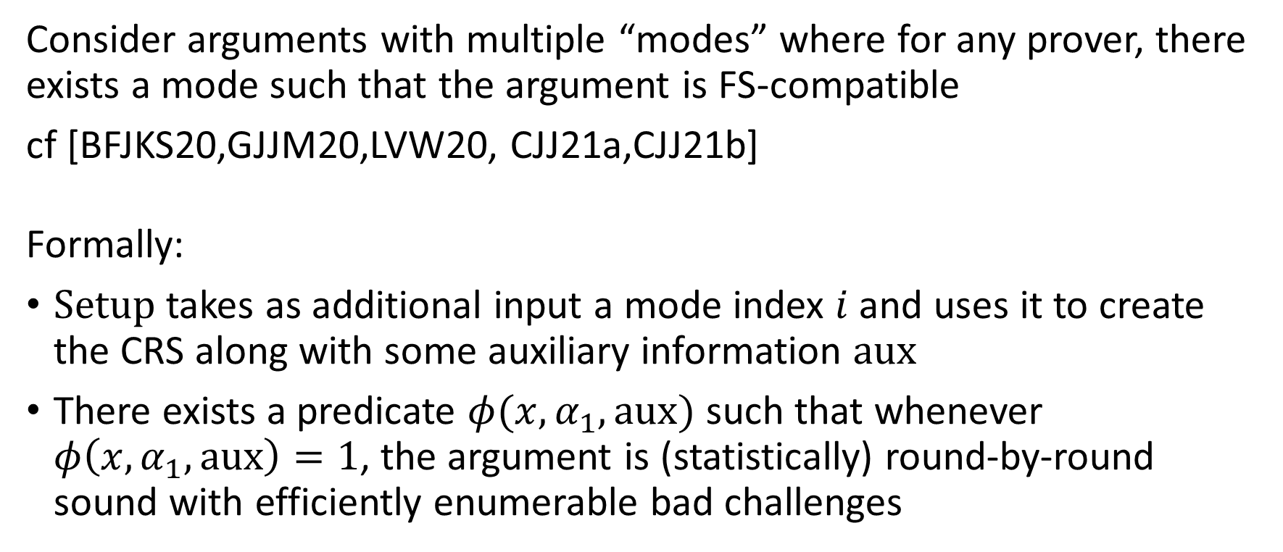
Fiat-Shamir Compatibility for Arguments
Consider arguments with multiple “modes” where for any prover, there exists a mode such that the argument is FS-compatible
cf [BFJKS20,GJJM20,LVW20, CJJ21a,CJJ21b]
Formally:
$\text{Setup}$ takes as additional input a mode index $i$ and uses it to create the CRS along with some auxiliary information $\text{aux}$
There exists a predicate $φ(x, α_{1}, \text{aux})$ such that whenever $φ\left(x, α_{1}, \text{aux}\right)=1$, the argument is (statistically) round-by-round sound with efficiently enumerable bad challenges

Slide 8
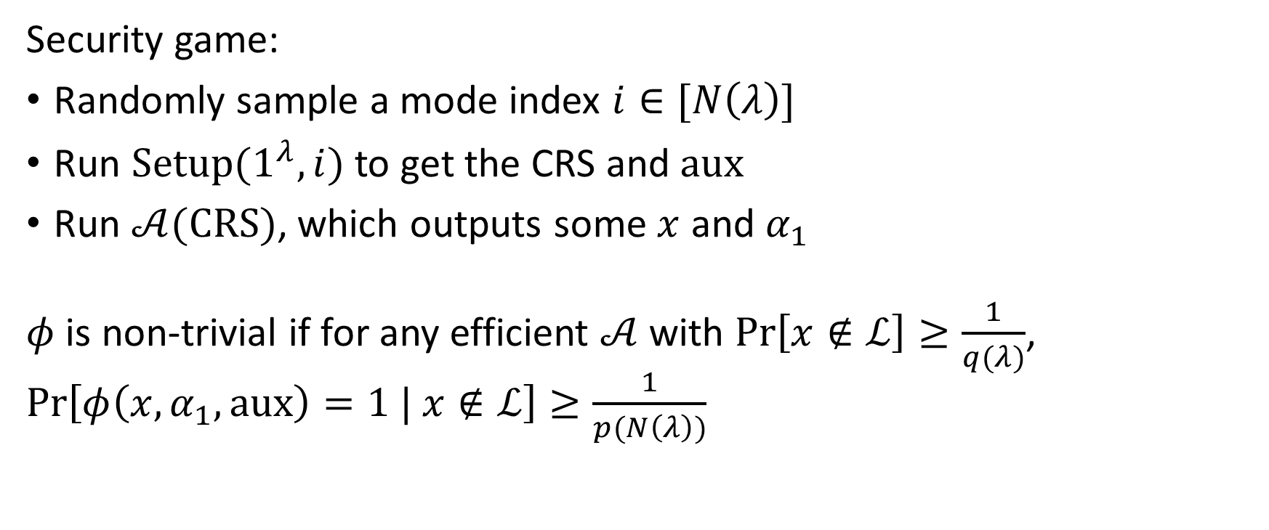
FSC for Arguments: Non-Trivial Predicate
Security game:
Randomly sample a mode index $i∈[N\left(λ\right)]$
Run $\text{Setup}\text{(}1^{λ}, i)$ to get the CRS and $\text{aux}$
Run $𝒜(\text{CRS})$, which outputs some $x$ and $α_{1}$
$φ$ is non-trivial if for any efficient $𝒜$ with $\text{Pr}\left[x∉ℒ\right]≥\frac{1}{q(λ)}$, $\text{Pr}\left[φ\left(x, α_{1},\text{aux}\right)=1 | x∉ℒ\right]≥\frac{1}{p(N\left(λ\right))}$

Slide 9
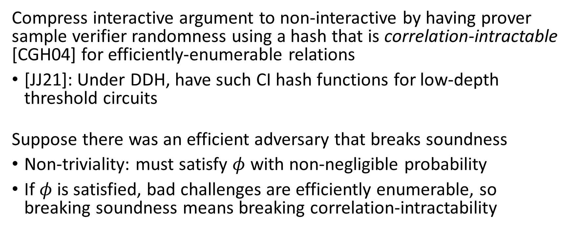
Why Fiat-Shamir Compatibility?
Compress interactive argument to non-interactive by having prover sample verifier randomness using a hash that is correlation-intractable [CGH04] for efficiently-enumerable relations
[JJ21]: Under DDH, have such CI hash functions for low-depth threshold circuits
Suppose there was an efficient adversary that breaks soundness
Non-triviality: must satisfy $φ$ with non-negligible probability
If $φ$ is satisfied, bad challenges are efficiently enumerable, so breaking soundness means breaking correlation-intractability

Slide 10
Interactive Argument Construction
Key idea: recursive proof building (cf [RRR16])
$$T$$
$s_{1}$, $s_{2}$, …, $s_{k−1}$
$$\text{Com}{\left(α_{1}^{\left(1\right)}, α_{1}^{\left(2\right)}, …, α_{1}^{\left(k\right)}\right)}^{}$$
$$s_{0}$$
$$\frac{T}{k}$$
$$\frac{T}{k}$$
$$\frac{T}{k}$$
…
$$\frac{T}{k}$$
$$s_{k}$$
$$β_{1}$$
$$s_{1}$$
$$s_{2}$$
$$s_{3}$$
$$s_{k−1}$$
…
$$β_{ℓ}$$
Prover
Verifier
Proof that committed transcripts would be accepted (batch-NP)

Slide 11
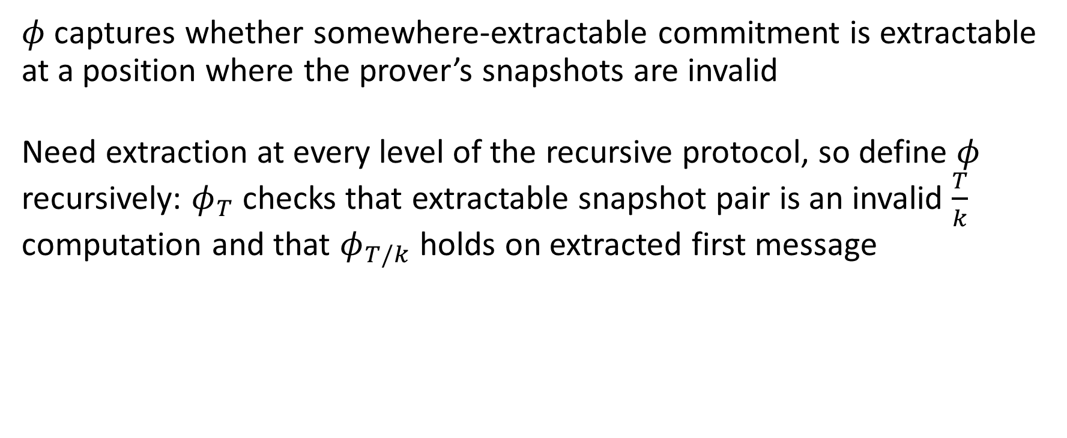
Proof of FSC: Predicate Definition
$φ$ captures whether somewhere-extractable commitment is extractable at a position where the prover’s snapshots are invalid
Need extraction at every level of the recursive protocol, so define $φ$ recursively: $φ_{T}$ checks that extractable snapshot pair is an invalid $\frac{T}{k}$ computation and that $φ_{T/k}$ holds on extracted first message

Slide 12
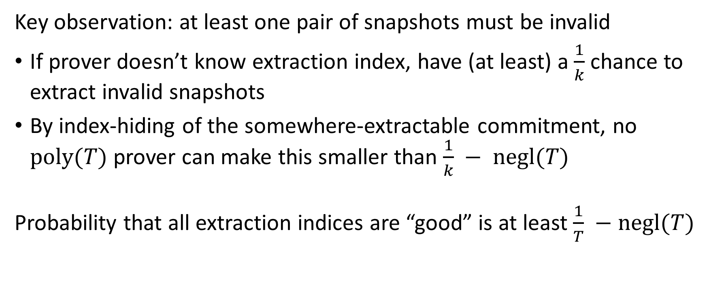
Proof of FSC: Non-Triviality
Key observation: at least one pair of snapshots must be invalid
If prover doesn’t know extraction index, have (at least) a $\frac{1}{k}$ chance to extract invalid snapshots
By index-hiding of the somewhere-extractable commitment, no $\text{poly}(T)$ prover can make this smaller than $\frac{1}{k} − \text{negl}(T)$
Probability that all extraction indices are “good” is at least $\frac{1}{T} −\text{negl}(T)$

Slide 13
Proof of FSC: Round-By-Round Soundness
“Emulation phase”:
Since predicate holds, extractable proof is for a false statement
By induction, extractable proof has efficient enumeration of bad challenges, so use those
“Batch-NP phase”:
If no bad challenges before, extractable transcript is rejecting
Then batch-NP has efficient enumeration of bad challenges [CJJ21a]

Slide 14
Thank You!

