Slide 1
Encryption end-runs
Legal challenges from around the world

Slide 2
Encryption policy context
CDT is in Brussels and Washington DC to watchdog impacts of technology policy on privacy, expression and civic space. We participate in IETF and W3C because policy implications are inherent in fundamental communications protocols.
GEC mission is to promote and defend the use of strong encryption around the world, steered by CDT, ISOC and GPD.
Thanks to those of you in the audience who are technical advisors to the GEC.
Global Encryption Day is 21 October.

Slide 4
Encryption policy playbook
Move the goal post
Import/export controls
Licencing
Max/min key length
Tackle: Compelled decryption
End run: Lawful intercept

Slide 5
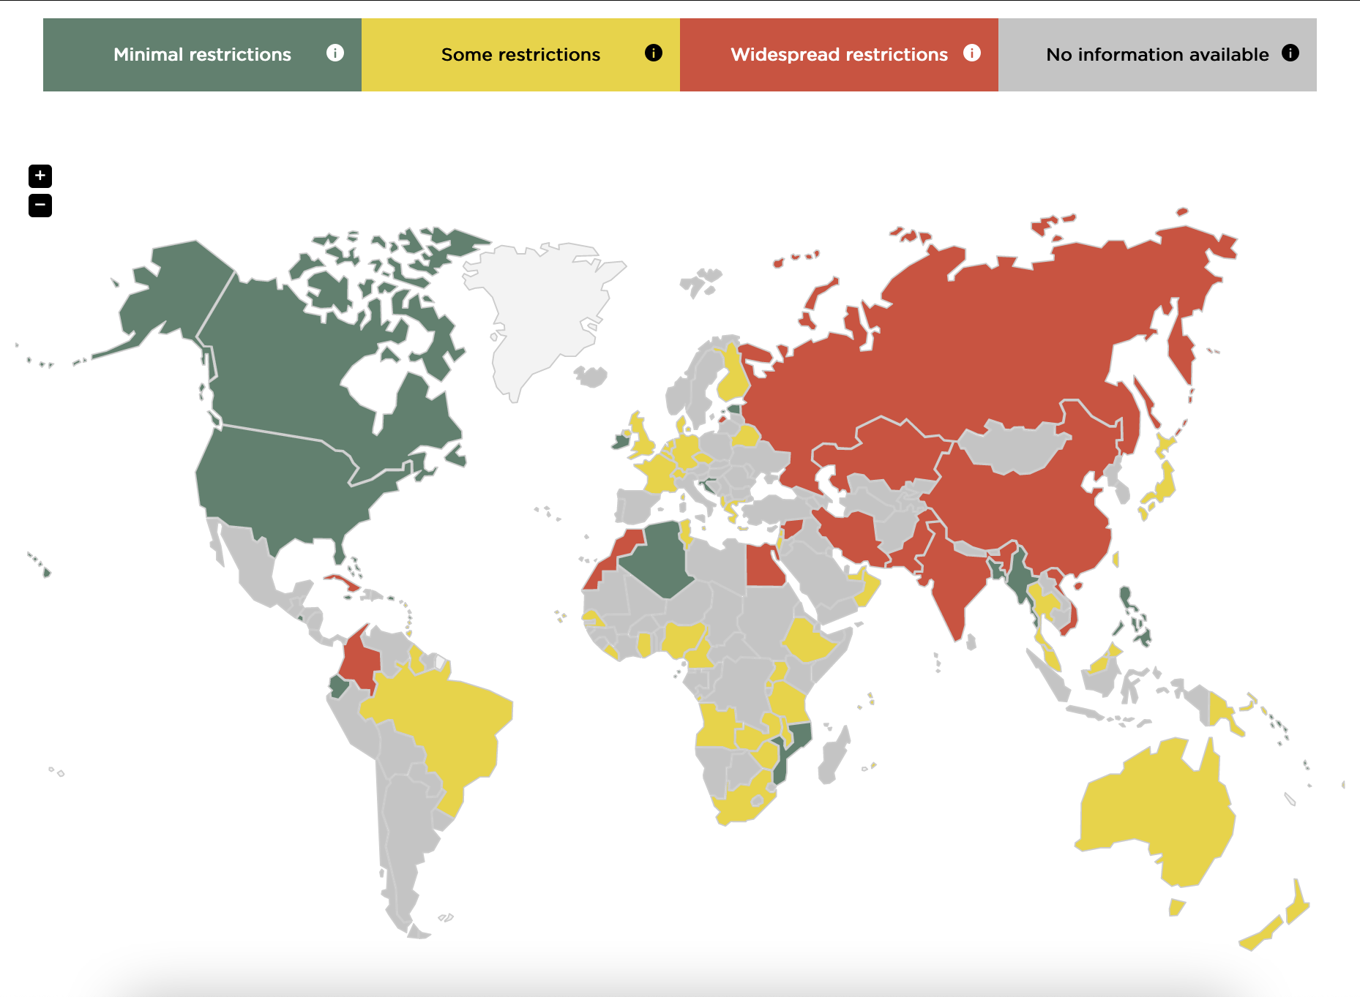

Slide 6
Critical intersections
Trust and safety
Terrorism
Child safety
Cybercrime
Intellectual property law
Criminal law
Define encryption
Free expression and association, right to information
Information security
Constitutional law
Human rights framework
Privacy, data protection and localisation
Define encryption
Proportionality requirements
Commerce, antitrust and competition
Interoperability

Slide 7
Photo by Niloy Biswas on Unsplash.

Slide 8
Bangladesh and law enforcement
The issue of “crime rings” use of apps has captured civic dialogue where it’s viewed the government is only catching up (and that other governments are far ahead).
Enhance metadata to track down known content,
Force platform compliance in order to operate in country.
Government passed the 'Regulation for Digital, Social Media and OTT Platforms' last month in 2022.
Other countries where traceability requirements have appeared in regulations: India 2021, Brazil (ongoing).
Other countries proposing LEA compliance features through regulation: Australia (2018); Belgium (defeated 2021), UK, EU, US (ongoing).

Slide 9
Photo by Endalk Chala on Global Voices.

Slide 10
Ethiopia and digital authoritarians
The Zone9 bloggers were arrested in 2014. Here the aim is to protect against free expression and dissent, and in this case under the cover of clandestine tools.
Make the use of encryption a crime,
Make encryption synonymous with clandestine terrorism and crime.
Government invoked criminal code from 2004, updated in 2016.
Other countries where regulation simply prohibits implementers rolling out encryption features: China, Belarus, Colombia, Egypt, Iran, Kazakhstan, Saudi Arabia, South Africa, Russia, Syria, Turkmenistan, Uganda and Pakistan.

Slide 11
@bullsbears2010 on Twitter.

Slide 12
Zimbabwe and censors
In 2016 with the economy on fire #shutdownzim protesters were threatened by Mugabe that their (newly encrypted) WhatsApp activity was being monitored, followed by a shutdown.
WA entered the Zimbabwe market in 2014 with credit bundles.
Shutdown affected finance, health and safety, reporting and journalism.
Single-app precarity, public crisis, no data localisation created the perfect storm.
Other countries shutting down internet/e2ee apps: Russia, Belarus, China, Cuba, Iran, Senegal, Nigeria, Chad, Ethiopia, India, Pakistan, Myanmar, Syria, Jordan.

Slide 13
Photo by mauro mora on Unsplash.

Slide 14
The long view
Risks are:
Copycat regulation.
Good (and bad) laws can be undone.
Three strategies:
Contain the privacy vs safety narrative’s sway over policy (direct end run)
Cover critical intersections impacting e2ee (policy pivots)
Protect civil liberties against compelled decryption, client-side scanning (direct intrusion)

Slide 15
@mallory on Github. | @malloryknodel on Twitter.

