Slide 1
Justifying Standard Parameters in the TLS 1.3 Handshake
Tighter and More Realistic Security Proofs for the TLS 1.3 1-RTT and PSK Modes
Hannah Davis¹ Denis Diemert² Felix Günther³ Tibor Jager²
¹University of California San Diego ²University of Wuppertal ³ETH Zürich
Notes:
Hi my name is Hannah Davis and today I am here to talk about how to give tight security bounds for the TLS 1.3 handshake protocol, and why it’s critical to this security that the first byte of the encoded length of the legacy session ID of a ClientHello message never equals the hexadecimal integers 36 or 5c. This is based on work by Denis Diemert, Felix Gunther, and Tibor Jager.

Slide 2
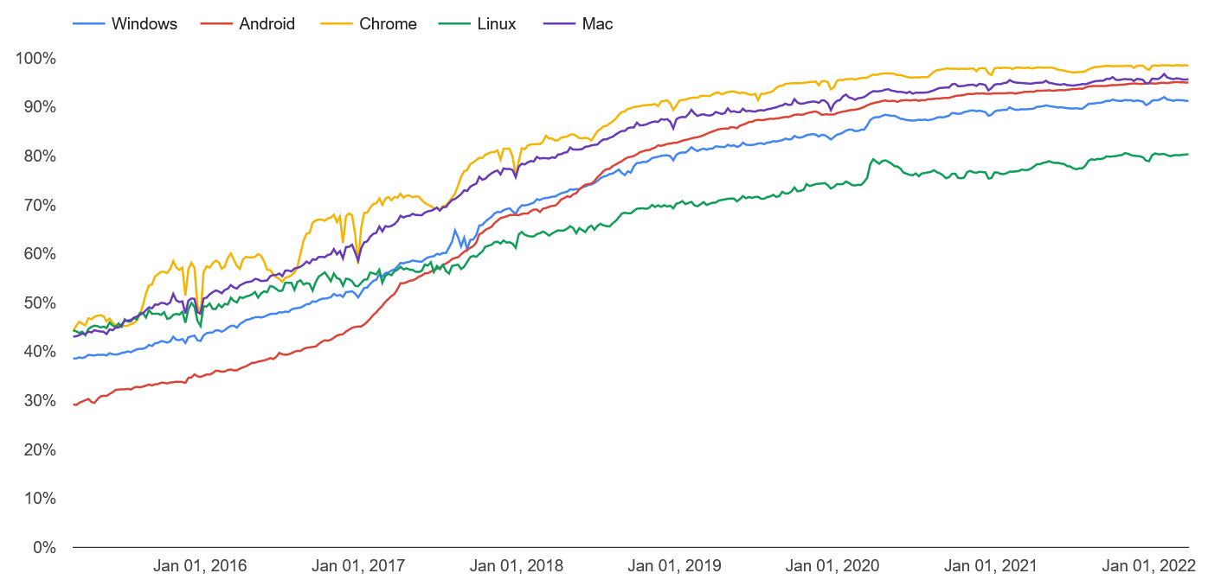
The Handshake Protocol
HTTPS adoption statistics in Chrome: 2015-2022
Client
Server
An authenticated key exchange protocol
[ Google Chrome Transparency Report, Jan 22]
63% of top 1M servers prefer TLS version 1.3 [F5 Labs, Oct 21]
Notes:
Since its release in 2018, TLS 1.3 has seen widespread adoption; last year it became the most preferred version across the top one million servers.

Slide 3
The Handshake Protocol
Full Handshake (1-RTT)
Client
Server
An authenticated key exchange protocol
Pre-Shared Key Mode (0-RTT)
PSK-(EC)DHE
Early data
Early data
+ forward secrecy
Notes:
The TLS 1.3 handshake usually refers to the full handshake, which uses public-key certificates for authentication, but there are also two other variants that we will discuss. Pre-shared key mode uses symmetric keys that the client and server already share to leverage a more efficient handshake with early application data. It’s mainly used for session resumption and low-power devices. It’s also possible to extend the pre-shared key handshake with an extra Diffie-hellman key exchange to add forward secrecy.

Slide 4
Security Bounds for TLS 1.3
A TLS 1.3 1-RTT configuration
Diffie-Hellman Group G
Hash Function H
Digital Signature Scheme S
Notes:
To prove security for a complex protocol like the TLS 1.3 handshake, we break it down into its building blocks. For the full handshake, those include a Diffie-Hellman group, a cryptographic hash function, and a digital signature scheme. In practice, there are several choices for each of these, as part of the standardized ciphersuites and other configuration options. The security of the handshake as a whole depends on the security of its parameters, which can guarantee different levels of security and efficiency.
<>
Dowling et al. capture that in this theorem.

Slide 5
Security Bounds for TLS 1.3
A TLS 1.3 1-RTT configuration
Finite fields:
ffdhe2048,
ffdhe3072,
ffdhe4096…
Elliptic curves:
secp256r1,
x25519,
secp384r1…
Diffie-Hellman Group G
or
Hash Function H
SHA256 or SHA384
Digital Signature Scheme S
RSAPSS
ECDSA
EDDSA
Notes:
To prove security for a complex protocol like the TLS 1.3 handshake, we break it down into its building blocks. For the full handshake, those include a Diffie-Hellman group, a cryptographic hash function, and a digital signature scheme. In practice, there are several choices for each of these, as part of the standardized ciphersuites and other configuration options. The security of the handshake as a whole depends on the security of its parameters, which can guarantee different levels of security and efficiency.
<>
Dowling et al. capture that in this theorem.

Slide 6
Security Bounds for TLS 1.3
A TLS 1.3 1-RTT configuration
Finite fields:
ffdhe2048,
ffdhe3072,
ffdhe4096…
Elliptic curves:
secp256r1,
x25519,
secp384r1…
Diffie-Hellman Group G
or
Hash Function H
SHA256 or SHA384
Digital Signature Scheme S
RSAPSS
ECDSA
EDDSA
Definition:
“b bits
of security”
b
2 =
Max Runtime
Max Advantage
Notes:
To prove security for a complex protocol like the TLS 1.3 handshake, we break it down into its building blocks. For the full handshake, those include a Diffie-Hellman group, a cryptographic hash function, and a digital signature scheme. In practice, there are several choices for each of these, as part of the standardized ciphersuites and other configuration options. The security of the handshake as a whole depends on the security of its parameters, which can guarantee different levels of security and efficiency.
<>
Dowling et al. capture that in this theorem.

Slide 7
Security Bounds for TLS 1.3
A TLS 1.3 1-RTT configuration
Finite fields:
ffdhe2048,
ffdhe3072,
ffdhe4096…
Elliptic curves:
secp256r1,
x25519,
secp384r1…
Diffie-Hellman Group G
or
128-bit
configuration:
192-bit
configuration:
Hash Function H
x25519
secp384r1
SHA256 or SHA384
ed25519
ECDSA_secp384r1
RSAPSS
ECDSA
EDDSA
G
Digital Signature Scheme S
SHA-256
SHA-384
Definition:
“b bits
of security”
b
2 =
Max Runtime
Max Advantage
Notes:
To prove security for a complex protocol like the TLS 1.3 handshake, we break it down into its building blocks. For the full handshake, those include a Diffie-Hellman group, a cryptographic hash function, and a digital signature scheme. In practice, there are several choices for each of these, as part of the standardized ciphersuites and other configuration options. The security of the handshake as a whole depends on the security of its parameters, which can guarantee different levels of security and efficiency.
<>
Dowling et al. capture that in this theorem.

Slide 8
Security Bounds for TLS 1.3
A TLS 1.3 1-RTT configuration
Finite fields:
ffdhe2048,
ffdhe3072,
ffdhe4096…
Elliptic curves:
secp256r1,
x25519,
secp384r1…
Diffie-Hellman Group G
or
128-bit
configuration:
192-bit
configuration:
Hash Function H
x25519
secp384r1
SHA256 or SHA384
ed25519
ECDSA_secp384r1
RSAPSS
ECDSA
EDDSA
G
Digital Signature Scheme S
SHA-256
SHA-384
Theorem [DFGS21]:
Adv(A, TLS 1.3) ≤ S² *Adv(B₁, G) + 6S * Adv(B₂, H) + S * U * Adv(B₃, S) +…
Definition:
“b bits
of security”
b
2 =
Max Runtime
Max Advantage
Notes:
To prove security for a complex protocol like the TLS 1.3 handshake, we break it down into its building blocks. For the full handshake, those include a Diffie-Hellman group, a cryptographic hash function, and a digital signature scheme. In practice, there are several choices for each of these, as part of the standardized ciphersuites and other configuration options. The security of the handshake as a whole depends on the security of its parameters, which can guarantee different levels of security and efficiency.
<>
Dowling et al. capture that in this theorem.

Slide 9
Security Bounds for TLS 1.3
Theorem [DFGS21]:
128-bit
configuration:
192-bit
configuration:
Given an adversary
A
x25519
secp384r1
ed25519
ECDSA_secp384r1
G
SHA-256
SHA-384
Adv(A, TLS 1.3) ≤ S² *Adv(B₁, G) + 6S * Adv(B₂, H) + S * U * Adv(B₃, S) +…
Notes:
The theorem bounds the probability that of an attacker trying to break the handshake by a function of its resources: runtime and the number of honest sessions and users it can interact with, and by the individual security of each of its components.
A theorem like this, where the multipliers are polynomial functions, means that we can make the probability of a break as small as we like, provided we’re willing to pick sufficiently secure parameters. <>

Slide 10
Security Bounds for TLS 1.3
Theorem [DFGS21]:
128-bit
configuration:
192-bit
configuration:
Given an adversary
A
x25519
secp384r1
with some resources
T:
ed25519
ECDSA_secp384r1
G
SHA-256
SHA-384
Adv(A, TLS 1.3) ≤ S² *Adv(B₁, G) + 6S * Adv(B₂, H) + S * U * Adv(B₃, S) +…
Notes:
The theorem bounds the probability that of an attacker trying to break the handshake by a function of its resources: runtime and the number of honest sessions and users it can interact with, and by the individual security of each of its components.
A theorem like this, where the multipliers are polynomial functions, means that we can make the probability of a break as small as we like, provided we’re willing to pick sufficiently secure parameters. <>

Slide 11
Security Bounds for TLS 1.3
Theorem [DFGS21]:
128-bit
configuration:
192-bit
configuration:
Given an adversary
A
x25519
secp384r1
with some resources
T:
S:
ed25519
ECDSA_secp384r1
G
SHA-256
SHA-384
Adv(A, TLS 1.3) ≤ S² *Adv(B₁, G) + 6S * Adv(B₂, H) + S * U * Adv(B₃, S) +…
Notes:
The theorem bounds the probability that of an attacker trying to break the handshake by a function of its resources: runtime and the number of honest sessions and users it can interact with, and by the individual security of each of its components.
A theorem like this, where the multipliers are polynomial functions, means that we can make the probability of a break as small as we like, provided we’re willing to pick sufficiently secure parameters. <>

Slide 12
Security Bounds for TLS 1.3
Theorem [DFGS21]:
128-bit
configuration:
192-bit
configuration:
Given an adversary
A
x25519
secp384r1
with some resources
T:
S:
U:
ed25519
ECDSA_secp384r1
G
SHA-256
SHA-384
Adv(A, TLS 1.3) ≤ S² *Adv(B₁, G) + 6S * Adv(B₂, H) + S * U * Adv(B₃, S) +…
Notes:
The theorem bounds the probability that of an attacker trying to break the handshake by a function of its resources: runtime and the number of honest sessions and users it can interact with, and by the individual security of each of its components.
A theorem like this, where the multipliers are polynomial functions, means that we can make the probability of a break as small as we like, provided we’re willing to pick sufficiently secure parameters. <>

Slide 13
Security Bounds for TLS 1.3
Theorem [DFGS21]:
128-bit
configuration:
192-bit
configuration:
Given an adversary
A
x25519
secp384r1
with some resources
T:
S:
U:
ed25519
ECDSA_secp384r1
G
SHA-256
SHA-384
A
can break the security of is
The probability that
TLS 1.3 [G,H,S]
Adv(A, TLS 1.3) ≤ S² *Adv(B₁, G) + 6S * Adv(B₂, H) + S * U * Adv(B₃, S) +…
Notes:
The theorem bounds the probability that of an attacker trying to break the handshake by a function of its resources: runtime and the number of honest sessions and users it can interact with, and by the individual security of each of its components.
A theorem like this, where the multipliers are polynomial functions, means that we can make the probability of a break as small as we like, provided we’re willing to pick sufficiently secure parameters. <>

Slide 14
Security Bounds for TLS 1.3
Theorem [DFGS21]:
128-bit
configuration:
192-bit
configuration:
Given an adversary
A
x25519
secp384r1
with some resources
T:
S:
U:
ed25519
ECDSA_secp384r1
G
SHA-256
SHA-384
A
can break the security of is
The probability that
TLS 1.3 [G,H,S]
Adv(A, TLS 1.3) ≤ S² *Adv(B₁, G) + 6S * Adv(B₂, H) + S * U * Adv(B₃, S) +…
Security of the Diffie-Hellman group
Notes:
The theorem bounds the probability that of an attacker trying to break the handshake by a function of its resources: runtime and the number of honest sessions and users it can interact with, and by the individual security of each of its components.
A theorem like this, where the multipliers are polynomial functions, means that we can make the probability of a break as small as we like, provided we’re willing to pick sufficiently secure parameters. <>

Slide 15
Security Bounds for TLS 1.3
Theorem [DFGS21]:
128-bit
configuration:
192-bit
configuration:
Given an adversary
A
x25519
secp384r1
with some resources
T:
S:
U:
ed25519
ECDSA_secp384r1
G
SHA-256
SHA-384
A
can break the security of is
The probability that
TLS 1.3 [G,H,S]
Adv(A, TLS 1.3) ≤ S² *Adv(B₁, G) + 6S * Adv(B₂, H) + S * U * Adv(B₃, S) +…
#sessions
Security of the Diffie-Hellman group
Notes:
The theorem bounds the probability that of an attacker trying to break the handshake by a function of its resources: runtime and the number of honest sessions and users it can interact with, and by the individual security of each of its components.
A theorem like this, where the multipliers are polynomial functions, means that we can make the probability of a break as small as we like, provided we’re willing to pick sufficiently secure parameters. <>

Slide 16
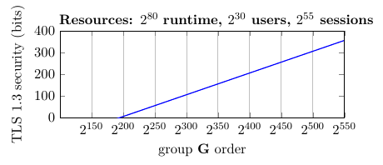
Security Bounds for TLS 1.3
Adv(A, TLS 1.3) ≤ S² *Adv(B₁, G) + 6S * Adv(B₂, H) + S * U * Adv(B₃, S) +…
Strong adversary
Notes:
We can demonstrate this approach for just one parameter; the Diffie-Hellman group, by plotting the size of the group against the security level that the Dowling bound guarantees for the resulting handshake. We can see that against either a large or small adversary, we can always guarantee more security by using a larger group. Scaling up will hurt efficiency, of course, but there are also bigger problems.

Slide 17
Security Bounds for TLS 1.3
Adv(A, TLS 1.3) ≤ S² *Adv(B₁, G) + 6S * Adv(B₂, H) + S * U * Adv(B₃, S) +…
Only standardized parameters matter in practice!
Strong adversary
5 elliptic curve groups
5 finite field groups
Notes:
We can demonstrate this approach for just one parameter; the Diffie-Hellman group, by plotting the size of the group against the security level that the Dowling bound guarantees for the resulting handshake. We can see that against either a large or small adversary, we can always guarantee more security by using a larger group. Scaling up will hurt efficiency, of course, but there are also bigger problems.

Slide 18
Security Bounds for TLS 1.3
Adv(A, TLS 1.3) ≤ S² *Adv(B₁, G) + 6S * Adv(B₂, H) + S * U * Adv(B₃, S) +…
Only standardized parameters matter in practice!
Strong adversary
secp256r1
x25519
secp521r1
5 elliptic curve groups
5 finite field groups
x448
secp384r1
Notes:
We can demonstrate this approach for just one parameter; the Diffie-Hellman group, by plotting the size of the group against the security level that the Dowling bound guarantees for the resulting handshake. We can see that against either a large or small adversary, we can always guarantee more security by using a larger group. Scaling up will hurt efficiency, of course, but there are also bigger problems.

Slide 19
Security Bounds for TLS 1.3
Adv(A, TLS 1.3) ≤ S² *Adv(B₁, G) + 6S * Adv(B₂, H) + S * U * Adv(B₃, S) +…
Only standardized parameters matter in practice!
Strong adversary
secp256r1
x25519
secp521r1
5 elliptic curve groups
5 finite field groups
x448
90% of all TLS 1.3 handshakes use 128-bit curves.
secp384r1
Notes:
We can demonstrate this approach for just one parameter; the Diffie-Hellman group, by plotting the size of the group against the security level that the Dowling bound guarantees for the resulting handshake. We can see that against either a large or small adversary, we can always guarantee more security by using a larger group. Scaling up will hurt efficiency, of course, but there are also bigger problems.

Slide 20
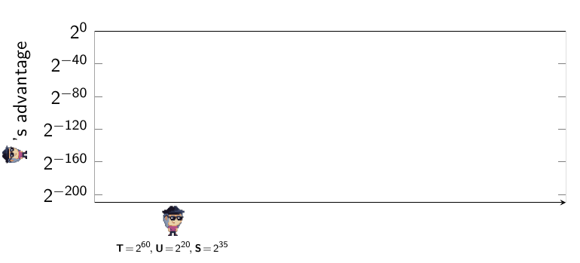
A Concrete Evaluation
Theorem [DFGS21]:
Adv(A, TLS 1.3) ≤ S² *Adv(B₁, G) + 6S * Adv(B₂, H) + S * U * Adv(B₃, S) +…
128-bit configuration:
Probability that breaks the security of TLS 1.3
x25519
ed25519
SHA-256
T = Runtime
U = Users
S = Sessions
128
Max Runtime
2 =
Max Advantage
Notes:
Since we are restricted by the standard to only a few reasonable configurations, we decided to evaluate the prior bounds at precisely these points, starting with our 128-bit secure example from a few slides before. We start with a weak We would hope, then, that the resulting instantiation of TLS 1.3 would guarantee 128 bit security for its session keys as well. Unfortunately, this isn’t the case. As we consider more powerful attackers, including those with nation-state-scaled resources, we see that the concrete security guarantees become entirely vacuous. For a powerful attacker, the theorem can only say that the probability of breaking this handshake is 1 or less.

Slide 21
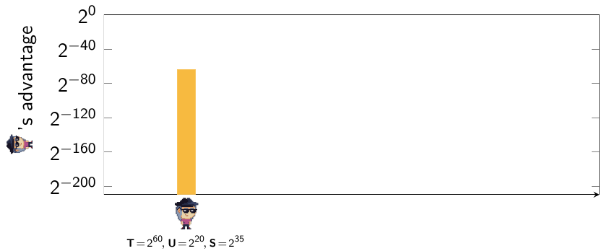
A Concrete Evaluation
Theorem [DFGS21]:
Adv(A, TLS 1.3) ≤ S² *Adv(B₁, G) + 6S * Adv(B₂, H) + S * U * Adv(B₃, S) +…
128-bit configuration:
Probability that breaks the security of TLS 1.3
x25519
ed25519
SHA-256
T = Runtime
U = Users
S = Sessions
128
Max Runtime
2 =
Max Advantage
Notes:
Since we are restricted by the standard to only a few reasonable configurations, we decided to evaluate the prior bounds at precisely these points, starting with our 128-bit secure example from a few slides before. We can start with our relatively weak adversary, plug in the numbers, and get out a bound on the advantage. To understand the result, we need a target security level. Since all of our components have 128-bit security, and the resulting session keys will be compatible with AES128, we’ll target 128-bit security as well, which translates, for runtime of 2^60 operations, into a target advantage of at most 2^-68. we see that the Dowling bound falls just short of guaranteeing this.

Slide 22
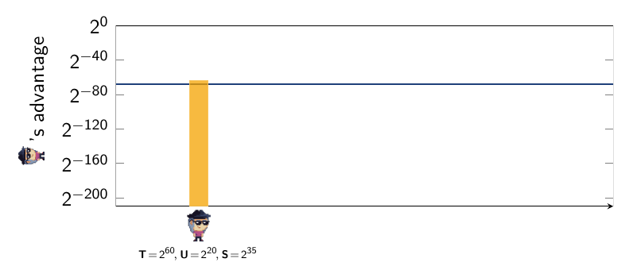
A Concrete Evaluation
Theorem [DFGS21]:
Adv(A, TLS 1.3) ≤ S² *Adv(B₁, G) + 6S * Adv(B₂, H) + S * U * Adv(B₃, S) +…
128-bit configuration:
Probability that breaks the security of TLS 1.3
x25519
ed25519
SHA-256
T = Runtime
U = Users
S = Sessions
128
Max Runtime
2 =
Max Advantage
Notes:
Since we are restricted by the standard to only a few reasonable configurations, we decided to evaluate the prior bounds at precisely these points, starting with our 128-bit secure example from a few slides before. We can start with our relatively weak adversary, plug in the numbers, and get out a bound on the advantage. To understand the result, we need a target security level. Since all of our components have 128-bit security, and the resulting session keys will be compatible with AES128, we’ll target 128-bit security as well, which translates, for runtime of 2^60 operations, into a target advantage of at most 2^-68. we see that the Dowling bound falls just short of guaranteeing this.

Slide 23
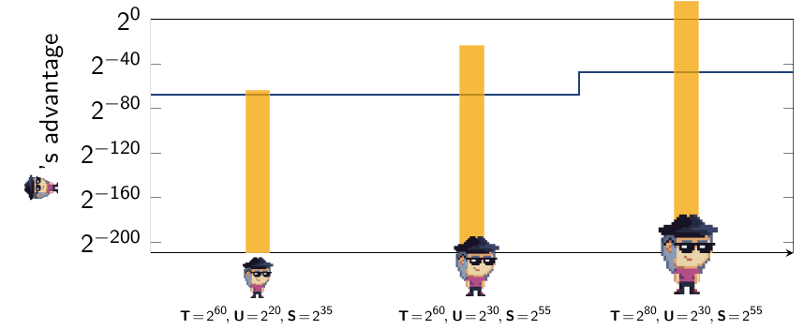
A Concrete Evaluation
Theorem [DFGS21]:
Adv(A, TLS 1.3) ≤ S² *Adv(B₁, G) + 6S * Adv(B₂, H) + S * U * Adv(B₃, S) +…
128-bit configuration:
Probability that breaks the security of TLS 1.3
x25519
ed25519
SHA-256
T = Runtime
U = Users
S = Sessions
128
Max Runtime
2 =
Max Advantage

Slide 24
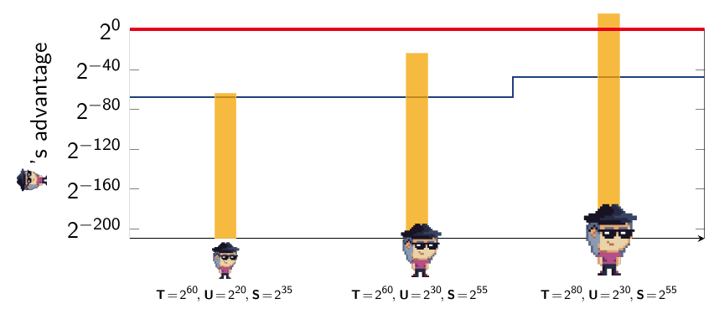
A Concrete Evaluation
Theorem [DFGS21]:
Adv(A, TLS 1.3) ≤ S² *Adv(B₁, G) + 6S * Adv(B₂, H) + S * U * Adv(B₃, S) +…
128-bit configuration:
Probability that breaks the security of TLS 1.3
x25519
ed25519
SHA-256
T = Runtime
U = Users
S = Sessions
128
Max Runtime
2 =
Max Advantage
Notes:
For a powerful attacker, the theorem can only say that the probability of breaking this handshake is 1 or less.

Slide 25
The Benefits of Tightness
Theorem [DFGS21]:
Adv(A, TLS 1.3) ≤ S² *Adv(B₁, G) + 6S * Adv(B₂, H) + S * U * Adv(B₃, S) +…
The reduction to the Diffie-Hellman
group is not tight.
Probability that breaks the security of TLS 1.3
Notes:
The reason the theorem is not giving us the guarantees we want is that it is not tight, meaning the functions of the adversary’s resources are not constant. The S^2 term means that the reduction to the Diffie Hellman assumption is quadratic in the number of total TLS 1.3 handshake sessions, which is in the billions per day.

Slide 26
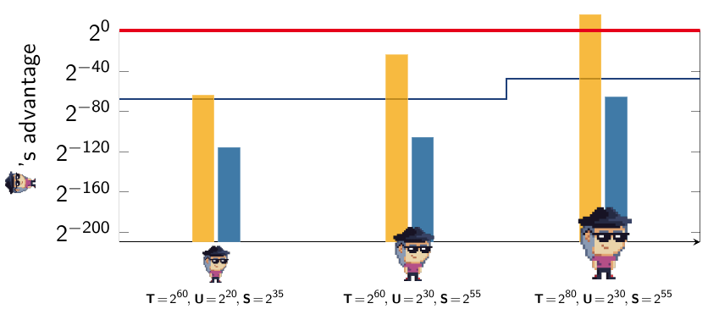
The Benefits of Tightness
Theorem [DFGS21]:
Adv(A, TLS 1.3) ≤ S² *Adv(B₁, G) + 6S * Adv(B₂, H) + S * U * Adv(B₃, S) +…
Theorem [DG21][DJ21]:
Adv(A, TLS 1.3) ≤ 4 * Adv(B₁, G) + 4 * Adv(B₂, H) + U * Adv(B₃, S) +…
Probability that breaks the security of TLS 1.3
128-bit configuration:
x25519
ed25519
SHA-256
Notes:
The reason the theorem is not giving us the guarantees we want is that it is not tight, meaning the functions of the adversary’s resources are not constant. The S^2 term means that the reduction to the Diffie Hellman assumption is quadratic in the number of total TLS 1.3 handshake sessions, which is in the billions per day.

Slide 27
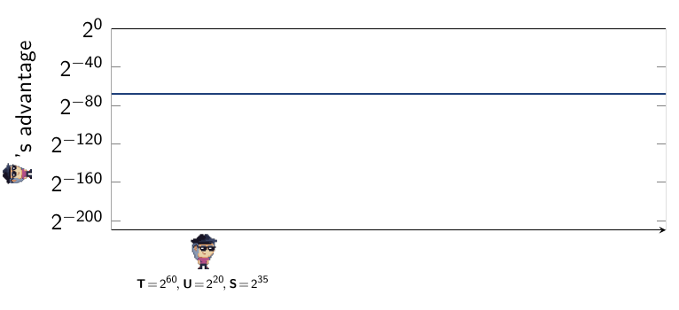
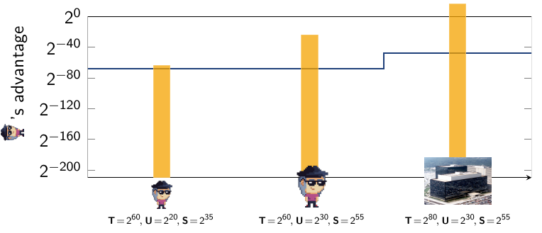
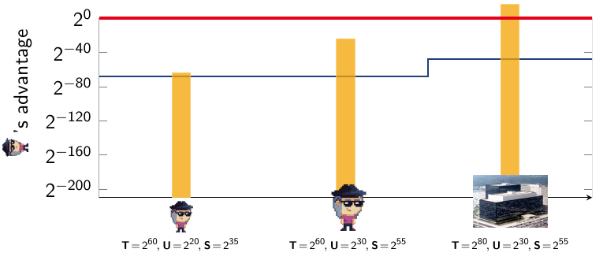
The Benefits of Tightness
Theorem [DFGS21]:
Adv(A, TLS 1.3) ≤ S² *Adv(B₁, G) + 6S * Adv(B₂, H) + S * U * Adv(B₃, S) +…
Theorem [DG21][DJ21]:
Adv(A, TLS 1.3) ≤ 4 * Adv(B₁, G) + 4 * Adv(B₂, H) + U * Adv(B₃, S) +…
Our bounds are tighter
than prior results.
Probability that breaks the security of TLS 1.3
128-bit configuration:
Empty graph
x25519
ed25519
SHA-256
Notes:
As a main contribution, we gave bounds for all three modes that reduce this loss to a constant, and thus we’re able to achieve the desired guarantees of 128-bit security for the standardized parameter set.

Slide 28
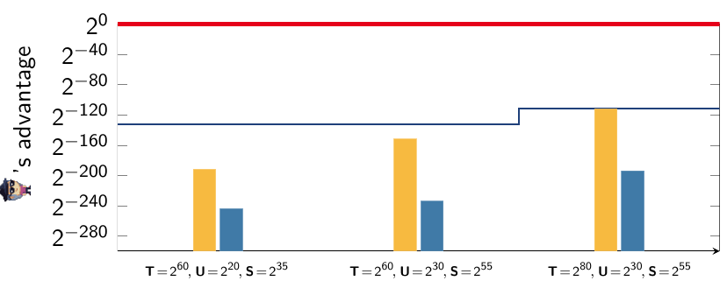
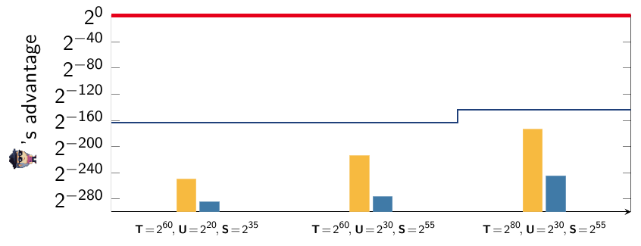
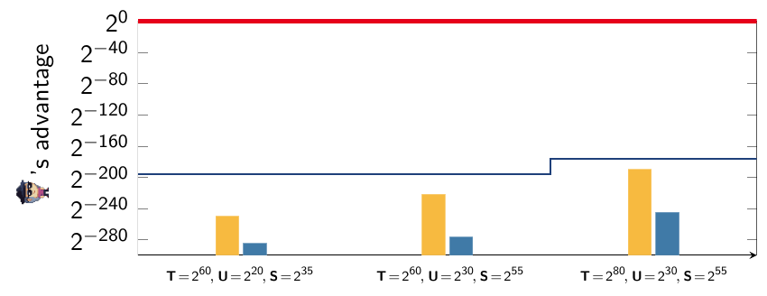
Full Handshake (1-RTT) configurations:
secp384r1
ECDSA_secp384r1
SHA-384
: ECDSA
x448
ed448
SHA-384
secp384r1
ECDSA_secp384r1
SHA-384
Notes:
Our tighter bounds achieve this sort of improvement across all three modes of the TLS 1.3 handshake, and all of the standardized elliptic curves. We performed these evaluations for all the elliptic curve groups and ciphersuites in the TLS 1.3 specification.
Wider variety of adversaries
Minimum and maximum bit improvement over all adversaries/suites for each of 3 papers/modes
Higher-security standardized curves (secp521) do grant more security under previous bounds, but still do not meet target levels for most of the adversaries we considered. Our bounds do.
Foreshadow: no results for psk-SHA384

Slide 29
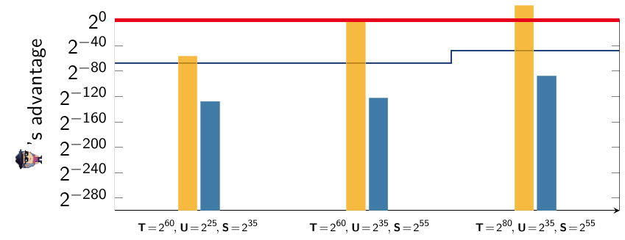
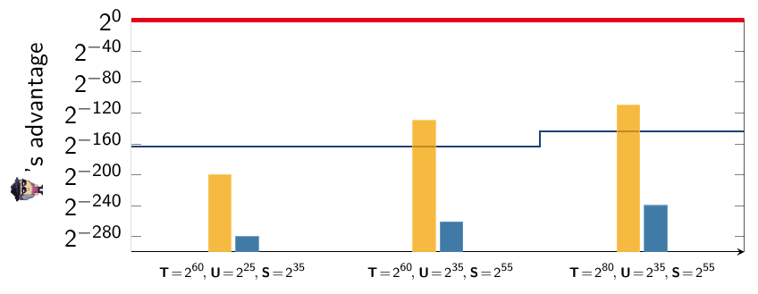
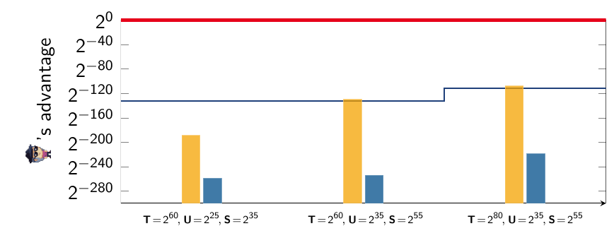
Full Handshake (1-RTT) configurations:
PSK-(EC)DHE configurations:
secp384r1
ECDSA_secp384r1
SHA-384
x25519
SHA-256
: ECDSA
x448
ed448
SHA-384
x448
SHA-384
secp384r1
ECDSA_secp384r1
SHA-384
secp384r1
SHA-384
secp384r1
Notes:
Our tighter bounds achieve this sort of improvement across all three modes of the TLS 1.3 handshake, and all of the standardized elliptic curves. We performed these evaluations for all the elliptic curve groups and ciphersuites in the TLS 1.3 specification.
Wider variety of adversaries
Minimum and maximum bit improvement over all adversaries/suites for each of 3 papers/modes
Higher-security standardized curves (secp521) do grant more security under previous bounds, but still do not meet target levels for most of the adversaries we considered. Our bounds do.
Foreshadow: no results for psk-SHA384

Slide 30
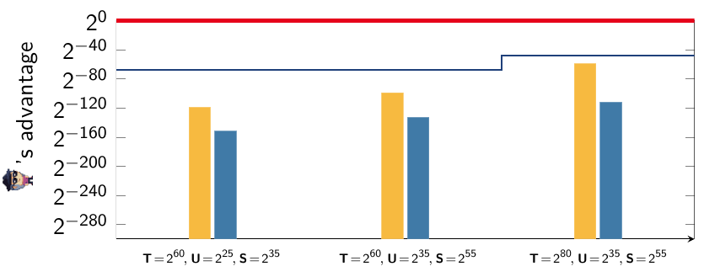
Full Handshake (1-RTT) configurations:
PSK-(EC)DHE configurations:
secp384r1
ECDSA_secp384r1
SHA-384
x25519
SHA-256
: ECDSA
Pre-Shared Key configurations:
x448
ed448
SHA-384
x448
SHA-384
SHA-256
secp384r1
ECDSA_secp384r1
SHA-384
secp384r1
SHA-384
SHA-384
X
secp384r1
Notes:
Our tighter bounds achieve this sort of improvement across all three modes of the TLS 1.3 handshake, and all of the standardized elliptic curves. We performed these evaluations for all the elliptic curve groups and ciphersuites in the TLS 1.3 specification.
Wider variety of adversaries
Minimum and maximum bit improvement over all adversaries/suites for each of 3 papers/modes
Higher-security standardized curves (secp521) do grant more security under previous bounds, but still do not meet target levels for most of the adversaries we considered. Our bounds do.
Foreshadow: no results for psk-SHA384

Slide 31
Diffie-Hellman Key Exchange
The Decisional Diffie-Hellman Problem
gª
g^{b}
g^{ab}
???
gª
g^{b}
g^{r}
Notes:
The biggest hurdle in achieving our tighter bounds was improving the reduction to the Diffie-Hellman problem. Let’s recall the Decisional Diffie-Hellman problem. In this problem we have a prime order group, G. A Diffie-Hellman instance consists of two “shares”, which are random elements of the group whose exponents, a and b, are secret. The problem is to distinguish the group element g^ab, which we call the “Diffie-Hellman” secret, from a random value.
To build a key exchange around this problem, the client and server sample and exchange two Diffie-Hellman shares, then extract a session key from both shares and the secret using a key derivation function.
<>
The problem, for a reduction, is that in a game based security model, an attacker will expect to see many Diffie-Hellman sessions occurring simultaneously, but a reduction must simulate this using only a single Decisional Diffie-Hellman instance. This causes something called the Commitment Problem, and historically the only way to solve it was to randomly choose one client and one server session to contain the challenge shares. This is where the quadratic factor of sessions comes in.
In CRYPTO 2019, however,
with We’ve mentioned several times that the TLS 1.3 key exchange uses elliptic curve Diffie-Hellman groups as one of its parameters. Two of the three modes base their security on a variant of the Diffie-Hellman problem. In a Diffie-Hellman-based key exchange, the client and server sample and exchange ephemeral Diffie-Hellman share. They then derive their key from both shares and the Diffie-Hellman secret using a key derivation function.
All proofs for Diffie-Hellman-based key exchange protocols, including TLS, face a problem called the Commitment problem. In a key exchange model, the adversary expects to see many sessions executing the protocol at once. A reduction to the Diffie-Hellman problem must find a way to simulate all of these sessions using only a single challenge pair. The classical way to do this is to pick one client session and one server session at random, and embed the challenge pair in these two sessions. Then if the adversary successfully attacks that session, the reduction can extract the Diffie-Hellman secret. This is where the quadratic loss in the number of sessions comes from in the Dowling bound: one factor of S to pick a client, and one to pick a server.
The great obstacle to achieving tight bounds for TLS 1.3 was a hurdle called the Commitment Problem, which i. We’ll try to briefly explain, using a simplified version of the handshake protocol as an example.
A basic DH key exchange -> SIGMA -> TLS 1.3
We need the key derivation function to be a programmable random oracle!
But this is the key derivation function of TLS 1.3. It is not a single programmable random oracle.
So we need to make choices about how to fit the random oracles in to the key schedule.

Slide 32
Diffie-Hellman Key Exchange
The Decisional Diffie-Hellman Problem
gª
g^{b}
g^{ab}
???
gª
g^{b}
g^{r}
A simplified DH key exchange
gª
a
Z_{p}
g^{b}
b
Z_{p}
KDF(gª , g^{b}, g^{ab})
KDF(gª , g^{b}, g^{ab})
Notes:
The biggest hurdle in achieving our tighter bounds was improving the reduction to the Diffie-Hellman problem. Let’s recall the Decisional Diffie-Hellman problem. In this problem we have a prime order group, G. A Diffie-Hellman instance consists of two “shares”, which are random elements of the group whose exponents, a and b, are secret. The problem is to distinguish the group element g^ab, which we call the “Diffie-Hellman” secret, from a random value.
To build a key exchange around this problem, the client and server sample and exchange two Diffie-Hellman shares, then extract a session key from both shares and the secret using a key derivation function.
<>
The problem, for a reduction, is that in a game based security model, an attacker will expect to see many Diffie-Hellman sessions occurring simultaneously, but a reduction must simulate this using only a single Decisional Diffie-Hellman instance. This causes something called the Commitment Problem, and historically the only way to solve it was to randomly choose one client and one server session to contain the challenge shares. This is where the quadratic factor of sessions comes in.
In CRYPTO 2019, however,
with We’ve mentioned several times that the TLS 1.3 key exchange uses elliptic curve Diffie-Hellman groups as one of its parameters. Two of the three modes base their security on a variant of the Diffie-Hellman problem. In a Diffie-Hellman-based key exchange, the client and server sample and exchange ephemeral Diffie-Hellman share. They then derive their key from both shares and the Diffie-Hellman secret using a key derivation function.
All proofs for Diffie-Hellman-based key exchange protocols, including TLS, face a problem called the Commitment problem. In a key exchange model, the adversary expects to see many sessions executing the protocol at once. A reduction to the Diffie-Hellman problem must find a way to simulate all of these sessions using only a single challenge pair. The classical way to do this is to pick one client session and one server session at random, and embed the challenge pair in these two sessions. Then if the adversary successfully attacks that session, the reduction can extract the Diffie-Hellman secret. This is where the quadratic loss in the number of sessions comes from in the Dowling bound: one factor of S to pick a client, and one to pick a server.
The great obstacle to achieving tight bounds for TLS 1.3 was a hurdle called the Commitment Problem, which i. We’ll try to briefly explain, using a simplified version of the handshake protocol as an example.
A basic DH key exchange -> SIGMA -> TLS 1.3
We need the key derivation function to be a programmable random oracle!
But this is the key derivation function of TLS 1.3. It is not a single programmable random oracle.
So we need to make choices about how to fit the random oracles in to the key schedule.

Slide 33
Diffie-Hellman Key Exchange
The Decisional Diffie-Hellman Problem
gª
g^{b}
g^{ab}
???
gª
g^{b}
g^{r}
A simplified DH key exchange
gª
a
Z_{p}
g^{b}
b
Z_{p}
KDF(gª , g^{b}, g^{ab})
KDF(gª , g^{b}, g^{ab})
Notes:
The biggest hurdle in achieving our tighter bounds was improving the reduction to the Diffie-Hellman problem. Let’s recall the Decisional Diffie-Hellman problem. In this problem we have a prime order group, G. A Diffie-Hellman instance consists of two “shares”, which are random elements of the group whose exponents, a and b, are secret. The problem is to distinguish the group element g^ab, which we call the “Diffie-Hellman” secret, from a random value.
To build a key exchange around this problem, the client and server sample and exchange two Diffie-Hellman shares, then extract a session key from both shares and the secret using a key derivation function.
<>
The problem, for a reduction, is that in a game based security model, an attacker will expect to see many Diffie-Hellman sessions occurring simultaneously, but a reduction must simulate this using only a single Decisional Diffie-Hellman instance. This causes something called the Commitment Problem, and historically the only way to solve it was to randomly choose one client and one server session to contain the challenge shares. This is where the quadratic factor of sessions comes in.
In CRYPTO 2019, however,
with We’ve mentioned several times that the TLS 1.3 key exchange uses elliptic curve Diffie-Hellman groups as one of its parameters. Two of the three modes base their security on a variant of the Diffie-Hellman problem. In a Diffie-Hellman-based key exchange, the client and server sample and exchange ephemeral Diffie-Hellman share. They then derive their key from both shares and the Diffie-Hellman secret using a key derivation function.
All proofs for Diffie-Hellman-based key exchange protocols, including TLS, face a problem called the Commitment problem. In a key exchange model, the adversary expects to see many sessions executing the protocol at once. A reduction to the Diffie-Hellman problem must find a way to simulate all of these sessions using only a single challenge pair. The classical way to do this is to pick one client session and one server session at random, and embed the challenge pair in these two sessions. Then if the adversary successfully attacks that session, the reduction can extract the Diffie-Hellman secret. This is where the quadratic loss in the number of sessions comes from in the Dowling bound: one factor of S to pick a client, and one to pick a server.
The great obstacle to achieving tight bounds for TLS 1.3 was a hurdle called the Commitment Problem, which i. We’ll try to briefly explain, using a simplified version of the handshake protocol as an example.
A basic DH key exchange -> SIGMA -> TLS 1.3
We need the key derivation function to be a programmable random oracle!
But this is the key derivation function of TLS 1.3. It is not a single programmable random oracle.
So we need to make choices about how to fit the random oracles in to the key schedule.

Slide 34
Diffie-Hellman Key Exchange
The Decisional Diffie-Hellman Problem
gª
g^{b}
g^{ab}
???
gª
g^{b}
g^{r}
A simplified DH key exchange
gª
a
Z_{p}
g^{b}
b
Z_{p}
KDF(gª , g^{b}, g^{ab})
KDF(gª , g^{b}, g^{ab})
Which sessions should contain gª and g^{b}?
Notes:
The biggest hurdle in achieving our tighter bounds was improving the reduction to the Diffie-Hellman problem. Let’s recall the Decisional Diffie-Hellman problem. In this problem we have a prime order group, G. A Diffie-Hellman instance consists of two “shares”, which are random elements of the group whose exponents, a and b, are secret. The problem is to distinguish the group element g^ab, which we call the “Diffie-Hellman” secret, from a random value.
To build a key exchange around this problem, the client and server sample and exchange two Diffie-Hellman shares, then extract a session key from both shares and the secret using a key derivation function.
<>
The problem, for a reduction, is that in a game based security model, an attacker will expect to see many Diffie-Hellman sessions occurring simultaneously, but a reduction must simulate this using only a single Decisional Diffie-Hellman instance. This causes something called the Commitment Problem, and historically the only way to solve it was to randomly choose one client and one server session to contain the challenge shares. This is where the quadratic factor of sessions comes in.
In CRYPTO 2019, however,
with We’ve mentioned several times that the TLS 1.3 key exchange uses elliptic curve Diffie-Hellman groups as one of its parameters. Two of the three modes base their security on a variant of the Diffie-Hellman problem. In a Diffie-Hellman-based key exchange, the client and server sample and exchange ephemeral Diffie-Hellman share. They then derive their key from both shares and the Diffie-Hellman secret using a key derivation function.
All proofs for Diffie-Hellman-based key exchange protocols, including TLS, face a problem called the Commitment problem. In a key exchange model, the adversary expects to see many sessions executing the protocol at once. A reduction to the Diffie-Hellman problem must find a way to simulate all of these sessions using only a single challenge pair. The classical way to do this is to pick one client session and one server session at random, and embed the challenge pair in these two sessions. Then if the adversary successfully attacks that session, the reduction can extract the Diffie-Hellman secret. This is where the quadratic loss in the number of sessions comes from in the Dowling bound: one factor of S to pick a client, and one to pick a server.
The great obstacle to achieving tight bounds for TLS 1.3 was a hurdle called the Commitment Problem, which i. We’ll try to briefly explain, using a simplified version of the handshake protocol as an example.
A basic DH key exchange -> SIGMA -> TLS 1.3
We need the key derivation function to be a programmable random oracle!
But this is the key derivation function of TLS 1.3. It is not a single programmable random oracle.
So we need to make choices about how to fit the random oracles in to the key schedule.

Slide 35
Diffie-Hellman Key Exchange
The Decisional Diffie-Hellman Problem
gª
g^{b}
g^{ab}
???
gª
g^{b}
g^{r}
A simplified DH key exchange
gª
a
Z_{p}
g^{b}
b
Z_{p}
KDF(gª , g^{b}, g^{ab})
KDF(gª , g^{b}, g^{ab})
Which sessions should contain gª and g^{b}?
Loss of #sessions^2
For all possible pairs
We guess!
Notes:
The biggest hurdle in achieving our tighter bounds was improving the reduction to the Diffie-Hellman problem. Let’s recall the Decisional Diffie-Hellman problem. In this problem we have a prime order group, G. A Diffie-Hellman instance consists of two “shares”, which are random elements of the group whose exponents, a and b, are secret. The problem is to distinguish the group element g^ab, which we call the “Diffie-Hellman” secret, from a random value.
To build a key exchange around this problem, the client and server sample and exchange two Diffie-Hellman shares, then extract a session key from both shares and the secret using a key derivation function.
<>
The problem, for a reduction, is that in a game based security model, an attacker will expect to see many Diffie-Hellman sessions occurring simultaneously, but a reduction must simulate this using only a single Decisional Diffie-Hellman instance. This causes something called the Commitment Problem, and historically the only way to solve it was to randomly choose one client and one server session to contain the challenge shares. This is where the quadratic factor of sessions comes in.
In CRYPTO 2019, however,
with We’ve mentioned several times that the TLS 1.3 key exchange uses elliptic curve Diffie-Hellman groups as one of its parameters. Two of the three modes base their security on a variant of the Diffie-Hellman problem. In a Diffie-Hellman-based key exchange, the client and server sample and exchange ephemeral Diffie-Hellman share. They then derive their key from both shares and the Diffie-Hellman secret using a key derivation function.
All proofs for Diffie-Hellman-based key exchange protocols, including TLS, face a problem called the Commitment problem. In a key exchange model, the adversary expects to see many sessions executing the protocol at once. A reduction to the Diffie-Hellman problem must find a way to simulate all of these sessions using only a single challenge pair. The classical way to do this is to pick one client session and one server session at random, and embed the challenge pair in these two sessions. Then if the adversary successfully attacks that session, the reduction can extract the Diffie-Hellman secret. This is where the quadratic loss in the number of sessions comes from in the Dowling bound: one factor of S to pick a client, and one to pick a server.
The great obstacle to achieving tight bounds for TLS 1.3 was a hurdle called the Commitment Problem, which i. We’ll try to briefly explain, using a simplified version of the handshake protocol as an example.
A basic DH key exchange -> SIGMA -> TLS 1.3
We need the key derivation function to be a programmable random oracle!
But this is the key derivation function of TLS 1.3. It is not a single programmable random oracle.
So we need to make choices about how to fit the random oracles in to the key schedule.

Slide 36
Diffie-Hellman Key Exchange
The Decisional Diffie-Hellman Problem
gª
g^{b}
g^{ab}
???
The Cohn-Gordon et al. solution to the Commitment Problem
gª
g^{b}
g^{r}
[CCGJJ19]
Requirements
A simplified DH key exchange
1
The underlying assumption is the Strong Diffie-Hellman Problem.
gª
a
Z_{p}
g^{b}
b
Z_{p}
KDF(gª , g^{b}, g^{ab})
KDF(gª , g^{b}, g^{ab})
Notes:
In CRYPTO 2019, however, Cohn-Gordon et al developed a solution for the commitment problem, for some specially designed Diffie-Hellman key exchange protocols with three critical properties.

Slide 37
Diffie-Hellman Key Exchange
The Decisional Diffie-Hellman Problem
gª
g^{b}
g^{ab}
???
The Cohn-Gordon et al. solution to the Commitment Problem
gª
g^{b}
g^{r}
[CCGJJ19]
Requirements
A simplified DH key exchange
1
The underlying assumption is the Strong Diffie-Hellman Problem.
gª
a
Z_{p}
g^{b}
b
Z_{p}
KDF(gª , g^{b}, g^{ab})
KDF(gª , g^{b}, g^{ab})
gª
g^{b}
DDH
The Strong Diffie-Hellman Problem
gª
g^{ab}
Notes:
In CRYPTO 2019, however, Cohn-Gordon et al developed a solution for the commitment problem, for some specially designed Diffie-Hellman key exchange protocols with three critical properties.

Slide 38
Diffie-Hellman Key Exchange
The Decisional Diffie-Hellman Problem
gª
g^{b}
g^{ab}
???
The Cohn-Gordon et al. solution to the Commitment Problem
gª
g^{b}
g^{r}
[CCGJJ19]
Requirements
A simplified DH key exchange
1
The underlying assumption is the Strong Diffie-Hellman Problem.
gª
a
Z_{p}
g^{b}
b
Z_{p}
KDF(gª , g^{b}, g^{ab})
KDF(gª , g^{b}, g^{ab})
gª
g^{b}
DDH
The Strong Diffie-Hellman Problem
gª
g^{ab}
Notes:
In CRYPTO 2019, however, Cohn-Gordon et al developed a solution for the commitment problem, for some specially designed Diffie-Hellman key exchange protocols with three critical properties.

Slide 39
Diffie-Hellman Key Exchange
The Decisional Diffie-Hellman Problem
gª
g^{b}
g^{ab}
???
The Cohn-Gordon et al. solution to the Commitment Problem
gª
g^{b}
g^{r}
[CCGJJ19]
Requirements
A simplified DH key exchange
1
The underlying assumption is the Strong Diffie-Hellman Problem.
gª
2
The Key Derivation Function must be modeled as a programmable random oracle.
a
Z_{p}
g^{b}
b
Z_{p}
The inputs to the Key Derivation Function must include all of (gª , g^{b}, g^{ab}).
3
KDF(gª , g^{b}, g^{ab})
KDF(gª , g^{b}, g^{ab})
gª
g^{b}
DDH
The Strong Diffie-Hellman Problem
gª
g^{ab}
Notes:
In CRYPTO 2019, however, Cohn-Gordon et al developed a solution for the commitment problem, for some specially designed Diffie-Hellman key exchange protocols with three critical properties.

Slide 40
The Decisional Diffie-Hellman Problem
G
is a prime-order group
Sample a and b randomly from the set Z_{p} = {1, 2, … p}
G
is a cyclic group with generator g and order p
Given gª and g^{b}, distinguish g^{ab} from a random element of
gª
a
Z_{p}
g^{b}
b
Z_{p}
KDF(gª , g^{b}, g^{ab})
KDF(gª , g^{b}, g^{ab})
Session key
Session key
Requirements
The Cohn-Gordon solution to the Commitment Problem
Strong Diffie-Hellman
1
The underlying assumption is the Strong Diffie-Hellman Problem.
Given gª and g^{b}, and an oracle for DDH(gª, _), find g^{ab}.
2
The Key Derivation Function must be modeled as a programmable random oracle.
3
The inputs to the Key Derivation Function must include all of (gª , g^{b}, g^{ab}).

Slide 41
!
Does changing to the StrongDH assumption hurt our overall results?
Theorem [DFGS21]:
Adv(A, TLS 1.3) ≤ S² *Adv(B₁, G) + 6S * Adv(B₂, H) + S * U * Adv(B₃, S) +…
Theorem [DG21][DJ21]:
Adv(A, TLS 1.3) ≤ 4 * Adv(B₁, G) + 4 * Adv(B₂, H) + U * Adv(B₃, S) +…
Notes:
When I mention changing assumptions, eyebrows go up, and for good reason. Changing the security assumption on the underlying group has the potential to cancel out any tightness improvements in the reduction. We address this concern from two angles.

Slide 42
!
Does changing to the StrongDH assumption hurt our overall results?
Not in the Generic Group Model!
Decisional Diffie-Hellman Problem
Strong Diffie-Hellman Problem
2
2
Adv(B, G) ≤ $\frac{ T }{p}$
Adv(B, G) ≤ $\frac{ 4T }{ p}$
[Shoup97]
[DG21]
And not for TLS 1.3!
Theorem [DFGS21]:
Adv(A, TLS 1.3) ≤ S² *Adv(B₁, G) + 6S * Adv(B₂, H) + S * U * Adv(B₃, S) +…
PRF-ODH Assumption
ROM + StrongDH
Notes:
First, we give the first direct comparison of the Decisional Diffie-Hellman and the Strong Diffie Hellman problems in the Generic Group Model, and we prove that the two problems are equally hard, up to a constant factor.
This is enough to let us prove tight bounds for the SIGMA key exchange protocol, which originally relied on the DDH assumption and satisfies all the other conditions of the Cohn-Gordon technique.
Of course, the Generic Group Model is an abstract model, and while it covers the best known attacks on elliptic curve groups, it is an additional assumption that not everyone wants to trust.
Luckily, the TLS 1.3 handshake protocol actually already relies on the Strong Diffie-Hellman assumption. The Dowling theorem reduces to the PRF-ODH security of the underlying group, and the only known way to instantiate PRF-ODH is in the random oracle mode, from Strong Diffie-Hellman. So we can directly compare our bounds to the prior work, without having to worry about comparing assumptions in the GGM or otherwise.

Slide 43
The TLS 1.3 Key Schedule
g^{ab}
(gª , g^{b})
CATS
SATS
EMS
RMS
ETS
EEMS
HKDF.Extract
“session” key
BFK
HKDF.Expand
+ label
CFK
CHTK
SHTK
SFK
internal key
Notes:
Let’s come back to our three requirements to apply the Cohn-Gordon technique. It asks that the key derivation function be a single, programmable random oracle, whose inputs include both Diffie-Hellman shares and the secret.
The TLS 1.3 handshake, on the other hand, uses a complex key schedule to derive many keys, and the shares and secret are input separately.

Slide 44
The [DG21] Key Schedule
g^{ab}
3
3
RO1
(gª , g^{b})
We model HKDF.Extract and HKDF.Expand as independent random oracles
0
1
2
4
5
7
8
9
10
RO2
6
*
6
*
6
Notes:
Let’s come back to our three requirements to apply the Cohn-Gordon technique. It asks that the key derivation function be a single, programmable random oracle, whose inputs include both Diffie-Hellman shares and the secret.
The TLS 1.3 handshake, on the other hand, uses a complex key schedule to derive many keys, and the shares and secret are input separately.

Slide 45
The [DG21] Key Schedule
g^{ab}
3
3
RO1
(gª , g^{b})
We model HKDF.Extract and HKDF.Expand as independent random oracles
0
1
2
4
5
7
8
9
10
RO2
6
*
6
*
6
Connect (gª , g^{b}) with g^{ab} in proof via careful lookups.
Exploit existing domain separation in HKDF.Expand
Notes:
Let’s come back to our three requirements to apply the Cohn-Gordon technique. It asks that the key derivation function be a single, programmable random oracle, whose inputs include both Diffie-Hellman shares and the secret.
The TLS 1.3 handshake, on the other hand, uses a complex key schedule to derive many keys, and the shares and secret are input separately.

Slide 46
The [DG21] Key Schedule
g^{ab}
3
3
RO1
(gª , g^{b})
We model HKDF.Extract and HKDF.Expand as independent random oracles
0
1
2
4
5
7
8
9
10
RO2
6
*
6
*
6
Connect (gª , g^{b}) with g^{ab} in proof via careful lookups.
Exploit existing domain separation in HKDF.Expand
!
HKDF.Extract and HKDF.Expand are not independent functions!
Notes:
Let’s come back to our three requirements to apply the Cohn-Gordon technique. It asks that the key derivation function be a single, programmable random oracle, whose inputs include both Diffie-Hellman shares and the secret.
The TLS 1.3 handshake, on the other hand, uses a complex key schedule to derive many keys, and the shares and secret are input separately.

Slide 47
The [DG21] Key Schedule
g^{ab}
3
3
RO1
(gª , g^{b})
We model HKDF.Extract and HKDF.Expand as independent random oracles
0
1
2
4
5
7
8
9
10
RO2
6
*
6
*
6
Connect (gª , g^{b}) with g^{ab} in proof via careful lookups.
Exploit existing domain separation in HKDF.Expand
!
HKDF.Extract and HKDF.Expand are not independent functions!
HKDF.Extract(S, K) := HMAC(S, K)
HKDF.Expand(K, L) := HMAC(K, L|0x01)
Notes:
Let’s come back to our three requirements to apply the Cohn-Gordon technique. It asks that the key derivation function be a single, programmable random oracle, whose inputs include both Diffie-Hellman shares and the secret.
The TLS 1.3 handshake, on the other hand, uses a complex key schedule to derive many keys, and the shares and secret are input separately.

Slide 48
The [DJ20] Key Schedule
g^{ab}
RO1
(gª , g^{b})
Notes:
Let’s come back to our three requirements to apply the Cohn-Gordon technique. It asks that the key derivation function be a single, programmable random oracle, whose inputs include both Diffie-Hellman shares and the secret.
The TLS 1.3 handshake, on the other hand, uses a complex key schedule to derive many keys, and the shares and secret are input separately.

Slide 49
The [DJ20] Key Schedule
RO2
g^{ab}
RO1
(gª , g^{b})
Notes:
Let’s come back to our three requirements to apply the Cohn-Gordon technique. It asks that the key derivation function be a single, programmable random oracle, whose inputs include both Diffie-Hellman shares and the secret.
The TLS 1.3 handshake, on the other hand, uses a complex key schedule to derive many keys, and the shares and secret are input separately.

Slide 50
The [DJ20] Key Schedule
RO2
g^{ab}
RO3
RO1
(gª , g^{b})
Notes:
Let’s come back to our three requirements to apply the Cohn-Gordon technique. It asks that the key derivation function be a single, programmable random oracle, whose inputs include both Diffie-Hellman shares and the secret.
The TLS 1.3 handshake, on the other hand, uses a complex key schedule to derive many keys, and the shares and secret are input separately.

Slide 51
The [DJ20] Key Schedule
RO2
g^{ab}
RO3
RO4
RO1
(gª , g^{b})
Notes:
Let’s come back to our three requirements to apply the Cohn-Gordon technique. It asks that the key derivation function be a single, programmable random oracle, whose inputs include both Diffie-Hellman shares and the secret.
The TLS 1.3 handshake, on the other hand, uses a complex key schedule to derive many keys, and the shares and secret are input separately.

Slide 52
The [DJ20] Key Schedule
RO2
g^{ab}
RO3
RO4
g^{ab} ,(gª , g^{b})
RO1
(gª , g^{b})
RO3
RO1
RO2
RO4
Notes:
Let’s come back to our three requirements to apply the Cohn-Gordon technique. It asks that the key derivation function be a single, programmable random oracle, whose inputs include both Diffie-Hellman shares and the secret.
The TLS 1.3 handshake, on the other hand, uses a complex key schedule to derive many keys, and the shares and secret are input separately.

Slide 53
The [DJ20] Key Schedule
RO2
g^{ab}
RO3
RO4
g^{ab} ,(gª , g^{b})
RO1
(gª , g^{b})
RO3
RO1
RO2
RO4
This allows a much more direct application of the Cohn-Gordon technique and a simpler proof…
Notes:
Let’s come back to our three requirements to apply the Cohn-Gordon technique. It asks that the key derivation function be a single, programmable random oracle, whose inputs include both Diffie-Hellman shares and the secret.
The TLS 1.3 handshake, on the other hand, uses a complex key schedule to derive many keys, and the shares and secret are input separately.

Slide 54
The [DJ20] Key Schedule
RO2
g^{ab}
RO3
RO4
g^{ab} ,(gª , g^{b})
RO1
(gª , g^{b})
RO3
RO1
RO2
RO4
This allows a much more direct application of the Cohn-Gordon technique and a simpler proof…
…but it’s hard to see the connection between the abstract and real key schedules.
Notes:
Let’s come back to our three requirements to apply the Cohn-Gordon technique. It asks that the key derivation function be a single, programmable random oracle, whose inputs include both Diffie-Hellman shares and the secret.
The TLS 1.3 handshake, on the other hand, uses a complex key schedule to derive many keys, and the shares and secret are input separately.

Slide 55
Abstraction Pitfalls
[DG21] Key Schedule
g^{ab}
RO2
g^{ab}
RO3
RO4
RO1
3
3
(gª , g^{b})
(gª , g^{b})
0
1
2
4
5
7
8
9
10
6
*
6
*
6
[DJ20] Key Schedule

Slide 56
Abstraction Pitfalls
Both miss: TLS 1.3 uses only one hash function
H
[DG21] Key Schedule
g^{ab}
RO2
g^{ab}
RO3
RO4
RO1
3
3
(gª , g^{b})
(gª , g^{b})
0
1
2
4
5
7
8
9
10
6
*
6
*
6
[DJ20] Key Schedule

Slide 57
Abstraction Pitfalls
Both miss: TLS 1.3 uses only one hash function
H
[DG21] Key Schedule
g^{ab}
RO2
g^{ab}
RO3
RO4
RO1
3
3
H
(gª , g^{b})
(gª , g^{b})
0
1
2
4
5
7
8
9
H
H
H
10
6
*
6
*
6
H
[DJ20] Key Schedule

Slide 58
Abstraction Pitfalls
Both miss: TLS 1.3 uses only one hash function
H
[DG21] Key Schedule
g^{ab}
RO2
g^{ab}
RO3
RO4
RO1
3
3
H
H
(gª , g^{b})
H
H
(gª , g^{b})
H
0
1
2
4
5
7
8
9
H
H
H
10
6
*
6
*
6
H
[DJ20] Key Schedule

Slide 59
Abstraction Pitfalls
Both miss: TLS 1.3 uses only one hash function
H
[DG21] Key Schedule
g^{ab}
RO2
g^{ab}
RO3
RO4
RO1
3
3
H
H
(gª , g^{b})
H
H
(gª , g^{b})
H
0
1
2
4
5
7
8
9
H
H
H
10
6
*
6
*
6
H
H
H
H
HMAC
H
H
H
[DJ20] Key Schedule

Slide 60
Abstraction Pitfalls
Both miss: TLS 1.3 uses only one hash function
H
[DG21] Key Schedule
g^{ab}
RO2
g^{ab}
RO3
RO4
RO1
3
3
H
H
(gª , g^{b})
H
H
(gª , g^{b})
H
0
1
2
4
5
7
8
9
H
H
H
10
6
*
6
*
6
H
H
H
H
HMAC
H
H
H
[DJ20] Key Schedule
We want:
as a single random oracle
H

Slide 61
Abstraction Pitfalls
Both miss: TLS 1.3 uses only one hash function
H
[DG21] Key Schedule
g^{ab}
RO2
g^{ab}
RO3
RO4
RO1
3
3
H
H
(gª , g^{b})
H
H
(gª , g^{b})
H
0
1
2
4
5
7
8
9
H
H
H
10
6
*
6
*
6
H
H
H
H
HMAC
H
H
H
[DJ20] Key Schedule
We want:
as a single random oracle
An independent KDF for each key
with g^{ab} and (gª , g^{b}) as input
H

Slide 62
Abstraction Pitfalls
Both miss: TLS 1.3 uses only one hash function
H
[DG21] Key Schedule
g^{ab}
RO2
g^{ab}
RO3
RO4
RO1
3
3
H
H
(gª , g^{b})
H
H
(gª , g^{b})
H
0
1
2
4
5
7
8
9
H
H
H
10
6
*
6
*
6
H
H
H
H
HMAC
H
H
H
[DJ20] Key Schedule
We want:
as a single random oracle
An independent KDF for each key
with g^{ab} and (gª , g^{b}) as input
A formally justified
abstraction
H

Slide 63
The Modular Indifferentiability Approach
Theorem [DDGJ21]:
Adv(A, TLS 1.3) ≤ Adv(B1, Abstract TLS 1.3) + IndiffAdv(B2, Abstraction)
Hash function
H
Notes:
We use the same multiple-random-oracle construction, but justify it formally in the indifferentiability framework
What this means is that our bounds assume only that SHA256/SHA384 is an RO, not HMAC/HKDF, or any higher part of the key schedule.
3 step approach to split 1 RO into 12:
Step 1: Abstract a separation between hashed transcripts and everything else
Step 2: Abstract HMAC as a random oracle
Step 3: Abstract a separation between each path through the key schedule.

Slide 64
The Modular Indifferentiability Approach
Theorem [DDGJ21]:
Adv(A, TLS 1.3) ≤ Adv(B1, Abstract TLS 1.3) + IndiffAdv(B2, Abstraction)
Hash function
H
A standard random oracle assumption
Random oracle
RO
Notes:
We use the same multiple-random-oracle construction, but justify it formally in the indifferentiability framework
What this means is that our bounds assume only that SHA256/SHA384 is an RO, not HMAC/HKDF, or any higher part of the key schedule.
3 step approach to split 1 RO into 12:
Step 1: Abstract a separation between hashed transcripts and everything else
Step 2: Abstract HMAC as a random oracle
Step 3: Abstract a separation between each path through the key schedule.

Slide 65
The Modular Indifferentiability Approach
Theorem [DDGJ21]:
Adv(A, TLS 1.3) ≤ Adv(B1, Abstract TLS 1.3) + IndiffAdv(B2, Abstraction)
Hash function
H
A standard random oracle assumption
Random oracle
RO
ROs: and
Transcript-RO
Component-RO
Notes:
We use the same multiple-random-oracle construction, but justify it formally in the indifferentiability framework
What this means is that our bounds assume only that SHA256/SHA384 is an RO, not HMAC/HKDF, or any higher part of the key schedule.
3 step approach to split 1 RO into 12:
Step 1: Abstract a separation between hashed transcripts and everything else
Step 2: Abstract HMAC as a random oracle
Step 3: Abstract a separation between each path through the key schedule.

Slide 66
The Modular Indifferentiability Approach
Theorem [DDGJ21]:
Adv(A, TLS 1.3) ≤ Adv(B1, Abstract TLS 1.3) + IndiffAdv(B2, Abstraction)
Hash function
H
A standard random oracle assumption
Random oracle
RO
ROs: and
Transcript-RO
Component-RO
ROs: and and
Transcript-RO
HMAC-RO
Notes:
We use the same multiple-random-oracle construction, but justify it formally in the indifferentiability framework
What this means is that our bounds assume only that SHA256/SHA384 is an RO, not HMAC/HKDF, or any higher part of the key schedule.
3 step approach to split 1 RO into 12:
Step 1: Abstract a separation between hashed transcripts and everything else
Step 2: Abstract HMAC as a random oracle
Step 3: Abstract a separation between each path through the key schedule.

Slide 67
The Modular Indifferentiability Approach
Theorem [DDGJ21]:
Adv(A, TLS 1.3) ≤ Adv(B1, Abstract TLS 1.3) + IndiffAdv(B2, Abstraction)
Hash function
H
A standard random oracle assumption
Random oracle
RO
ROs: and
Transcript-RO
Component-RO
ROs: and and
Transcript-RO
HMAC-RO
12 random oracles
Notes:
We use the same multiple-random-oracle construction, but justify it formally in the indifferentiability framework
What this means is that our bounds assume only that SHA256/SHA384 is an RO, not HMAC/HKDF, or any higher part of the key schedule.
3 step approach to split 1 RO into 12:
Step 1: Abstract a separation between hashed transcripts and everything else
Step 2: Abstract HMAC as a random oracle
Step 3: Abstract a separation between each path through the key schedule.

Slide 68
The Modular Indifferentiability Approach
Theorem [DDGJ21]:
Adv(A, TLS 1.3) ≤ Adv(B1, Abstract TLS 1.3) + IndiffAdv(B2, Abstraction)
Hash function
H
A standard random oracle assumption
Random oracle
RO
ROs: and
Transcript-RO
Component-RO
ROs: and and
Transcript-RO
HMAC-RO
Lookups by the HKDF-Expand labels (as in [DG21])
12 random oracles
Notes:
We use the same multiple-random-oracle construction, but justify it formally in the indifferentiability framework
What this means is that our bounds assume only that SHA256/SHA384 is an RO, not HMAC/HKDF, or any higher part of the key schedule.
3 step approach to split 1 RO into 12:
Step 1: Abstract a separation between hashed transcripts and everything else
Step 2: Abstract HMAC as a random oracle
Step 3: Abstract a separation between each path through the key schedule.

Slide 69
The Modular Indifferentiability Approach
Theorem [DDGJ21]:
Adv(A, TLS 1.3) ≤ Adv(B1, Abstract TLS 1.3) + IndiffAdv(B2, Abstraction)
Hash function
H
A standard random oracle assumption
Random oracle
RO
ROs: and
Transcript-RO
Component-RO
Indifferentiability of HMAC [DRS12]
ROs: and and
Transcript-RO
HMAC-RO
Lookups by the HKDF-Expand labels (as in [DG21])
12 random oracles
Notes:
We use the same multiple-random-oracle construction, but justify it formally in the indifferentiability framework
What this means is that our bounds assume only that SHA256/SHA384 is an RO, not HMAC/HKDF, or any higher part of the key schedule.
3 step approach to split 1 RO into 12:
Step 1: Abstract a separation between hashed transcripts and everything else
Step 2: Abstract HMAC as a random oracle
Step 3: Abstract a separation between each path through the key schedule.

Slide 70
The Modular Indifferentiability Approach
Theorem [DDGJ21]:
Adv(A, TLS 1.3) ≤ Adv(B1, Abstract TLS 1.3) + IndiffAdv(B2, Abstraction)
Hash function
H
A standard random oracle assumption
Random oracle
RO
???
ROs: and
Transcript-RO
Component-RO
Indifferentiability of HMAC [DRS12]
ROs: and and
Transcript-RO
HMAC-RO
Lookups by the HKDF-Expand labels (as in [DG21])
12 random oracles
Notes:
We use the same multiple-random-oracle construction, but justify it formally in the indifferentiability framework
What this means is that our bounds assume only that SHA256/SHA384 is an RO, not HMAC/HKDF, or any higher part of the key schedule.
3 step approach to split 1 RO into 12:
Step 1: Abstract a separation between hashed transcripts and everything else
Step 2: Abstract HMAC as a random oracle
Step 3: Abstract a separation between each path through the key schedule.

Slide 71
How Not to Separate Your Domains
???
ROs: and
Random oracle
Transcript-RO
RO
Component-RO
Labels here
Breaks down for PSK-only/SHA384!
Notes:
In order to abstract a separation between two uses of the hash function, we must have a clear way to distinguish which input is for which use
Is a particular input a transcript, a MAC, or part of the key schedule?
Good practice says that hash function inputs should have distinct labels
And TLS does this!
But only in the key schedule, not for MACs or when hashing transcripts
We can also distinguish by formatting:
In TLS 1.3, HMAC keys are always padded with at least 32 bytes of 0s; these keys are then XOR’d with 0x36363636… or 0x5c5c5c…
We can use the prescribed formatting of a ClientHello message (which starts every transcript) to rule out 32 bytes of 0x363636… in the appropriate positions…
…except in PSK-only mode when the hash function used is SHA-384.

Slide 72
How Not to Separate Your Domains
???
ROs: and
Random oracle
Transcript-RO
RO
Component-RO
RO(0x0303aaaaaaaaaaaaaaaaaaaaaaaaaaaaaaaaaaaaaaaaaaaaaaaaaaaaaaaaaaaaaaaa000002130101000105002b0003010304002d0002010000290007002c00070001bbaaaaaaaa)
Is this a partial transcript, or an intermediate call in an HMAC computation?
Labels here
Breaks down for PSK-only/SHA384!
Notes:
In order to abstract a separation between two uses of the hash function, we must have a clear way to distinguish which input is for which use
Is a particular input a transcript, a MAC, or part of the key schedule?
Good practice says that hash function inputs should have distinct labels
And TLS does this!
But only in the key schedule, not for MACs or when hashing transcripts
We can also distinguish by formatting:
In TLS 1.3, HMAC keys are always padded with at least 32 bytes of 0s; these keys are then XOR’d with 0x36363636… or 0x5c5c5c…
We can use the prescribed formatting of a ClientHello message (which starts every transcript) to rule out 32 bytes of 0x363636… in the appropriate positions…
…except in PSK-only mode when the hash function used is SHA-384.

Slide 73
How Not to Separate Your Domains
???
ROs: and
Random oracle
Transcript-RO
RO
Component-RO
RO(0x0303aaaaaaaaaaaaaaaaaaaaaaaaaaaaaaaaaaaaaaaaaaaaaaaaaaaaaaaaaaaaaaaa000002130101000105002b0003010304002d0002010000290007002c00070001bbaaaaaaaa)
71 bytes
Is this a partial transcript, or an intermediate call in an HMAC computation?
Always at least 96 bytes
Labels here
Breaks down for PSK-only/SHA384!
Notes:
In order to abstract a separation between two uses of the hash function, we must have a clear way to distinguish which input is for which use
Is a particular input a transcript, a MAC, or part of the key schedule?
Good practice says that hash function inputs should have distinct labels
And TLS does this!
But only in the key schedule, not for MACs or when hashing transcripts
We can also distinguish by formatting:
In TLS 1.3, HMAC keys are always padded with at least 32 bytes of 0s; these keys are then XOR’d with 0x36363636… or 0x5c5c5c…
We can use the prescribed formatting of a ClientHello message (which starts every transcript) to rule out 32 bytes of 0x363636… in the appropriate positions…
…except in PSK-only mode when the hash function used is SHA-384.

Slide 74
How Not to Separate Your Domains
???
ROs: and
Random oracle
Transcript-RO
RO
Component-RO
RO(0x0303aaaaaaaaaaaaaaaaaaaaaaaaaaaaaaaaaaaaaaaaaaaaaaaaaaaaaaaaaaaaaaaa000002130101000105002b0003010304002d0002010000290007002c00070001bbaaaaaaaa)
71 bytes
Is this a partial transcript, or an intermediate call in an HMAC computation?
All PSK modes
with SHA256:
Always at least 96 bytes
HMAC[RO](K, L)= RO((K |0x00…00)xor 0x36…36) | RO((K | 0x00…00)xor(0x5c…5c) | L))
ClientHello= legacy_version | random | legacy_session_id | ciphersuites…
Labels here
Breaks down for PSK-only/SHA384!
Notes:
In order to abstract a separation between two uses of the hash function, we must have a clear way to distinguish which input is for which use
Is a particular input a transcript, a MAC, or part of the key schedule?
Good practice says that hash function inputs should have distinct labels
And TLS does this!
But only in the key schedule, not for MACs or when hashing transcripts
We can also distinguish by formatting:
In TLS 1.3, HMAC keys are always padded with at least 32 bytes of 0s; these keys are then XOR’d with 0x36363636… or 0x5c5c5c…
We can use the prescribed formatting of a ClientHello message (which starts every transcript) to rule out 32 bytes of 0x363636… in the appropriate positions…
…except in PSK-only mode when the hash function used is SHA-384.

Slide 75
How Not to Separate Your Domains
???
ROs: and
Random oracle
Transcript-RO
RO
Component-RO
RO(0x0303aaaaaaaaaaaaaaaaaaaaaaaaaaaaaaaaaaaaaaaaaaaaaaaaaaaaaaaaaaaaaaaa000002130101000105002b0003010304002d0002010000290007002c00070001bbaaaaaaaa)
71 bytes
Is this a partial transcript, or an intermediate call in an HMAC computation?
All PSK modes
with SHA256:
32 bytes
32 bytes
Always at least 96 bytes
HMAC[RO](K, L)= RO((K |0x00…00)xor 0x36…36) | RO((K | 0x00…00)xor(0x5c…5c) | L))
ClientHello= legacy_version | random | legacy_session_id | ciphersuites…
Labels here
Breaks down for PSK-only/SHA384!
Notes:
In order to abstract a separation between two uses of the hash function, we must have a clear way to distinguish which input is for which use
Is a particular input a transcript, a MAC, or part of the key schedule?
Good practice says that hash function inputs should have distinct labels
And TLS does this!
But only in the key schedule, not for MACs or when hashing transcripts
We can also distinguish by formatting:
In TLS 1.3, HMAC keys are always padded with at least 32 bytes of 0s; these keys are then XOR’d with 0x36363636… or 0x5c5c5c…
We can use the prescribed formatting of a ClientHello message (which starts every transcript) to rule out 32 bytes of 0x363636… in the appropriate positions…
…except in PSK-only mode when the hash function used is SHA-384.

Slide 76
How Not to Separate Your Domains
???
ROs: and
Random oracle
Transcript-RO
RO
Component-RO
RO(0x0303aaaaaaaaaaaaaaaaaaaaaaaaaaaaaaaaaaaaaaaaaaaaaaaaaaaaaaaaaaaaaaaa000002130101000105002b0003010304002d0002010000290007002c00070001bbaaaaaaaa)
71 bytes
Is this a partial transcript, or an intermediate call in an HMAC computation?
All PSK modes
with SHA256:
32 bytes
32 bytes
Always at least 96 bytes
HMAC[RO](K, L)= RO((K |0x00…00)xor 0x36…36) | RO((K | 0x00…00)xor(0x5c…5c) | L))
ClientHello= legacy_version | random | legacy_session_id | ciphersuites…
2 bytes
32 bytes
Labels here
Breaks down for PSK-only/SHA384!
Notes:
In order to abstract a separation between two uses of the hash function, we must have a clear way to distinguish which input is for which use
Is a particular input a transcript, a MAC, or part of the key schedule?
Good practice says that hash function inputs should have distinct labels
And TLS does this!
But only in the key schedule, not for MACs or when hashing transcripts
We can also distinguish by formatting:
In TLS 1.3, HMAC keys are always padded with at least 32 bytes of 0s; these keys are then XOR’d with 0x36363636… or 0x5c5c5c…
We can use the prescribed formatting of a ClientHello message (which starts every transcript) to rule out 32 bytes of 0x363636… in the appropriate positions…
…except in PSK-only mode when the hash function used is SHA-384.

Slide 77
How Not to Separate Your Domains
???
ROs: and
Random oracle
Transcript-RO
RO
Component-RO
RO(0x0303aaaaaaaaaaaaaaaaaaaaaaaaaaaaaaaaaaaaaaaaaaaaaaaaaaaaaaaaaaaaaaaa000002130101000105002b0003010304002d0002010000290007002c00070001bbaaaaaaaa)
71 bytes
Is this a partial transcript, or an intermediate call in an HMAC computation?
All PSK modes
with SHA256:
32 bytes
32 bytes
Always at least 96 bytes
HMAC[RO](K, L)= RO((K |0x00…00)xor 0x36…36) | RO((K | 0x00…00)xor(0x5c…5c) | L))
ClientHello= legacy_version | random | legacy_session_id | ciphersuites…
2 bytes
32 bytes
Encoded length between 0 and 32: cannot equal 0x36 or 0x5c
Labels here
Breaks down for PSK-only/SHA384!
Notes:
In order to abstract a separation between two uses of the hash function, we must have a clear way to distinguish which input is for which use
Is a particular input a transcript, a MAC, or part of the key schedule?
Good practice says that hash function inputs should have distinct labels
And TLS does this!
But only in the key schedule, not for MACs or when hashing transcripts
We can also distinguish by formatting:
In TLS 1.3, HMAC keys are always padded with at least 32 bytes of 0s; these keys are then XOR’d with 0x36363636… or 0x5c5c5c…
We can use the prescribed formatting of a ClientHello message (which starts every transcript) to rule out 32 bytes of 0x363636… in the appropriate positions…
…except in PSK-only mode when the hash function used is SHA-384.

Slide 78
How Not to Separate Your Domains
???
ROs: and
Random oracle
Transcript-RO
RO
Component-RO
RO(0x0303aaaaaaaaaaaaaaaaaaaaaaaaaaaaaaaaaaaaaaaaaaaaaaaaaaaaaaaaaaaaaaaa000002130101000105002b0003010304002d0002010000290007002c00070001bbaaaaaaaa)
71 bytes
Is this a partial transcript, or an intermediate call in an HMAC computation?
All PSK modes
with SHA256:
32 bytes
32 bytes
Always at least 96 bytes
HMAC[RO](K, L)= RO((K |0x00…00)xor 0x36…36) | RO((K | 0x00…00)xor(0x5c…5c) | L))
ClientHello= legacy_version | random | legacy_session_id | ciphersuites…
2 bytes
32 bytes
Encoded length between 0 and 32: cannot equal 0x36 or 0x5c
For PSK-only mode with SHA384, domain separation fails and indifferentiability is impossible
Labels here
Breaks down for PSK-only/SHA384!
Notes:
In order to abstract a separation between two uses of the hash function, we must have a clear way to distinguish which input is for which use
Is a particular input a transcript, a MAC, or part of the key schedule?
Good practice says that hash function inputs should have distinct labels
And TLS does this!
But only in the key schedule, not for MACs or when hashing transcripts
We can also distinguish by formatting:
In TLS 1.3, HMAC keys are always padded with at least 32 bytes of 0s; these keys are then XOR’d with 0x36363636… or 0x5c5c5c…
We can use the prescribed formatting of a ClientHello message (which starts every transcript) to rule out 32 bytes of 0x363636… in the appropriate positions…
…except in PSK-only mode when the hash function used is SHA-384.

Slide 79
Takeaways
Tighter bounds for all modes of the TLS 1.3 handshake except
PSK-only/SHA384
We achieve target security for all standardized elliptic curve groups
We use indifferentiability to justify our key schedule abstraction
Separate your domains!
Notes:
Prior bounds for TLS 1.3 target only asymptotic security, and cannot guarantee 128 bits of security for session keys when 128-bit keys are used.
We give tighter bounds that validate the use of all standardized elliptic curves at their target security levels for TLS 1.3’s 1-RTT and PSK/PSK-ECDHE modes of operation.
Our bounds for the pre-shared key modes make minimal assumptions by modeling only the hash function as a random oracle; this is an improvement over prior models (including our own for the 1-RTT modes) which model correlated uses of the hash function as independent.
This approach breaks down for PSK-SHA356 mode due to a lack of domain separation in TLS 1.3 between the transcript hashing and the key schedule.

