Slide 1
ModuloNET Neural Networks Meet Modular Arithmetic for Efficient Hardware Masking
Anuj Dubey¹, Afzal Ahmad³, Muhammad Adeel Pasha³,
Rosario Cammarota², Aydin Aysu¹
¹North Carolina State University, United States
²Intel Labs, United States
³Lahore University of Management and Science, Pakistan
Sponsors

Slide 2
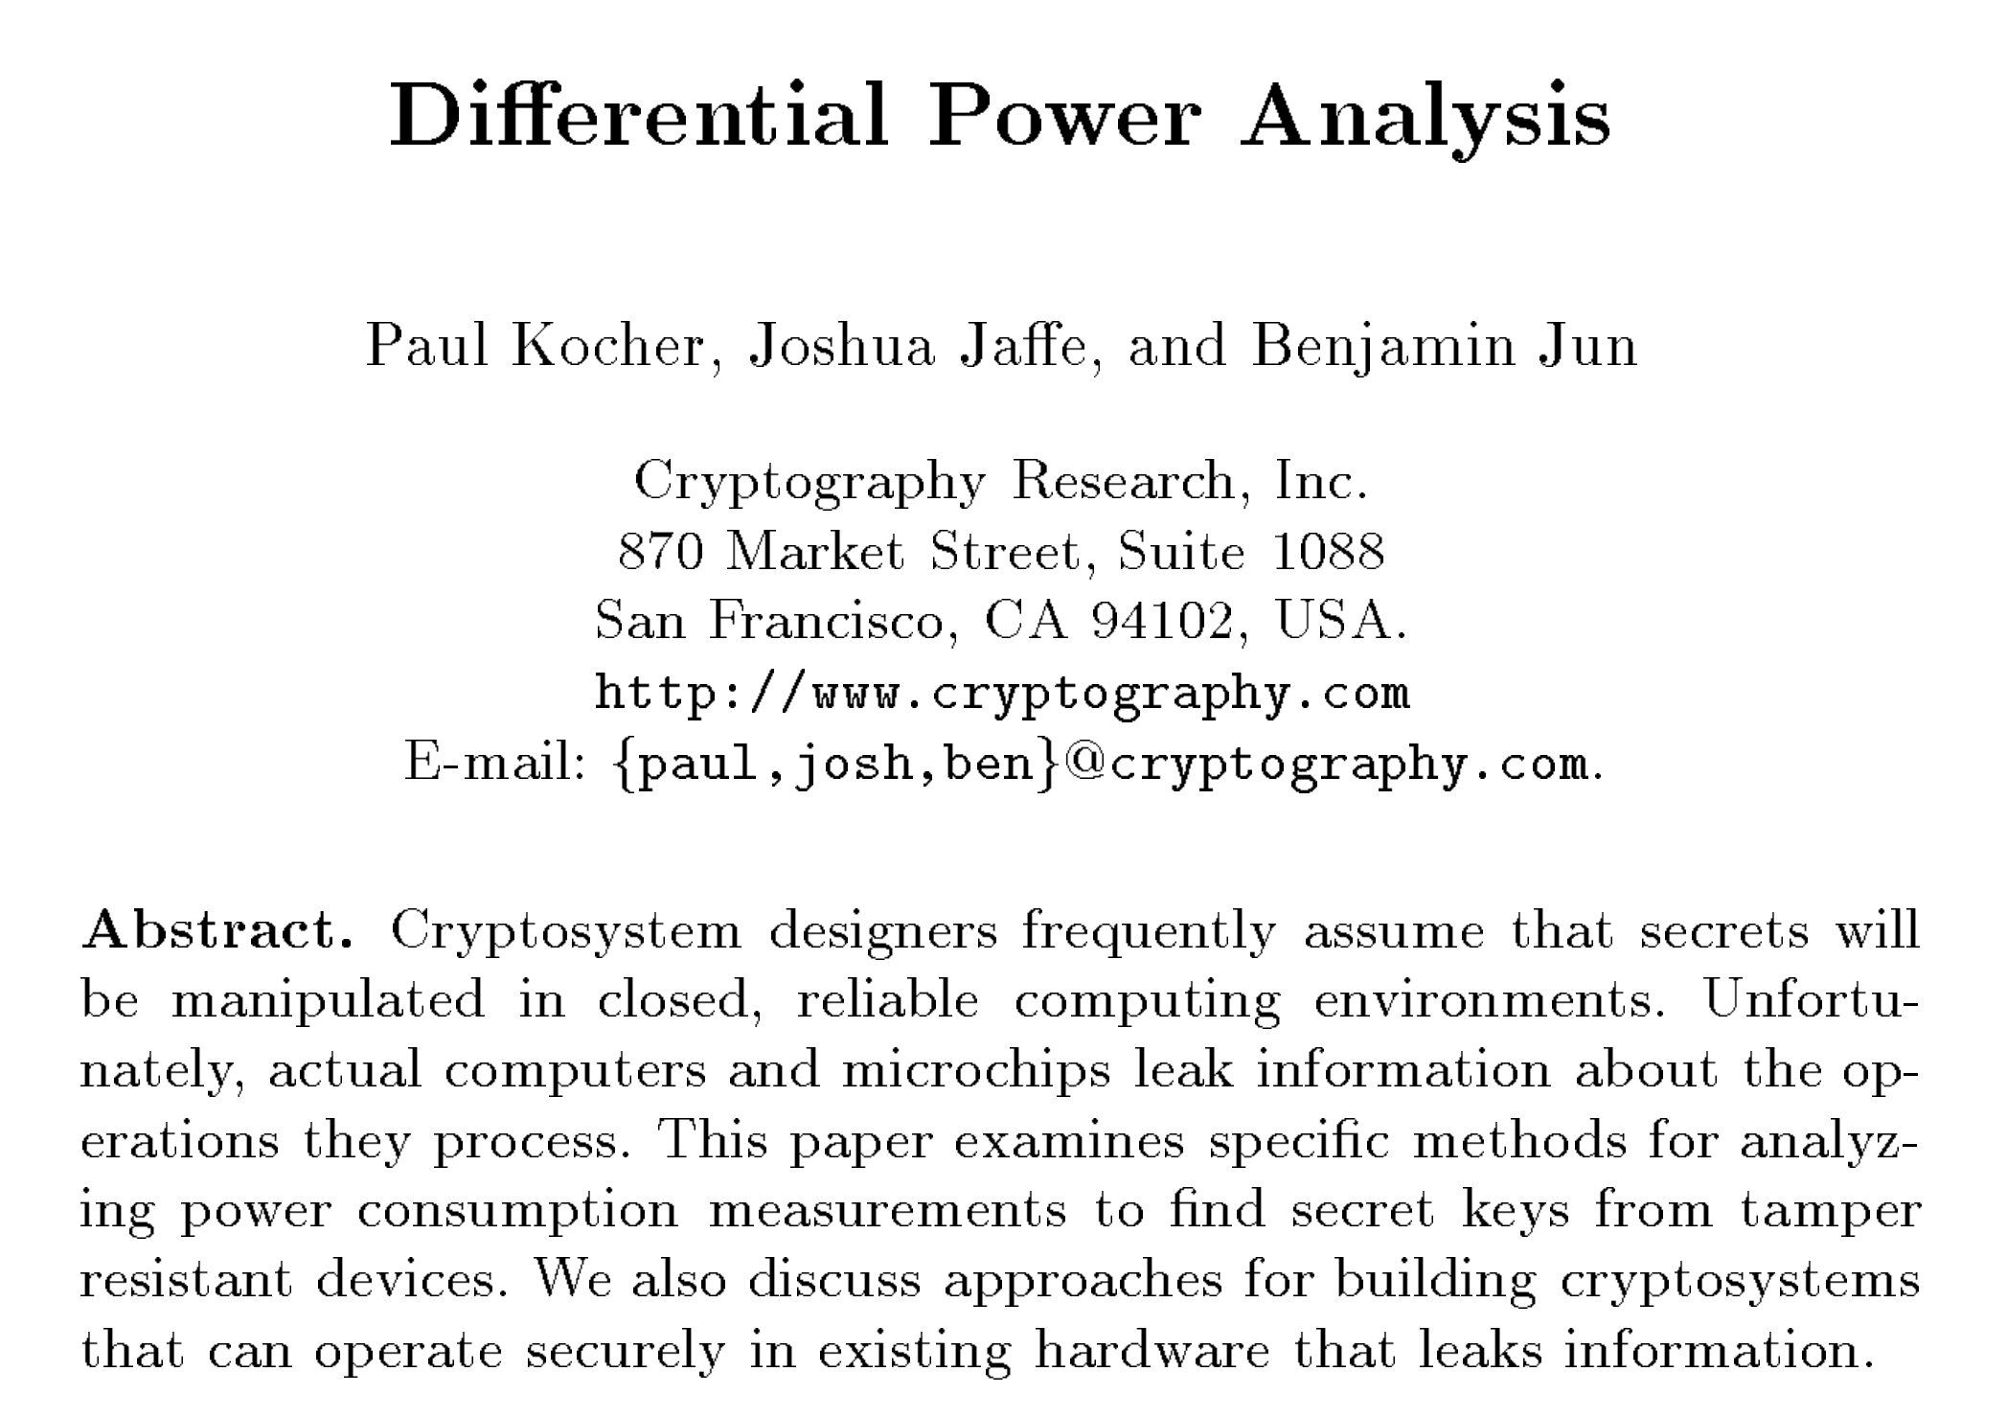
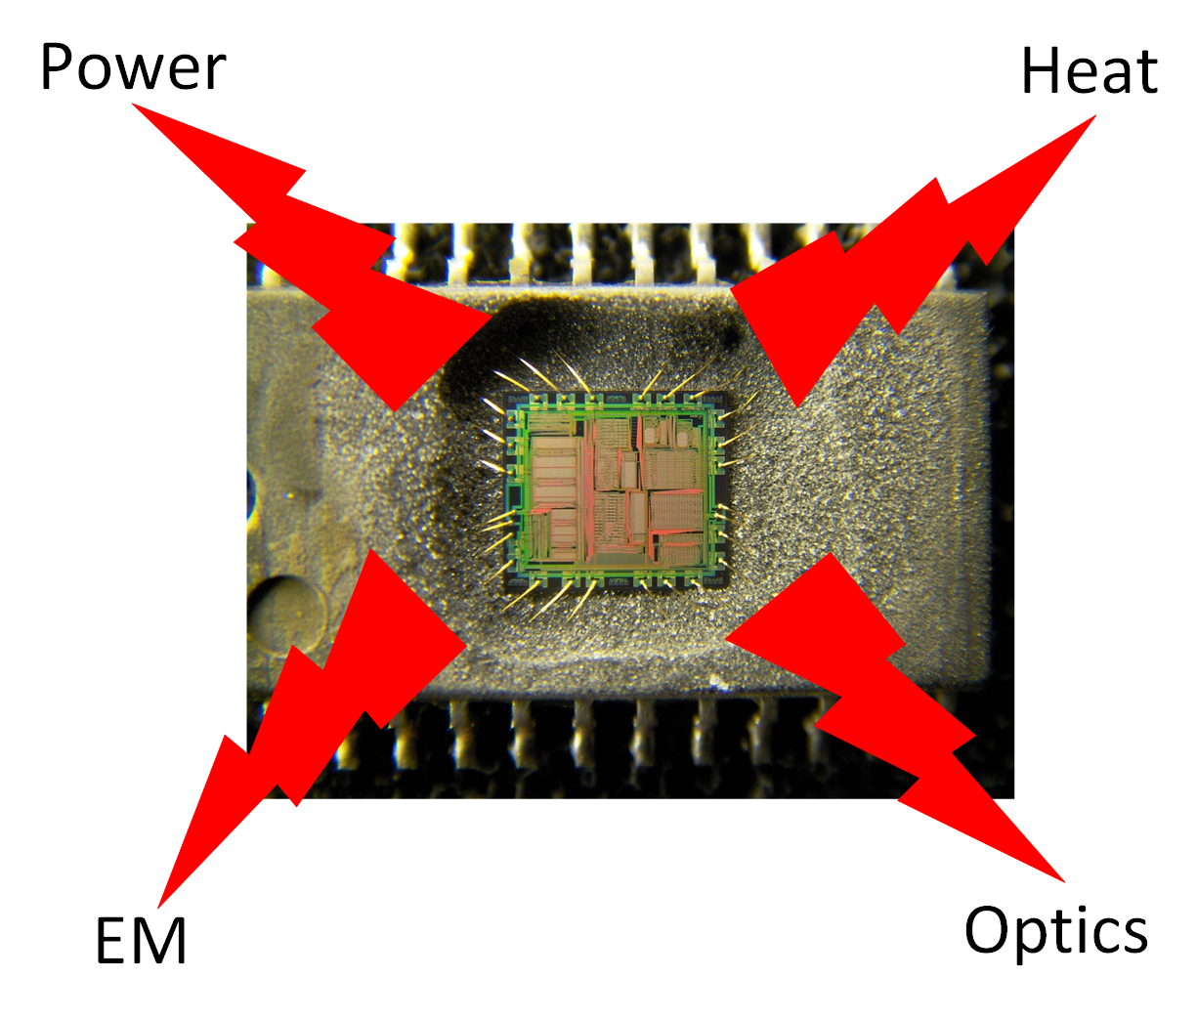
Advent of Physical Side-Channels
Introduction
Preliminaries
Design
Results
Conclusion
Exploit secret-data-dependent physical properties

Slide 3
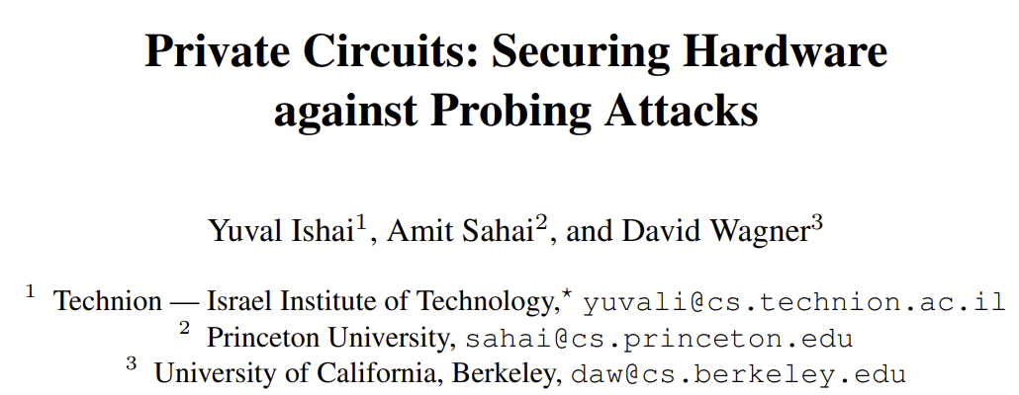
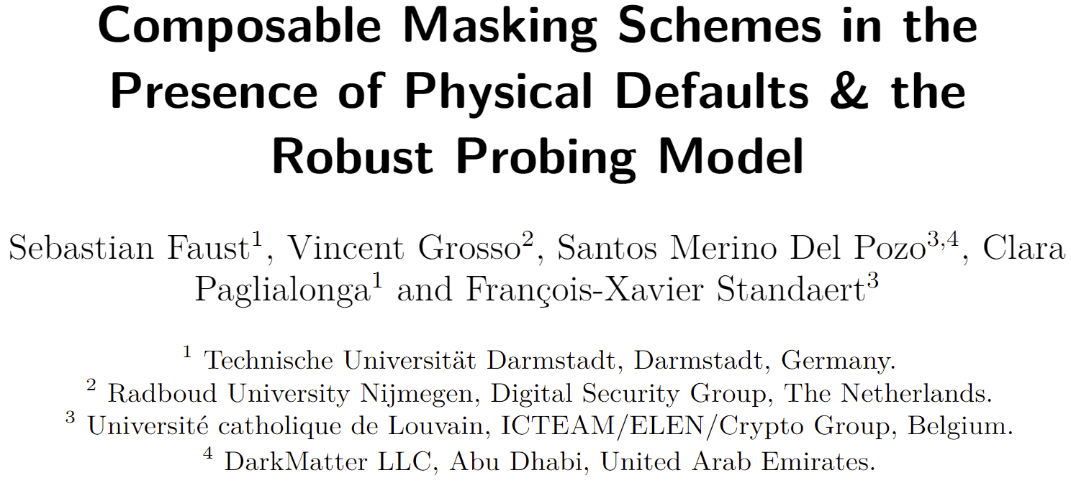
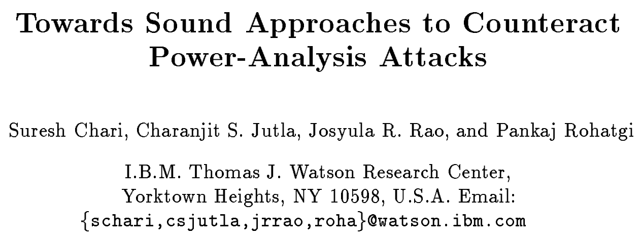
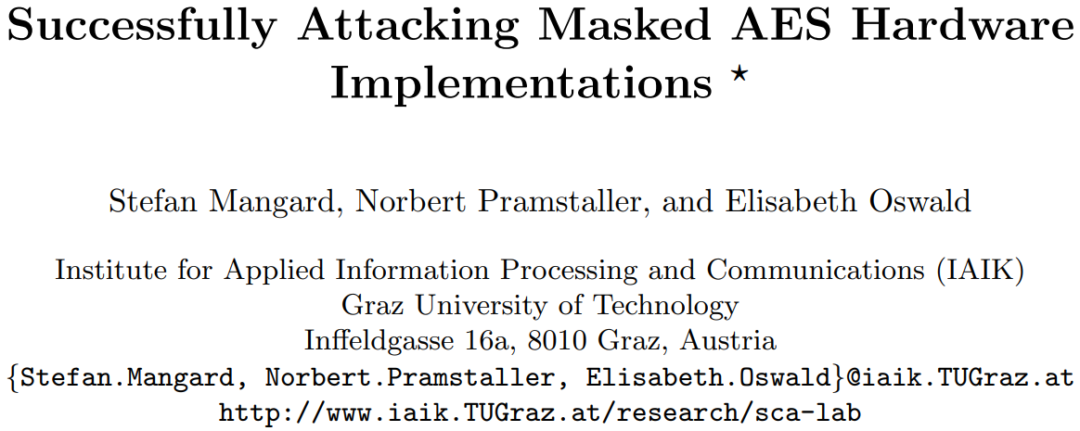
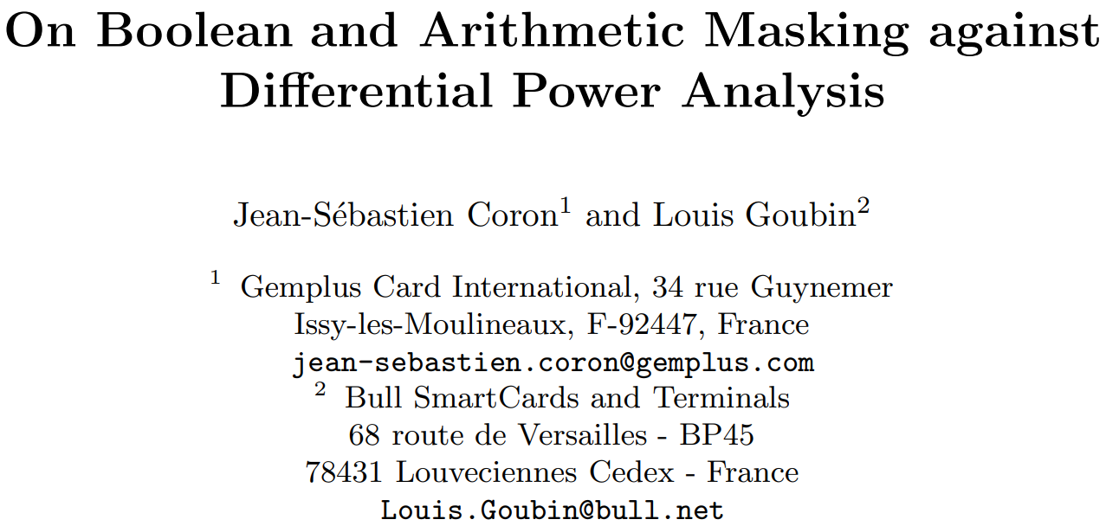
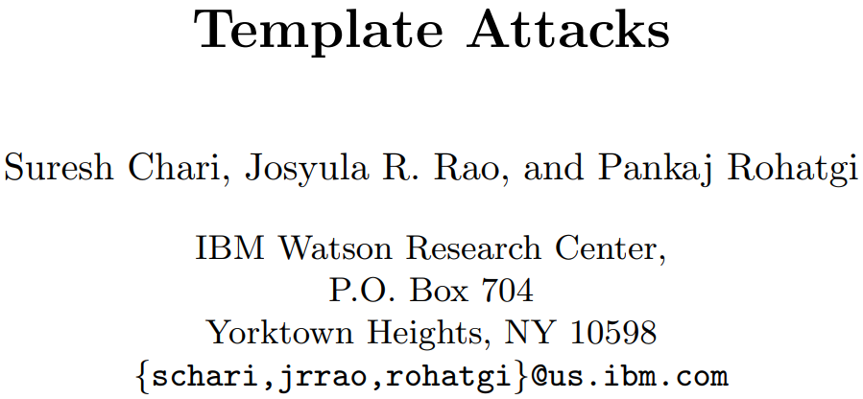
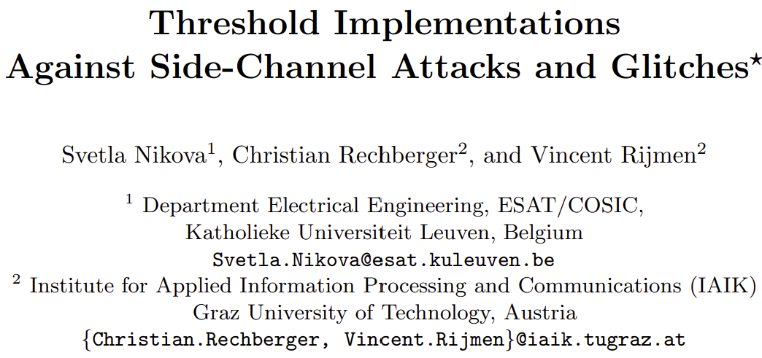
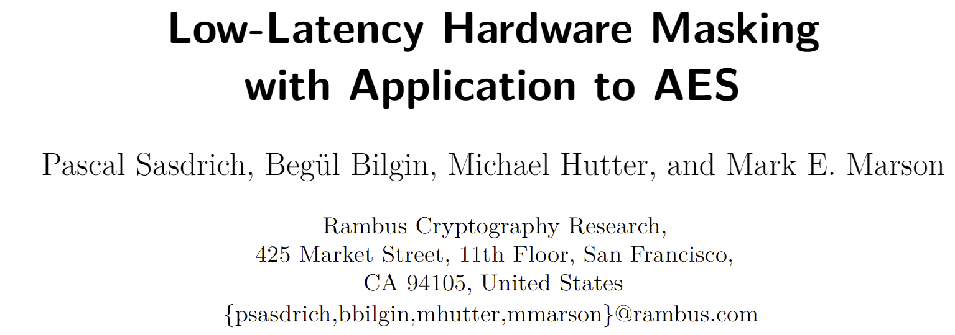
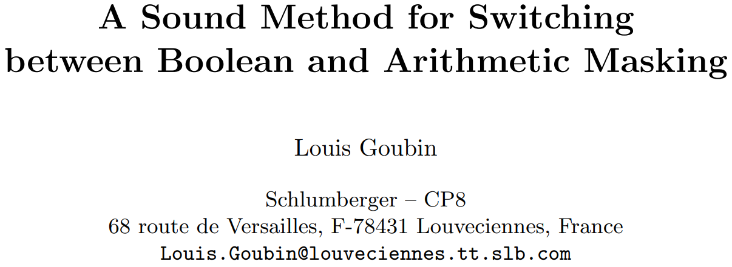
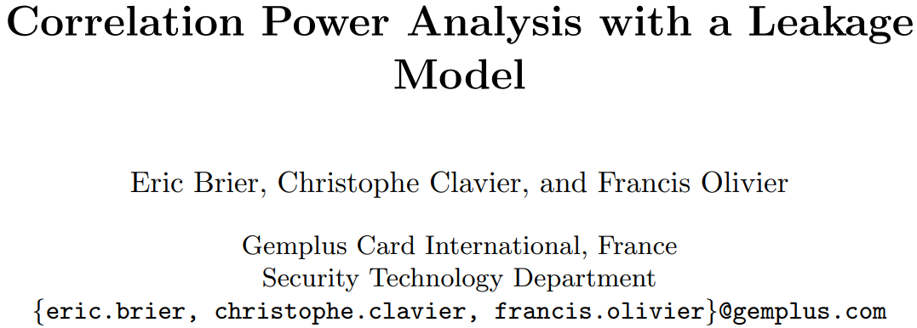
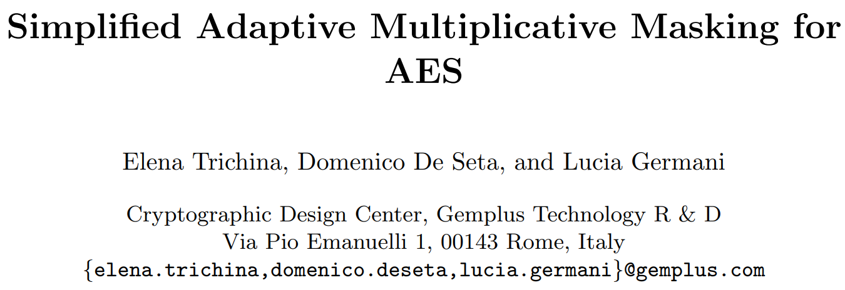
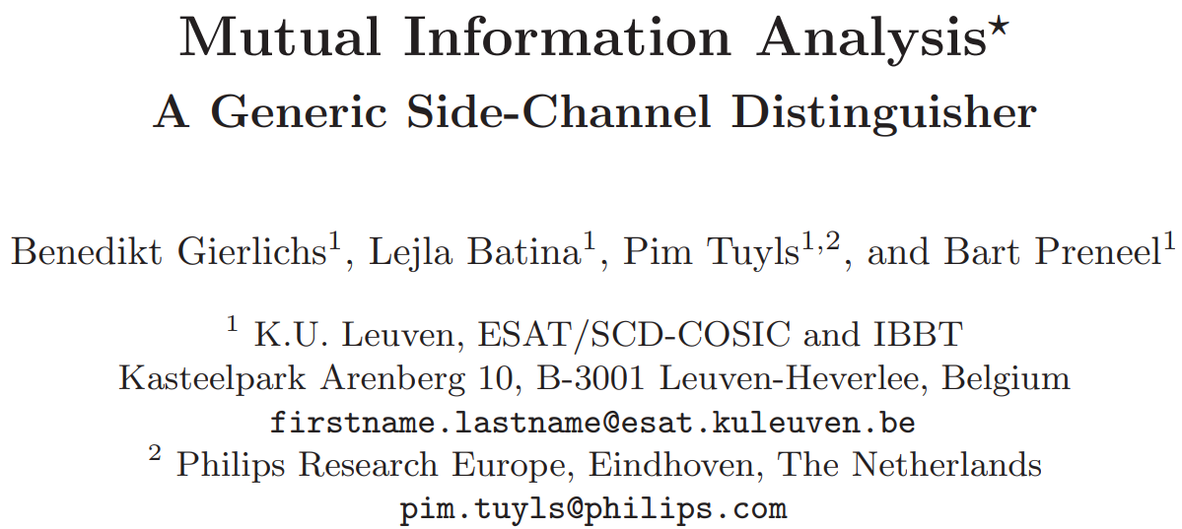
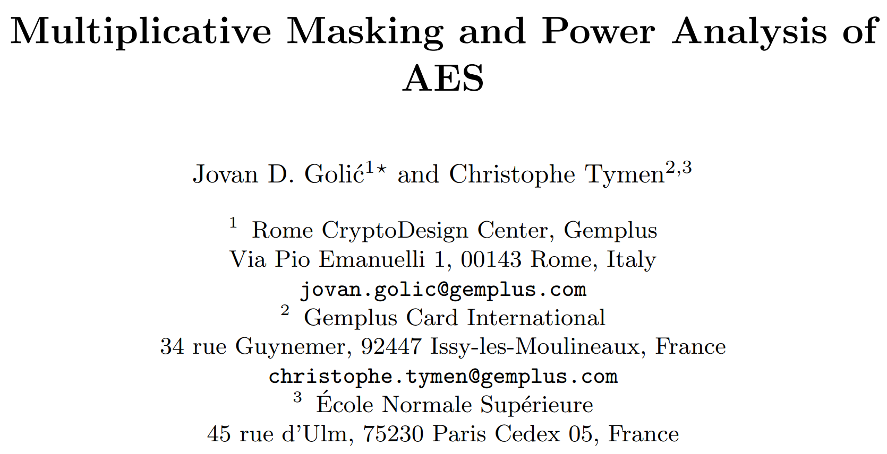
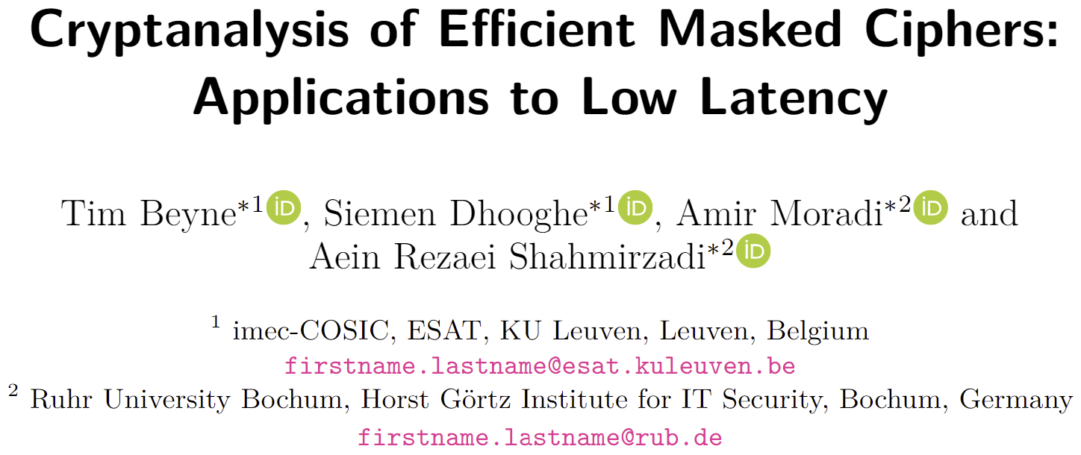
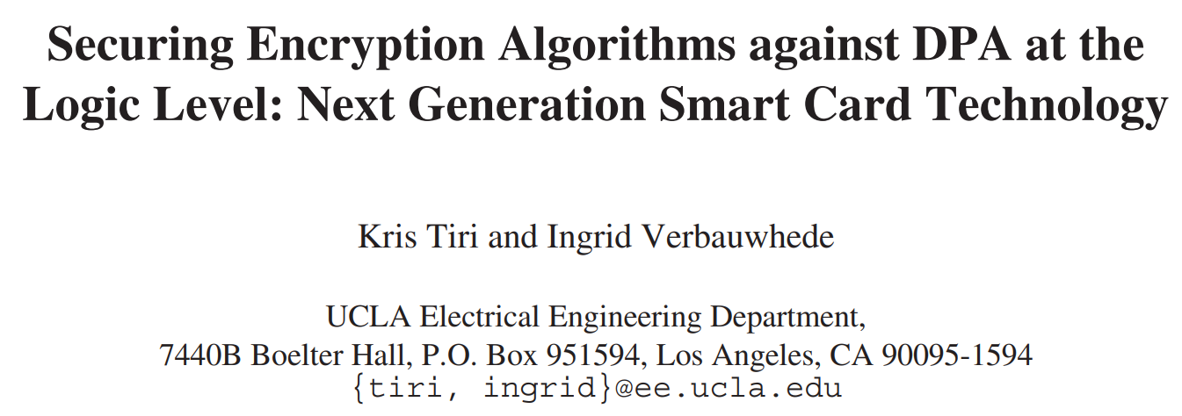
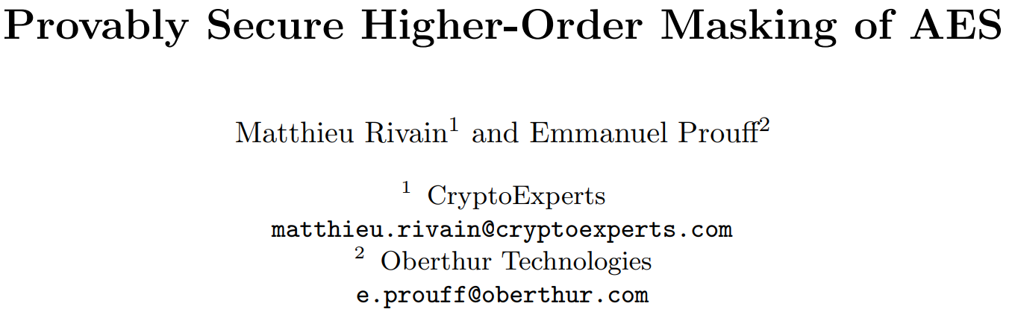
Defenses for Cryptosystems
Introduction
Preliminaries
Design
Results
Conclusion
Notes:
only done for crypto hardware until now…because the only appl with confidentiality requirements

Slide 4
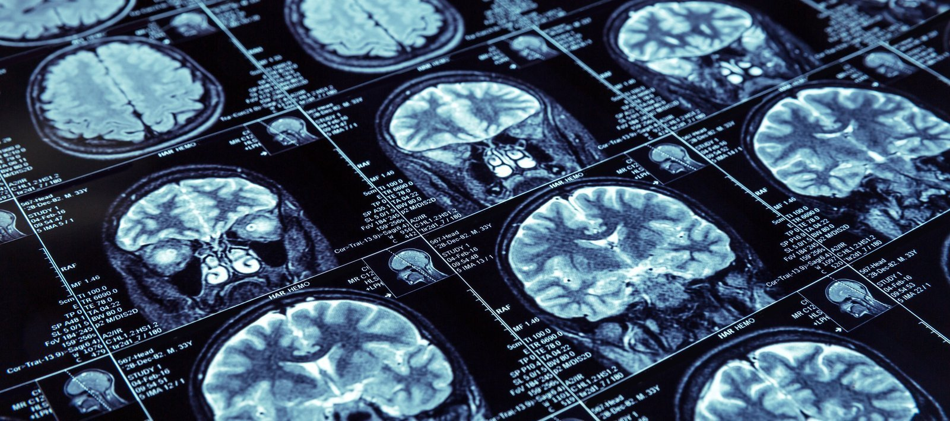
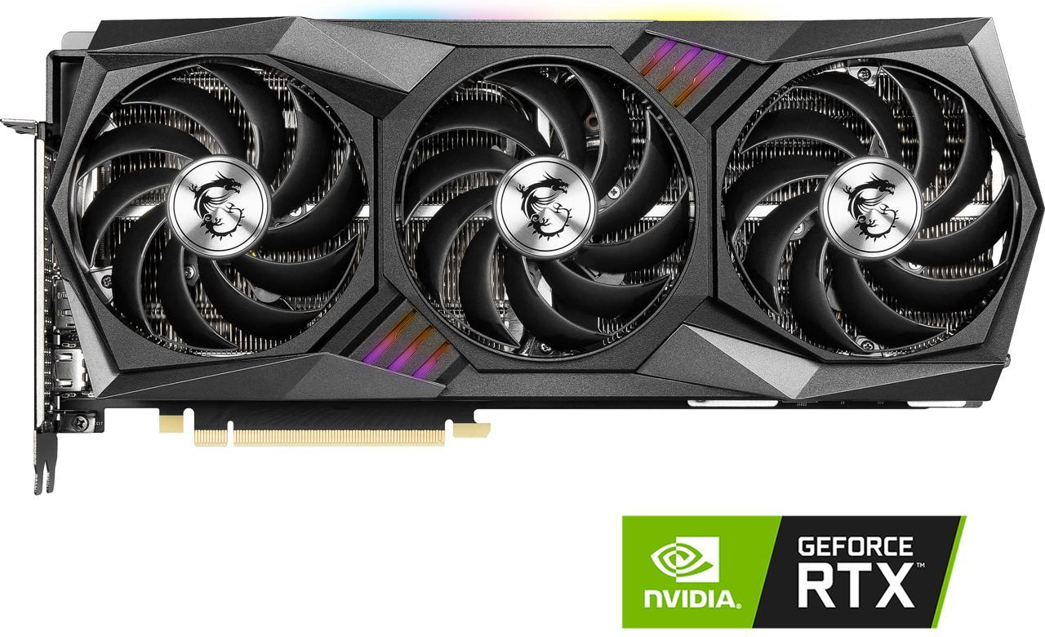
Confidentiality in ML
Introduction
Preliminaries
Design
Results
Conclusion
ML
R&D
Training Data
ML models are valuable
Compute
Notes:
Machine learning has emerged as a new application with confidentiality requirements

Slide 5
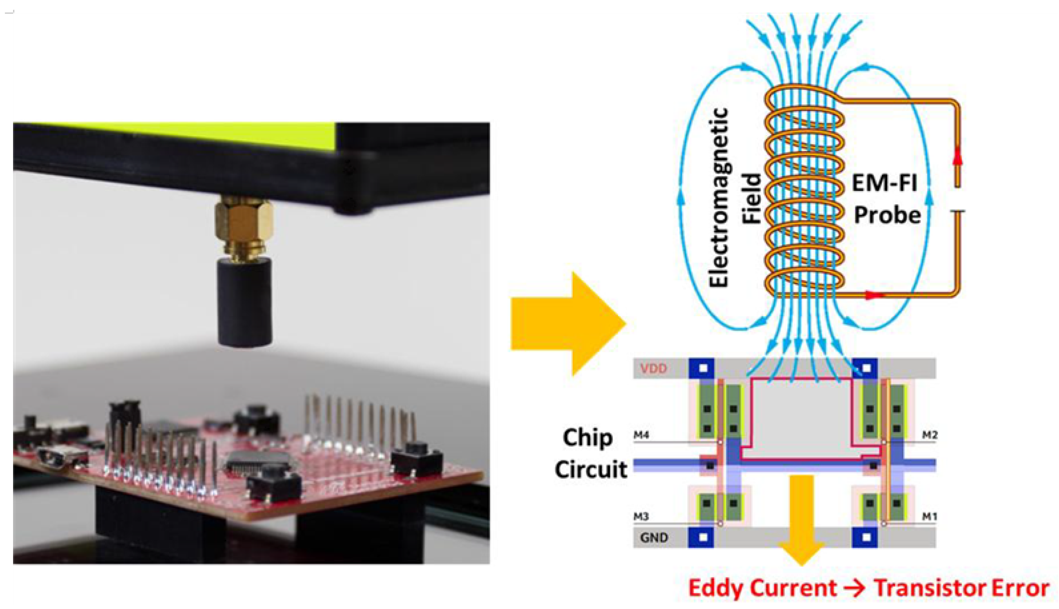
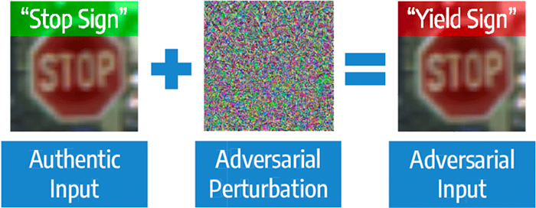
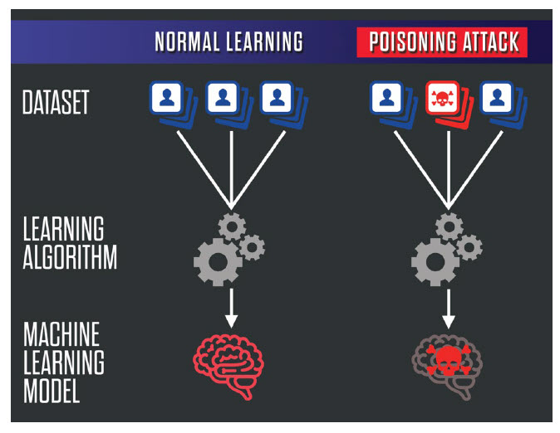
Confidentiality in ML
Introduction
Preliminaries
Design
Results
Conclusion
Adversarial Attack
Model Poisoning
Fault Injection
Model leakage also facilitates other attacks
Notes:
white box access also makes it easy to fool the models or poison the training data
mission critical applications

Slide 6
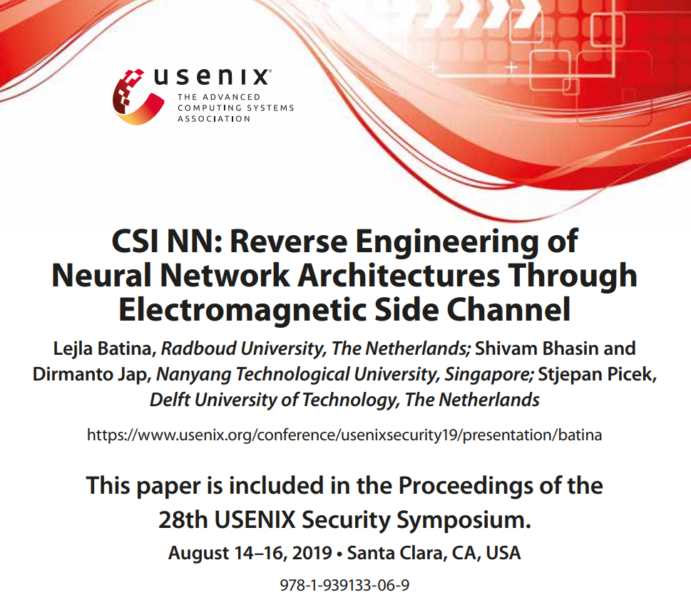
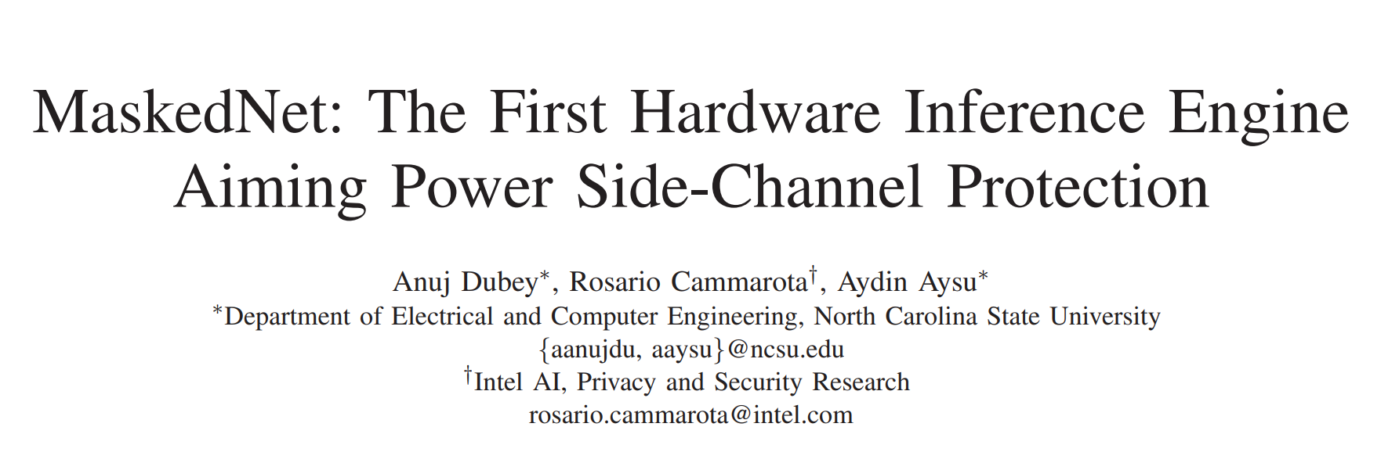
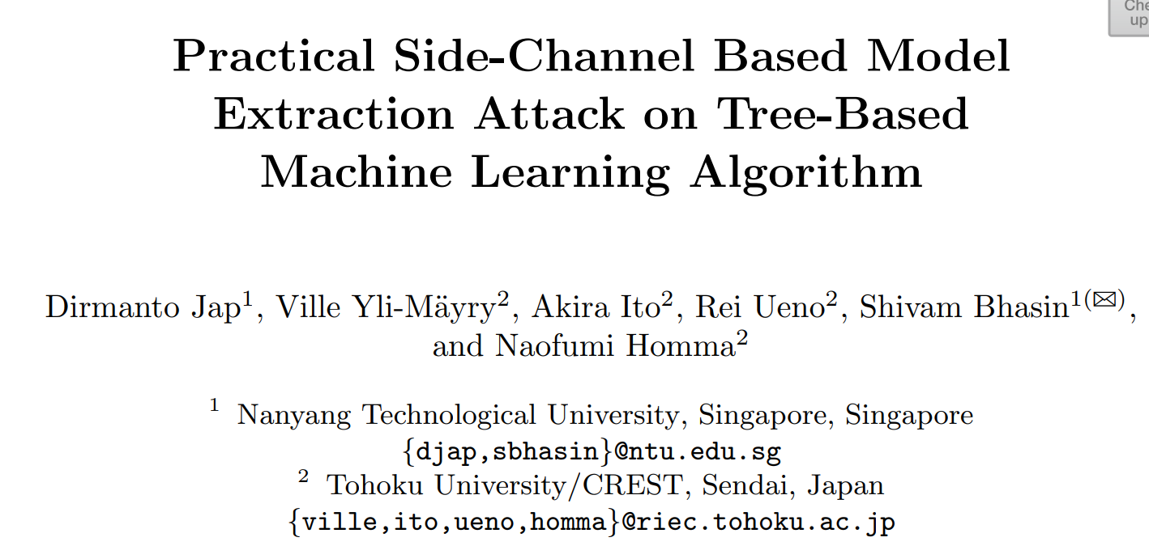
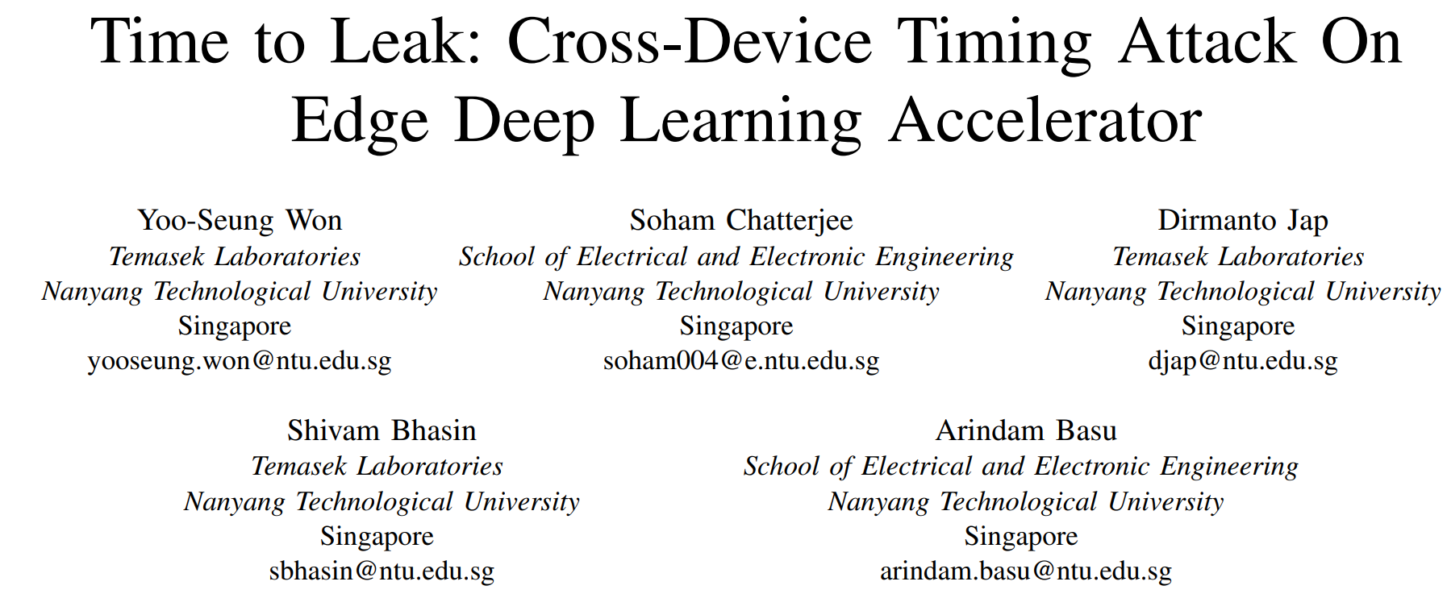
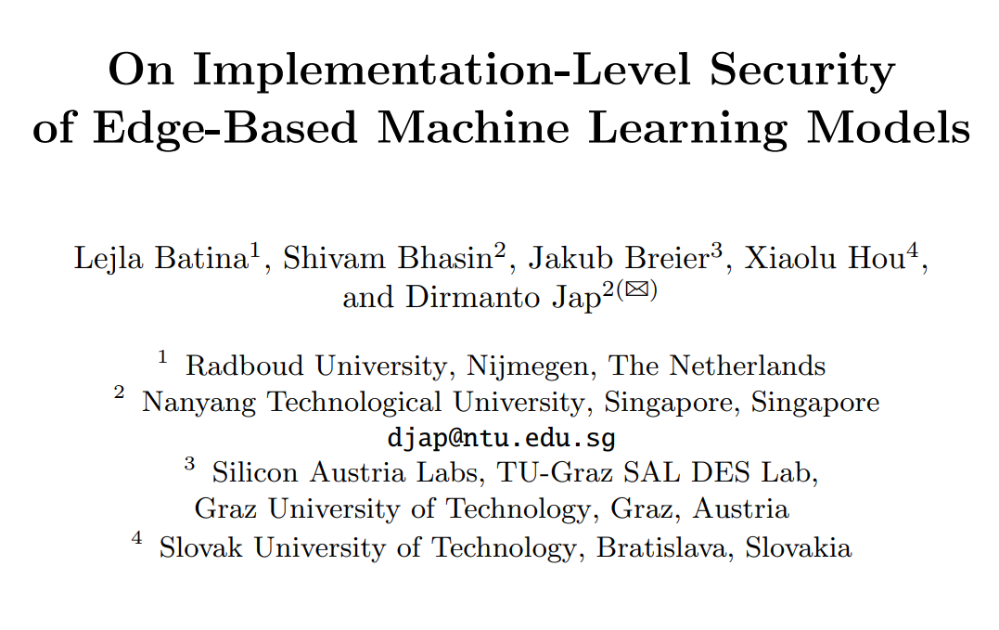
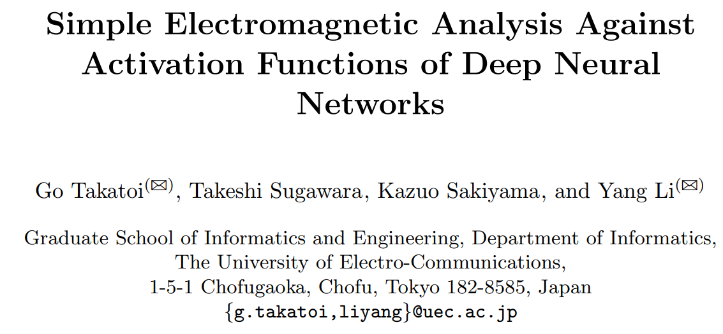
Side Channel Attacks on ML
Introduction
Preliminaries
Design
Results
Conclusion

Slide 7
Side Channel Attacks on ML
Introduction
Preliminaries
Design
Results
Conclusion
What about defenses??

Slide 8
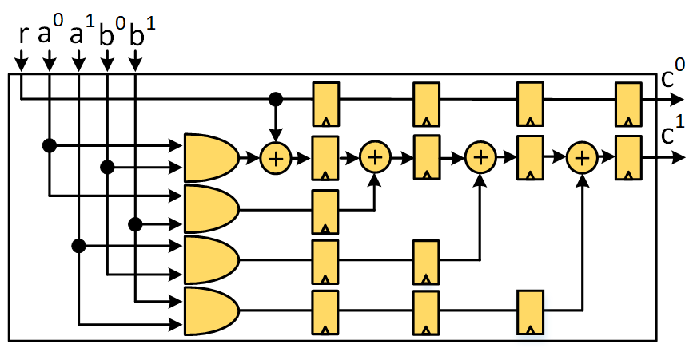
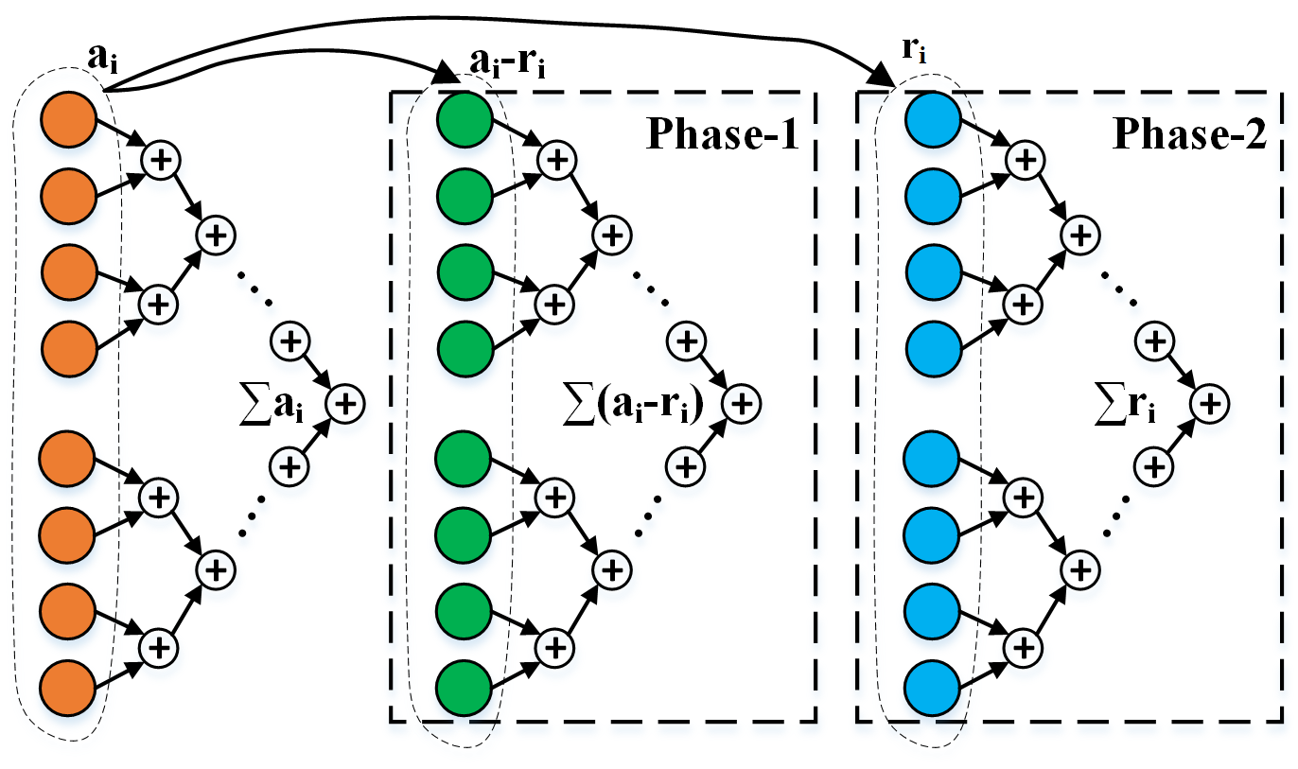
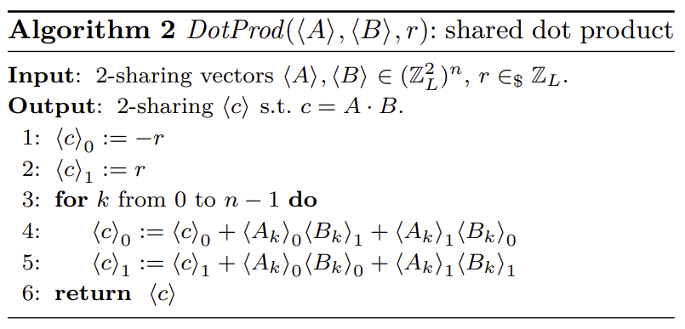
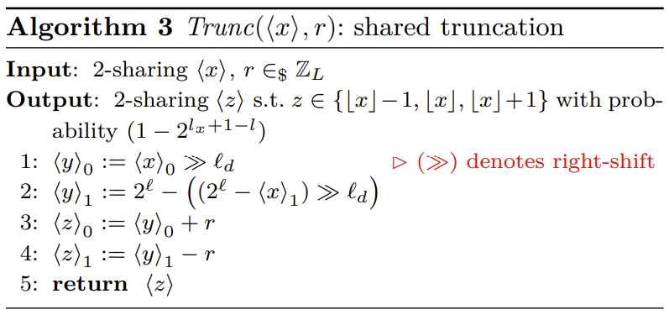
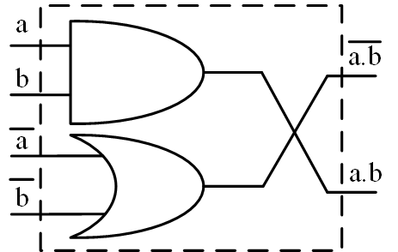
Related Works
Introduction
Preliminaries
Design
Results
Conclusion
[DCA20a]
[DCA20b]
[AWDF22]
[1] Dubey, A., Cammarota, R., & Aysu, A. (2020, December). Maskednet: The first hardware inference engine aiming power side-channel protection. In 2020 IEEE International Symposium on Hardware Oriented Security and Trust (HOST)
[2] Dubey, A., Cammarota, R., & Aysu, A. (2020, November). Bomanet: Boolean masking of an entire neural network. In 2020 IEEE/ACM International Conference On Computer Aided Design (ICCAD) (pp. 1-9). IEEE.
[3] Athanasiou, K., Wahl, T., Ding, A. A., & Fei, Y. (2022). Masking Feedforward Neural Networks Against Power Analysis Attacks. Proceedings on Privacy Enhancing Technologies, 2022(1), 501-521.
Notes:
Needs pictures

Slide 9
Towards Efficient Solutions
Introduction
Preliminaries
Design
Results
Conclusion
Until now: always tuned the defense according to ML
What if.. we tune ML to better suit defenses
Notes:
Applied Boolean masking on addition..efficiency requires arith on add and bool on act/output…

Slide 10
Introduction
Preliminaries
Design
Results
Conclusion
Towards Efficient Solutions
Until now: always tuned the defense according to ML
What if.. we tune ML to better suit defenses
Incorporate modular arithmetic in neural networks
Notes:
Applied Boolean masking on addition..efficiency requires arith on add and bool on act/output…

Slide 11
ModuloNET—Key Ideas and Results
Introduction
Preliminaries
Design
Results
Conclusion
Training is done in floating-point to preserve information
Inference is modified to work with modular arithmetic
Modulus fine-tuned via trials to improve accuracy—tested on MNIST, CIFAR10 & CIFAR100
Accuracy merely reduces by 0.27% and 0.77%
Reduced the LUT and FF overheads in the prior solution by 45.3% and 38%
Notes:
accuracy loss is 0.27% an 0.77%

Slide 12
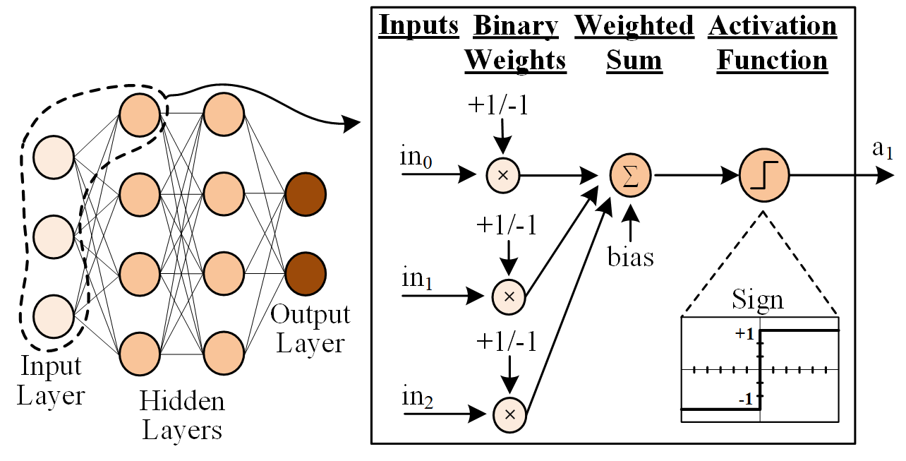
Binarized Neural Networks
Introduction
Preliminaries
Design
Results
Conclusion
Binary weights and activations
Expensive floating-point MAC→xnor+popcount
Notes:
Explain clearly the weighted summation etc..
We’ve implemented our solutions for both binarized and quantized neural networks. For this talk I will mainly discuss the details of binarized solutions.
Parameters versus hyperparameters

Slide 13
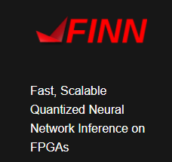
Binarized Neural Networks
Introduction
Preliminaries
Design
Results
Conclusion
Binary weights and activations
Expensive floating-point MAC→xnor+popcount
Gaining popularity in industry for edge AI
2020 VLSI Symposia
Xnor.ai
Notes:
Quantized neural network also implemented, but will only focus on BNNs for this talk

Slide 14
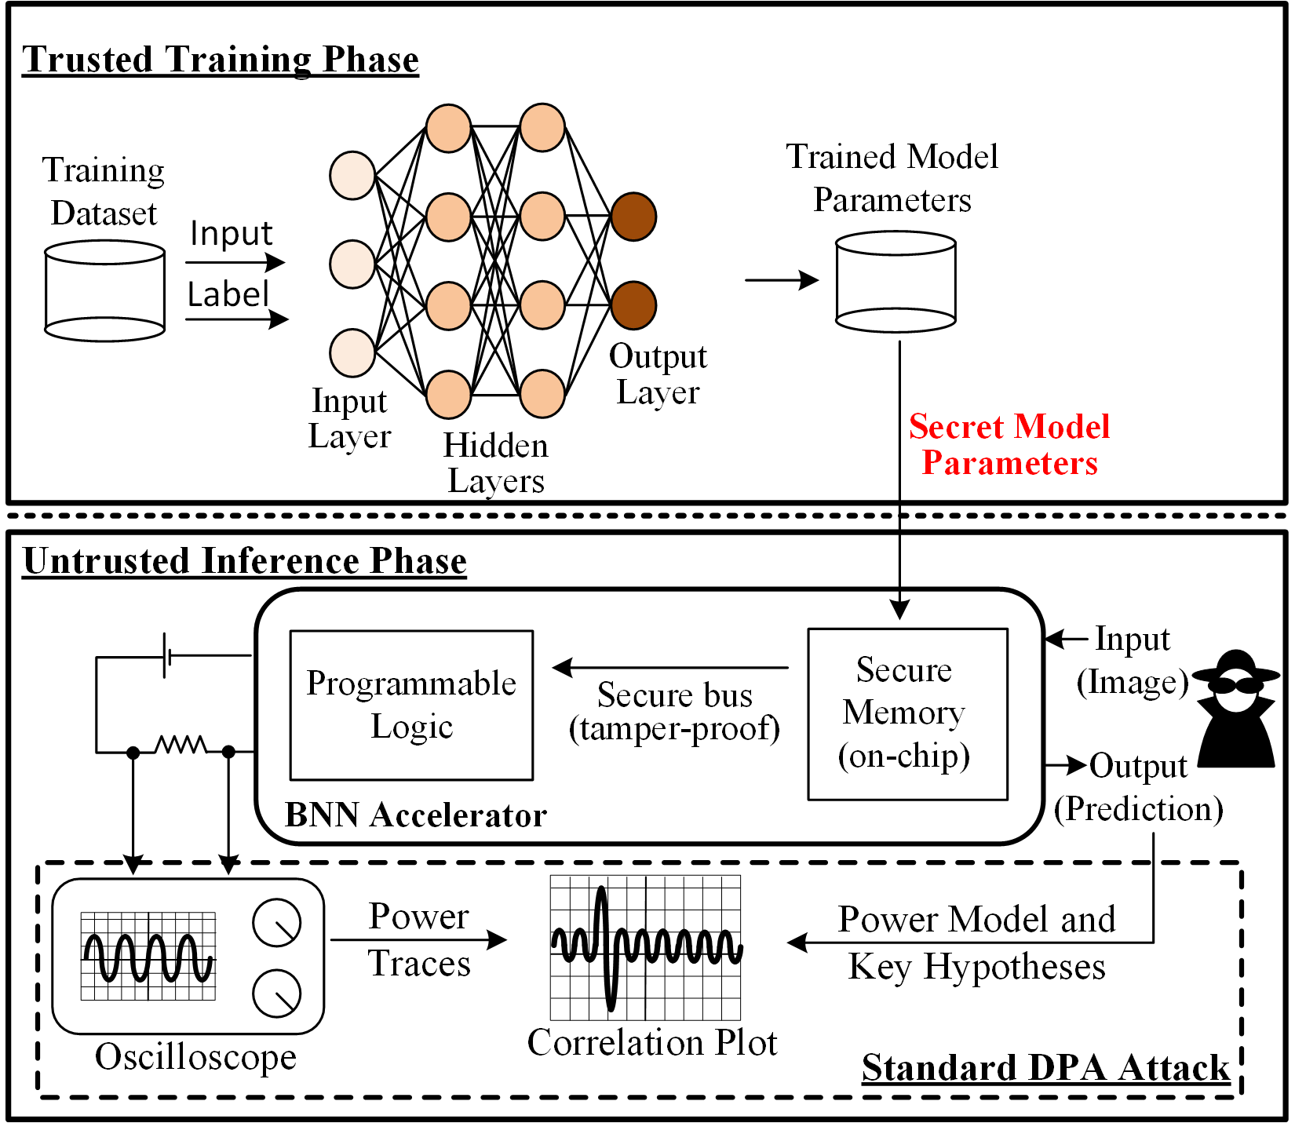
Threat Model
Introduction
Preliminaries
Design
Results
Conclusion
Attacker
Inputs chosen (chosen-plaintext)
Aims to extract parameters
Implementation
Constant-flow
Constant time
Platform
Power consumption obtainable
Hardware non-tamperable
Notes:
Training is done securely
Adversary targets hyperparameters as done in prior work..our work as well as prior work has been focusing more on parameters because they’re lucrative…..

Slide 15
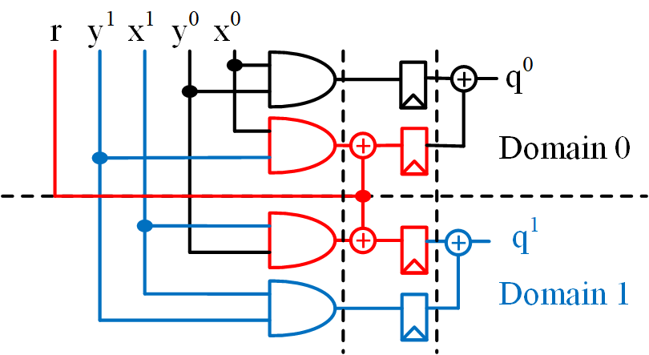
Domain Oriented Masking [GMK16]
Introduction
Preliminaries
Design
Results
Conclusion
Refresh and register the cross-domain terms
Notes:
thesis statement and the research questions I plan to answer

Slide 16
ModuloNet

Slide 17
Effects of Modulo Operation—Hidden
Introduction
Preliminaries
Design
Results
Conclusion
Without modulo
With modulo
-ve
+ve
<K/2
>K/2
Modulo inverts the distribution of weighted summations
Sign function→threshold with inversion
Notes:
thesis statement and the research questions I plan to answer

Slide 18
Effects of Modulo Operation—Output
Introduction
Preliminaries
Design
Results
Conclusion
Without modulo
With modulo
-ve
+ve
<K/2
>K/2
K
Modulo inverts the distribution of weighted summations
Maximum→thresholded maximum
Notes:
thesis statement and the research questions I plan to answer

Slide 19
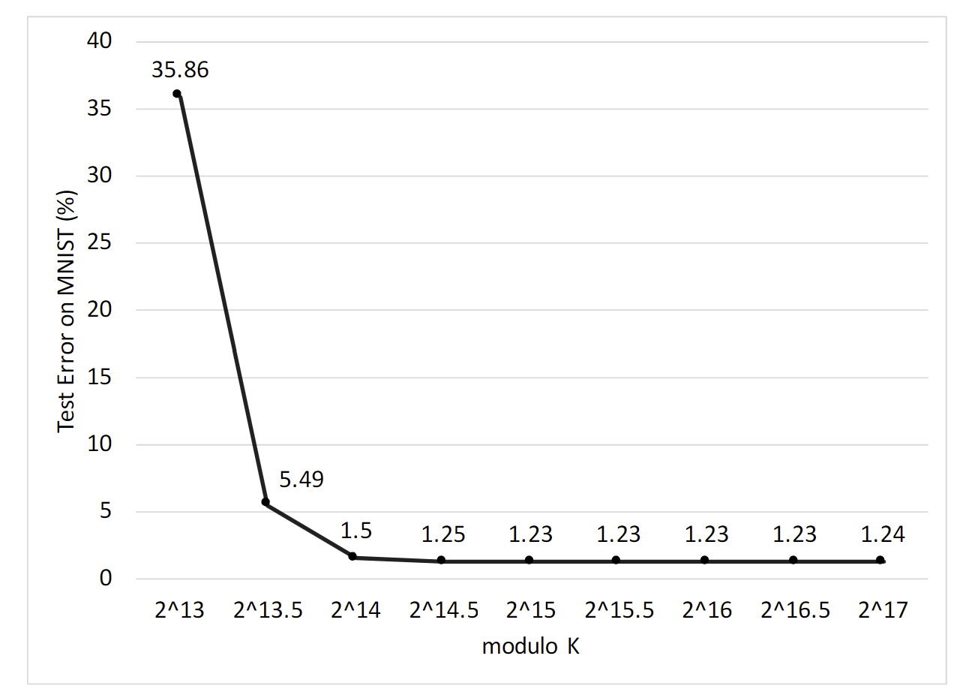
Test Error versus K
Introduction
Preliminaries
Design
Results
Conclusion
No significant gains beyond K=2¹⁵

Slide 20
Masking of the Output Layer
Introduction
Preliminaries
Design
Results
Conclusion
Two phase computation for local and global maxima
THRESH, COMP, MUX consist of DOM AND gates
Notes:
thesis statement and the research questions I plan to answer

Slide 21
ModuloNet MLP Hardware Design
Introduction
Preliminaries
Design
Results
Conclusion
Weighted summations use arithmetic masking
Non-linear functions use Boolean masking
Overheads: 3× in LUTs and 4.5× in FFs
Notes:
Power numbers…..

Slide 22
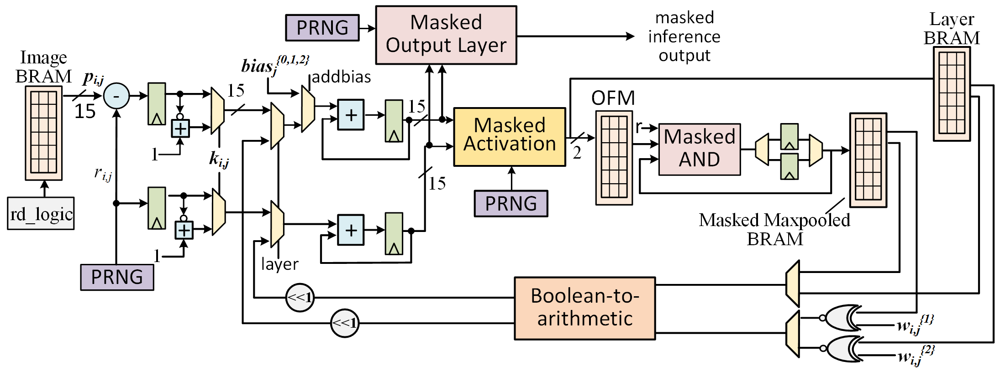
ModuloNet CNN Hardware Design
Introduction
Preliminaries
Design
Results
Conclusion
Convolutions use arithmetic masking
MaxPool is essentially an OR in BNN—DOM AND
Notes:
Power numbers…..

Slide 23
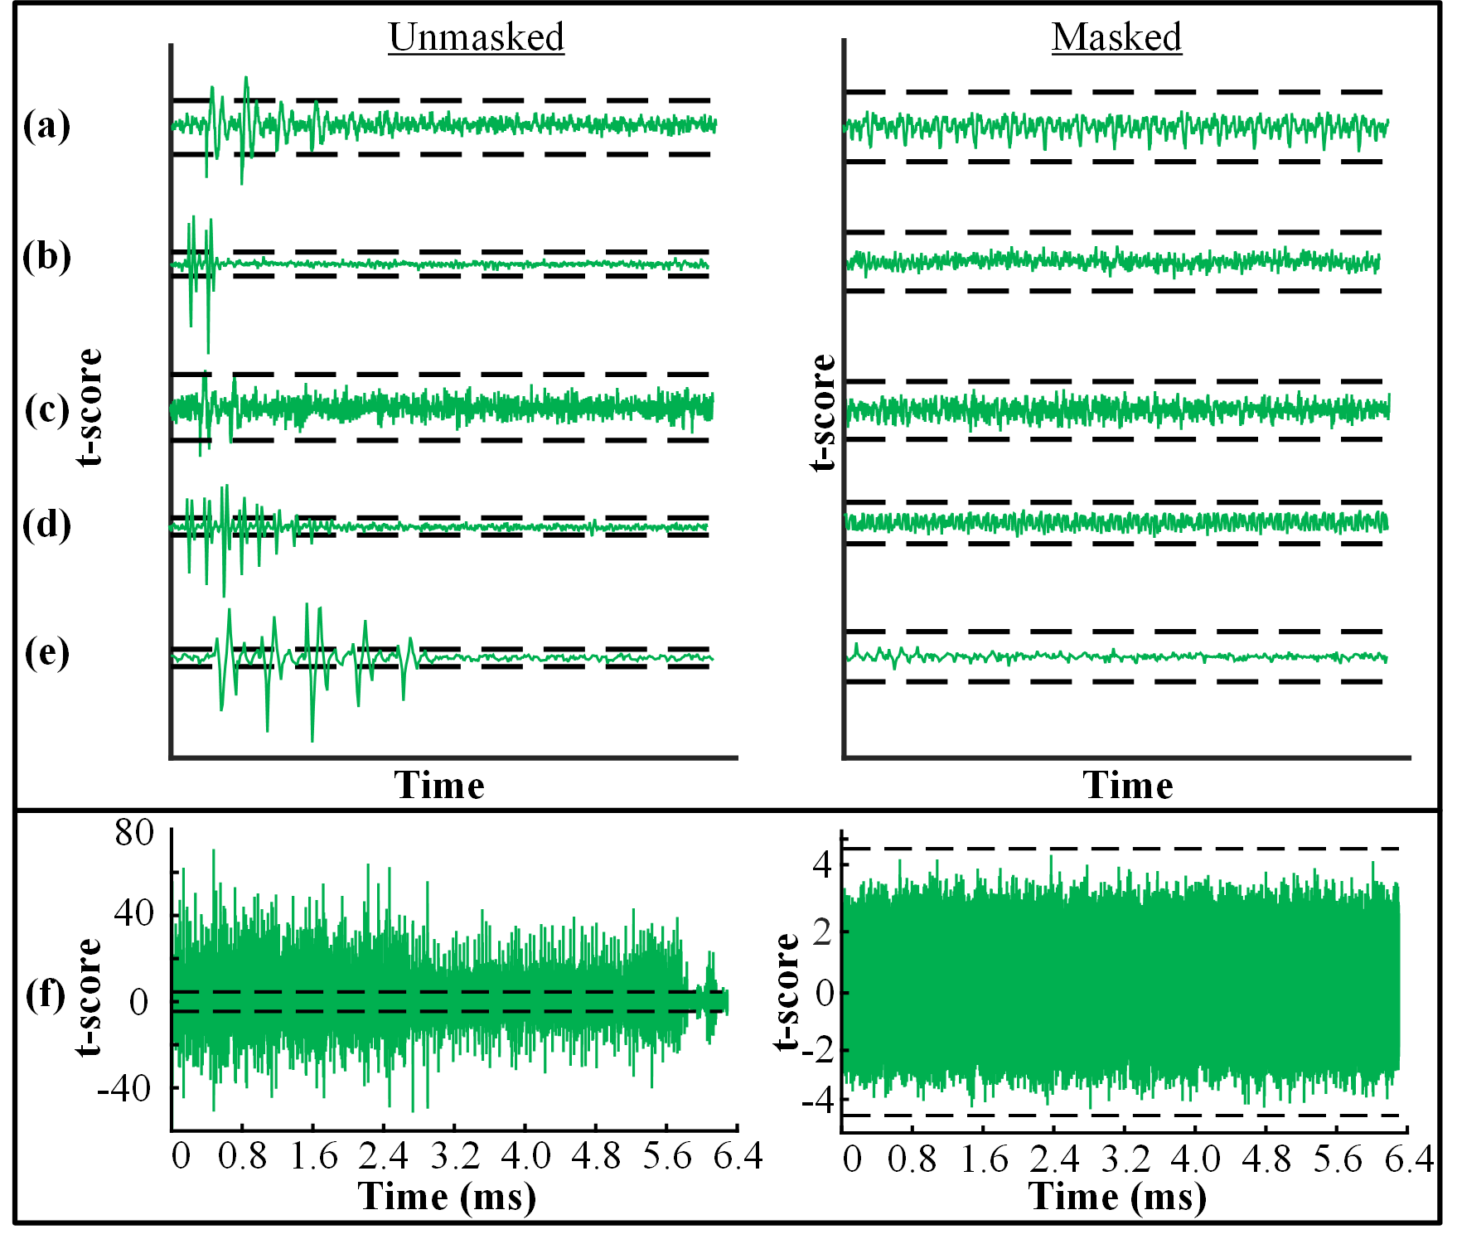
ModuloNet—SCA Results
Introduction
Preliminaries
Design
Results
Conclusion
Each masked gadget individually validated using TVLA
Unmasked design leaks within 10k traces
The masked design does not leak with 2M traces
Notes:
activation fn
b2a
a2b
masked comp
masked mux

Slide 24
More in the Paper
Introduction
Preliminaries
Design
Results
Conclusion
The design details of other masked gadgets like masked activation, masked multiplexor, B2A, A2B
Security proofs of the gadgets in the glitch-extended probing model
TVLA evaluations for conv and maxpool layers
Notes:
activation fn
b2a
a2b
masked comp
masked mux

Slide 25
Conclusions
Introduction
Preliminaries
Design
Results
Conclusion
ML provides a new avenue for side-channel research
Defenses relatively less explored compared to attacks
Security overheads can be reduced by employing transforms to ML algorithms
Extensive research needed to explore such solutions for other ML topologies
Notes:
activation fn
b2a
a2b
masked comp
masked mux

Slide 26
Questions?

Slide 27
Backup

Slide 28
Masked Comparator
Introduction
Preliminaries
Design
Results
Conclusion
.
E = a b , P = ~(a ⊕ b)
Registered outputs of DOM

