Slide 1
Racing BIKE: Improved Polynomial Multiplication and Inversion in Hardware
Jan Richter-Brockmann, Ming-Shing Chen, Santosh Ghosh, Tim Güneysu
CHES 2022

Slide 2
Motivation
Extensive research and advanced progress in quantum computing
In 2017, the NIST announced a PQC standardization process
In total, 69 submissions were revised
After the third round, seven finalists were selected and eight alternate candidates
One alternate candidate is BIKE which also proceeded to the fourth round

Slide 3
BIKE – Bit Flipping Key Encapsulation
Key Generation
Input: The target quantum security level $λ$
Output: Private key $(h_{0},h_{1},σ)$ and public key $h$
Generate ${(h}_{0},h_{1})\underset{←}{\$}ℛ^{2}$ both of weight $\left|h_{0}\right|=\left|h_{1}\right|=w/2$.
Generate $σ\underset{←}{\$}{\left\{0,1\right\}}^{ℓ}$ uniformly at random.
Generate $h←h_{1}⋅h_{0}^{−1}$.
Return $(h_{0},h_{1},σ)$ and $h$.
Decapsulation
Input: Private key $(h_{0},h_{1},σ)$ and ciphertext $C=(c_{0},c_{1})$
Output: Decapsulated key $K$
Compute syndrome $s←c_{0}⋅h_{0}$.
Compute $\left\{\left(e_{0}^{′},e_{1}^{′}\right), ⊥\right\}←decoder\left(s, h_{0},h_{1}\right)$.
Compute $m^{′}←c_{1}⊕L\left(e_{0}^{′},e_{1}^{′}\right)$.
if $H\left(m^{′}\right)≠\left(e_{0}^{′},e_{1}^{′}\right)$ then
Compute $K←K(σ,C)$.
Else
Compute $K←K(m^{′},C)$.
Return $K$.
Encapsulation
Input: Public key $h$
Output: Encapsulated key $K$ and cryptogram $C=(c_{0},c_{1})$
Generate $m\underset{←}{\$}{\left\{0,1\right\}}^{ℓ}$uniformly at random.
Compute $\left(e_{0},e_{1}\right)←H(m)$.
Compute $C=\left(c_{0},c_{1}\right)←\left(e_{0}+e_{1}⋅h,m⊕L({e_{0},e}_{1})\right)$.
Compute $K←K(m,C)$.
Return $(C,K)$.
Security | $$r$$ | $$w$$ | $$t$$
Level 1 | $$12 323$$ | $$142$$ | $$134$$
Level 2 | $$24 659$$ | $$206$$ | $$199$$
Level 3 | $$40 973$$ | $$274$$ | $$264$$

Slide 4
Sparse Multiplication
Multiplication: $h=f⋅g$ with $\left|f\right|=t≪r$
Representation: The set $I_{f}=\{i_{1},…,i_{t}\}$ represents the sparse polynomial $f=X^{i_{1}}+…+X^{i_{t}}$
Approach: $h=\sum_{i∈I_{f} }^{t}{g⋅X^{i}}$
→ The multiplication accumulates $t$ rotated $g$ by $i_{1},…,i_{t}$ bits!

Slide 5
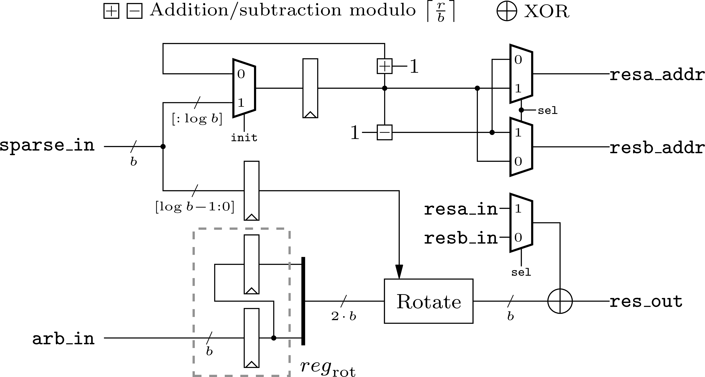
Hardware Implementation
Counter to determine addresses
Indices
Two memories to store intermediate results
Dense polynomial
Addition of partial products
Rotation unit

Slide 6
Hardware Implementation of the Sparse Multiplier Tailored to BIKE
Multiplication for key generation and decapsulation ✓
Multiplication for encapsulation: $c_{0}=e_{0}+e_{1}⋅h$ ?
More details in the paper!
$$L_{mult}\left(th\right)=\left(\left\lceil \frac{r}{b}\right\rceil +4\right)⋅hw+1$$

Slide 7
Implementation Results
General sparse multiplier for $hw=71$ and $b=32$
General sparse multiplier for $hw=134$ and $b=128$

Slide 8
BIKE – Bit Flipping Key Encapsulation
Key Generation
Input: The target quantum security level $λ$
Output: Private key $(h_{0},h_{1},σ)$ and public key $h$
Generate ${(h}_{0},h_{1})\underset{←}{\$}ℛ^{2}$ both of weight $\left|h_{0}\right|=\left|h_{1}\right|=w/2$.
Generate $σ\underset{←}{\$}{\left\{0,1\right\}}^{ℓ}$ uniformly at random.
Generate $h←h_{1}⋅h_{0}^{−1}$.
Return $(h_{0},h_{1},σ)$ and $h$.
Decapsulation
Input: Private key $(h_{0},h_{1},σ)$ and ciphertext $C=(c_{0},c_{1})$
Output: Decapsulated key $K$
Compute syndrome $s←c_{0} ⋅h_{0}$.
Compute $\left\{\left(e_{0}^{′},e_{1}^{′}\right), ⊥\right\}←decoder\left(s, h_{0},h_{1}\right)$.
Compute $m^{′}←c_{1}⊕L\left(e_{0}^{′},e_{1}^{′}\right)$.
if $H\left(m^{′}\right)≠\left(e_{0}^{′},e_{1}^{′}\right)$ then
Compute $K←K(σ,C)$.
Else
Compute $K←K(m^{′},C)$.
Return $K$.
Encapsulation
Input: Public key $h$
Output: Encapsulated key $K$ and cryptogram $C=(c_{0},c_{1})$
Generate $m\underset{←}{\$}{\left\{0,1\right\}}^{ℓ}$uniformly at random.
Compute $\left(e_{0},e_{1}\right)←H(m)$.
Compute $C=\left(c_{0},c_{1}\right)←\left(e_{0}+e_{1}⋅h,m⊕L({e_{0},e}_{1})\right)$.
Compute $K←K(m,C)$.
Return $(C,K)$.
Security | $$r$$ | $$w$$ | $$t$$
Level 1 | $$12 323$$ | $$142$$ | $$134$$
Level 2 | $$24 659$$ | $$206$$ | $$199$$
Level 3 | $$40 973$$ | $$274$$ | $$264$$

Slide 9
Extended Euclidean Algorithm
$$extGCD\left(f,g\right)=u⋅f−v⋅g$$
$→extGCD\left(X^{r}−1,h_{0}\right)=1=u⋅\left(X^{r}−1\right)−v⋅h_{0}$ and $v=h_{0}^{−1}$ since $v⋅h_{0}≡1 mod (X^{r}−1)$
Traditional extGCD is not constant time due to branches depending on secret inputs!

Slide 10
Constant-Time Extended Euclidean Algorithm [BY19]
Define $divstep : ℤ×𝔽_{2}\left[X\right]×𝔽_{2}\left[X\right]→ℤ×𝔽_{2}[X]×𝔽_{2}\left[X\right]$ as
$$divstep\left(δ,f,g\right)=\left\{\begin{matrix}{(1−δ,g,(g\left(0\right)f−f\left(0\right)g)}/X if δ>0 and g\left(0\right)≠0, \\ {(1+δ, f, (f\left(0\right)g−g\left(0\right)f)}/X otherwise \end{matrix}\right.$$
divstep
divstep
divstep
$$(δ,X^{r}−1,h_{0})$$
$$(1,u,v)$$
$$2r−1$$

Slide 11
Constant-Time Extended Euclidean Algorithm for BIKE
$$divstep\left(δ,f,g\right)=\left\{\begin{matrix}{(1−δ,g,(g\left(0\right)f−f\left(0\right)g)}/X if δ>0 and g\left(0\right)≠0, \\ {(1+δ, f, (f\left(0\right)g−g\left(0\right)f)}/X otherwise \end{matrix}\right.$$
Conditional swap: replacing $(δ,f,g)$ with $(−δ,g,f)$ if $δ>0$ and $g\left(0\right)≠0$
Elimination: replacing $(δ, f,g)$ with $\left(1+δ,f,{(f\left(0\right)g−g\left(0\right)f)}/X\right)$.
Two control bits
$δ>0$ $g(0)$
Simplification
$f\left(0\right)\&1$ always 1
For BIKE:
We split one divstep into get_control_bits() and update_fg_or_vw()

Slide 12
Constant-Time Extended Euclidean Algorithm for BIKE
$$f$$
update_fg()
$$f′$$
$$g$$
$$g′$$
$$D$$
$$D$$
$$D$$
$$D$$
$$D$$
control_bits()
$$δ′$$
$$δ$$
$s$ steps
$$v$$
update_vw()
$$v′$$
$$w$$
$$w′$$
divstep $D$
$\left\lceil \frac{2r−1}{s}\right\rceil$ iterations
→ Parametrization via step size $s$
→ Parametrization via bandwidth parameter $b$

Slide 13
Overall Design of the Polynomial Inversion
Implementation results for $b=32$

Slide 14
Implementation Results
Lightweight design $(s=1)$
High-speed design $(s=b)$

Slide 15
Implementation Results
Area (slices) comparison to [RBMG21] $(s=4, s=7, s=11)$

Slide 16
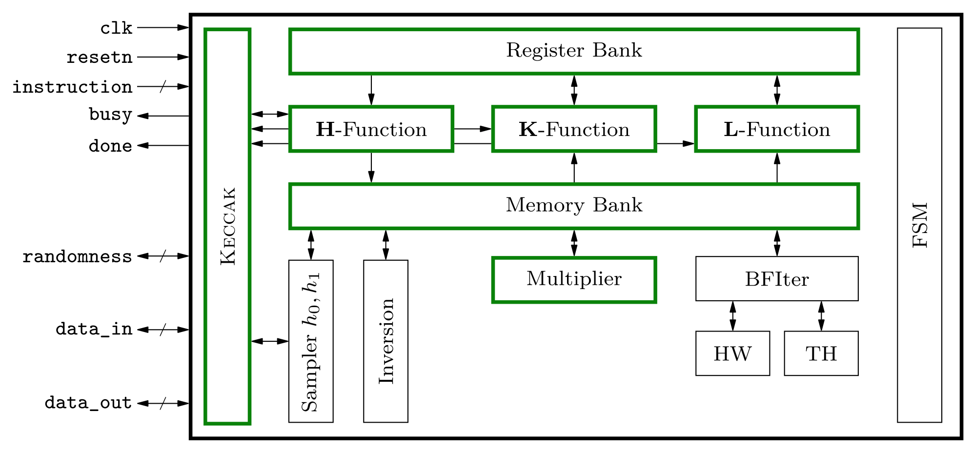
More Contributions
Validate that a single KECCAK core is more efficient for hardware than SHA2 and AES
Unified BIKE core that supports all KeyGen, Encaps, and Decaps
All Verilog files are publicly available on GitHub
https://github.com/Chair-for-Security-Engineering/RacingBIKE

Slide 17
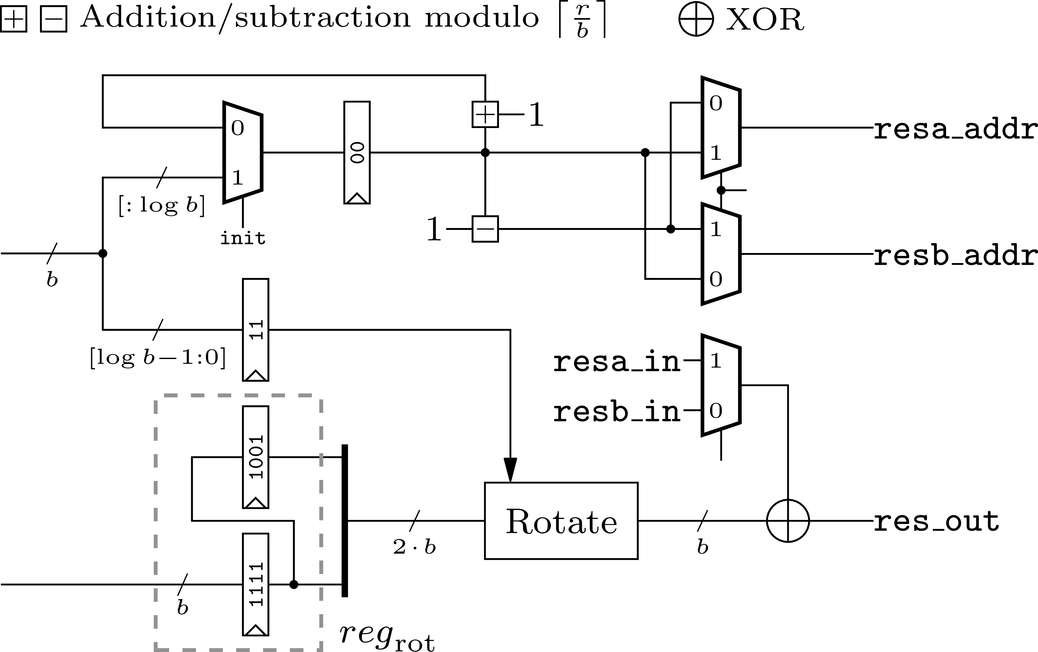
Summary
$$f$$
update_fg()
$$f′$$
$$g$$
$$g′$$
control_bits()
$$δ′$$
$$δ$$
$$v$$
update_vw()
$$v′$$
$$w$$
$$w′$$
divstep $D$
Polynomial Multiplier
Polynomial Inversion
United Hardware Implementation

Slide 18
Thank you!
jan.richter-brockmann@rub.de

Slide 19
References
[BY19] | Daniel J. Bernstein and Bo-Yin Yang. Fast constant-time gcd computation and modular inversion. IACR Trans. Cryptogr. Hardw. Embed. Syst., 2019(3):340–398, 2019.
[HWCW19] | Jingwei Hu, Wen Wang, Ray CC Cheung, and Huaxiong Wang. Optimized Polynomial Multiplier Over Commutative Rings on FPGAs: A Case Study on BIKE. In 2019 International Conference on Field-Programmable Technology (ICFPT) , pages 231–234. IEEE, 2019.
[RBMG21] | Jan Richter-Brockmann, Johannes Mono, and Tim Guneysu. Folding BIKE: Scalable Hardware Implementation for Recongurable Devices. IEEE Transactions on Computers , pages 1–1, 2021.

