Slide 1
VITI: A Tiny Self-Calibrating Sensor for Power-Variation Measurement in FPGAs
Brian Udugama, Darshana Jayasinghe, Hassaan Saadat,
Aleksandar Ignjatovic, Sri Parameswaran
CHES 2022
September 18-21, 2022
Leuven, Belgium

Slide 2
This talk is about…
VITI
(voltage induced time
interval sensor)
an area efficient on-chip sensor that
can calibrate itself to measure power
variations on an FPGA.
It can be used for remote power analysis
attacks.
1

Slide 3
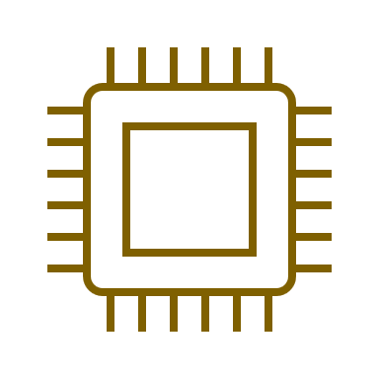
In this talk…
On-chip power sensors
Remote power analysis attacks
Design of VITI
Performance of VITI
2

Slide 4
On-chip power sensors
&
Remote power analysis
attacks

Slide 5
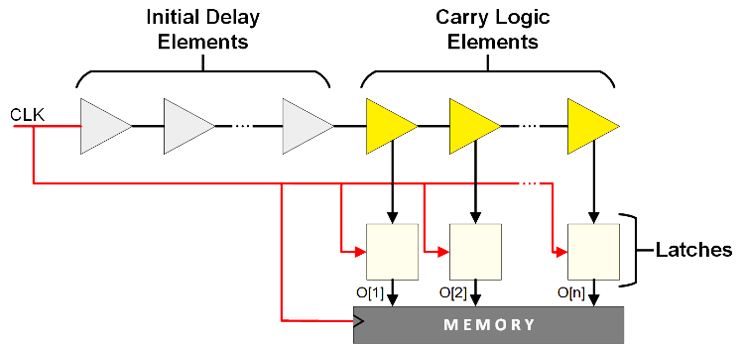
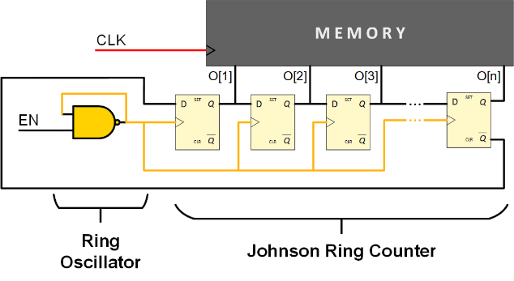
On-chip Power Sensors
Measure variations in signal propagation delay
Propagation delay variations are related to changes in operating condition such as supply-voltage
↑ Power consumption leads to
Therefore, signal propagation delay can be used to measure power consumption
Existing on-chip power sensors:
Time-to-digital converter (TDC)
Ring oscillator (RO)
VITI – proposed in this work
●●●●
↓ supply-voltage
4

Slide 6
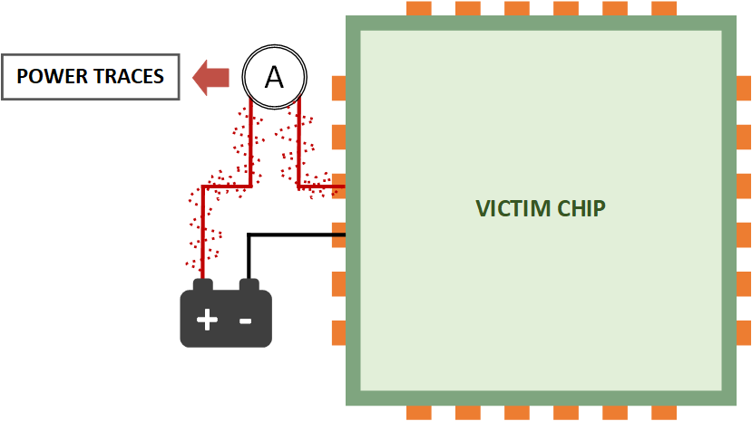
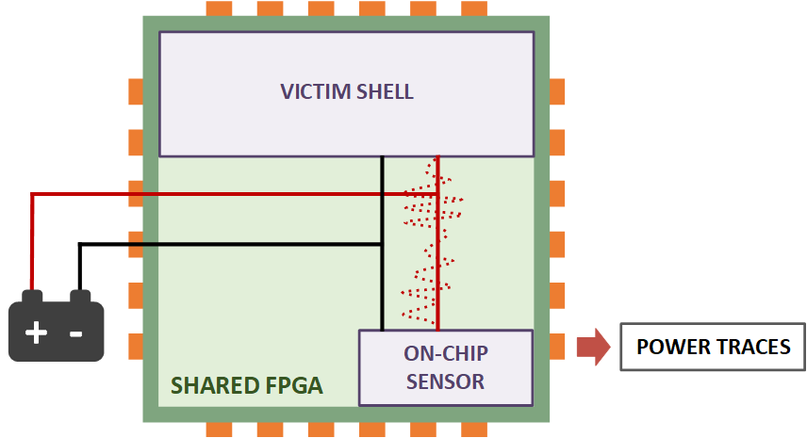
Remote Power Analysis (RPA) Attacks
Extract cryptographic secrets by analyzing power consumption
Uses on-chip power sensors – no oscilloscopes required
Can be performed remotely without having physical access
“Traditional” Power
Analysis Attacks
Remote Power
Analysis Attacks
5

Slide 7
Remote Power Analysis (RPA) Attacks
Extract cryptographic secrets by analyzing power consumption
Uses on-chip power sensors – no oscilloscopes required
Can be performed remotely without having physical access
Typical target is an Advanced Encryption Standard (AES) module
A good indication on the sensitivity of an on-chip sensor to small power variations
Key rank (KR)* is used as the performance metric
KR: the rank of the correct key, when all key guesses are sorted using the information recovered with RPA attack
Lower the KR, better it is: KR = 1 means, the key is fully recovered
5
* N. Veyrat-Charvillon et al., "Security Evaluations Beyond Computing Power"

Slide 8
TDC and RO
Sensor | Time-to-digital Converter* | Ring Oscillator⁺
Placement and routing | Constrained due to long tapped delay line | Arbitrary
Characteristic features | Contains latches Long CARRY chain on floorplan | Contains combinational loops – used in power viruses
Number of sensors | One | Several (≈64)
Resource requirement per sensor | High – 34 FPGA slices | Low – 2 FPGA slices
Sample Alignment | Aligned | Can be misaligned
6
* F. Schellenberg et al., "An inside job: Remote power analysis attacks on FPGAs"
⁺ J. Gravellier et al., "High-Speed Ring Oscillator based Sensors for Remote Side-Channel Attacks on FPGAs"

Slide 9
TDC and RO
Sensor | Time-to-digital Converter* | Ring Oscillator⁺
Placement and routing | Constrained due to long tapped delay line | Arbitrary
Characteristic features | Contains latches Long CARRY chain on floorplan | Contains combinational loops – used in power viruses
Number of sensors | One | Several (≈64)
Resource requirement per sensor | High – 34 FPGA slices | Low – 2 FPGA slices
Sample Alignment | Aligned | Can be misaligned
6
* F. Schellenberg et al., "An inside job: Remote power analysis attacks on FPGAs"
⁺ J. Gravellier et al., "High-Speed Ring Oscillator based Sensors for Remote Side-Channel Attacks on FPGAs"

Slide 10
TDC and RO
Sensor | Time-to-digital Converter* | Ring Oscillator⁺
Placement and routing | Constrained due to long tapped delay line | Arbitrary
Characteristic features | Contains latches Long CARRY chain on floorplan | Contains combinational loops – used in power viruses
Number of sensors | One | Several (≈64)
Resource requirement per sensor | High – 34 FPGA slices | Low – 2 FPGA slices
Sample Alignment | Aligned | Can be misaligned
6
* F. Schellenberg et al., "An inside job: Remote power analysis attacks on FPGAs"
⁺ J. Gravellier et al., "High-Speed Ring Oscillator based Sensors for Remote Side-Channel Attacks on FPGAs"

Slide 11
TDC and RO
Sensor | Time-to-digital Converter* | Ring Oscillator⁺
Placement and routing | Constrained due to long tapped delay line | Arbitrary
Characteristic features | Contains latches Long CARRY chain on floorplan | Contains combinational loops – used in power viruses
Number of sensors | One | Several (≈64)
Resource requirement per sensor | High – 34 FPGA slices | Low – 2 FPGA slices
Sample Alignment | Aligned | Can be misaligned
6
* F. Schellenberg et al., "An inside job: Remote power analysis attacks on FPGAs"
⁺ J. Gravellier et al., "High-Speed Ring Oscillator based Sensors for Remote Side-Channel Attacks on FPGAs"

Slide 12
TDC and RO
Sensor | Time-to-digital Converter* | Ring Oscillator⁺
Placement and routing | Constrained due to long tapped delay line | Arbitrary
Characteristic features | Contains latches Long CARRY chain on floorplan | Contains combinational loops – used in power viruses
Number of sensors | One | Several (≈64)
Resource requirement per sensor | High – 34 FPGA slices | Low – 2 FPGA slices
Sample Alignment | Aligned | Can be misaligned
Requires ≈128 FPGA slices in total
6
* F. Schellenberg et al., "An inside job: Remote power analysis attacks on FPGAs"
⁺ J. Gravellier et al., "High-Speed Ring Oscillator based Sensors for Remote Side-Channel Attacks on FPGAs"

Slide 13
TDC and RO
Sensor | Time-to-digital Converter* | Ring Oscillator⁺
Placement and routing | Constrained due to long tapped delay line | Arbitrary
Characteristic features | Contains latches Long CARRY chain on floorplan | Contains combinational loops – used in power viruses
Number of sensors | One | Several (≈64)
Resource requirement per sensor | High – 34 FPGA slices | Low – 2 FPGA slices
Sample Alignment | Aligned | Can be misaligned
Requires ≈128 FPGA slices in total
6
* F. Schellenberg et al., "An inside job: Remote power analysis attacks on FPGAs"
⁺ J. Gravellier et al., "High-Speed Ring Oscillator based Sensors for Remote Side-Channel Attacks on FPGAs"

Slide 14
TDC and RO
Sensor | Time-to-digital Converter* | Ring Oscillator⁺
Placement and routing | Constrained due to long tapped delay line | Arbitrary
Characteristic features | Contains latches Long CARRY chain on floorplan | Contains combinational loops – used in power viruses
Number of sensors | One | Several (≈64)
Resource requirement per sensor | High – 34 FPGA slices | Low – 2 FPGA slices
Sample Alignment | Aligned | Can be misaligned
6
* F. Schellenberg et al., "An inside job: Remote power analysis attacks on FPGAs"
⁺ J. Gravellier et al., "High-Speed Ring Oscillator based Sensors for Remote Side-Channel Attacks on FPGAs"

Slide 15
TDC and RO
Sensor | Time-to-digital Converter* | Ring Oscillator⁺
Placement and routing | Constrained due to long tapped delay line | Arbitrary
Characteristic features | Contains latches Long CARRY chain on floorplan | Contains combinational loops – used in power viruses
Number of sensors | One | Several (≈64)
Resource requirement per sensor | High – 34 FPGA slices | Low – 2 FPGA slices
Sample Alignment | Aligned | Can be misaligned
6
* F. Schellenberg et al., "An inside job: Remote power analysis attacks on FPGAs"
⁺ J. Gravellier et al., "High-Speed Ring Oscillator based Sensors for Remote Side-Channel Attacks on FPGAs"

Slide 16
Design of VITI

Slide 17
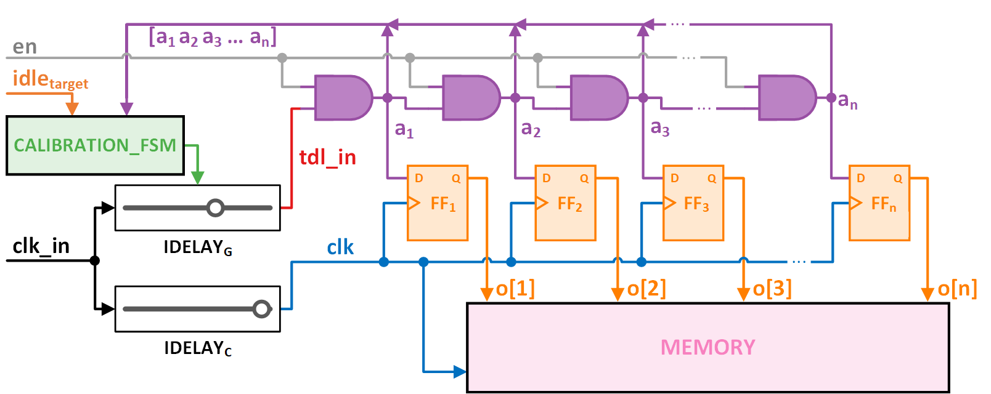
Design of VITI
8

Slide 18
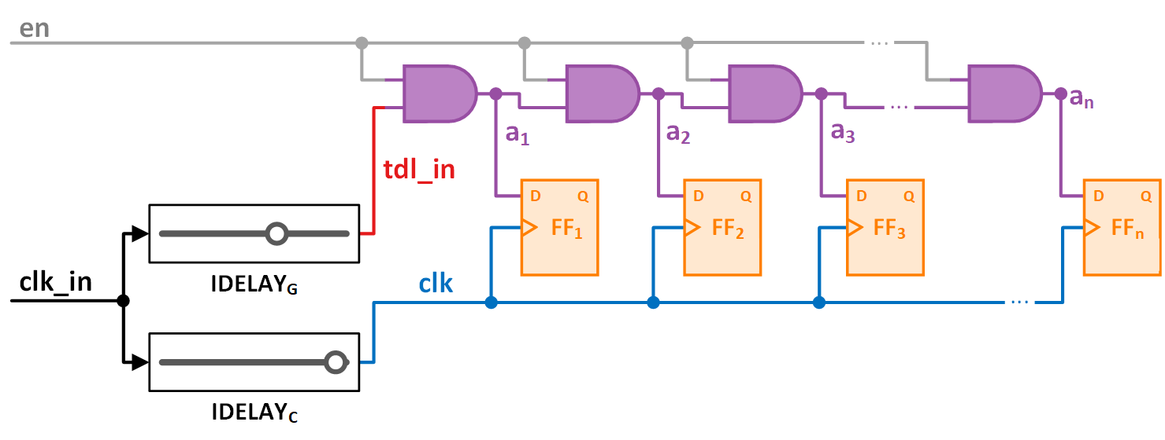
Design of VITI
8

Slide 19
Design of VITI
Tapped Delay Line
Adjustable Input Delay Element
Induced Delay
8

Slide 20
Design of VITI
Inputs |  | Output
A | B
0 | 0 | 0
0 | 1 | 0
1 | 0 | 0
1 | 1 | 1
A
Output
B
= 1
1
1
1
1
1
1
1
1
1
= 1
8

Slide 21
Design of VITI
Inputs |  | Output
A | B
0 | 0 | 0
0 | 1 | 0
1 | 0 | 0
1 | 1 | 1
A
Output
B
= 1
1
1
1
1
1
1
1
1
1
= 1
8

Slide 22
Design of VITI
= 1
1
8

Slide 23
Design of VITI
= 1
1
1
1
1
1
1
1
0
= 1
8

Slide 24
Design of VITI
1
Low
Power
Consumption
1
1
1
0
Propagation Delay
Power Consumption
High
Power
Consumption
1
1
0
0
9

Slide 25
Design of VITI
10

Slide 26
Design of VITI
✓ Arbitrary placement and routing
✓ Works with one sensor
✓ Low resource requirement per sensor
✓ Aligned samples
✓ Clock frequency independent resource requirement
✓ Built-in automatic runtime calibration
11

Slide 27
RPA Performance of
VITI (4-bit)

Slide 28
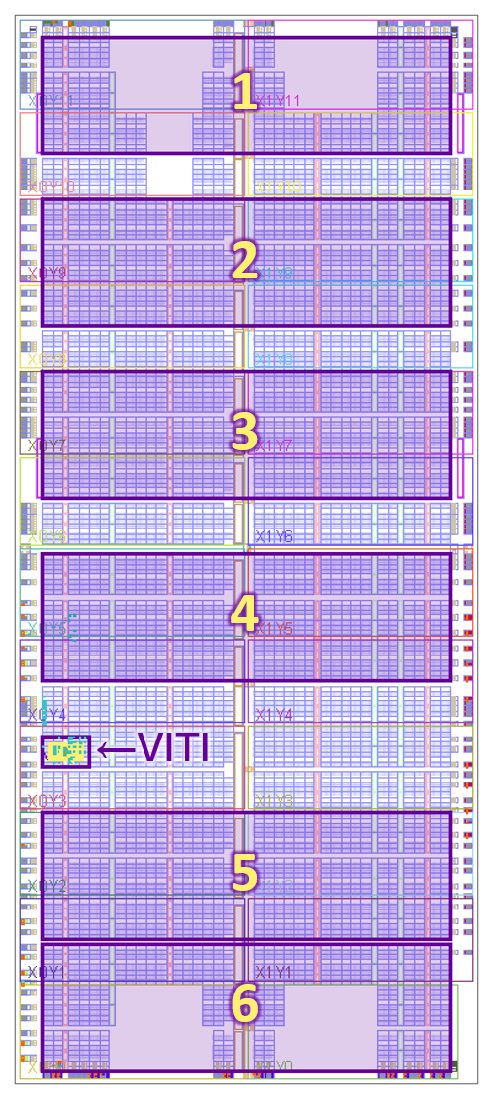
RPA Performance of VITI – Placement of AES module
Varied the placement of AES module
Fixed parameters:
VITI placement
VITI frequency – 96 MHz
Victim AES frequency – 6 MHz
13

Slide 29
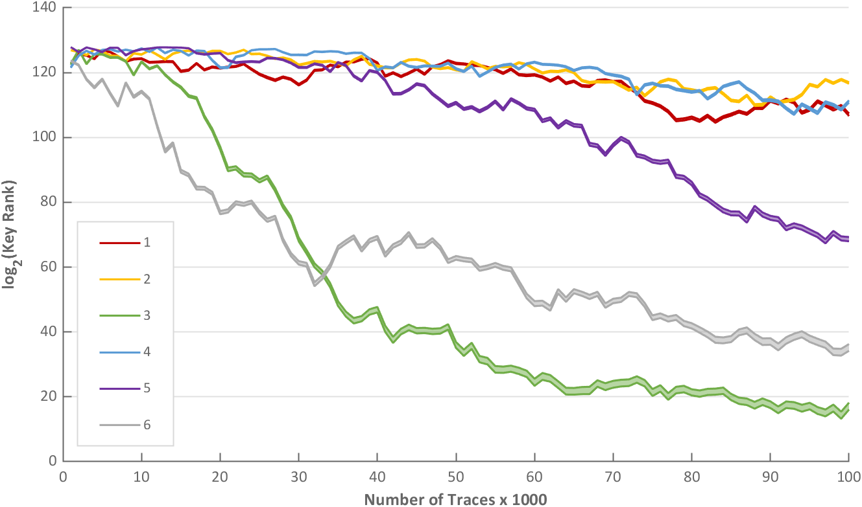
RPA Performance of VITI – Placement of AES module
Can pickup the activity of the victim AES module across the chip
14

Slide 30
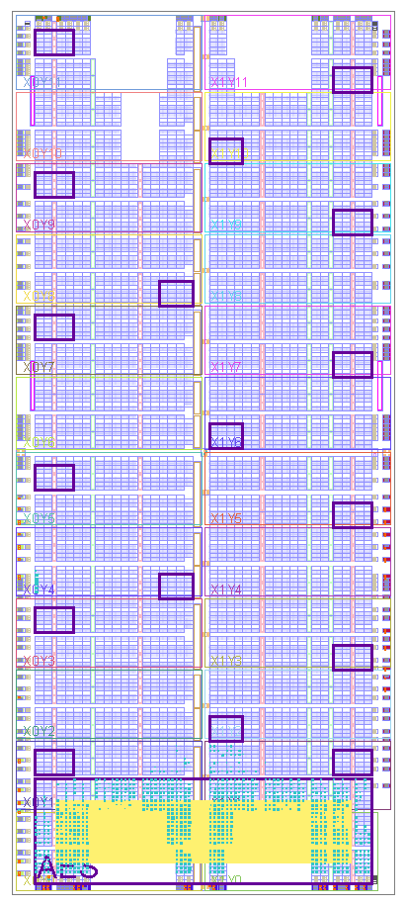
RPA Performance of VITI – Placement of VITI
Varied the placement of VITI
Fixed parameters:
AES module placement
VITI frequency – 96 MHz
Victim AES frequency – 6 MHz
15

Slide 31
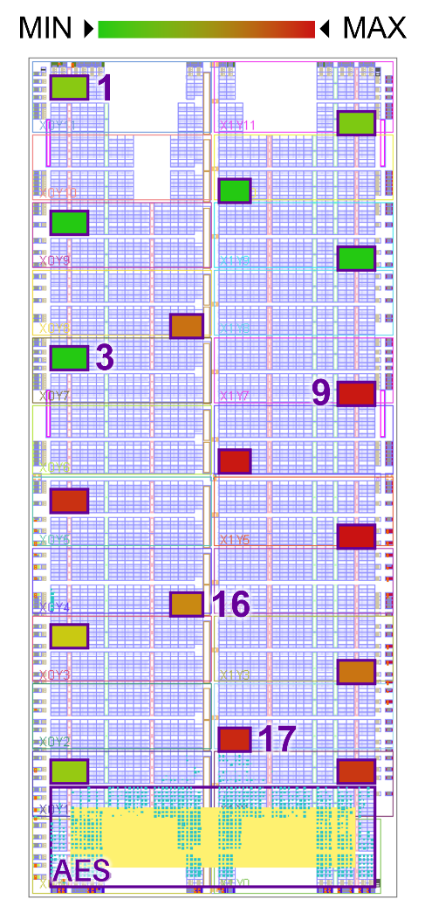
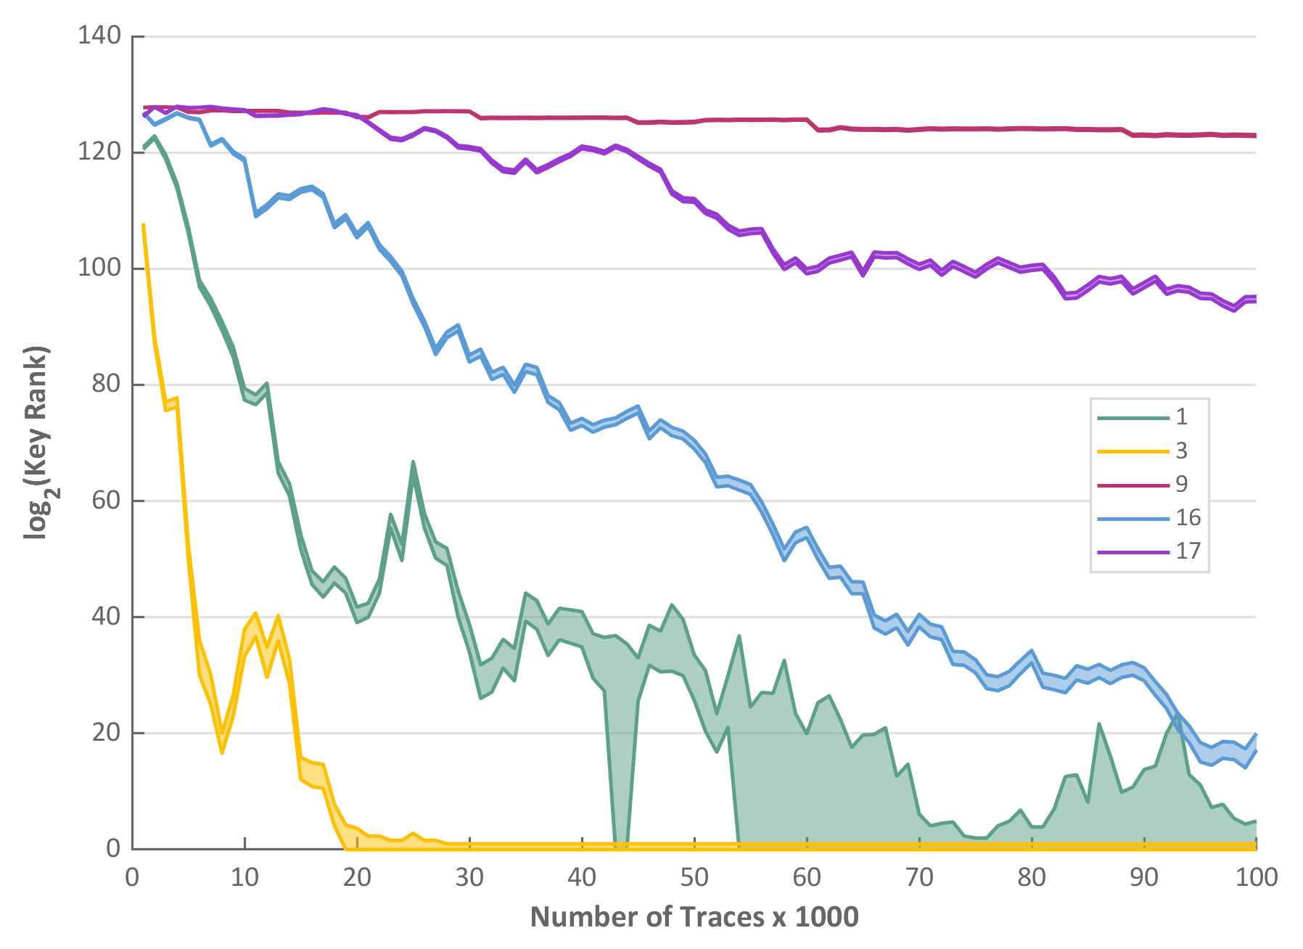
RPA Performance of VITI – Placement of VITI
16

Slide 32
RPA Performance of VITI – Placement of VITI
16

Slide 33
RPA Performance of VITI – Placement of VITI
16

Slide 34
RPA Performance of VITI – Placement of VITI
16

Slide 35
RPA Performance of VITI – Placement of VITI
16

Slide 36
RPA Performance of VITI – Placement of VITI
16

Slide 37
RPA Performance of VITI – Placement of VITI
Placement of VITI has a significant impact on attack efficacy
16

Slide 38
RPA Performance of VITI – Temperature Change
On-chip sensors are susceptible to temperature changes
Slightly modified CALIBRATION_FSM
Recalibrates when no variation is observed
Fixed parameters:
VITI/AES module placement
VITI frequency – 96 MHz
Victim AES frequency – 6 MHz
While AES module is running, blew hot air over the chip to change the temperature
17

Slide 39
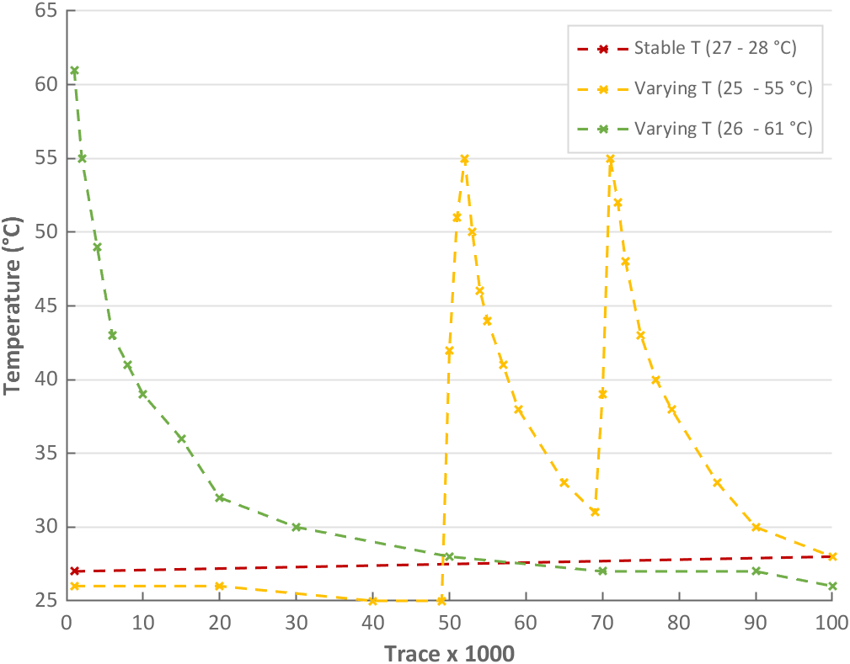
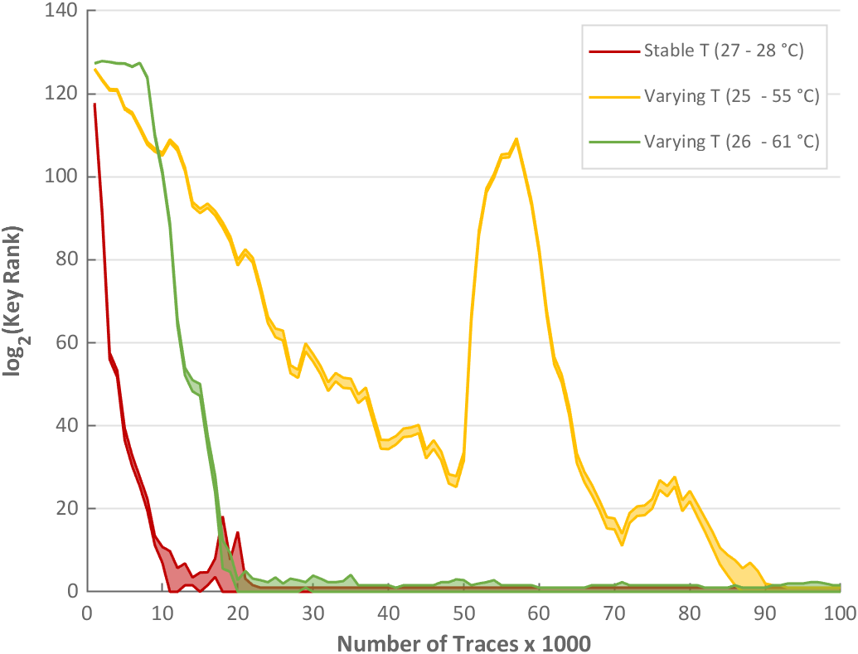
RPA Performance of VITI – Temperature Change
With recalibration enabled, VITI is capable of adapting to temperature changes
VITI can respond to abrupt changes
18

Slide 40
RPA Performance of VITI – Resource Efficiency
Sensor | VITI | Time-to-digital Converter | Ring Oscillator
Number of sensors | 1 | 1 | 64
Total sensor area | 8 FPGA slices 2 IODELAY2 elements | 34 FPGA slices | 128 FPGA slices
Block RAM elements for holding samples | 1 | 2 | 64
Size of a power trace with 256 sampling points | 128 bytes | 256 bytes | 16,384 bytes
19

Slide 41
RPA Performance of VITI – Resource Efficiency
Sensor | VITI | Time-to-digital Converter | Ring Oscillator
Number of sensors | ✓ | 1 | 64
Total sensor area | 8 FPGA slices 2 IODELAY2 elements | 34 FPGA slices | 128 FPGA slices
Block RAM elements for holding samples | 1 | 2 | 64
Size of a power trace with 256 sampling points | 128 bytes | 256 bytes | 16,384 bytes
19

Slide 42
RPA Performance of VITI – Resource Efficiency
Sensor | VITI | Time-to-digital Converter | Ring Oscillator
Number of sensors | ✓ | 1 | 64
Total sensor area | ✓ | 34 FPGA slices | 128 FPGA slices
Block RAM elements for holding samples | 1 | 2 | 64
Size of a power trace with 256 sampling points | 128 bytes | 256 bytes | 16,384 bytes
19

Slide 43
RPA Performance of VITI – Resource Efficiency
Sensor | VITI | Time-to-digital Converter | Ring Oscillator
Number of sensors | ✓ | 1 | 64
Total sensor area | ✓ | 34 FPGA slices | 128 FPGA slices
Block RAM elements for holding samples | ✓ | 2 | 64
Size of a power trace with 256 sampling points | 128 bytes | 256 bytes | 16,384 bytes
19

Slide 44
RPA Performance of VITI – Resource Efficiency
Sensor | VITI | Time-to-digital Converter | Ring Oscillator
Number of sensors | ✓ | 1 | 64
Total sensor area | ✓ | 34 FPGA slices | 128 FPGA slices
Block RAM elements for holding samples | ✓ | 2 | 64
Size of a power trace with 256 sampling points | ✓ | 256 bytes | 16,384 bytes
19

Slide 45
RPA Performance of VITI
Experimentally evaluated the effects of:
Frequency of AES module – operating frequency of the victim
Frequency of VITI – sampling frequency of VITI
Magnitude of power variation – magnitude of the peak-to-peak variation of the power consumption
Experimentally evaluated the following properties:
Portability – ability to port VITI across device instances
Cloud deployability – ability to deploy on a cloud FPGA instance
Noise tolerance – tolerance to noise due to other active circuits
20

Slide 46
For more results and information
VITI: A Tiny Self-Calibrating Sensor for Power-Variation Measurement in FPGAs
Udugama, B., Jayasinghe, D., Saadat, H., Ignjatovic, A., & Parameswaran, S.
IACR Transactions on Cryptographic Hardware and Embedded Systems, 2022(1), 657–678.
Artifacts (design sources, sample datasets etc.) are available at https://artifacts.iacr.org/tches/2022/a5/
21

Slide 47
In this talk…
On-chip power sensors and their characteristics
Remote power analysis (RPA) attacks and key rank (KR)
Design of VITI
Performance and properties of VITI
22

Slide 48
It is time for your questions!
23

Slide 49
Thank you! A special thanks to CHES 2022 organizers and sponsors for their generous support for expenses. Thank you!
24

