Slide 1
Bypassing Isolated Execution on RISC-V using Side-Channel-Assisted Fault-Injection and Its Countermeasure
CHES 2022
21th September 2022 in Leuven
S. Nashimoto*, D. Suzuki*, R. Ueno†, N. Homma†
*Mitsubishi Electric Corporation
†Tohoku University
Notes:
Thank you for the introduction.
I'm Shoei Nashimoto from Mitsubishi Electric.
Today, I'm gonna talk about fault attacks on isolated execution on RISC-V.

Slide 2

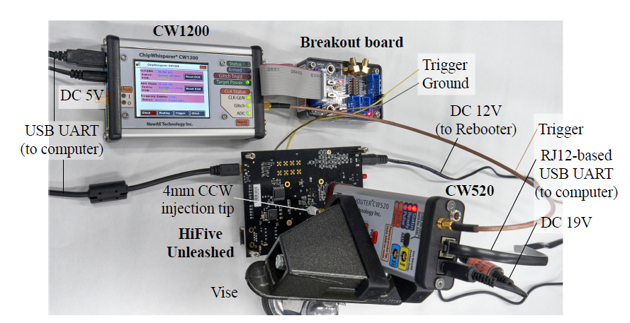
Overview
If critical instructions are skipped by fault injection, isolated execution on RISC-V can be compromised
Proposed attack skips reconf. of isolation setting at context switch and obtains previous permission
Proposed software-based countermeasure makes the attack completely unsuccessful
Victim
app
Attacker
app
Isolation settings
RWX
Addr
RWX
Addr
Monitor
skip
Reconfiguration
RWX
Addr
RWX
Addr
Concept of proposed attack
Experimental setup
Notes:
In the beginning, I'd like to show you the overview of my presentation.
What I want to say in this presentation is if critical instructions are skipped by fault injection, a trusted execution environment on RISC-V can be compromised.
Our proposed attack skips the reconfiguration of isolation settings in a context switch like this.
And obtains the previous permission.
We evaluated the effectiveness of the proposed attack through the experiment using RISC-V Keystone.
We also proposed a software-based countermeasure that makes the attack completely unsuccessful.

Slide 3
Outline
Background
Security on RISC-V
Proposed attack
Experiment
Countermeasure
Conclusion
Notes:
Here is the outline of my presentation.
It has six parts.
Now, let's begin with the background.

Slide 4



Trusted Execution Environment (TEE)
Secure area of processor, isolated by hardware support
  Promising countermeasure to protect secure apps from malicious and vulnerable apps
Examples: ARM TrustZone, Intel SGX, RISC-V Keystone
Secure
Normal
Cryptographic operation
Command
Vulnerable
Application or OS
Result
Secret
Key
Malicious
application or library
BG>RISC-V>Attack>Exp.>Counter
Notes:
A trusted execution environment or TEE is a secure area of a processor, isolated by hardware support.
So, our attack target is a TEE.
It is a promising countermeasure to protect secure applications from malicious and vulnerable applications.
ARM TrustZone and Intel SGX are famous TEE enabler technologies.

Slide 5






Fault injection attack (FIA)
Injecting malicious signals into processor
Causing instruction skips and data corruption
  Threats to security mechanisms and cryptographic operations
Glitch
High
Voltage
(V-FI)
Laser
(Laser-FI)
Low
High
Clock
(Clock FI)
Electromagnetic wave (EMFI)
Low
BG>RISC-V>Attack>Exp.>Counter
Notes:
Fault injection attacks inject malicious signals into a processor.
Voltage, clock, laser and electromagnetic wave are major injection methods.
Fault injection causes instruction skips and data corruption.
They are threats to security mechanisms and cryptographic operations.

Slide 6
FIA against TEE & motivation
Motivating questions
Any generic bypassing attack on RISC-V TEE other than cryptanalysis?
Realistic attack including fault parameter extraction?
Bypassing attack on RISC-V TEE is applicable to other TEE technologies?
Year | Paper | TEE technology | Attack target | Injection
2022 | This work | RISC-V (PoC TEE, Keystone) | Isolation itself | Clock, EMFI
2020 | Plundervolt | Intel SGX | Cryptography | DVFS
2020 | V0LTpwn | Intel SGX | Cryptography | DVFS
2019 | VoltJockey | ARM TrsutZone, Intel SGX | Cryptography | DVFS
2018 | Laser-Induced FI | ARM TrsutZone | Secure boot | Laser
2017 | Attack TrustZone with Rowhammer | ARM TrsutZone | Cryptography | Rowhammer
2017 | CLK screw | ARM TrsutZone | Cryptography | DVFS
BG>RISC-V>Attack>Exp.>Counter
Notes:
This table summarizes existing studies on fault injection attacks against TEEs.
This indicates that most of the works target cryptography on Intel SGX and ARM TrustZone.
So, we aimed for a different way to attack another TEE technology.
There are three motivating questions:
1) is there any generic bypassing attack on RISC-V-based TEEs other than cryptanalysis?
2) is it a realistic attack, including fault parameter extraction?
And 3) is the bypassing attack applicable to other TEEs?
According to our work, the answer is yes to all of these questions.
Let's take a closer look.

Slide 7
Outline
Background
Security on RISC-V
Proposed attack
Experiment
Countermeasure
Conclusion
BG>RISC-V>Attack>Exp.>Counter
Notes:
Now, let's move on to security on RISC-V.

Slide 8
Major Components in RISC-V TEE
Goal: Control access to ROM, RAM, and peripherals for
1) each application or 2) applications between secure and non-secure
① Memory Access Monitoring
Requires to check memory access settings and decide whether it is allowed.
→ Physical Memory Protection (PMP)
② Privilege Level
Requires separation of access rights to security settings in ISA level.
→ Privilege mode
isolation
non-secure
secure
App 1
App 2
App 3
App 1
App 2
App
Privilege
OS
OS
Monitor
Monitor
1) Isolate each application
2) Isolate two worlds
Notes:
I'll present the major components comprising a TEE on RISC-V.
TEEs aim to control access ROM, RAM, and peripherals for each application or application between secure and non-secure areas.
For this purpose, memory access must be monitored.
It is required to check memory access settings and decide whether it is allowed.
A hardware unit called physical memory protection or PMP handles this.
Privileges are required for vertical separation.
It is required to separate access rights to security settings in the instruction set level.
In RISC-V, this is called privilege mode.
Let's see more details.

Slide 9
① Physical Memory Protection (PMP)
31
24
15
8
7
0
Assign "write, read, and execute" permissions to specific memory ranges
  pmpcfg: permission
  pmpaddr: covered address
  PMP entry (pair of pmpicfg and pmpaddri) manages one memory range
All memory accesses are monitored
  Assert access fault exception in case of invalid access
pmp3cfg
pmp1cfg
pmp0cfg
8
8
8
L | 0 | A | X | W | R
Config register
(pmpcfg)
31
0
pmpaddr0
pmpaddr1
Address register
(pmpaddr)
BG>RISC-V>Attack>Exp.>Counter
Notes:
The purpose of the PMP is to assign "write, read, and execute" permissions to specific memory ranges.
The PMP consists of config and address registers.
The config and address registers define permission and covered address, respectively.
A PMP entry, a pair of pmpcfg and pmpaddr, manages one memory range.
The PMP monitors all memory accesses and asserts an access fault exception in case of invalid memory access.

Slide 10
② Privilege mode
Hierarchy with high/low privilege levels for memory access and exception handling
Only m-mode can handle PMP registers
Privilege
Mode
Role
Control
Low
U-mode (User)
App
App
App
App
Controlled in S, H, and M-mode
S-mode (Supervisor)
OS
OS
H-mode (Hypervisor)
Hypervisor
High
M-mode (Machine)
Security monitor (Bootloader/Firmware)
Access to all memories, peripherals and, registers including PMP; handles exceptions and interrupts
BG>RISC-V>Attack>Exp.>Counter
Notes:
The privilege mode is vertical separation and defines rights regarding memory access and exception handling.
RISC-V has four privilege modes, namely M, H, S, and U-modes.
The significant point here is that only M-mode can handle PMP registers.

Slide 11
Outline
Background
Security on RISC-V
Proposed attack
Experiment
Countermeasure
Conclusion
BG>RISC-V>Attack>Exp.>Counter
Notes:
Next, I'd like to explain our proposed attack.

Slide 12


Goal & Concept of proposed attack
Goal: Bypassing isolation and accessing protected memory by PMP
Idea: Partial Inheritance of victim PMP setting by skipping reconfiguration of PMP
Access permission
① Call victim app
Shared memory
PMP registers
…
App 1
App 2
App 3
pmpcfg0
pmpaddr0
pmpcfg0
pmpaddr0
App2
①
pmpcfg7
pmpaddr7
pmpcfg7
pmpaddr7
App3
User
interface
AES
encryption
Memory dump
Shared memory
Monitor
pmpcfg0
pmpaddr0
pmpcfg0
pmpaddr0
…
②
App2
② Return to attacker app
pmpcfg7
pmpaddr7
pmpcfg7
pmpaddr7
App3
BG>RISC-V>Attack>Exp.>Counter
Notes:
The proposed attack aims to bypass isolation and access protected memory by the PMP.
Like this example, a typical case includes an invalid key extraction.
The basic idea is to inherit partially the victim's PMP settings by skipping reconfiguration of the PMP.
First, we call the victim's application.
At this time, PMP settings are reconfigured for application 2.
Then, the control flow returns to the attacker's application and access permission is also restored.
Like this, the attacker normally cannot access the victim.

Slide 13
Goal & Concept of proposed attack
Goal: Bypassing isolation and accessing protected memory by PMP
Idea: Partial Inheritance of victim PMP setting by skipping reconfiguration of PMP
Access permission
① Call victim app
Shared memory
PMP registers
…
App 1
App 2
App 3
pmpcfg0
pmpaddr0
pmpcfg0
pmpaddr0
App2
①
pmpcfg7
pmpaddr7
pmpcfg7
pmpaddr7
App3
User
interface
AES
encryption
Memory dump
Shared memory
Monitor
pmpcfg0
pmpaddr0
pmpcfg0
pmpaddr0
…
②
App2
② Return to attacker app
pmpcfg7
pmpaddr7
pmpcfg7
pmpaddr7
App3
BG>RISC-V>Attack>Exp.>Counter
Notes:
So, we need fault injection to skip the reconfiguration of the PMP.
As a result, the attacker can partially inherit the victim's permission.

Slide 14
General FIA requirements
Target instructions reconfiguring PMP
Fault intensity enabling to skip target instructions
Fault timing indicating clock cycle when target instructions are executed
Trigger signal indicating the reference clock cycle for calculating fault timing
①
Instruction
Clock
Trigger
④
②
Voltage
③
Glitch
Pulse width
E.g., EMFI
BG>RISC-V>Attack>Exp.>Counter
Notes:
Generally, fault injection attacks require
1) target instructions,
2) fault intensity,
3) fault timing, and
4) trigger signal.
And we focus on the target instructions and the extraction of the fault intensity and fault timing.

Slide 15


Attack scenario & Attacker model
②
RISC-V CPU
Attack scenario
ARM TrustZone use case (e.g., smartphones)
  Use of blank areas on a device
Goal: Dump memory of isolated applications
Attacker model
Fault injection capability
Running arbitrary app in U-mode
Known but unmodifiable TEE code
& unknown app code
Attacker
Other apps
/ Monitor
Blank
Malicious
③
①
BG>RISC-V>Attack>Exp.>Counter
Notes:
We referred to one of the ARM TrustZone use cases.
It's like the use case of smartphones, where a user can use the blank area of the device.
The goal of the attacker is to acquire a memory dump of isolated applications.
In this scenario, the attacker has fault injection capability, runs an arbitrary application in U-mode, and knows the TEE code but cannot modified it.
Other application codes are unknown.

Slide 16




Proposed attack scheme
Fault intensity and injection timing are extracted using profiling and target devices
  Attacker model requires cross-device attack
Profiling device
1
Side-channel template
2
Fault intensity
STEP
STEP
Target device
Side-channel trace
STEP
3
4
Injection timing
5
Exploit
STEP
STEP
STEP
BG>RISC-V>Attack>Exp.>Counter
Notes:
Here is the proposed attack scheme including the extraction of the fault parameters.
Based on the attacker model, we extract fault intensity and injection timing using profiling and target devices.
Simply put, cross-device verification is more realistic since there are many constraints on the target device.
The proposed attack scheme has 5 steps.
Let's see more details.

Slide 17

Target instructions: Generality and efficiency
Only three kinds of target instructions: csrw, csrc, csrs (write, bit clear, bit set)
  PMP is one of the special registers and requires privilege instructions
Any TEE must use these instructions
  Common vulnerability for all RISC-V TEEs
Make it easy to extract injection timing and fault intensity
  Few templates and profiling instructions (only three!)
Injection timing by side-channel template matching
Fault intensity by cross-device profiling
2
5
Exploit
STEP
Fault intensity
STEP
1
STEP
STEP
4
Injection timing
Side-channel template
STEP
3
Side-channel trace
# occurrence
STEP
Candidates
Fault intensity
BG>RISC-V>Attack>Exp.>Counter
Notes:
I will now explain the most important aspect of the proposed attack: the target instruction.
This feature makes the proposed attack general and efficient.
First of all, we only have three kinds of target instructions, that is csrw, csrc, and csrs.
This is because the PMP is one of the special registers and requires privilege instructions for rewriting them.
Therefore, any TEE must use these instructions.
This means that skipping PMP reconfiguration is a common vulnerability for all RISC-V TEEs.
Moreover, this feature makes it easy to extract injection timing and fault intensity.
Our proposed scheme extracts injection timing and fault intensity by side-channel-based template matching and cross-device profiling, respectively.
Typical fault injection attacks require a lot of effort for the extraction of fault parameters.
However, our attack is efficient because we have few templates and profiling instructions.

Slide 18
Outline
Background
Security on RISC-V
Proposed attack
Experiment
Countermeasure
Conclusion
BG>RISC-V>Attack>Exp.>Counter
Notes:
Now, I'd like to move on to the experiments.

Slide 19
Two targets: PoC TEE & Keystone
Validation of generality using simple and more practical TEEs
 | #1 PoC TEE | #2 Keystone
Isolation
OS | Bare metal | Linux OS
Publisher | (Self-made) | UCB
App 1
App 2
App 3
App 1
App
OS
runtime
Monitor
Monitor
BG>RISC-V>Attack>Exp.>Counter
Notes:
We validated the generality of the proposed attack through experiments using two different targets.
One is our self-made TEE named proof-of-concept TEE, the other is Keystone Enclave which is one of the famous RISC-V-based TEEs.
In short, the PoC TEE is a bare metal implementation and simple, while Keystone is linux-based and practical.

Slide 20
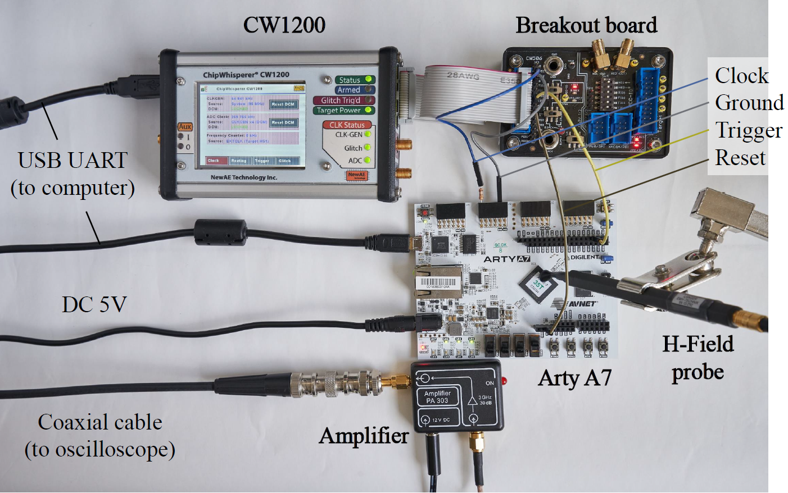

Experiment #1: Self-made TEE
Setup
X300 core is burned into FPGA and self-made TEE
(PoC TEE) is running on it
Fault injection: Clock FI with ChipWhisperer
Side channel: EM leakage
App 1
App 2
App 3
Goal
Extract secret key of app 2 save in RAM
Attack flow
  app 3 → monitor → app 2 → monitor → app3
Shared memory
User
interface
AES
encryption
Memory dump
…
App2
Monitor
App3
BG>RISC-V>Attack>Exp.>Counter
Notes:
The first target is the PoC TEE.
The PoC TEE runs on a soft core on an FPGA board.
We adopted clock fault injection with ChipWhisperer.
And we adopted EM leakage as side channel information.
We had three applications on the PoC TEE.
The attacker tries to extract a secret key of application 2.
As I mentioned earlier, the attacker calls the victim application; then injects faults when returning from the victim application.

Slide 21
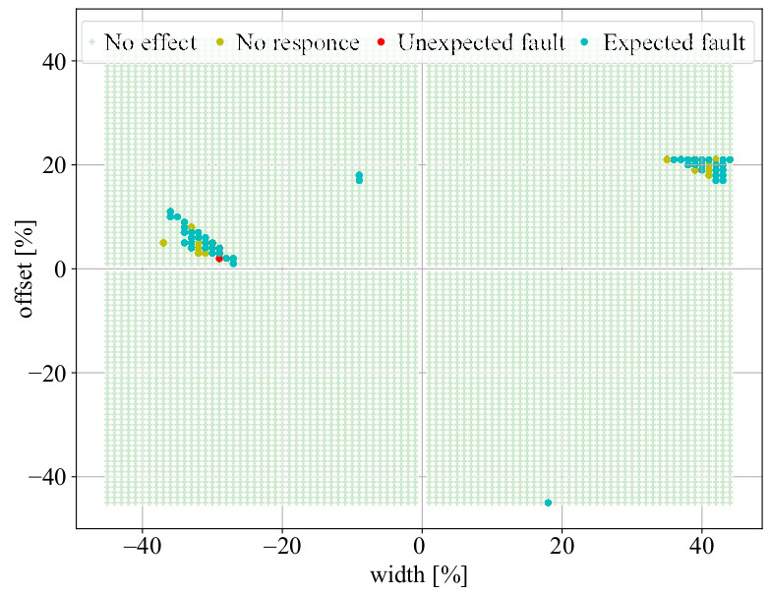
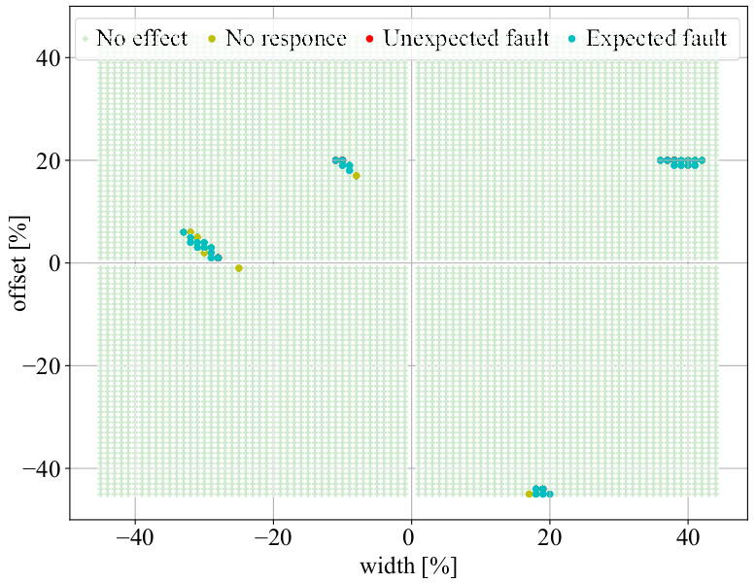
Result: Fault intensity
Similar fault sensitivity
→ cross-device profiling works
Clock FI parameters
No effect No response Unexpected fault Expected fault
No effect No response Unexpected fault Expected fault
Profiling device
Target device
BG>RISC-V>Attack>Exp.>Counter
Notes:
Here are the fault intensity from the profiling and target devices.
The circled areas show the expected fault result, indicating that the two results are similar and cross-device profiling works.

Slide 22
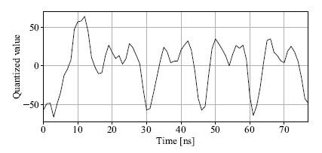
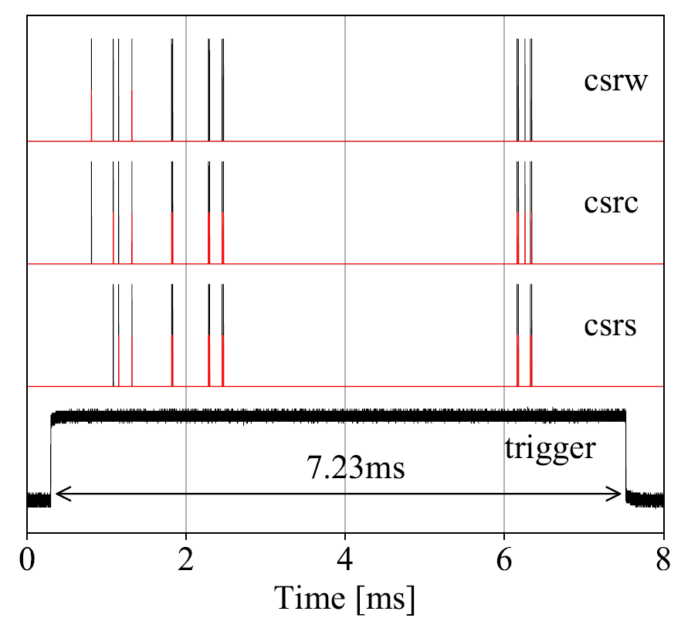
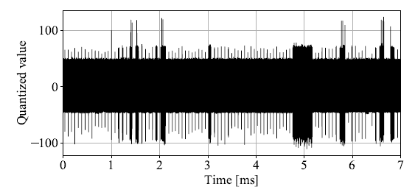
Result: Injection timing
Some false positives, but no false negatives → template match is effective
SAD matching
(Sum of absolute difference)
True execution timing (GPIO)
Identified execution timing
EM template from profiling device
(5 clock cycles including target instruction)
EM trace from target device
(including operations for app2, app3, and monitor)
BG>RISC-V>Attack>Exp.>Counter
Notes:
Next is the injection timing.
The left figures illustrate an EM template from the profiling device and an EM trace from the target device, respectively.
We applied SAD matching and succeeded to identify execution timing.
Red and black represents the true and identified execution timings, respectively.
This result indicates that there are false positives, but no false negatives.
This means that side-channel-based template matching works.

Slide 23

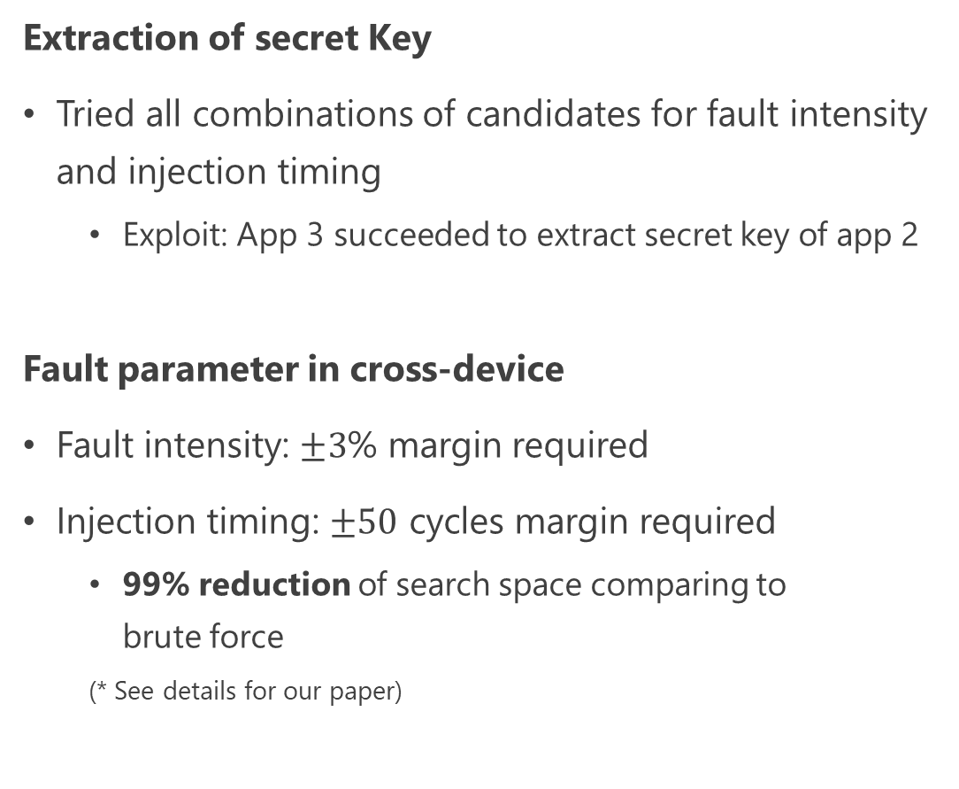
Result: Exploitation
No effect No response Unexpected fault Expected fault
Extraction of secret Key
Tried all combinations of candidates for fault intensity and injection timing
  Exploit: App 3 succeeded to extract secret key of app 2
Fault parameter in cross-device
Fault intensity: $±3$% margin required
Injection timing: $±50$ cycles margin required
  99% reduction of search space comparing to
  brute force
  (* See details for our paper)
Intensity
True target
Timing
BG>RISC-V>Attack>Exp.>Counter
Notes:
The last is the exploitation result.
We tried all combinations of candidates for the fault intensity and injection timing.
As a result, we succeeded to bypass the isolation and extract the secret key.
I'll omit the details but as for the extraction of fault parameters in a cross-device environment, we found that both parameters require margins.
Of course, even with these margins, it is much more efficient than brute force.

Slide 24
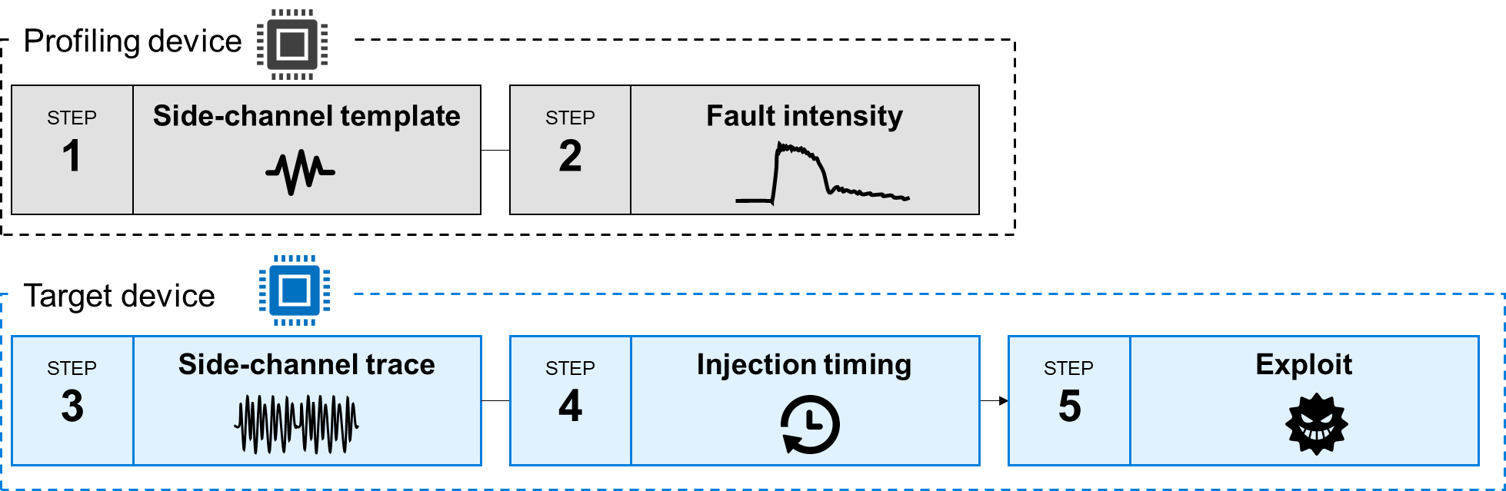
Experiment #2: Keystone
Experimental setup
Keystone and its sample application is running on HiFive unleashed
Fault injection: EMFI with ChipSHOUTER
Side channel: (Omit)
  Verified only the effectiveness of the proposed attack
non-secure
secure
Attacker
app
Victim
app
Linux
Runtime
Security monitor
BG>RISC-V>Attack>Exp.>Counter
Notes:
Next target is Keystone.
Keystone and its sample application run on a HiFive unleashed board.
We modified the user application to dump memory.
We adopted EMFI with ChipSHOUTER.
This experiment only validates the exploitation step.

Slide 25
Result: exploitation
# ./victim.ke 0x80400000
Verifying archive integrity... All good.
Uncompressing Keystone Enclave Package
address 0x80400000@0x1b1c0
[ 40.289769] hello-native-ru[272]: …
[ 40.300615] CPU: 3 PID: 272 Comm: …
…
[ 40.382136] t5 : 0000003ffff5f3c0 t6 : 0000003ffff5f3f0
[ 40.387515] status: 8000000200006020 badaddr: 0000003fe4b30000 cause: 0000000000000005
./victim.ke: line 580: 272 Segmentation fault …
#
Without EMFI
Segmentation fault with load access fault (cause No. 5)
# ./victim.ke 0x80400000
Verifying archive integrity... All good.
Uncompressing Keystone Enclave Package
address 0x80400000@0x1b1c0
0000000020106801
0000000000000000
…
0000000000000000
Enclave said: "Hello World"
#
With EMFI
Memory dump successful
BG>RISC-V>Attack>Exp.>Counter
Notes:
Here are the console outputs when attacking with and without EMFI.
Without EMFI, the application halted with a segmentation fault caused by a load access fault.
With EMFI, such invalid access was succeeded.
Thus, we confirmed that our attack would be successful in a more practical TEE.
I believe that other RISC-V-based TEEs could also be compromised by our attack.

Slide 26
Outline
Background
Security on RISC-V
Proposed attack
Experiment
Countermeasure
Conclusion
BG>RISC-V>Attack>Exp.>Counter
Notes:
Next is a countermeasure.

Slide 27
Approach to countermeasure
Goal
Ensure PMP is configured correctly at each application runtime
Problem
PMP verification process is meaningless because of instruction skip by fault injection
Approach
Transition to abnormal control flow if PMP reconfiguration is skipped
App 1
App 2
App 3
User
interface
AES
encryption
Memory dump
Monitor
Shared memory
Shared memory
…
…
App2
App2
App3
App3
OK
NG
BG>RISC-V>Attack>Exp.>Counter
Notes:
Our goal is to ensure that the PMP is configured correctly at each application runtime.
Inserting a PMP verification process is a naïve idea, but it's meaningless because such verification is skipped by fault injection.
Therefore, we aimed for an approach where the control flow transitions to an abnormal state when the PMP reconfiguration is skipped.

Slide 28




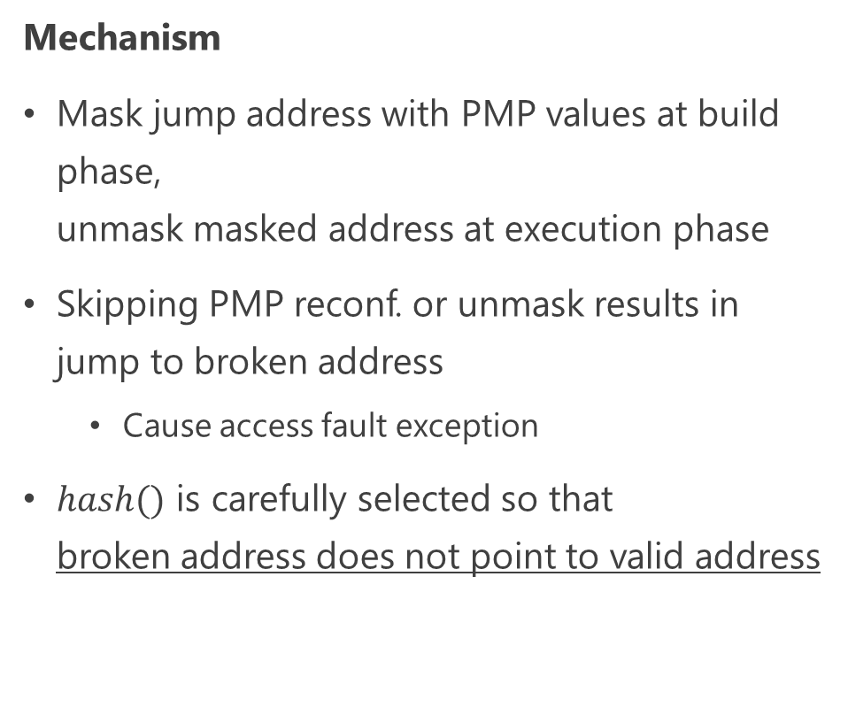



Jump address masking
Build phase (protected)
Jump
address
Mechanism
Mask jump address with PMP values at build phase,
unmask masked address at execution phase
Skipping PMP reconf. or unmask results in
jump to broken address
  Cause access fault exception
$hash()$ is carefully selected so that
broken address does not point to valid address
PMP registers
Masked 0
Entry
pmpcfg0
pmpaddr0
$$=$$
or
$$⊕hash$$
Masked 1
Ret addr 1
pmpcfg7
pmpaddr7
Execution phase (unprotected)
OK
Masked 0
$$⊕hash$$
pmpcfg0
pmpaddr0
$$=$$
Entry
Without attack
？
Masked 0
$$⊕hash$$
pmpcfg0
pmpaddr0
$$=$$
Broken
With attack
BG>RISC-V>Attack>Exp.>Counter
Notes:
Based on the approach, we proposed jump address masking.
It has two phases.
It masks jump addresses with hashed PMP values at the build phase; and unmasks the masked address at the execution phase.
If the PMP reconfiguration or unmasking process is skipped, the program flow transits to a broken address, which causes an access fault exception.
In this way, we have integrated the verification and program flow.
I'll note that the hash function should be carefully selected so that the broken address does not point to a valid address.
The details are given in the paper, but it proves that the proposed countermeasure is resistant to possible attacks.

Slide 29
Outline
Background
Security on RISC-V
Proposed attack
Experiment
Countermeasure
Conclusion
BG>RISC-V>Attack>Exp.>Counter
Notes:
Now, let me summarize my talk.

Slide 30
Conclusion & Future work
NOT applicable
applicable
Conclusion
Proposal: bypassing attack against RISC-V TEE
  Skipping PMP reconfiguration by fault injection
  ARM TrustZone: Applicable to app isolation, but not applicable to world isolation
Experiment & Result
  Application of proposed attack (scheme) to PoC TEE and Keystone
  Demonstration of bypassing isolation and accessing protected memory area
Proposal: Jump address masking
  Prevention of skipping PMP reconfiguration by masking/unmasking jump address with PMP values
Future work
Implementation and demonstration of proposed countermeasure
Application of proposed attack to TrustZone-based TEEs
App
App
Trusted App
Rich OS
Trusted OS
Hypervisor
Secure Monitor
ARMv8-A
Notes:
We proposed a bypassing attack against RISC-V-based TEE.
The idea of the attack is to skip the PMP reconfiguration by fault injection.
Considering ARM TrustZone, the proposed attack would be applicable to application isolation but not applicable to world isolation.
We verified the feasibility of the proposed attack scheme through experiments targeting PoC TEE and Keystone.
We demonstrated that we could bypass the isolation and access a protected memory area.
We also proposed a countermeasure named jump address masking.
It prevents skipping the PMP reconfiguration by masking and unmasking jump addresses with the PMP values.
Future work includes implementation and demonstration of the proposed countermeasure and application of the proposed attack to TrustZone-based TEEs.

Slide 31

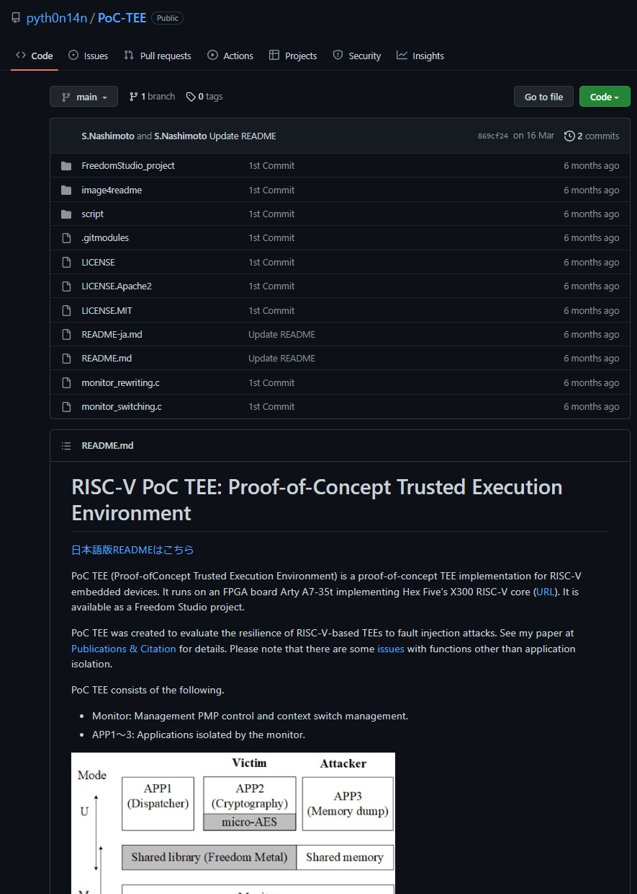

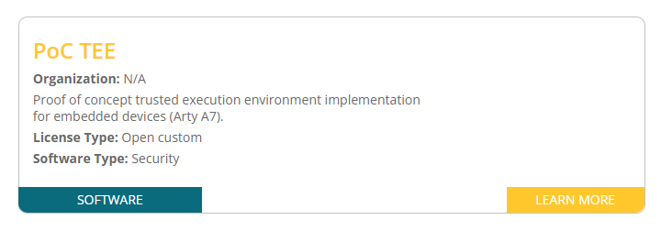
PoC TEE is open source now
https://riscv.org/exchange/
Notes:
In closing, we have open-sourced the PoC TEE we used in our experiments, and you can get it from the RISC-V Exchange page.
I hope you like it.

Slide 32
Thank you
Any question?
Notes:
That's all of my presentation.
Thank you for your kind attention.

Slide 33
Supplement material

Slide 34
Security claims of TEEs
TEE only ensures runtime memory protection, but security evaluation is important
  Attackers do not consider security claims
  They break a target using all techniques including fault injection
Future RISC-V implementation of DVFS may follow in the footsteps as SGX and TrustZone
  Our attack can be performed by DVFS-based remote fault injection
  DVFS-based fault injection is software attack, so It is within TEEs’ security claims

Slide 35
SC-based template matching vs. …
SAD matching-based trigger
  It’s a promising method
  But, PMP reconfigurations happen a few times, so we need to decide which trigger signal should we follow
  If we inject fault at all SAD matching timing, all PMP settings are completely same as the one in the previous application
Brute force
  It took too much time…
  65 MHz × 4.84 ms: 314,600 clock cycles vs. 100 (margin) x 24 candidates = 2,400 clock cycles

Slide 36
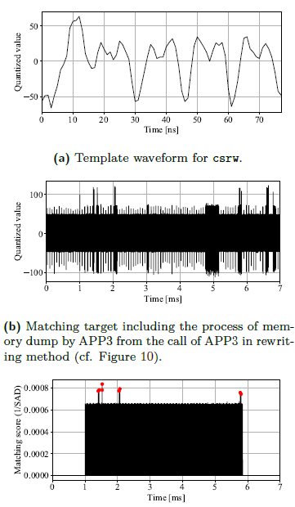
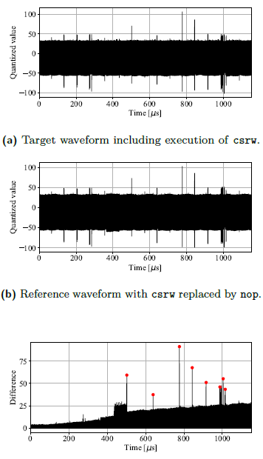
Template matching
Target waveform with csrw
Extracted template
Reference waveform with nop replaced from csrw
Trace waveform
Diff. of above two waveforms
1/SAD: identified timing

Slide 37
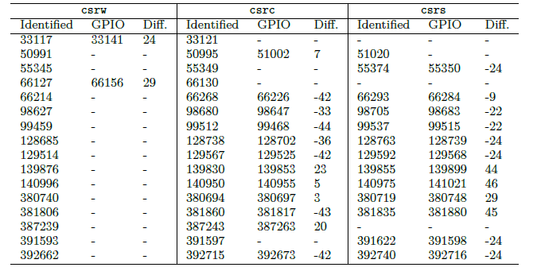
Injection timing: comparison

Slide 38
Limitations of proposed attack (1/3)
Address matching method in pmpcfg
  In the experiments, target pmpaddr adopted NAPOT in both PoC TEE and Keystone
  But if TOR was adopted, impact of fault attacks was unknown
NAPOT: Naturally aligned power-of-2
TOR: Top or Region
pmpaddr0
pmpaddr1
31
24
15
8
7
0
pmp3cfg
pmp1cfg
pmp0cfg
NAPOT
addr0 | size0
addr1 | size1
8
8
8
L | 0 | A | X | W | R
TOR
addr (from)
addr (to)
Config register
(pmpcfg)

Slide 39
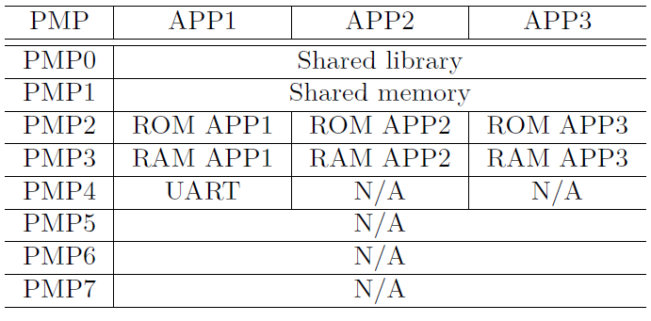
Limitations of proposed attack (2/3)
Order of PMP entry
  Proposed attack inherits the previous permission → Order of PMP entry is important
  e.g., APP3 and APP2 can exchange RAM permission
  If order of ROM and RAM were reversed, APP3 cannot exchange ROM with RAM (ability of code execution)
But our PoC TEE was not intentionally weak target
  Usually (or based on naïve idea), permissions are aligned from the top and filled in
PMP usage in PoC TEE
Notes:
You might think this was an arbitrary target of attack, but it is not. Because our attack was succeded in Keystone.

Slide 40
Limitations of proposed attack (3/3)
How to call other applications
  PoC TEE: Each application calls other arbitrary applications
  MultiZone: Execution rights turn on round robin basis
Round robin makes it impossible to attack arbitrary applications
App 1
App 2
App 3
App 1
App 2
App 3
Monitor
Monitor
PoC TEE
MultiZone
Notes:
You might think this was an arbitrary target of attack, but it is not. Because our attack was succeded in Keystone.

Slide 41
Runtime overhead
Comparison between major processes
  Jump address masking: hashing (e.g., Toeplitz hash)
  Memory encryption: AES128
  Context switch
Jump address masking is countermeasure with reasonable execution time
  Memory encryption is another promising countermeasure, but 4.9—6.3 times slower than address masking
  Jump address masking makes the context switch 1.0～2.2 times slower
TEE | Input size | Toeplitz hash | AES128 | Context switch
PoC TEE | Toeplitz: 320 bit AES: 128 bit | 127.75 us | 798.73 us | 110.97 us
Keystone | Toeplitz: 576 bit AES: 128 bit | 42.22 us | 208.70 us | Run Stop Resume Exit | 11.01 us 3.43 ms 5.52 us 2.74 us

Slide 42
Result: exploitation (w/o EMFI)
Attacker’s accessing address
Correct behavior of deprivation of permission
1f=0(L) 00(-) 11(A) 111(XWR)
18=0(L) 00(-) 11(A) 000(XWR)
# ./victim.ke 0x80400000
Verifying archive integrity... All good.
Uncompressing Keystone Enclave Package
hello-native, eyrie-rt, 0x80400000
t1(2047) t2(2047) t3(2047) addr(2013ffff)->(2013ffff) cfg(1041f18)->(1041818) t4(2047) t5(2047)
address 0x80400000@0x1b1c0
[ 40.289769] hello-native-ru[272]: unhandled signal 11 code 0x2 at 0x00000000000118f0 in hello-native-runner[10000+a000]
[ 40.300615] CPU: 3 PID: 272 Comm: hello-native-ru Tainted: G O 5.7.0-dirty #108
[ 40.309298] epc: 00000000000118f0 ra : 00000000000118ce sp : 0000003ffff5f8e0
…
[ 40.382136] t5 : 0000003ffff5f3c0 t6 : 0000003ffff5f3f0
[ 40.387515] status: 8000000200006020 badaddr: 0000003fe4b30000 cause: 0000000000000005
pmp_unset() [hart 1]: reg[1], mode[NAPOT], range[0x80400000-0x80600000], perm[xxx]
pmp_unset() [hart 2]: reg[1], mode[NAPOT], range[0x80400000-0x80600000], perm[xxx]
pmp_unset() [hart 3]: reg[1], mode[NAPOT], range[0x80400000-0x80600000], perm[xxx]
pmp_unset() [hart 4]: reg[1], mode[NAPOT], range[0x80400000-0x80600000], perm[xxx]
./victim.ke: line 580: 272 Segmentation fault "./hello-native-runner" hello-native eyrie-rt "$@"
#
Exception was caused by load access fault (No. 5)
Victim memory range: 0x8040 0000 – 0x8060 0000
BG>RISC-V>Attack>Exp.>Counter>Discussion

Slide 43
Result: exploitation (w/ EMFI)
# ./victim.ke 0x80400000
Verifying archive integrity... All good.
Uncompressing Keystone Enclave Package
hello-native, eyrie-rt, 0x80400000
t1(2047) t2(2047) t3(203) addr(2013ffff)->(2013ffff) cfg(1f18)->(1f18) t4(538181886) t5(0)
address 0x80400000@0x1b1c0
0000000020106801
0000000000000000
…
0000000000000000
Enclave said: "Hello World"
t1(2047) t2(2047) t3(203) addr(2013ffff)->(2013ffff) cfg(1f18)->(1f18) t4(538181886) t5(0)
t1(2047) t2(2047) t3(203) addr(2013ffff)->(2013ffff) cfg(1f18)->(1f18) t4(538181886) t5(0)
pmp_unset() [hart 1]: reg[1], mode[NAPOT], range[0x80400000-0x80600000], perm[xxx]
pmp_unset() [hart 2]: reg[1], mode[NAPOT], range[0x80400000-0x80600000], perm[xxx]
pmp_unset() [hart 3]: reg[1], mode[NAPOT], range[0x80400000-0x80600000], perm[xxx]
pmp_unset() [hart 4]: reg[1], mode[NAPOT], range[0x80400000-0x80600000], perm[xxx]
#
Permission did not change
Access to victim memory was allowed w/o load access fault
Same victim memory range
BG>RISC-V>Attack>Exp.>Counter>Discussion

Slide 44
Comparison with ARM TrustZone
World isolation
App isolation
Hardware unit for isolation
Applicability
Proposed attack is applicable to app isolation
  Skip reconfigurations of MPU in v8-M, MMU in v8-A
Proposed attack is not applicable to world isolation
  SAU is not reconfigured after initialization in v8-M
  Each world has its MMU setting in v8-A
    Skipping isolation reconfiguration in normal world does not affect isolation for secure world
Normal
Secure
Isolation | RISC-V | ARMv8-A | ARMv8-M
World | PMP | MMU (Memory Management Unit) | SAU (Secure Attribution Unit)
App |  | MMU | MPU (Memory Protection Unit)
App
App
Trusted App
Trusted
App
Rich OS
Trusted OS
Hypervisor
Secure Monitor
ARMv8-A
Non-secure
Secure
App
App
App
App
OS
OS
ARMv8-M
BG>RISC-V>Attack>Exp.>Counter>Discussion

Slide 45
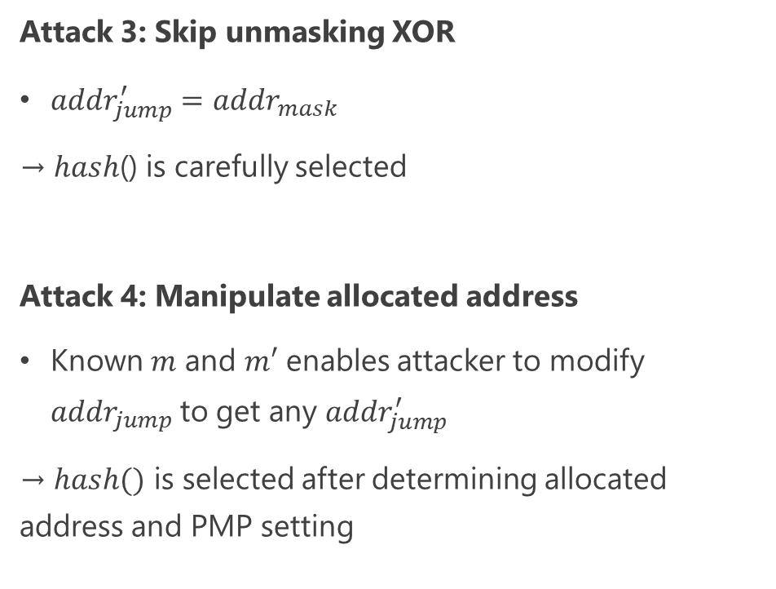
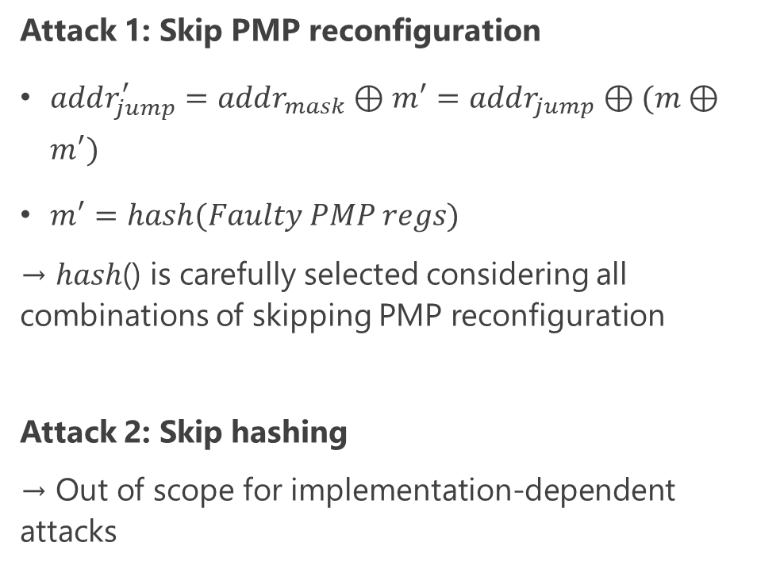
Security evaluation: Four possible attacks
Attack 1: Skip PMP reconfiguration
$addr_{jump}^{′}=addr_{mask}⊕m^{′}=addr_{jump}⊕(m⊕m^{′})$
$m^{′}=hash(Faulty PMP regs)$
→ ℎ𝑎𝑠ℎ() is carefully selected considering all combinations of skipping PMP reconfiguration
Attack 2: Skip hashing
→ Out of scope for implementation-dependent attacks
Attack 3: Skip unmasking XOR
$addr_{jump}^{′}=addr_{mask}$
→ ℎ𝑎𝑠ℎ() is carefully selected
Attack 4: Manipulate allocated address
Known $m$ and $m′$ enables attacker to modify $addr_{jump}$to get any $addr_{jump}^{′}$
→ $hash()$ is selected after determining allocated address and PMP setting
※ See paper for security claims, requirements for hash function selection , and feasibility of hash selection
BG>RISC-V>Attack>Exp.>Counter>Discussion

Slide 46

Injection timing extraction
Problem
Unmodifiable TEE code: Unable to trigger immediately before injection
Unknown victim code: Counting clocks (injection timing) from code is not possible
Power/EM template matching
Small searching effort due to only three target instructions and infrequently execution
Call
Return
Attacker app
Monitor
Victim app
Monitor
Attacker app
Unknown and/or modification impossible
Clock
Trigger
?
Glitch
BG>RISC-V>Attack>Exp.>Counter
Notes:
There are two problems to extract the injection timing.
First, we cannot modify the TEE code, so the trigger signal cannot be generated immediately before the injection.
Second, we don't know the victim code, so the injection timing cannot be extracted by code analysis.

Slide 47
Injection timing extraction
Problem
Unmodifiable TEE code: Unable to trigger immediately before injection
Unknown victim code: Counting clocks (injection timing) from code is not possible
Power/EM template matching
Small searching effort due to only three target instructions and infrequently execution
Only three templates
1
Side-channel template
STEP
STEP
4
Injection timing
STEP
3
Side-channel trace
STEP
Timing candidates
BG>RISC-V>Attack>Exp.>Counter
Notes:
So, we use side-channel based pattern matching.
We obtain a side-channel template of the target instruction at the profiling device.
Then, we get the trace of the triggering interval at the target device.
By pattern matching the template and the trace, the injection timing is obtained.
This method has a small searching effort due to few target instructions and their infrequently execution.

Slide 48
Fault intensity extraction
Problem
U-mode app cannot execute privileged instructions such as PMP reconfiguration instructions
Cross-device profiling
Small profiling effort due to only three target instructions
2
Fault intensity
5
Exploit
STEP
STEP
Similar
fault sensitivity
# occurrence
# occurrence
Fault intensity
Fault intensity
BG>RISC-V>Attack>Exp.>Counter
Notes:
Next is the fault intensity.
The fault intensity cannot be obtained on the target device because a U-mode application cannot execute privileged instructions such as PMP reconfiguration instructions.
Therefore, we need cross-device profiling.
But the profiling effort is small because there are only three target instructions.

Slide 49
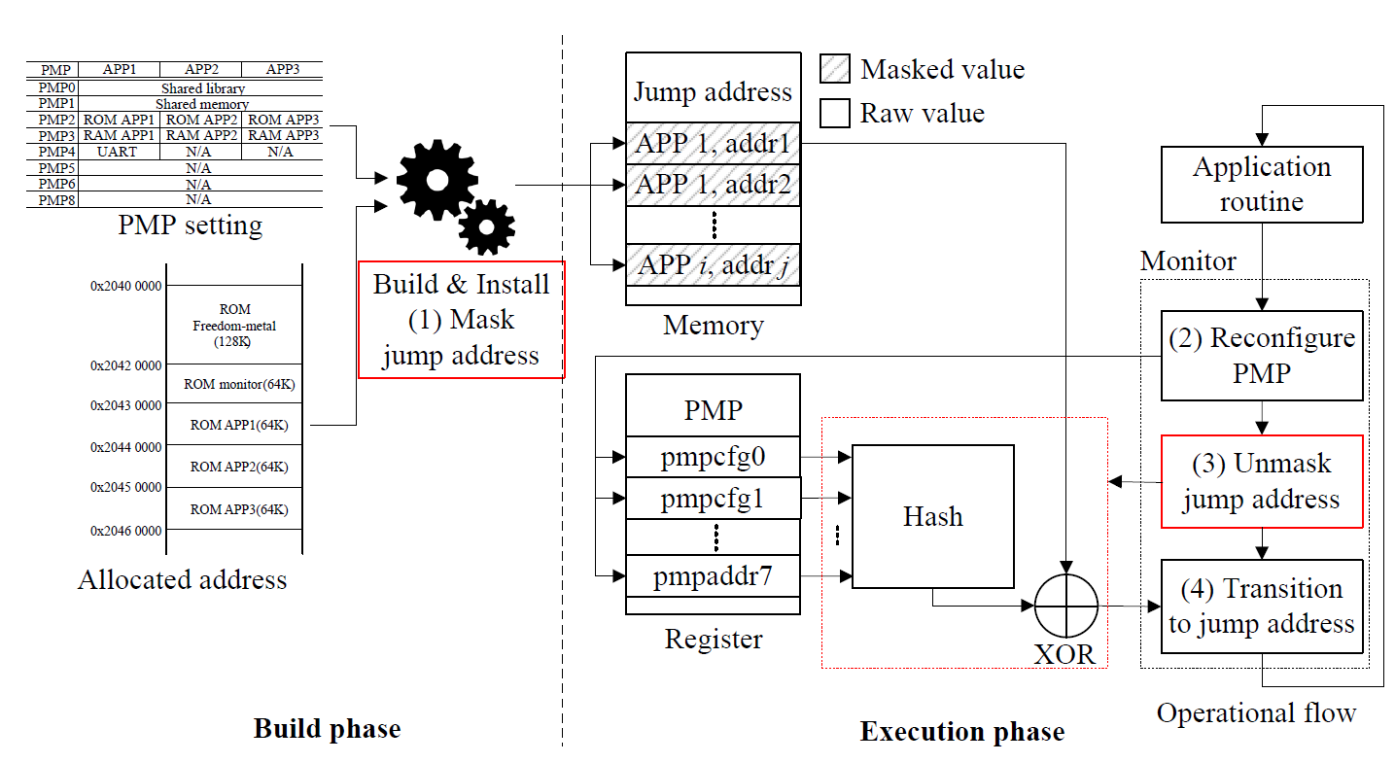
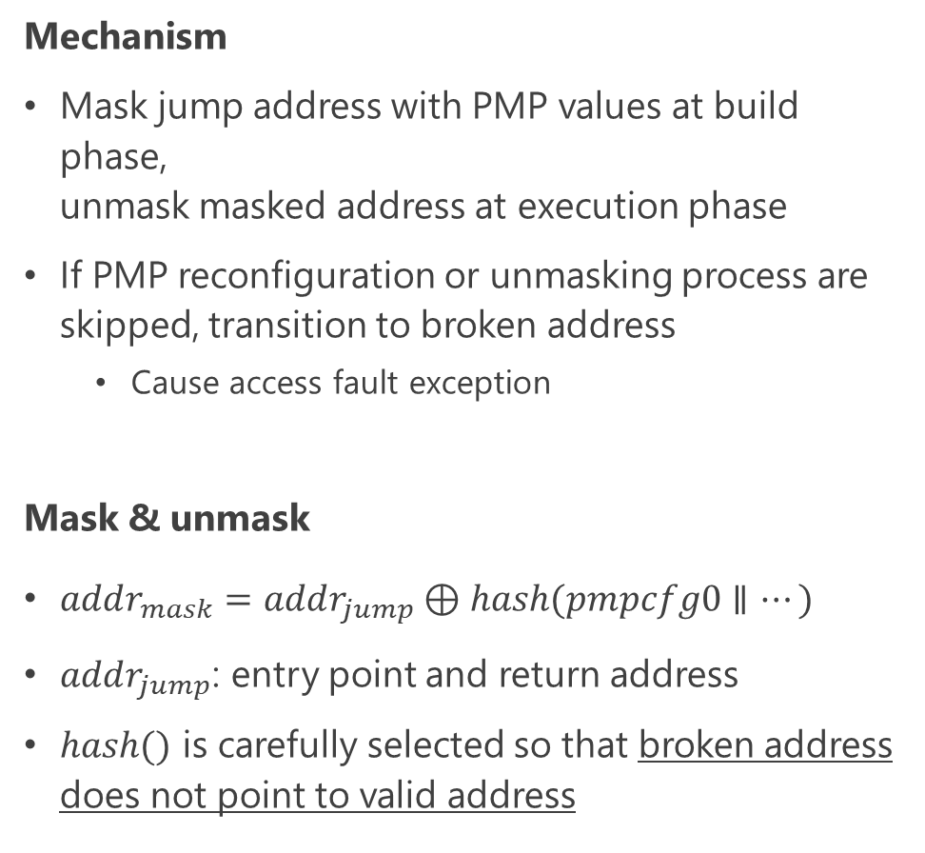
Jump address masking
Mechanism
Mask jump address with PMP values at build phase,
unmask masked address at execution phase
If PMP reconfiguration or unmasking process are skipped, transition to broken address
  Cause access fault exception
Mask & unmask
$addr_{mask}=addr_{jump}⊕hash(pmpcfg0∥…)$
$addr_{jump}$: entry point and return address
$hash()$ is carefully selected so that broken address does not point to valid address
BG>RISC-V>Attack>Exp.>Counter
Notes:
Based on the approach, we proposed jump address masking.
This countermeasure masks jump addresses with PMP values at the build phase, and unmasks the masked addressed at the execution phase.
If the PMP reconfiguration or the unmasking process are skipped, the program flow transitions to a broken address, which causes an access fault exception.
The specific masking method is to XOR the hashed value of all PMP registers with a jump address.
The jump address indicates an entry point and return addresses for each application.
The significant point here is that the hash function should be carefully selected so that the broken address does not point to valid address.
The details are given in the paper, but it proves that the proposed countermeasure is resistant to all possible attacks.

Slide 50
+Institution
Year | Paper | Institution | Target | Injection | Attack
2017 | Attack TrustZone with Rowhammer | eShard | ARM TrsutZone | Rowhammer | Cryptography
2018 | Laser-Induced FI | eShard, ALPhANOV | ARM TrsutZone | Laser | Secure boot
2017 | CLK screw | Columbia Univ. | ARM TrsutZone | DVFS | Cryptography
2019 | VoltJockey | Tsinghua Univ., Univ. of Maryland | ARM TrsutZone, Intel SGX | DVFS | Cryptography
2020 | Plundervolt | Univ. of Birmingham TU Graz, KU Leuven | Intel SGX | DVFS | Cryptography
2020 | V0LTpwn | TU Darmstadt UC Irvine | Intel SGX | DVFS | Cryptography
2022 | Bypassing Isolated Execution | Mitsubishi Electric | RISC-V (PoC TEE, Keystone) | Clock, EMFI | Isolation itself

Slide 51
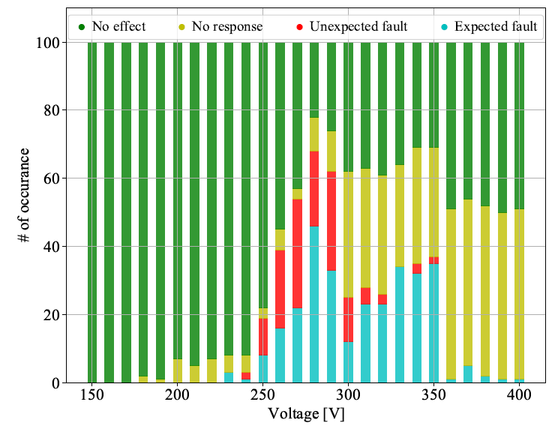

Profiling：Pulse voltage vs. Success rate
EMFI
【Successful & Error】
Success @ 230～400 [V]（Blue）
Error: 300 $≥$ [V] (Yellow）
【Efficient parameter】
250～290 [V] are good
  High success rate
  A little errors -> small reboot required
背景＞RISC-V＞攻撃＞実験＞対策

Slide 52
Injection timing: Problem
Unable to trigger immediately before injection
Counting clocks from code is not possible owing to unknown victim app
Brute force takes too much time
Call
Return
Attacker app
Monitor
Victim app
Monitor
Attacker app
Unknown and/or modification impossible
BG>RISC-V>Attack>Exp.>Counter>Discussion

Slide 53
Injection timing: Problem
Unable to trigger immediately before injection
Counting clocks from code is not possible owing to unknown victim app
Brute force takes too much time
Call
Return
Attacker app
Monitor
Victim app
Monitor
Attacker app
Unknown and/or modification impossible
BG>RISC-V>Attack>Exp.>Counter>Discussion

