Slide 1
Transitional Leakage in Theory and Practice –
Unveiling Security Flaws in Masked Circuits
Nicolai Müller, David Knichel, Pascal Sasdrich, Amir Moradi

Slide 2
Motivation
Implementation Attacks
Status Quo
Cryptography is secure in a black-box model
Secure implementation remains challenging
Problem: Implementation attacks
Physical characteristics of a hardware device can reveal secrets [Koc96]
Timing
Power Consumption
Electro-magnetic radiation

Slide 3
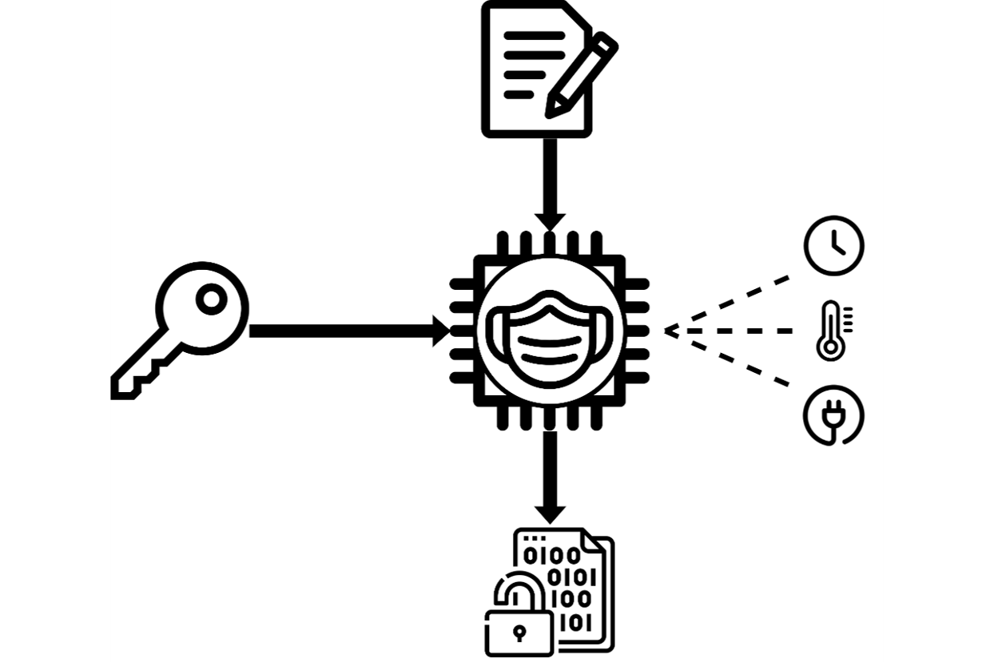
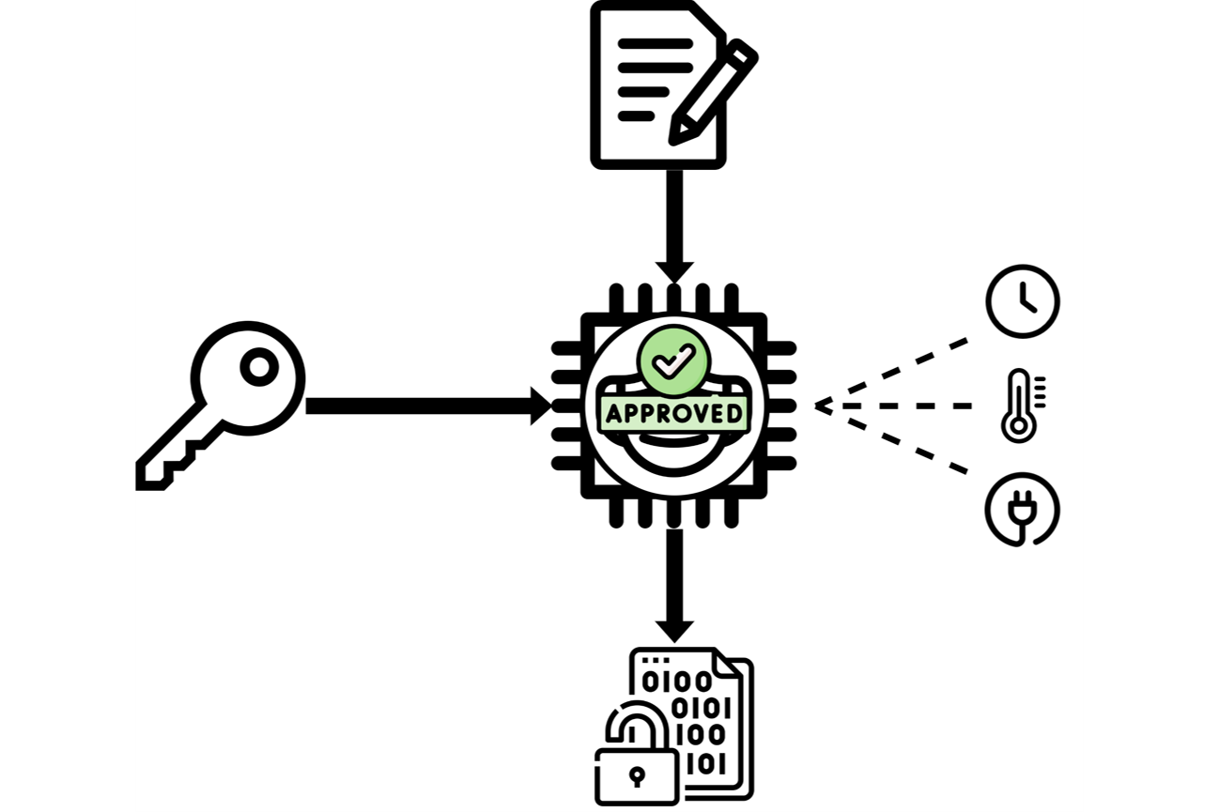
Motivation
Countermeasures
Solution: Boolean Masking [CJRR99]
Based on secret sharing
$x=x_{0}⨁x_{1}⨁\text{…}⨁x_{n−1}$
Applied on algorithmic level
Independend of the undelying device
Problem: Security flaws
Manual and error-prone implementation
How can we verify the security of a masked implementation?

Slide 4
Motivation
Contribution
Solution: Formal Verification
Automated tools verify masked hardware under a formal adversary model
Problem: Partial modeling of physical defaults
Most formal verification tools cover glitches
Transitions are not considered
Our Contribution
Algorithmically model leakage due to glitches and transitions
Integrate our approach into SILVER [KSM20]

Slide 5
Background
Probing Models
Baseline: Probing model [ISW03]
Probe up to d intermediates of an ideal circuit
Does not consider any physical effect
Advance: Robust probing model [FGP+18]
Extends the probing model by covering physical defaults
All coverd via probe-extension procedures
Glitches → (1,0,0)-robust probing
Transitions → (0,1,0)-robust probing
Coupling → (0,0,1)-robust probing

Slide 6
Example
Transitional Leakage in Iterative Circuits
Observation [CS21]: Iterative circuits
Transitions may lead to problems in iterative circuits
Iterative circuits evaluate the same function multiple times
Different but not necessarily independent inputs
Example
Consider the given iterative circuit
Shared n-bit input and output
Multiplexer stage with select signal s

Slide 7
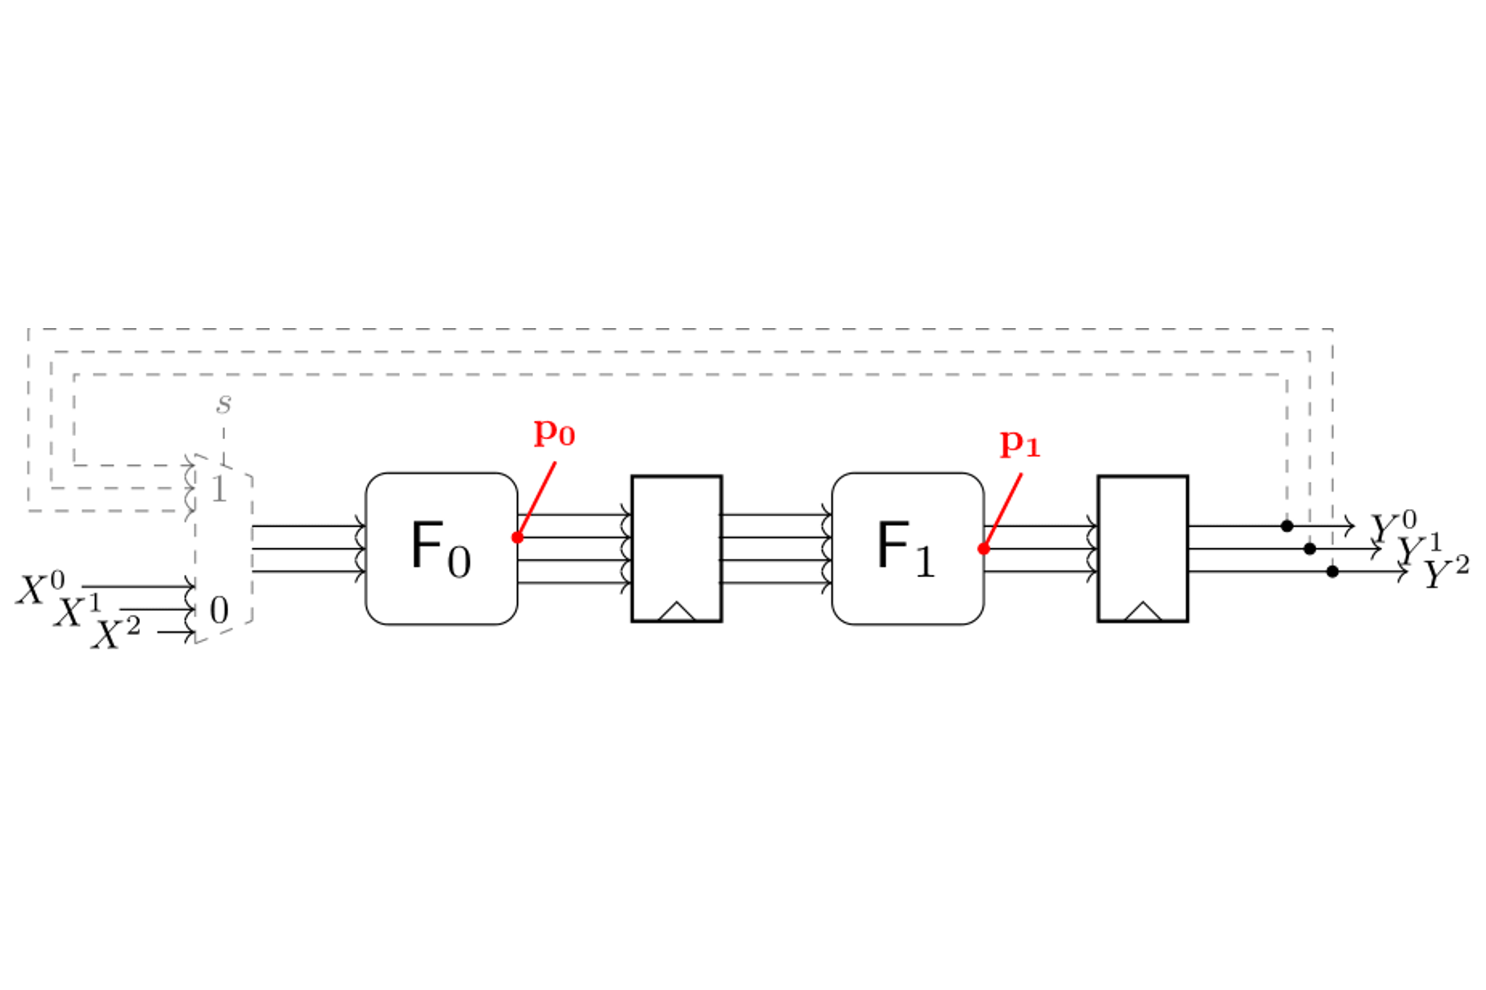
Example
Static Primary Inputs
Assumption
Primary inputs remain stable throughout the entire execution
Formal verification
Consider a set of two probes
$P=\{p_{0},p_{1}\}$
Extend $P$ to cover glitches and transitions

Slide 8
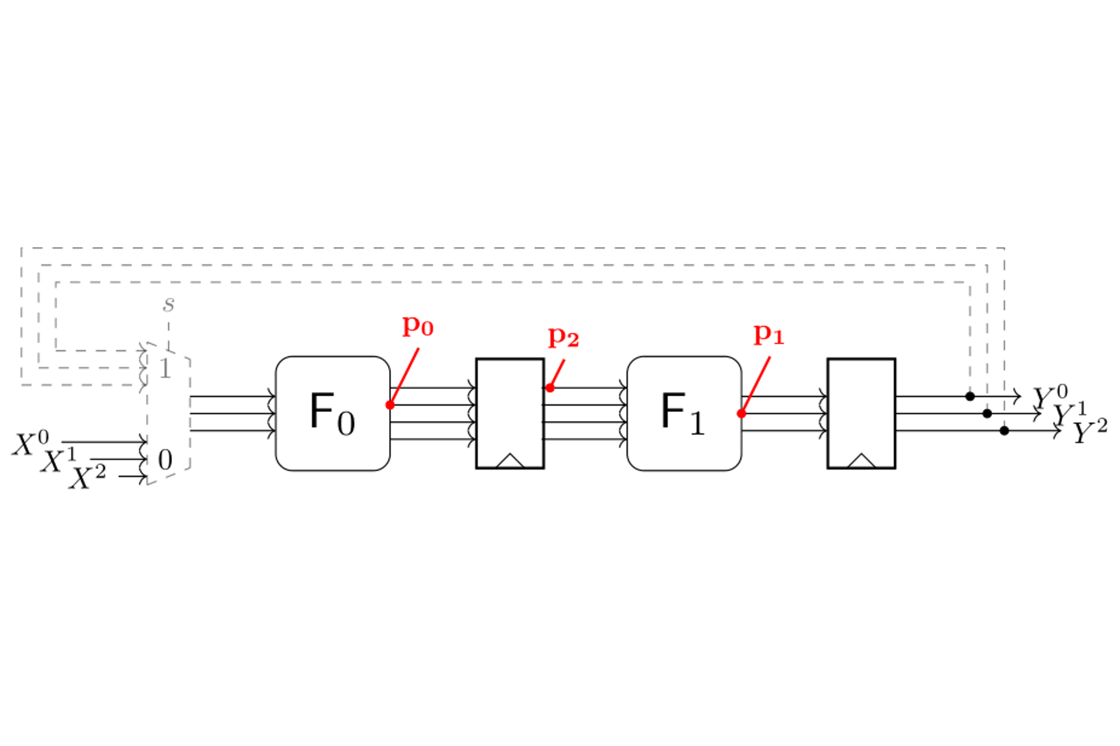
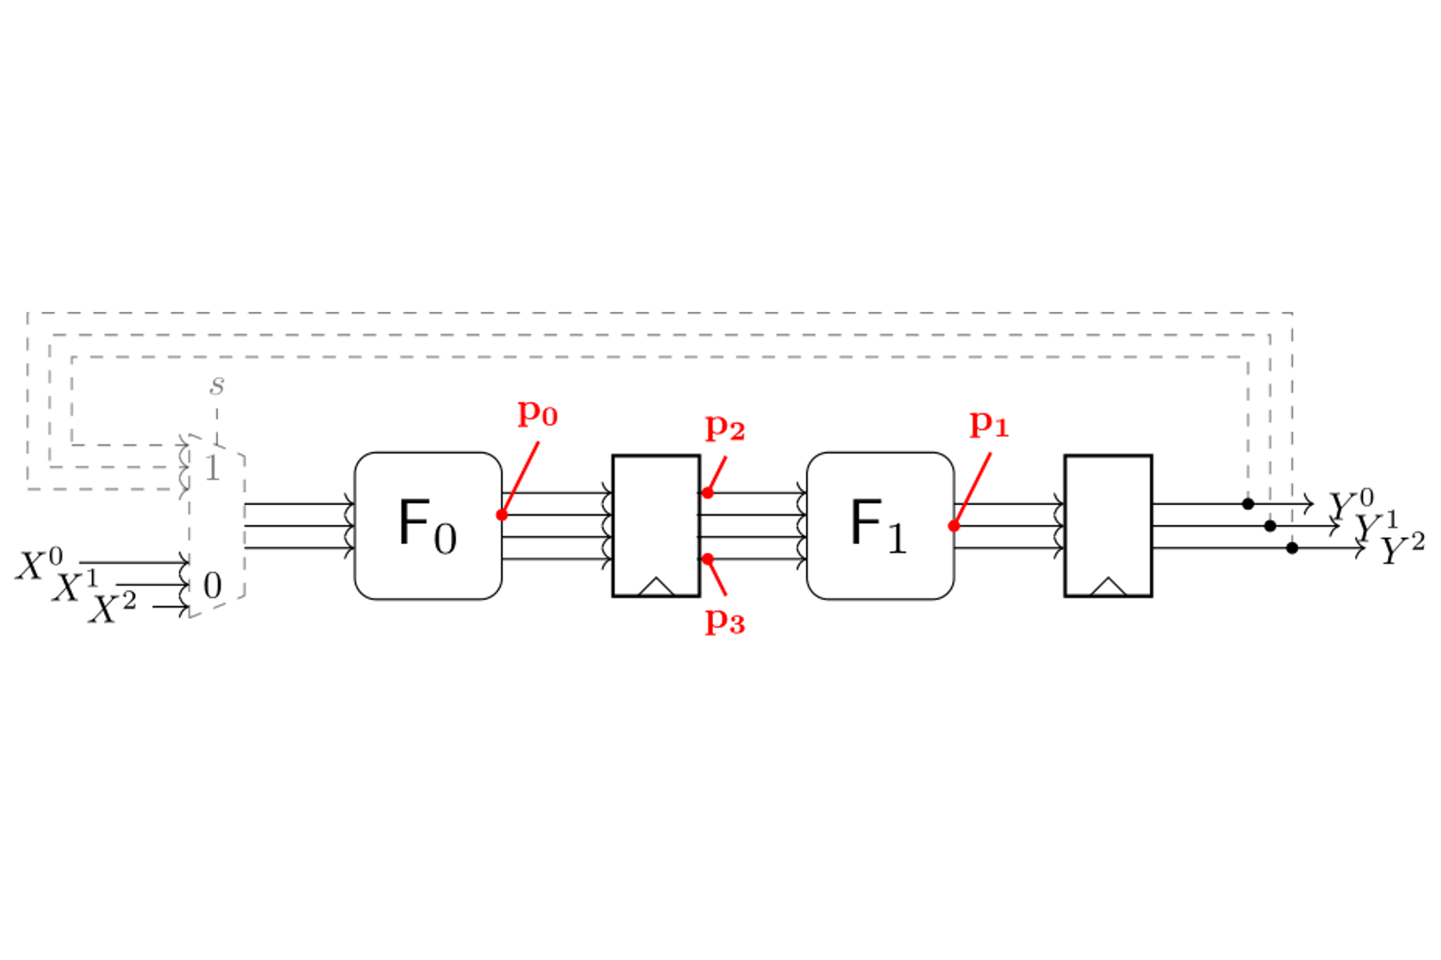
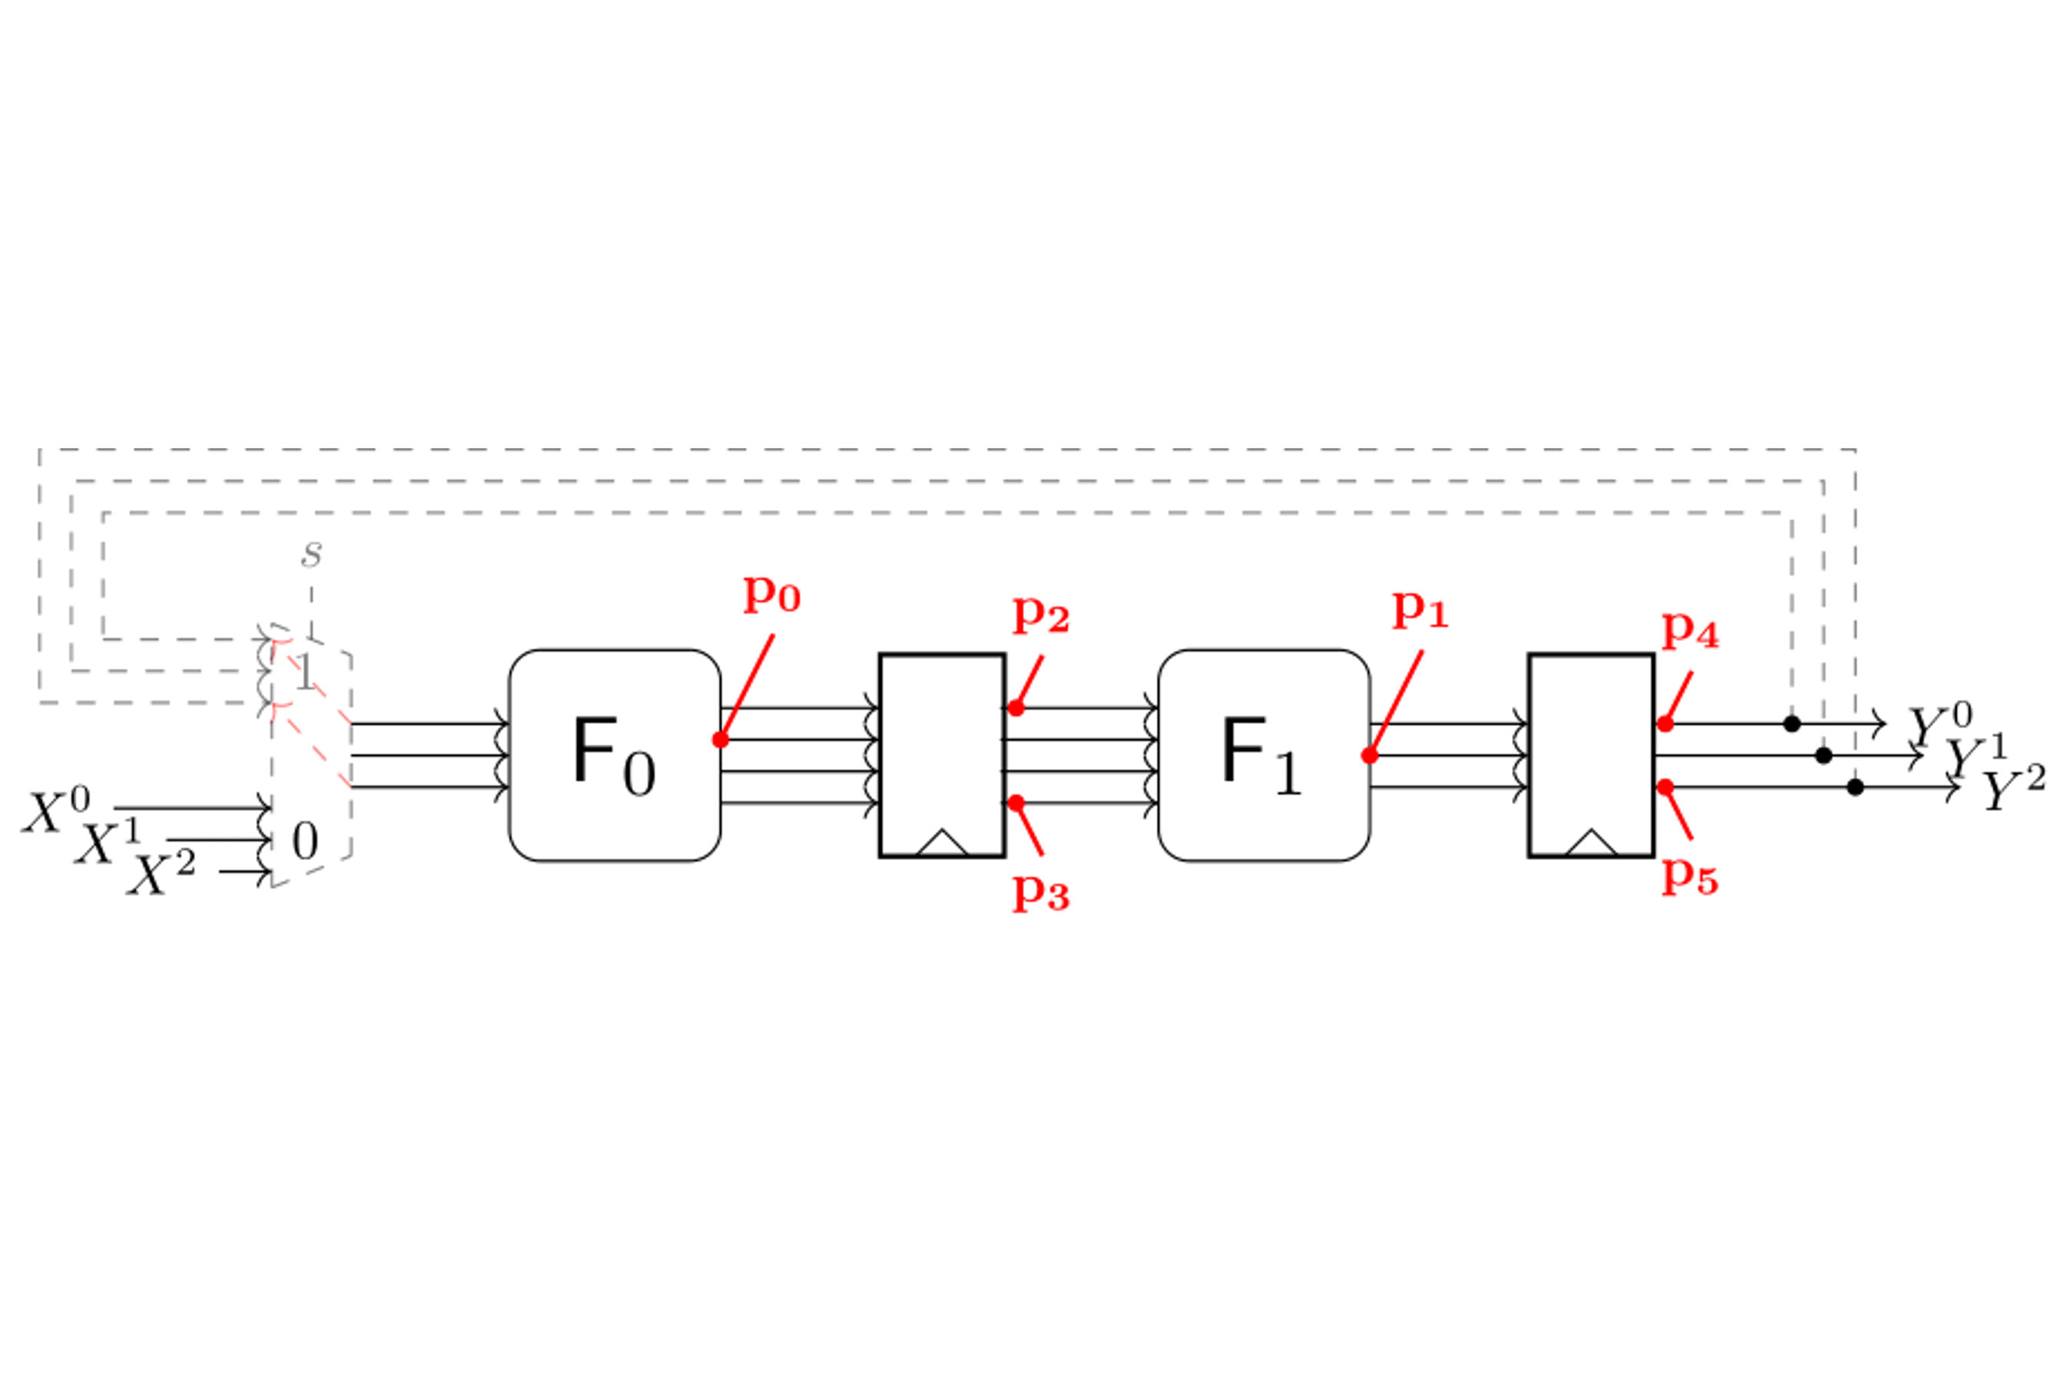
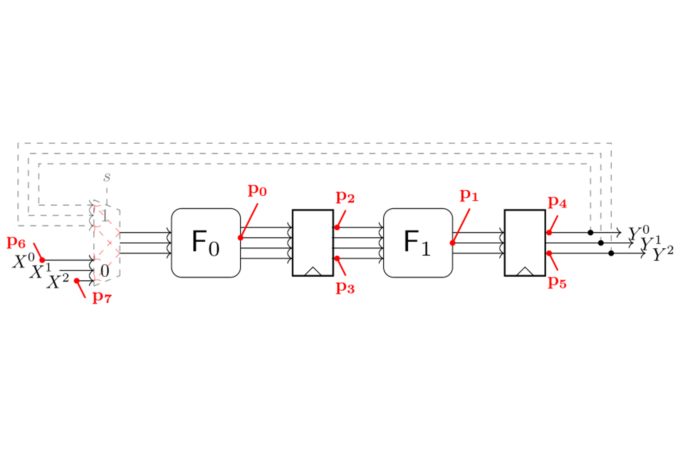
Example
Glitch Extension
Extend $P$ with glitch-extended probes
Backpropagation to the last register stage
$p_{1}\underset{→}{(1,0,0)}\{p_{2},p_{3}\}$
Glitches are propagated through the multiplexers
Consider feedback signals and primary inputs
$p_{0}\underset{→}{(1,0,0)}\{p_{4},p_{5},p_{6},p_{7}\}$
Glitch-extended probing set
$P_{g}=\{p_{2},p_{3},p_{4},p_{5},p_{6},p_{7}\}$

Slide 9
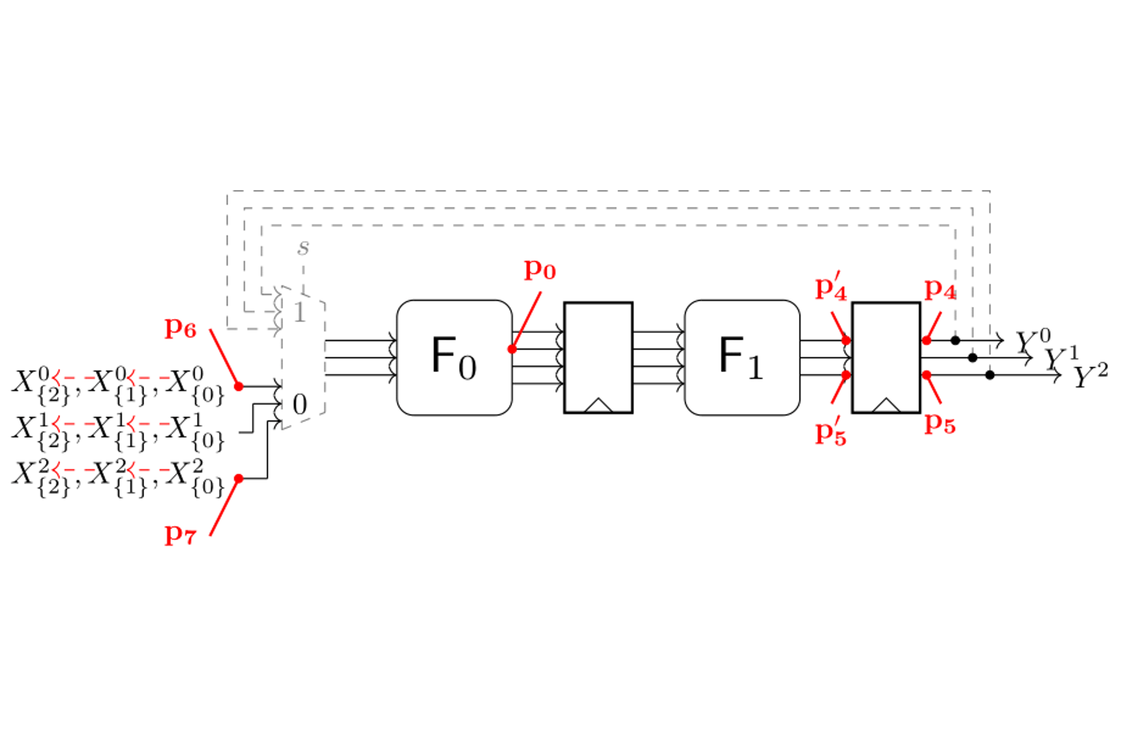
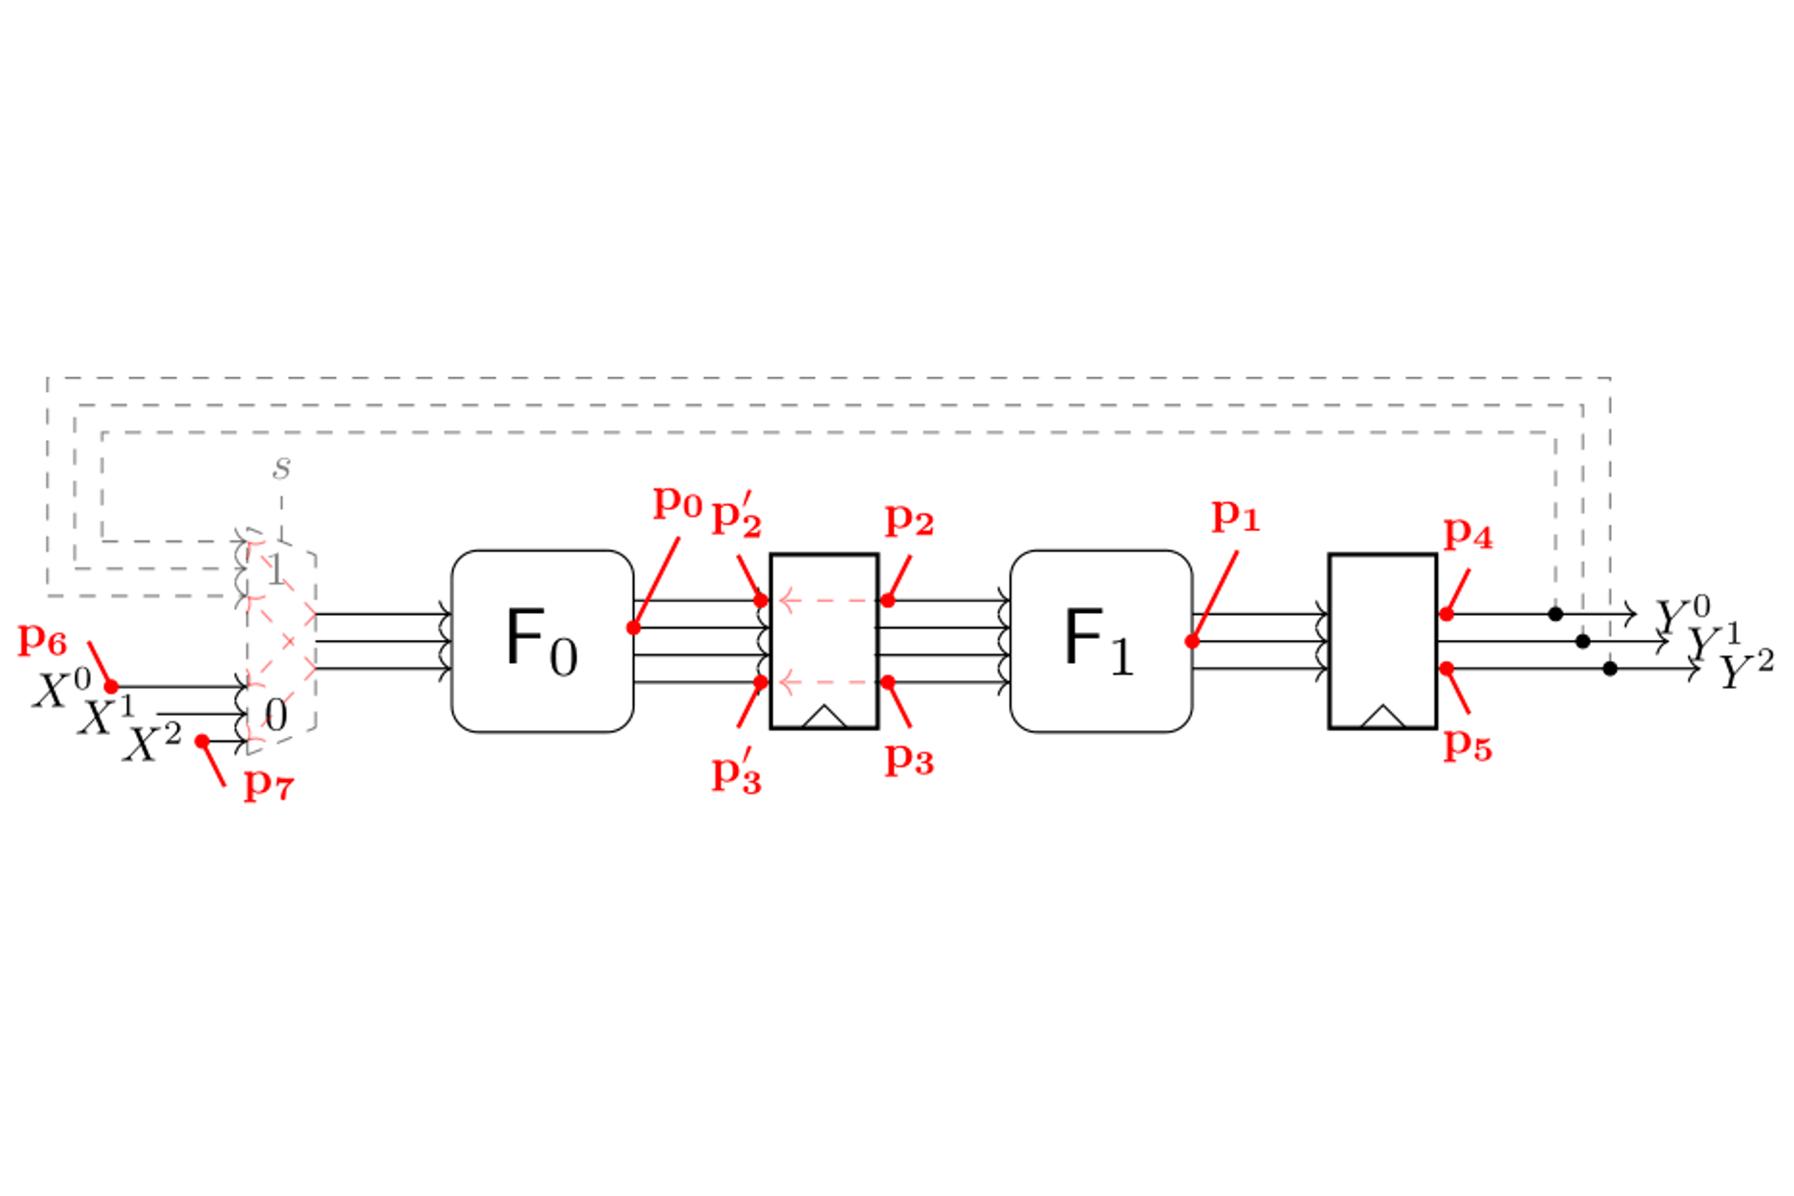
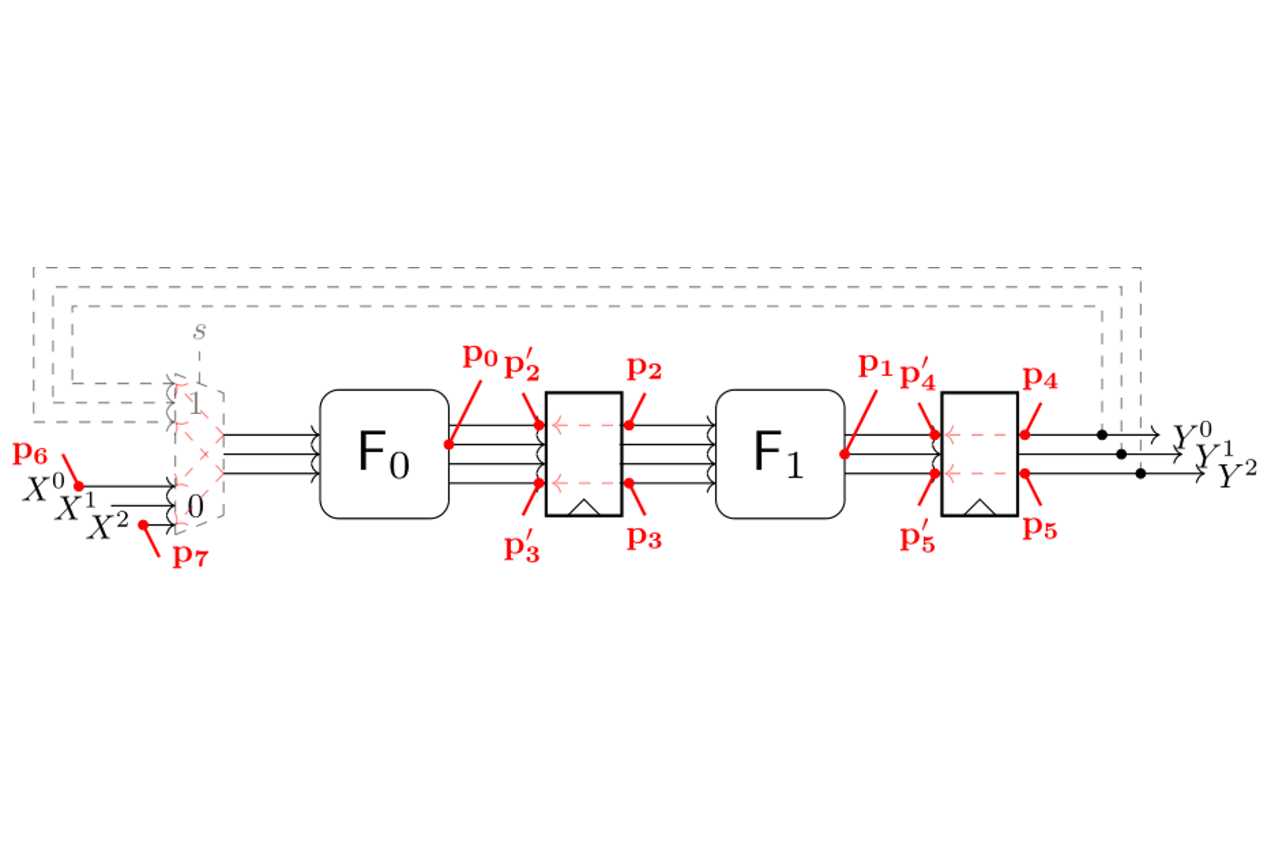
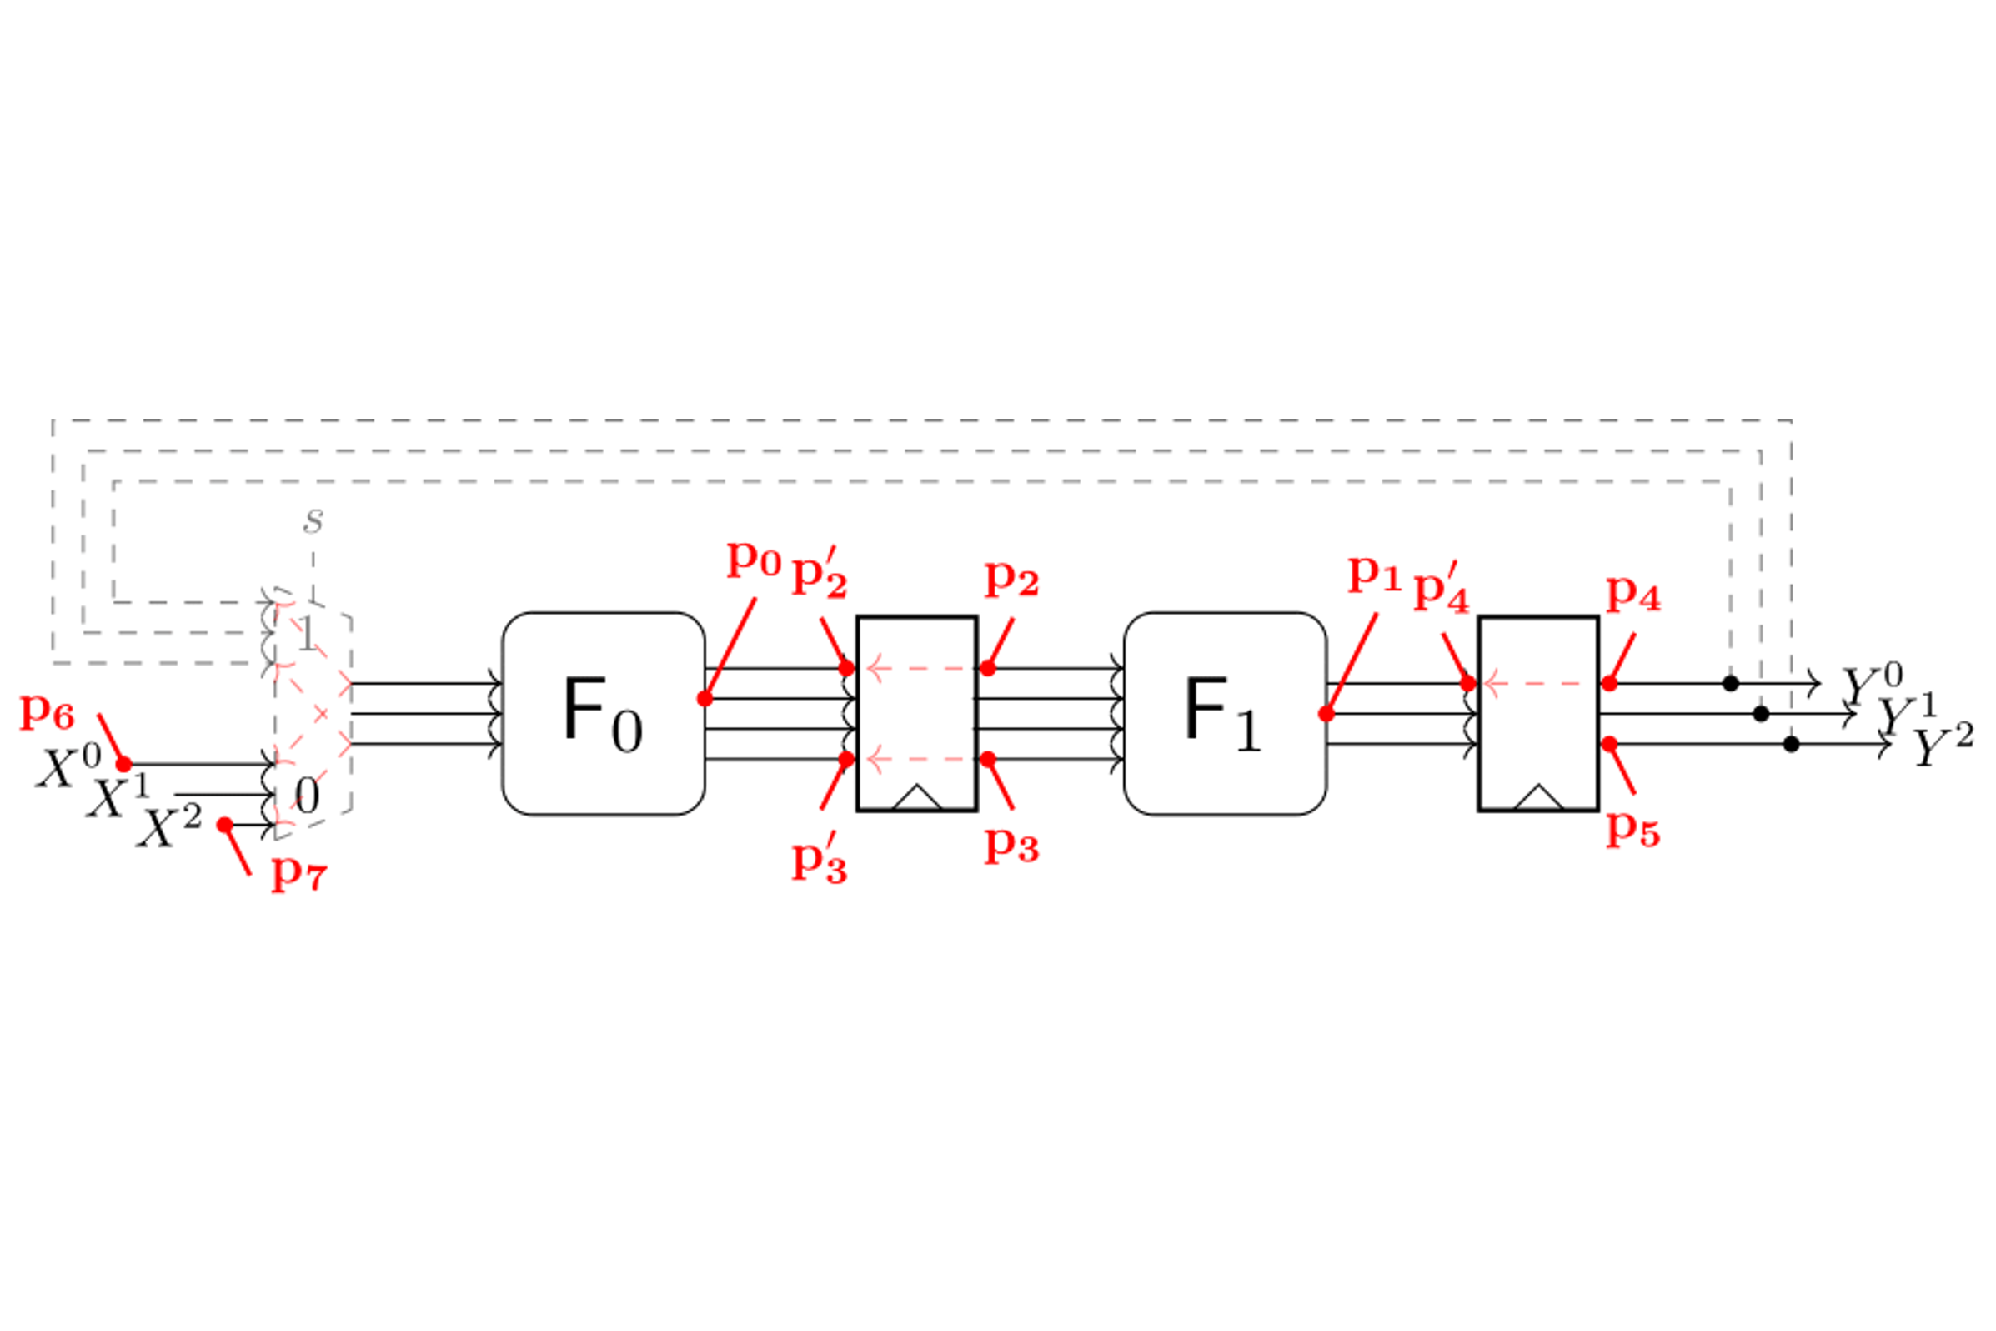
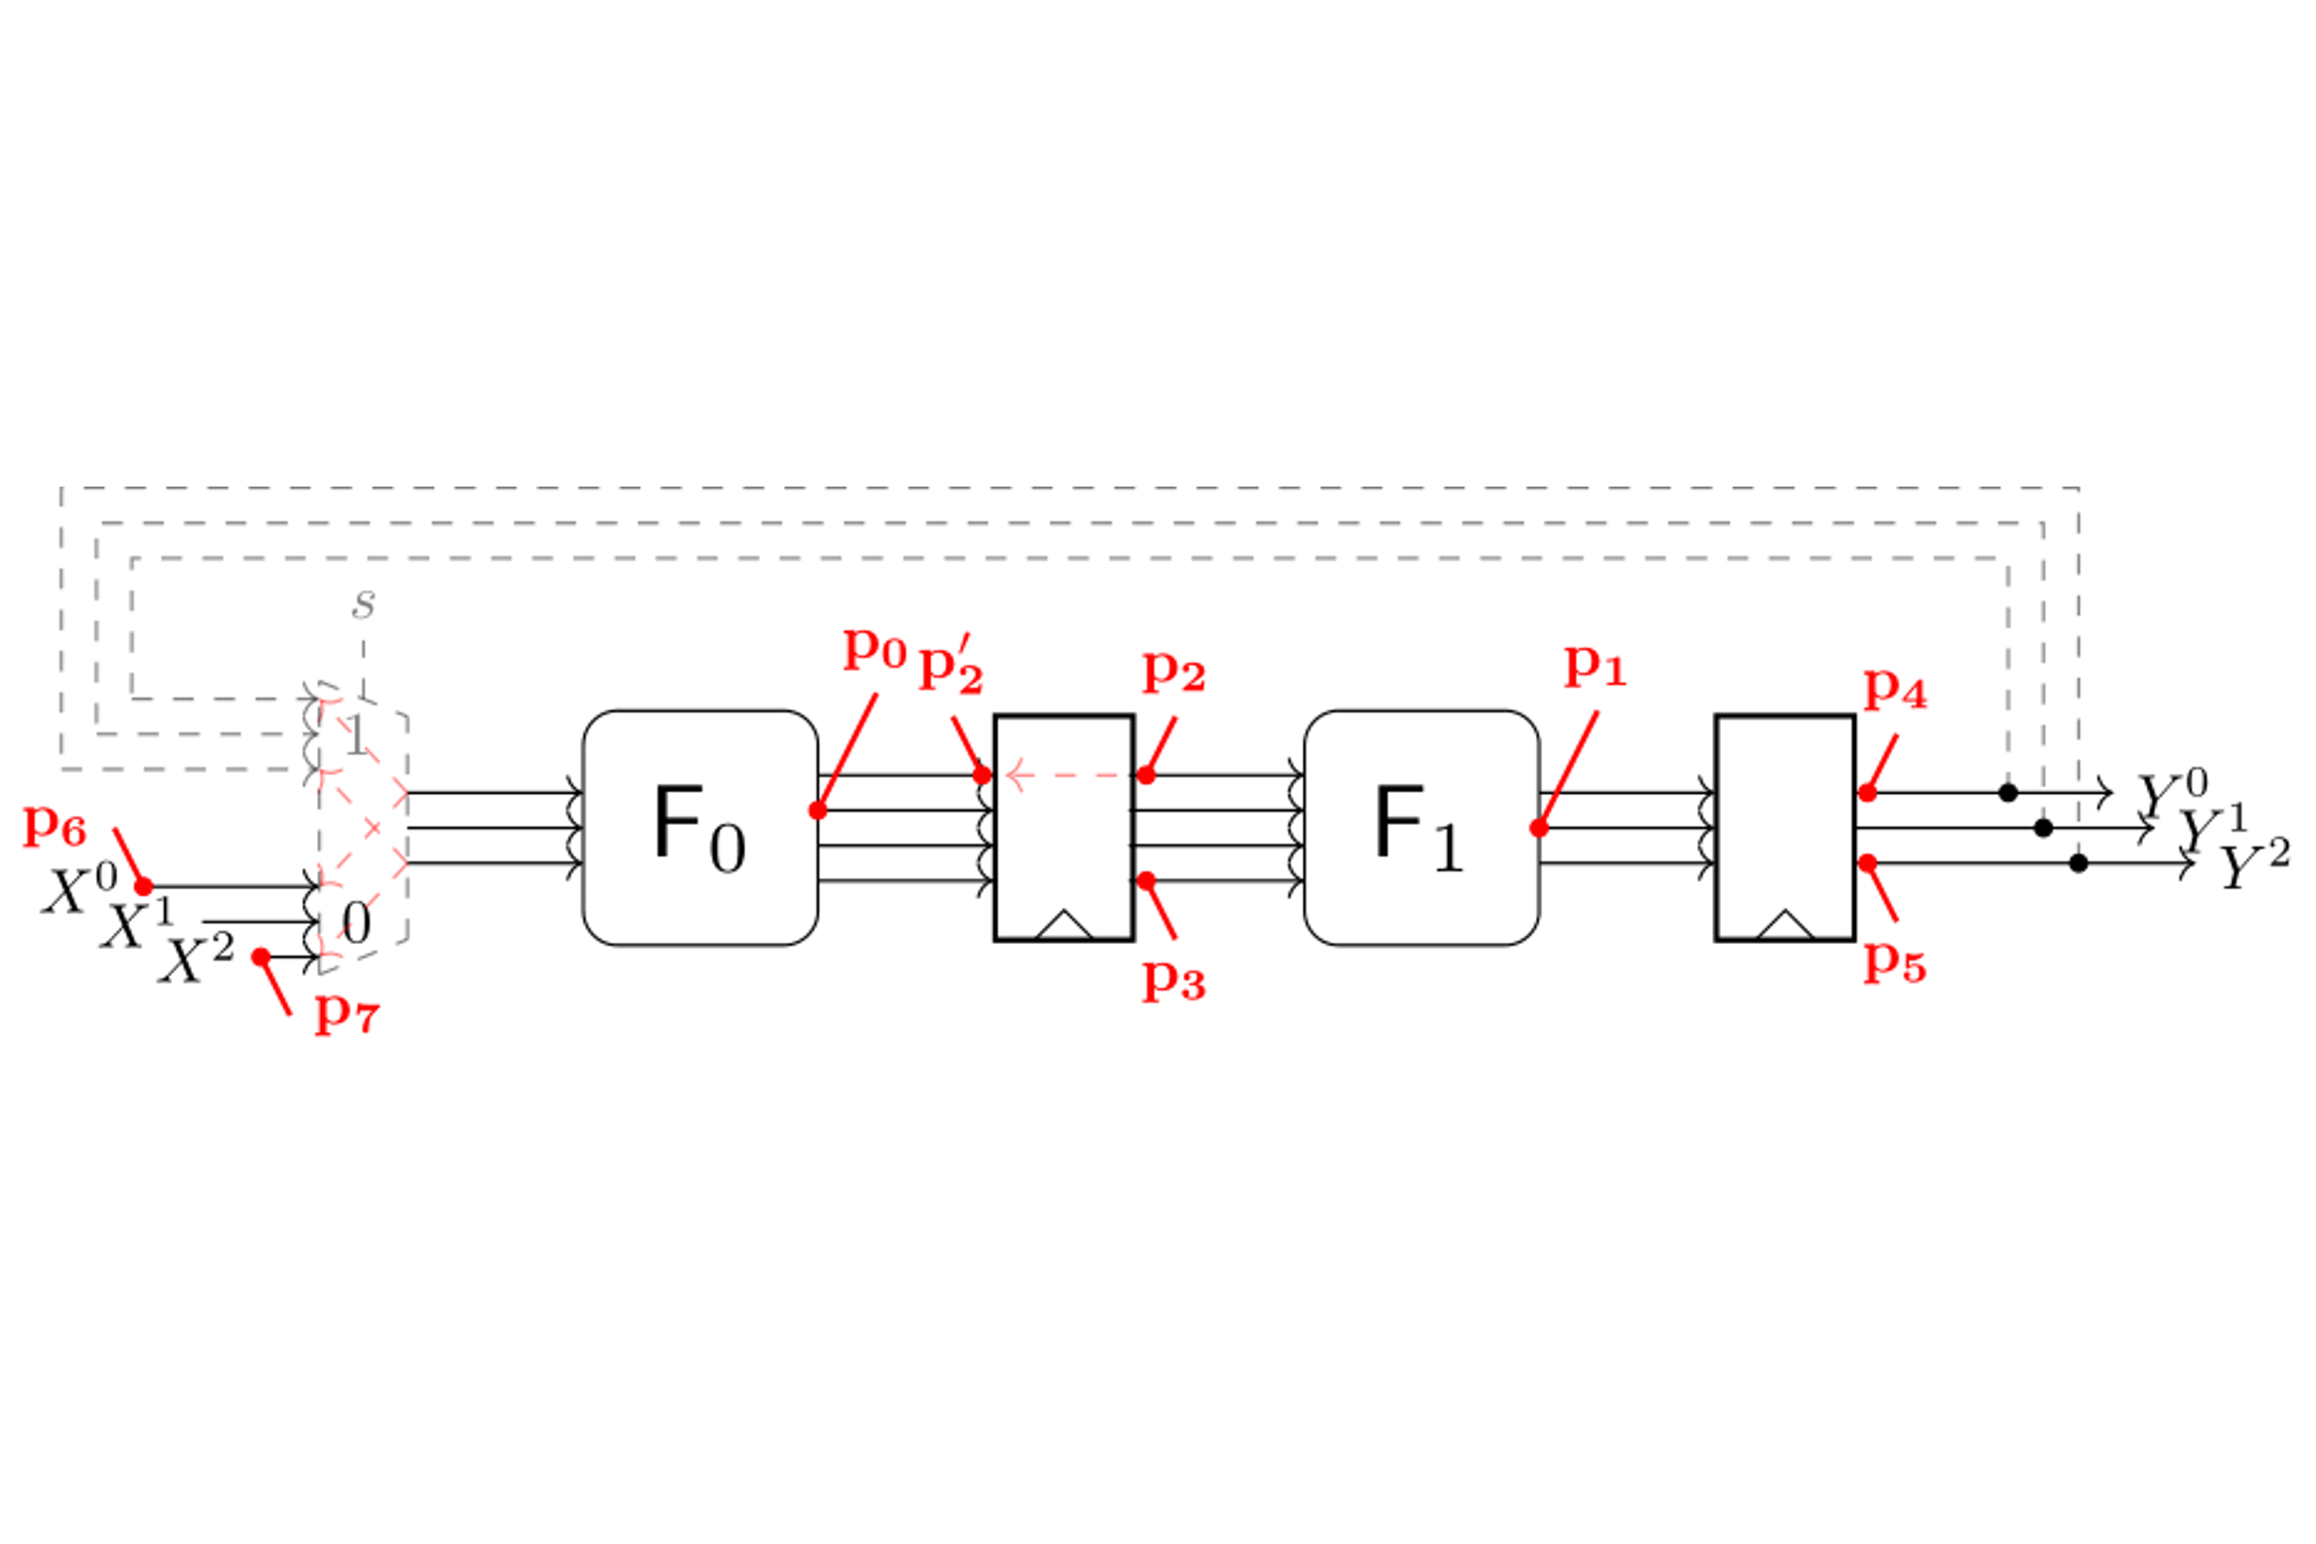
Example
Transition Extension
Extend $P_{g}$ with transition-extended probes
Transitions between register inputs and outputs
$p_{2}\underset{→}{(0,1,0)}\{p_{2},{p′}_{2}\}$, $p_{3}\underset{→}{(0,1,0)}\{p_{3},{p′}_{3}\}$
$p_{4}\underset{→}{(0,1,0)}\{p_{4},{p′}_{4}\}$, $p_{5}\underset{→}{(0,1,0)}\{p_{5},{p′}_{5}\}$
Primary inputs can change at every clock cycle
Consider sequences of primary inputs
$p_{6}\underset{←}{probe}X_{\{0\}}^{0}$, ${p′}_{6}\underset{←}{probe}X_{\{1\}}^{0}$
$p_{7}\underset{←}{probe}X_{\{0\}}^{2}$, ${p′}_{7}\underset{←}{probe}X_{\{1\}}^{2}$
Glitch- and transition-extended probing set
$P_{g,t}=\{p_{2},p_{2}^{′},p_{3},p_{3}^{′},p_{4},p_{4}^{′},p_{5},p_{5}^{′},p_{6},p_{6}^{′},p_{7},p_{7}^{′}\}$

Slide 10
Modeling Glitch- and Transition-Extended Probes
Integration into SILVER
Circuit model of SILVER
Directed acyclic graph (DAG)
All gates are represented as nodes
All wire are represented as edges
Inputs are manually annotated
We extend the notation to cover sequences
Problem: SILVER does not support loops
Extract a loop-free graph
Remove the loop
Store the loop as a list of transitions
$$\left(X_{\{2\}}^{0},Y^{0},2\right)$$
$$(X_{\{2\}}^{1},Y^{1},2)$$
$$\left(X_{\{2\}}^{2},Y^{2},2\right)$$
${(X}_{\{0\}}^{0},X_{\{0\}}^{1},X_{\{0\}}^{2},0)$
$${(X}_{\{1\}}^{0},X_{\{1\}}^{1},X_{\{1\}}^{2},1)$$
$${(X}_{\{2\}}^{0},X_{\{2\}}^{1},X_{\{2\}}^{2},2)$$
$$\left(X_{\{0\}}^{0},X_{\{1\}}^{0},1\right)$$
$$\left(X_{\{0\}}^{1},X_{\{1\}}^{1},1\right)$$
$$\left(X_{\{0\}}^{2},X_{\{1\}}^{2},1\right)$$
…
$$X^{0},X^{1},X^{2}$$

Slide 11
Modeling Glitch- and Transition-Extended Probes
Integration of Probe Extension
Modeling Glitches
Depth-first search back to register outputs
Already done in SILVER
Extend probes on „primary inputs“
Signal from the input list
Search the signal in the feedback list
Add a probe on the feedback signal
Caveat: Probing sets change over time
Create one glitch-extended probing set per clock cycle
$$\left(X_{\{2\}}^{0},Y^{0},2\right)$$
$$(X_{\{2\}}^{1},Y^{1},2)$$
$$\left(X_{\{2\}}^{2},Y^{2},2\right)$$
${(X}_{\{0\}}^{0},X_{\{0\}}^{1},X_{\{0\}}^{2},0)$
$${(X}_{\{1\}}^{0},X_{\{1\}}^{1},X_{\{1\}}^{2},1)$$
$${(X}_{\{2\}}^{0},X_{\{2\}}^{1},X_{\{2\}}^{2},2)$$
$$\left(X_{\{0\}}^{0},X_{\{1\}}^{0},1\right)$$
$$\left(X_{\{0\}}^{1},X_{\{1\}}^{1},1\right)$$
$$\left(X_{\{0\}}^{2},X_{\{1\}}^{2},1\right)$$
…

Slide 12
Modeling Glitch- and Transition-Extended Probes
Integration of Probe Extension
Modeling Transitions
For any probe on a register output, we place a probe on the register input
No further glitch-extension
For any probe on a primary input $x_{\{l\}}$, we place a probe on $x_{\{l−1\}}$
Search $(x_{\left\{l−1\right\}},x_{\left\{l\right\}},l)$ in the input transition list
$$\left(X_{\{2\}}^{0},Y^{0},2\right)$$
$$(X_{\{2\}}^{1},Y^{1},2)$$
$$\left(X_{\{2\}}^{2},Y^{2},2\right)$$
${(X}_{\{0\}}^{0},X_{\{0\}}^{1},X_{\{0\}}^{2},0)$
$${(X}_{\{1\}}^{0},X_{\{1\}}^{1},X_{\{1\}}^{2},1)$$
$${(X}_{\{2\}}^{0},X_{\{2\}}^{1},X_{\{2\}}^{2},2)$$
$$\left(X_{\{0\}}^{0},X_{\{1\}}^{0},1\right)$$
$$\left(X_{\{0\}}^{1},X_{\{1\}}^{1},1\right)$$
$$\left(X_{\{0\}}^{2},X_{\{1\}}^{2},1\right)$$
…

Slide 13
Case Study 1: Strong 8-bit S-boxes
Architecture
Sbox design idea [BGG+17]
Build 8-bit S-boxes by using 4-bit S-boxes with linear operations in known constructions
Iterate the „weak“ S-box multiple times to get good cryptographic properties
Architecture
Constructions
Feistel network
MISTY construction
Substitution permutation network
Share permutation layer

Slide 14
Case Study 1: Strong 8-bit S-boxes
Evaluation Results
Protection
First-order secure TI with three shares
All designs are first-order secure under the (1,0,0)-robust probing-model
We confirmed this with SILVER
Research Question
Are the designs secure under the (1,1,0)-robust probing-model?

Slide 15
Case Study 2: HPC Gadgets
Architecture
Problem: Iterated gadgets
HPC2 gadgets are composable under the PINI notion [CGLS21]
But only under glitches are considered
Iterated HPC2 gadgets may leak information due to transitions
Solution [CS21]: O-PINI notion
Refined notion considering glitches and transitions
Extended O-PINI2 gadgets are already available

Slide 16
Case Study 2: HPC Gadgets
Evaluation Results
Evaluation
We analyzed the PINI and O-PINI secure gadgets up to order three with SILVER
Results
Transitional leakage decreases the security oder by one if the gadget is PINI secure
O-PINI2 gadgets achieve the desired security level

Slide 17
Conclusions
Contributions
We created an algorithmically procedure for the formal verification of hardware in the presence of glitches and transitions.
We integrated the modeling of transition- and glitch-extended probes into SILVER.
We demonstrated the feasibility to detect leakage in multiple case studies
Future work
Publicly available on GitHub: https://github.com/Chair-for-Security-Engineering/SILVER
Ability to cover transitional leakage is limited to a certain form of circuits
SILVER is restricted to the evaluation of small circuits

Slide 18
Sources
[Koc96] Paul C. Kocher. Timing Attacks on Implementations of Diffie-Hellman, RSA,DSS, and Other Systems. In CRYPTO 1996, volume 1109 of LNCS, pages 104–113. Springer, 1996.
[KSM20] David Knichel, Pascal Sasdrich, and Amir Moradi. SILVER – Statistical Independence and Leakage Verification. In ASIACRYPT 2020, volume 12491of LNCS, pages 787–816. Springer, 2020.
[CJRR99] Suresh Chari, Charanjit S. Jutla, Josyula R. Rao, and Pankaj Rohatgi. Towards Sound Approaches to Counteract Power-Analysis Attacks. In CRYPTO 1999, volume 1666 of LNCS, pages 398–412. Springer,1999.
[ISW03] Yuval Ishai, Amit Sahai, and David A. Wagner. Private Circuits: Securing Hardware against Probing Attacks. In CRYPTO 2003, volume 2729 of LNCS, pages 463–481. Springer, 2003.
[FGP+18] Sebastian Faust, Vincent Grosso, Santos Merino Del Pozo, Clara Paglialonga,and François-Xavier Standaert. Composable Masking Schemes in the Presence of Physical Defaults & the Robust Probing Model. IACR TCHES, 2018(3):89–120, 2018.
[CS21] Gaëtan Cassiers and François-Xavier Standaert. Provably Secure Hardware Masking in the Transition- and Glitch-Robust Probing Model: Better Safe than Sorry. IACR TCHES, 2021(2):136–158,2021.
[BGG+17] Erik Boss, Vincent Grosso, Tim Güneysu, Gregor Leander, Amir Moradi,and Tobias Schneider. Strong 8-bit sboxes with efficient masking in hardwareextended version.J. Cryptogr. Eng., 7(2):149–165, 2017.
[CGLS21] Gaëtan Cassiers, Benjamin Grégoire, Itamar Levi, and François-Xavier Stan-daert. Hardware private circuits: From trivial composition to full verification.IEEE Trans. Computers, 70(10):1677–1690, 2021.

Slide 19
Nicolai.mueller@rub.de

