Slide 1
The Best of Two Worlds: Deep Learning-assisted Template Attack
Lichao Wu¹, Guilherme Perin^{2,1} and Stjepan Picek^{2,1}
¹Delft University of Technology, The Netherlands
²Radboud University, The Netherlands

Slide 2
Side-channel Analysis (SCA)
Hardware
Input
Plaintext
Cryptographic algorithm
Output Ciphertext
Side-channel Leakage
Side-channel Analysis
Introduction Motivation Similarity Learning Results Conclusion
Notes:
Introduction to SCA

Slide 3
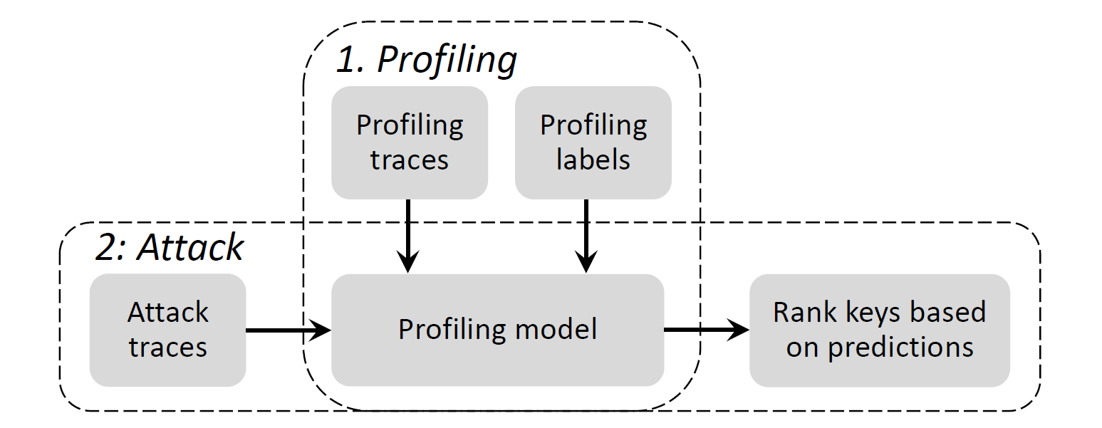
Profiled SCA
Template attack
Deep learning attack
...
Introduction Motivation Similarity Learning Results Conclusion
Notes:
Introduction to profiled SCA

Slide 4
The Challenges in Feature Engineering
Only a few features are related to the real leakages
The crypto implementations are more likely to be SCA-resilient, making the feature engineering a challenging task
How to select relevant features effectively?
Introduction Motivation Similarity Learning Results Conclusion
Notes:
Motivate on why we need triplet attack

Slide 5
Motivation: Unite and Divide
Unite ($a_{i}$ and $p_{i}$):
Minimize the intra-class difference
The features should be similar when they are extracted from the leakages with the same cluster (i)
Divide ($a_{i} \text{and} n_{i+1}$):
Maximize the inter-class difference
The features should be different when they are extracted from the leakages with different clusters (i and i+1)
$$p_{i}$$
$$a_{i}$$
$$n_{i+1}$$
Introduction Motivation Similarity Learning Results Conclusion
Notes:
Intuitive introduction on similarity learning

Slide 6
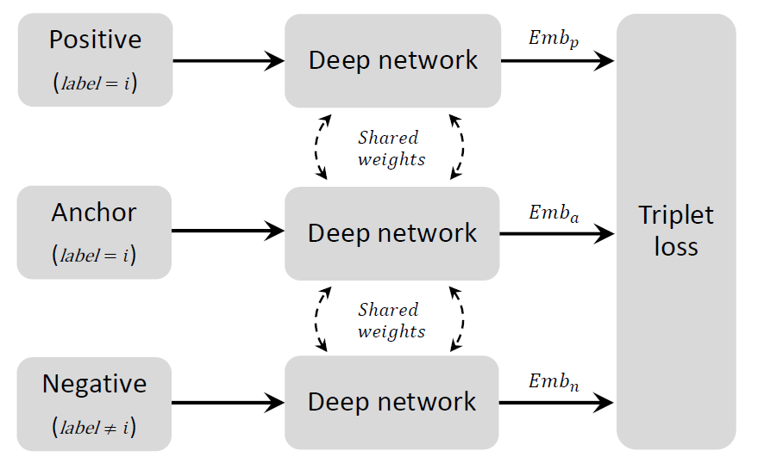
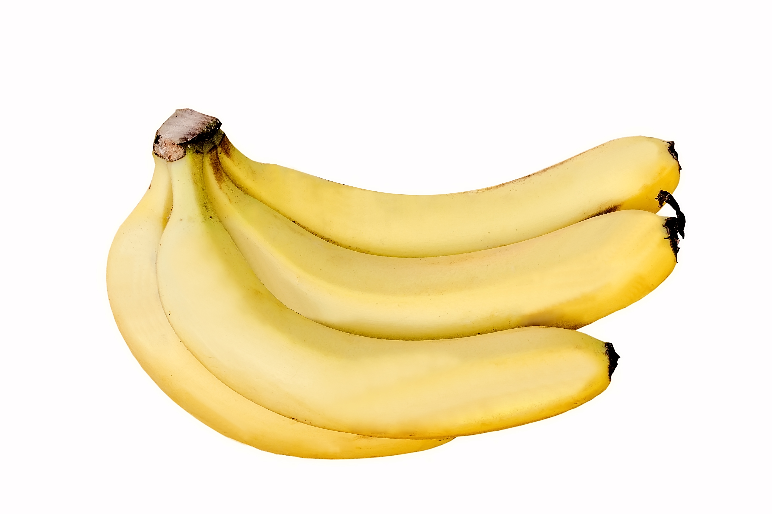
Triplet Network
$$p_{i}$$
$$a_{i}$$
$$n_{i+1}$$
Introduction Motivation Similarity Learning Results Conclusion
Notes:
Explain how it works

Slide 7
Learning from Semi-hard Samples
Easy positives/negatives ($n_{i}$):
$D\left(a, p\right)≪D\left(a,n_{i}\right)$
The bias introduced by easy negatives makes it difficult for a network to learn rich semantic relationships from samples
$$p_{i}$$
$$a_{i}$$
$$n_{i}$$
Introduction Motivation Similarity Learning Results Conclusion
Notes:
Introduce the types of negative samples. Explain why the semi-hard negative mining is beneficial

Slide 8
Learning from Semi-hard Samples
Easy positives/negatives ($n_{i}$):
$D\left(a, p\right)≪D\left(a,n_{i}\right)$
The bias introduced by easy negatives makes it difficult for a network to learn rich semantic relationships from samples
Hard negatives ($n_{i+2}$):
$D\left(a, p\right)>D\left(a,n_{i+2}\right)$
The hard learning task make the learning algorithm difficult to converge.
$$p_{i}$$
$$a_{i}$$
$$n_{i}$$
$$n_{i+2}$$
Introduction Motivation Similarity Learning Results Conclusion
Notes:
Introduce the types of negative samples. Explain why the semi-hard negative mining is beneficial

Slide 9
Learning from Semi-hard Samples
Easy positives/negatives ($n_{i}$):
$D\left(a, p\right)≪D\left(a,n_{i}\right)$
The bias introduced by easy negatives makes it difficult for a network to learn rich semantic relationships from samples
Semi-hard samples ($n_{i+1}$)
$D\left(a, p\right)+margin$ < $D\left(a,n_{i+1}\right)$
Hard negatives ($n_{i+2}$):
$D\left(a, p\right)>D\left(a,n_{i+2}\right)$
The hard learning task make the learning algorithm difficult to converge.
$$p_{i}$$
$$a_{i}$$
$$n_{i}$$
$$n_{i+2}$$
$$n_{i+1}$$
Introduction Motivation Similarity Learning Results Conclusion
Notes:
Introduce the types of negative samples. Explain why the semi-hard negative mining is beneficial

Slide 10
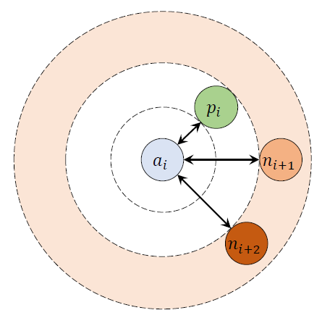
Triplet Loss with Hybrid Distance
Triplet loss:
$loss=max\left(d\left(a, p\right)−d\left(a,n\right)+margin\right), 0)$
$margin$: the lower bound of anchor-negative embedding distance
Introduction Motivation Similarity Learning Results Conclusion
Notes:
Introduce the original triplet loss function

Slide 11
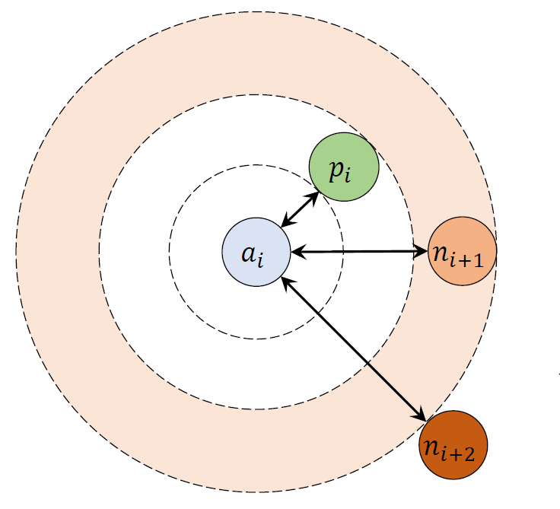
Triplet Loss with Hybrid Distance
Triplet loss:
$loss=max\left(d\left(a, p\right)−d\left(a,n\right)+margin\right), 0)$
$margin$: the lower bound of anchor-negative embedding distance
$d= f\left(D_{feature}, D_{label}\right)= \frac{D_{feature}}{a^{D_{label}}}, a∈(0, 1]$
$D:$ Euclidian distance
$a$: a constant that determine the importance of the label distance
Introduction Motivation Similarity Learning Results Conclusion
Notes:
Introduce the new triplet loss function,
n_{i+2} is pushed more far away from the anchor

Slide 12
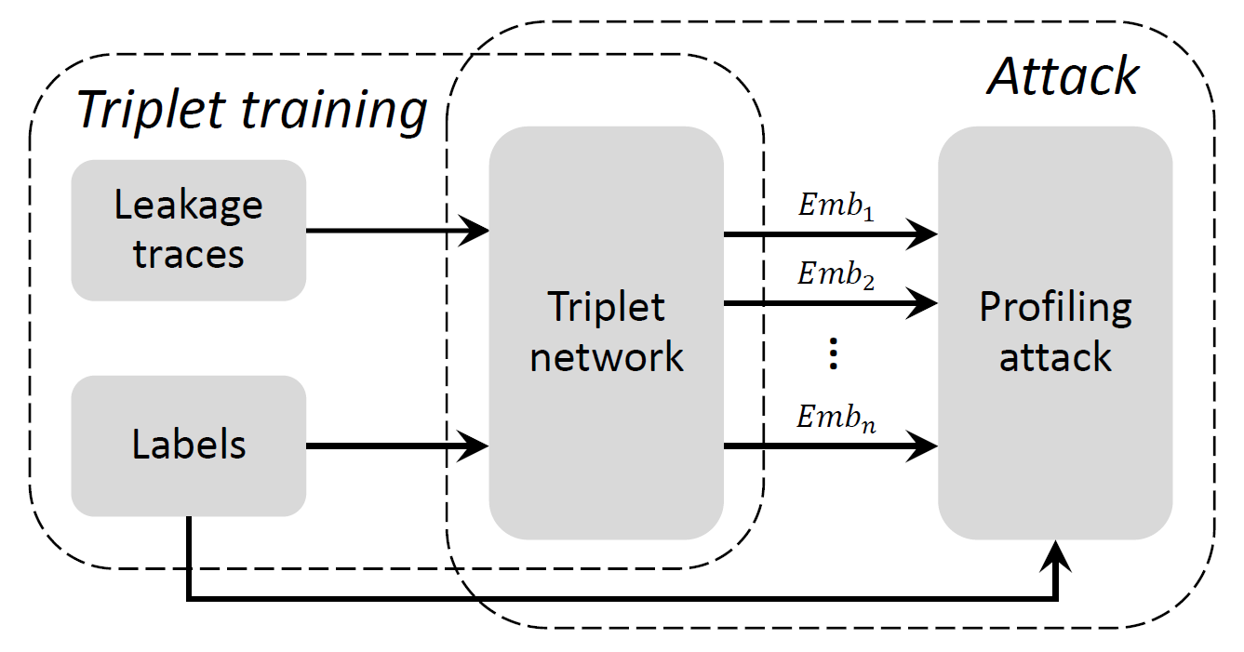
Triplet-assisted profiled SCA
Introduction Motivation Similarity Learning Results Conclusion
Notes:
The learning framework

Slide 13
Attack Method and Setup
Single-epoch similarity learning on a small network (<1min @ single-core CPU)
2. Template attack on the learnt features (HW/ID/HD)
Introduction Motivation Similarity Learning Results Conclusion
Notes:
Attack Method and Setup
Highlight the model size (super small!) and the training epoch (only one epoch!)

Slide 14
Performance Benchmark
Attack Methods
Noise Resilience
Loss Functions

Slide 15
Benchmark: Attack Methods
ASCAD fixed key
ASCAD random keys
AES_HD
Introduction Motivation FLR Results Conclusion
Notes:
We are (almost) always the best

Slide 16
Benchmark: Noise Resilience*
ASCAD fixed key
ASCAD random keys
AES_HD
*Failed methods from the previous slides are excluded
Introduction Motivation Similarity Learning Results Conclusion
Notes:
We are always the best

Slide 17
Benchmark: Loss Functions
Introduction Motivation Similarity Learning Results Conclusion
Notes:
We are (almost) always the best

Slide 18
Hyperparameter Evaluation
Loss function: $a$
Embedding size
Triplet margin
Training epochs
Training set size

Slide 19
Loss Function: $a$
Introduction Motivation Similarity Learning Results Conclusion
Notes:
𝑎 determine the importance of the label distance.
The introduce of 𝑎 to the loss function is helpful
Tuning should be careful, recommend to start with low value

Slide 20
Embedding Size
Introduction Motivation Similarity Learning Results Conclusion
Notes:
Embedding size is important
Recommend to start with low value. Too high value will introduce irrelevant features that degrade the attack performance

Slide 21
Triplet Margin
Introduction Motivation Similarity Learning Results Conclusion
Notes:
Three different strategies for setting the parameters of FLR.

Slide 22
Training Epochs
Default network settings
Network with increased pooling size and stride
Introduction Motivation Similarity Learning Results Conclusion
Notes:
With the original network, overfitting is very easy to occur.
One solution is to enlarge the pooling size and stride, the extraction of the global features would make the model more robust

Slide 23
Training Set Size
Introduction Motivation Similarity Learning Results Conclusion
Notes:
Triplet network relies on the building of the triplet pairs. The more dataset, the performance becomes better.

Slide 24
Conclusions
Our proposed approach can extract an efficient embedding of side-channel traces.
With minimal computation effort, our results are comparable to or better than state-of-the-art deep learning architectures and feature reduction techniques in all benchmark scenarios.
The evaluation of several critical hyperparameters in the proposed attack scheme can serve as a guideline for potential evaluators/attackers.
Introduction Motivation Similarity Learning Results Conclusion

Slide 25
The Best of Two Worlds: Deep Learning-assisted Template Attack
Paper: https://tches.iacr.org/index.php/TCHES/article/view/9707
Code: https://github.com/AISyLab/Triplet-attack
Lichao Wu¹, Guilherme Perin^{2,1} and Stjepan Picek^{2,1}
¹Delft University of Technology, The Netherlands
²Radboud University, The Netherlands

