Slide 1
Triplex: an Efficient and One-Pass Leakage-Resistant Mode of Operation
Yaobin Shen
joint work with Thomas Peters, François-Xavier Standaert,
Gaëtan Cassiers and Corentin Verhamme
UCLouvain Crypto Group
September 19, CHES 2022

Slide 2
Authenticated Encryption (AE)
Integrity & confidentiality
Protection against side-channel attacks, e.g., masking
$$M_{3}$$
$$M_{1}$$
$$C_{3}$$
$$C_{1}$$
$$M_{2}$$
$$C_{2}$$
$$N$$
KDF
$$K′$$
message processing
TGF
tag
$$K$$
$$M_{1}$$
$$C_{1}$$
$$M_{2}$$
$$C_{2}$$
$$M_{3}$$
$$C_{3}$$
$$N$$
KDF
$$K′$$
message processing
tag
TGF
$$K$$
significant performance overheads

Slide 3
How to improve the performance?
Leveled implementation [PSV15]
avoid equally protecting all parts of an implementation
identify the protection level of each part (performance gains)
[BPPS17]: DPA-protected KDF/TGF + unbounded leakage for the rest
substantial performance gains for integrity
$$M_{1}$$
$$C_{1}$$
$$M_{2}$$
$$C_{2}$$
$$M_{3}$$
$$C_{3}$$
usually the main part
$$N$$
KDF
$$K′$$
message processing
tag
TGF
$$K$$
[PSV15]: Olivier Pereira, François-Xavier Standaert, Srinivas Vivek: Leakage-Resilient Authentication and Encryption from Symmetric Cryptographic Primitives. CCS 2015: 96-108
[BPPS17]: Francesco Berti, Olivier Pereira, Thomas Peters, François-Xavier Standaert: On Leakage-Resilient Authenticated Encryption with Decryption Leakages. IACR Trans. Symmetric Cryptol. 2017(3): 271-293 (2017)On Leakage-Resilient Authenticated Encryption with Decryption Leakages. IACR Trans. Symmetric Cryptol. 2017(3): 271-293 (2017)

Slide 4
One-pass Modes: CIML2 + CCAmL1
CIML2 & CCAmL1[BBB+20]
Ciphertext Integrity with nonce Misuse-resistance and Leakage in enc & dec
CCA with misuse-resilience and Leakage in enc
Ascon: DPA protection in KGF & TGF [DEMS21]
sponge-based
[BBB+20]: Bellizia et al.:Spook: Sponge-Based Leakage-Resistant Authenticated Encryption with a Masked Tweakable Block Cipher. IACR Trans. Symmetric Cryptol. 2020(S1): 295-349 (2020)
[DEMS21]: Christoph Dobraunig, Maria Eichlseder, Florian Mendel, Martin Schläffer: Ascon v1.2: Lightweight Authenticated Encryption and Hashing. J. Cryptol. 34(3): 33 (2021)

Slide 5
One-pass Modes: CIML2 + CCAmL1
TET [BGP+20]
TBC-based
rate 1/2 (two TBCs per n-bit message)
[BGP+20]: Francesco Berti, Chun Guo, Olivier Pereira, Thomas Peters, François-Xavier Standaert:TEDT, a Leakage-Resist AEAD Mode for High Physical Security Applications. IACR Trans. Cryptogr. Hardw. Embed. Syst. 2020(1): 256-320 (2020)

Slide 6
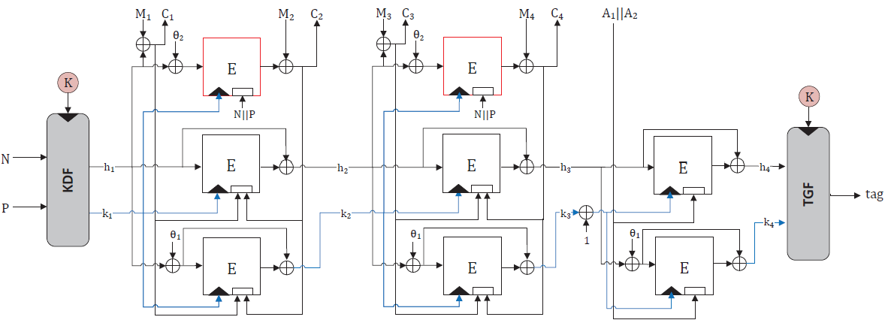
Our Design: Triplex, One-Pass and More Efficient
Triplex: CIML2 + CCAmL1
rate 2/3 for message (three TBCs per 2n-bit)
rate 1 for AD (two TBCs per 2n-bit)
TBC with 2n-bit tweak
Skinny-128-384, Deoxys-TBC-128-384

Slide 7
Start point: Hirose’s compression function
Hirose’s compression function $F$ based on a TBC
$F\left(h_{i−1},k_{i−1}\right)=(h_{i},k_{i})$
the outputs are random
Encryption rate: 1/2
two TBCs per n-bit message
1 block for encryption (xor)
1 block used as the subkey for next iteration

Slide 8
A third TBC call
another TBC call for encryption
Rate: 2/3
Authenticity: the tweak is public but influences the outputs
1 block for encryption (xor)
1 block used as the subkey for next iteration
ciphertext or AD as tweak to be authenticated

Slide 9
The full-fledged scheme: Triplex
More design considerations
multi-user security, tag generation [BGPS21],…
key derivation function
for 2n-bit initial state
encrypt and authenticate messages by Hirose + a third TBC
tag generation function
[BGPS21] Francesco Berti, Chun Guo, Thomas Peters, François-Xavier Standaert: Efficient Leakage-Resilient MACs Without Idealized Assumptions. ASIACRYPT (2) 2021: 95-123

Slide 10
Integrity analysis
$n−\log_{2}{n}$ bits of CIML2 in the unbounded leakage model
integrity holds if #queries $≤2^{n}/n$
DPA protection
DPA protection
requires no protection

Slide 11
Confidentiality analysis
$n/2$ bits for CCAmL1 due to re-keying process
$n−\log_{2}{n}$ bits confidentiality without leakage in the nonce misuse-resilient setting [ADL17]
[ADL17] Tomer Ashur, Orr Dunkelman, Atul Luykx: Boosting Authenticated Encryption Robustness with Minimal Modifications. CRYPTO (3) 2017: 3-33

Slide 12
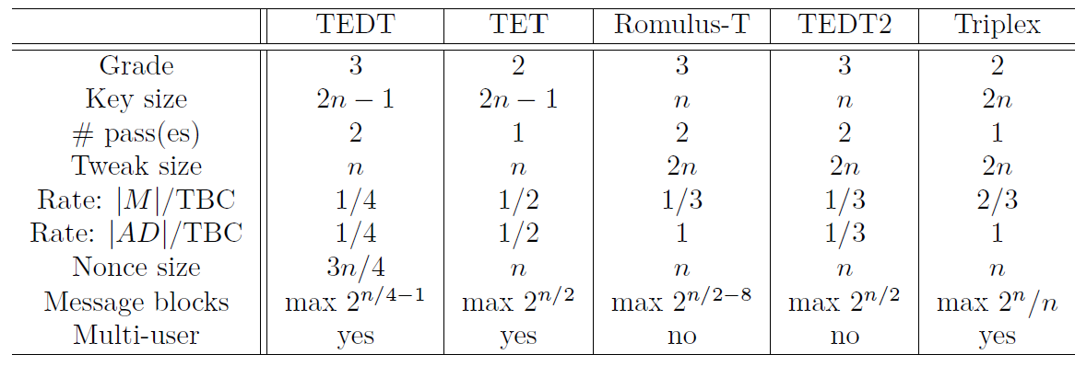
Comparisons with Other TBC-based LR-AE
Grade 2 = CIML2 + CCAmL1
Grade 3 = CIML2 + CCAmL2
high rate
large

Slide 13
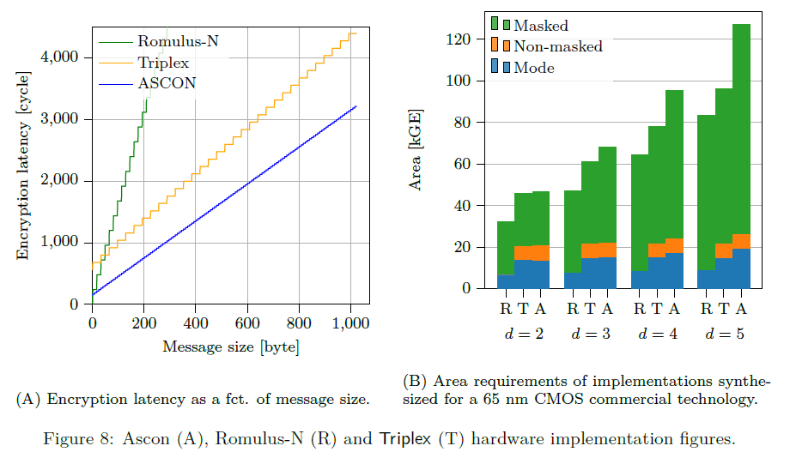
Implementation results
Triplex-skinny vs Romulus-N
limited area overhead but significant performance gains
Notes:
Triplex and Ascon are levled protected while Romulus-N is uniformly protected.
In Figure A, we show the number of cycles required for encrypting messages of various
length.
1. For short messages, the encryption time is dominated by the KDF and TGF. This
duration is longer for Triplex than for Ascon, mainly due to the larger number of rounds
in Skinny.
2. For longer messages, Ascon takes 24 cycles to encrypt a 64 bit message block,
while Triplex takes 3 × 40 cycles to encrypt 256 bits of message.
3. Overall, Ascon has a slightly better throughput despite a more serial architecture.
But these results are sensitive to the security margins taken by designers.
4. Eventually, the different slope of Romulus-N’s performance confirms an interest of
leveled implementations from the viewpoint of throughput.
In Figure B, we can see that the area of these implementations is dominated by
the masked primitives (confirming the limited overheads of the leveled approach when
high physical security levels are required).
1. So compared to Romulus-N, Triplex has a slightly higher area cost due to the need for both a masked and an unmasked cipher implementations. But this overhead shrinks relatively with a growing number of shares in the masking scheme, and is rewarded with a significantly better performance for messages
larger than 48 bytes.
2. Moreover, we observe that the masked Skinny and Ascon have similar areas for small number of shares, while the area of Ascon grows faster than the one of Skinny.

Slide 14
Implementation results
Triplex-skinny vs Ascon
sensitive to security margin: #rounds, #shares
state size

Slide 15
Conclusion
Triplex: an efficient and one-pass leakage-resistant AE
rate 2/3
$n−\log_{2}{n}$ bits for CIML2
$n−\log_{2}{n}$ bits for standard confidentiality and n/2 bits for CCAmL1
base on TBC with $2n$-bit tweak
Make TBC-based designs more comparable to Sponge-based
Leveled implementation is generally beneficial to improve the performance

Slide 16
Thanks

