Slide 1
Randomness Optimization for Gadget Composition in Higher-Order Masking
Jakob Feldtkeller, David Knichel, Pascal Sasdrich, Amir Moradi, Tim Güneysu

Slide 2
Where Are We?
Side-Channel Attacks
ISW-Probing Model
Notes:
Not necessary to introduce or motivate SCA at this point in the conference.
For analysis we use the ISW-Probing model -> introduced now in more detail

Slide 3
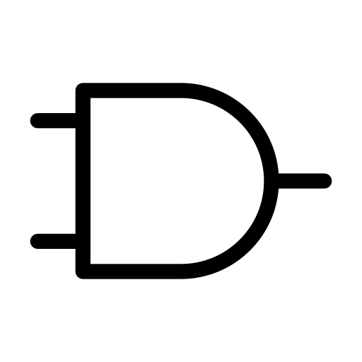
ISW-Probing Model
Glitch-Extended
Model:
Free placement of probes, where each probe leak the exact values of last synchronization points.
t-Probing Security
Up to t probes can be simulated without access to any secret.
[Faust et al, 2018]
Notes:
Adversary is given a circuit, before each invocation they can place up to t probes that reveal the exact values at this wires.

Slide 4
Security via Composition
Masking & Gadgets
$$G_{1}$$
$$t+1$$
$$r_{0}$$
$$r_{1}$$
$$r_{2}$$
$$G_{4}$$
$$t+1$$
$$r_{9}$$
$$r_{10}$$
$$r_{11}$$
$$G_{6}$$
$$G_{2}$$
$$t+1$$
$$r_{3}$$
$$r_{4}$$
$$r_{5}$$
$$t+1$$
$$r_{15}$$
$$r_{16}$$
$$r_{17}$$
$$G_{5}$$
$$G_{3}$$
$$r_{12}$$
$$r_{13}$$
$$r_{14}$$
$$t+1$$
$$r_{6}$$
$$r_{7}$$
$$r_{8}$$
Masking of Values:
Replace each value by a vector of random values (secret sharing).
Masking of Circuits:
Replace each gate with gadgets, such that composition is probing secure.
Unique randomness for each gadget.
[Chari et al, 1999]
[Barthe et al. 2015]

Slide 5
High-Level Idea
1
Create clusters of gadgets
$$G_{1}$$
$$r_{3}$$
2
$$r_{9}$$
$$r_{0}$$
$$r_{1}$$
$$r_{2}$$
$$G_{4}$$
$$r_{0}$$
Reuse randomness within clusters
$$r_{6}$$
$$r_{9}$$
$$r_{10}$$
$$r_{11}$$
$$G_{6}$$
$$r_{1}$$
$$r_{4}$$
$$G_{2}$$
$$r_{10}$$
$$r_{7}$$
$$r_{2}$$
$$r_{3}$$
$$r_{4}$$
$$r_{5}$$
$$r_{15}$$
$$r_{16}$$
$$r_{17}$$
$$r_{8}$$
$$G_{5}$$
$$r_{5}$$
$$r_{11}$$
$$G_{3}$$
$$r_{12}$$
$$r_{13}$$
$$r_{14}$$
$$r_{6}$$
$$r_{7}$$
$$r_{8}$$
Goal: Reduce required randomness!

Slide 6
Coverage
Paper
Gadgets:
Domain Orientated Masking
Composition: SNI
Multiplication & Refresh
Hardware Private Circuits 2
Composition: PINI
Multiplication
Clustering:
Strict Clustering:
Smaller clusters
High randomness reuse
Relaxed Clustering:
Larger clusters
Unique randomness per gadget
Security Order:
$$t ≥2$$

Slide 7
Coverage
This Talk
Gadgets:
Domain Orientated Masking
Composition: SNI
Multiplication & Refresh
Hardware Private Circuits 2
Composition: PINI
Multiplication
Clustering:
Strict Clustering:
Smaller clusters
High randomness reuse
Relaxed Clustering:
Larger clusters
Unique randomness per gadget
Security Order:
$$t ≥2$$

Slide 8
DOM-Gadget Composition
SNI – Clustering – Randomness Distribution

Slide 9
Strong Non-Interference
Intuition
SNI
Full-stop for probe propagation!
$$t_{1} internal probes+ t_{2 }output probes (t_{1}+ t_{2} ≤t)$$
$$can be simulated with$$
$$t_{1} shares of each input.$$
[Barthe et al, 2016]

Slide 10
Multiple-Output Strong Non-Interference
Intuition
MO-SNI
Full-stop for probe propagation!
$$t_{1} internal probes+ t_{2 }output probes of each output (t_{1}+ t_{2} ≤t)$$
$$can be simulated with$$
$$t_{1} shares of each input.$$
[Cassiers & Standaert, 2020]

Slide 11
Restricted Multiple-Output Strong Non-Interference
Intuition
RMO-SNI
Not arbitrarily
composable
Full-stop for probe propagation!
$$t_{1} internal probes+ t_{2 }output probes of each output (t_{1}+ t_{2} ≤t)$$
$$can be simulated with$$
$$t_{1} shares of each input.$$

Slide 12
Simplified Computation Tree
Intuition
SNI
NI
SNI
SNI
SNI
SNI
SNI Gadgets are cut in two independent parts for dependency analysis.

Slide 13
DOM-Gadget Composition
SNI – Clustering – Randomness Distribution

Slide 14
Clustering Rules
Informal – based on simplified computation tree
There is no path from the same source to two inputs of the cluster.
There exist no path from one gadget to another gadget in the same cluster.
SNI
$$r_{0}$$
There is no path from two outputs of a cluster to the same target gadget.
There is at most one path from each output to another gadget (trivially true).
SNI
Notes:
Cluster can not be SNI if it has two-times the same input

Slide 15
Clustering Rules
Informal – based on simplified computation tree
There is no path from the same source to two inputs of the cluster.
There exist no path from one gadget to another gadget in the same cluster.
SNI
$$r_{0}$$
$$x ⊕r_{0}$$
There is no path from two outputs of a cluster to the same target gadget.
There is at most one path from each output to another gadget (trivially true).
$$x$$
Notes:
Randomness could cancel out if shared

Slide 16
Clustering Rules
Informal – based on simplified computation tree
There is no path from the same source to two inputs of the cluster.
There exist no path from one gadget to another gadget in the same cluster.
SNI
SNI
$$r_{0}$$
$$x ⊕r_{0}$$
$$y⊕r_{0}$$
There is no path from two outputs of a cluster to the same target gadget.
There is at most one path from each output to another gadget (trivially true).
$$x⊕y$$
Notes:
Randomness could cancel out, Probes propagate to more than one cluster output

Slide 17
Clustering Rules
Informal – based on simplified computation tree
There is no path from the same source to two inputs of the cluster.
There exist no path from one gadget to another gadget in the same cluster.
SNI
There is no path from two outputs of a cluster to the same target gadget.
There is at most one path from each output to another gadget (trivially true).
Notes:
Probes propagate to more than one cluster output

Slide 18
DOM-Gadget Composition
SNI – Clustering – Randomness Distribution

Slide 19
Randomness Distribution Rule
Informal – within cluster
$$r_{i}$$
$$r_{j}$$
No pair of random values is used in more than one gadget of a cluster.
$$G_{1}: r_{0}, r_{1}, r_{2} \\ G_{2}: r_{0}, r_{3}, r_{4}$$
$$G_{3}:{ r}_{1}, r_{3}, r_{5}$$
Each probe can remove at most one random bit from another probe!
Notes:
Otherwise cross-gadget leakage can exist where the randomness cancels out

Slide 20
Security Guarantees
Theorems (informal)
Clustering:
Given a composition of NI and SNI gadgets, where the SNI gadgets are clustered according to the given rules, then placing t probes leads to at most t probes at the outputs of each cluster via probe propagation.
Gadgets:
A cluster of DOM gadgets where randomness is shared according to the given rule is RMO-SNI.
Proofs in
Paper

Slide 21
Evaluation
Strict Clustering

Slide 22
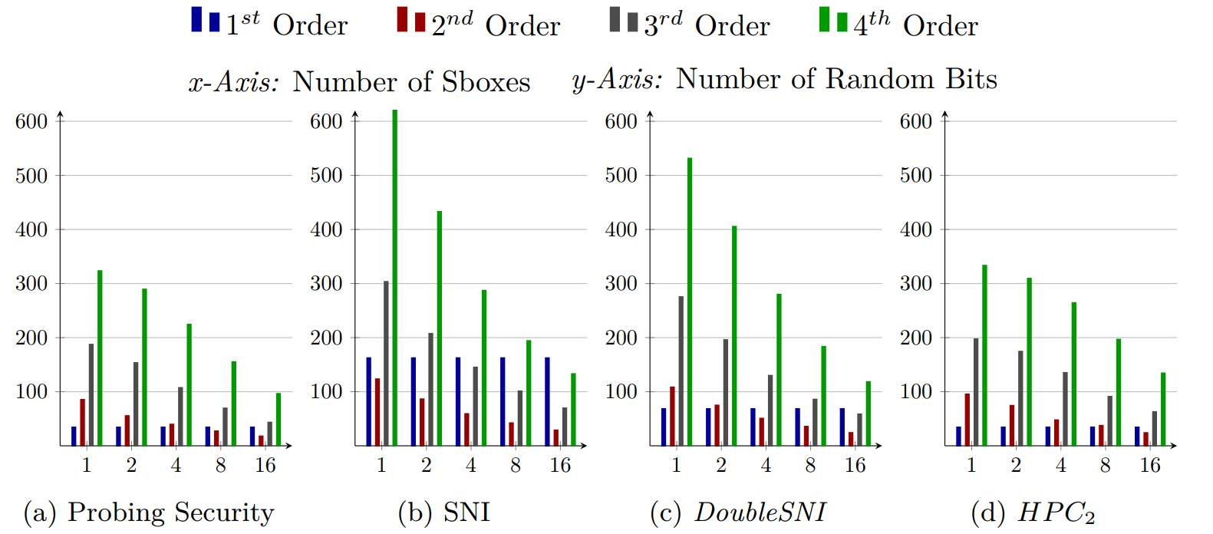
Parallel Structures
AES S-box [BP12]
Parallel structures allow efficient clustering.
Number of random bits per S-box (average)
Notes:
Clear benefit Heuristic nearly as good as SMT

Slide 23
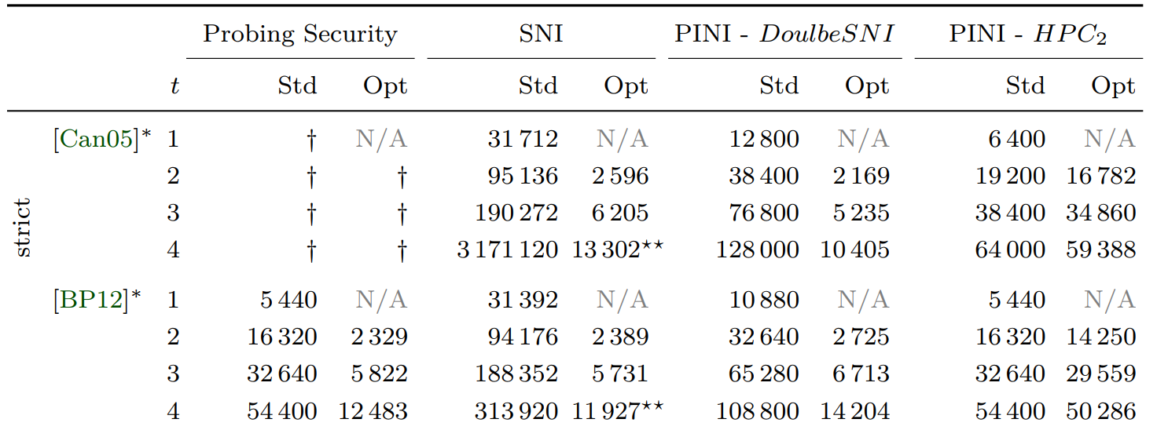
Performance
Unrolled AES
More Details
in Paper
Notes:
Clear benefit Heuristic nearly as good as SMT

Slide 24
1
$$r_{3}$$
$$G_{1}$$
$$G_{4}$$
$$r_{9}$$
$$r_{0}$$
Create clusters of gadgets
$$r_{6}$$
Thank you!
$$r_{1}$$
$$r_{4}$$
$$G_{2}$$
$$G_{6}$$
$$r_{10}$$
$$r_{7}$$
2
$$r_{2}$$
Reuse randomness within clusters
$$r_{8}$$
$$G_{3}$$
$$G_{5}$$
$$r_{5}$$
$$r_{11}$$
Jakob Feldtkeller

Slide 25
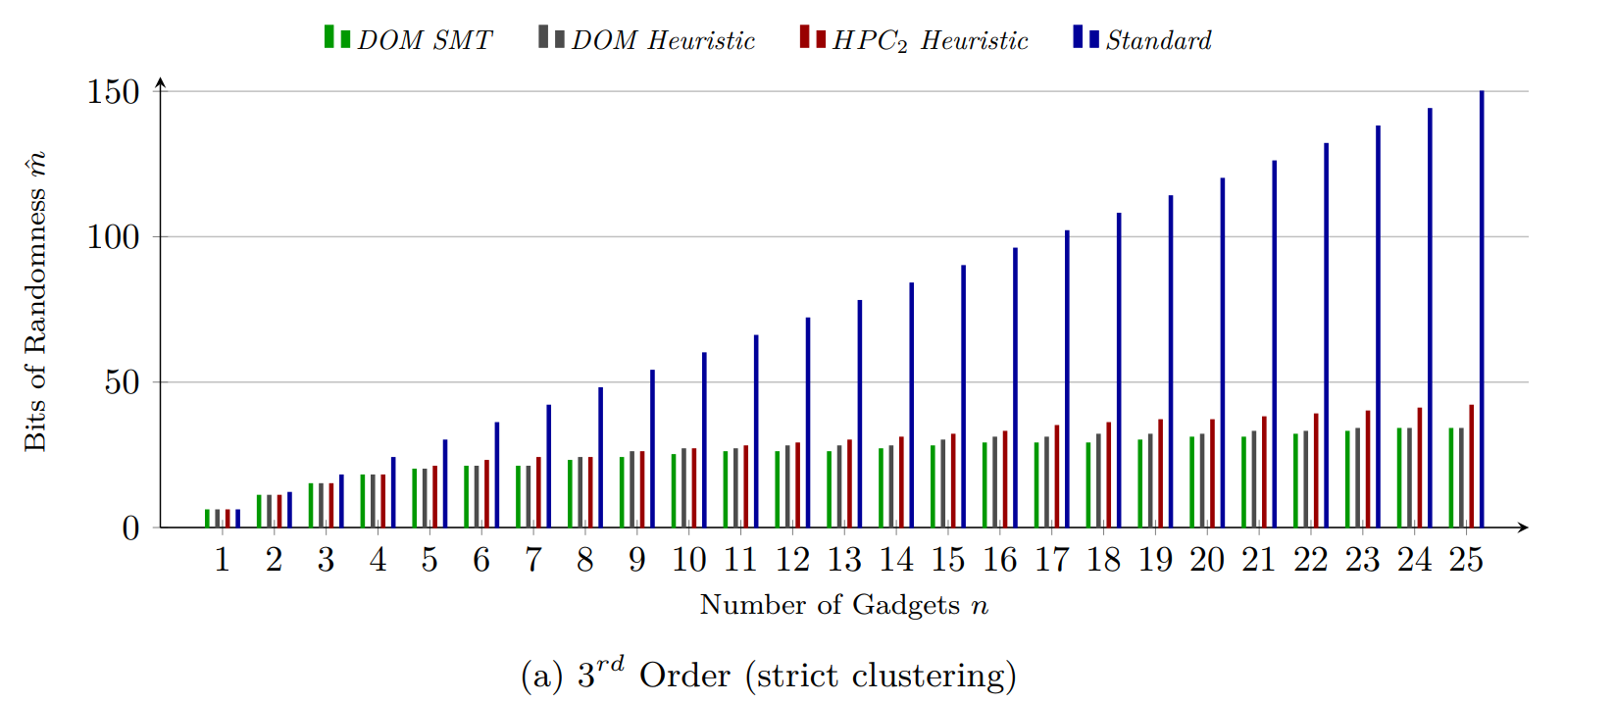
Randomness Distribution Algorithms
SMT vs. Heuristic
No closed formula for randomness distribution within clusters.
SMT:
Use SMT solver to find nearly optimal solution (timeout).
Heuristic:
Initialize first gadget and then iteratively search a valid distribution for next gadget..
Notes:
Clear benefit Heuristic nearly as good as SMT

