Slide 1
VERICA – Verification of Combined Attacks
Automated formal verification of security against simultaneous information leakage and tampering
Jan Richter-Brockmann, Jakob Feldtkeller, Pascal Sasdrich, Tim Güneysu
CHES 2022

Slide 2
Physical Attacks
Fault-Injection Attacks
Side-Channel Attacks
A powerful attacker may combine both attack vectors!

Slide 3
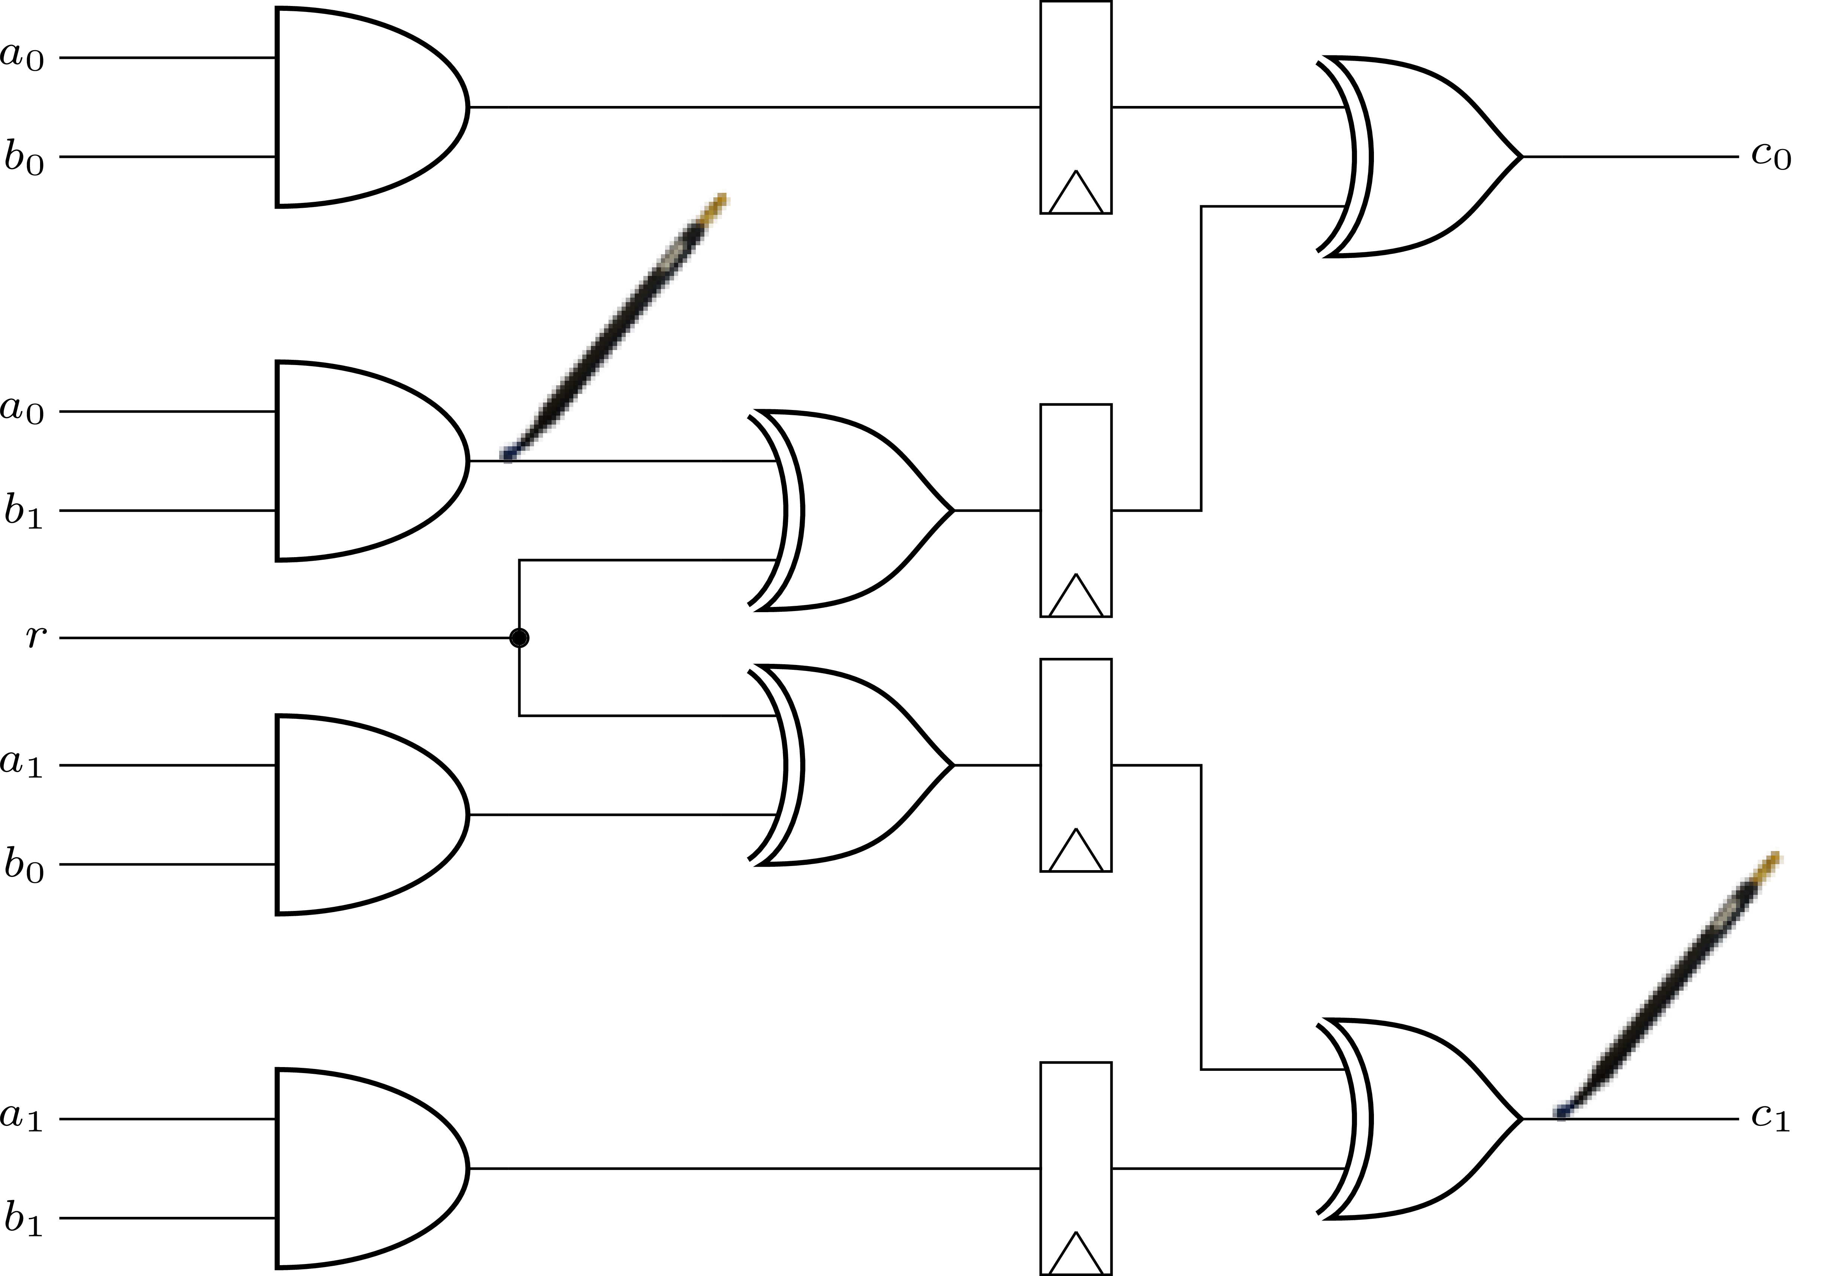
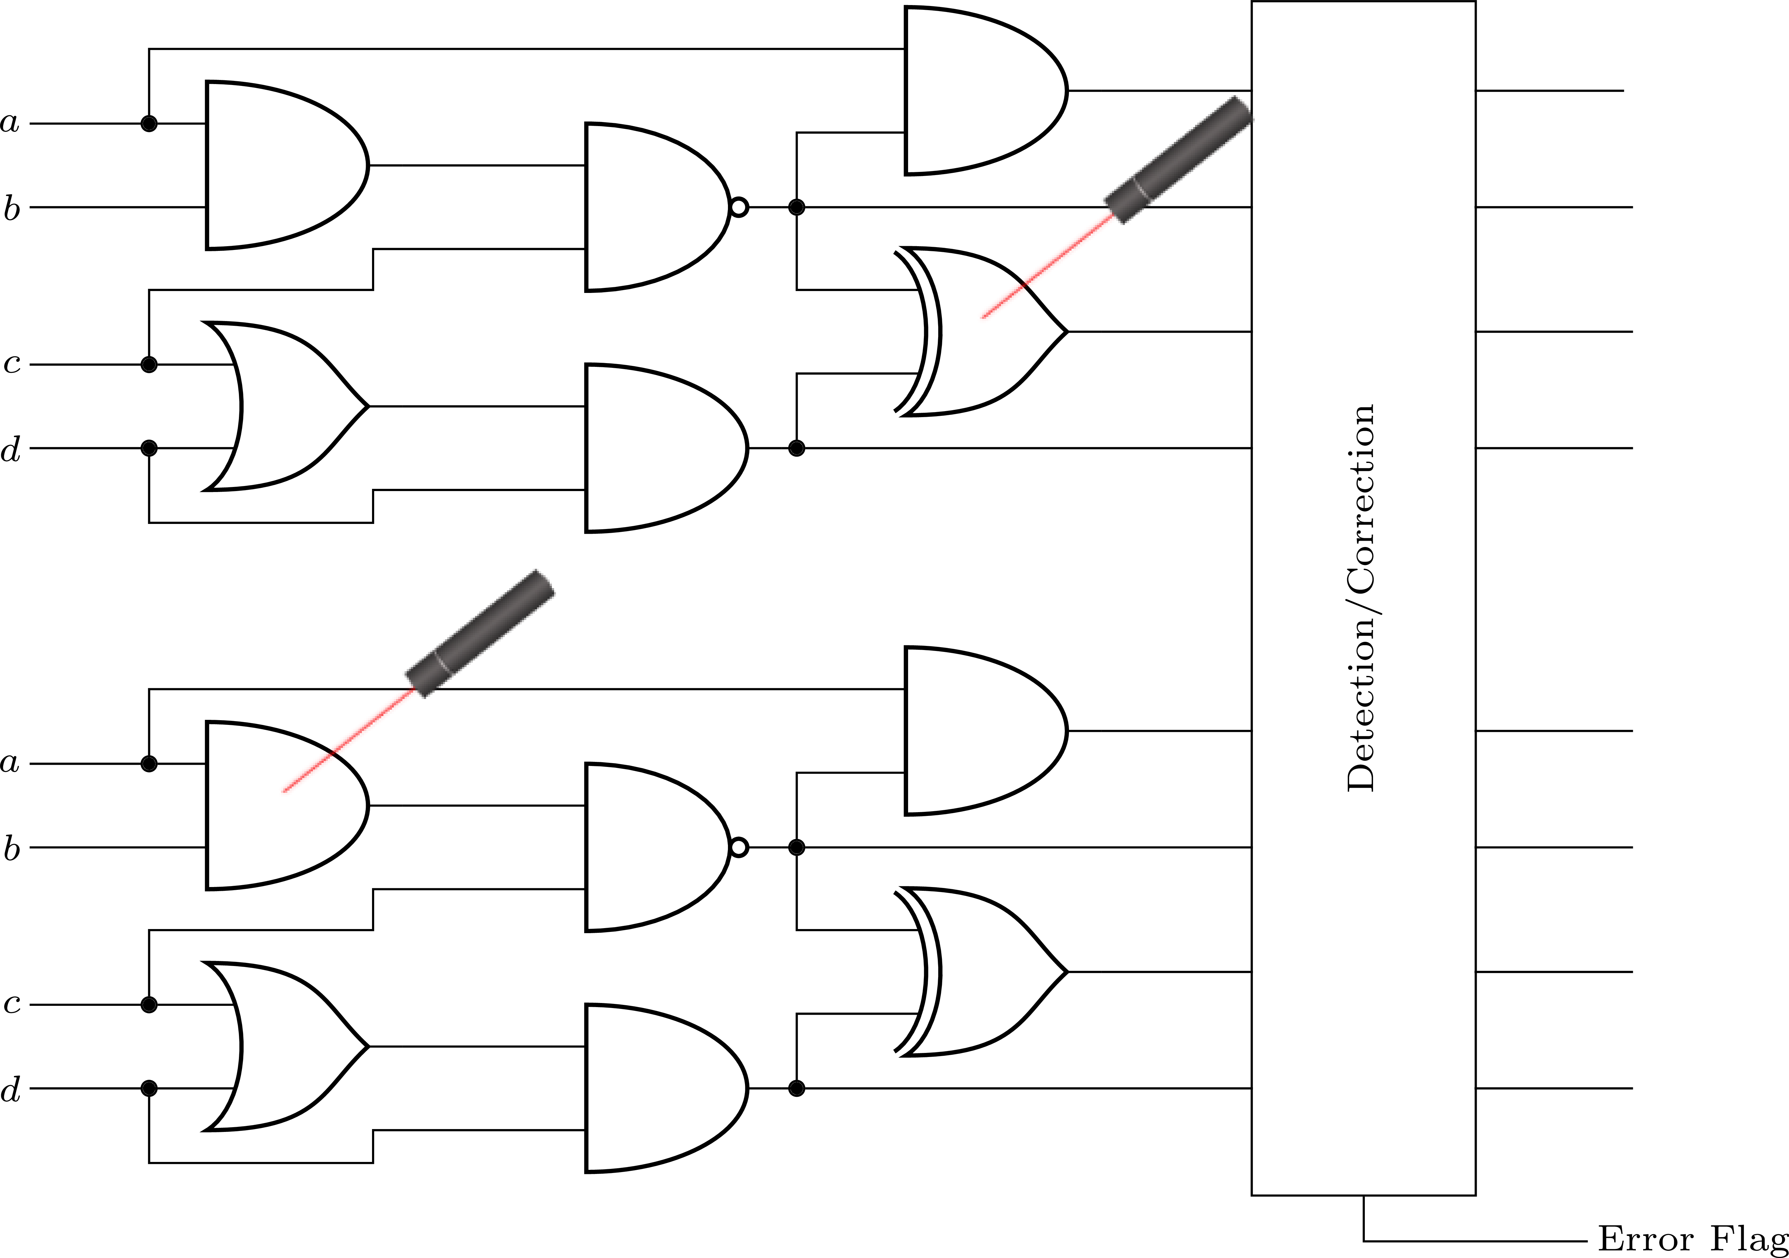
Adversary Models
Side-Channel Attacks
Fault-Injection Attacks
$d$-probing model for SCA [ISW03]
$ζ\left(n,t,l\right)$ model for FIA [RBSG21]
An adversary is given the exact values of up to $d$ wires of a circuit $C$.
An adversary can alter up to $n$ gates defined by the types $t$ in predefined locations $l$.

Slide 4
Countermeasures
Side-Channel Attacks
Fault-Injection Attacks
+
Masking
Duplication
Combined Protection?

Slide 5
Using Gadgets to Construct Secure Circuits
$$a$$
$$b$$
$$x$$
$$c$$
$$d$$
Replace all gates in a target circuit $C$ by secure gadgets with same function
Share inputs and outputs

Slide 6
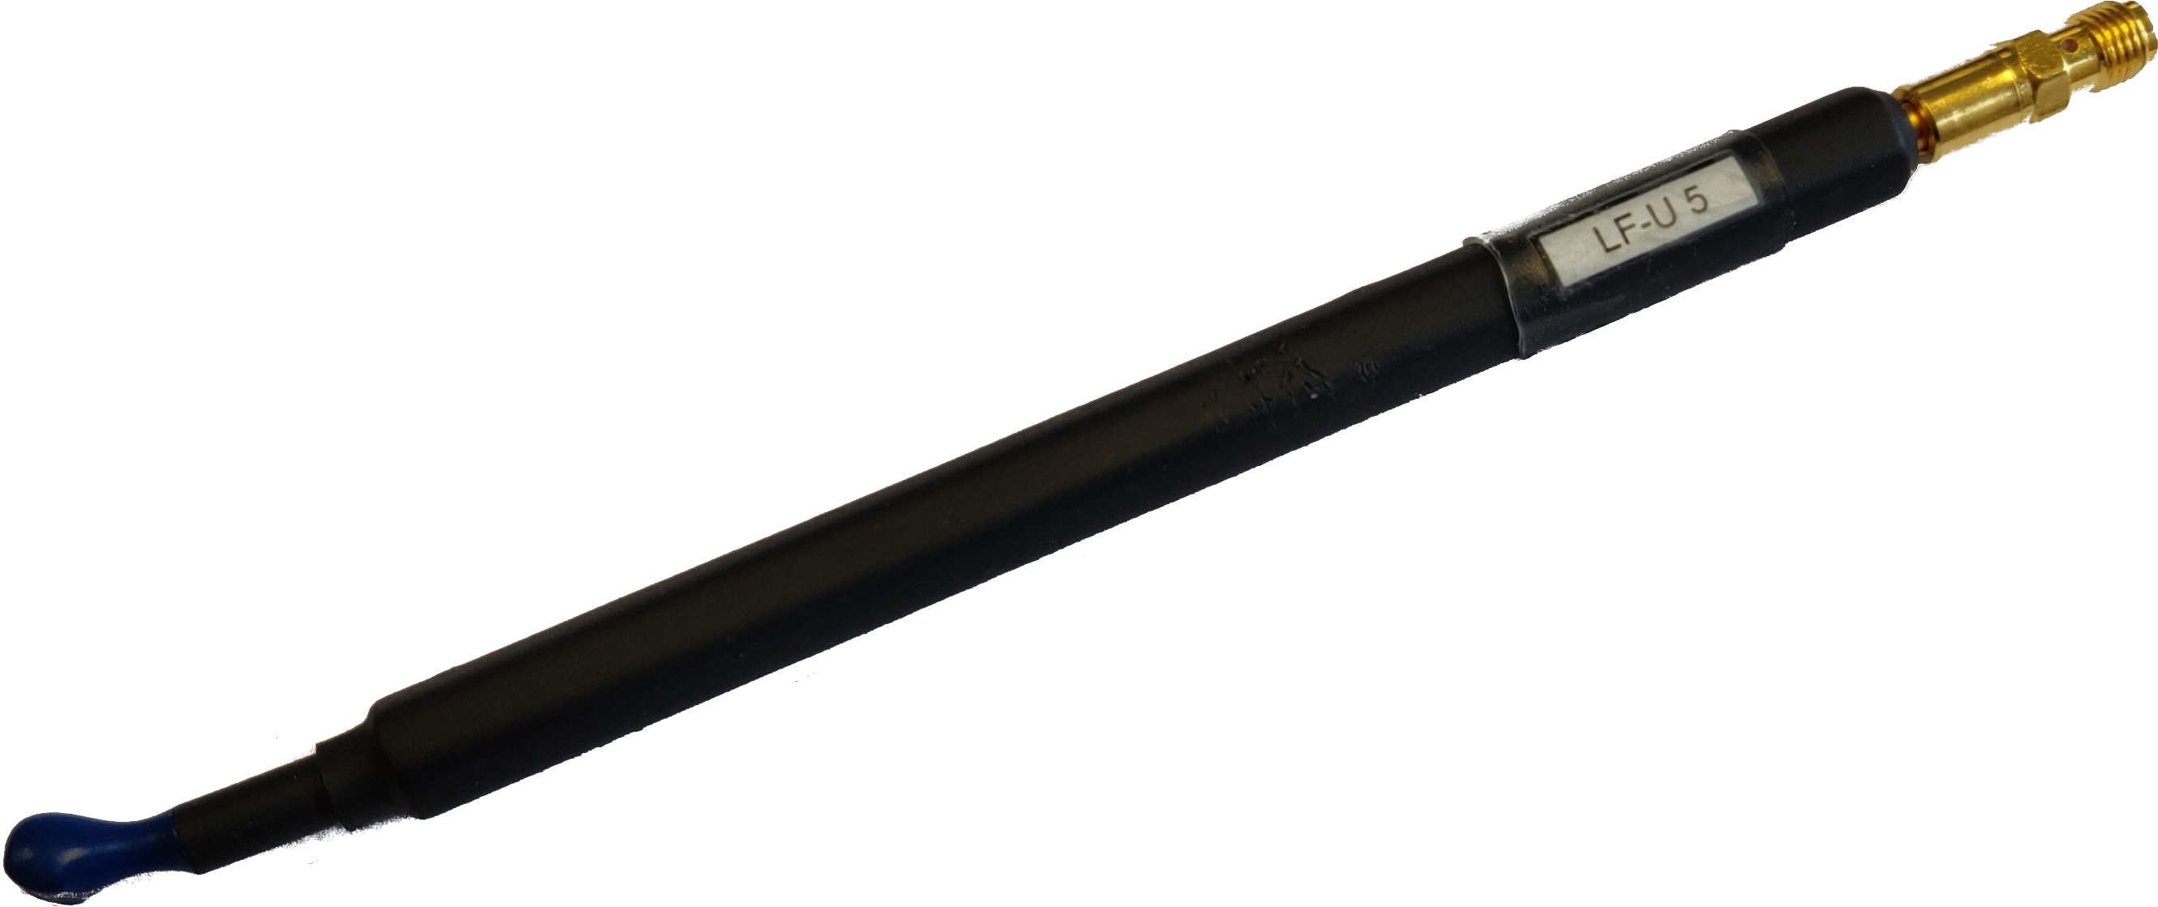
Composability Notions for SCA Gadgets
P-NI [BBD+15]
Probe Non-Interference
P-SNI [BBD+16]
Probe Strong Non-Interference
$$d_{1}$$
$$d_{2}$$
$$d^{′}≤d$$
$$d_{1}+d_{2}≤d$$

Slide 7
Composability Notions for FIA Gadgets
F-NI [DN20]
Fault Non-Interference
F-SNI [DN20]
Fault Strong Non-Interference
$$k_{1}$$
$$k_{2}$$
$$k^{′}≤k$$
$$k_{1}+k_{2}≤k$$

Slide 8
Composability Notions for Combined Gadgets
C-NI [DN20]
Combined Non-Interference
C-SNI [DN20]
Combined Strong Non-Interference
$$k_{1}$$
$$k_{1}$$
$$k_{2}$$
$$k_{2}$$
$$d_{1}$$
$$d_{2}$$
$$d^{′}+k_{1}+k_{2}≤d$$
$$k_{1}+k_{2}≤k$$
$$d_{1}+d_{2}+k_{1}+k_{2}≤d$$
$$k_{1}+k_{2}≤k$$

Slide 9
Composability Notions for Combined Gadgets
C-SNI_{ind} [DN20]
Independent Combined Strong Non-Interference
$$k_{1}$$
$$k_{2}$$
$$d_{1}$$
$$d_{2}$$
$$d_{1}+d_{2}≤d$$
$$k_{1}+k_{2}≤k$$

Slide 10
VERICA
Verification of Combined Attacks

Slide 11
Verification Concept – Combining SILVER & FIVER
SILVER [KSM20]
FIVER [RBRSS+21]
$d$-probing model
(shared) detection
P-NI
SIFA
+
F-NI
P-SNI
PINI
(shared) correction
F-SNI

Slide 12
Verification Concept – Combined Analysis
$(d,k)$-Combined Security (analysis of entire cryptographic primitives )

Slide 13
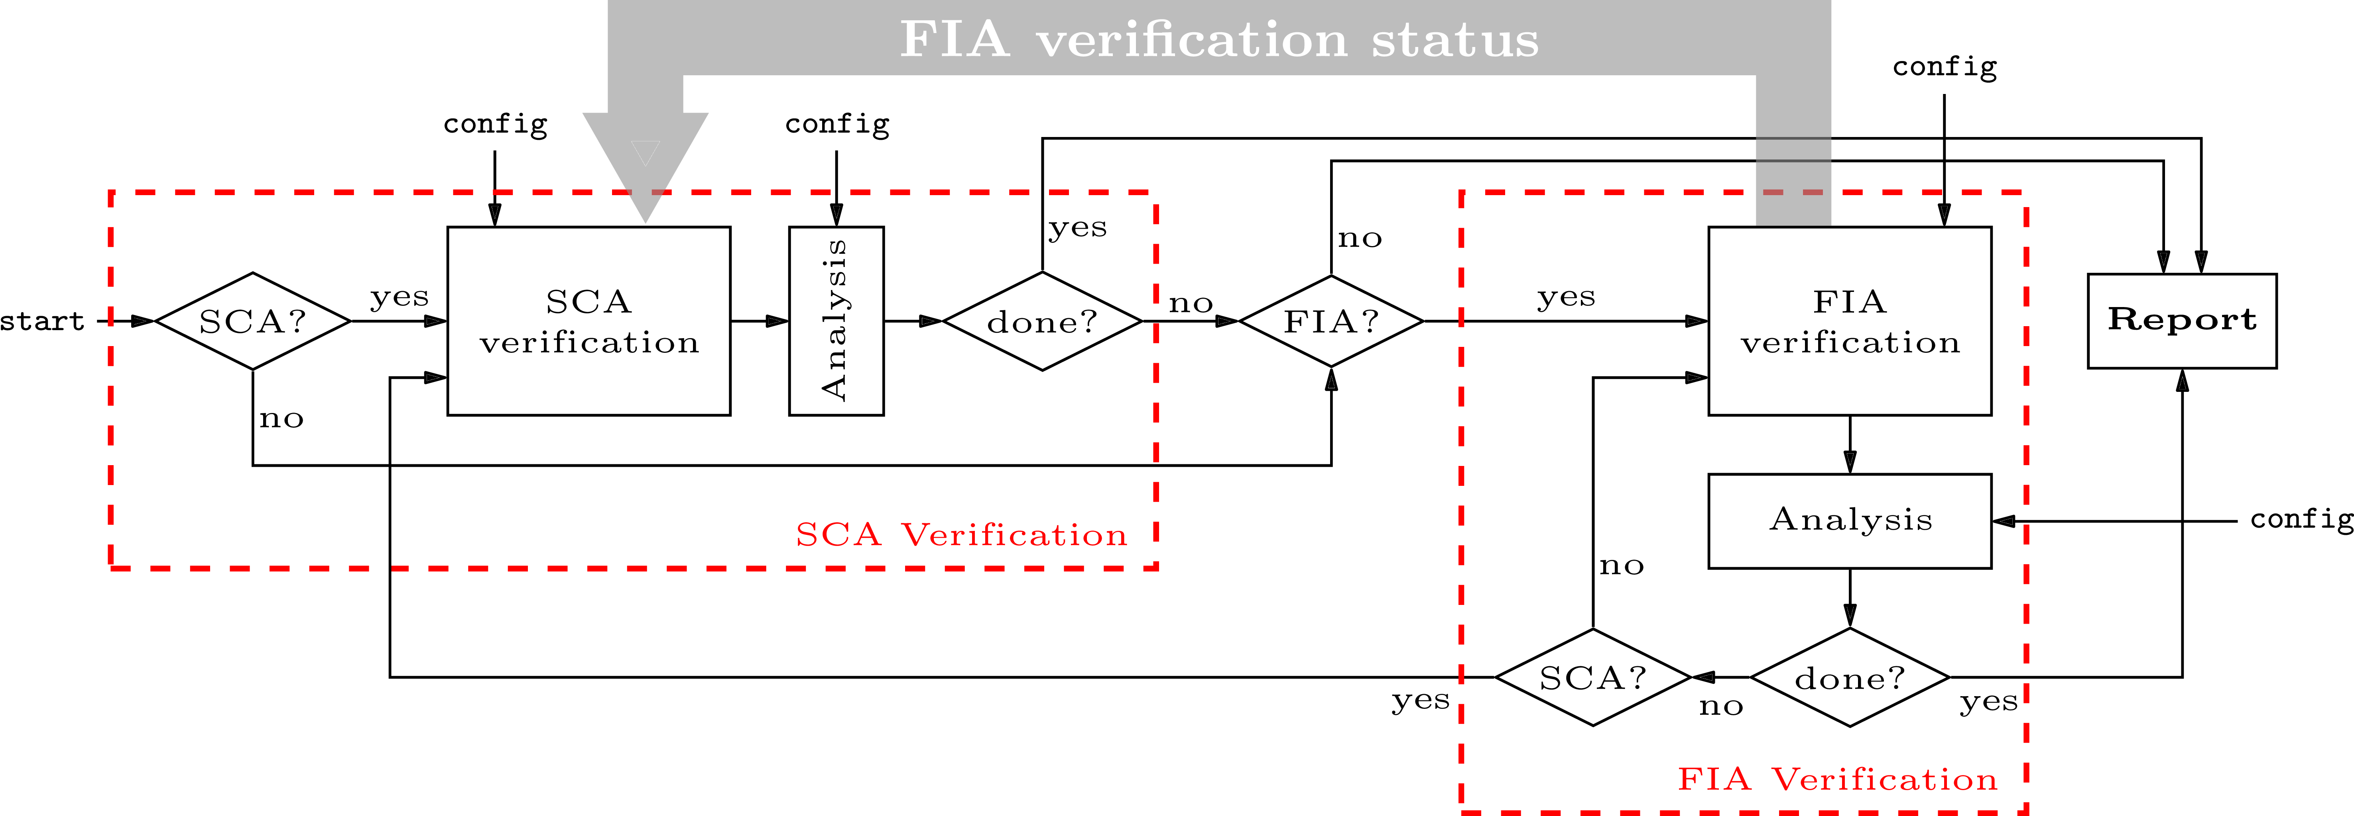
Verification Concept – Combined Analysis
Composability verification (mostly used for gadgets)

Slide 14
Case Study – Analysis of Combined Gadgets [DN20]
NINA
Non-Interference Non-Accumulation
SNINA
Strong Non-Interference Non-Accumulation
SININA
Strong Independent Non-Interference Non-Accumulation
$$+$$
(shared)
$$+$$
(shared)
$$+$$
(shared)
$$×$$
(shared)
$$×$$
(shared)
$$×$$
(shared)
$$×$$
(shared)
$$×$$
(shared)
$$×$$
(shared)
Register
Register
$k+1$-replications
Det.
Det.
Det.
Corr.
Corr.
Corr.
Comp.
Comp.
Comp.
Register
Comp.
Comp.
Comp.
$k+1$-replications
$2k+1$-replications

Slide 15
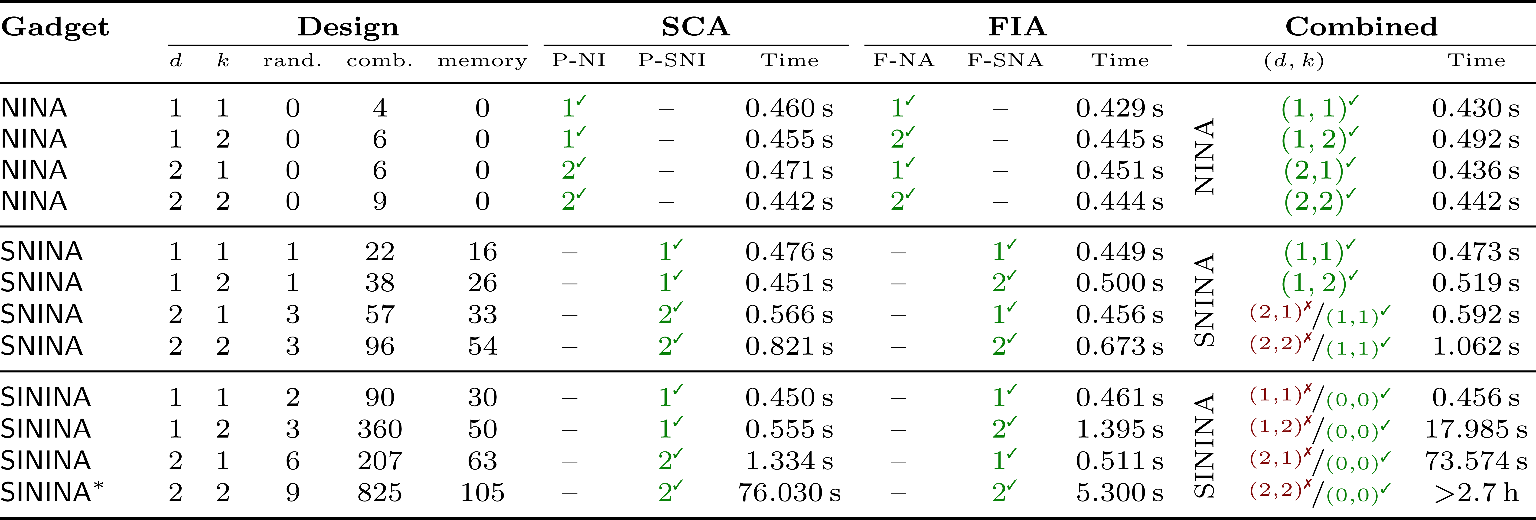
Case Study – Analysis of Combined Gadgets
* Due to the high verification complexity, we interrupted the combined analysis after testing $\left(2,1\right)$-C-SNI_{ind} where VERICA already reported a failure

Slide 16
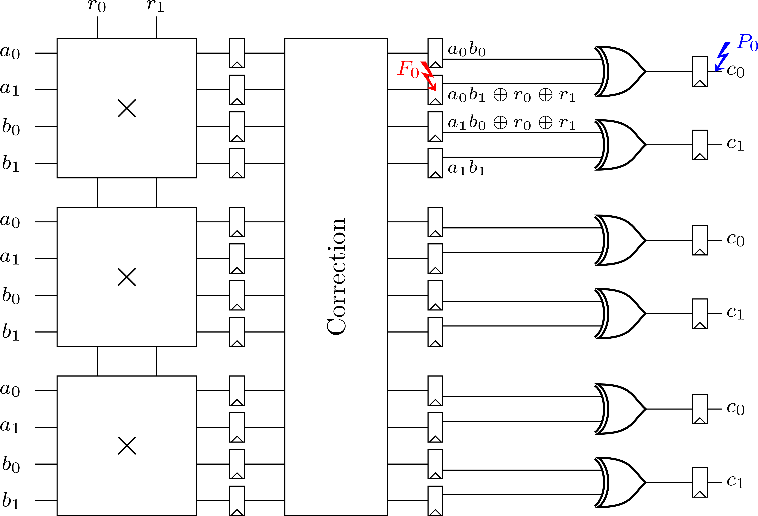
Case Study – Analysis of Combined Gadgets
A fault should not influence the SCA protection
Faulting one input of the compression, reveals one share of each input to an output probe
This violates the SNI notion

Slide 17
Conclusion
VERICA
Security notions for combined attacks
Verification framework VERICA
Detected flaws in existing countermeasures
https://github.com/Chair-for-Security-Engineering/VERICA

Slide 18
Thank you!
jan.richter-brockmann@rub.de

Slide 19
References
[ISW03] | Yuval Ishai, Amit Sahai, and David A. Wagner. Private Circuits: Securing Hardware against Probing Attacks. In Dan Boneh, editor, CRYPTO, volume 2729 of Lecture Notes in Computer Science, pages 463–481. Springer, 2003.
[RBSG21] | Jan Richter-Brockmann, Pascal Sasdrich, and Tim Güneysu. Revisiting Fault Adversary Models - Hardware Faults in Theory and Practice. Cryptology ePrint Archive, Report 2021/296, 2021. https://eprint.iacr.org/2021/296.
[BBD+15] | Gilles Barthe, Sonia Belaïd, François Dupressoir, Pierre-Alain Fouque, Benjamin Grégoire, and Pierre-Yves Strub. Verifi ed Proofs of Higher-Order Masking. In EUROCRYPT, pages 457–485, 2015.
[BBD+16] | Gilles Barthe, Sonia Belaïd, François Dupressoir, Pierre-Alain Fouque, Benjamin Grégoire, Pierre-Yves Strub, and Rébecca Zucchini. Strong Non-Interference and Type-Directed Higher-Order Masking. In SIGSAC, pages 116–129, 2016.
[DN20] | Siemen Dhooghe and Svetla Nikova. My Gadget Just Cares for Me – How NINA Can Prove Security Against Combined Attacks. In CT-RSA, volume 12006 of Lecture Notes in Computer Science, pages 35–55. Springer, 2020.
[KSM20] | David Knichel, Pascal Sasdrich, and Amir Moradi. SILVER – Statistical Independence and Leakage Verification. In ASIACRYPT, volume 12491 of Lecture Notes in Computer Science, pages 787–816. Springer, 2020.
[RBRSS+21] | Jan Richter-Brockmann, Aein Rezaei Shahmirzadi, Pascal Sasdrich, Amir Moradi, and Tim Güneysu. FIVER – Robust Verification of Countermeasures against Fault Injections. IACR Trans. Cryptogr. Hardw. Embed. Syst., 2021(4):447–473, Aug. 2021.
[HPB21] | Vedad Hadzic, Robert Primas, and Roderick Bloem. Proving SIFA protection of masked redundant circuits. In Automated Technology for Verifi cation and Analysis, volume 12971 of Lecture Notes in Computer Science, pages 249–265. Springer, 2021.
[DDE+20] | Joan Daemen, Christoph Dobraunig, Maria Eichlseder, Hannes Groß, Florian Mendel, and Robert Primas. Protecting against Statistical Ineff ective Fault Attacks. IACR Trans. Cryptogr. Hardw. Embed. Syst., 2020(3):508–543, 2020.
[SMG16] | Tobias Schneider, Amir Moradi, and Tim Güneysu. ParTI - Towards Combined Hardware Countermeasures Against Side-Channel and Fault-Injection Attacks. In CRYPTO 2016, volume 9815 of Lecture Notes in Computer Science, pages 302–332. Springer, 2016.

Slide 20
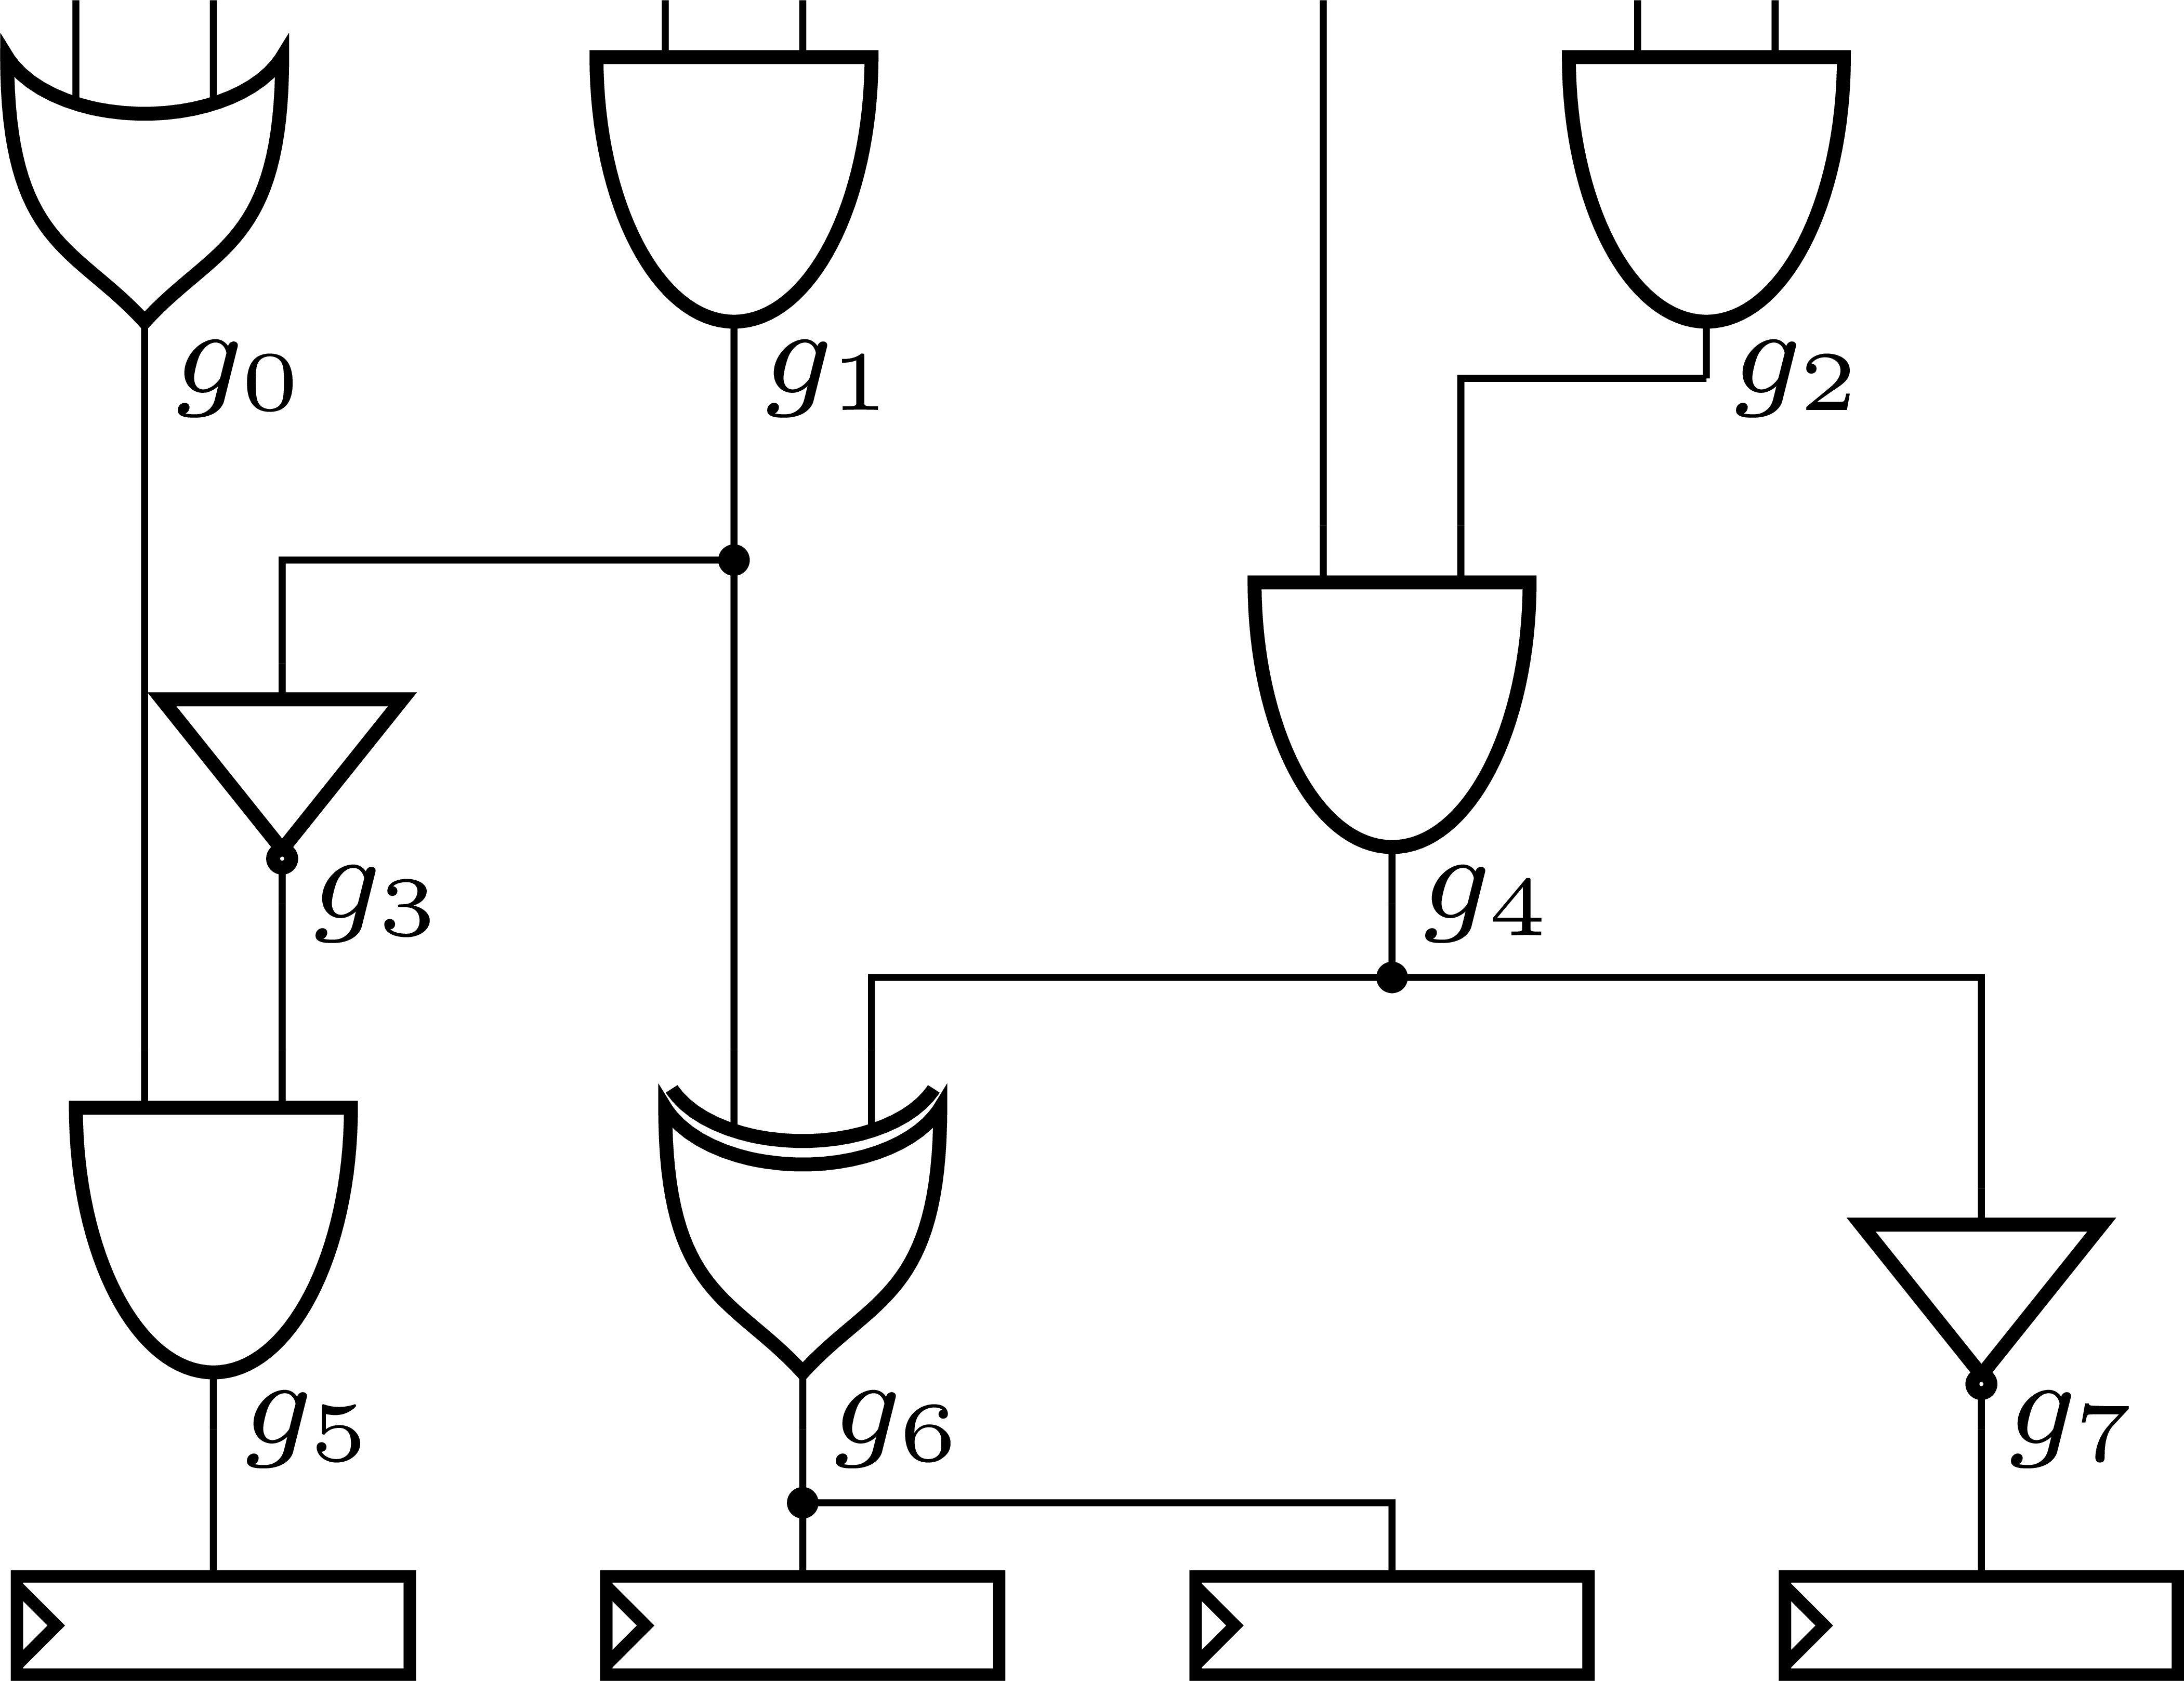
Verification Concept – Circuit Model
Gate-Level Netlist
Directed Acyclic Graph (DAG)
Binary Decision Diagram (BDD)
IN
IN
IN
IN
IN
IN
IN
$$y$$
$$x_{0}$$
OR
AND
AND
1
INV
AND
0
$$x_{1}$$
AND
XOR
INV
0
1
$$x_{2}$$
REG
REG
REG
REG
0
1
OUT
OUT
OUT
OUT
0
1

Slide 21
Case Studies II – Analysis of Toffoli Constructions [DDE+20]
$$p_{TS}\left(a_{0}, a_{1}, b_{0}, b_{1}, c_{0}, c_{1}\right)↦ \{ a_{0}⊕ \left(b_{0}⋅ c_{1}\right)⊕ \left(b_{0}⋅ c_{0}\right), a_{1}⊕ \left(b_{1}⋅ c_{1}\right)⊕ (b_{1}⋅ c_{0}) ,b_{0}, b_{1}, c_{0}, c_{1}\}$$
$$p_{χS}\left(a_{0}, a_{1}, b_{0}, b_{1}, c_{0}, c_{1}\right)↦ \{a_{0}⊕ \left({\overline{b}}_{0}⋅ c_{1}\right)⊕ \left({\overline{b}}_{0}⋅ c_{0}\right), a_{1}⊕ \left(b_{1}⋅ c_{1}\right)⊕ (b_{1}⋅ c_{0}),b_{0}, b_{1}, c_{0}, c_{1}\}$$
→ All designs meet their claimed protection
→ The AES S-boxes are only secure in the standard $d$-probing model (designed for software)

Slide 22
Case Studies III – Analysis of ParTI [SMG16]
Threshold Implementations + Linear Error Correction Codes
→ The countermeasure is not designed to resist simultaneous performed attacks
→ Demonstrates the evaluation of $(d,k)$-combined security

