Slide 1








PreMSat: Preventing Magnetic Saturation
Attack on Hall Sensors
Autonomous and Intelligent
Cyber-Physical Systems Laboratory
Anomadarshi Barua, Mohammad Abdullah Al Faruque
Department of Electrical Engineering and Computer Science,
University of California, Irvine (UCI), USA.
Notes:
HI everyone I am Anomadarshi barua from UC Irvine. I am going to present one of our works today. Our work is related to a defense methodology for next generation hall sensors. We name our work as PreMSat which has a full form Preventing Magnetic Saturation Attack on Hall Sensors

Slide 2
Outline
Market growth, basics, and vulnerability of Hall sensors
Saturation attack model and lack of work along this direction
Defense against the saturation attack - PreMSat
Prototype, justification, and evaluation of our defense PreMSat
Limitations
Notes:
Before going to present our main work, I want to give an outline of this presentation first. (click) we will start our presentation giving a generalized view of hall sensors indicating their operational basics, market growth and vulnerability in detail. (click) Next, we will define the saturation attack and motivate you about the importance of our work by indicating the lack of work along this direction. (click)After that we will start explaining our defense Premsat. (click) We will also present a prototype of our defense with proper justification and evaluation. (click) and At the end, we will conclude our presentation indicating the limitations of our defense
Now we are going to start by giving the market growth of hall sensors

Slide 3
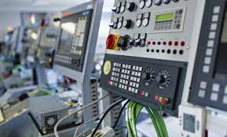


Hall Sensors Market Growth in Safety critical Systems
Hall sensor market size is expected to grow from USD 831 million in 2016 to USD 1473.7 million by 2023, at a CAGR of 8.4%
Major Components
  Industrial controllers
  Power systems
  automotive
  Aircraft, etc.
Summary: Hall sensors are pervasive in many safety-critical systems
Notes:
At the very beginning, lets give some foundational knowledge on economic growth of hall sensors in todays market. Hall Sensors are so abundant, prevelant in todays safety critical systems. Hall Sensors are everywhere. It has been estimated that hall Sensors market size is expected to grow from USD 831 million in 2016 to USD 1473 million by 2023. (click)We can find hall sensors in industrial controllers, (click) in power systems, (click) in automotive industry and (click)aircrafts. therefore hall sensors are pervasive and works as ears and eyes of many safety critical systems. And therefore the security of hall sensors is really important

Slide 4
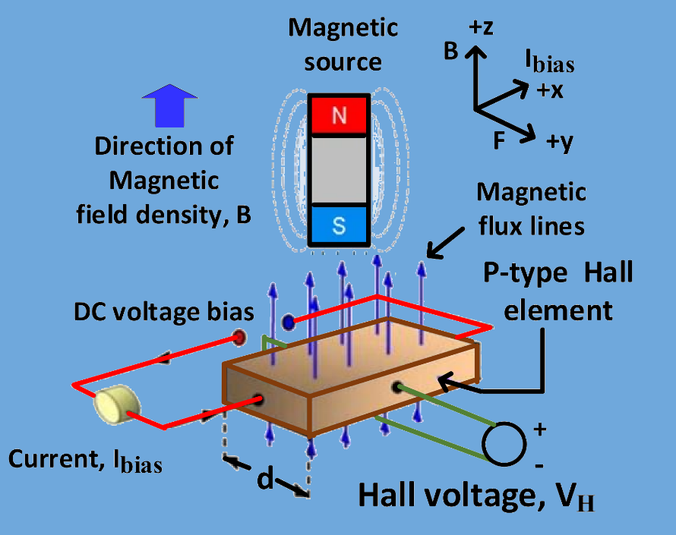
Hall Sensor Basics
Hall sensors physics
Hall sensors electronics
Hall sensors transfer curve
Notes:
In this slide we will discuss different components of hall sensor hardware in general. We will start from the hall sensor physics.
As we can see from this figure (click) the main component of the hall sensor is the hall element. This hall element is typically is a p-type semiconductor. A DC voltage bias is applied across the Hall element that causes (click) a bias current, Ibias flowing through the Hall element A magnetic field (click) is also applied on the hall element in a perpendicular direction of the bias current. Because of this perpendicular presence of the bias current and magnetic field, a voltage will be generated across the hall element (click). This voltage is known as hall voltage. The generated hall voltage is proportional to the magnetic field.
(click)Next, we will discuss what other electronics hall sensors have in addition to a hall element. The output of the Hall element is given to a signal conditioning block, (click) which has a differential amplifier. The differential amplifier amplifies the Hall voltage and also removes the common-mode noises from the Hall voltage. (click) A regulator is also used to provide supply voltage and stable bias current to the hall sensor.
(click) Next we discuss the linear and saturation region of the hall sensor using its transfer curve. The output (click) of the differential amplifer (click) is linear within a certain region. (click) This is known as the linear region of the sensor. Sensors operate in this linear region. The sensor output voltage begin to flat (click) when the supply voltage (click) limits are reached. (click)This flattened region is known as the saturation region. In this saturation region, no information can be recovered.
regionFor example, a microphone has diaphragm as sensing structure. This sensing structure measures physical quantities and stimulus signals coming from the surrounding environments. These measured physical quantities are then converted into a usable electrical signal that passes through amplifiers, filters, ADCs and eventually arrives in the main connected systems.
It is clear from this discussion that there is no hardware/software firewall present between the sensor and the system interface. Therefore this could be an entry point of an attacker. A smart attacker can noninvasively inject fake signals into sensors by using a suitable spoofing technique. The injected fake signals can eventually propagate from sensors to the underlying system controller and cause system failure resulting in denial-of-service (DoS) attacks on connected systems.

Slide 5




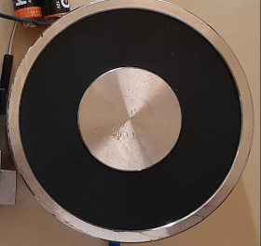
Attack Model: Saturation Attack
No Security in hall sensor-hardware
Low-cost electromagnet
Notes:
In this slide we will discuss the vulnerability of hall sensor hardware and also define the attack model. As we can see from this figure the main component of a hall sensor is the (click) hall element. The output from the hall element passes through (click) differential amplifiers, (click)filters, (click)ADCs and eventually arrives in the main (click)connected systems.
It is clear from this discussion that there is no hardware/software firewall present between the sensor and the system interface. Therefore this could be an entry point of an attacker. A smart attacker can noninvasively (click) inject fake external signals into sensors by using (click) a simple low cost electromagnet. The injected fake signals can eventually (click) spoof the hall sensor in its (click)linear region or drive the sensor to its (click)saturation region. We name this as the saturation attack. In this saturation region, no information can be recovered and the sensor faces a denial-of-service (DoS) attacks.

Slide 6
No Work Can Prevent Saturation Attack
Paper | Year | Sensor type | Sensor | Defense technique | Research challenge
Barua et al., USENIX | 2020 | Magnetic | Hall | Shielding | Not scalable, bulky, not for saturation
Shoukry et al., CHES | 2013 | Magnetic | Hall | PyCRA | Can be bypassed, not for saturation
Wang et al., Black Hat | 2017 | Inertial | Accelerometer & Gyroscope | Noise cancellation | Not for in-band signal, not for saturation
Son et al., USENIX | 2015 | Inertial | Gyroscope | Sound wave | Not for in-band signal, not for saturation
Trippel et al., Euro S&P | 2017 | Inertial | Accelerometer | Randomized and 180 phase sampling | Not for in-band signal, not for saturation
Tu et al., USENIX | 2018 | Inertial | Accelerometer & Gyroscope | LPF and dampening | Not for in-band signal, not for saturation
Bolton et al, S&P | 2018 | Inertial | Shock sensor | Sensor fusion | Costly, redundant, not for saturation
Barua et al., CCS | 2022 | Pressure | Pressure sensor | LPF | Not for in-band signal, not for saturation
Tu et al., Asia CCS | 2021 | Pressure | Pressure sensor | Transduction shield | Finite physical distance, not for saturation
Park et al., USENIX | 2016 | Optical | Optical sensor | PyCRA | Can be bypassed, not for saturation
Davidson et al., USENIX | 2016 | Optical | Camera and Lidar | Modified optical flow algorithm | Not applicable, not for saturation
Shin et al., CHES | 2017 | Optical | Lidar | Sensor fusion, redundancy | Costly, not for saturation
Zhang et al., CCS | 2017 | Acoustic | Microphone | Noise cancellation | Not for in-band signal, not for saturation
Yan et al., DEFCON | 2016 | Acoustic | Ultrasound | Acoustic noise reduction (ANR) | For acoustic only, not for saturation
.
Notes:
We already define the saturation attack in the last slide. Now we are going to motivate you about the importance of our work by indicating the lack of work along this direction. There have been quiet a few works on sensor defense over last 6 years. This table indicates the list of those work. If you observe this table, you can see that (Click) no work exists to prevent a saturation attack on Hall sensors. People are using (click) different shielding and filtering techniques to prevent the spoofing in the linear region, but none of them actually prevent the sensor from going into the saturation. The reason behind this these filtering occurs as post processing after the sensor sense the data. Therefore, if sensor is already in the saturation, no amount of post processing after the fact can actually help. So we need a defense that can work before the post processing of the sensed data.

Slide 7

Defense Methodology: Preventing Magnetic Saturation (PreMSat)
Defense Methodology:
1. Will not allow the sensor to go to the saturation.
2. Will provide the same amount of internal magnetic field in opposite polarity to nullify the injected fake magnetic field.
Same amount of internally generated magnetic field with opposite polarity
Injected fake external magnetic field
Nullification of the injected external fake signal
Notes:
Now we are going to discuss how our defense work against the saturation attack before the post processing of the sensor data. The main strategy (click) is we will not allow the hall sensor to go into its saturation region. The next question comes how will we ensure that the hall sensor will not go into its saturation region? (click)We will ensure this by providing the same amount of internal magnetic field in opposite polarity to nullify the injected fake external magnetic field. This is explained with an animation. (click)As you see this animation, if we can provide the same amount of internal magnetic field to the sensor in right direction, it can nullify the external fake signal. This will prevent the sensor from going into the saturation region.

Slide 8
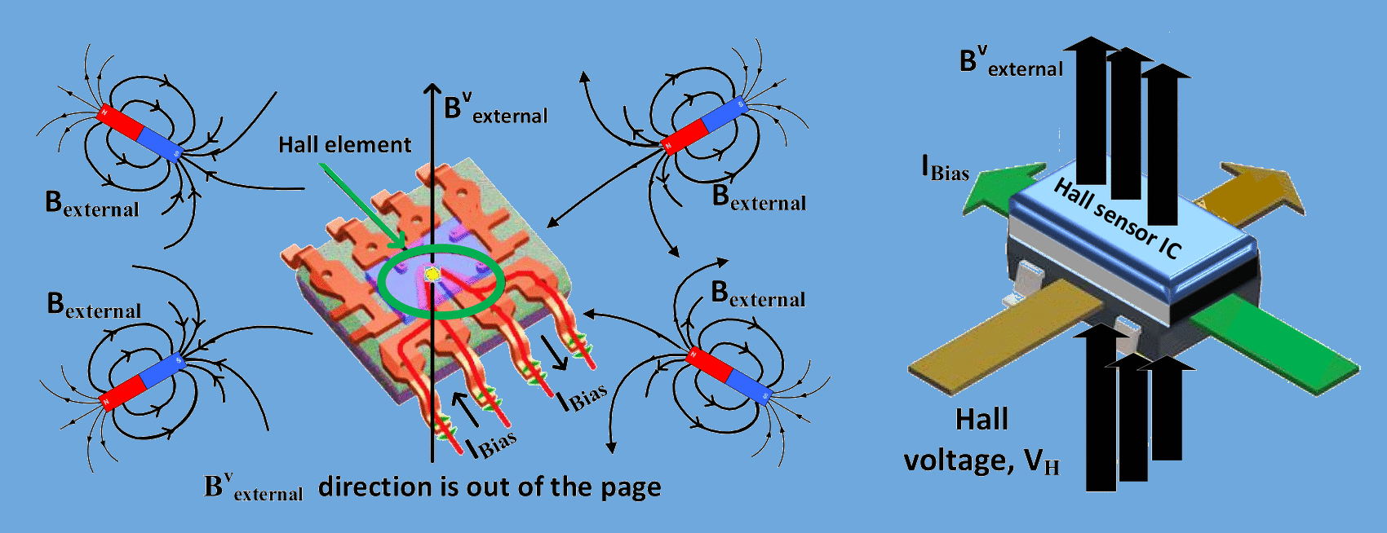

Contributing Direction of the External Fake Magnetic Field
Not all component of the external fake magnetic field can influence the Hall sensor
The vector summation of all the vertical components of the external fake fields can only influence the Hall sensor. This is called by B^{v}_{external}
Hall sensors physics
Notes:
Now we explain in which direction we need to generate the internal magnetic field to nullify the external fake magnetic field. We need to remember that (click) not all component of the external fake magnetic field can influence the Hall sensor. (click) only the vector summation of all the vertical components of the external fake fields can only influence the Hall sensor. This is called by B^{v}_{external .} (click)Lets explain this with this figure. (click) According to Lorentz Force, the Hall voltage is only sensitive to magnetic fields B, which is perpendicular to bias current IBias. Therefore (click) If there is one or multiple magnetic sources are present for the attack, the hall element is only sensitive (click) to the vector summation of all the vertical components of the external fake fields which is shown here with the blinking arrow.

Slide 9
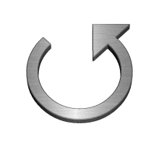

Toroidal Core Structure to Nullify Attack Magnetic field
Target Hall sensor
Secondary sensor
Toroid
Primary coil
Blue: Injected external magnetic field B^{v}_{external}
Gray: Internally generated magnetic field B_{internal}
Notes:
Now we know from the previous slide the vertical component can influence the hall sensor. To collect this vertical component from the external magnetic fields, we use a low-resistance (click) circular toroidal magnetic path made with ferrite core and we place the target hall sensor within (click) the gap of the toroid. We use a primary coil (click) wrapped on the same toroid to generate the internal magnetic field to nullify the vertical component of the fake external field. This concept is explained here with this animation (click). If you notice here the blue one is the fake external field inside of the toroid. And the gray one is the internally generated magnetic field by the primary coil which has same strength and in opposite direction of the blue one. Therefore, the gray one is nullifying the blue one inside of the toroid. In this way the external fake field can be nullified with the internal field using our defense Premsat. (click) the right figure is the physical implementation of the toroid with the primary coil.

Slide 10
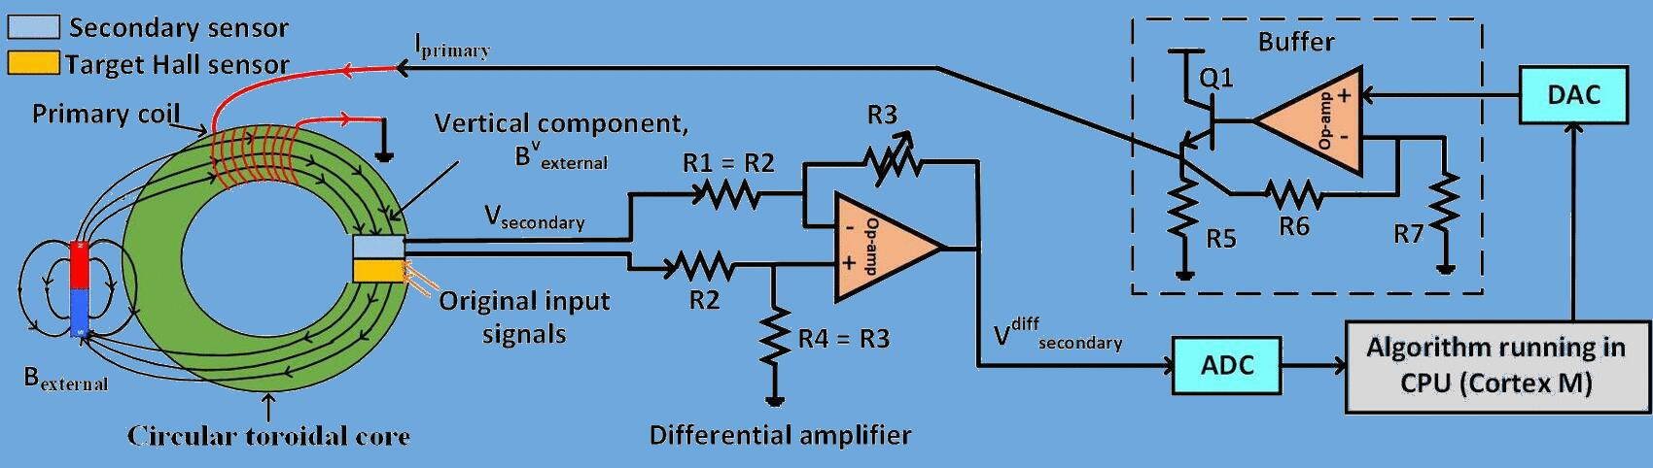
Different Blocks of PreMSat
Different blocks of PreMSat
Notes:
Now we explain the different blocks of our defense in detail. The circular toroidal core (click) is already explained in the last slide. The toroid also (click) host a secondary sensor to sense the magnetic field present inside of the toroid. The output from the secondary sensor(click)(click) is amplified and noise cancelled using a differential amplifier. Next the signal (click)(click) from the differential amplifier is digitized using an ADC and feed into a CPU. The cpu actually runs an algorithm which generates a digital signal to nullify the magnetic field present inside of the toroid. This digital signal from the CPU (click)(click) is converted into an analog signal using a DAC and feed into (click)(click) the primary coil using a power buffer. Next (click) the primary coil generates the internal field inside of the toroid to nullify the fake field present. The nullification process already is explained in the last slide.

Slide 11
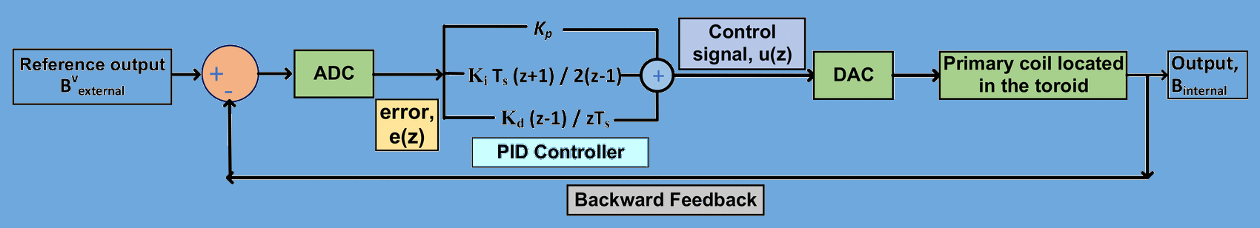
PID Controller Running on CPU
Minimize the error
PID controller used in PreMSat
Notes:
Now we discuss the algorithm which runs on the CPU. The algorithm is a PID controller. The pid controller (click) takes the fake external field as the reference signal. (click) (click)The kp, Ki and kd constants of the PID controller are chosen in a way to have the fast response time. the PID controller is implemented in the z-domain instead of the s-domain or continuous-time domain to make the pid controller more stable and deterministic with fast response. The output from the PID controller is (click) (click) converted into an analog signal using a DAC that is fed into the primary coil. (click)(click) Next the generated internal field is again provided as a feedback to minimize the error between the external and internal field. (click)This iteration continues until the internal field is equal to the external fake field with a minimum error. In this way, the pid controller ensures that the generated internal field has the same strength as the external fake field to nullify the external fake field completely.

Slide 12
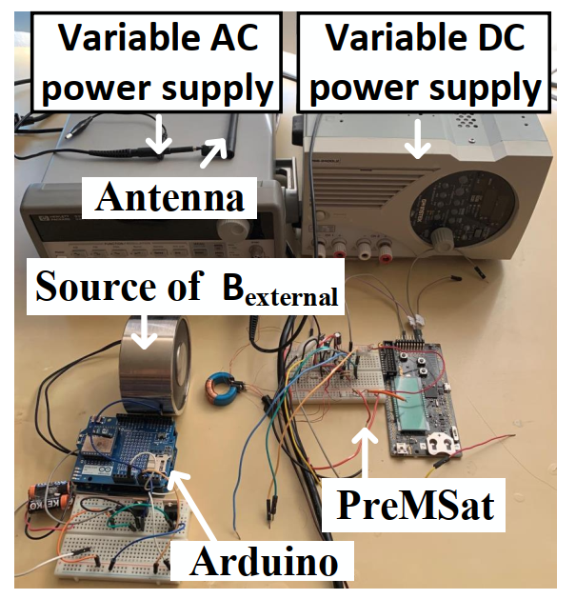
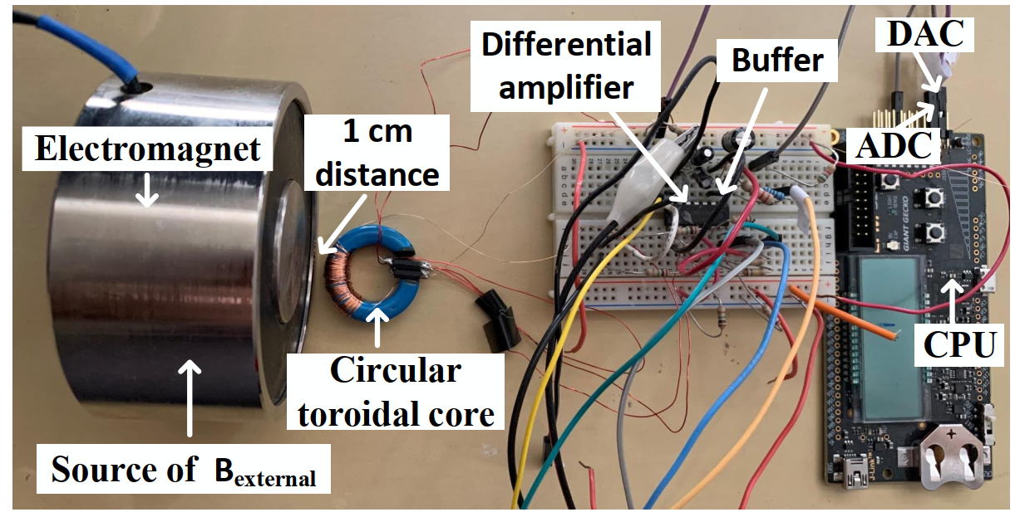
Prototype and Testbed to Evaluate PreMSat
Prototype of PreMSat
Testbed to evaluate PreMSat
Notes:
In this slide we discuss the prototype and the testbed to evaluate our defense premsat. (click) we use a strong electromagnet as the source of the external fake field. (click)(click) a Mn-Zn soft ferrite is used as the toroid core in our prototype. (click)(click) we also use a low-power op-amp as for the differential amplifier. (click)(click) an EFM-32 Giant Gecko development board from Silicon Labs is used as the CPU to run the PID controller algorithm for our defense. (click)(click) we use an Arduino board to control the external fake magnetic field generated by the strong electromagnet in our testbed. (click)(click) and an antenna is also used to inject EMI interreference into the prototype in our testbed.

Slide 13
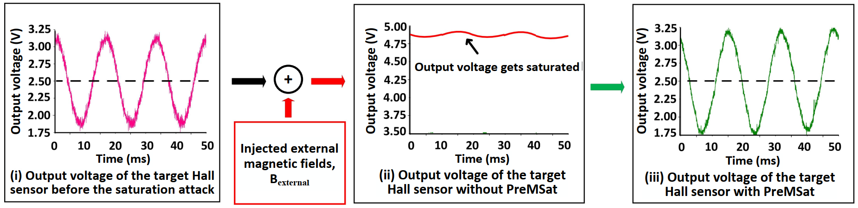
Justification of PreMSat
Measuring Correlation Coefficient as Performance metric = ~ 1
Output signal before any attack
Output signal after attack without PreMSat
Output signal after attack with PreMSat
Notes:
In this slide we will justify the effectiveness of our defense premsat against the saturation attack. (click) the first figure is the output from the hall sensor before any attack happens. And (click) the second figure is the output after an attack happens. You can see that the output of the target Hall sensor is driven to its saturation voltage close to 4.8 V after the saturation attack resulting in a flattened output signal. Next we integrate our defense premsat with the hall sensor. The output signal (click) after the attack when we use premsat is shown in the third figure. Next (click) we measure the similarity between the output signal before the attack and after the attack when our defense is present using the correlation coefficient. We find that the correlation coefficient between this two signals is close to 1. this indicates that the output signal is not perturbed even after the attack when we use our defense. This gives justification of our proposed defense against the saturation attack.

Slide 14
Testing Different Hall Sensors with PreMSat
Tested within the entire frequency range of 10 different Hall sensors from 4 different manufacturers
Tested with different strength of external fake magnetic fields B^{v}_{external}
SL | Part# | Frequency range of input signal | Avg. C | Strength of the injected field | Avg. C
1 | ACS718MATR-20B | 0 Hz–40 kHz | 0.94 | 0 A-t–4200 A-t | 0.95
2 | ACS710KLATR-10BB | 0 Hz–120 kHz | 0.94 | 0 A-t–4200 A-t | 0.94
3 | ACS715ELCTR-20A | 0 Hz–80 kHz | 0.96 | 0 A-t–4200 A-t | 0.97
4 | ACS724LLCTR-10AU | 0 Hz–120 kHz | 0.96 | 0 A-t–4200 A-t | 0.95
5 | LTSR 6-NP | 0 Hz–100 kHz | 0.94 | 0 A-t–4200 A-t | 0.94
6 | LV 25 P | 0 Hz–25 kHz | 0.95 | 0 A-t–4200 A-t | 0.95
7 | DRV5053OA | 0 Hz–20 Hz | 0.96 | 0 A-t–4200 A-t | 0.96
8 | SS49/SS19 | 0 Hz–30 Hz | 0.97 | 0 A-t–4200 A-t | 0.97
9 | SS39ET | 0 Hz–40 Hz | 0.95 | 0 A-t–4200 A-t | 0.96
10 | SS494B | 0 Hz–30 Hz | 0.96 | 0 A-t–4200 A-t | 0.94
Notes:
This slide present the result after evaluating the defense premsat with ten different hall sensors from four different manuacturers. (click) we tested premsat within the entire frequency range of 10 different hall sensors. you can see the similarity or the correlation coefficient is close to 1 when we use our defense. This proves that our defense premsat works within the entire frequency range of the hall sensors. (click)(click) next we test our defense premsat against different strength of the external fake magnetic fields. You can see our defense works upto 4200 A-t which is really a strong field and maintain a correlation coefficient close to 1. as we tested our defense for 10 different hall sensors, it supports the generality of our defense.

Slide 15
Comparing PreMSat with a Ferromagnetic Shield
Increase of shield thickness provides better shielding
Shield can be saturated at high magnetic field. Therefore, its shielding property gets diminished
PreMSat provides good defense compared to shield against strong magnetic field B^{v}_{external}
SL | Part# | C (0.3 in. thick) | C (0.5 in. thick) | C (1 in. thick) | C (PreMSat only)
1 | ACS718MATR-20B | 0.20 | 0.26 | 0.37 | 0.94
2 | ACS710KLATR-10BB | 0.14 | 0.21 | 0.31 | 0.96
3 | ACS715ELCTR-20A | 0.19 | 0.27 | 0.36 | 0.97
4 | ACS724LLCTR-10AU | 0.27 | 0.35 | 0.39 | 0.95
5 | LTSR 6-NP | 0.28 | 0.39 | 0.41 | 0.97
6 | LV 25 P | 0.13 | 0.28 | 0.38 | 0.94
7 | DRV5053OA | 0.33 | 0.39 | 0.42 | 0.96
8 | SS49/SS19 | 0.10 | 0.21 | 0.32 | 0.96
9 | SS39ET | 0.15 | 0.29 | 0.35 | 0.95
10 | SS494B | 0.25 | 0.32 | 0.37 | 0.94
Notes:
Now we are going to compare our defense with a ferromagnetic shield. This will answer the question whether our defense is better than shielding. (click) we know that the increase of the shield thickness provides better shielding. Therefore (click) we vary the shield thickness from 0.3 inch to 1 inch and measure the correlation coefficient for every sensor. We can see that even 1 inch shield cannot prevent a strong magnetic field. It is evident from the value of correlation coefficient which are less than 0.5. Because (click) Shield gets saturated at high magnetic field. Therefore, its shielding property gets diminished. Next (click)(click) when we use premsat only, we can see that the correlation coefficient is close to 1. (click) This indicates that premsat is more effective than a shield.

Slide 16
Limitations
PreMSat consumes 0 - 3 W power while generating a strong internal field
Non-zero settling time 23 μs of the PID controller contributes to the real-time requirement of the defense
Non-zero (<1%) steady-state error of the PID controller adds error in the output
Upper limit strength of the prototype~ 4200 A-t MMF
Upper limit frequency ~ 30kHz
Notes:
Now we discuss on the limitations of our defense PreMSat. These limitations exists because of the practical limitation of the hardware, not for the design methodology. (click) PreMSat consumes 0 - 3 W power while generating the strong internal field. This power consumption may be small for some applications, such as solar inverters and automotives, but may be substantial for few applications, such as proximity detection and position sensing. (click) Non-zero settling time 23 μs of the PID controller contributes to the real-time requirement of the defense. Therefore, if the attacker changes the injected fake magnetic fields within 23 μs, the timeliness of the defense may not be guaranteed. (click) In spite of the fine-tuning, the PID controller has a non-zero <1% steady-state error, which may add small error to the internal field while nullifying external fake magnetic field. (click) Our prototype can prevent an external magnetic fieldup to an MMF of 4200 A-t. this limit can be theoretically increased to any value using a stronger buffer. (click) Our prototype can prevent the external magnetic field up to a frequency of ∼30 kHz. This upper limit results from the total time required to generate the internal magnetic field. This time can be reduced further using a faster CPU having a clock frequency higher than 48 MHz

Slide 17
Work Summary
Introduce the saturation attack and lack of work along this direction
Provide a defense against the saturation attack for Hall sensors
Provide a prototype, justification, and evaluation of our defense
Provide limitations of our defense
Notes:
We are close to the end of our presentation. Now we provide a summary of our work. (click) We introduce the saturation attack model and lack of work along this direction. (click) We provide a defense against the saturation attack for Hall sensors. (click) We provide a prototype, justification, and evaluation of our defense. And (click) we also provide limitations of our defense.

Slide 18

Questions
Autonomous and Intelligent
Cyber-Physical Systems Laboratory
Thank You for Your Attention
PreMSat: Preventing Magnetic Saturation
Attack on Hall Sensors
Contact Email: anomadab@uci.edu
Notes:
Yup that’s all for today. Thank you very much for your patience and time to listen our work. I am happy to answer any question if you have.

