Slide 1
Abu Dhabi, UAE
Roulette:
A Diverse Family of Feasible Fault Attacks on Masked Kyber
CHES 2022, Leuven, Belgium
Jeroen Delvaux Cryptography Research Center
tii.ae

Slide 2
Our target: Kyber
Post-quantum-secure key encapsulation
Learning with errors
Will be standardized by NIST
Encapsulation:
Decapsulation:
random message
public
Recovered message
Recovered ciphertext
ciphertext
Hash & Re-encrypt
Hash & Encrypt
Decrypt
=?
constant
Hash & KDF
Reject invalid ciphertexts
private
Hash & KDF
symmetric
symmetric
TII – Technology Innovation Institute
Roulette: A Diverse Family of Feasible Fault Attacks on Masked Kyber
02/11

Slide 3
Starting point: fault attack from Indocrypt ‘21
Ciphertext polynomial with 4-bit coefficients: v[x] = v₀ +
v₁ x +
v₂ x² +
…
v₂₅₅ x²⁵⁵
Decapsulation:
Bit flip in either input operand of the comparison (using a laser)
Recovered 256-bit message m₀ m₁ … m₂₅₅
Recovered ciphertext
Decrypt
Hash & Re-encrypt
=?
Depending on the private key, m’₁ is either correct or wrong (≈ 50/50)
Avalanche effect: either entirely correct or entirely wrong
private
Bit flip such that v’₁ = v₁ + 4 mod 16
1 linear inequality over the private key (gather 1000s to obtain a solvable system)
Success
Failure
m₁ = m’₁
m₁ ≠ m’₁
TII – Technology Innovation Institute
Roulette: A Diverse Family of Feasible Fault Attacks on Masked Kyber
03/11

Slide 4
We facilitate and diversify the attack
Indocrypt ’21:
This work:
Extension of attack surface:
Either input operand of the comparison
Several building blocks of the re-encryption
Re-encrypt
=?
(which leads to a new countermeasure)
(which enables bypassing the IndoCrypt countermeasure)
Relaxed fault model:
Random faults, set-to-0/1 faults, instruction corruption, arbitrary bit-flip patterns, … (various equipment)
Single-bit flips (laser)
Masking:
Countermeasure
Helps the attack
Solving inequalities:
≈ 100 minutes
Up to 1% error rate
≤ 1 minute
Up to 25% error rate
Simulation exclusively
ChipWhisperer proof-of-concept
TII – Technology Innovation Institute
Roulette: A Diverse Family of Feasible Fault Attacks on Masked Kyber
04/11

Slide 5
More faults are needed
☹ Higher execution time (T₅): the setup needs to run overnight or during the weekend
☺ Potential to lower T₁ + T₂ + T₃ + T₄ , given that the attacker can use various equipment besides a laser
Time T = T₁ + T₂ + T₃ + T₄ + T₅
T₁: Training T₂: Target preparation (decapsulation, soldering, …)
T₃: Building the setup (scripting, …)
T₄: Calibration
T₅: Execution
☹ More faults (x10… x100)
☺ Larger attack surface ☺ More fault models ☺ Masking helps
TII – Technology Innovation Institute
Roulette: A Diverse Family of Feasible Fault Attacks on Masked Kyber
05/11

Slide 6
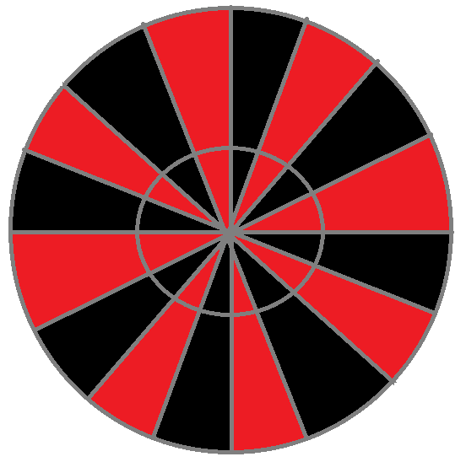
Larger Attack Surface
This work: rely on fault propagation and multiple attempts
Indocrypt ’21:
Fault
Analogy: spin a roulette wheel until the ball lands in the desired pocket
Somewhat uniformly distributed on [0, 3328]
v’ = v + 4 mod 16
Flip 1 bit
Decompress
4
Centered binomial distribution
=?
+
Barrett reduction
Somewhat uniformly distributed on [0, 15]
Hash
+
Countermeasure
Compress
=?
x
Hash
-
x
Countermeasure bypassed
constant
Butterflies in the last layer of INTT
constant
TII – Technology Innovation Institute
Roulette: A Diverse Family of Feasible Fault Attacks on Masked Kyber
06/11

Slide 7
Relaxed Fault Model (and why masking helps)
This work:
Indocrypt ’21:
Example 1:
random fault
Example 3: masked software
instruction corruption (or skip)
Flip 1 bit
f
y
y’₁ is independent of y₁ (or x₁)
f₁
Example 2: masked hardware
x₁
f
set-to-{0, 1, constant}
f₂
y
x₂
y₂
f₁
y₁
➔ Unmasked value y is uniform
f₂
y₂
Equipment: clock glitching, voltage glitching, EM, laser, …
Equipment: laser
➔ Unmasked value y is uniform
TII – Technology Innovation Institute
Roulette: A Diverse Family of Feasible Fault Attacks on Masked Kyber
07/11

Slide 8
Solving systems of linear inequalities (1/2)
∈ [-2, 2]
∈ [-2, 2]
x₁
x
b
≥ 0
(decapsulation failure)
A (public; data from encapsulation)
x
b
≥ 0
(decapsulation failure)
A (public; data from encapsulation)
< 0
< 0
(decapsulation success)
×
+
(decapsulation success)
×
+
x₂
7000 (or more)
7000 (or more)
belief propagation (iterative):
…
…
…
…
…
x₁₅₃₆
≥ 0
≥ 0
1536
1536
CBD
Point distributions
First improvement: reduce computation time
In each iteration, compute the distribution of 7000 x 1536 ≈ 10.8 M linear combinations of x₁, …, x₁₅₃₆
Indocrypt ’21:
This work:
Exactly (linear convolution): 10.8 M FFTs & IFFTs
Approximate by normal distribution (central limit theorem)
≈ 15 minutes / iteration
(single thread)
≤ 5 seconds / iteration
TII – Technology Innovation Institute
Roulette: A Diverse Family of Feasible Fault Attacks on Masked Kyber
08/11

Slide 9
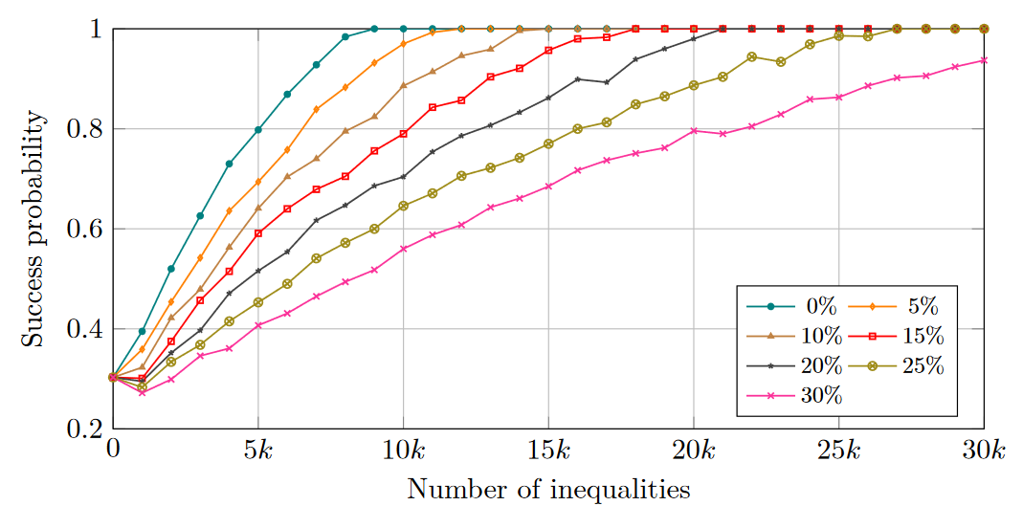
Solving systems of linear inequalities (2/2)
Second improvement: higher error tolerance.
Estimate based on the observed number of decapsulation successes and failures
Pr(inequality satisfied | PMF(x)) = Pr(inequality satisfied | PMF(x)) × Pr(inequality correct) + (1 - Pr(inequality satisfied | PMF(x))) × (1 - Pr(inequality correct))
CHES’21: 1% error rate
Indocrypt’21: 0% error rate
This work: 25% error rate
Fault injection setup does not need to be perfectly reliable
Importance of CLT-based acceleration increases with the error rate
Kyber512
Our solver is available on GitHub and as CHES artifact
TII – Technology Innovation Institute
Roulette: A Diverse Family of Feasible Fault Attacks on Masked Kyber
9/11

Slide 10
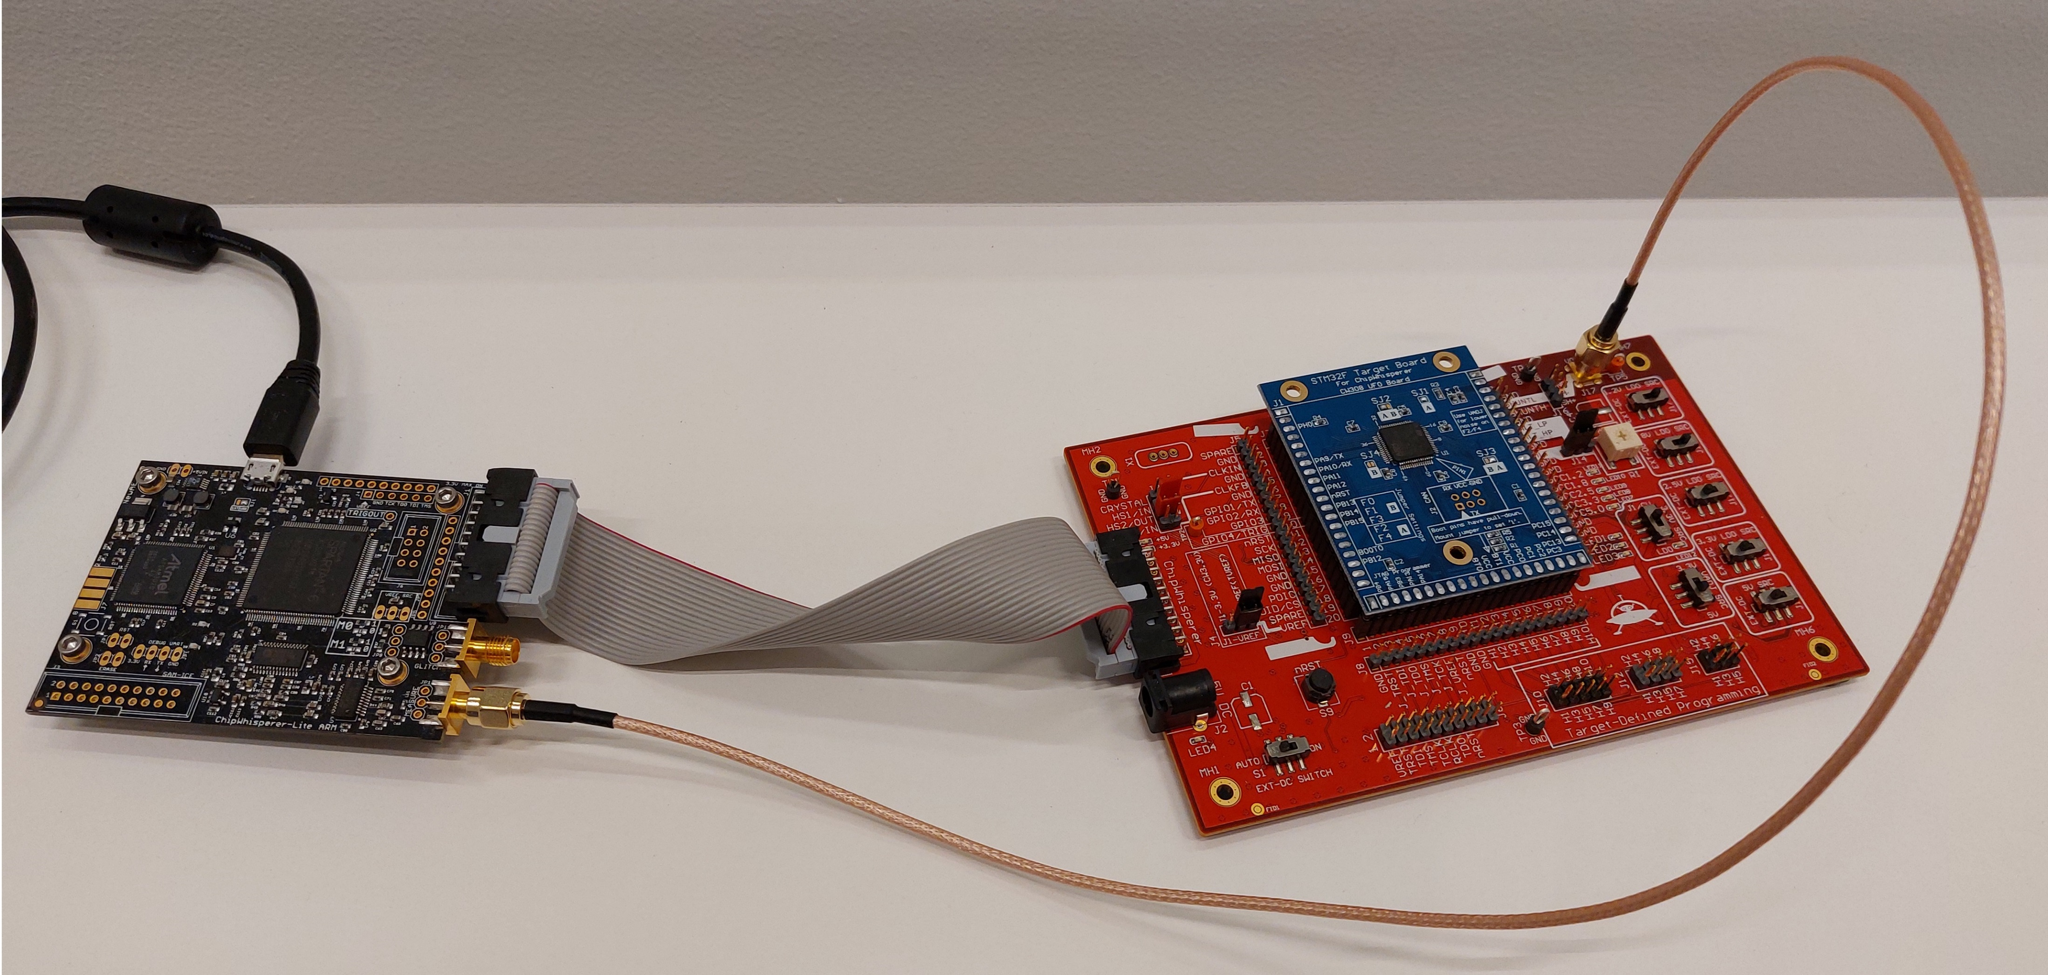
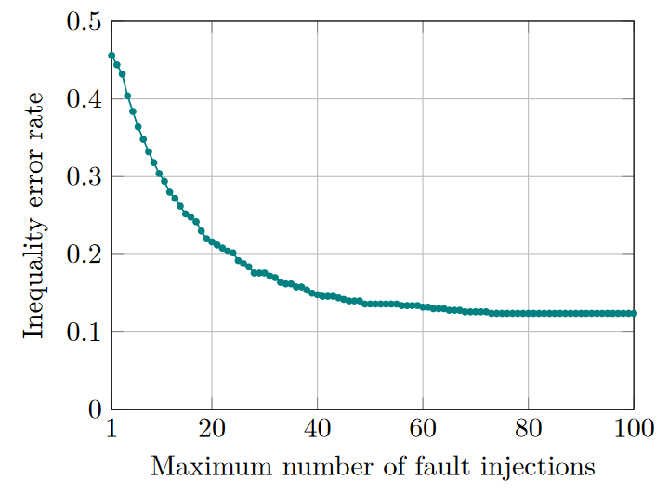
ChipWhisperer Experiments
Unfortunately, unoptimized:
Portable C (the NTT is not written in assembly)
24 MHz << 168 MHz
Glitching a 24 MHz clock
First-order masked Kyber768 decapsulation [Coron et al., CHES 2022]
STM32F405 ARM Cortex-M4
Instruction corruption (or skip) in last layer of INTT
+
It would take 5 days to gather enough inequalities for key recovery; we assess their correctness instead
TII – Technology Innovation Institute
Roulette: A Diverse Family of Feasible Fault Attacks on Masked Kyber
10/11

Slide 11
Concluding Remarks
Our contribution: opening pathways for the attacker
More building blocks
More fault models
Higher error tolerance
Masking as a facilitator
More diverse, cheaper, and less reliable fault-injection equipment
Suggestions for further research
Experiments on an optimized target
Vulnerability of other PQC algorithms
Design of new countermeasures
Thank you!
TII – Technology Innovation Institute
Roulette: A Diverse Family of Feasible Fault Attacks on Masked Kyber
11/11

Slide 12
tii.ae

