Slide 1
SoC RootCanal!
Root cause analysis of power side-channel leakage in SoC
CHES 2022
Pantea Kiaei, Patrick Schaumont
September 2022

Slide 2
Outline
Protecting SoC against Power SCA
Post-Silicon vs. Pre-Silicon Assessment
Examples of what can cause leakage
RootCanal: find causes of leakage automatically

Slide 3

Protecting SoC against Power SCA
Multiple abstraction layers
  Root of the attack: HW
  Cause of the attack: SW
Secret data from software
To find the root cause, start from HW
Software
ISA
RTL
Gate-level

Slide 4
Post-Silicon vs. Pre-Silicon Assessment
Saves time and money
Can find the root cause

Slide 5
Leakage from Compiler Optimization
ISW Multiplication
compile
re-ordered

Slide 6
Leakage from Interaction bw HW/SW
Byte-masked SW AES

Slide 7
Automated Tool
Unified automated tool
  Find leakage
  Find cause of leakage
    Independent of the source (compiler, source code, architecture, etc.)
RootCanal
    Finds where leakage occurs at gate-level
    Points to the instruction that causes the leakage

Slide 8
SoC RootCanal

Slide 9
RootCanal Methodology

Slide 10
Summary of Results

Slide 11
Execution Time
Design size
Netlist size
Testbench length
Netlist size
Trace length
Leaky samples
Netlist size
Leaky gates
< 24h to capture bugs
  Replaces post-silicon which takes months
The bugs can be at any abstraction level

Slide 12
Conclusion
Interaction between multiple abstraction layers must be considered in protecting SoCs against hardware attacks
RootCanal enables root cause analysis of power SCL in HW and SW components of SoCs

Slide 13
Thank You
Questions

Slide 14
Backup

Slide 15
Platform for Experiments

Slide 16
RootCanal Experiments
AES HW accelerator (ex 1)
Byte-masked SW AES (ex 3)
blue fonts show leaky stages
SKIVA redundancy schemes (ex2)

Slide 17
RootCanal Experiments
ISW Multiplication (ex 4)
compile
re-ordered

Slide 18
Non-Specific Architecture Correlation Analysis

Slide 19
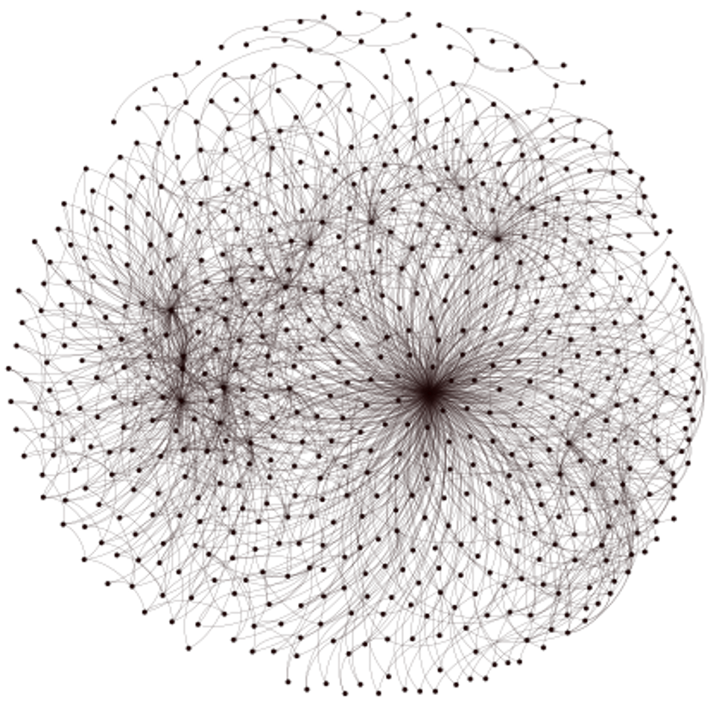
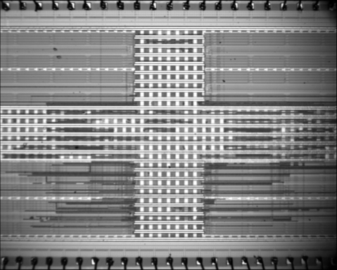
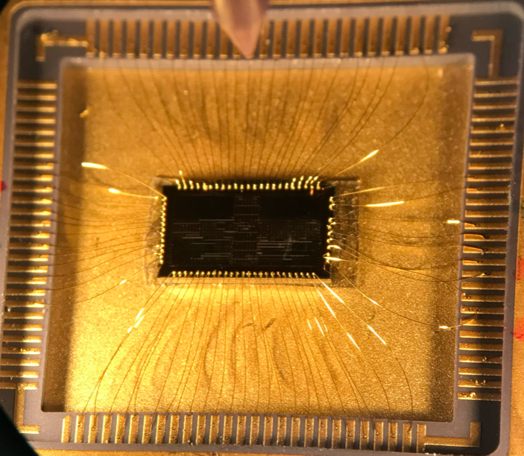
Design Abstraction Layers - HW
Behavioral Design
Packaging
and Assembly
Synthesis
Place and Route
RTL
Design
Post-Synthesis
Netlist
Post-Layout
Netlist
Transistor-Level
Netlist
Fabricated
Chip

Slide 20




Design Abstraction Layers - SW
13 00 00 00 13 00 00 00 13 00 00 00 13 00 00 00 13 00 00 00 93 00 00 00 13 01 00 60 93 01 00 00 13 02 00 00 93 02 00 00 13 03 00 00 93 03 00 00 13 04 00 00 13 05 00 00 93 05 00 00 13 06 00 00 93 09 00 00 13 07 00 00 93 07 00 00 13 08 00 00 93 08 00 00 13 09 00 00 93 09 00 00 13 0A 00 00 …
Source
Code
Compiler
IR
Machine
Code
define i32 @factorial(i32) {
entry:
%eq = icmp eq i32 %0, 0
br i1 %eq, label %then, label %else
then:
br label %ifcont
else:
%sub = sub i32 %0, 1
%2 = call i32 @factorial(i32 %sub)
%mult = mul i32 %0, %2
br label %ifcont
ifcont:
%iftmp = phi i32 [ 1, %then ], [ %mult, %else ]
ret i32 %iftmp
}
.c
.ll
.exe
int factorial(int n){
if (n==0) {
1
}
else{
n * factorial(n - 1)
}
}

Slide 21
RootCanal Experiments
AES HW accelerator (example 1)
SKIVA redundancy schemes (example 2)
blue fonts show leaky stages

Slide 22
RootCanal Experiments
AES HW accelerator (ex 1)
Byte-masked SW AES (ex 3)
SKIVA redundancy schemes (ex2)

Slide 23
RootCanal Experiments
ISW Multiplication (ex 4)
compile
re-ordered

