Slide 1
Breaking the Size Barrier: Universal Circuits meet Lookup Tables
Yann Disser, Daniel Günther, Thomas Schneider,
Maximilian Stillger, Arthur Wigandt, Hossein Yalame
ASIACRYPT 2023

Slide 2
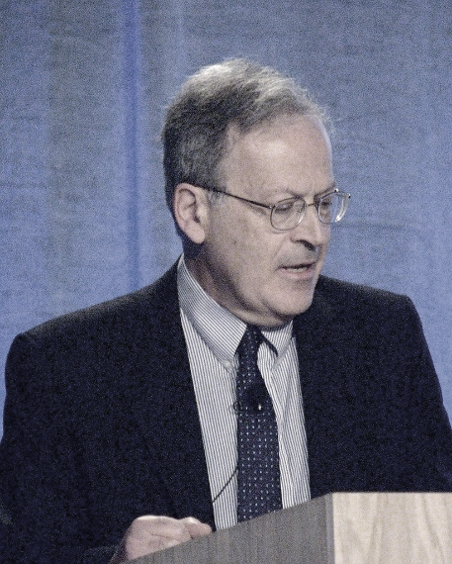
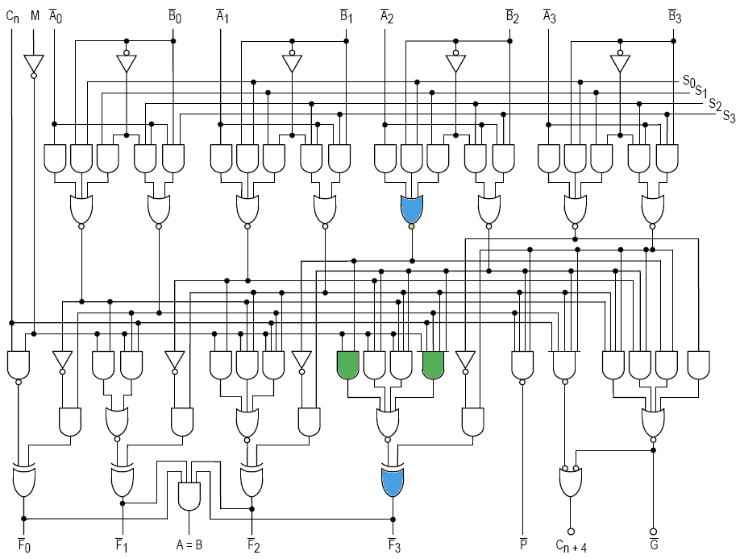
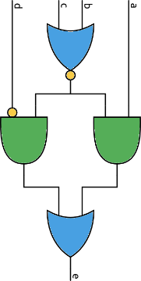



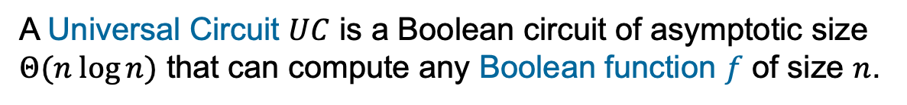


Universal Circuit (UC)
A Universal Circuit $UC$ is a Boolean circuit of asymptotic size $Θ(n log{n)}$ that can compute any Boolean function $f$ of size $n$.
$$x$$
$$p_{f}$$
$$x$$
Leslie G. Valiant
1976
$$f(x)$$
$$UC\left(p_{f},x\right)=f(x)$$

Slide 3



Universal Circuits
Many Applications
Obfuscation
Attribute-based Encryption
Private Function Evaluation
Computations can be obfuscated.
Generalize policies in Attribute-based Encryption Schemes.
Securely evaluate private function on private data.

Slide 4







Secure Function Evaluation
SFE
data $x$
data $y$
$$f$$
$$f\left(x,y\right)$$
$$f\left(x,y\right)$$
Compute $f\left(x,y\right)$ without revealing private inputs $x$ and $y$.

Slide 5


Secure Function Evaluation
data $x$
data $y$
$$f\left(x,y\right)$$
$$f(x,y)$$
$$f\left(x,y\right)$$
Circuit $f\left(x,y\right)$ in SFE is public
Program known to both parties!

Slide 6




Private Function Evaluation
PFE
data $x$
function $f$
$$f\left(x\right)$$
$$f\left(x\right)$$
Compute $f\left(x\right)$ without revealing private input $x$ and private function $f$.

Slide 7
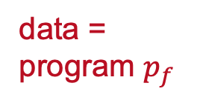

Private Function Evaluation
SFE
data =
program $p_{f}$
data $x$
$$UC(p_{f},x)$$
$$f\left(x,y\right)$$
$$f\left(x,y\right)$$
Reduce PFE to SFE by using a UC as public function.

Slide 8



Universal Circuit design VS Circuit Synthesis
Universal Circuit Design
Reduce prefactors of UC size
  $5.0n\log{n}$ [Val76]
  $3.0n\log{n}$ [LYZ+21] ($2.95n\log{n}$ lower bound)
Reduce concrete size [KS16, GKS17]
  Hybrid constructions [AGKS20]
Evaluate $ρ$-input LUTs [Val76, SS08]
Circuit Synthesis
Evaluated circuit consists of
2-input, 1-output gates
MPC-optimized circuits
  Consisting of only AND and XOR gates [KS16, GKS17, AGKS20]
  UCs can evaluate all 16 = $2^{2^{2}}$ possible gate types
Our work: Combine Circuit Synthesis and UC Design to minimize the UC size by evaluating $ρ$-input, $ω$-output LUTs!
Notes:
Circuit Synthesis
- PFE research always considered MPC area
- restriction to circuits that consists of only AND and XOR gates
- however, at the same time, all UC compilers use so-called universal gates in their construction
- for each universal gate, we spend 3 AND gates, but in fact they are never fully used, as we only use 2 of the 16 programmings
- so what we basically have already now, are UCs that can evaluate 2-input Lookup Tables
And that‘s what we were looking into in our work
- we no longer want to consider UC Design and Circuit Synthesis as two independent tasks, but combine them to minimize the size of Ucs
- concretely, we do not only look into 2-input Lookup Tables, but adapt UCs so that we can compute LUTs of any dimensions
- Namely, LUTs that have rho inputs and compute omega outputs

Slide 9
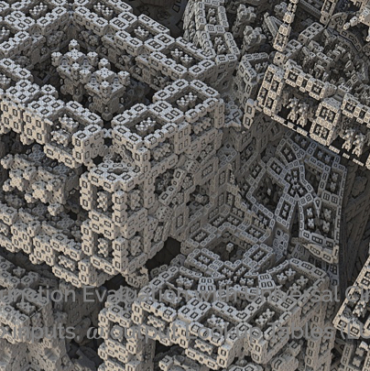
Our Contributions
LUT-Based UC (LUC)

Slide 10







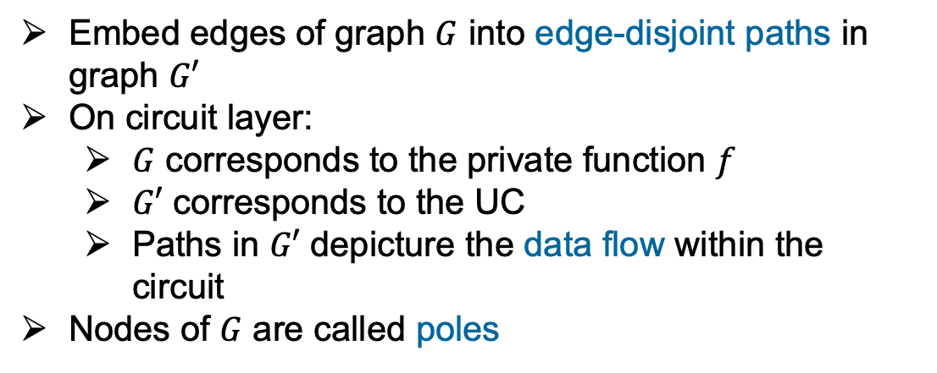




Edge-Embedding
$${ p}_{1}$$
$${ p}_{1}$$
Properties
$${ p}_{2}$$
$${ p}_{2}$$
Embed edges of graph $G$ into edge-disjoint paths in graph $G′$
On circuit layer:
  $G$ corresponds to the private function $f$
  $G′$ corresponds to the UC
  Paths in $G′$ depicture the data flow within the circuit
Nodes of $G$ are called poles
$${ p}_{3}$$
$${ p}_{3}$$
$${ p}_{4}$$
$${ p}_{4}$$
$$G$$
$$G′$$

Slide 11

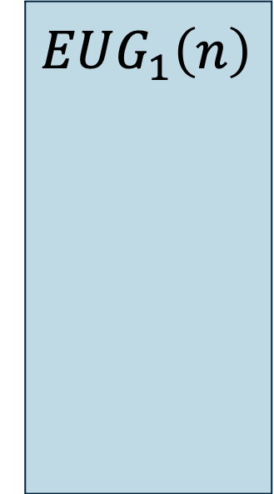





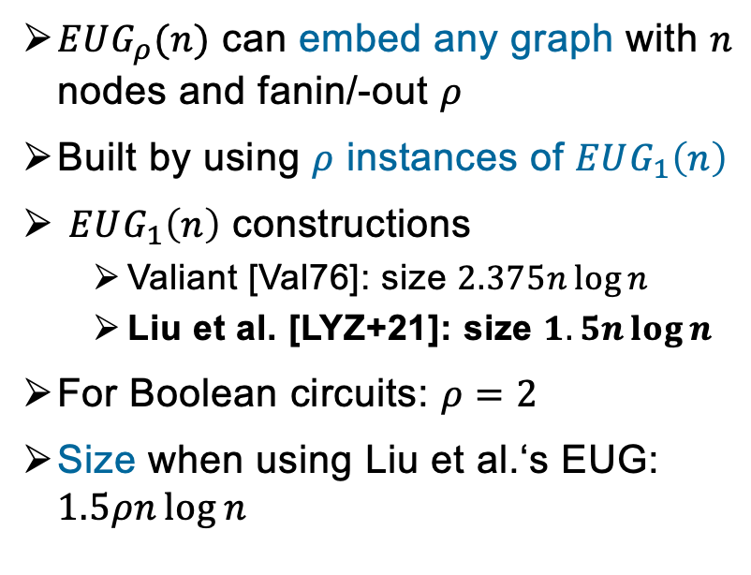
Edge-Universal Graph (EUG)
Definition
$$EUG_{2}\left(n\right)$$
$$EUG_{1}\left(n\right)$$
$$EUG_{1}\left(n\right)$$
$EUG_{ρ}(n)$ can embed any graph with $n$ nodes and fanin/-out $ρ$
Built by using $ρ$ instances of $EUG_{1}\left(n\right)$
$EUG_{1}\left(n\right)$ constructions
  Valiant [Val76]: size $2.375n\log{n}$
  Liu et al. [LYZ+21]: size $1.5n\log{n}$
For Boolean circuits: $ρ=2$
Size when using Liu et al.‘s EUG: $1.5ρn\log{n}$
$${ p}_{1}$$
$${ p}_{2}$$
…
$${ p}_{n}$$

Slide 12

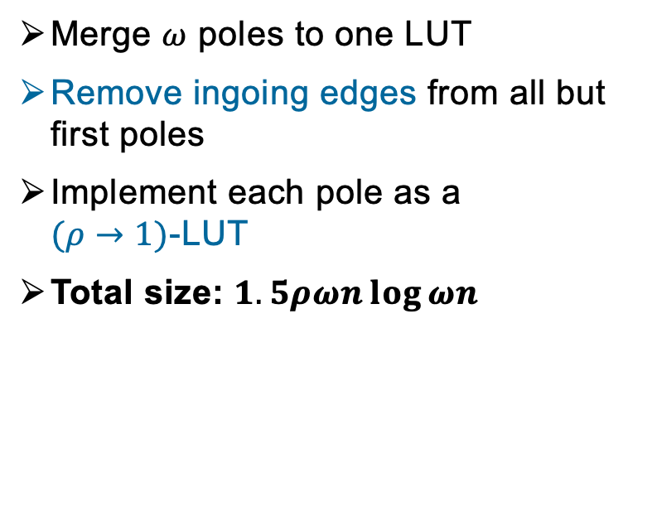
From one Output to $ω$ outputs
Procedure
$$EUG_{2}\left(n\right)$$
$$EUG_{1}\left(n\right)$$
$$EUG_{1}\left(n\right)$$
Merge $ω$ poles to one LUT
Remove ingoing edges from all but first poles
Implement each pole as a
$(ρ→1)$-LUT
Total size: $1.5ρωn\log{ωn}$
LUT
$${ p}_{1}$$
$${ p}_{2}$$
…
$${ p}_{n}$$

Slide 13



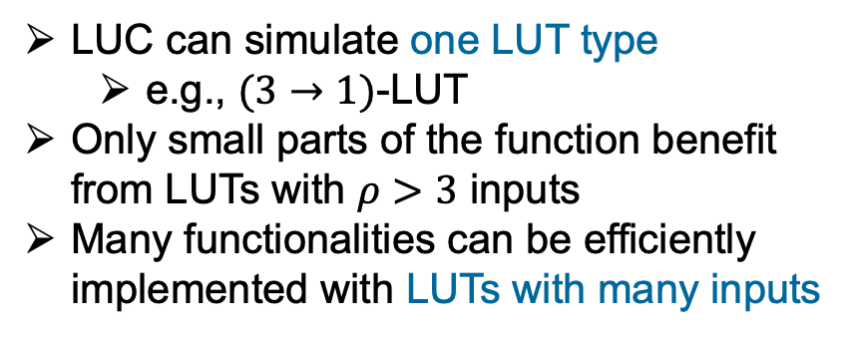
Varying PFE
What we have
LUC can simulate one LUT type
  e.g., $(3→1)$-LUT
Only small parts of the function benefit from LUTs with $ρ>3$ inputs
Many functionalities can be efficiently implemented with LUTs with many inputs
Can we efficiently mix multiple LUTs without having the $ρ$ factor in the total circuit size?

Slide 14

Our Contributions
LUT-Based UC (LUC)
Varying UC
(VUC)

Slide 15


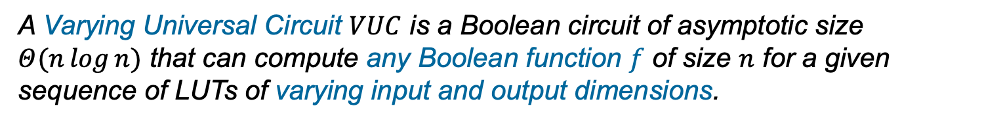
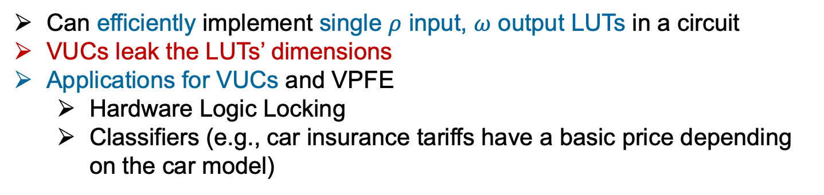
Varying Universal Circuits
A Varying Universal Circuit $VUC$ is a Boolean circuit of asymptotic size $Θ(n\log{n})$ that can compute any Boolean function $f$ of size $n$ for a given sequence of LUTs of varying input and output dimensions.
Can efficiently implement single $ρ$ input, $ω$ output LUTs in a circuit
VUCs leak the LUTs’ dimensions
Applications for VUCs and VPFE
  Hardware Logic Locking
  Classifiers (e.g., car insurance tariffs have a basic price depending on the car model)
Notes:
This sequence is leaked, so Alice, who should not learn any information about the function can see the LUT dimensions, which is not fully private function evaluation anymore
- but, we still have applications for this
- hardware logic locking, where we aim to hide our hardware design, requires the knowledge of the LUT dimensions in the manufacturing process, so hiding these will not bring any further value for this particular application
- another application is, when we use varying LUT dimensions for classifiers, which usually are public information in some use cases. And classifiers are natural Lookup Tables, as we want to look up a particular value
- For example, a car insurance company will calculate the basic price of the insurance according to the car model of the client
– This is information we know, so there is not much damage to leak that there is indeed a classifier in the circuit for this use case

Slide 16





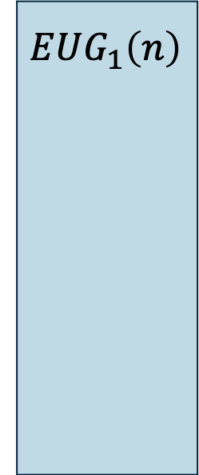








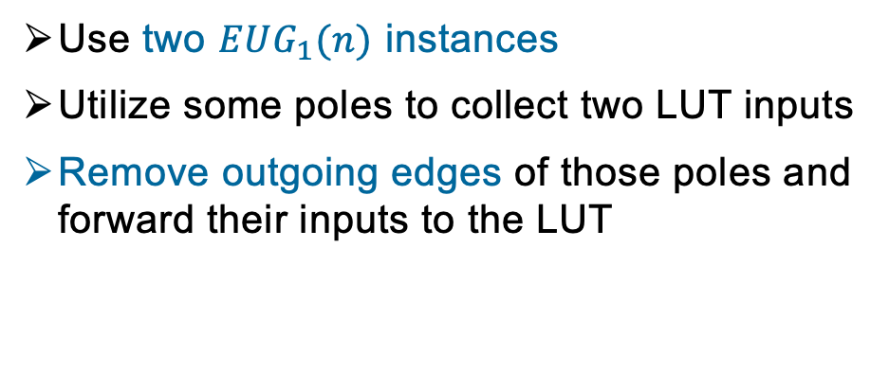


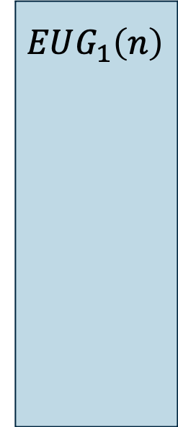



VUC Construction
Use two $EUG_{1}(n)$￼instances
Utilize some poles to collect two LUT inputs
Remove outgoing edges of those poles and forward their inputs to the LUT
$$EUG_{2}\left(n\right)$$
$$EUG_{1}\left(n\right)$$
$$EUG_{1}\left(n\right)$$
…
$${ p}_{6}$$
Convert to fanin 2 graph
Embed into EUG
$${ p}_{7}$$
$${ p}_{1}$$
$${ p}_{2}$$
$${ p}_{3}$$
$${ p}_{4}$$
$${ p}_{5}$$
$${ p}_{1}$$
$${ p}_{2}$$
$${ p}_{3}$$
$${ p}_{4}$$
$${ p}_{5}$$
$${ p}_{8}$$
…
$${ p}_{6}$$
$${ p}_{6}$$
$${ p}_{7}$$
$${ p}_{8}$$

Slide 17

Our Contributions
LUT-Based UC (LUC)
Varying UC
(VUC)
Implementation +
Synthesis

Slide 18
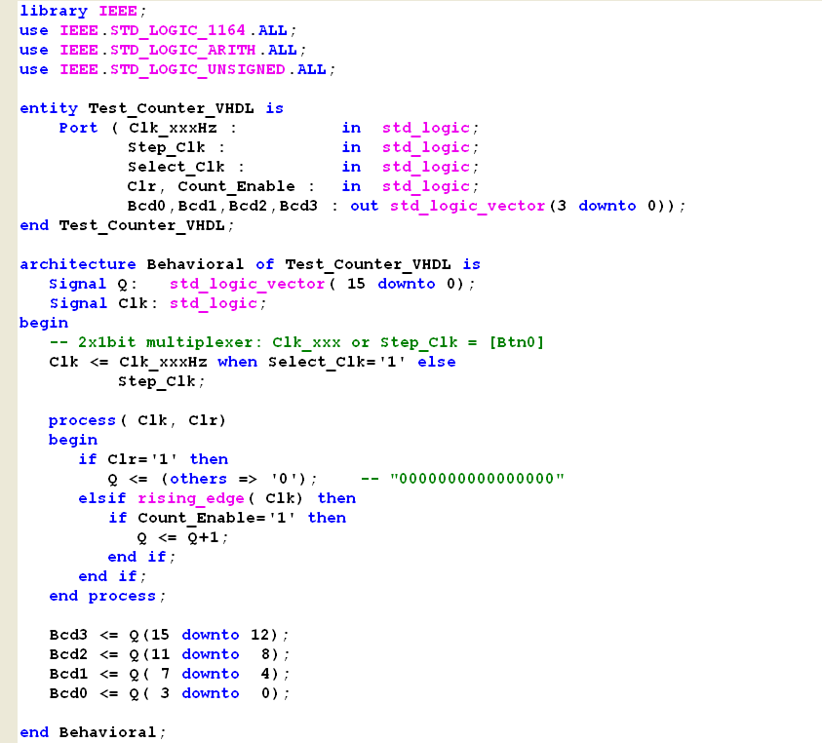
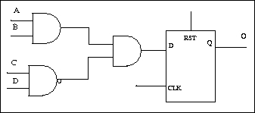
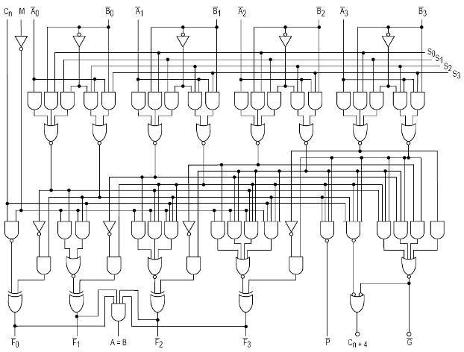



Synthesis Toolchain
VHDL / Verilog Code
Circuit Synthesis
Technology Library
Hardware Synthesis
Synthetic Libraries
Building blocks
LUT output mapping
Netlist
Yosys
ABC mapping
LUC/VUC
Design
LUC/VUC Compiler
UC Program
UC Description
$$x$$
$$p$$
PFE
ABY Framework
$$UC(p,x)$$

Slide 19
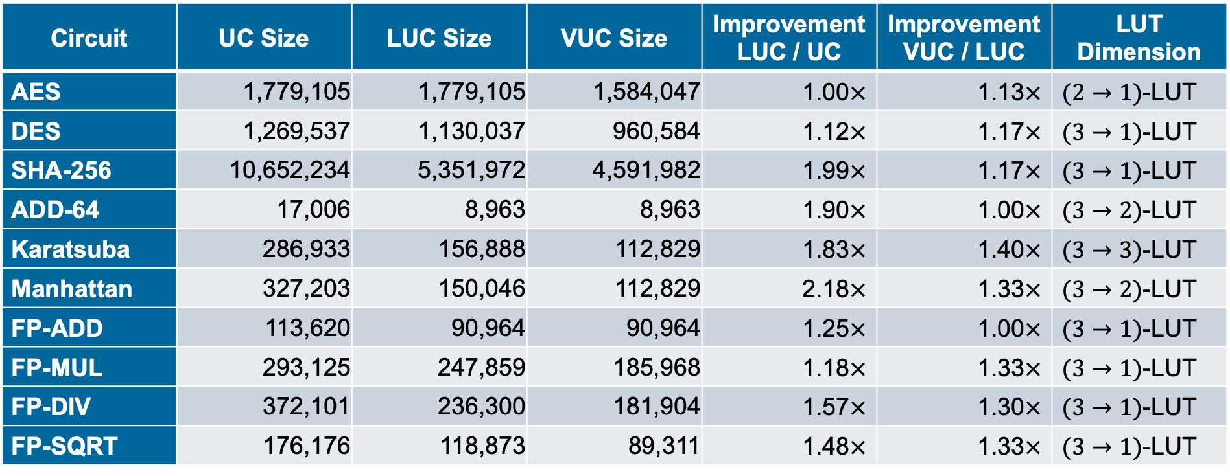
LUC and VUC Sizes
Circuit | UC Size | LUC Size | VUC Size | ImprovementLUC / UC | Improvement VUC / LUC | LUT Dimension
AES | 1,779,105 | 1,779,105 | 1,584,047 | 1.00$×$ | 1.13$×$ | $(2→1)$-LUT
DES | 1,269,537 | 1,130,037 | 960,584 | 1.12$×$ | 1.17$×$ | $(3→1)$-LUT
SHA-256 | 10,652,234 | 5,351,972 | 4,591,982 | 1.99$×$ | 1.17$×$ | $(3→1)$-LUT
ADD-64 | 17,006 | 8,963 | 8,963 | 1.90$×$ | 1.00$×$ | $(3→2)$-LUT
Karatsuba | 286,933 | 156,888 | 112,829 | 1.83$×$ | 1.40$×$ | $(3→3)$-LUT
Manhattan | 327,203 | 150,046 | 112,829 | 2.18$×$ | 1.33$×$ | $(3→2)$-LUT
FP-ADD | 113,620 | 90,964 | 90,964 | 1.25$×$ | 1.00$×$ | $(3→1)$-LUT
FP-MUL | 293,125 | 247,859 | 185,968 | 1.18$×$ | 1.33$×$ | $(3→1)$-LUT
FP-DIV | 372,101 | 236,300 | 181,904 | 1.57$×$ | 1.30$×$ | $(3→1)$-LUT
FP-SQRT | 176,176 | 118,873 | 89,311 | 1.48$×$ | 1.33$×$ | $(3→1)$-LUT

Slide 20
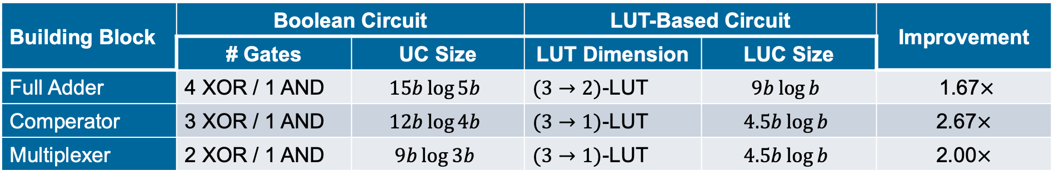
Building Block Sizes for LUC
Building Block | Boolean Circuit |  | LUT-Based Circuit |  | Improvement
 | # Gates | UC Size | LUT Dimension | LUC Size
Full Adder | 4 XOR / 1 AND | $$15b\log{5b}$$ | $(3→2)$-LUT | $$9b\log{b}$$ | 1.67$×$
Comperator | 3 XOR / 1 AND | $$12b\log{4b}$$ | $(3→1)$-LUT | $$4.5b\log{b}$$ | 2.67$×$
Multiplexer | 2 XOR / 1 AND | $$9b\log{3b}$$ | $(3→1)$-LUT | $$4.5b\log{b}$$ | 2.00$×$

Slide 21



Thank You!
Contact
Paper
Code
https://encrypto.de/guenther
https://ia.cr/2022/1652
https://encrypto.de/code/LUC

Slide 22
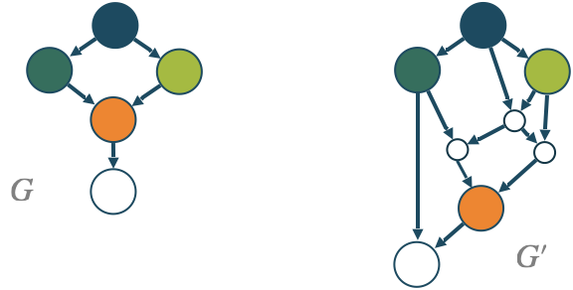
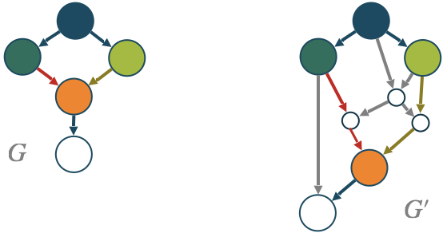

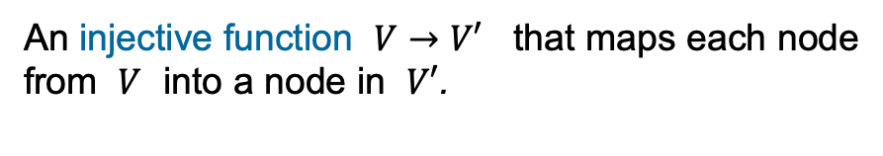
Edge-Embedding
An edge-embedding of a graph $G=(V,E)$ into another graph $G^{′}=(V^{′},E^{′})$ is defined by two mappings:
An injective function $V→V′$ that maps each node from $V$ into a node in $V′$.
An function $E→\{\text{paths} \text{in} E′\}$ where each of those paths are pairwise edge-disjoint.
Notes:
Looking ahead, G is the function that we want to compute with the UC, while G’ represents the UC
Only holding G‘ no information about G
But with the embedding you can dervie G from G‘

Slide 23
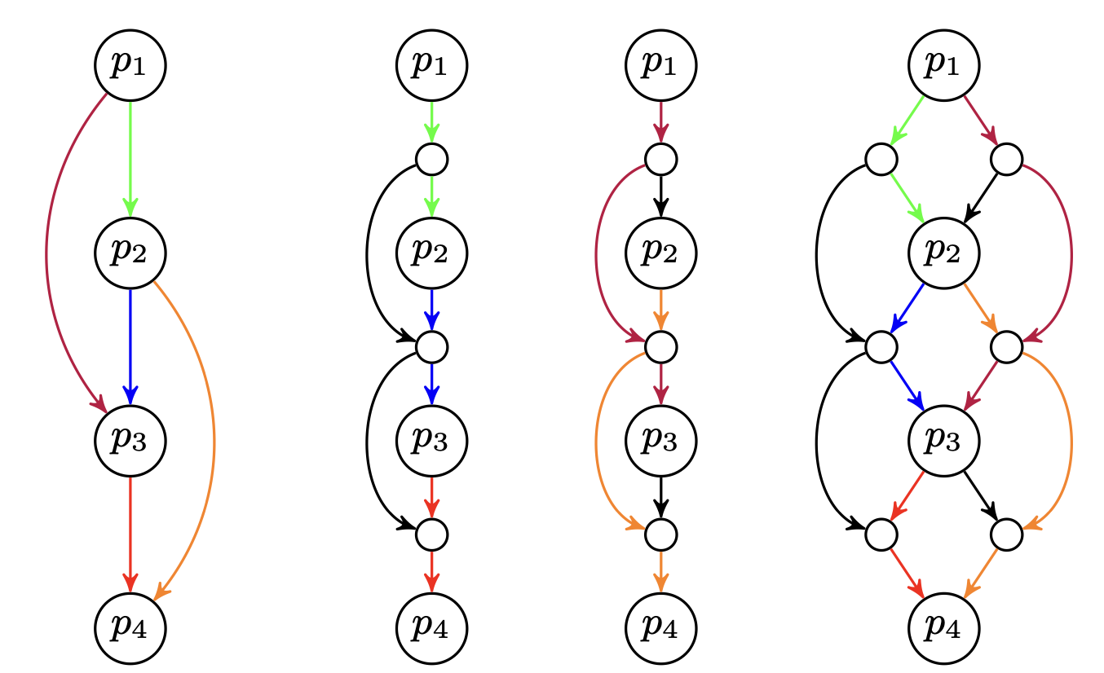



Edge-Universal Graphs (EUG)
A graph $EUG_{k}\left(n\right)$ is a universal graph if every graph $G∈Γ_{k}(n)$￼with $n$￼nodes can be edge-embedded into $EUG_{k}\left(n\right)$.
$Γ_{2}\left(4\right)$ graph
${EUG}_{1}\left(4\right)$ graphs
${EUG}_{2}\left(4\right)$ graph

Slide 24
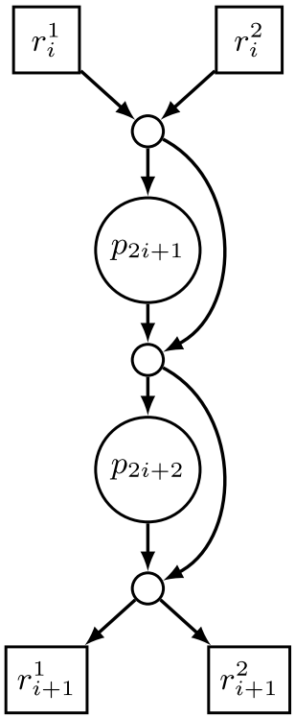
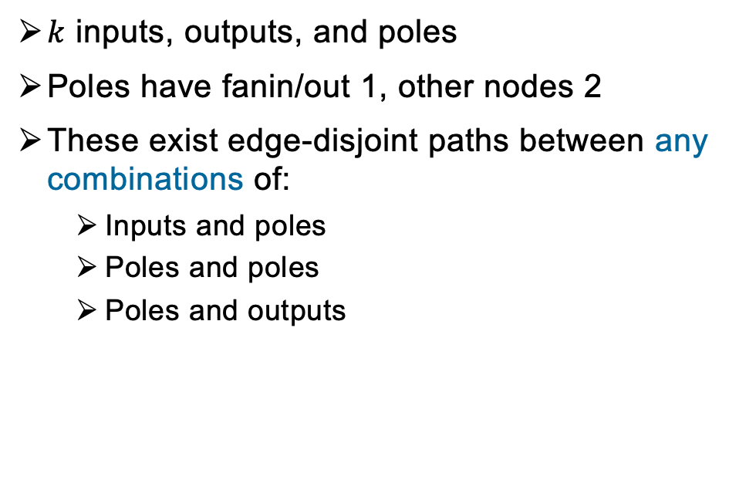
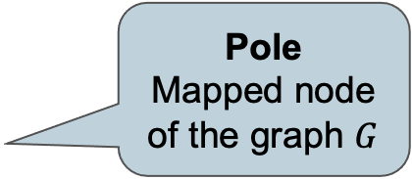
k-way Superpole
Requirements
Pole
Mapped node of the graph $G$
$k$ inputs, outputs, and poles
Poles have fanin/out 1, other nodes 2
These exist edge-disjoint paths between any combinations of:
  Inputs and poles
  Poles and poles
  Poles and outputs
Input/Output
Pole of the next recursion step
Notes:
this is the core building block for Valiant’s 2-way UC construction
Poles are either inputs, outputs or gates of the circuit that we want to compute with the UC
The nodes around these are to establish paths between these poles
Idea of this building block: we can forward all incoming wires to any of the poles, we can connect the poles, and we can direct the outgoing wires of the poles to the outputs of this block
The interface of these superposes allows us, to direct input wires to the poles and we get the output wires for example after the gates are evaluated to the outputs of the superpole

Slide 25
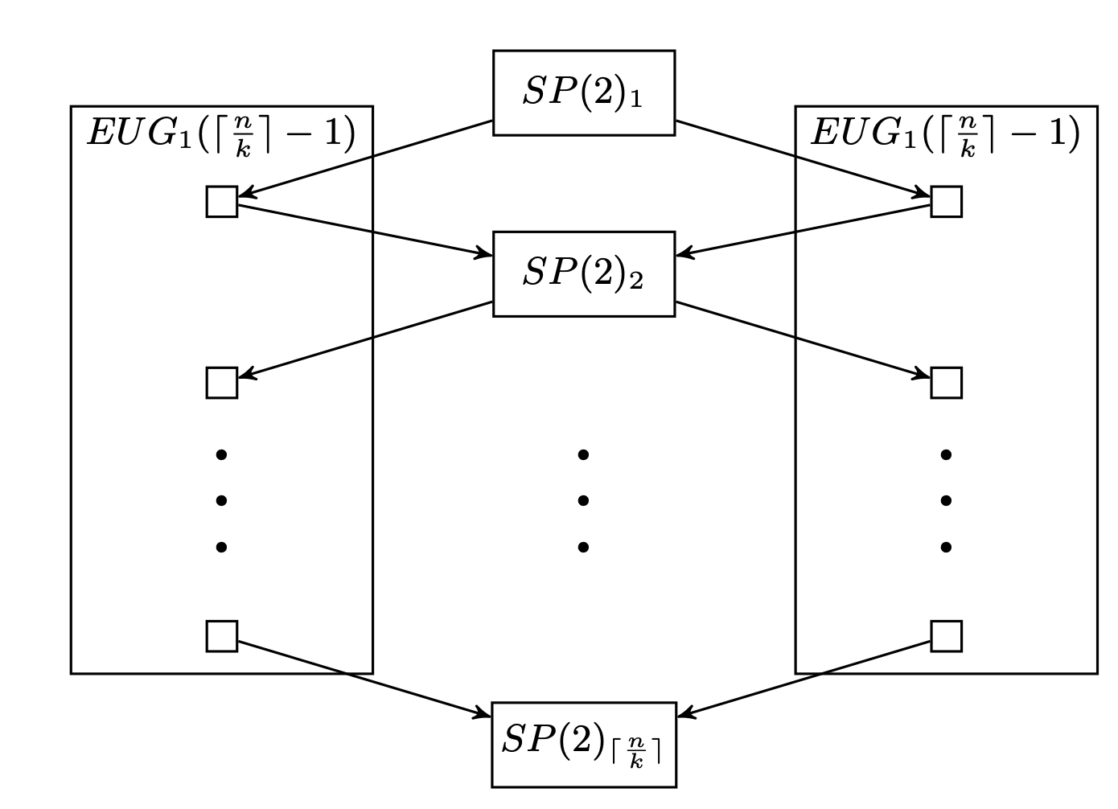
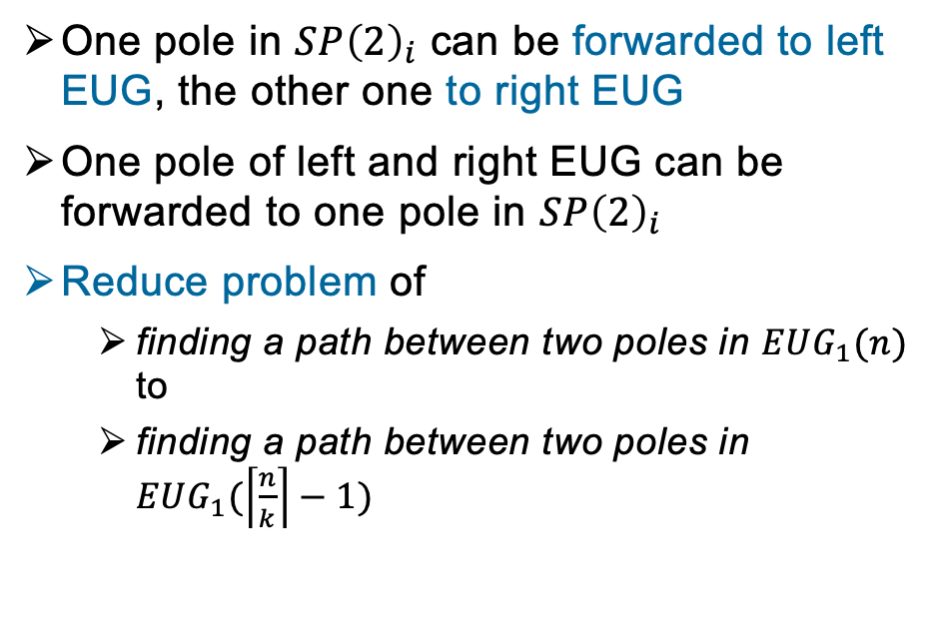
Edge-Universal-Graph from Superpoles
Properties
One pole in $SP{\left(2\right)}_{i}$ can be forwarded to left EUG, the other one to right EUG
One pole of left and right EUG can be forwarded to one pole in $SP{\left(2\right)}_{i}$
Reduce problem of
  finding a path between two poles in $EUG_{1}(n)$ to
  finding a path between two poles in $EUG_{1}(\left\lceil \frac{n}{k}\right\rceil −1)$
Notes:
Now that we have a superpole construction, we need to use many of them in a clever way to build a UC and
the good news is, we don’t need more building blocks for the UC

Slide 26




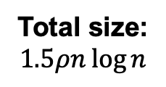

From $EUG_{1}(n)$ to $EUG_{ρ}\left(n\right)$ [Val76]
Idea: Merge poles of $ρ$ instances of $EUG_{1}(n)$
Pole appears in all EUGs
Size: $1.5n\log{n}$
Total size:
$$1.5ρn\log{n}$$
Size: $1.5n\log{n}$
…
Take care of LUT‘s first input
Take care of LUT‘s $ρ$-th input

