Slide 1
CCA-1 Secure Updatable Encryption with Adaptive Security
Huanhuan Chen Yao Jiang Galteland Kaitai Liang
TU Delft Qredo TU Delft
December 6th, Asiacrypt 2023

Slide 2
﻿Key Rotation Is Necessary
DB1
DB2

Slide 3
﻿Key Rotation Is Necessary
DB1
DB1
DB2

Slide 4
﻿Updatable Encryption [BLMR13]
DB1
Token
DB2

Slide 5
﻿Updatable Encryption [BLMR13]
DB1
DB2
$$Dec\left(Update\left(c_{1}, Δ_{1,2}\right)\right)=m_{1}$$
Ciphertext-Independent UE [LT18, KLR19, BDGJ20, Jia20, Nis22, SS23, GP23]:
$Δ_{1,2}=TokenGen(k_{1},k_{2})$

Slide 6
﻿Ciphertext-Dependent UE
DB1
=(
$$\tilde{ct_{1}}$$
, $ct_{1}$)
Token
DB2
$$Dec\left(Update\left(c_{1}, Δ_{1,2}\right)\right)=m_{1}$$
Ciphertext-Dependent UE [EPRS17, BEKS20, CLT20] :
$Δ_{1,2}=TokenGen(k_{1},k_{2},\tilde{ct_{1}})$

Slide 7
﻿C-D UE Compared to C-I UE
 | C-I UE | C-D UE
Efficiency | Imply PKE [AMP19], DDH | [BEKS20] Approaches AES, lattice: 200 times faster
Security | Open problem: no-directional key updates [Jia20, Nis22, SS23] | All are no-directional key updates [EPRS17, BEKS20, CLT20]

Slide 8
﻿C-D UE Compared to C-I UE
 | C-I UE | C-D UE
Efficiency | Imply PKE [AMP19], DDH | [BEKS20] Approaches AES, lattice: 200 times faster
Security | Open problem: no-directional key updates [Jia20, Nis22, SS23] | All are no-directional key updates [EPRS17, BEKS20, CLT20]

Slide 9
﻿C-D UE Compared to C-I UE
 | C-I UE | C-D UE
Efficiency | Imply PKE [AMP19], DDH | [BEKS20] Approaches AES, lattice: 200 times faster
Security | Open problem: no-directional key updates [Jia20, Nis22, SS23] | All are no-directional key updates [EPRS17, BEKS20, CLT20]

Slide 10
﻿C-D UE Compared to C-I UE
 | C-I UE | C-D UE
Efficiency | Imply PKE [AMP19], DDH | [BEKS20] Approaches AES, lattice: 200 times faster
Security | Open problem: no-directional key updates [Jia20, Nis22, SS23] | All are no-directional key updates [EPRS17, BEKS20, CLT20]

Slide 11
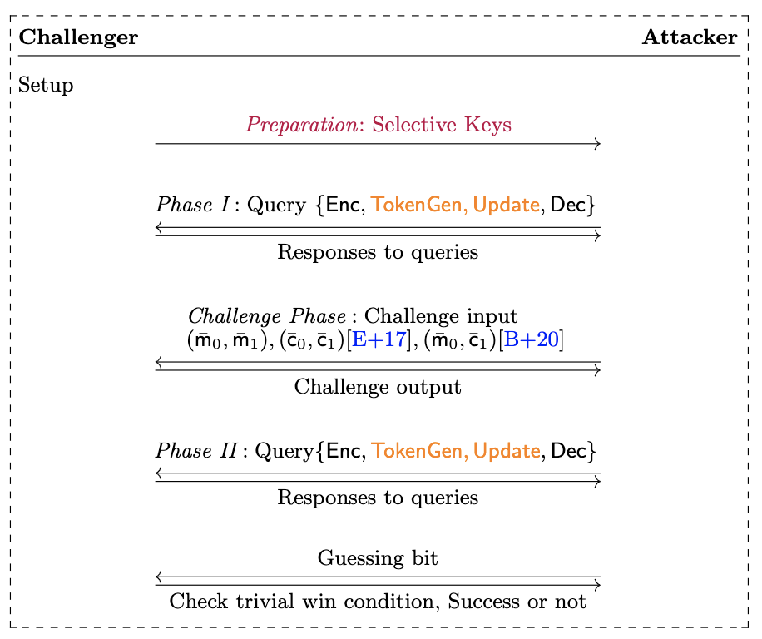
﻿Prior Security: Secure Under Key Leakage
DB1
$$Δ_{1,2}$$
DB2
$$Δ_{2,3}$$
DB3
$$Δ_{3,4}$$
DB4
$$Δ_{4,5}$$
DB5
$$Δ_{5,6}$$
DB6
$$Δ_{6,7}$$
DB7
$$Δ_{7,8}$$
DB8
$$Δ_{8,9}$$
DB9

Slide 12
﻿Prior Security: Secure Under Key Leakage
DB1
$$Δ_{1,2}$$
DB2
$$Δ_{2,3}$$
DB3
$$Δ_{3,4}$$
DB4
$$Δ_{4,5}$$
DB5
$$Δ_{5,6}$$
DB6
$$Δ_{6,7}$$
DB7
$$Δ_{7,8}$$
DB8
$$Δ_{8,9}$$
DB9

Slide 13
﻿Prior Security: Secure Under Key Leakage
DB1
$$Δ_{1,2}$$
DB2
$$Δ_{2,3}$$
DB3
$$Δ_{3,4}$$
DB4
$$Δ_{4,5}$$
DB5
$$Δ_{5,6}$$
DB6
$$Δ_{6,7}$$
DB7
$$Δ_{7,8}$$
DB8
$$Δ_{8,9}$$
DB9

Slide 14
﻿Prior Security: Secure Under Key Leakage
DB1
$$Δ_{1,2}$$
DB2
$$Δ_{2,3}$$
DB3
$$Δ_{3,4}$$
DB4
$$Δ_{4,5}$$
DB5
$$Δ_{5,6}$$
Challenge
epoch
DB6
$$Δ_{6,7}$$
DB7
$$Δ_{7,8}$$
DB8
$$Δ_{8,9}$$
DB9

Slide 15
﻿Prior Security: Secure Under Key Leakage
DB1
$$Δ_{1,2}$$
DB2
$$Δ_{2,3}$$
DB3
$$Δ_{3,4}$$
DB4
$$Δ_{4,5}$$
$$Δ_{5,6}$$
Challenge
epoch
DB5
DB6
$$Δ_{6,7}$$
DB7
$$Δ_{7,8}$$
DB8
$$Δ_{8,9}$$
DB9

Slide 16
Questions
The current security notions for c-d UE only capture selective security
Prior notions only apply to randomized ciphertext updates
The security models are complex

Slide 17
Our Work (c-d UE)
A stronger model that captures adaptive security
A lattice-based updatable encryption: cca1-secure with adaptive security
A packing UE: simultaneous encryption and update of multiple messages

Slide 18
No-Directional Key Updates
C-I UE
C-D UE
[BDGJ20]
Key homomorphic PRFs
$$k_{1}$$
$$C_{1}=π(N|{\left|m\right)}^{k_{1}}$$
$$k_{1}$$
Dec: $Enc_{k_{1}}\left(k_{prf}\right)$
Generate: $k_{prf}^{′}$
Enc: $Enc_{k_{2}}\left(k_{prf}^{′}\right)$
$k_{prf}^{up}=k_{prf}^{′}$- $k_{prf}$
(${\tilde{ct}}_{1},ct_{1})=(Enc_{k_{1}}\left(k_{prf}\right),$
${ m}_{i}+F(k_{prf},i))$
$$Δ_{1,2 }=k_{1}/k_{2}$$
$$k_{2}$$
$$update?$$
$$k_{2}$$
$$update?$$
$Update\left(C_{1}, Δ_{1,2}\right)=C_{1}^{Δ_{1,2}}$ = $π(N|{\left|m\right)}^{k_{1}⋅\frac{k_{2}}{k_{1}}}=π(N|{\left|m\right)}^{k_{2}}$
$$Update\left(C_{1}, Δ_{1,2}\right)={ m}_{i}+F\left(k_{prf},i\right)+F\left(k_{prf}^{up},i\right)$$
$=m_{i}+F\left(k_{prf}^{′},i\right)$
Bi-directional key updates
Open problem: no-directional key updates [Jia20, Nis22, SS23]
Dec-then-Enc structure
No-directional key updates [EPRS17, BEKS20, CLT20]

Slide 19
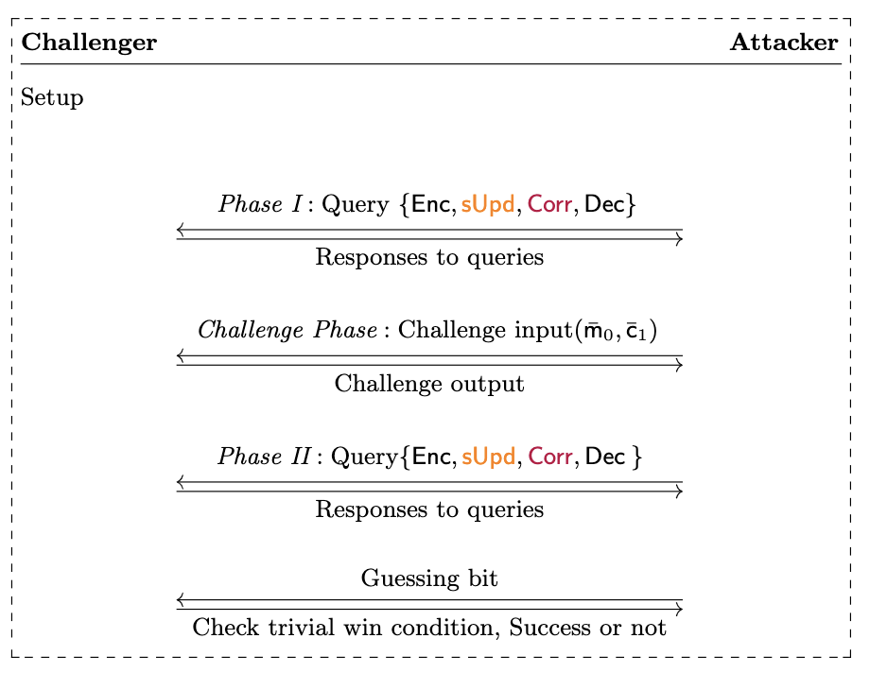
A Simplified Confidentiality
Theorem: sConfidentiality is equal to Confidentiality [BEKS20] for n-d c-d UE

Slide 20
Adaptive Security

Slide 21
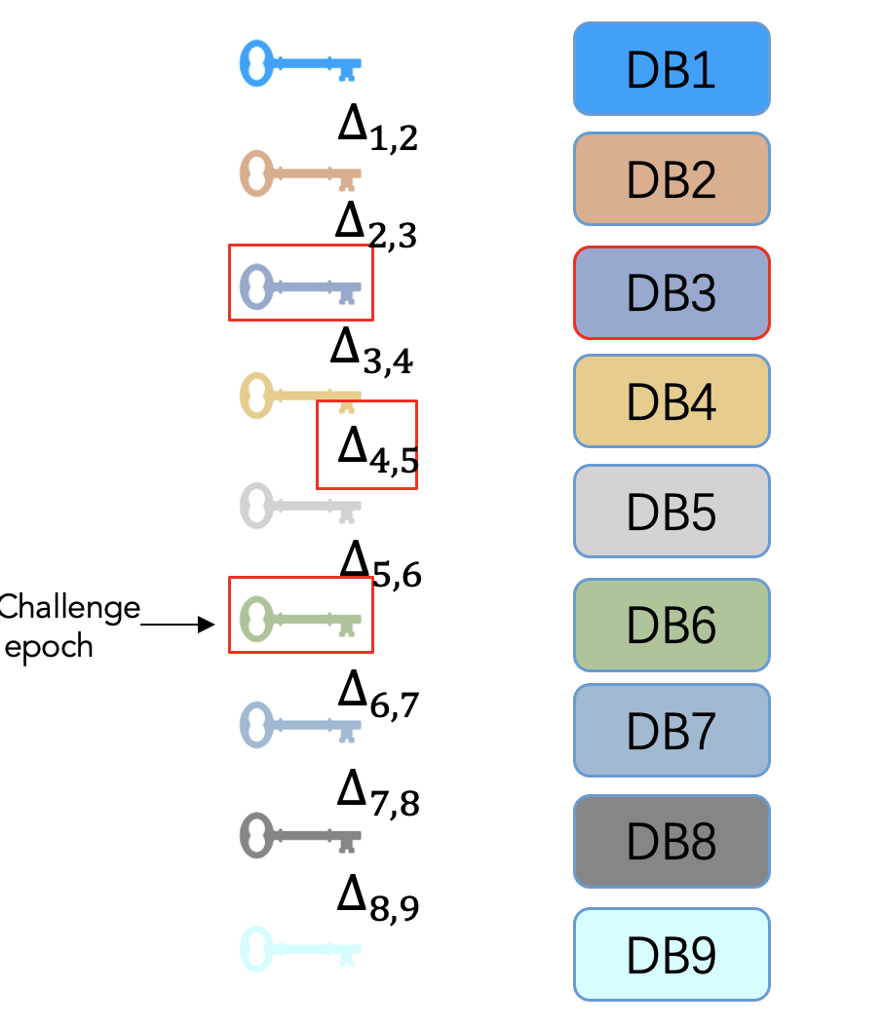
Trivial Win Conditions
Prior notions for c-d UE only apply to
randomized ciphertext updates
Checking if the adversary knows the epoch key and
a valid challenge-equal ciphertext in the same epoch
is enough at the end of the game:
no need to check extended leakage sets
(compared to C-I UE [LT18,KLR19,BDGJ20])

Slide 22
Construction: A New Lattice-based PKE
Recap
 | Random matrix | Matrix with a trapdoor
LWE | Hard | Efficiently solved
SIS (ISIS) | Hard | Efficiently solved

Slide 23
Construction: A New Lattice-based PKE
Recap
LWE: Recover $s$and e from (A, b) $∈ℤ_{q}^{n×m}×ℤ_{q}^{m}$, where b^{t}=s^{t} A + e^{t} mod q
SIS: Find a short non-zero vector x such that Ax = 0 mod q
ISIS: Find a short non-zero vector x such that Ax = u mod q
Trapdoor [MP12]: A G-trapdoor for matrix A $∈ℤ_{q}^{n×m}$ ($m>nk>n$) is a matrix R $∈ℤ_{q}^{(m−nk)×nk}$ such that for some invertible matrix H $∈ℤ_{q}^{n×n}$, where G = diag($g^{t},⋯,g^{t}$) $∈ℤ_{q}^{n×nk}$ for $g=\left[1 2 4⋯2^{k−1}\right] and k=⌈\log{q} ⌉$. An example is A = [A₀ | -A₀R + HG ]
For a random matrix A $∈ℤ_{q}^{n×m}$ with trapdoor R, there exist two efficient algorithms [MP12]
Invert(R, A, H, b) that recovers $s$and e from (A, b), where b^{t}=s^{t} A + e^{t}
SampleD(R, A, H, u, s) that samples a ﻿discrete Gaussian vector x with parameter s such that Ax = u mod q

Slide 24
A New Lattice-based PKE
TDP.KG($λ$): Random A₀, and R₁,R₂ $←𝔇$, pk = A = [A₀ | - A₀ R₁ | - A₀ R₂ ], sk = R₁
TDP.Enc(pk $,m∈{\left\{0,1\right\}}^{nk}$): choose an invertible matrix H$μ$, a random vector s, and an error vector e, output the ciphertext c = (H$μ$ , b), where
Fef Recover s from the first two blocks and then m from the last block.
Recover s: call the invert algorithm on
Recover plaintext: )
Lemma: TDP is CCA-1 secure if the LWE problem is hard.

Slide 25
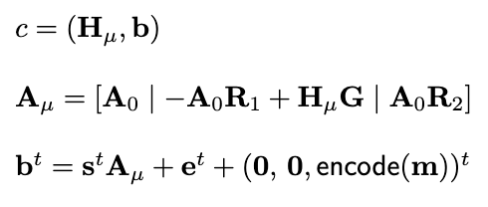
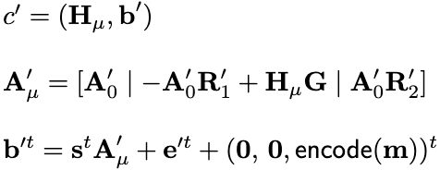
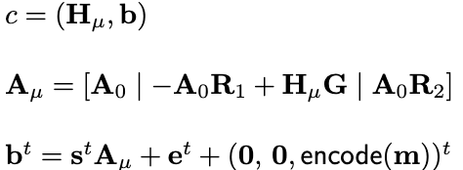
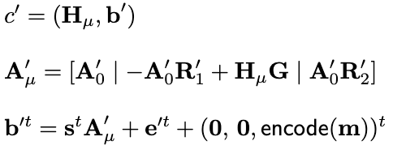
A New Updatable Encryption
High-level: TDP as the underlying encryption scheme
update

Slide 26
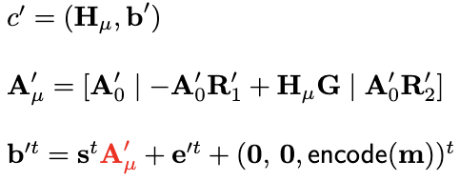
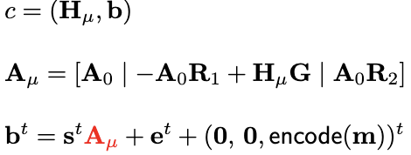
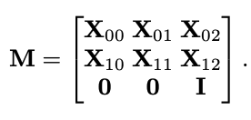
A New Updatable Encryption
High-level: TDP as the underlying encryption scheme
update
Call the sampling algorithm:

Slide 27
Is it secure? No!
update
Recall the challenge input is (m,c)

Slide 28
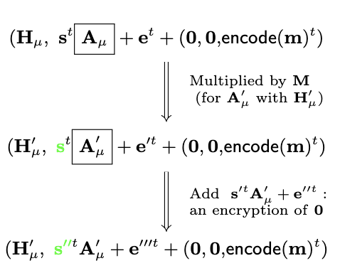
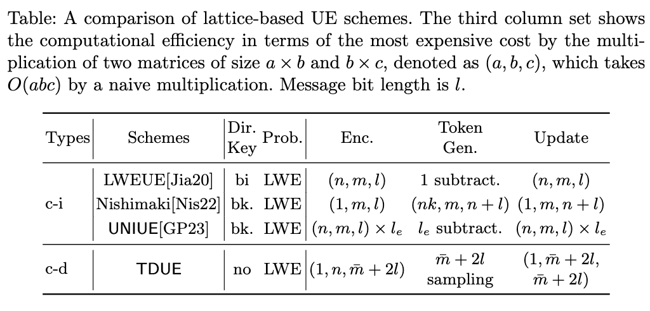
Solutions
No-directional key updates
CCA-1 secure with adaptive security
Efficiency

Slide 29
A Packing UE
Ciphertext:
TokenGen:
Lemma: GSampleD(R, A, H, u(x), s) that samples a ﻿discrete Gaussian polynomial vector p(x) with parameter s such that Ap(x) = u(x) mod q for the matrix A with trapdoor R
Compared to TDUE, the packing UE reduces the number of ciphertexts by a factor of N , and only one ciphertext header is required to be downloaded in the token generation procedure

Slide 30
Summary
A stronger confidentiality notion that captures adaptive security
A new lattice-based PKE, UE (of interests for ABE,IBE)
A packing UE

Slide 31
Thanks

