Slide 1
On Black-Box Knowledge—Sound Commit-and-Prove SNARKs
Helger Lipmaa
University of Tartu, Estonia
(Asiacrypt 2023 virtual presentation)

Slide 2
Non-Interactive Zero-Knowledge
( , )

Slide 3
Succinct Non-Interactive Argument
Honest V does not accept if P does not know the witness
Knowledge
Soundness
Honest V does not accept if statement is not true
Soundness
SNARK
NIZK
Honest V accepts honest P
Completeness
SNARG
Honest P’s private information is not leaked
Zero-knowledge
Argument is succinct + honest V is efficient
Succinctness

Slide 4
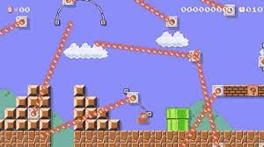
Impossibilities
1024 impossibility results
NIZK impossible in the plain model
CRS model: common input from a trusted party
Succinct ZK proofs impossible for NP
Arguments: computationally sound proofs
Falsifiable perfect ZK impossible for NP
Non-falsifiable assumptions OR computational ZK
Sometimes, impossibility and possibility results match
Every SNARK paper ever: Our paper uses non-falsifiable assumptions/ROM due to the impossibility result of Gentry-Wichs

Slide 5
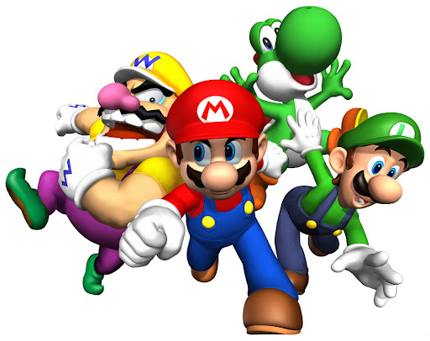
Enter Gentry-Wichs
Possibility/Imposs. | Soundness | Succinct | Hard languages | Falsifiable assumptions | Paper
IMP | A SNARG |  |  |  | Abe-Fehr 07, Gentry-Wichs 11, CLMP13
POS | A SNARK | Non-suc |  |  | Feige-Lapidot-Shamir (~1991)
POS | A SNARG |  | P |  | Delegation schemes (~2019)
POS | A SNARK |  |  | Non-falsif. | SNARKs (~2010)
??? |  |  |  |  | ???

Slide 6
Enter Gentry-Wichs
Possibility/Imposs. | Soundness | Succinct | Hard languages | Falsifiable assumptions | Paper
IMP | A SNARG |  |  |  | Abe-Fehr 07, Gentry-Wichs 11, CLMP13
POS | A SNARK | Non-suc |  |  | Feige-Lapidot-Shamir (~1991)
POS | A SNARG |  | P |  | Delegation schemes (~2019)
POS | A SNARK |  |  | Non-falsif. | SNARKs (~2010)
POS | NA SNARG |  |  |  | Lipmaa-Pavlyk (AC 2021)
IMP | NA SNARK |  |  |  | Campanelli-Ganesh-Kho…-Siim (2023)
POS | NA SNARG |  | FewP |  | Campanelli-Ganesh-Kho…-Siim (2023)

Slide 7
Enter Gentry-Wichs
Possibility/Imposs. | Soundness | Succinct | Hard languages | Falsifiable assumptions | Paper
IMP | A SNARG |  |  |  | Abe-Fehr 07, Gentry-Wichs 11, CLMP13
POS | A SNARK | Non-suc |  |  | Feige-Lapidot-Shamir (~1991)
POS | A SNARG |  | P |  | Delegation schemes (~2019)
POS | A SNARK |  |  | Non-falsif. | SNARKs (~2010)
POS | NA SNARG |  |  |  | Lipmaa-Pavlyk (AC 2021)
IMP | NA SNARK |  |  |  | Campanelli-Ganesh-Kho…-Siim (2023)
POS | NA SNARG |  | FewP |  | Campanelli-Ganesh-Kho…-Siim (2023)
POS | SA SNARK |  |  |  | Current work
??? | NA SNARG |  |  |  | Open
We show this construction does not work
New notion, new construction
Open question
Separation between SNARGs and SNARKs?

Slide 8
Adaptive Commit-And-Prove SNARG
(1) $crs=(…,ck)$
(2) $(x,C=Com\left(ck;w\right),π)$
Most SNARGs can be rewritten as C&P
$π$ contains commitment to witness
“Equivalently”, $C$ can be be part of $x$

Slide 9
Non-Adaptive Commit-And-Prove SNARG
(1) $x$
(2) $crs$
(3) $π$
Since $x$ is sent before CRS, cannot be C&P

Slide 10
BB Extraction In Interactive Protocols
$$a$$
$$c$$
$$z$$
$$c’$$
$$z’$$
Rewinding and sending new verifier messages
$$w$$

Slide 11
BBE in NIZK
$$crs,x,…$$
$$π$$
$$crs’,x’,…$$
$$π’$$
Black-box Extraction. Only IO behavior can be analyzed. No RO
$$w$$

Slide 12
Impossibility of BBE in NA SNARKs
$$x$$
Problem!
P can use different witness in each rewind
Not enough rounds to build a contradiction
No public parameters before $x$ => cannot commit to $w$
$$crs$$
$$π$$
$$crs’$$
$$π’$$
This is only intuition (not a proof)!
[GW11] and [CGKS23] prove impossibility by using unrelated ideas
The proofs rely on $π$ being short
$$w$$

Slide 13
Flaw in [LP21]
$$x$$
Problem!
P can use different witness in each rewind
Not enough rounds to build a contradiction
No public parameters before $x$ => cannot commit to $w$
$$crs$$
$$π$$
Everything else worked well…
[LP21] assumed P uses the same $w$
Not true!
How to correct: need to build contradiction from $w$’s being different
We need to add more “rounds”
$$crs’$$
$$π’$$
This is only intuition (not a proof)!
[GW11] and [CGKS23] prove impossibility by using unrelated ideas
The proofs rely on $π$ being short
$$w$$

Slide 14
New Adaptivity Notion: Semi-Adaptive C&P SNARG
(1) $ck$
(2) $(x,C=Com\left(ck;w\right))$
(3) $crs$
(4) $π$
This adds “rounds”
freedom to choose the “rewinding” point
$w$ is “fixed” before extractor sends last message

Slide 15
(Knowledge-)Soundness Proof Intuition
ck
$$(x,C=Com\left(w\right))$$
}
Rewind $n=|wires|$ times
Each time reprogram $crs$
$crs_{i}$ is somewhere extractable
one can extract from $π_{i}$ $i$th gate and its neighbourhood
If P used two inconsistent witnesses, we extract two inconsistent wire values from committed by $C$
Use vector commitment and hide succinct VC opening in $π_{i}$
$$crs_{i}$$
$$π_{i}$$

Slide 16
Our Construction: Punic
Kilian works, but is way way impractical
PCP, Merkle trees, …
One of our main contributions is a practical semi-adaptively knowledge-sound zk-SNARK Punic
On top of breaking [LP21], defining semi-adaptive knowledge-soundness, new tools, and a new proof technique
Getting a practical construction is a major hassle and requires several new insights
Unfortunately, this margin is too small to describe the construction
It’s 50%+ of the paper

Slide 17
Our NA zk-SNARK: Punic
FSE-friendly vector commitment
(1) $VC.ck$
(2) $(x,C=VC.Com\left(w\right))$
(3) $crs=\left(…,FSE.ck_{i}\right))$
functional somewhere extractable commitment
(4) $π=(…,FSE.com(w,VC.op))$
$π$ contains FSE commitment to $w$ and VC opening, extractable at location $i$
… and a QA-NIZK argument this and VC commitments are consistent

Slide 18
Somewhere Extraction
Vector commitment to:
$$w[1]$$ | $$w[2]$$ | $$w[3]$$ | $$w[4]$$ | … | $$w[n−1]$$ | $$w[n]$$
$$VC.op[1]$$ | $$VC.op[2]$$ | $$VC.op[3]$$ | $$VC.op[4]$$ | … | $$VC.op[n−1]$$ | $$VC.op[n]$$
Gate $i$’s neighbourhood
Gate $j$’s neighbourhood
If there does not exist a witness satisfying all gates, there exist two gates $i$ and $j$ such that P used different values $w_{i}\left[k\right]≠w_{j}[k]$ in at least one location when committing
In KS proof, we use FSE commitment to obtain two contradictory wire values together with VC openings $VC.op_{i}\left[k\right], VC.op_{j}\left[k\right]$ of two contradictory openings
This breaks (a variant of) position binding!

Slide 19
Our Tools and Assumptions - Summary
Functional Somewhere Extractable Commitment
From [Fauzi-Lipmaa-Pindado-Siim, FC 2021]
Bilateral Subspace QA-NIZK
From [González-Hevia-Ràfols, AC 2015]
“FSE-friendly” Vector Commitment
New properties, new construction
Partially based on [Kate-Zaverucha-Goldberg, AC 2010], [Camenisch-Dubovitskaya-Haralambiev-Kohlweiss, AC 2015]
$n$-QALINRES assumption
From [Lipmaa-Pavlyk 2021]
DDH
SKerMDH
VCSDH (new)

Slide 20
Main Security Theorem
Theorem (intuitive). Let $F={\left[.\right]}_{γ}$. Assume
FSE is somewhere $F$-extractable
BLS is quasi-apdatively strongly-sound
VC is $F$-position-binding
$n$-QALINRES holds
Then, Punic is semi-adaptively computationally $F$-special-sound
One can obtain knowledge-soundness from special-soundness by using standard tools

Slide 21
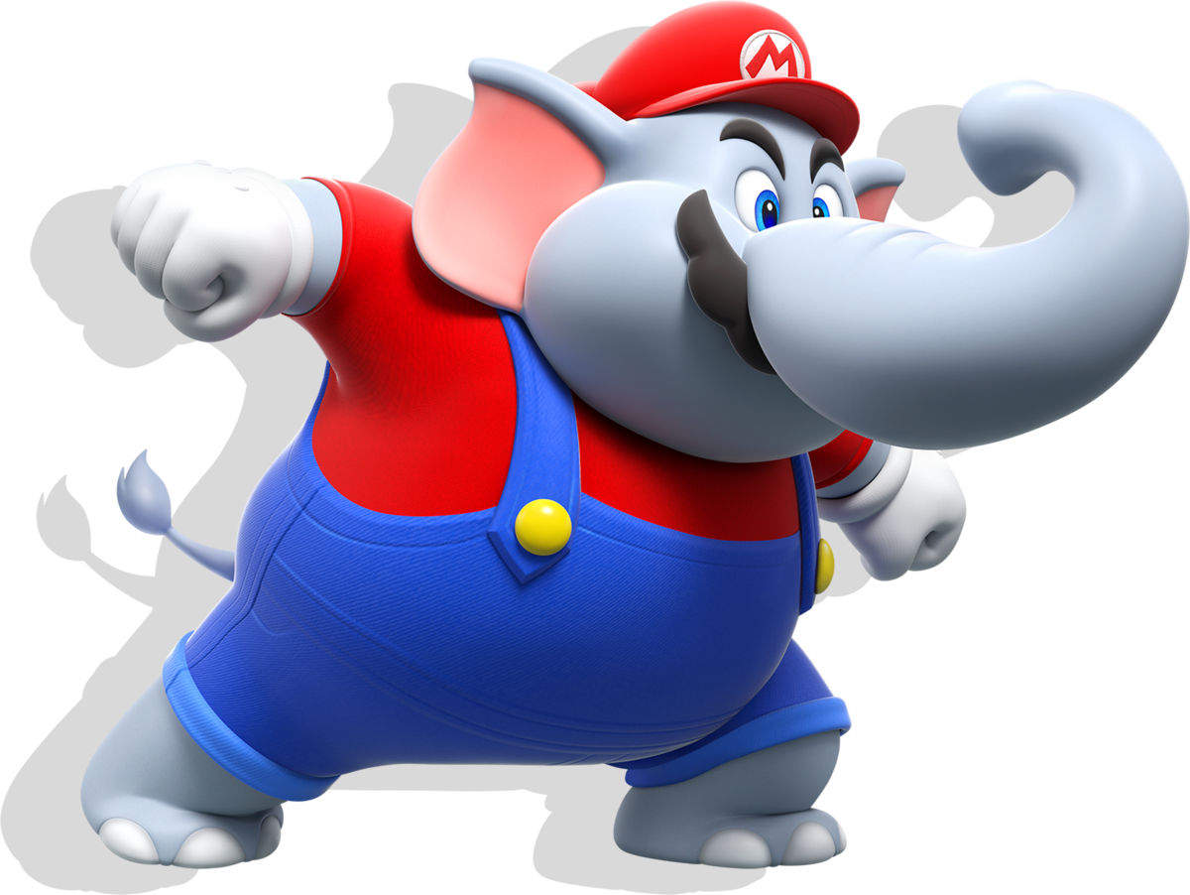
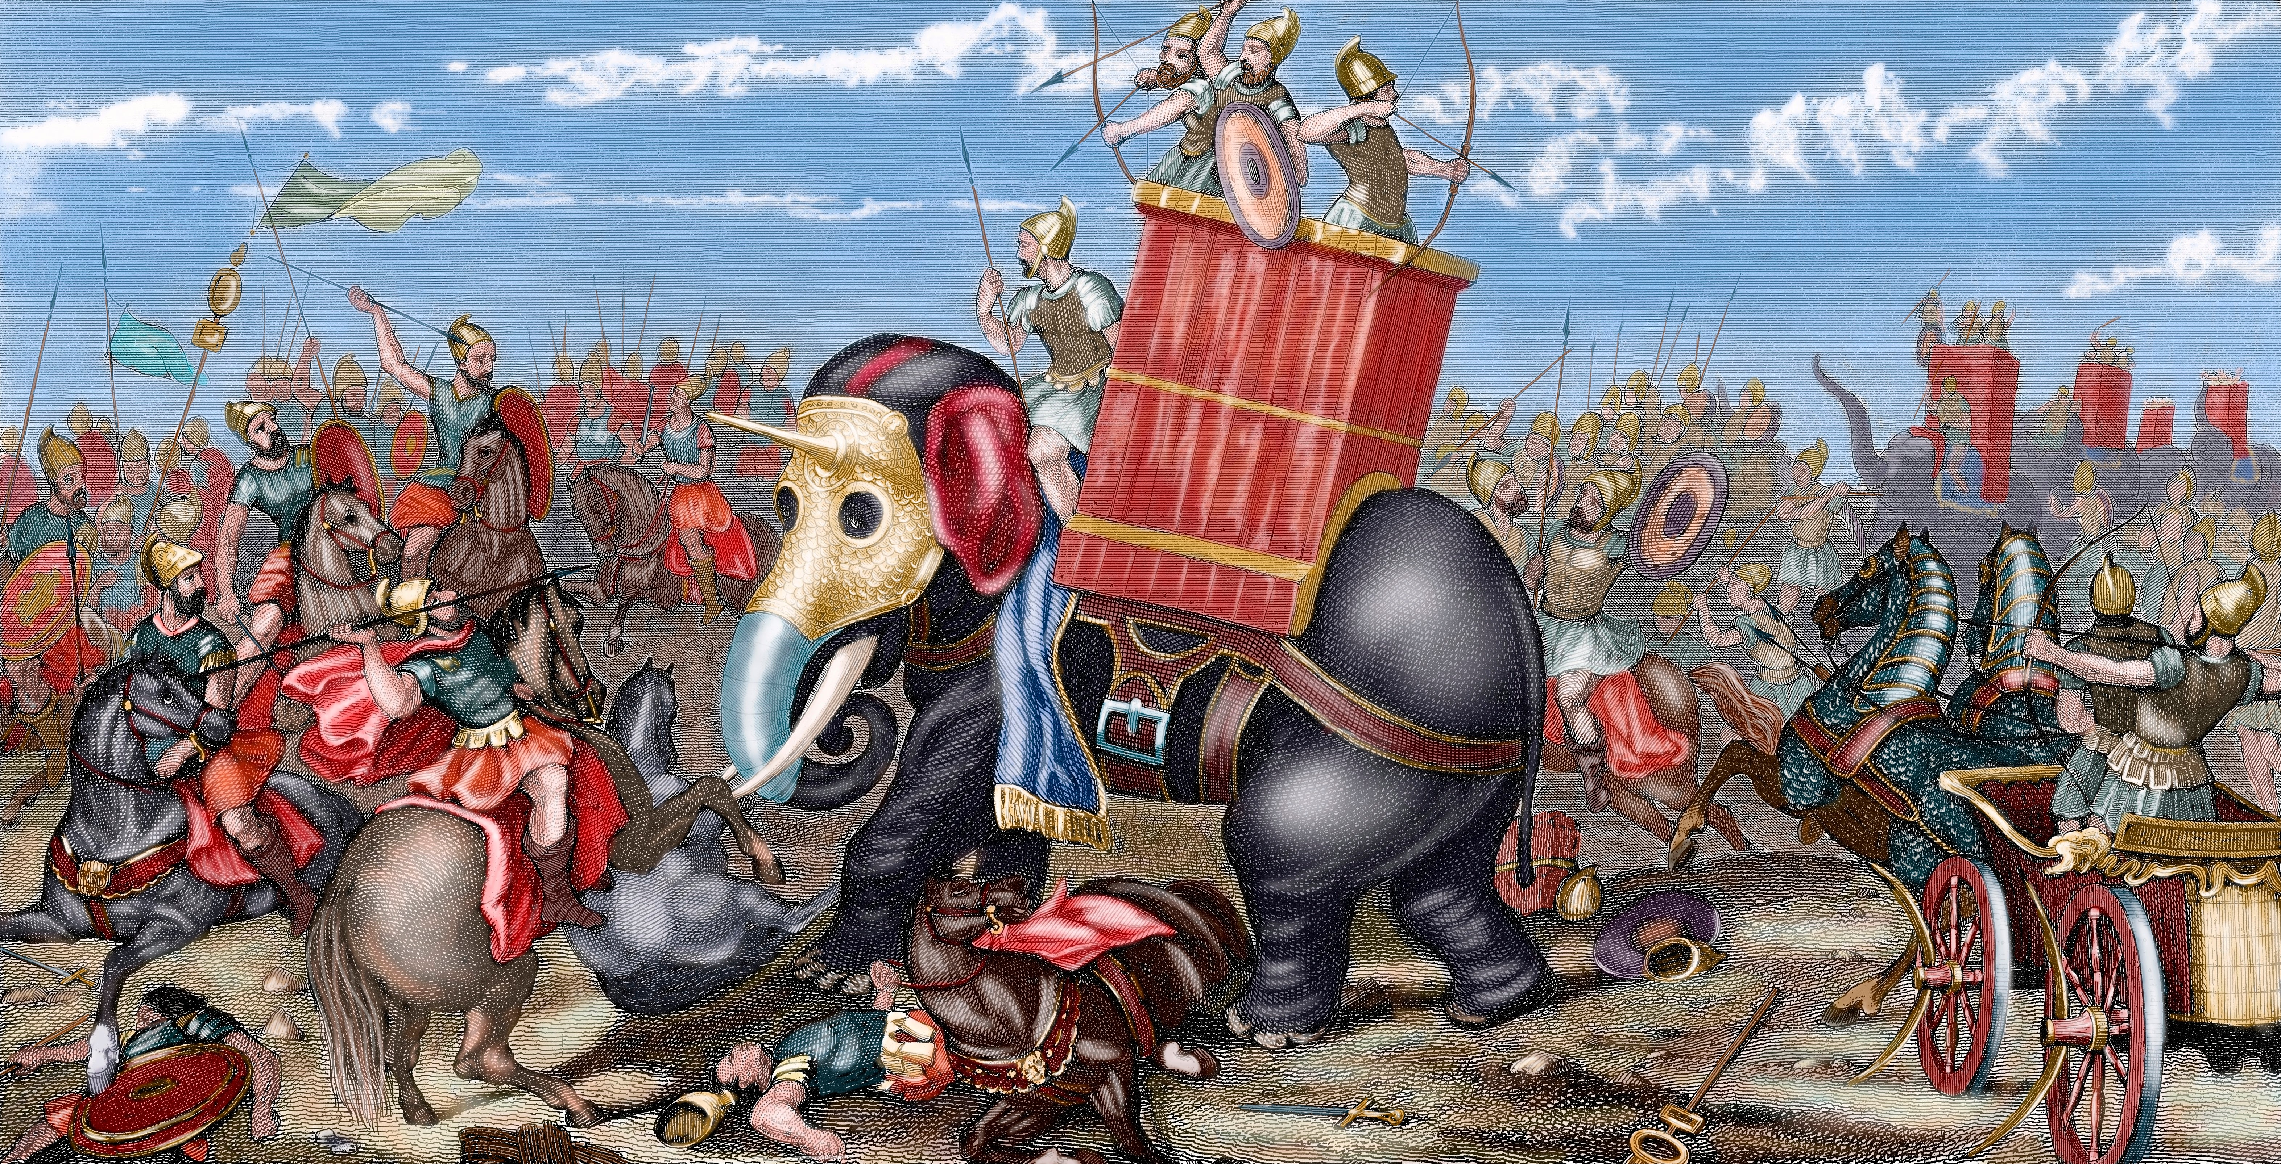
Thank you!

