Slide 1
Anonymous Counting Tokens
Fabrice Benhamouda*
Amazon Web Services
Mariana Raykova
Google
Karn Seth
Google
*Work done while at Algorand Foundation

Slide 2
Introduction

Slide 3
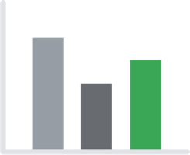
Private Counting
Histogram
of
Counts
“Orange”
“Keyboard”
“Puppy”
“Holiday”
“Skateboard”
“Orange”
“Puppy”
“Footstool”
“Holiday”

Slide 4
Private Counting
Histogram
of
Counts
“Orange”
“Keyboard”
“Puppy”
“Holiday”
“Skateboard”
“Orange”
“Puppy”
“Footstool”
“Holiday”

Slide 5
Private Counting
Histogram
of
Counts
Secure Aggregation
[BIK+17, BBG+20]
“Orange”
“Keyboard”
“Puppy”
“Holiday”
“Skateboard”
“Orange”
“Puppy”
“Footstool”
“Holiday”

Slide 6
Private Counting
Histogram
of
Counts
Secure Aggregation
[BIK+17, BBG+20]
“Orange”
“Keyboard”
“Puppy”
“Orange”
“Orange”
“Orange”
“Puppy”
“Footstool”
“Holiday”

Slide 7
Private Counting
Histogram
of
Counts
Secure Aggregation !!
[BIK+17, BBG+20]
“Orange”
“Keyboard”
“Puppy”
“Orange”
“Orange”
“Orange”
“Puppy”
“Footstool”
“Holiday”

Slide 8
Private Counting
Histogram
of
Counts
Secure Aggregation !!
[BIK+17, BBG+20]
“Orange”
“Keyboard”
“Puppy”
“Orange”
“Orange”
“Orange”
“Puppy”
“Footstool”
“Holiday”
…
“Orange”
“Keyboard”
“Puppy”
“Orange”
“Orange”
“Orange”
“Puppy”
“Footstool”
“Holiday”
…
“Orange”
“Keyboard”
“Puppy”
“Orange”
“Orange”
“Orange”
“Puppy”
“Footstool”
“Holiday”
…
Magnified when we want users to be able to contribute many times

Slide 9
Private Counting
(Could add proofs of one-hotness, but Secure Aggregation still has other limitations)
Histogram
of
Counts
Secure Aggregation !!
[BIK+17, BBG+20]
“Orange”
“Keyboard”
“Puppy”
“Orange”
“Orange”
“Orange”
“Puppy”
“Footstool”
“Holiday”
…
“Orange”
“Keyboard”
“Puppy”
“Orange”
“Orange”
“Orange”
“Puppy”
“Footstool”
“Holiday”
…
“Orange”
“Keyboard”
“Puppy”
“Orange”
“Orange”
“Orange”
“Puppy”
“Footstool”
“Holiday”
…
Magnified when we want users to be able to contribute many times

Slide 10
Can we privately count user contributions while enforcing rate-limits?

Slide 11
Can we privately count user contributions while enforcing rate-limits?
Server should not learn which specific user had which specific contributions
A specific user should be able to contribute many times, but only be able to contribute each specific term at most once
Notes:
How can we do this? One way is to try to add more features to Secure Aggregation protocols, like proofs of boundedness of contributions, but those add their own limitations, like needing users to be online at the same time to update the count.

Slide 12
Private Counting via Tokens
Histogram
of
Counts
“This contribution is distinct from all prior contributions from this user”
“Holiday”
“Skateboard”
“Orange”

Slide 13
Anonymous Counting Tokens
Issuer
Redeemer
Blind
Request
“Holiday”
“Holiday”

Slide 14
Anonymous Counting Tokens
Issuer
Redeemer
Blind
Request
“Holiday”
“Holiday”
“signed out”/
anonymous
“signed in”

Slide 15
Anonymous Counting Tokens
Issuer
Redeemer
Could be the same party
or different parties
Blind
Request
“Holiday”
Anonymity could be achieved via IP Blinding
“Holiday”
“signed out”/
anonymous
“signed in”

Slide 16
What we want from the primitive
Security for the client:
Blind: Server shouldn’t learn the client’s contribution
Unlinkable: Server shouldn’t be able to link a token redemption (during counting) to any token issuance.
Security for the server:
A malicious client shouldn’t be able to inflate the counts for any contribution
Unforgeable: A client should only be able to obtain tokens for a message for which it has issued a successful token request
Single-use: Tokens can only be used once
Detecting Duplicate Requests: A server should be able to detect if the client is requesting/redeeming a token for the same message it requested previously

Slide 17
What we want from the primitive
Security for the client:
Blind: Server shouldn’t learn the client’s contribution
Unlinkable: Server shouldn’t be able to link a token redemption (during counting) to any token issuance.
Security for the server:
A malicious client shouldn’t be able to inflate the counts for any contribution
Unforgeable: A client should only be able to obtain tokens for a message for which it has issued a successful token request
Single-use: Tokens can only be used once
Detecting Duplicate Requests: A server should be able to detect if the client is requesting/redeeming a token for the same message it requested previously

Slide 18
In this work
We show it’s possible to efficiently contruct Anonymous Counting Tokens
We give 4 different constructions, with different assumptions, underlying primitives, and efficiency

Slide 19
Applications

Slide 20
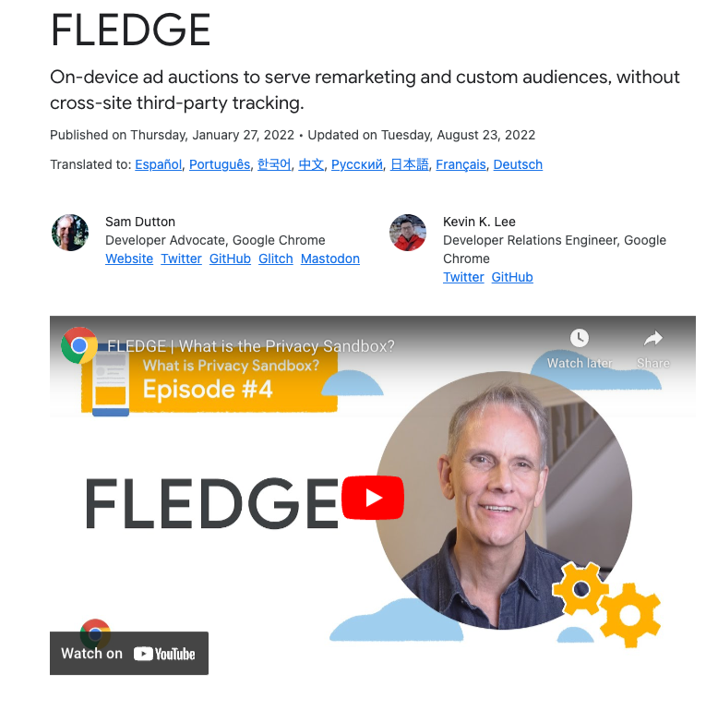
Private Interest Groups for Privacy Sandbox
The Privacy Sandbox proposal enables private auctions to be run on-device rather than in the cloud, thereby allowing a higher degree of privacy.
In this proposal, a users can join interest groups that affect the ads they are served.
Source: https://developer.chrome.com/docs/privacy-sandbox/protected-audience/

Slide 21
Private Interest Groups for Privacy Sandbox
Privacy Sandbox servers need to determine whether sufficiently many users have been added to each interest group before allowing that interest group to be used in an auction.
Anonymous counting tokens allow a server to perform this counting while hiding which individual user joined which interest groups

Slide 22
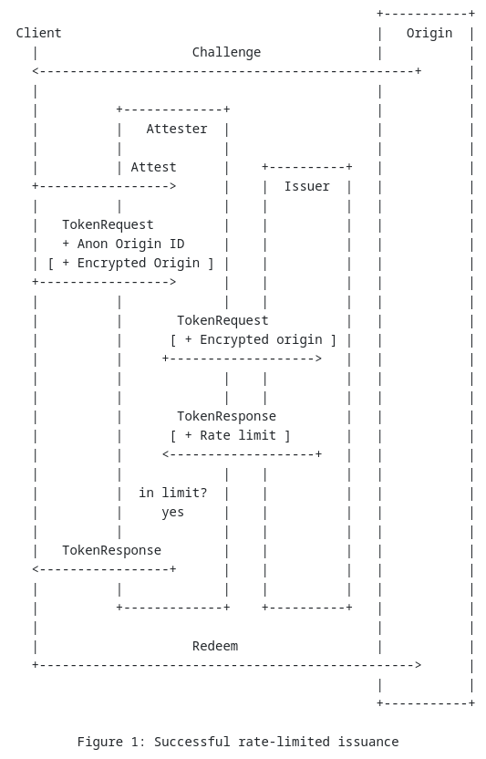
IETF draft: Rate Limited tokens
Proposal for rate-limited tokens
Requires 2 non-colluding servers at issuance
Our constructions allow replacing them with a single server.
Source:https://datatracker.ietf.org/doc/draft-ietf-privacypass-rate-limit-tokens/

Slide 23
Our approach

Slide 24
Can we use any blind token scheme?
Issuer
Redeemer
Blind
Request
“Holiday”
“Holiday”
“signed out”/
anonymous
“signed in”

Slide 25
Can we use any blind token scheme? No
Issuer
Redeemer
1000x
Blind
Request
“Holiday”
1000x
“Holiday”
“signed out”/
anonymous
“signed in”
A generic blind signature scheme doesn’t prevent repeated queries

Slide 26
Can we use any blind + deterministic token scheme?
Issuer
Redeemer
Only one possible token for “Holiday”
Blind
Request
“Holiday”
“Holiday”
“signed out”/
anonymous
“signed in”

Slide 27
Can we use any blind + deterministic token scheme? No
Issuer
Redeemer
1000x
Only one possible token for “Holiday”
Blind
Request
“Holiday”
“Signed out” attacker can simply replay the token
Server can’t tell whether it’s the same attacker or different users
“Holiday”
“signed out”/
anonymous
“signed in”

Slide 28
Can we use any blind + deterministic token scheme?
Issuer
Redeemer
Only one possible request for “Holiday”
Blind
Request
“Holiday”
“Holiday”
“signed out”/
anonymous
“signed in”

Slide 29
Can we use any blind + deterministic token scheme? No
Issuer
Redeemer
Only one possible request for “Holiday”
Blind
Request
“Holiday”
Server can break blindness by guessing the message
“Holiday”
“signed out”/
anonymous
“signed in”

Slide 30
Can we add client-specific deterministic tags?

Slide 31
Can we add client-specific deterministic tags?
Yes
But we have to be careful not to break privacy

Slide 32
Variant 1: Tag the request, throttle at Issuance
Issuer rejects on repeated tag
Issuer
Redeemer
Blind
Request
“Holiday”
Same for repeated
(client +
message)
“Holiday”
“signed out”/
anonymous
“signed in”

Slide 33
Variant 1: Tag the request, throttle at Issuance
Issuer rejects on repeated tag
Issuer
Redeemer
Blind
Request
Tag must hide the message
“Holiday”
Same for repeated
(client +
message)
“Holiday”
“signed out”/
anonymous
“signed in”

Slide 34
Variant 2: Tag the token, throttle at Redemption
Redeemer rejects on repeated tag
Issuer
Redeemer
Blind
Request
“Holiday”
Same for repeated
(client +
message)
“Holiday”
“signed out”/
anonymous
“signed in”

Slide 35
Variant 2: Tag the token, throttle at Redemption
Redeemer rejects on repeated tag
Issuer
Redeemer
Blind
Request
Tag must hide the client
(and the issuance session)
“Holiday”
Same for repeated
(client +
message)
“Holiday”
“signed out”/
anonymous
“signed in”

Slide 36
Related works that don’t quite achieve what we need
Anonymous tokens schemes
[DGS+18, KLOR20]
“messages” are random, no rate-limiting
Blind signatures [Cha82]
No rate-limiting
Equivalence Class Signatures (EQS) and Anonymous credentials
[FHS19] and [HS21] have a construction for anonymous credentials which are “tag-based” and “aggregatable”
Requires the issuer to learn the tag
Anonymous tokens with Public or Private metadata
[KLOR20, TCR+22, SS22, CDV23]
Require the issuer to know the metadata

Slide 37
Our constructions

Slide 38
Our contributions
 | Tagging | Assumption | Message Size | Publicly Verifiable | Notes
OPRF based | Issuance | q-DDHI, DCR, ROM | any |  | Doesn’t require bilinear groups
EQS-based Construction 1 | Redemption | SXDH, q-DDHI | log(q) |  | Restricted to short messages, no ROM
EQS-based Construction 2 | Redemption | SXDH, q-DDHI, ROM | any
EQS-based Construction 3 | Redemption | GBGM, ROM | any |  | Most efficient

Slide 39
Our contributions
 | Request size | Response size | Token size
OPRF based | 5 * Ped + 4 * CS + 12 * Z_{p} + 11 * Z_{N} | 1 * Ped + 1 * Z_{p} + 3 * Z_{N} | 1 * |G|
EQS-based Construction 1 | 7 * |G₁| + 6 * |G₂| | 5 * |G₁| + 1 * |G₂| | 23 * |G₁| + 12 * |G₂|
EQS-based Construction 2 | 2 * Z_{p} + 3 * |G₁| | 5 * |G₁| + 1 * |G₂| | 23 * |G₁| + 12 * |G₂|
EQS-based Construction 3 | 2 * Z_{p} + 2 * |G₁| | 2 * |G₁| + 1 * |G₂| | 3 * |G₁| + 1 * |G₂|

Slide 40
Our contributions
 | Request size | Response size | Token size
OPRF based | 5 * Ped + 4 * CS + 12 * Z_{p} + 11 * Z_{N} | 1 * Ped + 1 * Z_{p} + 3 * Z_{N} | 1 * |G|
EQS-based Construction 1 | 7 * |G₁| + 6 * |G₂| | 5 * |G₁| + 1 * |G₂| | 23 * |G₁| + 12 * |G₂|
EQS-based Construction 2 | 2 * Z_{p} + 3 * |G₁| | 5 * |G₁| + 1 * |G₂| | 23 * |G₁| + 12 * |G₂|
EQS-based Construction 3 | 2 * Z_{p} + 2 * |G₁| | 2 * |G₁| + 1 * |G₂| | 3 * |G₁| + 1 * |G₂|
Privacy Pass | 1 * |G| | 1 * |G| + 2 * Z_{p} | λ

Slide 41
Notes on our constructions
Require clients to register a public key with the Issuer
The client must also store the corresponding local secret
The client-specific tags will depend on this key
Without this key, it is hard to force a client to generate colliding tags
Put another way, without registrations it’s hard to distinguish between a returning client and a never-before-seen client
Our schemes require trusted setup for the issuer parameters
For Construction 1, the parameters can be generated in MPC or certified by a third party
For Constructions based on EQS, we require a CRS.

Slide 42
Constructions

Slide 43
Construction 1:
Based on Boneh-Boyen PRF

Slide 44
How we can construct it (high-level)
Tag a blind signature request with an attached blind fingerprint
Fingerprints collide when messages are identical
The fingerprint reveals nothing extra about the underlying message
A client can’t fake or forge the fingerprint
Consistency is enforced between the signature request and the fingerprint
Server keeps track of all fingerprints for previous requests from the client
The server will only responds to requests with a fresh fingerprint

Slide 45
Cryptographic components
Verifiable Random Function
Used for fingerprint
Inputs: Com(key), Com(message)
Outputs: F_{key}(message), proof of consistency
Blind Signature on Committed Message
Client Input: Com(message)
Blind Signature request contains a proof that the underlying message is consistent with Com(message)
Client Output: (message, nonce, signature)

Slide 46
How we can construct it (high-level)
Client
Server
Com(k_{VRF})
Registration

Slide 47
How we can construct it (high-level)
Client
Server
Com(k_{VRF})
Registration
Com(m)
VRF_{k_VRF}(m) + proof
Token Request

Slide 48
How we can construct it (high-level)
Client
Server
Com(k_{VRF})
Registration
Com(m)
VRF_{k_VRF}(m) + proof
Checks VRF_{k_VRF}(m) is unique
Token Request

Slide 49
How we can construct it (high-level)
Client
Server
Com(k_{VRF})
Registration
Com(m)
VRF_{k_VRF}(m) + proof
Checks VRF_{k_VRF}(m) is unique
Token Request
BlindSignatureRequest(m) + proof
BlindSignatureResponse(m)

Slide 50
How we can construct it (high-level)
Client
Server
Com(k_{VRF})
Registration
Com(m)
VRF_{k_VRF}(m) + proof
Checks VRF_{k_VRF}(m) is unique
Token Request
BlindSignatureRequest(m) + proof
BlindSignatureResponse(m)

Slide 51
Dodis-Yampolskiy VRF
Dodis-Yampolskiy VRF:
F_{K}(m) = g^{1/(k+m)}
Supports a proof:
Given Com(m), Com(k) and 𝝈, Client can prove that 𝝈 = F_{K}(m)
Uses Pedersen Commitments.
Proof is a “sigma protocol”
(3 round protocol made non-interactive using the Fiat-Shamir heuristic)

Slide 52
Boneh-Boyen Signature
Boneh-Boyen Signature (privately verifiable):
Secret key = (k, y)
Sign_{(k,y)}(m, r) = g^{1/(k + m + yr)}
Nonce r is required for signatures to be distinct
(Otherwise signatures are deterministic, and clients can replicate them)

Slide 53
Boneh-Boyen Signature
Boneh-Boyen Signature (privately verifiable):
Secret key = (k, y)
Sign_{(k,y)}(m, r) = g^{1/(k + m + yr)}
Blind issuance with client-chosen nonce:
Server generates and sends Enc(k), Enc(y) using an additive homomorphic scheme
Client homomorphically computes Enc(a * (k + m + yr)) using random mask “a”
Server decrypts and computes 𝝈’ = g^{1/a(k + m + yr)}
Client computes 𝝈 = (𝝈’)ª = g^{1/(k + m + yr)}

Slide 54
Boneh-Boyen Signature
Boneh-Boyen Signature (privately verifiable):
Secret key = (k, y)
Sign_{(k,y)}(m, r) = g^{1/(k + m + yr)}
Blind issuance with client-chosen nonce:
Server generates and sends Enc(k), Enc(y) using an additive homomorphic scheme
Client homomorphically computes Enc(a * (k + m + yr)) using random mask “a”
Server decrypts and computes 𝝈’ = g^{1/a(k + m + yr)}
Client computes 𝝈 = (𝝈’)ª = g^{1/(k + m + yr)}
Need the nonce to be collaboratively chosen
r = r_{C} + r_{S} where r_{C} is chosen by the client and r_{S} by the server
Need proofs of consistency with a committed message.

Slide 55
Boneh-Boyen Signatures
Client
Server
Enc(k), Enc(y)
Setup

Slide 56
Boneh-Boyen Signatures
Client
Server
Enc(k), Enc(y)
Setup
Com(m), Com(r_{C})
Signature Request

Slide 57
Boneh-Boyen Signatures
Client
Server
Enc(k), Enc(y)
Setup
Com(m), Com(r_{C})
r_{S}
Signature Request
r := r_{C} + r_{S}

Slide 58
Boneh-Boyen Signatures
Client
Server
Enc(k), Enc(y)
Setup
Com(m), Com(r_{C})
r_{S}
Signature Request
Com(a), Enc(a * (k + m + yr)), proof
r := r_{C} + r_{S}

Slide 59
Boneh-Boyen Signatures
Client
Server
Enc(k), Enc(y)
Setup
Com(m), Com(r_{C})
r_{S}
Signature Request
Com(a), Enc(a * (k + m + yr)), proof
r := r_{C} + r_{S}

Slide 60
Boneh-Boyen Signatures
Client
Server
Enc(k), Enc(y)
Setup
Com(m), Com(r_{C})
r_{S}
Signature Request
Com(a), Enc(a * (k + m + yr)), proof
r := r_{C} + r_{S}
β = Decrypt(
Enc(a * (k + m + yr)))

Slide 61
Boneh-Boyen Signatures
Client
Server
Enc(k), Enc(y)
Setup
Com(m), Com(r_{C})
r_{S}
Signature Request
Com(a), Enc(a * (k + m + yr)), proof
r := r_{C} + r_{S}
β = Decrypt(
Enc(a * (k + m + yr)))
𝝈’ = g^{1/β} = g^{1/a(k + m + yr)}, proof
𝝈 = (𝝈’)ª

Slide 62
Boneh-Boyen Signatures
Client
Server
Enc(k), Enc(y)
Setup
Com(m), Com(r_{C})
r_{S}
Signature Request
Com(a), Enc(a * (k + m + yr)), proof
r := r_{C} + r_{S}
β = Decrypt(
Enc(a * (k + m + yr)))
𝝈’ = g^{1/β} = g^{1/a(k + m + yr)}, proof
𝝈 = (𝝈’)ª
= g^{1/(k + m + yr)}

Slide 63
Boneh-Boyen Signatures
Client
Server
Enc(k), Enc(y)
Setup
This round can be made noninteractive by having client locally compute
r_{S} := H(Com(m)||Com(r_{C}))
(Fiat-Shamir heuristic)
Com(m), Com(r_{C})
r_{S}
Signature Request
Com(a), Enc(a * (k + m + yr)), proof
r := r_{C} + r_{S}
β = Decrypt(
Enc(a * (k + m + yr)))
𝝈’ = g^{1/β} = g^{1/a(k + m + yr)}, proof
𝝈 = (𝝈’)ª
= g^{1/(k + m + yr)}

Slide 64
Boneh-Boyen Signature
All proofs are sigma protocols
Technically, we use 2 masks a and b, and homomorphically compute
Enc(a * (k + m + yr) + bq)
“bq” can be seen as homomorphically taking a “mod-q”
It’s needed because the message space of the encryption scheme (i.e. N) is different from the order of g (i.e. q)

Slide 65
Constructions 2,3,4:
Based on Bilinear maps and EQS

Slide 66
Equivalence Class Signature
Allows signing vectors of messages
𝛔 = Sign(M₁, M₂, …, M_{t}, sk)
Verify(M₁, M₂, …, M_{t}, sk)
Built-in homomorphism: signature can be publicly adapted into another one in the same “class”
The constructions we use allow multiplying by a constant
Let 𝜇 be a scalar
Adapt(𝛔, 𝜇) yields 𝛔’, where 𝛔’ is a signature on (𝜇 * M₁, 𝜇* M₂, …, 𝜇* M_{t})

Slide 67
Equivalence Class Signature → Blind Signature
Client can request a signature on (𝜇⁻¹ * G, 𝜇⁻¹ * M) for a message M, a random 𝜇 and a fixed G.
Let 𝛔 be the resulting signature.
Then the client can run Adapt(𝛔, 𝜇) to get a signature on (G, M)
The verifier can require the first element of the signature to always be G.

Slide 68
EQS → Blind Signature
Client
Server
𝜇 ←$
𝜇⁻¹*G, 𝜇⁻¹*M
𝛔 = Sign(𝜇⁻¹*G, 𝜇⁻¹*M, sk)
𝛔
𝛔’ = Adapt (𝜇, 𝛔)
𝛔’ is a signature on (G, M)

Slide 69
Our idea for tagging:
Have the client register a public key for a VRF with the issuer
U = u * G for fixed generator G
Public key = U, secret key = u
Let m be the message and let M = m * G.
Let F_{u}(m) be the output of the VRF on the message m.
Then we use the EQS scheme to blindly request a signature on (G, F_{u}(m), M)
Together with proofs that:
The same m is used in M and F_{u}(m)
The key used for F_{u}(m) is the same as that in U.
The unblinded signature serves as the token, with the F_{u}(m) component of the message serving as the tag
The PRF property of the VRF guarantees that the tag doesn’t allow linkability

Slide 70
EQS → Blind Signature
Client
Server
Register
u ←$
U = u*G
Signature Request
(𝜇⁻¹*G, 𝜇⁻¹*F_{u}(m), 𝜇⁻¹*m*G), proof
𝜇 ←$
𝛔 = Sign(
𝜇⁻¹*G, 𝜇⁻¹*F_{u}(m), 𝜇⁻¹*m*G,
sk)
𝛔
𝛔’ = Adapt (𝜇, 𝛔)
𝛔’ is a signature on (G, F_{u}(m) , m*G)

Slide 71
EQS → Blind Signature
Client
Server
Register
u ←$
U = u*G
Signature Request
(𝜇⁻¹*G, 𝜇⁻¹*F_{u}(m), 𝜇⁻¹*m*G), proof
𝜇 ←$
𝛔 = Sign(
𝜇⁻¹*G, 𝜇⁻¹*F_{u}(m), 𝜇⁻¹*m*G,
sk)
𝛔
𝛔’ = Adapt (𝜇, 𝛔)
𝛔’ is a signature on (G, F_{u}(m) , m*G)

Slide 72
Equivalence Class Signature
Existing schemes:
Structure-preserving signatures (e.g. [JR17]) + Groth-Sahai NIZK
The adaptation of the signature of a message vector M to a message M′ = 𝜇*M is a ZK proof of knowledge of a valid signature on M and of a scalar 𝜇 such that M′ = 𝜇*M
Uses Groth-Sahai proofs ([GS08], [EG14])
Secure under Strong External Diffie Hellman (SXDH) assumption in bilinear groups.
[FHS19]:
Uses Fiat-Shamir transform of Sigma protocols as the adaption.
Secure in the Generic Bilinear Group model (GBGM).

Slide 73
Implementation

Slide 74
Implementation
https://github.com/google/anonymous-counting-tokens
Implements a batched version of Construction 1
Batching has a significant impact on the efficiency of token issuance
All commitments and sigma protocols are batched.
Incurs about 70 ms of computation and 9 KB of communication per token
Includes implementations of Boneh-Boyen oblivious PRF evaluation, DY VRF, and all the underlying cryptographic primitives.

Slide 75
Summary

Slide 76
Summary
Introduced the notion of Anonymous Counting Tokens
Supporting rate-limiting and blind issuance
Discussed applications
Gave 4 new constructions, with a variety of underlying assumptions
3 requiring bilinear maps, 1 without
3 requiring Random Oracles, 1 without
Our most efficient constructions are competitive with anonymous token schemes without rate-limiting, like Privacy Pass
Extension to general rate-limiting (presented in full paper)
Implementation of Construction 1

Slide 77
Thank you!

