Slide 1
The Relationship Between Idealized Models
Under Computationally Bounded Adversaries
Cong Zhang¹ Mark Zhandry²
¹ Zhejiang University
² NTT Research

Slide 2
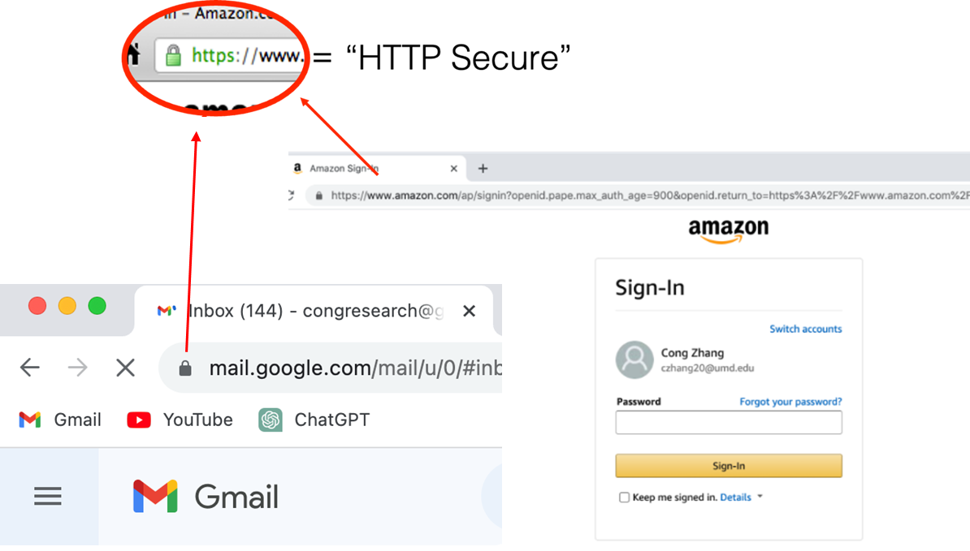
Where do we use cryptography technology in our daily life?
Cryptography is everywhere!
Http Secure
Hash and Signature
End to End Encryption

Slide 3
How could we justify the security of those crypto tools?
Provable security
Hmm.., explain it
Provable security shows that breaking crypto tools is as hard as solving some mathematical problems
Mathematical Problems
Reductions
Models of Computation
Aka. Computational Assumptions
Standard Model
Random Oracle Model
Generic Group Model
Discrete Logarithm
Factoring
Short Vector Problem
Hard
problems
Crypto
tools

Slide 4
Diving In

Slide 5
Outline
Motivation
GGM is strictly stronger than ROM
GBM is strictly stronger than GGM
Conclusion

Slide 6
Outline
Motivation
GGM is strictly stronger than ROM
GBM is strictly stronger than GGM
Conclusion

Slide 7
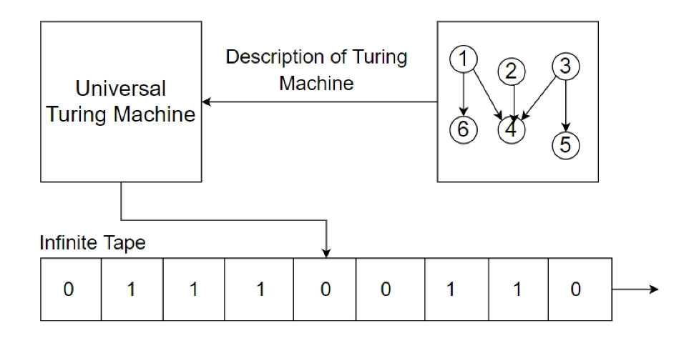
Standard Model
In modern cryptography, standard model is the most popular model of computation which captures all the algorithms that can be described via a Turing machine
In cyberspace, the standard model captures all kinds of adversaries in the world
( ignoring quantum adversaries for now)
Sometimes, efficiency of crypto tools in the standard model is not good enough
To obtain better efficiency，variants of models of computation are proposed

Slide 8
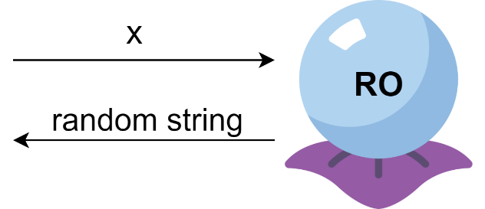
Idealized Models
Random Oracle Model (ROM)
The random oracle model is an idealized model of a truly random publicly accessible hash function H：${\left\{0,1\right\}}^{∗}→{\left\{0,1\right\}}^{n}$.
Utility: OAEP, Fiat-Shamir transform, Fujisaki-Okamoto transform
Generic Group Model (GGM)
The generic group model is an idealized model of a random group encoding from $Z_{P}$ to some set $S.$ It consists of two interfaces: group labeling and group addition.
Utility: Justify tons of assumptions e.g. Dlog, CDH, DDH
Generic Bilinear-map Model (GBM)
The generic bilinear map model is an idealized model of a random bilinear group.
Utility: zk-SNARKs (Groth16)
These three models are well received in the community!

Slide 9
Relationship Between Them
Why the relationship is important？
If
can build
Then
can justify all the assumptions in
However, IR’89 and Zhandry’22 show impossibility
Key agreement is black-box separated from the Random Oracle model
GGM implies key agreement
Identity-based encryption is black-box separated from GGM
GBM implies IBE
GBM>GGM>ROM

Slide 10
Under Computationally Bounded Adversaries
computational
assumptions
If TRUE , then and imply all the assumptions in
This motivation is encouraged by Zhandry and Zhang（Crypto 2020）
ZZ20 shows ideal NIKE can be built from ROM and assumptions, which bypass the impossibility of IR89
Unfortunately, we prove:
GBM>GGM>ROM，even considering computationally Bounded adversaries

Slide 11
Our Results
Theorem: In the framework of indifferentiability, the Generic Group Model is strictly stronger than the Random Oracle Model unconditionally (against computational bounded adversaries)
[Zhang-Zhandry,Asiacrypt’23]
Theorem: In the framework of indifferentiability, the Generic Bilinear-map Model is strictly stronger than the Generic Group Model unconditionally (against computational bounded adversaries)
[Zhang-Zhandry,Asiacrypt’23]

Slide 12
Think Deeper
An introspection on the hierarchy of the idealized models
heuristic
GBM
GGM
[ZZ’20]
ROM
Ideal NIKE
Hash
Key Agreement
IBE
standard model

Slide 13
Moving on...

Slide 14
Outline
Motivation
GGM is strictly stronger than ROM
GBM is strictly stronger than GGM
Conclusion

Slide 15
GGM>ROM via indifferentiability
The framework of indifferentiability
Real World
$$≈$$
Ideal World
Construction
Simulator
Composition Theorem: If A implies B in the framework of indifferentiability, then for any cryptosystem P that is secure in model B, we have that P is also secure in model A with respect to the construction.
[Maurer-Renner-Holenstein, TCC2004]
Indifferentiability becomes the typical framework to study the relationship between distinct models

Slide 16
Our Strategy
GGM implies ROM statistically
We build a construction $C$ such that $C^{GGM}$ is indifferentiable from ROM
GGM is separated from ROM computationally
Identify a hard problem P
Prove P is hard in the GGM
Prove for any construction $C$, P is easy in ROM with respect to $C$
Prove if $C^{ROM}$ is indifferentiable from GGM, then P is easy in the GGM

Slide 17
Our Strategy
GGM implies ROM statistically
We build a construction $C$ such that $C^{GGM}$ is indifferentiable from ROM
GGM is separated from ROM computationally
Identify a hard problem P
Prove P is hard in the GGM
Prove for any construction $C$, P is easy in ROM with respect to $C$
Prove if $C^{ROM}$ is indifferentiable from GGM, then P is easy in the GGM

Slide 18
GGM Implies ROM Statistically
Attempt 1
Attack
H(x):=label(x)
Step1.
Label: x, y, x+y
H(x), H(y), H(x+y)
H(x+y)$=$str?
Step2.
Add: H(x), H(y)
str
Our solution
Prevent the adversary to make group addition query without making labeling queries
H(x):=truc(label(x)), only outputting the first half bits of label(x)
Adversary can only obtain half of the bits and can not recover the entire bits w.h.p.

Slide 19
Our Strategy
GGM implies ROM statistically
We build a construction $C$ such that $C^{GGM}$ is indifferentiable from ROM
GGM is separated from ROM computationally
Identify a hard problem P
Prove P is hard in the GGM
Prove for any construction $C$, P is easy in ROM with respect to $C$
Prove if $C^{ROM}$ is indifferentiable from GGM, then P is easy in the GGM

Slide 20
Identifying the hard problem
Difficulty of defining such a problem
Due to bounded adversaries, the problem is against statistical adversaries
Due to indifferentiability, the problem is against computational adversaries
Our solution
We design a hybrid: a two-stage problem——Discrete Logarithm Identification ( DLI )
1 If z=x
z
P
Label(x)
B
output
P
0 otherwise
Efficient adversary with oracle access
circuit
An oracle-free circuit that identifies x
Stage 1. efficient phase
Stage 2. inefficient phase
DLI is hard: $∄$ efficient B that outputs a circuit P which identifies the challenging term x

Slide 21
Our Strategy
GGM implies ROM statistically
We build a construction $C$ such that $C^{GGM}$ is indifferentiable from ROM
GGM is separated from ROM computationally
Identify a hard problem P
Prove P is hard in the GGM
Prove for any construction $C$, P is easy in ROM with respect to $C$
Prove if $C^{ROM}$ is indifferentiable from GGM, then P is easy in the GGM

Slide 22
Breaking DLI in ROM w.r.t $C^{ROM}$
The DLI game:
Observations：
$C^{ROM}$=( $L^{ROM},A^{ROM}$ )
If setting P(·)$≔$ $L^{ROM}$(·), then P identifies x perfectly
However, P must be query-free!!!
$$C^{ROM}$$
Label(1), Label(x)
Our ideas
a query-free circuit P
challenger
adversary B
Gathering important queries in an efficient table T via adversary B
Hardware T into the circuit P
P(·)$≔L^{T}$(·)
Prove P identifies x properly
Adversary wins if P identifies x
L
Our goal
T
Build an efficient adversary B that outputs a proper circuit
If query $∉$ T, responds with random string

Slide 23
Gathering important queries
What are important queries?
Part 1
For L(x), the important queries are the one made during the labeling procedure $L^{ROM}$(x)
Denote the set of the important queries as $Q_{x}$
Trivial, responds with random string
Part 2
Trivial, sampling $x_{1},…,x_{s}$
Gathering $Q_{x_{1}}∪⋯∪Q_{x_{s}}$
Compiling $Q_{x}$ via efficient adversary B
Part 3
Part 1
Part 2
Part 3
L(x)=A(L(x-r) , L(r))
Sampling r
Gathering the queries in the addition procedure A(L(x-r) , L(r))
Query in part3 must appear in the addition procedure
Sensitive
and
frequent
queries
Sensitive
but
non-frequent
queries
non-sensitive queries
sensitive queries

Slide 24
Our Strategy
GGM implies ROM statistically
We build a construction $C$ such that $C^{GGM}$ is indifferentiable from ROM
GGM is separated from ROM computationally
Identify a hard problem P
Prove P is hard in the GGM
Prove for any construction $C$, P is easy in ROM with respect to $C$
Prove if $C^{ROM}$ is indifferentiable from GGM, then P is easy in the GGM

Slide 25
Breaking DLI in the GGM via $C^{ROM}$
Assuming $C^{ROM}$ is indifferentiable from GGM
There exists an efficient simulator
DLI is easy in ROM with respects to $C^{ROM}$
There exists an efficient adversary that can output a proper circuit
If the circuit can not identify the challenging term properly, then we can build an efficient differentiator that breaks indifferentiability
output
P
proper circuit
Combining the simulator and adversary, we break DLI in GGM

Slide 26
GGM>ROM
GGM implies ROM statistically
We build a construction $C$ such that $C^{GGM}$ is indifferentiable from ROM
GGM is separated from ROM computationally
Identify a hard problem P
Prove P is hard in the GGM
Prove for any construction $C$, P is easy in ROM with respect to $C$
Prove if $C^{ROM}$ is indifferentiable from GGM, then P is easy in the GGM
Combining together, we establish the hierarchy

Slide 27
Outline
Motivation
GGM is strictly stronger than ROM
GBM is strictly stronger than GGM
Conclusion

Slide 28
GBM>GGM
The separation is established via the same strategy but with additional difficulty
In the GGM, queries are two forms:
Labeling form and Addition form
Queries gathered in the addition procedure might be addition form
Queries needed in the labeling procedure might be labeling form
Part 1
Part 2
Part 3
Sensitive
and
frequent
queries
Sensitive
but
non-frequent
queries
non-sensitive queries
Our ideas:
sensitive queries
Although (L(x), L(y), L(z)) does not give out z explicitly, it shows a linear constraint: x+y=z
Gathering constraints and forming a linear system
Solve z from the linear system
z
(L(x) L(y) L(z))
(L(u) L(v) L(w))
L(z) or L(w)?
…
Url：https://eprint.iacr.org/2021/240

Slide 29
Outline
Motivation
GGM is strictly stronger than ROM
GBM is strictly stronger than GGM
Conclusion

Slide 30
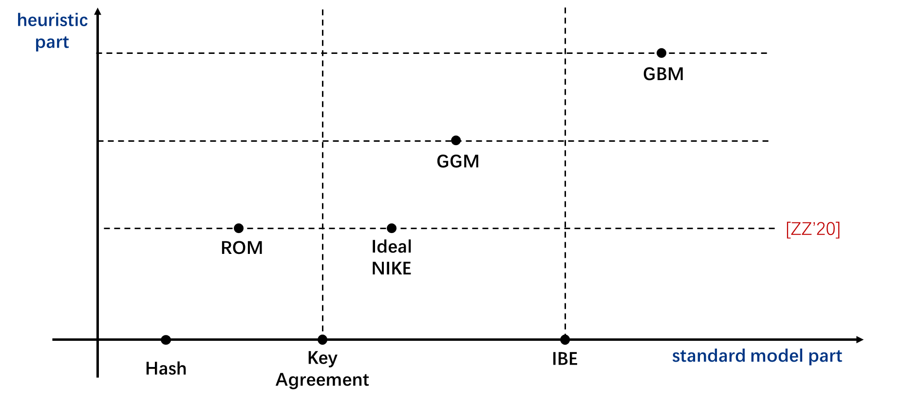
Conclusion
Our results deepen the understanding of the idealized models
Open question:
Does this hierarchy still hold in generalized case？Say, trilinear, fourth linear …
Thanks!

