Slide 1
Degree-D Reverse Multiplication-Friendly Embeddings: Constructions and Applications
Daniel Escudero, Cheng Hong, Hongqing Liu, Chaoping Xing, Chen Yuan
JP Morgan Ant Group Shanghai Jiao Tong University

Slide 2





Secure Multiparty Computation（MPC）
$$X_{1}$$
$$F(X_{1},X_{2},X_{3})$$
$$X_{2}$$
$$X_{3}$$

Slide 3


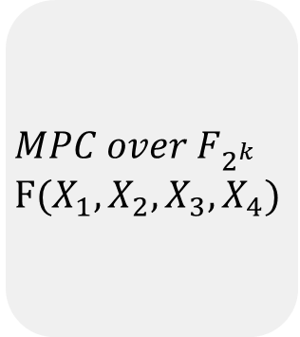


MPC protocols
For dishonest majority MPC protocol, large field size implies that the adversary will be caught with high probability.
For threshold honest majority MPC protocol, the number of parties is at most the field size. This is due to the use of Shamir secret sharing scheme and hyper-invertible matrix.
$$X_{1}∈F_{2^{k}}$$
$$X_{3}∈F_{2^{k}}$$
Question: Can we achieve the same performance for any field?
$$MPC over F_{2^{k}}$$
$$F(X_{1},X_{2},X_{3},X_{4})$$
$$X_{2}∈F_{2^{k}}$$
$$X_{4}∈F_{2^{k}}$$

Slide 4
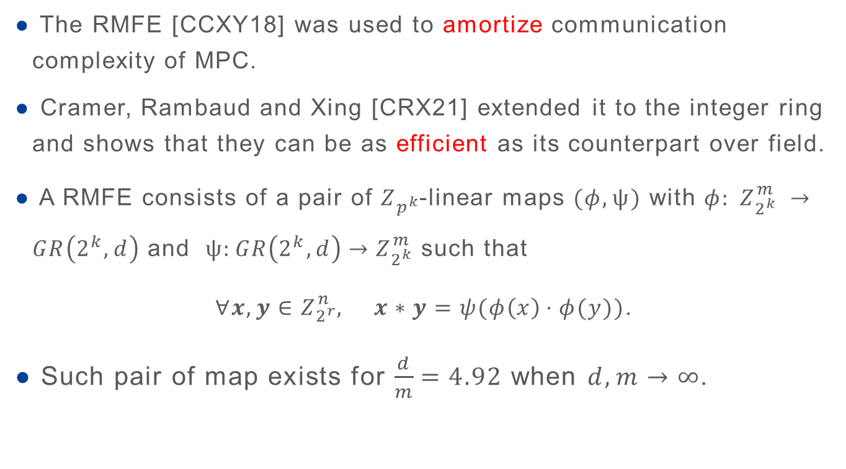
Reverse Multiplication Friendly Embedding（RMFE）
The RMFE [CCXY18] was used to amortize communication complexity of MPC.
Cramer, Rambaud and Xing [CRX21] extended it to the integer ring and shows that they can be as efficient as its counterpart over field.
A RMFE consists of a pair of $Z_{p^{k}}$-linear maps $(φ,ψ)$ with $φ: Z_{2^{k}}^{m} →GR\left(2^{k},d\right)$ and $ψ:GR\left(2^{k},d\right)→Z_{2^{k}}^{m}$ such that
$∀x,y∈Z_{2^{r}}^{n}, x∗y=ψ(φ\left(x\right)⋅φ(y))$.
Such pair of map exists for $\frac{d}{m}=4.92$ when $d,m→∞$.

Slide 5




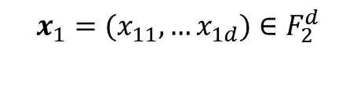


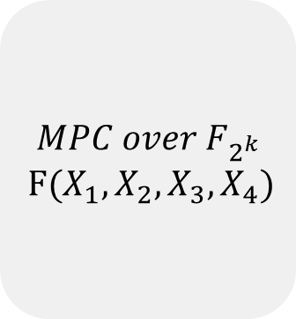

Application of RMFE
$$x_{3}=(x_{31},…x_{3d})∈F_{2}^{d}$$
$$x_{1}=(x_{11},…x_{1d})∈F_{2}^{d}$$
$${φ(x}_{3})∈F_{2^{k}}$$
$${φ(x}_{1})∈F_{2^{k}}$$
$$MPC over F_{2^{k}}$$
$$F(X_{1},X_{2},X_{3},X_{4})$$
$$x_{2}=(x_{21},…x_{2d})∈F_{2}^{d}$$
$$x_{4}=(x_{41},…x_{4d})∈F_{2}^{d}$$
$${φ(x}_{2})∈F_{2^{k}}$$
$${φ(x}_{4})∈F_{2^{k}}$$
Output
$$ψ\left(F\left(φ\left(x_{1}\right),…φ\left(x_{4}\right)\right)\right)=(f\left(x_{11},x_{21},x_{31},x_{41}\right), …,f(x_{1d},x_{2d},x_{3d },x_{4d}))$$

Slide 6
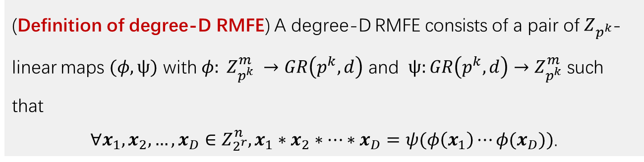
Degree-D RMFE
The previous work on RMFE only supports the multiplication of 2 elements
We generalize RMFE to degree-D RMFE which supports the multiplication of D elements.
(Definition of degree-D RMFE) A degree-D RMFE consists of a pair of $Z_{p^{k}}$-linear maps $(φ,ψ)$ with $φ: Z_{p^{k}}^{m} →GR\left(p^{k},d\right)$ and $ψ:GR\left(p^{k},d\right)→Z_{p^{k}}^{m}$ such that
$∀x_{1},x_{2},…,x_{D}∈Z_{2^{r}}^{n},x_{1}∗x_{2}∗⋯∗x_{D}=ψ(φ\left(x_{1}\right)⋯φ(x_{D}))$.

Slide 7
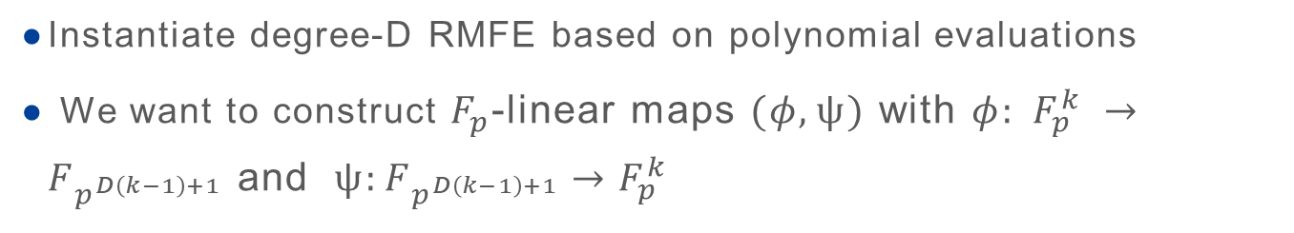
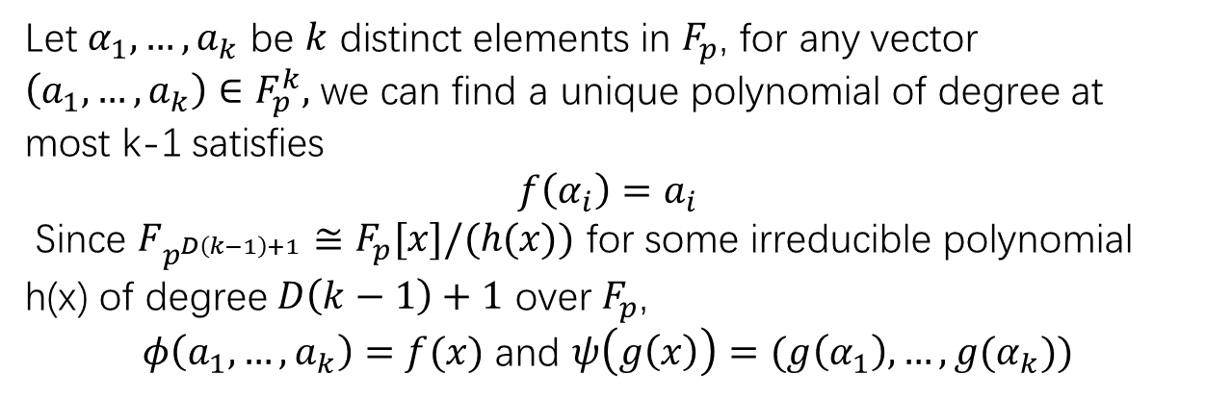
Instantiation of degree-D RMFE
Instantiate degree-D RMFE based on polynomial evaluations
We want to construct $F_{p}$-linear maps $(φ,ψ)$ with $φ: F_{p}^{k} →F_{p^{D\left(k−1\right)+1}}$ and $ψ:F_{p^{D\left(k−1\right)+1}}→F_{p}^{k}$
Let $α_{1},…,a_{k}$ be $k$ distinct elements in $F_{p}$, for any vector $\left(a_{1},…,a_{k}\right)∈F_{p}^{k},$ we can find a unique polynomial of degree at most k-1 satisfies
$$f\left(α_{i}\right)=a_{i}$$
Since $F_{p^{D\left(k−1\right)+1}}≅F_{p}[x]/(h(x))$ for some irreducible polynomial h(x) of degree $D\left(k−1\right)+1$ over $F_{p}$,
$φ\left(a_{1},…,a_{k}\right)=f(x)$ and $ψ\left(g\left(x\right)\right)=(g\left(α_{1}\right),…,g(α_{k}))$

Slide 8
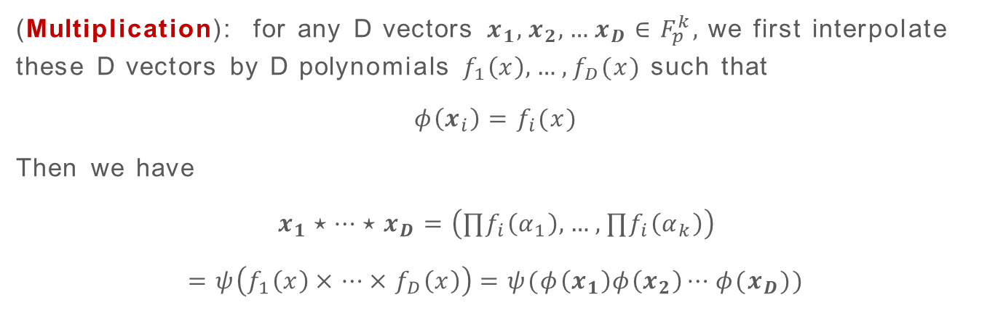
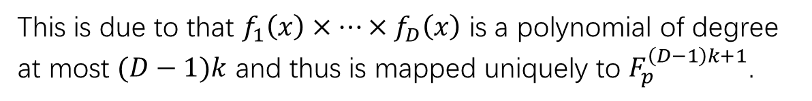
Instantiation of degree-D RMFE
(Multiplication): for any D vectors $x_{1},x_{2},…x_{D}∈F_{p}^{k},$ we first interpolate these D vectors by D polynomials $f_{1}\left(x\right),…,f_{D}(x)$ such that
$$φ\left(x_{i}\right)=f_{i}(x)$$
Then we have
$$x_{1}⋆⋯⋆x_{D}=\left(∏f_{i}\left(α_{1}\right),…,∏f_{i}\left(α_{k}\right)\right)$$
$$=ψ\left(f_{1}\left(x\right)×⋯×f_{D}\left(x\right)\right)=ψ(φ\left(x_{1}\right)φ\left(x_{2}\right)⋯φ(x_{D}))$$
This is due to that $f_{1}\left(x\right)×⋯×f_{D}\left(x\right)$ is a polynomial of degree at most $(D−1)k$ and thus is mapped uniquely to $F_{p}^{\left(D−1\right)k+1}$.

Slide 9
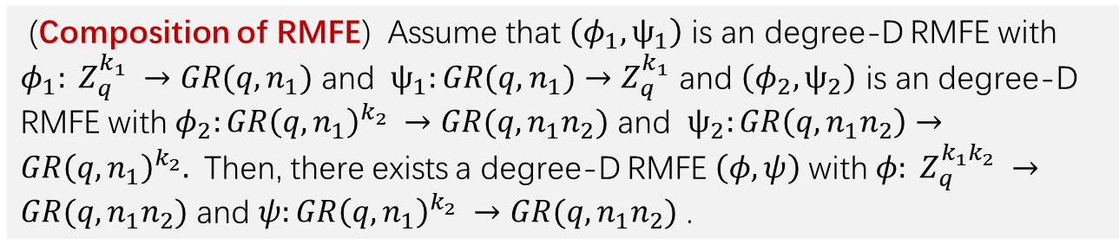
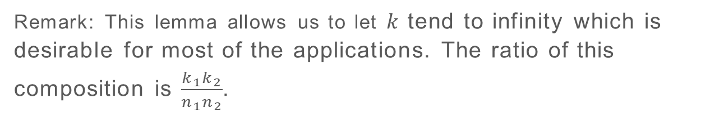
Composition of degree-D RMFE
(Composition of RMFE) Assume that $\left(φ_{1},ψ_{1}\right)$ is an degree-D RMFE with $φ_{1}: Z_{q}^{k_{1}} →GR(q,n_{1})$ and $ψ_{1}:GR(q,n_{1})→Z_{q}^{k_{1}}$ and $\left(φ_{2},ψ_{2}\right)$ is an degree-D RMFE with $φ_{2}:GR{\left(q,n_{1}\right)}^{k_{2}} →GR(q,n_{1}n_{2})$ and $ψ_{2}:GR\left(q,n_{1}n_{2}\right)→GR{\left(q,n_{1}\right)}^{k_{2}}.$ Then, there exists a degree-D RMFE $\left(φ,ψ\right)$ with $φ: Z_{q}^{k_{1}k_{2}} →GR(q,n_{1}n_{2})$ and $ψ:GR{\left(q,n_{1}\right)}^{k_{2}} →GR(q,n_{1}n_{2})$ .
Remark: This lemma allows us to let $k$ tend to infinity which is desirable for most of the applications. The ratio of this composition is $\frac{k_{1}k_{2}}{n_{1}n_{2}}$.

Slide 10
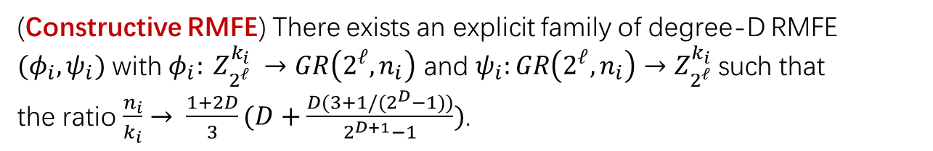
Asymptotic construction of Degree-D RMFE
(Constructive RMFE) There exists an explicit family of degree-D RMFE $(φ_{i},ψ_{i})$ with ${φ_{i}: Z}_{2^{ℓ}}^{k_{i}} →GR\left(2^{ℓ},n_{i}\right)$ and $ψ_{i}:GR\left(2^{ℓ},n_{i}\right)→Z_{2^{ℓ}}^{k_{i}}$ such that
the ratio $\frac{n_{i}}{k_{i}}→ \frac{1+2D}{3}(D+\frac{D(3+1/(2^{D}−1))}{2^{D+1}−1})$.
Remark: Such construction is obtained by composing three degree-D RMFE one of which is derived from the algebraic geometry code.

Slide 11
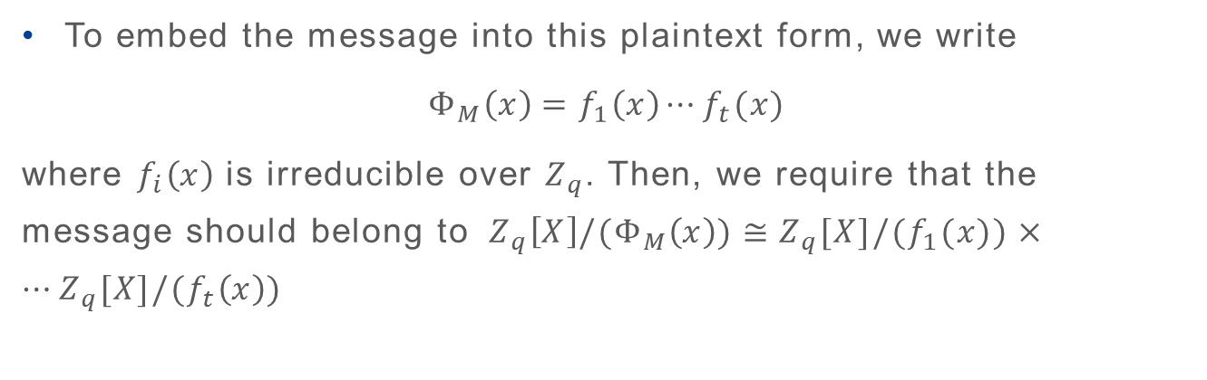
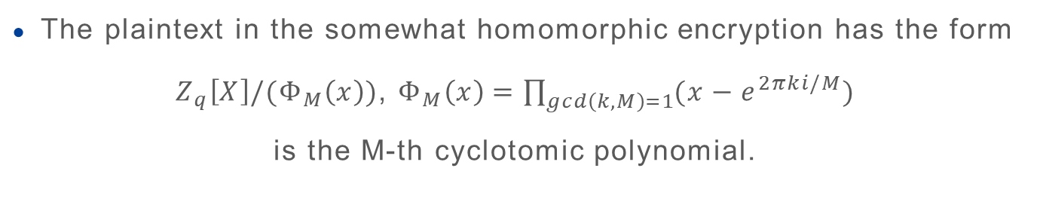
Homomorphic Encryption
The plaintext in the somewhat homomorphic encryption has the form
$Z_{q}\left[X\right]/(Φ_{M}\left(x\right))$, $Φ_{M}\left(x\right)=\prod_{gcd\left(k,M\right)=1}{(x−e^{2πki/M})}$
is the M-th cyclotomic polynomial.
To embed the message into this plaintext form, we write
$$Φ_{M}\left(x\right)=f_{1}\left(x\right)⋯f_{t}(x)$$
where $f_{i}\left(x\right)$ is irreducible over $Z_{q}$. Then, we require that the message should belong to${ Z}_{q}\left[X\right]/(Φ_{M}\left(x\right))≅Z_{q}[X]/(f_{1}(x))×⋯Z_{q}[X]/(f_{t}\left(x\right))$

Slide 12
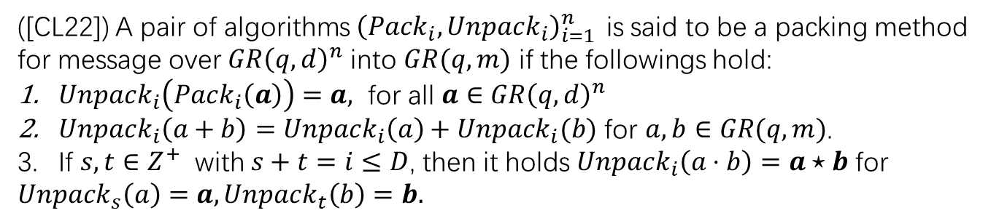
Connection with Homomorphic Encryption
The Homomorphic encryption was used in the variants of SPDZ protocol ([RSS19], [OSV20],[CKL21]) to prepare the correlated randomness for the online phase.
To embed the message into the plaintext of homomorphic encryption, Cheon and Lee [CL22] proposed a unified framework called the packing method.
([CL22]) A pair of algorithms ${\left(Pack_{i}, Unpack_{i}\right)}_{i=1 }^{n}$is said to be a packing method for message over $GR{\left(q,d\right)}^{n}$ into $GR(q,m)$ if the followings hold:
$Unpack_{i}\left(Pack_{i}\left(a\right)\right)=a,$ for all $a∈GR{\left(q,d\right)}^{n}$
$Unpack_{i}\left(a+b\right)=Unpack_{i}\left(a\right)+Unpack_{i}(b)$ for $a,b∈GR(q,m)$.
If $s,t∈Z^{+}$ with $s+t=i≤D$, then it holds $Unpack_{i}\left(a⋅b\right)=a⋆b$ for
$Unpack_{s}\left(a\right)=a, Unpack_{t}\left(b\right)=b.$

Slide 13
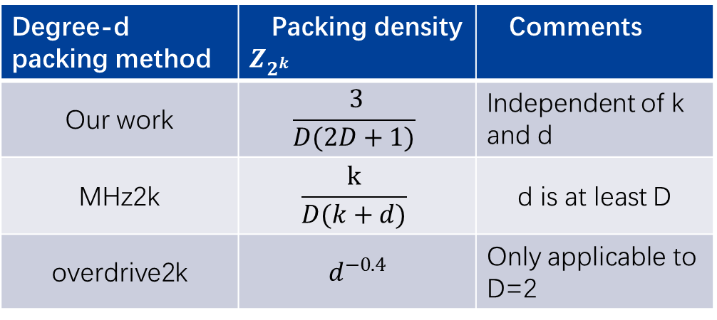
Connection with Homomorphic Encryption
We show that if the packing method is linear, then it is equivalent to the definition of degree-D RMFE. Thus, the construction of RMFE can be also applied to the packing method.
Degree-d packing method | Packing density $Z_{2^{k}}$ | Comments
Our work | $$\frac{ 3}{D(2D+1)}$$ | Independent of k and d
MHz2k | $$\frac{k}{D(k+d)}$$ | d is at least D
overdrive2k | $d^{−0.4}$ | Only applicable to D=2

Slide 14
Application to MPC protocol
We consider an application to MPC where high degree computation is required, but interaction is less desired.
The role of preprocessing committee P is to generate the required correlations.
The role of online committee Q is to consume these correlations to securely compute the desired functionality on their private inputs.

Slide 15
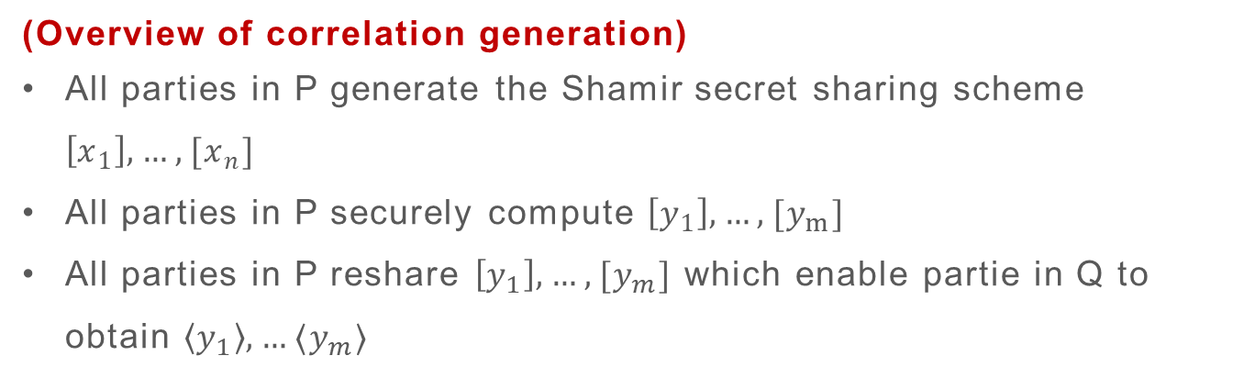
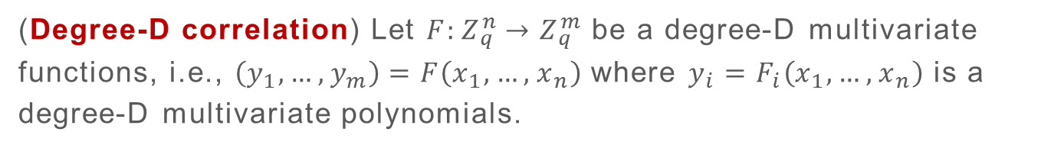
Non-interactive Correlation Generation
(Degree-D correlation) Let $F:Z_{q}^{n}→Z_{q}^{m}$ be a degree-D multivariate functions, i.e., $\left(y_{1},…,y_{m}\right)=F\left(x_{1}, …,x_{n}\right)$ where $y_{i}=F_{i}\left(x_{1}, …,x_{n}\right)$ is a degree-D multivariate polynomials.
Example: Beaver triple, ${y_{1}=x}_{1},y_{2}=x_{2},y_{3}=x_{1}x_{2}$
(Overview of correlation generation)
All parties in P generate the Shamir secret sharing scheme $\left[x_{1}\right],…,[x_{n}]$
All parties in P securely compute $\left[y_{1}\right],…,[y_{m}]$
All parties in P reshare $\left[y_{1}\right],…,[y_{m}]$ which enable partie in Q to obtain $\left\langle y_{1}\right\rangle ,…⟨y_{m}⟩$

Slide 16
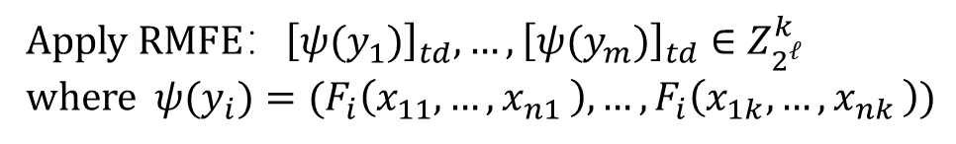
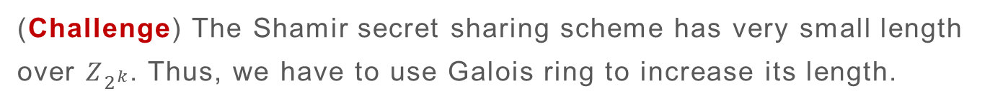
Non-interactive Correlation Generation
(Challenge) The Shamir secret sharing scheme has very small length over $Z_{2^{k}}$. Thus, we have to use Galois ring to increase its length.
$${Input:x_{1}=(x}_{11},…x_{1k}),…,x_{n}=(x_{n1},…,x_{nk})∈Z_{2^{ℓ}}^{k}$$
$$Apply RMFE：φ\left(x_{1}\right), …,φ\left(x_{n}\right)∈GR(2^{ℓ},d)$$
$$Generate secret sharing：{\left[φ\left(x_{1}\right)\right]}_{t}, …,{\left[φ\left(x_{n}\right)\right]}_{t}∈GR(2^{ℓ},d)$$
$$Generate the correlations：{\left[y_{1}\right]}_{td}, …,{\left[y_{m}\right]}_{td}∈GR(2^{ℓ},d)$$
Apply RMFE$：{\left[{ψ(y}_{1})\right]}_{td}, …,{\left[{ψ(y}_{m})\right]}_{td}∈Z_{2^{ℓ}}^{k}$
where ${ψ(y}_{i})=(F_{i}\left(x_{11},…{,x}_{n1}\right),…,F_{i}\left(x_{1k},…{,x}_{nk}\right))$

Slide 17
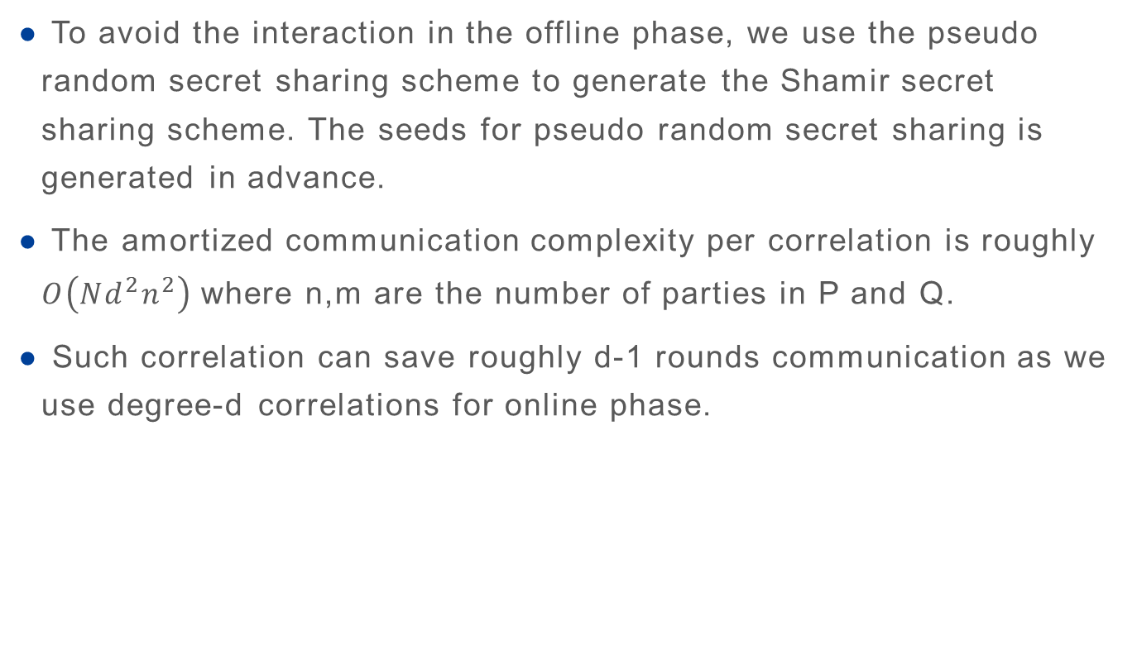
Performance
To avoid the interaction in the offline phase, we use the pseudo random secret sharing scheme to generate the Shamir secret sharing scheme. The seeds for pseudo random secret sharing is generated in advance.
The amortized communication complexity per correlation is roughly $O\left({Nd}^{2}n^{2}\right)$ where n,m are the number of parties in P and Q.
Such correlation can save roughly d-1 rounds communication as we use degree-d correlations for online phase.

Slide 18
Thank you for
your attention

