Slide 1
VSS from Distributed ZK Proofs and Applications
ASIACRYPT 2023 4-8 Dec 2023, Guangzhou, China
Shahla Atapoor$^{1}$, Karim Baghery$^{1}$, Daniele Cozzo$^{1,2}$, Robi Pedersen$^{1}$
$^{1}$COSIC KU Leuven, Belgium
$^{2}$IMDEA Software Institute Madrid, Spain
ia.cr/2023/992
karim.baghery@kuleuven.be

Slide 2
Secret Sharing: Motivation
In 2019, two different exchanges in Canada and Korea lost their secret keys and lost $150 million and 2.5 billion Won worth of cryptocurrency forever!
If the exchange’s private key had been backed up or recovered, this disaster would have been prevented!
Secret
A | B | C
Share 1
Share 2
Share 3
A | B
A | C
B | C
Notes:
mention sigma protocols = 3-round protocols

Slide 3
Shamir Secret Sharing: A Toy Example
Given a secret $f_{0}$ a trusted dealer $P_{0}$ shares it with $n≥2t+1$ parties $\{P_{i}\}_{i=1}^{n},$ s.t.,
$t+1$ shareholders can reconstruct the secret $f_{0}$
$t$ shareholders cannot reconstruct the secret $f_{0}$
$$f_{X}−f_{1}=\frac{f_{2}−f_{1}}{2−1}\left(X−1\right)$$
$$f_{1}$$
$$f_{1}$$
$$f_{0}=\frac{f_{2}−f_{1}}{2−1}\left(0−1\right)+f_{1}$$
$$f_{i}$$
$$f_{2}$$
$$f_{2}$$
$$f_{0}$$
Given a secret $f_{0}$
Sample a degree $t=1$ polynomial $f(X)$ s.t. $f\left(0\right)=f_{0}$
Compute $f_{i}=f\left(i\right)$ for $i=1, 2, 3$
$$(1,f_{1})$$
$$f_{3}$$
$$f_{1}$$
$$f_{2}$$
$$(2,f_{2})$$
$$f_{3}$$
$$(3,f_{3})$$
$$f_{3}$$
$$0$$
$$1$$
$$2$$
$$3$$
$$X$$
Notes:
mention sigma protocols = 3-round protocols

Slide 4
VSS from Homomorphic Commitments:
Feldman [Fel87]
Given a secret $f_{0}$ a trusted dealer $P_{0}$ shares it with $n≥2t+1$ parties $\{P_{i}\}_{i=1}^{n},$ s.t.,
$t+1$ shareholders can reconstruct the secret $f_{0}$
$t$ shareholders cannot reconstruct the secret $f_{0}$
$$g^{f_{i}}=\prod_{j=0}^{t}{c_{j}^{i^{j}}}$$
Given a secret $f_{0}$
Sample a degree $t$ polynomial $f\left(X\right)=f_{0}+a_{1}X+ …+a_{t}X^{t}$
Compute $f_{i}=f\left(i\right)$ for $i=1, …, n$
Sets $c_{0}=g^{f_{0}}, c_{1}=g^{a_{1}},…,c_{t}=g^{a_{t}}$
$$f_{1}$$
$$g^{f_{1}}=c_{0}^{1^{0}}×c_{1}^{1^{1}}×…×c_{t}^{1^{t}}$$
$=g^{f_{0}}×g^{a_{1}}×…×g^{a_{t}}=g^{f(1)}$
$$f_{2}$$
$$g^{f_{2}}=c_{0}^{2^{0}}×c_{1}^{2^{1}}×…×c_{t}^{2^{t}}$$
$=g^{f_{0}}×g^{2a_{1}}×…×g^{{2^{t}a}_{t}}=g^{f(2)}$
Publish $π=(c_{0}, …, c_{t+1})$ and send privatly $f_{i}$ to party $P_{i}$
$$f_{2}$$
$$…$$
$π=(c_{0}, …, c_{t+1})$
$$f_{n}$$
Add. Homomorphic Commitments:
$$com\left(a_{1}\right)×com\left(a_{2}\right)=com(a_{1}+a_{2})$$
$$g^{f_{n}}=c_{0}^{n^{0}}×c_{1}^{n^{1}}×…×c_{t}^{n^{t}}$$
$=g^{f_{0}}×g^{na_{1}}×…×g^{{n^{t}a}_{t}}=g^{f(n)}$
e.g., $g^{a_{1}}×g^{a_{2}}=g^{a_{1}+a_{2}}$
Notes:
mention sigma protocols = 3-round protocols

Slide 5
VSS from Homomorphic Commitments: Pedersen [Ped91]
Pedersen VSS: $t$ of shareholders (information theoretically) learns nothing about $f_{0}$
Pedersen Commitment: $com\left(f, r\right)=g^{f}h^{r}$ (Perfectly Hiding + Computationally Binding)
$$g^{f_{i}}h^{r_{i}}=\prod_{j=0}^{t}{c_{j}^{i^{j}}}$$
Given a secret $f_{0}$
Sample a degree $t$ polynomial $f\left(X\right)=f_{0}+a_{1}X+ …+a_{t}X^{t}$
Sample another degree $t$ polynomial $r\left(X\right)=r_{0}+b_{1}X+ …+b_{t}X^{t}$
Set $f_{i}=f\left(i\right)$ and $r_{i}=r\left(i\right)$ for $i=1, …, n$
Sets $c_{0}=g^{f_{0}}h^{r_{0}},c_{1}=g^{a_{1}}h^{b_{1}}$, …, $c_{t}=g^{a_{t}}h^{b_{t}}$
Publish $π=(c_{0}, …, c_{t+1})$ and send privatly ($f_{i}$, $r_{i}$) to party $P_{i}$
$f_{1}$, $r_{1}$
$$g^{f_{1}}h^{r_{1}}=c_{0}^{1^{0}}×c_{1}^{1^{1}}×…×c_{t}^{1^{t}}$$
$=g^{f_{0}}h^{r_{0}}×g^{a_{1}}h^{b_{1}}×…×g^{a_{t}}h^{b_{t}}=g^{f(1)}h^{r(1)}$
$f_{2}$, $r_{2}$
$$g^{f_{2}}h^{r_{2}}=c_{0}^{2^{0}}×c_{1}^{2^{1}}×…×c_{t}^{2^{t}}$$
$=…=g^{f(2)}h^{r(2)}$
$f_{2}$, $r_{2}$
$$…$$
$f_{n}$, $r_{n}$
Pedersen Commitment:
$$com\left(f, r\right)×com\left(f′, r′\right)=g^{f}h^{r}×g^{f^{′}}h^{r^{′}}$$
$=g^{f+f^{′}}h^{r+r^{′}}=$ $com\left(f+f^{′}, r+r′\right)$
$π=(c_{0}, …, c_{t+1})$
$$…$$
Notes:
mention sigma protocols = 3-round protocols

Slide 6
ZK Proofs Over Secret Shared Data: [BBC+19]
Involves a prover and $n≥2t+1$ verifiers, which allows the parties to communicate in synchronous rounds.
The prover holds an $n$-distributed input $x≔x_{1}∥…∥$ $x_{n}$ and a witness $w$, and each $V_{i}$ holds an input piece $x_{j}$.
$$x_{1}$$
Completeness: If $x∈L$, honest prover will convince honest verifiers.
$x≔x_{1}∥…∥$ $x_{n}$
Soundness against prover and $t$ verifiers: If $x∉L$, honest verifiers will reject the proof, except for a negligible probability, even if up to t of verifiers collude with the prover.
$(x$, $w)∈R_{L}$
$$x_{2}$$
Proof
Threshold Zero-Knowledge (TZK): any subset of the verifiers up to $t$, should learn no additional information about $x$, beyond their own shares and the fact that $x∈L$.
$$…$$
$$x_{n}$$
Positive Result: We can build NI-TZK proof schemes for $n≥2t+1$ [BBC+19].
[BBC+19]: Dan Boneh, Elette Boyle, Henry Corrigan-Gibbs, Niv Gilboa, Yuval Ishai. Zero-Knowledge Proofs on Secret-Shared Data via Fully Linear PCPs.
Notes:
mention sigma protocols = 3-round protocols

Slide 7
VSS from Distributed ZK Proofs

Slide 8
Our Contribution: A TZK Proof for Shamir Relation
We present a NI-TZK proof scheme for the following (Shamir) $n$-distributed relation,
$R_{i}=\left\{\left(f_{i}, f\left(X\right)\right) | f\left(i\right)=f_{i}\right\}$ for $i=1, …, n$.
$(x$, $w)∈R_{L}$
Verifier $V_{i}$
($f_{i},y_{i},y_{i}^{′})$
$x≔f_{1}∥…∥$ $f_{n}$
$$…$$
$$π=(C_{1}, …, C_{n},C_{1}^{′}, …, C_{n}^{′}, z(X))$$
Sample a degree $t$ polynomial $r\left(X\right)$
For $i=1, …, n$: sample $y_{i}$ and $y_{i}^{′}$ and set $C_{i}=Com(r(i), y_{i})$ & $C_{i}′=Com(f_{i}, y_{i}′)$
Set $d=Hash\left(C_{1}, …, C_{n},C_{1}^{′}, …, C_{n}\right)$
Set $z\left(X\right)=r\left(X\right)+df\left(X\right)$
Publish $π=\left(C_{1}, …, C_{n},C_{1}^{′}, …, C_{n}^{′}, z\left(X\right)\right)$ and send privatly $\left(f_{i}, y_{i},y_{i}^{′}\right)$ to verifier $V_{i}$.
1) Party $V_{i}→$accept/reject:
- If $deg(z\left(X\right))≠d$ or $C_{i}^{′}≠ Com(f_{i}, y_{i}′)$ reject
- Set $d=Hash\left(C_{1}, …, C_{n},C_{1}^{′}, …,C_{n}^{′}\right)$
- If $C_{i}==Com(z\left(i\right)−df_{i}, y_{i})$ outputs accept, otherwise, reject.
Return accept, if all parties return accept.
Completeness
Soundness against prover and $t$ verifiers
Threshold ZK
Notes:
mention sigma protocols = 3-round protocols

Slide 9
Our Contribution: A VSS Scheme from New TZK Proof
Given the new NI-TZK proof scheme we construct a PQ secure (hash-based) NI-VSS
Shareholder $V_{i}$
Dealer
($f_{i},y_{i},y_{i}^{′})$
$$f_{0}$$
$$…$$
$$π=(C_{1}, …, C_{n},C_{1}^{′}, …, C_{n}^{′}, z(X))$$
Given $(n, t, f_{0})$: sample a degree-$t$ $f\left(X\right)$ s.t., $f\left(0\right)=f_{0}$ & set $f_{i}=f\left(i\right)$ for $i=1, …, n$
Using $f_{1}∥…∥f_{n}$and $f\left(X\right)$ run the new NI-TZK scheme & obtains $π=(C_{i},C_{i}^{′}, z(X))$ and $\left(f_{i}, y_{i},y_{i}^{′}\right)$ for $i=1, …, n$
Publish $π=(C_{i},C_{i}^{′}, z(X))$ and send privatly $\left(f_{i}, y_{i},y_{i}^{′}\right)$ to participant $V_{i}$
Completeness
Reconstructability (soundness)
Unpredictable (TZK)
1) Party $V_{i}→$outputs accept/reject:
- If $deg(z\left(X\right))≠d$ or $C_{i}^{′}≠ Com(f_{i}, y_{i}′)$ reject
- Set $d=Hash(C_{1}, …, C_{n},C_{1}^{′}, …,C_{n}^{′})$
- If $C_{i}==Com(z\left(i\right)−df_{i}, y_{i})$ outputs accept, otherwise, reject.
If $V_{j}$ complains, dealer publish $(f_{j},y_{j},y_{j}^{′})$, s.t., other parties can check them.
At the end, the honest parties either reject, or get sure that they have received a valid share.
In practice we can omit $y_{i}$($and y_{i}^{′}$if $f_{0}$ has enough entropy)
Notes:
mention sigma protocols = 3-round protocols

Slide 10
Our Contribution: (New) Secret Reconstruction Approach
Given $t+1$ valid shares, parties can reconstruct the secret:
E.g., given $f_{1}, …, f_{t+1}$ → interpolate $\hat{f}\left(X\right)$ of degree $t$.
Compute $\hat{r}\left(X\right)≔z\left(X\right)−d\hat{f}\left(X\right)$ and verify if $C_{i}^{′}= Com(\hat{f}\left(i\right))$ & $C_{i}= Com(\hat{r}\left(i\right))$ for all $i$. If yes, output $\hat{f}\left(0\right)$, else output reject.
$$f_{1}$$
$$f_{2}$$
$$…$$
$$f_{t+1}$$
$$\hat{f}\left(X\right)→ f_{0}=\hat{f}\left(0\right)$$
New Approach:
The dealer publishes $f_{0}= f\left(0\right)$ along with a NI-TZK proof for the distributed relation,
$R_{i}=\left\{\left(f_{0},f_{i}, f\left(X\right)\right) |f\left(0\right)=f_{0}∧ f\left(i\right)=f_{i}\right\}$ for $i=1, …, n$
- the proof is TZK, but can be verified by any set of $t+1$valid shares.
$$f_{0}$$
$$f_{1}$$
$$f_{0},$$ TZK Proof
$$f_{2}$$
$$…$$
$$f_{t+1}$$
Using the new approach, one can perform both sharing and reconstruction at the same time, and construct low-round (and more efficient) protocols.
Notes:
mention sigma protocols = 3-round protocols

Slide 11
Performance of New VSS: Asymptotic Costs
New VSS Scheme vs. Pedersen VSS [Ped91]
DL: Discrete Logarithm, BC: Broadcast, $n$: Number of parties, $E_{G}$: Exponentiation in $G$, $PE$: Degree-$d$polynomial evaluations, $H$: Hashing, $|X|$: $X$ element size.
VSS Scheme | Assumption | Sharing | Dealer’s Communication | Verification
Pedersen [Ped91] | DL | $$1n E_{G}$$ $$2n PE$$ | Private: $2n |Z_{q}|$ BC: $t≈0.5n |G|$ | $$t≈0.5n E_{G}$$
This Work | Hash function | $$2n H$$ $$2n PE$$ | Private: $1n \left|Z_{q}\right|$(or $2n |Z_{q}|)$ BC: $2n \left|H\right|+ 0.5n |Z_{N}|$ | $$1 PE+3 H$$ $$(1 H for RO)$$
☺ Considerably faster verification ☺ Faster sharing (lightweight operations) ☺ PQ secure 😐 Slightly higher communication 😐 Not IT-unpredictable
Notes:
mention sigma protocols = 3-round protocols

Slide 12
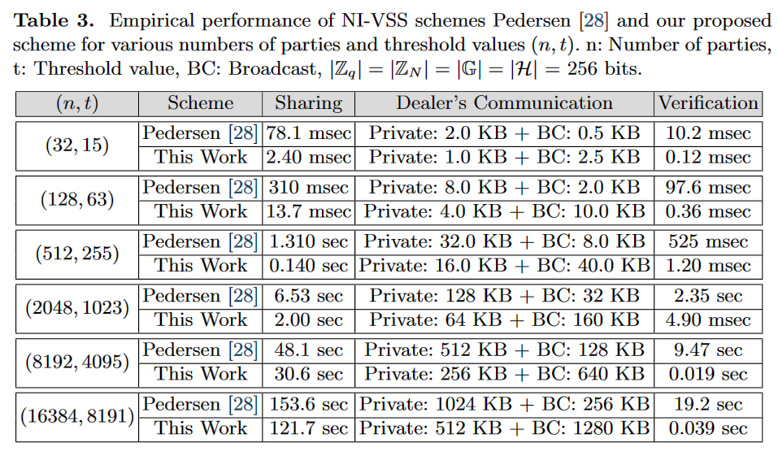
Performance of New VSS: Empirical Performance
For both commitment and random oracle, we used the SHA256 hash function.
For the implementation of Pedersen VSS, we have used Curve 25519.
Laptop: Ubuntu 22.04 LTS, a 11th Gen Intel(R) Core i9-11950H at base frequency 2.60GHz, & 64GB of memory.
Our codes are available on github.com/Baghery/VSS-ABCP23
Can be run by scanning the QR-code
(n, t) | VSS Scheme | Sharing | Dealer’s Communication | Verification
Notes:
mention sigma protocols = 3-round protocols

Slide 13
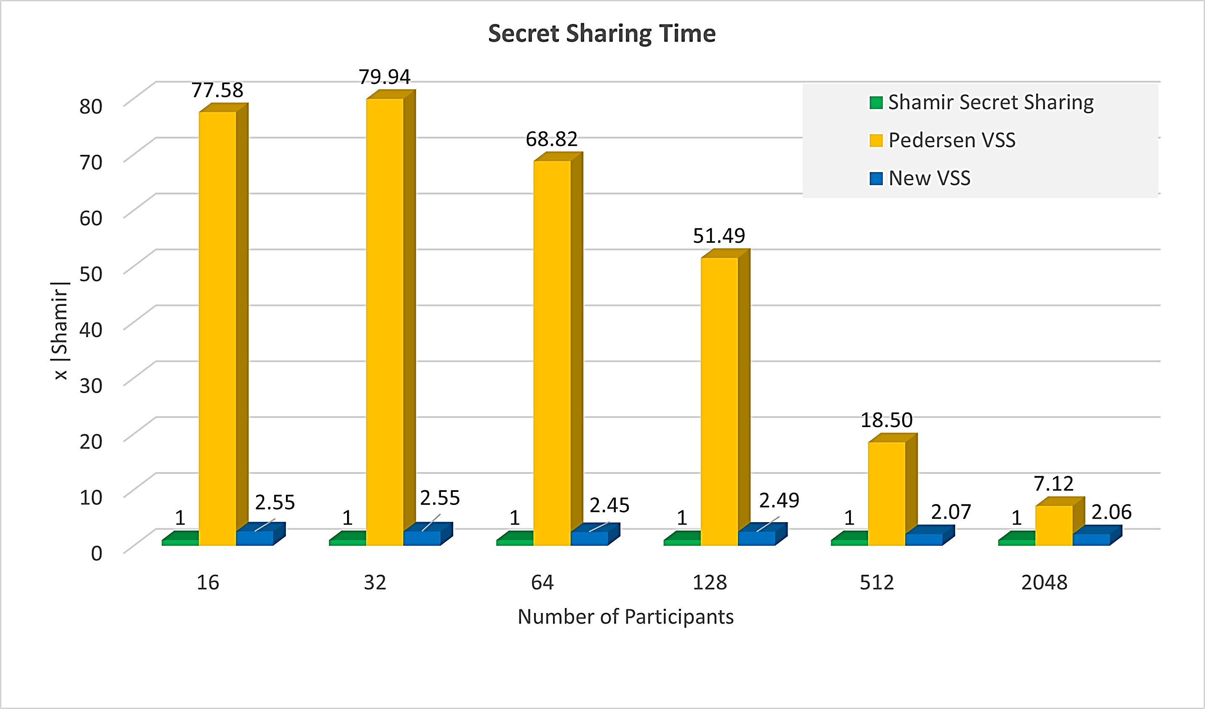
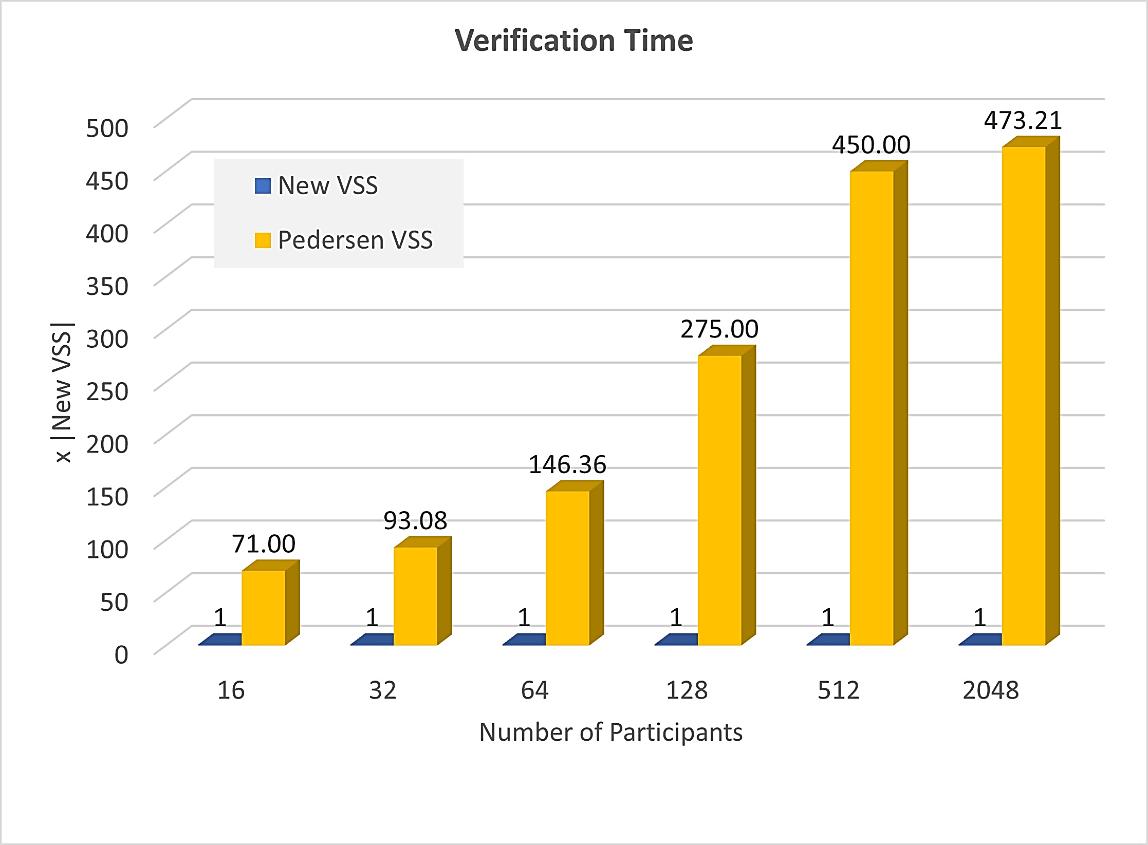
The Overhead to Achieve Verifiability: Pedersen, New VSS
Comparison of sharing time in standard Shamir secret sharing and VSS schemes.
Comparison of verification time for new VSS and Pedersen scheme
Notes:
mention sigma protocols = 3-round protocols

Slide 14
Applications of New VSS Scheme

Slide 15
More Efficient Robust Threshold Protocols:
More Efficient Robust DKG Protocols and Threshold Signatures
More Efficient Robust DKG Protocols and Threshold Signatures
DL (Classic)
DL (Classic)
Isogenies (PQ Secure)
Pedersen DKG Protocol [Ped91, GJKR07]
Pedersen DKG Protocol [Ped91, GJKR07]
Threshold Robust Signature of GJKR [GJKR07]
ABCP DKG Protocol for CSIDH [ABCP23]
Threshold Robust Signature of Campos-Muth [CM22]

Slide 16
A More Efficient Robust DKG Protocol for DL:
Pedersen DKG protocol [Ped91] allows a set of parties to sample $PK=g^{SK}$ in a fully distributed manner.
Key building block: a NI-TZK proof scheme for
$R_{i}=\left\{\left(y,f_{i}, f\left(X\right)\right) | y=g^{f\left(0\right)}∧ f\left(i\right)=f_{i}\right\}$ $∀ i=1, …, n$.
$$f_{1}$$
$$f_{2}$$
Allows a party to prove that he/she has generated (partial public key) $y$ using the shared secret $f(0)$.
$$PK=g^{SK}$$
$$f_{i}$$
$$(0,y=g^{f\left(0\right)})$$
Publicly Verifiable
By Party 1
$$f_{n}$$
$$(0, f_{0})$$
By Party 2
$$(1,f_{1})$$
$$f_{1}$$
By Party $t+1$
TZK proof scheme for DL → More efficient DKG protocol for DL (2-round in the happy path)
$$f_{2}$$
$$(2,f_{2})$$
$$(t+1,f_{t+1})$$
$$f_{t+1}$$
NI-TZK for DL can be of an independent interest.
$$0$$
$$1$$
$$2$$
… $t+1$
$$x$$

Slide 17
Efficiency of New DKG Protocol: Asymptotic Costs
Pedersen DKG protocol [Ped91, GJKR07] vs. our proposed variant
DL: Discrete Logarithm, $n$: number of parties, $t≈n/2$: threshold parameter, $E_{G}$: Exponentiation in $G$, $PE$: Degree-$d$polynomial evaluation, $H$: Hashing, $|X|$: $X$ element size.
DKG Scheme | Assumption | Parties’ Computation | Communication
Pedersen [Ped91, GJKR07] | DL | $(2nt+n) E_{G}$ + $2n PE$ + $1 H$ | Private: $2n |Z_{q}|$ Broadcast: $2t≈n |G|$
This Work | DL & Hash | $2n E_{G}+3n PE$ + $5n H$ | Private: $1n (or 2n) \left|Z_{q}\right|$ Broadcast: $2n \left|H\right|+t |Z_{N}|$
In new DKG protocol each party needs to compute $O\left(n\right)$ exponentions instead of $O\left(n^{2}\right)$.
Notes:
mention sigma protocols = 3-round protocols

Slide 18
Conclusion and Future Research:
The First Practical Hash-based (PQ-secure) NI-VSS Scheme (for $n≥2t+1$)
Uses an efficient NI-TZK proof scheme for the Shamir Relation
Assomptetically only 1x slower than standard Shamir
Comes with a novel secret reconstruciton approach based on TZK proof systems
More Efficient DKG and Robust Threshold Signature based on DL
An efficient variant of Pedersen DKG protocol [Ped91]
and GJKR robust threshold signature scheme [GJKR07]
More Efficient DKG and Robust Threshold Signature from Isogenies
An efficient variant of ABCP DKG [ABCP23] for the CSIDH-based premitivies
and Campos-Muth [CM22] robust threshold signature based on isogenies
New VSS scheme can be used in various classic/PQ-secure protocols
Future research can explore the integration of the new VSS scheme and the revised protocols into other settings and threshold protocols.

Slide 19
Thank You!
karim.baghery@kuleuven.be

