Slide 1
Robust Publicly Verifiable Covert Security Limited Information Leakage and Guaranteed Correctness with Low Overhead
Yi Liu¹, Junzuo Lai¹, Qi Wang², Xianrui Qin³, Anjia Yang¹, Jian Weng¹
Jinan University
Southern University of Science and Technology
The University of Hong Kong
ePrint: 2023/1392

Slide 2
Secure Computation Protocols
Security
Weak
Strong
Protocol with security against semi-honest adversaries
What about here?
Protocol with security against malicious adversaries
Efficiency
Fast
Slow

Slide 3
Covert Security [AL07]
I catch you!
But I cannot convince others this deviation has happened…
90%
May deviate from the protocol
deterrence factor
(fixed and high)

Slide 4
Publicly Verifiable Covert (PVC) Security [AO12]
This guy is cheating!
I catch you!
I can convince others the malicious party was deviating from the protocol!
Publicly Verifiable Certificate
90%
deviate from the protocol
deterrence factor
(fixed and high)
Security: Impose reputational risk and provide accountability measures
Efficiency: PVC secure protocol with deterrence factor $50\%$ incurs only $20$−$40\%$ overhead compared to the SOTA semi-honest protocol based on GC.

Slide 5
Publicly Verifiable Covert (PVC) Security [AO12]
This guy is cheating!
I catch you!
I can convince others the malicious party was deviating from the protocol!
Publicly Verifiable Certificate
90%
deviate from the protocol
Don’t know the deviation.
10%
Is this the end?
No!

Slide 6
Problems of Publicly Verifiable Covert (PVC) Security
If cheating is not detected, no security guarantee is provided for the honest party.
deviate from the protocol
decrease this prob.？
Existing PVC secure protocols have diminishing marginal benefits!
$10\%→1\%$, $10×$ Cost
10%
May gain complete knowledge of the honest party’s input and manipulate the output.
(complete loss of input privacy and output correctness)
In many scenarios, parties who less concerned about reputation may take risks in obtaining significant gains.

Slide 7
Our Contributions
We address this problem for two-party scenario.
New security notion:
When misbehaviors are detected: Maintain the increased cost for malicious parties (provided by PVC security).
When misbehaviors are not detected: Reduce the benefits of malicious behavior.
Robust PVC security

Slide 8
Our Contributions
: Reduce the benefits of malicious behavior when it goes undetected.
Robust PVC security
This guy is cheating!
I catch you!
I can convince others the malicious party was deviating from the protocol!
Publicly Verifiable Certificate
90%
deviate from the protocol
The malicious party can only obtain at most an additional 1-bit of information about my input while the correctness of the protocol’s output is preserved.
Don’t know the deviation.
10%

Slide 9
Our Contributions
We address this problem for two-party scenario.
New security notion:
Reduce the benefits of malicious behavior when it goes undetected.
Maintain the increased cost for cheater when caught (provided by PVC security).
Robust PVC secure protocol with low overhead
For deterrence factor $90\%$: incur only additional $∼10\%$overhead compared to the state-of-the-art PVC-secure protocol.
Robust PVC security

Slide 10
Start from PVC Secure Protocols

Slide 11
Derandomization for PVC Security [HKKLW19]
Garbled Circuit 1
$$s_{1}$$
Garbled Circuit 2
$$s_{2}$$
$$s_{2}$$
Garbled Circuit 3
$$s_{3}$$
$$s_{3}$$
Alice
Bob
Generate $5$ seeds (to generate randomness for each instance)
Randomly pick and obviously obtain $4$ seeds
Garbled Circuit 4
$$s_{4}$$
$$s_{4}$$
Each seed is used to generate a GC in each instance
Check executions of Alice using corresponding seeds (re-generate GCs using seeds)
Garbled Circuit 5
Sign the transcripts
$$s_{5}$$
$$s_{5}$$
If misbehaviors are detected, use transcript and signature to generate the publicly verifiable certificate

Slide 12
Derandomization for PVC Security [HKKLW19]
Garbled Circuit 1
Unchecked Evaluated by Bob
Garbled Circuit 2
Use seeds to generate $5$ GCs and sign the transcripts
Garbled Circuit 3
Alice
Bob
Randomly check $4$ using Alice’s seeds
Garbled Circuit 4
Garbled Circuit 5
Deterrence Factor = $\frac{4}{5}=80\%$

Slide 13
Make PVC Security Robust

Slide 14
Robust PVC security
This guy is cheating!
I catch you!
I can convince others the malicious party was deviating from the protocol!
Publicly Verifiable Certificate
90%
deviate from the protocol
The malicious party can only obtain at most an additional 1-bit of information about my input while the correctness of the protocol’s output is preserved.
Don’t know the deviation.
10%
Output Correctness
At most 1-Bit-Leakage

Slide 15
Dual Execution [MF06, HKE12]
Garbled Circuit 1
Generated by Alice
Evaluated by Bob
$Garbled_{Outputs}_{1}$ + ${Result}_{1}$
Alice
GC1’s Labels for ${Result}_{2}$
$Garbled_{Outputs}_{2}$
Equality Test
$Garbled_{Outputs}_{1}$
GC2’s Labels for ${Result}_{1}$
Bob
$Garbled_{Outputs}_{2}$ + ${Result}_{2}$
True/False
Garbled Circuit 2
Evaluated by Alice
Generated by Bob
If the equality test outputs true, parties accept the output. Otherwise, reject.

Slide 16
Dual Execution [MF06, HKE12]
Garbled Circuit 1
Generated by Alice
Evaluated by Bob
$Garbled_{Outputs}_{1}$ + ${Result}_{1}$
Alice
GC1’s Labels for ${Result}_{2}$
$Garbled_{Outputs}_{2}$
Equality Test
$Garbled_{Outputs}_{1}$
GC2’s Labels for ${Result}_{1}$
Bob
$Garbled_{Outputs}_{2}$ + ${Result}_{2}$
False
Garbled Circuit 2
Evaluated by Alice
Generated by Bob
Should be correct (Bob is honest)
If outputs are inconsistent
If the equality test outputs false, Bob rejects the output.
Achieve output correctness

Slide 17
Dual Execution [MF06, HKE12]
Garbled Circuit 1
Generated by Alice
Evaluated by Bob
$Garbled_{Outputs}_{1}$ + ${Result}_{1}$
Alice
GC1’s Labels for ${Result}_{2}$
$Garbled_{Outputs}_{2}$
Equality Test
$Garbled_{Outputs}_{1}$
GC2’s Labels for ${Result}_{1}$
Bob
$Garbled_{Outputs}_{2}$ + ${Result}_{2}$
True/False
Garbled Circuit 2
Evaluated by Alice
Generated by Bob
As GC evaluator
Learn at most 1 bit!
What malicious Alice learn?
Achieve at most 1-bit-leakage

Slide 18
A Straightforward Approach
Alice
Bob
Alice
Bob
Garbled Circuit 1
Evaluated by Bob
Garbled Circuit 1
Garbled Circuit 2
Garbled Circuit 2
Output
Checked by Alice
Garbled Circuit 3
Equality Test
Garbled Circuit 3
Checked by Bob
Garbled Circuit 4
Output
Garbled Circuit 4
Garbled Circuit 5
Evaluated by Alice
Garbled Circuit 5
To achieve deterrence factor $80\%$, each party needs to generate $9$ GCs and evaluates $1$ GC
As a garbler, $5$ GCs are generated
As an evaluator, $4$ GCs are generated for checking (regenerate GCs)
Cost $≈$ $2×$ Cost of state-of-the-art PVC-secure protocol
Should be different?
Can we do better?

Slide 19
Our Approach
Alice
Bob
Garbled Circuit 1
Evaluated by Bob
Garbled Circuit 2
Garbled Circuit 2
Generated by Alice
Garbled Circuit 3
Checked by Bob
Checked by Alice
Garbled Circuit 3
Garbled Circuit 4
Garbled Circuit 4
Generated by Bob
Garbled Circuit 5
Garbled Circuit 5
Evaluated by Alice
Garbled Circuit 6

Slide 20
Our Approach
Checked by Both Parties
Alice
Bob
Garbled Circuit 1
Evaluated by Bob
Garbled Circuit 2
Garbled Circuit 2
Generated by Alice
Garbled Circuit 3
Garbled Circuit 3
Garbled Circuit 4
Generated by Bob
Garbled Circuit 4
Garbled Circuit 5
Garbled Circuit 5
Evaluated by Alice
Garbled Circuit 6
Each party generates $5$ GCs.
The overlap has 4 GCs.
Checked by the other party (no need for regeneration, reuse the materials for common GCs).
Parties perform dual execution for the two remaining GCs. (Each party evaluate $1$ GC. )

Slide 21
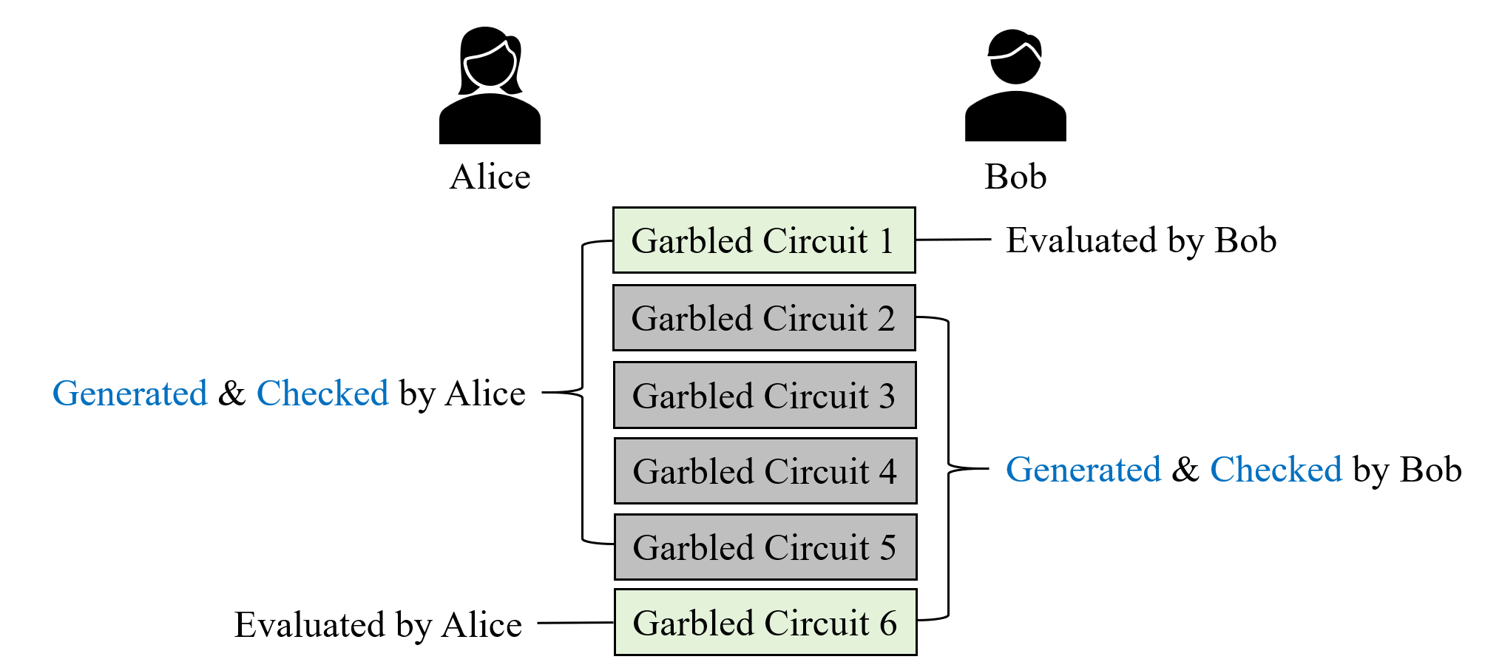
Our Approach
Q: How to let parties obtain 4 same seeds and 1 different seed, in a blind fashion?
A: Two parties jointly generate seeds by OT

Slide 22
Our Approach
Alice
Bob
$$s_{1}^{A}$$
$$s_{1}^{A}$$
$$s_{2}^{A}$$
$$s_{2}^{A}$$
$$s_{3}^{A}$$
$$s_{3}^{A}$$
OTs
$$s_{4}^{A}$$
$$s_{4}^{A}$$
$$s_{5}^{A}$$
$$s_{5}^{A}$$
$$s_{6}^{A}$$

Slide 23
Our Approach
Alice
Bob
$$s_{1}^{A}$$
$$s_{1}^{A}$$
$$s_{2}^{A}$$
$$s_{2}^{A}$$
$$s_{3}^{A}$$
OTs
$$s_{3}^{A}$$
$$s_{4}^{A}$$
$$s_{4}^{A}$$
$$s_{5}^{A}$$
$$s_{5}^{A}$$
$$s_{6}^{A}$$

Slide 24
Our Approach
Alice
Bob
$$s_{1}^{A}$$
$$s_{1}^{B}$$
$$s_{1}^{A}$$
$$s_{1}^{B}$$
$$s_{2}^{A}$$
$$s_{2}^{B}$$
$$s_{2}^{A}$$
$$s_{2}^{B}$$
$$s_{3}^{A}$$
$$s_{3}^{B}$$
$$s_{3}^{A}$$
OTs
$$s_{3}^{B}$$
$$s_{4}^{A}$$
$$s_{4}^{B}$$
$$s_{4}^{A}$$
$$s_{4}^{B}$$
$$s_{5}^{A}$$
$$s_{5}^{B}$$
$$s_{5}^{A}$$
$$s_{5}^{B}$$
$$s_{6}^{A}$$
$$s_{6}^{B}$$
$$s_{6}^{B}$$

Slide 25
Our Approach
Alice
Bob
$$s_{1}^{A}$$
$$s_{1}^{B}$$
$$s_{1}^{A}$$
$$s_{2}^{B}$$
$$s_{2}^{A}$$
$$s_{2}^{B}$$
$$s_{2}^{A}$$
$$s_{3}^{B}$$
$$s_{3}^{A}$$
OTs
$$s_{3}^{B}$$
$$s_{3}^{A}$$
$$s_{4}^{B}$$
$$s_{4}^{A}$$
$$s_{4}^{B}$$
$$s_{4}^{A}$$
$$s_{5}^{B}$$
$$s_{5}^{A}$$
$$s_{5}^{B}$$
$$s_{5}^{A}$$
$$s_{6}^{B}$$
$$s_{6}^{A}$$
$$s_{6}^{B}$$

Slide 26
Our Approach
Alice
Bob
$$s_{1}^{A}$$
$$s_{1}=s_{1}^{A}⊕s_{1}^{B}$$
$$s_{1}$$
$$s_{1}^{B}$$
$$s_{1}^{A}$$
$$s_{2}^{B}$$
$$s_{2}^{A}$$
$$s_{2}$$
$$s_{2}=s_{2}^{A}⊕s_{2}^{B}$$
$$s_{2}$$
$$s_{2}^{B}$$
$$s_{2}^{A}$$
$$s_{3}^{B}$$
$$s_{3}^{A}$$
$$s_{3}$$
$$s_{3}=s_{3}^{A}⊕s_{3}^{B}$$
$$s_{3}$$
$$s_{3}^{B}$$
$$s_{3}^{A}$$
$$s_{4}^{B}$$
$$s_{4}^{A}$$
$$s_{4}$$
$$s_{4}=s_{4}^{A}⊕s_{4}^{B}$$
$$s_{4}$$
$$s_{4}^{B}$$
$$s_{4}^{A}$$
$$s_{5}^{B}$$
$$s_{5}^{A}$$
$$s_{5}$$
$$s_{5}=s_{5}^{A}⊕s_{5}^{B}$$
$$s_{5}$$
$$s_{5}^{B}$$
$$s_{5}^{A}$$
$$s_{6}^{B}$$
$$s_{6}^{A}$$
$$s_{6}$$
$$s_{6}=s_{6}^{A}⊕s_{6}^{B}$$
$$s_{6}^{B}$$

Slide 27
Our Approach
Alice
Bob
$$s_{1}=s_{1}^{A}⊕s_{1}^{B}$$
$$s_{1}$$
$$s_{2}$$
$$s_{2}=s_{2}^{A}⊕s_{2}^{B}$$
$$s_{2}$$
$$s_{3}$$
$$s_{3}=s_{3}^{A}⊕s_{3}^{B}$$
$$s_{3}$$
$$s_{4}$$
$$s_{4}=s_{4}^{A}⊕s_{4}^{B}$$
$$s_{4}$$
$$s_{5}$$
$$s_{5}=s_{5}^{A}⊕s_{5}^{B}$$
$$s_{5}$$
$$s_{6}$$
$$s_{6}=s_{6}^{A}⊕s_{6}^{B}$$
Ensure that they are not equal. (restart if equal)
Equality Test

Slide 28
Our Approach
Alice
Bob
$$GC_{1}$$
$$s_{1}=s_{1}^{A}⊕s_{1}^{B}$$
$$s_{1}$$
$$s_{2}$$
$$GC_{2}$$
$$s_{2}$$
$$s_{2}=s_{2}^{A}⊕s_{2}^{B}$$
$$s_{3}$$
$$GC_{3}$$
$$s_{3}$$
$$s_{3}=s_{3}^{A}⊕s_{3}^{B}$$
$$s_{4}$$
$$GC_{4}$$
$$s_{4}$$
$$s_{4}=s_{4}^{A}⊕s_{4}^{B}$$
$$s_{5}$$
$$GC_{5}$$
$$s_{5}$$
$$s_{5}=s_{5}^{A}⊕s_{5}^{B}$$
$$s_{6}$$
$$GC_{6}$$
$$s_{6}=s_{6}^{A}⊕s_{6}^{B}$$

Slide 29
Our Approach
Alice
Bob
Evaluated by Alice
$$GC_{1}$$
$$s_{1}$$
$$s_{2}$$
$$GC_{2}$$
$$s_{2}$$
$$s_{3}$$
$$GC_{3}$$
Generated & Checked by Bob
$$s_{3}$$
$$s_{4}$$
Generated & Checked by Alice
$$GC_{4}$$
$$s_{4}$$
$$s_{5}$$
$$GC_{5}$$
$$s_{5}$$
$$s_{6}$$
$$GC_{6}$$
Evaluated by Bob
Similar to the PVC-secure protocol
Each party will send out GCs (derived from each seed in each instance).
The other party will use the seeds to check GCs (that have been generated by themselves).
But they only know 5 seeds…

Slide 30
Our Approach
Generate and exchange GCs
Alice
Bob
$$?$$
$$GC_{1}$$
$$s_{1}$$
$$s_{2}$$
${GC}_{2}$
$$GC_{2}$$
$$s_{2}$$
$$s_{3}$$
$GC_{3}$
$$GC_{3}$$
$$s_{3}$$
$$s_{4}$$
$GC_{4}$
$$GC_{4}$$
$$s_{4}$$
$$s_{5}$$
$GC_{5}$
$$GC_{5}$$
$$s_{5}$$
$$s_{6}$$
$GC_{6}$
$$?$$

Slide 31
Our Approach
Generate and exchange GCs
Both parties sign the transcript.
Check GCs generated by the other party
Evaluate remain GC and dual execution.
Alice
Bob
$$GC_{1}$$
$$?$$
$$s_{1}$$
$$s_{2}$$
$$GC_{2}$$
${GC}_{2}$
$$s_{2}$$
$$s_{3}$$
$$GC_{3}$$
$GC_{3}$
$$s_{3}$$
$$s_{4}$$
$$GC_{4}$$
$GC_{4}$
$$s_{4}$$
$$s_{5}$$
$$GC_{5}$$
$GC_{5}$
$$s_{5}$$
$$s_{6}$$
$$?$$
$GC_{6}$

Slide 32
Our Approach
Generate and exchange GCs
Both parties sign the transcript.
Alice
Bob
$$GC_{1}$$
$$?$$
$$s_{1}$$
$$s_{2}$$
$$GC_{2}$$
${GC}_{2}$
$$s_{2}$$
Q: What shall we do?
A: Ensure that both parties can (see the GCs and) check their correctness only after all materials (e.g., signatures) for certificate generation are ready.
Use time-lock puzzle!
$$s_{3}$$
$$GC_{3}$$
$GC_{3}$
$$s_{3}$$
$$s_{4}$$
$$GC_{4}$$
$GC_{4}$
$$s_{4}$$
$$s_{5}$$
$$GC_{5}$$
$GC_{5}$
$$s_{5}$$
$$s_{6}$$
$$?$$
$GC_{6}$
If Alice’s ${GC}_{6}$ is malicious, she can cheat.
If Alice’s other GCs are malicious, she can refuse to sign the transcript. (Then Bob cannot generate the PVC certificate)
This is the dummy GC!
It means that Bob will evaluate this GC and check other GCs!

Slide 33
Time-Lock Puzzle
I need to spend at least time $T$ solving the puzzle.
$$m$$
$$m$$
Time $T$
Time parameter $T$

Slide 34
We also need …
$$m$$
Open!
$$m$$
Can be regard as a commitment before Time $T$.
Time parameter $T$

Slide 35
Our Approach
Alice
Bob
$$?$$
$$GC_{1}$$
$$s_{1}$$
$$s_{2}$$
$GC_{2}$
$$GC_{2}$$
$$s_{2}$$
$$s_{3}$$
$GC_{3}$
$$GC_{3}$$
$$s_{3}$$
$$s_{4}$$
$GC_{4}$
$$GC_{4}$$
$$s_{4}$$
$$s_{5}$$
$GC_{5}$
$$GC_{5}$$
$$s_{5}$$
$$s_{6}$$
$GC_{6}$
$$?$$

Slide 36
Our Approach
Even if the malicious party aborts, the other party can open the puzzles by himself after time $T$ (and may generate the certificate).
Alice
Bob
$$GC_{1}$$
$?$
$$s_{1}$$
$$s_{2}$$
$$GC_{2}$$
$GC_{2}$
$$s_{2}$$
Both parties can now check instances.
Don’t need to solve puzzles if both parties are honest.
$$s_{3}$$
$$GC_{3}$$
$GC_{3}$
$$s_{3}$$
$$s_{4}$$
$$GC_{4}$$
$GC_{4}$
$$s_{4}$$
$$s_{5}$$
$$GC_{5}$$
$GC_{5}$
$$s_{5}$$
$$s_{6}$$
$$?$$
$GC_{6}$
Both Parties open their own puzzles for checking after:
All materials for generation of certificate are ready.

Slide 37
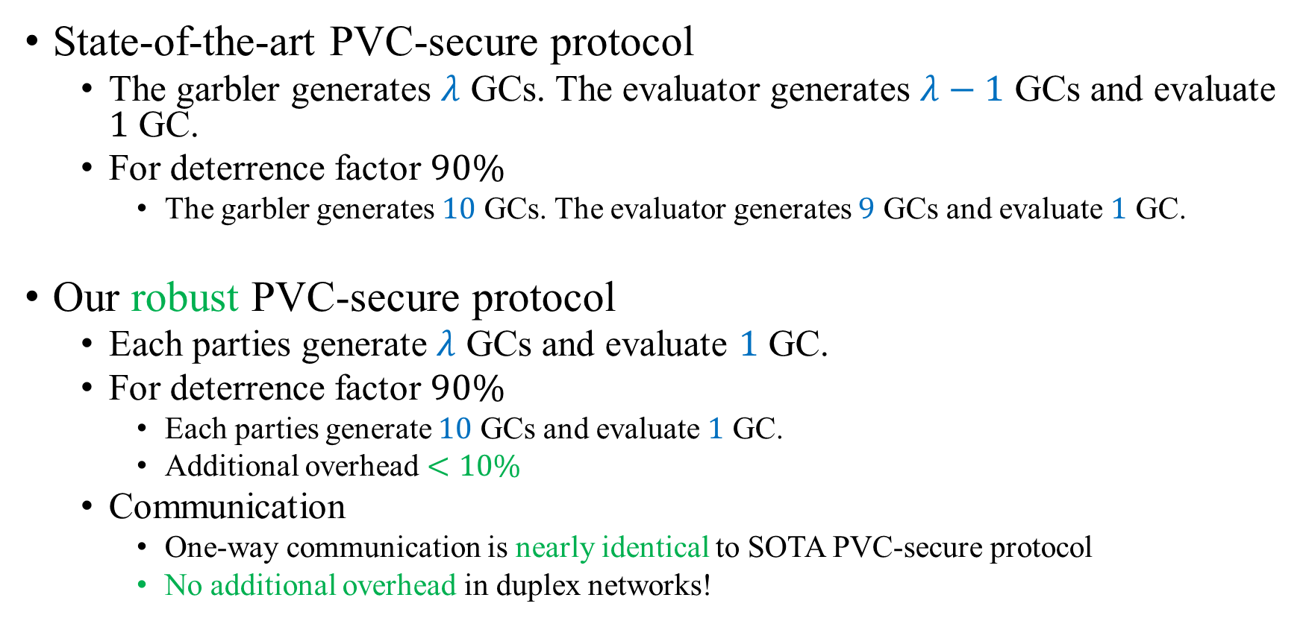
Performance (Deterrence Factor $\frac{λ−1}{λ}$)
State-of-the-art PVC-secure protocol
The garbler generates $λ$ GCs. The evaluator generates $λ−1$ GCs and evaluate $1$ GC.
For deterrence factor $90\%$
The garbler generates $10$ GCs. The evaluator generates $9$ GCs and evaluate $1$ GC.
Our robust PVC-secure protocol
Each parties generate $λ$ GCs and evaluate $1$ GC.
For deterrence factor $90\%$
Each parties generate $10$ GCs and evaluate $1$ GC.
Additional overhead $<10\%$
Communication
One-way communication is nearly identical to SOTA PVC-secure protocol
No additional overhead in duplex networks!

Slide 38
Thank You! For more details: https://eprint.iacr.org/2023/1392

Slide 39
Summary
Seed preparation
Both parties jointly generate seeds.
Circuit and input preparation
Both parties generate GCs based on seeds for each instance.
Publicly verifiable evidence creation
Each party signs the transcripts.
All materials for certificate generation are ready.
Check of instances
Open time-lock puzzles and check instances.
If deviation is detected, publicly verifiable certificate will be generated.
Circuit evaluation
Each party evaluates the GC. Then they perform the dual execution to derive the final evaluation result.

