Slide 1
Rotation Key Reduction for Client-Server Systems of Deep Neural Network on Fully Homomorphic Encryption
ASIACRYPT 2023
Joon-Woo Lee Chung-Ang University, Republic of Korea
Eunsang Lee Sejong University, Republic of Korea
Young-Sik Kim DGIST, Republic of Korea
Jong-Seon No Seoul National University, Republic of Korea
Dec. 6, 2023

Slide 2
Contents
Rotation Key Problem in Fully Homomorphic Encryption
Hierarchical Rotation Key System and Algorithms
Efficient Rotation Key Set Generation
Simulation Results

Slide 3
Rotation Key Problem in Fully Homomorphic Encryption
Main Problem

Slide 4
Fully Homomorphic Encryption
Encryption scheme supporting arithmetic operations on encrypted data
Solution for the privacy issue of outsourcing computation
Application
Genomic analysis
Cloud service
AI-as-a-Service (AIaaS)
Types of FHE
Bit-wise HE: TFHE
Integer-valued HE: BGV, BFV
Real-valued HE: CKKS

Slide 5
Rotation Operation in BFV/CKKS
Packing: multiple data in one ciphertext
$ct=Enc_{pk}(m_{0}, m_{1},⋯,m_{n−1})$
Single Instruction Multiple Data (SIMD)
$ct_{1}=Enc_{pk}\left(m_{0}, m_{1},⋯,m_{n−1}\right),ct_{2}=Enc_{pk}\left(t_{0}, t_{1},⋯,t_{n−1}\right)$
Homomorphic addition: $ct_{1}⊕ct_{2}=Enc_{pk}\left(m_{0}+t_{0}, m_{1}+t_{1},⋯,m_{n−1}+t_{n−1}\right)$
Homomorphic multiplication: $ct_{1}⊙ct_{2}=Enc_{pk}\left(m_{0}⋅t_{0}, m_{1}⋅t_{1},⋯,m_{n−1}⋅t_{n−1}\right)$
Packing structure in BFV/CKKS
$$ct_{BFV}=Enc\left(\begin{matrix}m_{00} & m_{01} & ⋯ & m_{0(n−1)} \\ m_{10} & m_{11} & ⋯ & m_{1(n−1)}\end{matrix}\right)∈ℤ_{p}^{2×n}$$
BFV scheme
$$ct_{CKKS}=Enc\left(z_{0}, z_{1}, ⋯, z_{n−1}\right)∈ℂ^{n}$$
CKKS scheme

Slide 6
Rotation Operation in BFV/CKKS
(Homomorphic) Rotation operation in HE is needed.
Operations with different location ($m_{0}+t_{1}$)
Operations in the one ciphertext ($m_{0}+m_{1}$)
Rotation operation in BFV scheme
Rotation operation in CKKS scheme
$$Enc\left(\begin{matrix}m_{00} & m_{01} & ⋯ & m_{0(n−1)} \\ m_{10} & m_{11} & ⋯ & m_{1(n−1)}\end{matrix}\right)⟶Enc\left(\begin{matrix}m_{0r} & m_{0\left(r+1\right)} & ⋯ & m_{0(n−1)} & m_{00} & ⋯ & m_{0\left(r−1\right)} \\ m_{10} & m_{11} & ⋯ & m_{1(n−1)} & m_{10} & ⋯ & m_{1\left(n−1\right)}\end{matrix}\right)$$
(Row) Rotation by $r$ shifts
$$Enc\left(\begin{matrix}m_{00} & m_{01} & ⋯ & m_{0(n−1)} \\ m_{10} & m_{11} & ⋯ & m_{1(n−1)}\end{matrix}\right)⟶Enc\left(\begin{matrix}m_{10} & m_{11} & ⋯ & m_{1(n−1)} \\ m_{00} & m_{01} & ⋯ & m_{0(n−1)}\end{matrix}\right)$$
Column rotation
$$Enc\left(z_{0}, z_{1}, ⋯, z_{n−1}\right)⟶Enc\left(z_{r}, z_{r+1}, ⋯, z_{n−1}, z_{0}, ⋯,z_{r−1}\right)$$
Rotation by $r$ shifts

Slide 7
Rotation Key in Rotation Operation
The server should have the rotation key for rotation operation.
Main problem: Each $r$-shift rotation operation requires separate rotation key.
Homomorphic rotation $Rot_{rk_{r}}\left(ct;r\right): r$-shift rotation operation requires a rotation key $rk_{r}$
If $r_{1}≠r_{2}$, we need different rotation key $rk_{r_{1}}≠rk_{r_{2}}$
These separate rotation keys should be generated and transmitted by the clients.
Privacy-preserving
Computing Model
Client
Server
$\left\{r_{1}, r_{2}, ⋯,r_{k}\right\}$-shifts rotation $∈$
Rotation keys
Transmission
Rotation keys
Secret key
$$\{rk_{r_{1}},rk_{r_{2} }, ⋯rk_{r_{k}}\}$$
$$\{rk_{r_{1}},rk_{r_{2} }, ⋯rk_{r_{k}}\}$$

Slide 8
Privacy-Preserving Deep Neural Network
Then, what if many types of rotation operations are required in complex computing model?
ResNet-18 CNN model with CKKS scheme requires 617 rotation shifts with Lee et al.’s implementation technique.
Client: a PC with no accelerator / Server: high-performance GPU devices.
If the client generates all rotation keys,
Generation of rotation keys by clients: 145.1s → Too long for clients
Transmission of rotation keys : 115.7GB → Too heavy communication for clients
We want to minimize the burden in the client!
The client usually do not want to compute much and have the high-performance devices.
If possible, the server (service provider) is willing to take some burdens for the clients.
However, the keys are generated in the client-side...

Slide 9
Power-of-Two Rotation Keys
One trivial solution: The $r$-shift rotation can be composed by several power-of-two-shift rotations.
$Rot\left(ct;13\right)→Rot\left( ⋅ ;1\right)∘Rot\left( ⋅ ;4\right)∘Rot\left( ⋅ ;8\right)$
Power-of-two rotation key set is enough to enable all types of rotation operations.
${\left\{rk_{2^{i}}\right\}}_{i=0, 1, 2, ⋯,\log{n}−1}$
617 rotation keys →15 rotation keys
Generation of rotation keys by clients : 145.1s → 3.53s
Transmission of rotation keys : 115.7GB → 2.81GB
However, the latency of whole computation model is significantly increased!
Computation time for ResNet-18 (CPU 1 thread) : 646.8s → 1471.2s (2.27x slower!)
We do not want to increase the runtime of homomorphic computation!

Slide 10
Main Question
How to reduce the computation and communication for the rotation keys in the client,
while the runtime of homomorphic computation in the server remains the same?

Slide 11
Hierarchical Rotation Key System and Algorithms
Main Concept and Technique

Slide 12
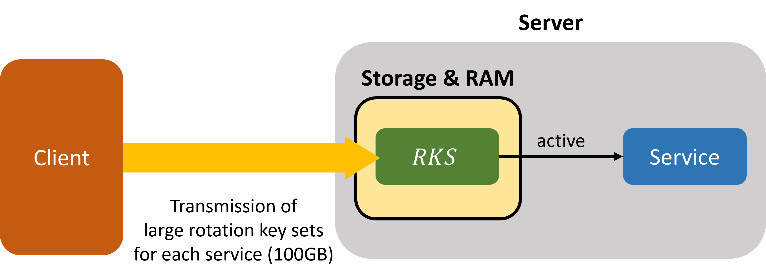
Main Concept
Is there any methods for the server to generate all required rotation keys without the secret key?
The client generates a small number of rotation keys and sends them to the server.
Meanwhile, the server generates and uses the necessary rotation keys by itself.
Same homomorphic computation
Previous key generation
Proposed key generation

Slide 13
Construction Idea
$r$-shift rotation key: a bunch of ciphertexts encrypting rotated secret keys
$rk_{r}={\left\{rk_{r,i}\right\}}_{i=0, ⋯,dnum−1}={\left\{Enc\left(P⋅{\hat{Q}}_{i}⋅{\left[{\hat{Q}}_{i}^{−1}\right]}_{Q_{i}}⋅s\left(X^{5^{r}}\right)\right)\right\}}_{i=0, ⋯,dnum−1}∈{\left(R_{PQ}^{2}\right)}^{dnum}$
Main idea: Applying rotation operation to rotation keys!
$r$-shift rotation : a homomorphic operation for automorphism $m\left(X\right)↦m(X^{5^{r}})$
If we apply $r′$-shift rotation operation to the $r$-shift rotation key..
$$Rot_{{\overline{rk}}_{r′}}\left(rk_{r,i} ;r^{′}\right)=Enc\left(P⋅{\hat{Q}}_{i}⋅{\left[{\hat{Q}}_{i}^{−1}\right]}_{Q_{i}}⋅s\left({\left(X^{5^{r′}}\right)}^{5^{r}}\right)\right)=Enc\left(P⋅{\hat{Q}}_{i}⋅{\left[{\hat{Q}}_{i}^{−1}\right]}_{Q_{i}}⋅s\left(X^{5^{r+r′}}\right)\right)$$
Then, ${\left\{Rot_{{\overline{rk}}_{r^{′}}}\left(rk_{r,i} ;r^{′}\right)\right\}}_{i=0, ⋯,dnum−1}$ can be regarded as $rk_{r+r′}$!
We can derive $rk_{r+r′}$ from $rk_{r}$ with “rotation key for rotation key” ${\overline{rk}}_{r′}$!

Slide 14
Hierarchy in Rotation Keys
Can any rotation keys be used as “rotation keys for rotation keys”?
No! the rotation keys should be in the larger modulus than the ciphertext to be rotated.
If $ct∈R_{Q}^{2}$, then $rk_{r}={\left\{rk_{r,i}\right\}}_{i}∈{\left(R_{PQ}^{2}\right)}^{dnum}$ for $P≈\frac{Q}{dnum}$
“Rotation keys for rotation keys” should be in the larger modulus than the conventional rotation keys.
Let $dnum′$ be the decomposition number of the rotation operation for rotation keys.
For ${\overline{rk}}_{r′}={\left\{{\overline{rk}}_{r^{′},j}\right\}}_{j=0, ⋯,dnum′}$ to be used in $Rot(rk_{r,i};r^{′})$ for each $i$, ${\overline{rk}}_{r′}$ should be in ${\left(R_{P^{′}PQ}^{2}\right)}^{dnum′}$ for $P^{′}≈\frac{PQ}{dnum′}$.
We can give a hierarchy in the rotation keys with the modulus size!

Slide 15
$k$-level Hierarchical Rotation Key System
$k$-(key-)level Hierarchical Rotation Key System
$Q_{0}$: ciphertext evaluation modulus (for homomorphic evaluation)
$P_{ℓ}$: $ℓ$th special modulus ($i=0, ⋯,k−1$)
$Q_{ℓ}=Q_{0}⋅\prod_{j=0}^{ℓ−1}{P_{j}}$: $ℓ$th evaluation modulus
$hdnum_{ℓ}$: decomposition number for $ℓ$th key level ($dnum=hdnum_{0}$)
$Q_{ℓ,i}$: $i$th decomposed modulus in the $ℓ$th evaluation modulus ($Q_{ℓ}=\prod_{i=0}^{{hdnum}_{ℓ}−1}{Q_{ℓ,i}}$)
$r$-shift Rotation key in the key level $ℓ$ ($\left(r,ℓ\right)$ rotation key)
$$rk_{r}^{(ℓ)}={\left\{rk_{r,i}^{\left(ℓ\right)}\right\}}_{i=0, ⋯,hdnum_{ℓ}}={\left\{\left(b_{r,i}^{\left(ℓ\right)},a_{r,i}^{\left(ℓ\right)}\right)\right\}}_{i=0, ⋯,hdnum_{ℓ}}∈{\left(R_{P_{ℓ}Q_{ℓ}}^{2}\right)}^{{hdnum}_{ℓ}}$$
where $b_{r,i}^{(ℓ)}=−a_{r,i}^{\left(ℓ\right)} ⋅s+e_{r,i}^{\left(ℓ\right)}+P_{ℓ}⋅{\hat{Q}}_{ℓ,i}⋅{\left[{\hat{Q}}_{ℓ,i}^{−1}\right]}_{Q_{ℓ,i}}⋅s(X^{5^{r}})$.

Slide 16
RotToRot Operation
Generation of $\left(r+r′,ℓ\right)$ rotation key from $(r,ℓ)$-shift rotation key using $\left(r^{′},ℓ^{′}\right)$ rotation key ($ℓ^{′}>ℓ$)
Applying rotation operation to each element in the rotation key
RotToRot Operation
for $i=0$ to $hdnum_{ℓ}−1$:
$\left(b_{r+r^{′},i}^{\left(ℓ\right)},a_{r+r^{′},i}^{\left(ℓ\right)}\right)←Rot\left(\left(b_{r,i}^{\left(ℓ\right)},a_{r,i}^{\left(ℓ\right)}\right);r^{′}\right)$ using $rk_{r^{′}}^{(ℓ^{′})}$
end
return $rk_{r+r^{′}}^{(ℓ)}={\left\{\left(b_{r+r^{′},i}^{\left(ℓ\right)},a_{r+r^{′},i}^{\left(ℓ\right)}\right)\right\}}_{i=0,⋯,hdnum_{ℓ}−1}$

Slide 17
PubToRot Operation
Assume that only the highest$(=k−1)$ key level rotation keys are transmitted from the client.
What is the basic source of the lower-level rotation keys? → Public Key
Main idea: Converting public key into $(0,ℓ)$ rotation key
(formal) $\left(0,ℓ\right)$ rotation key: $rk_{0}^{(ℓ)}={\left\{\left(b_{0,i}^{\left(ℓ\right)},a_{0,i}^{\left(ℓ\right)}\right)\right\}}_{i=0,⋯,hdnum_{ℓ}}$ such that
$$b_{0,i}^{(ℓ)}=−a_{0,i}^{\left(ℓ\right)}⋅s+e_{0,i}^{\left(ℓ\right)}+P_{ℓ}⋅{\hat{Q}}_{ℓ,i}⋅{\left[{\hat{Q}}_{ℓ,i}^{−1}\right]}_{Q_{ℓ,i}}⋅s$$

Slide 18
PubToRot Operation
Public key: $pk=\left(b,a\right)∈R_{Q_{k−1}}^{2}$ such that $b=−a⋅s+e∈R_{Q_{k−1}}$
But let’s modify the formula.. ($Q_{k−1}>P_{ℓ}⋅Q_{ℓ}$)
$$b=−\left(a+P_{ℓ}⋅{\hat{Q}}_{ℓ,i}⋅{\left[{\hat{Q}}_{ℓ,i}^{−1}\right]}_{Q_{ℓ,i}}\right)⋅s+e+P_{ℓ}⋅{\hat{Q}}_{ℓ,i}⋅{\left[{\hat{Q}}_{ℓ,i}^{−1}\right]}_{Q_{ℓ,i}}⋅s∈R_{P_{ℓ}⋅Q_{ℓ}}$$
If we set $\left(b_{0,i}^{\left(ℓ\right)},a_{0,i}^{\left(ℓ\right)}\right)=\left(b,a+P_{ℓ}⋅{\hat{Q}}_{ℓ,i}⋅{\left[{\hat{Q}}_{ℓ,i}^{−1}\right]}_{Q_{ℓ,i}}\right)$, then
$$rk_{0}^{(ℓ)}={\left\{\left(b_{0,i}^{\left(ℓ\right)},a_{0,i}^{\left(ℓ\right)}\right)\right\}}_{i=0,⋯,hdnum_{ℓ}}$$
is $(0,ℓ)$ rotation key!
Then we can simply perform the rotation operation to this (formal) $(0,ℓ)$ rotation key.

Slide 19
PubToRot Operation
Generation of $\left(r,ℓ\right)$ rotation key from public key using $\left(r,ℓ^{′}\right)$ rotation key ($ℓ^{′}>ℓ$)
Applying rotation operation to each element in the formal $(0,ℓ)$ rotation key from the public key.
PubToRot Operation
for $i=0$ to $hdnum_{ℓ}−1$:
$\left(b_{r,i}^{\left(ℓ\right)},a_{r,i}^{\left(ℓ\right)}\right)←Rot\left(\left(b,a+P_{ℓ}⋅{\hat{Q}}_{ℓ,i}⋅{\left[{\hat{Q}}_{ℓ,i}^{−1}\right]}_{Q_{ℓ,i}}\right);r^{′}\right)$ using $rk_{r}^{(ℓ^{′})}$
end
return $rk_{r}^{(ℓ)}={\left\{\left(b_{r,i}^{\left(ℓ\right)},a_{r,i}^{\left(ℓ\right)}\right)\right\}}_{i=0,⋯,hdnum_{ℓ}−1}$

Slide 20
Two-level Rotation Key Generation
Level-1 rotation key set = $\left\{rk_{1}^{(1)},rk_{2}^{(1)},rk_{4}^{(1)},rk_{8}^{\left(1\right)}\right\}$
Required level-0 rotation shift set = $\left\{1, 3, 4, 7, 9, 11, 12, 13, 15\right\}$
$$rk_{4}^{(1)}$$
$$rk_{7}^{(0)}$$
$$rk_{3}^{(0)}$$
: PubToRot
$$rk_{2}^{(1)}$$
$$rk_{11}^{(0)}$$
$$rk_{15}^{(0)}$$
: RotToRot
$$rk_{2}^{(1)}$$
$$rk_{1}^{(0)}$$
$$rk_{4}^{(1)}$$
$$rk_{9}^{(0)}$$
$$rk_{8}^{(1)}$$
$$rk_{13}^{(0)}$$
$$rk_{1}^{(1)}$$
$$rk_{4}^{(1)}$$
Server can generate all required rotation keys from public key!
$$pk$$
$$rk_{4}^{(0)}$$
$$rk_{12}^{(0)}$$
$$rk_{4}^{(1)}$$
$$rk_{8}^{(1)}$$

Slide 21
Three-level Rotation Key Generation
Level-2 rotation key set = $\left\{rk_{1}^{(2)}, rk_{4}^{(2)} \right\}$ → Less rotation keys
Required level-0 rotation shift set = $\left\{1, 3, 4, 7, 9, 11, 12, 13, 15\right\}$
: PubToRot
: RotToRot
Level-0 rotation key
generation
$$rk_{4}^{(1)}$$
$$rk_{7}^{(0)}$$
$$rk_{2}^{(1)}$$
$$rk_{3}^{(0)}$$
$$rk_{1}^{(2)}$$
$$rk_{2}^{(1)}$$
$$rk_{11}^{(0)}$$
$$rk_{15}^{(0)}$$
Level-1 rotation key
generation
$$rk_{1}^{(0)}$$
$$rk_{2}^{(1)}$$
$$rk_{1}^{(1)}$$
$$rk_{4}^{(1)}$$
$$rk_{9}^{(0)}$$
$$rk_{8}^{(1)}$$
$$rk_{13}^{(0)}$$
$$rk_{1}^{(2)}$$
$$rk_{8}^{(1)}$$
$$rk_{4}^{(1)}$$
$$rk_{1}^{(1)}$$
$$pk$$
$$rk_{4}^{(1)}$$
$$rk_{4}^{(2)}$$
$$pk$$
$$rk_{4}^{(0)}$$
$$rk_{12}^{(0)}$$
$$rk_{4}^{(2)}$$
$$rk_{4}^{(1)}$$
$$rk_{8}^{(1)}$$

Slide 22
Efficient Rotation Key Set Generation
Main Technique

Slide 23
Minimum Spanning Tree Problem
How can we set the generating order for some required rotation key set with minimum operation?
Note that the following generating structure is a tree (graph without cycle).
Main idea: Minimum Spanning Tree(MST) Problem!
Prim’s algorithm (undirected)
Edmonds’ algorithm (directed)
$$rk_{4}^{(1)}$$
$$rk_{7}^{(0)}$$
$$rk_{3}^{(0)}$$
$$rk_{2}^{(1)}$$
$$rk_{11}^{(0)}$$
$$rk_{15}^{(0)}$$
$$rk_{1}^{(0)}$$
$$rk_{2}^{(1)}$$
$$rk_{4}^{(1)}$$
$$rk_{9}^{(0)}$$
$$rk_{8}^{(1)}$$
$$rk_{13}^{(0)}$$
$$rk_{1}^{(1)}$$
$$rk_{4}^{(1)}$$
$$pk$$
$$rk_{4}^{(0)}$$
$$rk_{12}^{(0)}$$
$$rk_{4}^{(1)}$$
$$rk_{8}^{(1)}$$

Slide 24
Generation Order of Rotation Key Set
Input
Cyclic shift set $𝒯_{ℓ}$ for the key level $ℓ$
Cyclic shift generator set $𝒰_{ℓ}$ for the key level higher than $ℓ$
After obtaining the number of PubToRot or RotToRot operations from $rk_{u}$ to $rk_{v}$, we apply Prim’s algorithm ($a∈𝒰_{ℓ}⇒−a∈𝒰_{ℓ}$) or Edmond’ algorithm (otherwise).
Key Generation Order Setting
$V←𝒯_{ℓ}∪\left\{0\right\}$
$E←\left\{\left(u,v\right)|u,v∈V\right\}$
$w\left(u,v\right)←$ the minimum number of elements in $𝒰_{ℓ}$ summed to $v−u$ allowing repetition
$G^{′}=\left(V,E^{′}\right)←$ Prim’s algorithm or Edmonds’ algorithm for $G=(V,E)$
Return $G^{′}=(V,E^{′})$

Slide 25
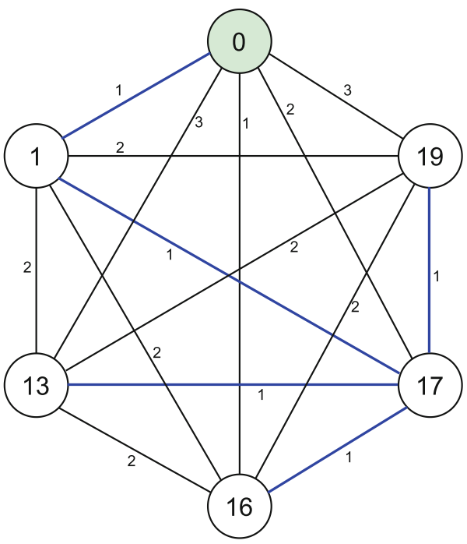
Generation Order of Rotation Key Set
Cyclic shift set $𝒯_{ℓ}=\{1, 13, 16, 17, 19\}$
Cyclic shift generator set $𝒰_{ℓ}=\left\{±1, ±2, ±4,±8,±16\right\}$
$w\left(1,19\right)=2$ (19-1=16+2)
$w\left(13,17\right)=1$ (17-13=4)
Minimum spanning tree → Efficient generating order!

Slide 26
Hoisted Rotation Key Generation
For further optimization of operations, we can use hoisting technique in RotToRot and PubtoRot operations
Main idea: Combining “Decompose” operation in the key-switching operation
Whole runtime is reduced by about half!
$$rk_{4}^{(1)}$$
$$rk_{7}^{(0)}$$
: PubToRot
$$rk_{3}^{(0)}$$
$$rk_{2}^{(1)}$$
: RotToRot
$$rk_{11}^{(0)}$$
$$rk_{15}^{(0)}$$
$$rk_{1}^{(0)}$$
$$rk_{2}^{(1)}$$
Multiple PubToRot operation
from the public key
$$rk_{4}^{(1)}$$
$$rk_{9}^{(0)}$$
$$rk_{8}^{(1)}$$
$$rk_{13}^{(0)}$$
$$rk_{1}^{(1)}$$
$$rk_{4}^{(1)}$$
Multiple RotToRot operation
from one rotation key
$$pk$$
$$rk_{4}^{(0)}$$
$$rk_{12}^{(0)}$$
$$rk_{4}^{(1)}$$
$$rk_{8}^{(1)}$$

Slide 27
Simulation Results

Slide 28
Simulation Environment
Asymmetric environment in the client-server system
Client: Intel(R) Core(TM) i9- 13900K CPU 1 thread
Server: NVIDIA GeForce RTX 4090 GPU
Homomorphic encryption scheme: CKKS scheme
Target application: ResNet CNN model for Image Classification (CIFAR-10/ImageNet)

Slide 29
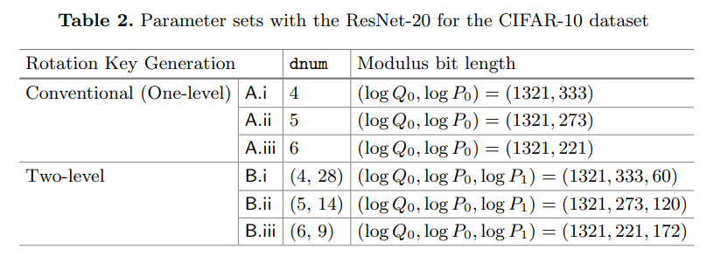
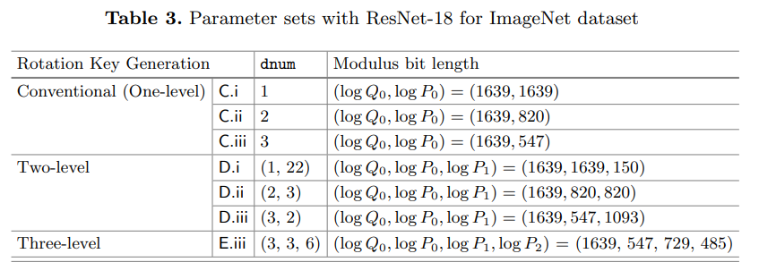
Parameter and Cyclic Shift Generator
Setting $dnum$ value for optimal rotation operation for the ciphertext
Rotation with level-0 rotation key
Then we use the remaining modulus as higher level special modulus $P_{i}$
Two-level system:
16-ary level-1 rotation key set
Three-level system
{1,256}-shift level-2 rotation key set

Slide 30
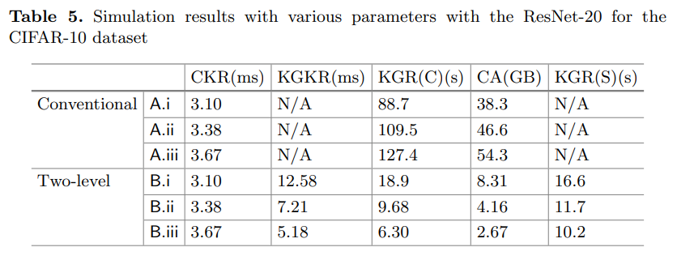
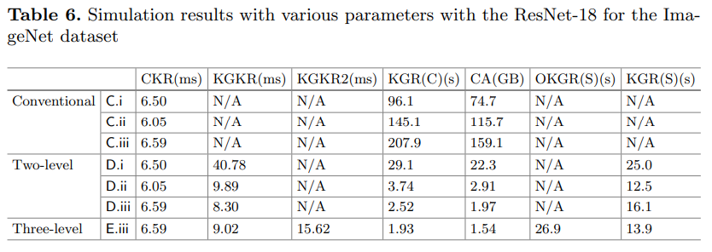
Simulation Results
When the ciphertext rotation runtime remains the same, the key generation and communication in the client are significantly reduced!
x4.7 and x39.8, respectively
It takes 16.6s and 12.5s to generate the required level-0 rotation keys.
x4.7
x39.8

Slide 31
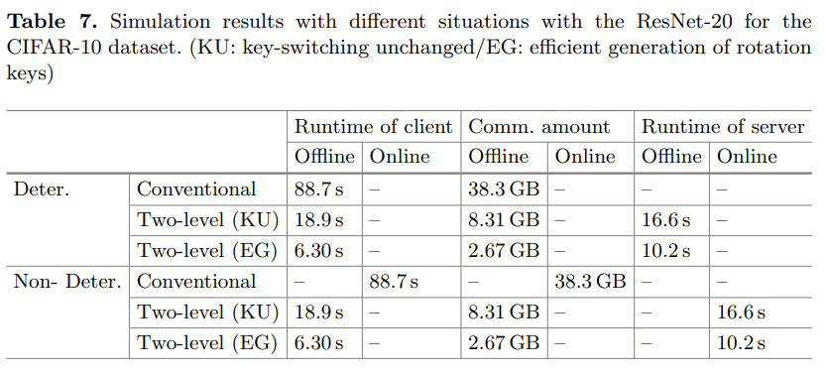
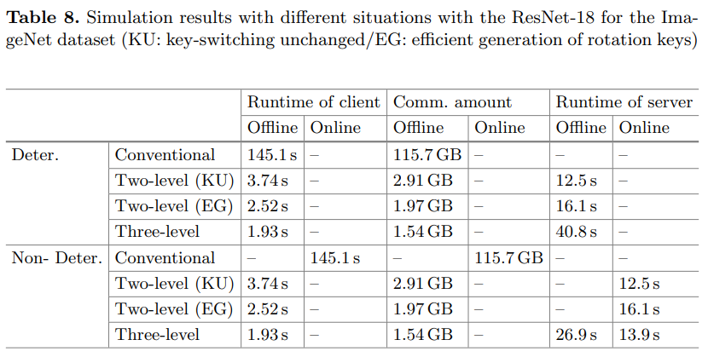
Simulation Results
At most x14.3 and x75.1 improvement in rotation key transmission with the offline computation in the server
It significantly reduces the burden in the client!
x14.3
KU: key-switching unchanged
The runtime of homomorphic computation is the priority.
EG: efficient generation of rotation keys
Slight increase of homomorphic computation for significant improvement in key generation
x75.1

Slide 32
Thank you for listening!
Any Questions?

