Slide 1
Efficient Secure Storage with Version Control and Key Rotation
Long Chen, Hui Guo, Ya-Nan Li, Qiang Tang
Notes:
Confuse with related to key management

Slide 2
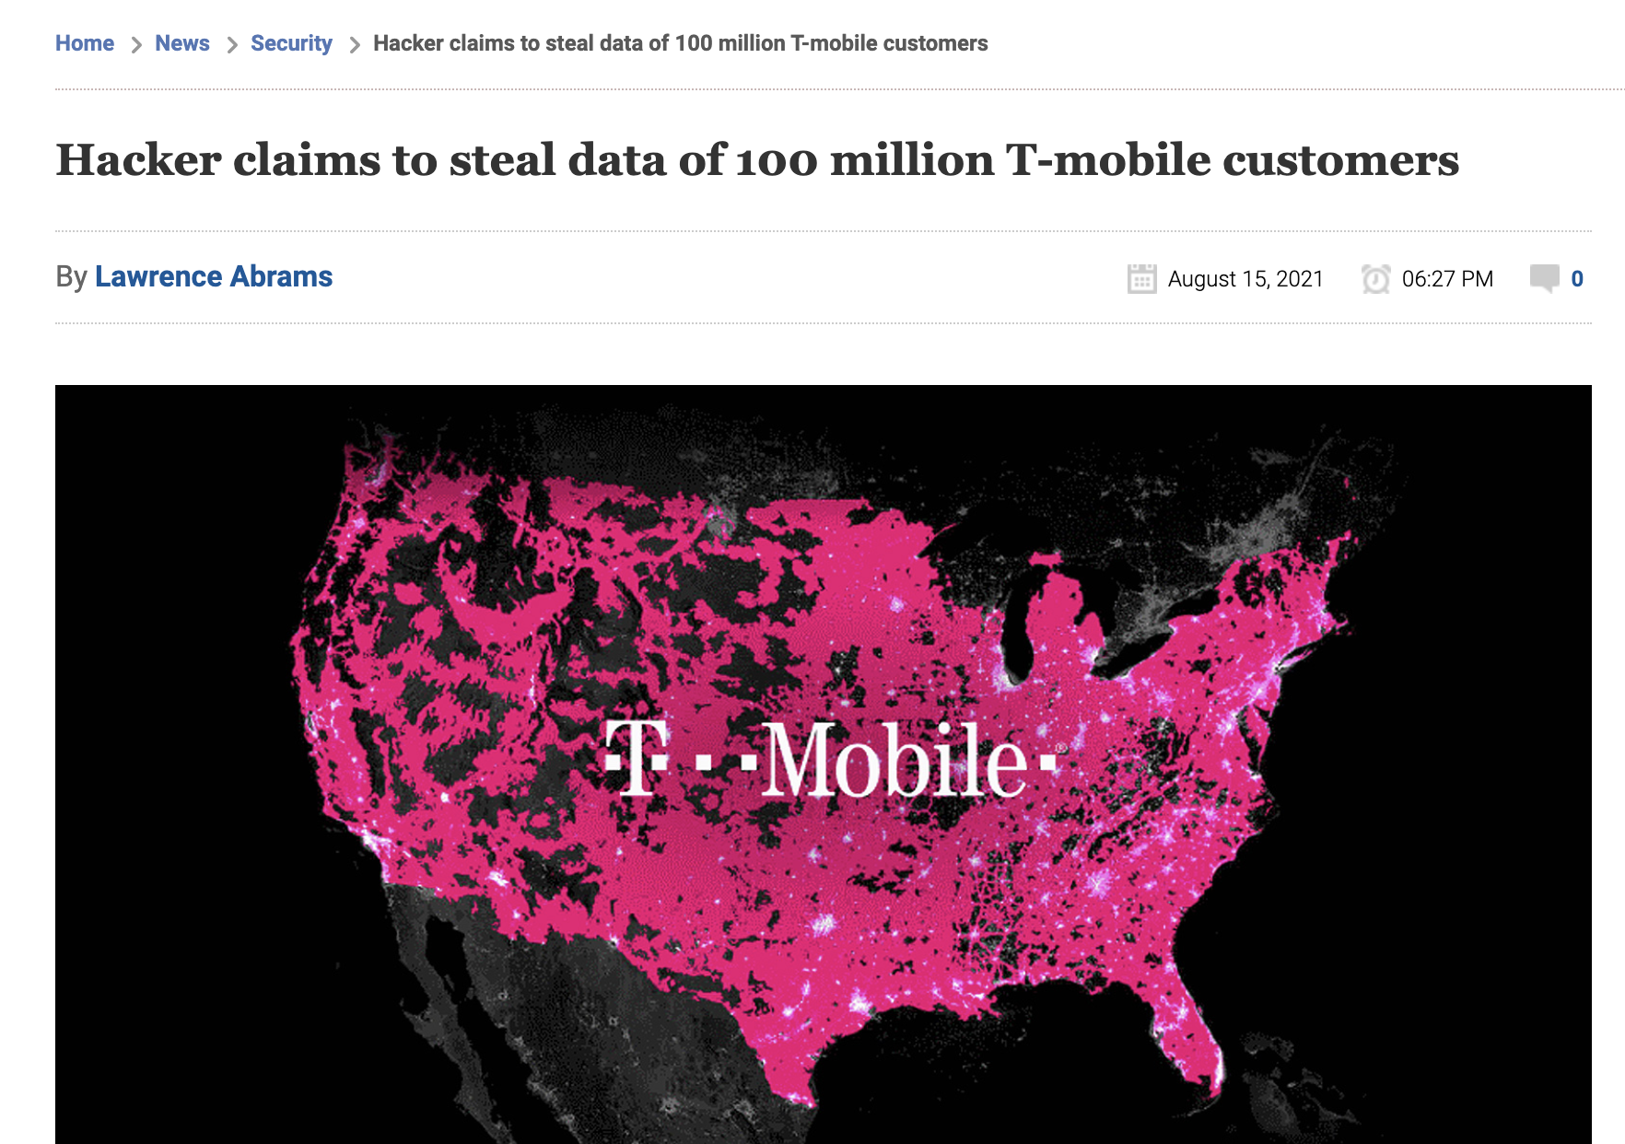
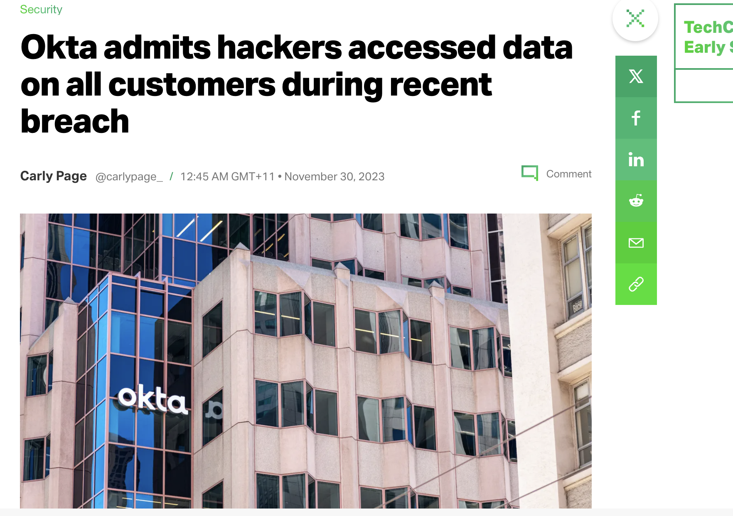
Data breach happens frequently

Slide 3
Encryption is not a panacea
Data is securely protected by Encryption on condition that key is safe
Key is vulnerable to be compromised

Slide 4
Key compromise issue is universal
Encryption for secure communication VS Encryption for secure storage
Quite different
As data has a long lifespan
Deal with data encrypted under prior key
Large data size; efficiency
Authenticated Encryption (AE)
with confidentiality (CPA/CCA) and integrity (PTXT/CTXT)
Easy to handle key compromise:
create
store
Edit/
process
destroy
Alice
Bob
$${AE.Enc(k}_{1},m_{1})$$
$$k_{1}$$
$$k_{1}$$
$${AE.Enc(k}_{2},m_{2})$$
$$k_{2}$$
$$k_{2}$$
Updatable Encryption (UE)
$$k_{3}$$
$${AE.Enc(k}_{3},m_{3})$$
$$k_{3}$$

Slide 5
Research status of secure storage
Integrity
Are we done with secure storage?
File integrity
PTXT/CTXT
Updatable Authenticated Encryption (UAE)
Authenticated Encryption (AE)
Confidentiality
No key compromise
(CPA/CCA security)
Allow key compromise
(CPA/CCA security)

Slide 6
Existing research missed a basic feature of storage
Edit/
process
destroy
create
store

Slide 7
Cloud storage are usually dynamic
Dynamic: data changes all the time
…

Slide 8
Integrity challenge in dynamic storage
“Version Downgrade” attack: malicious server may fool users with old data
v1
v1
v3
v2
10GB
1kB
Priya Mistry
Standard integrity ensures no valid ciphertext of new plaintext (PTXT) or no valid new ciphertext (CTXT).
AE and UAE ‘s integrity are Insecure against version downgrade attack.
Notes:
Motivation that server does not store the latest version
First version 1kb
Third version 1GB

Slide 9
Overview of status of secure storage
Integrity
Fie version integrity
File integrity
Updatable Authenticated Encryption (UAE)
Authenticated Encryption (AE)
Confidentiality
No key compromise
(CPA/CCA security)
Allow key compromise
(CPA/CCA security)

Slide 10
Our focus
Integrity
Our work
Version integrity
File integrity
Updatable Authenticated Encryption (UAE)
Authenticated Encryption (AE)
Confidentiality
No key compromise
(CPA/CCA security)
Allow key compromise
(CPA/CCA security)

Slide 11
Our contribution
Define updatable secure storage (USS) with key rotation and version control
Formalize its security to capture confidentiality with key rotation and file version integrity against version downgrade attack
Propose an efficient USS construction
- constant local storage
- constant computation and communication cost in key update
- independent cost with whole storage in file update
Notes:
with following properties
Against key compromise
Against downgrade attack
O(1) user storage
Efficient Communication

Slide 12
Updatable secure storage (USS)

Slide 13
USS basic functions
…
Communication independent of #files
Constant user storage, efficient computation
1. USS.Store:
2. USS.Rev:
3. USS.KeyUp:
4. USS.FileUp:
Securely upload a database with n files
retrieve one file
key rotation on the whole database
update one file

Slide 14
USS security requirements
For confidentiality
Data Confidentiality
Re-enc indistinguishability
>> Additional confidentiality for new operation
File update confidentiality: ciphertexts and update token do not leak information about update $∆$
File version integrity (ordered-file plaintext integrity ): capture the version downgrade attack – malicious server cannot fool user with old data
Similar to UE’s confidentiality
For Integrity

Slide 15
Construction idea of USS

Slide 16
Inspired by Authenticated Encryption
Goal: confidentiality with key rotation & file version integrity for file update
Recall Authenticated Encryption (AE)
How about similar combination approaches for secure USS?
- Confidentiality with key rotation → UE
- File version integrity -- ??
combination | Enc-&-Mac | Enc-then-Mac | Mac-then-Enc
security | Insecure | CPA & CTXT | CPA & PTXT
Notes:
Start from AE inspiration
CTXT solution
Introduce VC for trivial integrity

Slide 17
Updatable Encryption (UE)
UE is a symmetric encryption with secure and efficient key rotation
* Focus on ciphertext independent UE
Key Requirements:
Efficiency: constant client computation and communication
Security: Confidentiality (Enc-IND and Re-Enc-IND) and integrity (PTXT/CTXT)
Many recent works study UE’s security and efficient constructions [EPRS17, LT18, KLR19, BDGJ20, CLQ20,…]
Notes:
Move back
Requirement:
Client efficiency: computation independent of file size
Communication efficiency: communication independent of file size

Slide 18
File version integrity without confidentiality
1. Hash method
2. Vector commitment
$$f_{1}$$
$$VC.SetUp\left(λ\right)→pp$$
Hash()
$$f_{2}$$
C
$$H_{1}$$
$$⋮$$
$$VC.Com(pp,f)$$
$$⋮$$
$$f_{i}$$
$$VC.Open(pp,i,f)$$
$π_{i}$: proof of the $i$-th file is $f_{i}$
$$⋮$$
Hash()
$$VC.Ver(pp,i,{C, f}_{i},π_{i})→0/1$$
$$H_{i}$$
$$f_{n}$$
$$⋮$$
Key properties:
Succinctness: $\left|C\right|=\left|π_{i}\right|=O(1)$
Position binding: cannot open one position to two different messages
Hash()
$$H_{n}$$
Client cost: O(1) storage;
Server cost for storing all proofs : O(n)
Client costs O(n) storage
Notes:
Or vector commitment
One node update, all other proof changes accordingly
O(n) Communication due to data update

Slide 19
Inspired by Authenticated Encryption
Goal: confidentiality with key rotation & file version integrity for file update
Recall Authenticated Encryption (AE)
How about similar combination approaches for secure USS?
- Confidentiality with key rotation → UE
- File version integrity -- ??
combination | Enc-&-Mac | Enc-then-Mac | Mac-then-Enc
Security | Insecure | CPA & CTXT | CPA & PTXT
Combination | UE-&-VC | UE-then-VC | UE-then-VC
Security | Insecure | CPA conf & file version CTXT | CPA conf & file version PTXT
VC
Notes:
Start from AE inspiration
CTXT solution
Introduce VC for trivial integrity

Slide 20
Naïve VC-then-UE for USS
CT form of Mac-then-Enc: Enc(f, mac)
VC-then-UE:
Security issue:
$$UE_{k}(f_{1},π_{1})$$
$$UE_{k}(f_{2},π_{2})$$
$$⋮$$
C
$$UE_{k}(f_{i},π_{i})$$
$$k$$
$$⋮$$
$$UE_{k}(f_{n},π_{n})$$
General VC : C and${ π}_{i}$leak info --> hurt confidentiality
1. VC without hiding property:
2. VC with hiding property:
C, $π_{i}$ leak info
→ no data confidentiality
Unchanging C,${ π}_{i}$leak whether file has been changed
→ no Re-Enc IND
We need Re-randomizable VC with hiding property
Notes:
Naieve using mac then enc
Citation of re-randomizable VC??

Slide 21
Naïve VC-then-UE for USS
CT form of Mac-then-Enc: Enc(f, mac)
VC-then-UE:
Security issue:
Efficiency issue: in file update and key rotation
communication: all proofs change, needs to retrieve all files
computation: Client operates all files
$$UE_{k}(f_{1},π_{1})$$
$$UE_{k}(f_{2},π_{2})$$
$$⋮$$
C
$$UE_{k}(f_{i},π_{i})$$
$$k$$
$$⋮$$
$$UE_{k}(f_{n},π_{n})$$
Notes:
Naieve using mac then enc
Citation of re-randomizable VC??

Slide 22
Efficiency comparison
File update | User comp | communication
Naïve VC-then-UE | O(n* |f|) | O(n * |f|)
Our goal | O(|f|) | O(|f|)
Key update | User comp | communication
Naïve VC-then-UE | O(n * |f|) | O(n * |f|)
Our goal | O(1) | O(1)
|f| represents file size, n represents number of files
CTXT alone for UE was already challenging, solved in [CLT20]
Notes:
Ctxt

Slide 23
Our idea- KEM/DEM paradigm
Achieve our goal if server can help update all encrypted proofs!
$$UE_{k}(f_{i},π_{i})$$
Update one file:
- Retrieve one file and all proofs
- Operate them
Key update:
- Retrieve all proofs
- Operate them
UE(File) || UE($π_{i}$)
File update | User comp | communication
VC-then-UE | O(n * |f|) | O(n * |f|)
KEM/DEM with any UE | O(n + |f|) | O(n + |f|)
Our goal | O(|f|) | O(|f|)
Key update | User comp | communication
VC-then-UE | O(n * |f|) | O(n * |f|)
KEM/DEM with any UE | O(n) | O(n)
Our goal | O(1) | O(1)
|f| represents file size, n represents number of files
Notes:
aChieve our goal

Slide 24
Our idea - Delegate proof update via compatible homomorphism
Homomorphic property of UE and VC to allow server to help update encrypted proof
UE homomorphism:
$${UE}_{k}\left(m⨂∆\right)←{UE}_{k}(m){⨀UE}_{k}(∆)$$
VC homomorphism:
$$VC.Com(\vec{m}⨁\vec{∆})←VC.Com(\vec{m})⨂VC.Com(\vec{∆})$$
Proof of $m_{i}^{′}$ is $π_{i}^{′} ←π_{i}⨂π_{∆_{i}}$
Compatibility: UE operation on message compatible with VC operation on proof
UE(File) || UE(proof)
Instantiation: HVC > re-randomizable + hiding + homomorphic
- a variant of Pedersen vector commitment
UE: - an ElGamal-based UE called RISE

Slide 25
Our USS performance
File update | User comp | communication
VC-then-UE | O(n * |f|) | O(n * |f|)
KEM/DEM with any UE | O(n + |f|) | O(n + |f|)
KEM/DEM for special UE & VC | O(|f|) | O(|f|)
Key update | User comp | communication
VC-then-UE | O(n * |f|) | O(n * |f|)
KEM/DEM with any UE | O(n) | O(n)
KEM/DEM for special UE & VC | O(1) | O(1)
|f| represents file size, n represents number of files
UE(File) || UE(proof)
DEM: Any UE with confidentiality, can benefit from UE’s efficiency improvement

Slide 26
Intuitive challenge of USS with ciphertext integrity (CTXT)
UE(File) || Proof( UE(File) )
UE(File) || UE(proof)
UE only provides confidentiality + VC provide integrity
Three main barriers:
More requirements on UE: UE should satisfy CTXT [KLR19, BDGJ20, BEKS20, CLT20]
UE ciphertext re-enc operation compatible with proof update (no satisfied so far)
Better efficiency: structured ciphertext is hard to be compressed for efficient VC

Slide 27
Take away
Problem: existing research on secure storage does not support dynamic storage
USS Solution:
- achieve confidentiality with key rotation and file version plaintext integrity
- satisfy the efficiency in local storage and computation, and communication
- KEM/DEM paradigm + extra homomorphic property on KEM part, which is special but very small, and DEM part could benefit from general UE improvement
Future work:
explore more efficient UE
USS with CTXT
Mapping all functions in existing version control to secure storage
Thanks for your attention

