Slide 1
Non-Interactive Commitment from Non-Transitive Group Actions
G. D'Alconzo¹, A. Flamini², A. Gangemi².
¹Polytechnic of Turin, Italy ²University of Trento, Italy
Asiacrypt 2023 Guangzhou, China December 6

Slide 2

Group actions in Cryptography
Let $X$ be a set, $G$ be a group and $⋆ :G×X →X$. $\left(G,X,⋆\right)$ is a group action if $⋆$ is compatible with the group operation: $e⋆x = x$ and $\left(gh\right)⋆x = g⋆\left(h⋆x\right)$.
Effective
Pseudorandom
One-way
E
$g$ ?
PPT algorithms for $X$, $G$ and $⋆$.
$$g$$
$$x$$
$$y$$
$$x$$
$$y$$
Many constructions from GAs! Key exchanges, digital signatures, oblivious transfers, PRFs, etc.
Alamati, De Feo, Montgomery, Patranabis. "Cryptographic group actions and applications." Asiacrypt 2020.

Slide 3
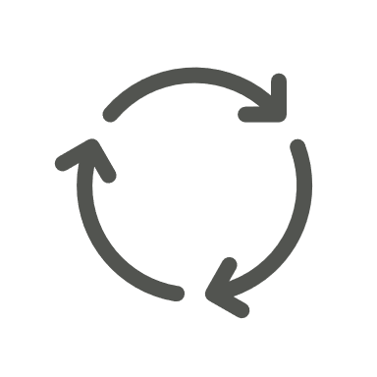
On the Transitive Property
$$X$$
$$X$$
LESS, MEDS, ALTEQ
$$G$$
$$G$$
$$G$$
Non-Transitive
Transitive
In cryptography, we usually restrict to one orbit (transitive-by-design).
Mainly used in cryptography.
$$G$$
$$G$$
CSIDH, DLog

Slide 4
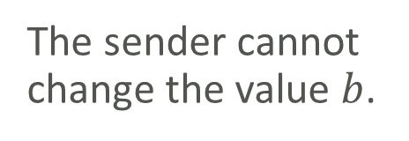
Commitment Scheme
Commit phase:
$$b$$
Opening phase:
$b$,
Binding
Hiding
The sender cannot change the value $b$.
does not give information on $b$.

Slide 5
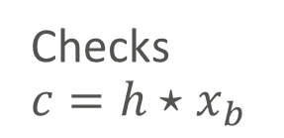
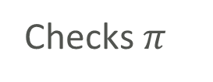

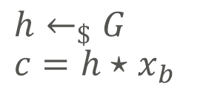
Bit Commitment from GAs [BY91, JQSY19]
Public parameters
Issue 1
$$\left(G,X,⋆\right)$$
$π$ can be huge
$$b$$
$$x_{0},x_{1},π$$
$g,x_{0},x_{1}=g⋆x_{0}$ proof $π$
Setup phase:
Checks $π$
Commit phase:
$$h←_{\$}G \\ c=h⋆x_{b}$$
$c$
Issue 2
$c$
Interaction!
Opening phase:
$$b, h$$
Checks $$c=h⋆x_{b}$$

Slide 6
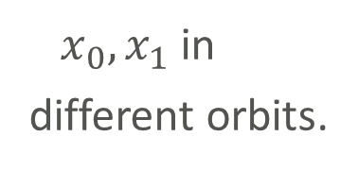
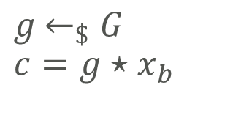

A first attempt
Trusted third party (TTP)
Public parameters
$$\left(G,X,⋆\right)$$
$x_{0},x_{1}$ in
different orbits.
$$b$$
Commit phase:
$g$ $←_{\$}G$ $$c=g⋆x_{b}$$
$$c$$
$$c$$
$$b, g$$
Checks $$c=g⋆x_{b}$$
Opening phase:

Slide 7
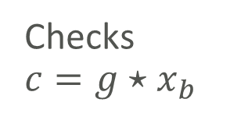

Removing the TTP
Issue
can cheat by choosing $x_{1}=h⋆x_{0}$. Then he can open a different bit from $b$.
First try
Public parameters
Generates $x_{0},x_{1}$ in different orbits.
$$\left(G,X,⋆\right)$$
$$b$$
Commit phase:
$g$ $←_{\$}G$ $$c=g⋆x_{b}$$
$$x_{0},x_{1},c$$
$$c$$
$$b, g$$
Checks $$c=g⋆x_{b}$$
Opening phase:

Slide 8
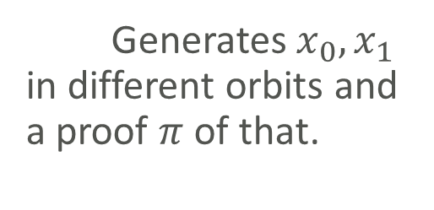
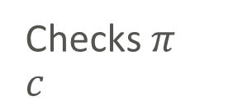
Removing the TTP
Issue
Second try
No suitable techniques to produce such a non-interactive proof $π$.
Public parameters
Generates $x_{0},x_{1}$ in different orbits and a proof $π$ of that.
$$\left(G,X,⋆\right)$$
$$b$$
Commit phase:
$g$ $←_{\$}G$ $$c=g⋆x_{b}$$
$$x_{0},x_{1},c, π$$
Checks $π$ $$c$$
$$b, g$$
Checks $$c=g⋆x_{b}$$
Opening phase:

Slide 9
Removing the TTP
Issue
Third try
Interaction!
As in [BY91, JQSY19].
Public parameters
Generates $x_{0},x_{1}$ in different orbits.
$$\left(G,X,⋆\right)$$
$$x_{0},x_{1}$$
$$b$$
Commit phase:
$g$ $←_{\$}G$ $$c=g⋆x_{b}$$
$$c$$
$$c$$
$$b, g$$
Checks $$c=g⋆x_{b}$$
Opening phase:

Slide 10
The Framework
Given $\left(G,X,⋆\right)$, we need a way to certify that two elements lie in different orbits.
Ingredients.
Invariant function $f : X →T$ such that $f\left(g⋆x\right)= f\left(x\right)$.
Let $T^{′}⊆f\left(X\right)$, then $\left\langle ⋅\right\rangle :T^{′}→X$ is a canonical map for $f$ if $f\left(\left\langle t\right\rangle \right)=t.$
Easy: recognize and compute $\left\langle t\right\rangle$ for any $t$ in $T^{′}$;​
Hard: computing $f$ in general. In particular, we have the following assumption: for any PPT $𝒜$, Pr$\left[𝒜\left(g⋆\left\langle t\right\rangle \right)=t\right] ≤ negl\left(λ\right)$.
We call the tuple $\left(G,X,⋆,f, \left\langle ⋅\right\rangle \right)$ Group Action with Canonical Elements (GACE).

Slide 11
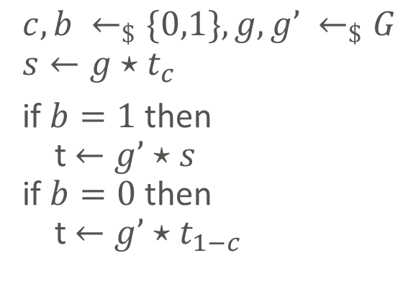
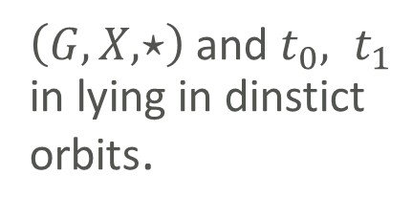
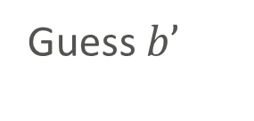
Pseudorandom Assumption
Any PPT adversary wins the following game with negligible probability.
Public parameters:
$\left(G,X,⋆\right)$and $t_{0}, t_{1}$ in lying in dinstict orbits.
Adversary
Challenger
$$c,b ←_{\$}\{0,1\}, g,g’ ←_{\$}G \\ s←g⋆t_{c}$$ if $b=1$ then t $←g’⋆s$ if $b=0$ then t $←g’⋆t_{1−c}$
$$s, t$$
Guess $b’$
$$b′$$
The adversary wins if $b’=b$.

Slide 12
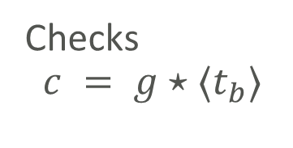
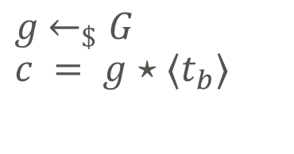
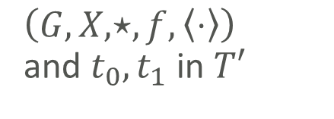
Bit commitment from GACE
Public parameters
$$b$$
$\left(G,X,⋆,f,\left\langle ⋅\right\rangle \right)$ and $t_{0},t_{1}$ in $T′$
Commit phase:
$$c$$
$g$ $←_{\$}G$ $$c = g⋆⟨t_{b}⟩$$
$$c$$
Opening phase:
$$b, g$$
Checks $$c = g⋆⟨t_{b}⟩$$
Computationally hiding under the Pseudorandom assumption. Perfectly binding.

Slide 13
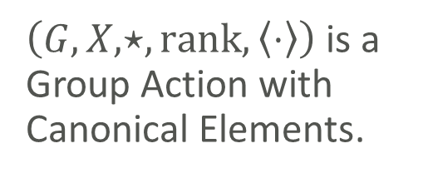
A concrete instantiation (tensors!)
Let $F_{q}^{n}⊗F_{q}^{n}⊗F_{q}^{n}$ and $G=\text{GL}{\left(n,q\right)}^{3}$
$$\left(A,B,C\right)⋆\sum_{ijk}{S_{ijk}}e_{i}⊗e_{j}⊗e_{k}= \sum_{ijk}{S_{ijk}}Ae_{i}⊗Be_{j}⊗Ce_{k}$$
The invariant function is the tensor rank (NP-hard to compute)
$f=\text{ran}\text{k}$
Tensor rank
Minimal $r$ such that
$$S = \sum_{i=1}^{r}{a_{i}}⊗b_{i}⊗c_{i}$$
It is hard to build tensors of any given rank, but for small $r$ we have
$\text{rank}\left(\sum_{i=1}^{r}{e_{i}}⊗e_{i}⊗e_{i}\right)= r$.
Hence, $T’⊂\{0,…,n\}$ and the canonical map is given by
$$\left\langle r\right\rangle = \sum_{i=1}^{r}{e_{i}}⊗e_{i}⊗e_{i}.$$
$\left(G,X,⋆, \text{rank}, \left\langle ⋅\right\rangle \right)$ is a Group Action with Canonical Elements.
Bläser. "Explicit tensors." 2014.

Slide 14
Recap
Future Other Group Action with Canonical Elements.New constructions.
Non-transitivity is not a bug, but a feature!
We presented the first non-interactive bit commitment from cryptographic group actions.
What you can find in the paper:
more on assumptions,
linkable commitments.
Thanks for your attention!

Slide 15
On the Transitive Property
Transitive
Non-Transitive
In cryptography, we usually restrict to one orbit.
Mainly used in cryptography.

