Slide 1
An Efficient Strong Asymmetric PAKE Compiler Instantiable from Group Actions
Ian McQuoid Jiayu Xu

Slide 2
Password-Authenticated Key Exchange (PAKE)
Password-only: no PKI
Only online guessing attack possible (guess pw and impersonate one party)
Unfit for client-server setting
pw
pw
$$SK$$
$$SK$$

Slide 3
Strong asymmetric PAKE (saPAKE) [JKX18]
3 possible attacks:
1. Online guessing attack
2. Offline dictionary attack after compromising server (get $f(\text{pw})$, brute-force over dictionary to find pw)
Asymmetric PAKE (aPAKE) if part of attack can be done before server compromise
3. Impersonating server after compromising server
pw
$$f(\text{pw})$$
$$SK$$
$$SK$$

Slide 4
Security notions for (sa)PAKE
UC has become standard
Support arbitrary composition
Model password reuse across different accounts
 | game-based | Universally Composable
PAKE | [BPR00] | [CHK⁺05]
aPAKE | [BP13] | [GMR06]
saPAKE |  | [JKX18]

Slide 5
Strong asymmetric PAKE (saPAKE)
E: group exponentiation
H: hash into group
P: pairing operation
Difficult to construct
Only 5 saPAKE protocols to this date, all UC-secure
All 5 have significant issues
 | client | server | round | security | assumption | model
[BJX19] | 13E | 8E | 2 | full | 2-SDH, DDH | ROM offline GGM
OPAQUE [JKX18] | 5E, 1H | 4E | 3 | relaxed | OMGDH | ROM
OPAQUE’ [JKX18] | 2E, 1H aPAKE | 1E aPAKE | 3 | relaxed | OMGDH | ROM
CRISP [CNP⁺22] | 6E, 3P, 3H PAKE | 3E, 3P, 1H PAKE | 3 | full | CDH | ROM bilinear GGM
AuCPace [HL19] | 6E, 2H | 5E, 1H | 3 | relaxed | sSDH, OMGDH | ROM

Slide 6
OPAQUE, OPAQUE’ [JKX18], AuCPace [HL19]
Only realizes a contrived relaxed UC functionality
Very strong assumption (one-more gap Diffie-Hellman)
[BJX19]
Inefficient
Offline security analysis sketchy (“adversary can test constant number of passwords per GGM operation”)
CRISP [CNP⁺22]
Uses bilinear map → inefficient
Uses GGM in a pairing group

Slide 7
saPAKE under post-quantum assumptions
Even PAKE under post-quantum assumptions poorly studied
No such saPAKE ever proposed

Slide 8
Our contributions
2 new saPAKE constructions (PAKE-to-saPAKE compilers)
One based on DH-type assumptions
One based on group-action assumptions (post-quantum)
Realizes full UC saPAKE functionality
Based on mild assumptions (CDH; GACDH)
Precise offline security analysis (“adversary can test 2 passwords per GGM operation”)
Efficient
Conceptually simple
Online security relies on the Algebraic Group Model (AGM)

Slide 9
E: group exponentiation
H: hash into group
P: pairing operation
A: group action
 | client | server | round | security | assumption | model
[BJX19] | 13E | 8E | 2 | full | 2-SDH, DDH | ROM offline GGM
OPAQUE [JKX18] | 5E, 1H | 4E | 3 | relaxed | OMGDH | ROM
OPAQUE’ [JKX18] | 2E, 1H aPAKE | 1E aPAKE | 3 | relaxed | OMGDH | ROM
CRISP [CNP⁺22] | 6E, 3P, 3H PAKE | 3E, 3P, 1H PAKE | 3 | full | CDH | ROM bilinear GGM
AuCPace [HL18] | 6E, 2H | 5E, 1H | 3 | relaxed | sSDH, OMGDH | ROM
Our protocol 1 | 1E PAKE | 2E PAKE | 2 | full | CDH | ROM offline GGM online AGM
Our protocol 2 | 1A PAKE | 2A PAKE | 2 | full | GACDH | ROM offline GGAM online AGAM

Slide 10
Our protocol (DH-based): first attempt
$$h=H(\text{pw})$$
$R^{h}$ low-entropy to eavesdropper who sees $R$
pw
$$g^{h}$$
$$r⇠ℤ_{p}$$
$$R≔g^{r}$$
$$R^{h}$$
$${(g^{h})}^{r}$$

Slide 11
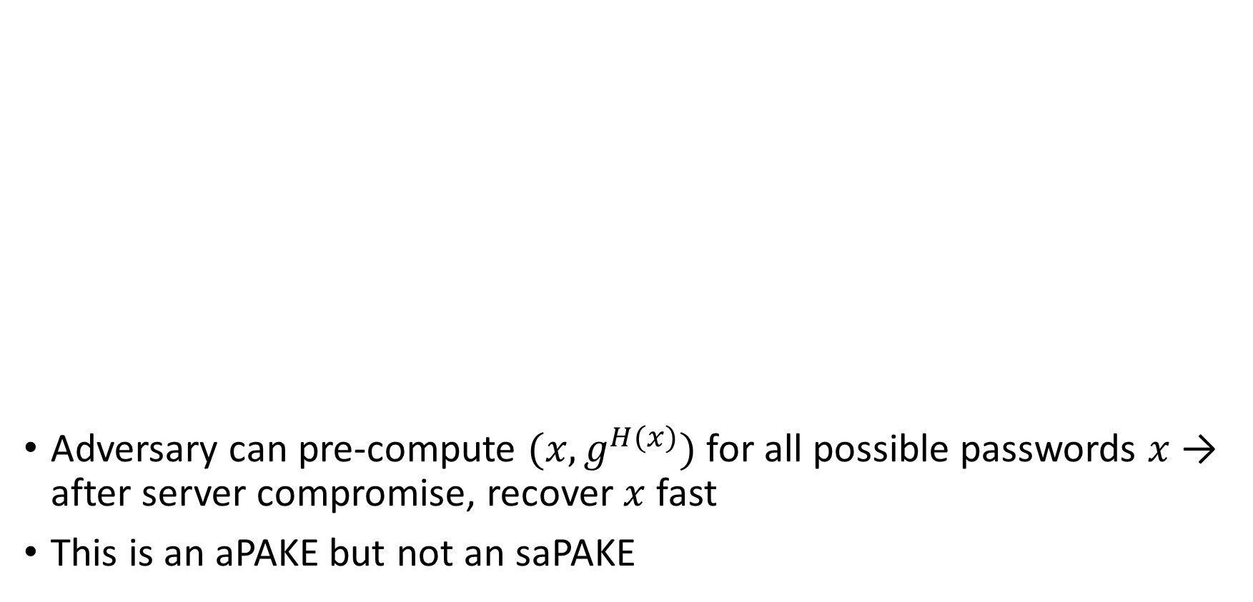
$$h=H(\text{pw})$$
Adversary can pre-compute $(x,g^{H(x)})$ for all possible passwords $x$ → after server compromise, recover $x$ fast
This is an aPAKE but not an saPAKE
pw
$$g^{h}$$
$$r⇠ℤ_{p}$$
$$R≔g^{r}$$
$$R^{h}$$
$${(g^{h})}^{r}$$
PAKE
$$SK$$
$$SK$$

Slide 12
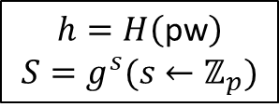
$$h=H\left(\text{pw}\right)$$
$$S=g^{s}(s←ℤ_{p})$$
After server compromise, adversary can “effectively impersonate server” by running server’s algorithm on $(S^{r^{∗}},{(S^{h})}^{r^{∗}})$
Simulator cannot detect if DDH hard → have to work in AGM
pw
$${(S,S}^{h})$$
$$r⇠ℤ_{p}$$
$$R≔S^{r}$$
$$R^{h}$$
$${(S^{h})}^{r}$$
PAKE
$$SK$$
$$SK$$

Slide 13
Offline security analysis
Given ${(S,S}^{h})$ where $h$ has low entropy (drawn from a random polynomial-size subset of $ℤ_{p}$), how long does it take to recover $h$?
“Discrete logarithm over sparse set”
Highly non-trivial, first studied in [Sch01]
Can test 2 $h$ values per GGM operation
[BJX19] uses a similar idea, but says “can test $O(1)$ $h$ values per GGM operation”

Slide 14
Summary
2 new saPAKE protocols
DH-based: under CDH, in ROM+offline GGM+online AGM
Group action-based: under GACDH, in ROM+offline GGAM+online AGAM
Conceptually simple, more efficient than existing protocols

Slide 15
An Efficient Strong Asymmetric PAKE Compiler Instantiable from Group Actions THANK YOU!
Ian McQuoid, Jiayu Xu
https://eprint.iacr.org/2023/1434

