Slide 1
Algebraic Attacks on Round-Reduced Rain and Full AIM-III
Kaiyi Zhang
Shanghai Jiao Tong University
Qingju Wang
Telecom Paris, Institut Polytechnique de Paris
Yu Yu
Shanghai Jiao Tong University
Chun Guo
Shandong University
Hongrui Cui
Shanghai Jiao Tong University

Slide 2
MPC-in-the-head Paradigm
MPCitH: ZK based on MPC
Used in lots of post-quantum signatures
(inaccurate) ZK* + OWF = SIG
Let H be a OWF, $H(x)=y$
Secret key = $x$, public key = $y$
Signature $≈$ ZK Proof
Signer proves it knows $x$ such that $H\left(x\right)=y$ via ZK
*: actually we need PQNIZKPoK a.k.a post-quantum non-interactive zero-knowledge proof of knowledge

Slide 3
Post-Quantum Signatures from MPCitH
Picnic(CCS’17) = ZK + LowMC
FAEST(Crypto’23) = ZK + AES
Rainier(CCS’22) = ZK + Rain
AIMer(CCS’23) = ZK + AIM
And more …
Linear functions are friendly to ZK
XOR
Constant matrix multiplication
Non-linear functions are NOT friendly to ZK
AND
$x↦x^{−1}$ over $GF(2^{8})$
Improvement ?
Improve ZK
Use OWF with low non-linearity

Slide 4
Overview
Rain and AIM are OWFs designed for signatures based on MPCitH
Our Results:
Key Recovery Attacks
1-Round Rain : $2^{64},{ 2}^{96} ,2^{128}$
2-Round Rain : $2^{120},2^{180},2^{243}$
AIM-192 : $2^{187}$
Exploit the algebraic structure of the power function $x↦x^{d}$

Slide 5
Rain
$P,C∈𝔽_{2}^{n}$: Known plain/ciphertext
$M_{i}∈𝔽_{2}^{n×n}$: invertible matrix
$k∈𝔽_{2}^{n}$: secret key
$x^{−1}$: inverse function over $GF\left(2^{n}\right)$
Use “block cipher” as OWF
$H_{P}\left(k\right)=Enc\left(k,P\right)=C$
Resist Known Plaintext Attack
$⇒$ One-wayness

Slide 6
Obstacle
One known plaintext/ciphertext
statistical attacks not applicable
algebraic attacks ONLY
Large Sbox and Linear layer
Linear Layers are unstructured
We have to analyze the algebraic structure of the Sbox $x↦x^{−1}$

Slide 7
Observation
$x^{−1}=x^{254}$ over $GF(2^{8})$
(with mapping zero to zero)
$x^{254}={\left(x^{17}\right)}^{14}⋅x^{16}$
$x↦x^{2^{k}}$ is linear, $L\left(x\right)=x^{2}$
$L\left(x+y\right)=x^{2}+y^{2}=L\left(x\right)+L(y)$
$x^{2^{k}}=Mx$, $M∈𝔽_{2}^{n×n}$
The multiplicative group $𝔽_{q}^{∗}$ of a finite field $𝔽_{q}$ is cyclic.
$x^{17}$ is a subgroup of $𝔽_{2^{8}}^{∗}$ because 17 is a divisor of 255
$\left|\left\{x^{17}:x∈𝔽_{2^{8}}^{∗}\right\}\right|=\frac{255}{17}=15$

Slide 8
Observation
$x^{254}={\left(x^{17}\right)}^{14}⋅x^{16}$
$x↦x^{16}$ is linear
$x^{16}=Mx$ for some matrix $M$
$x↦x^{17}$ has 15 possible choices
Denote them by $a_{i}$
$x^{254}=a_{i}^{14}⋅Mx=M_{i}^{′}x$
where $M_{i}$ is some matrix
Thus $x↦x^{254}$ can be expressed as 1 of 15 linear mappings.
S(x):
$for i=1 to 15$
$if x^{17}=a_{i}$
$return M_{i}^{′}x$
No impact on AES

Slide 9
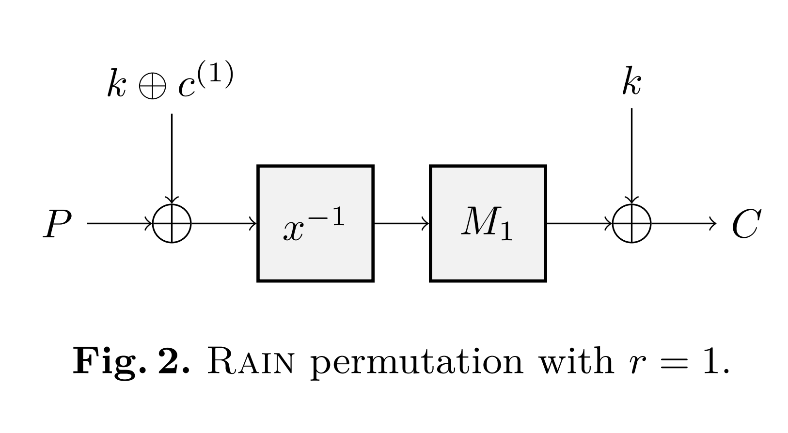
1-Round Rain
$P,C∈𝔽_{2}^{n}$: Known plain/ciphertext
$M_{i}∈𝔽_{2}^{n×n}$: invertible matrix
$k∈𝔽_{2}^{n}$: secret key
$x^{−1}$: inverse function over $GF\left(2^{n}\right)$

Slide 10
Analysis
$x^{254}={\left(x^{17}\right)}^{14}⋅x^{16}$
We want $d,s,2^{t}$ such that
$x^{−1}=x^{|𝔽|−2}={\left(x^{d}\right)}^{s}x^{2^{t}}$
Where $d$ is a divisor of $\left|𝔽\right|−1$
For even $n$, $𝔽=GF(2^{n})$
$\left|𝔽\right|−2=2^{n}−2$
$=\left(2^{\frac{n}{2}}+1\right)\left(2^{\frac{n}{2}}−1\right)−1$
$=\left(2^{\frac{n}{2}}+1\right)\left(2^{\frac{n}{2}}−2\right)+2^{n/2}$
$d$ $s$ $2^{t}$
$x↦x^{d}$ has $2^{n/2}−1$ possible choices

Slide 11
Attack on 1-Round Rain
Linearlize it
$x^{−1}=x^{|𝔽|−2}={\left(x^{d}\right)}^{s}x^{2^{t}}$
$x^{d}$ has $2^{n/2}−1$ possible choices
$x^{2^{t}}$ is linear
Enum the value of $x^{d}$, linearize $x↦x^{−1}$. Solve linear equations about $k$.
Complexity $2^{n/2}$, assume Gaussian Elimination and Encryption are both $n^{3}$

Slide 12
2-Round Rain
$P,C∈𝔽_{2}^{n}$: Known plain/ciphertext
$M_{i}∈𝔽_{2}^{n×n}$: invertible matrix
$k∈𝔽_{2}^{n}$: secret key
$x^{−1}$: inverse function over $GF\left(2^{n}\right)$
Linearlize two Sbox takes $2^{n/2}×2^{n/2}=2^{n}$

Slide 13
Observation
For $𝔽=GF(2^{8})$
Guess $x^{5}$ over $\frac{255}{5}=51$ choices
Suppose $x^{5}=1$
(1)
$x^{16}={\left(x^{5}\right)}^{3}x$ $⇒$ $x^{16}−x=0$
$x^{16},x$ are Linear; Linear Constraints
(2)
$x^{5}=x^{4}x=1$
$x^{4},x$ are Linear; Quadratic Constraints
For proper $d$, guess $x^{d}$
Obtain linear and quadratic constraints
Solve equations

Slide 14
Solve quadratic equations
Solve quadratic equations over $𝔽_{2}$
$∑a_{i,j}x_{i}x_{j}+∑b_{i}x_{i}+c=0$
$v$ variables $m$ (linearly independent) equations
NP-Complete in general
Solvable if $m≥v+v(v−1)/2$
Let $y_{k}=x_{i}x_{j}$, solve linear equations about $y$

Slide 15
Attack on 2-Round Rain
(For $n=128$) Guess $x^{257}$
Obtain 112 linear equations
Express $k$ as 16 free variables
Obtain quadratic equations at the second Sbox
Solve equations about free variables
Complexity: $\frac{|𝔽|−1}{d}×{\left(\frac{136}{128}\right)}^{3}≈2^{120}$
$$L_{input}\left(k\right)⋅L_{output}\left(k\right)=1$$
Linearlize it

Slide 16
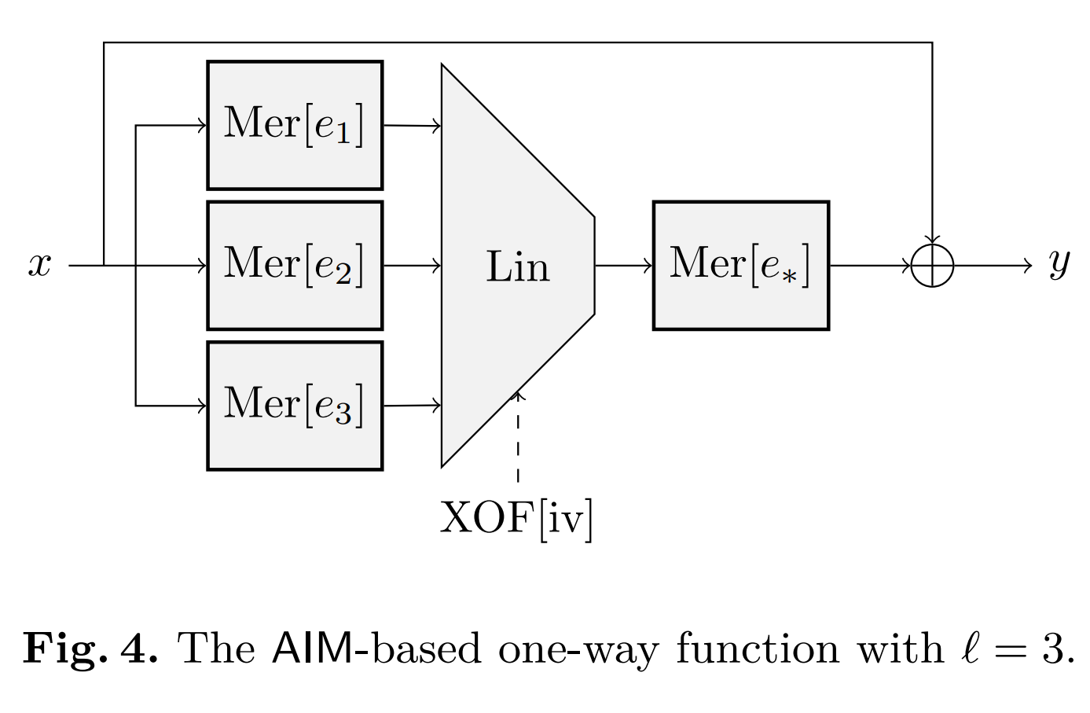
AIM
$x$ : secret input
$y$ : public output
$Mer\left[e\right]\left(x\right)=x^{2^{e}−1}$
$Lin\left(x\right)$ : Linear Mapping

Slide 17
AIM
Flaw: The inputs of non-linear layer are identical.
Possible to linearlize all the non-linear layer

Slide 18
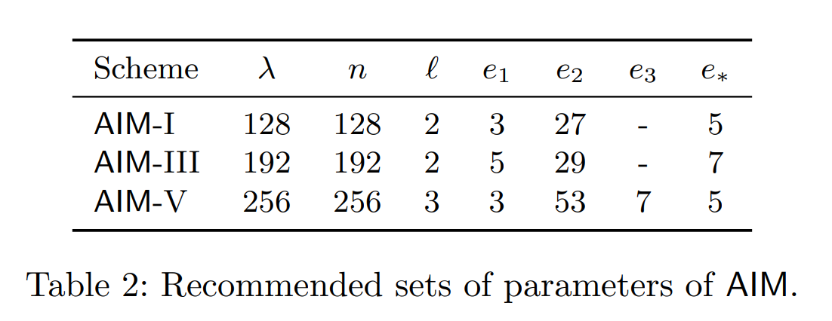
Attack on AIM-192
Does not work on AIM-128/256
For AIM-192
Guess $x^{45}$
$x^{2^{e_{1}}−1}=x^{31}={\left(x^{45}\right)}^{s_{1}}x^{8}$
$x^{2^{e_{2}}−1}=x^{2^{29}−1}={\left(x^{45}\right)}^{s_{2}}x^{8}$
Obtain 180 linear equations
Express $k$ as 12 free variables
Obtain quadratic equations at the second layer.
Complexity: $\frac{|𝔽|−1}{d}×{\left(\frac{192}{192}\right)}^{3}≈2^{187}$

Slide 19
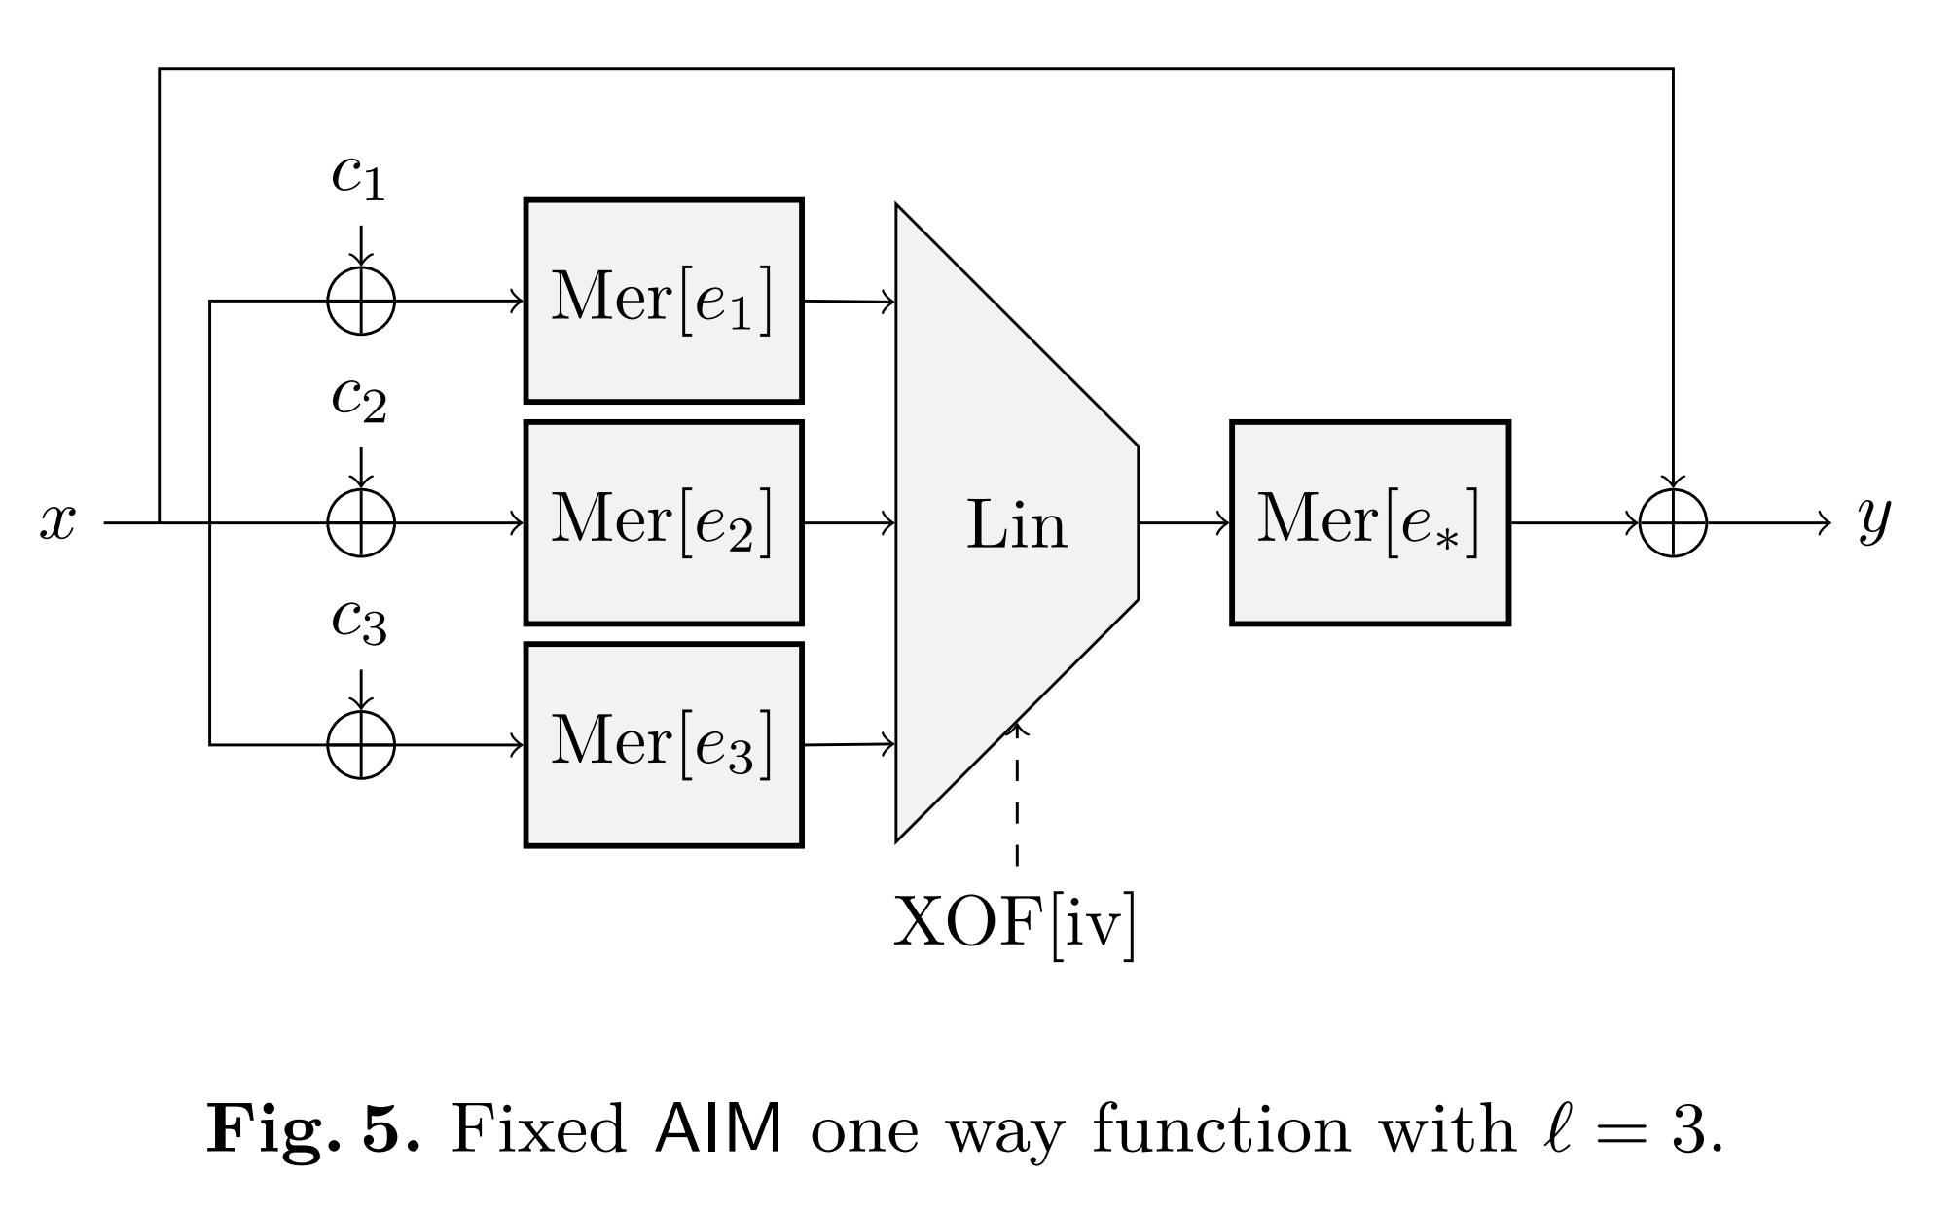
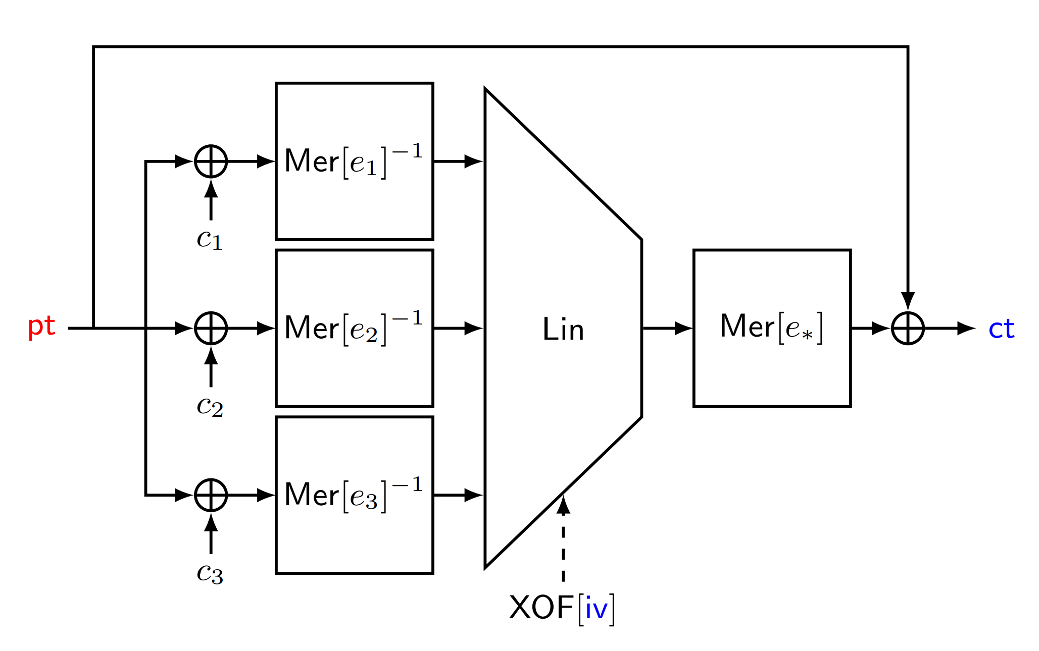
Our Suggestion and AIM2
Our suggestion: add offset $c_{i}$
AIM2

Slide 20
Thank You!
Q & A

