Slide 1
Fine-Grained Proxy Re-Encryption： Definitions & Constructions from LWE
Yunxiao Zhou, Shengli Liu, Shuai Han, Haibin Zhang
Shanghai Jiao Tong University, Beijing Institute of Technology
Asiacrypt 2023, Guangzhou, China
Notes:
Good morning, my name is Yunxiao Zhou.
I’m gonna give a talk about the paper <Fine-Grained Proxy Re-Encryption Definitions & Constructions from LWE>.
This is a joint work with Shengli Liu, Shuai Han and Haibing Zhang.

Slide 2
Proxy Re-Encryption
Forward to proxy
Re-encryption
$$msg$$
$$msg$$
Alice
Polly
Bob
$$ct^{(A)}$$
$$ct^{(B)}$$
$$(pk^{(A)},sk^{(A)})$$
Encrypt
Decrypt
$$rk_{A→B}$$
$$(pk^{(B)},sk^{(B)})$$
$$msg$$
$$msg$$
Proxy Re-Encryption (PRE) is an Extension of Public Key Encryption (PKE). It allows Alice to allocate her Decryption Right to Bob, with the help of a proxy Polly that has a Re-Encryption Key.
Notes:
We start from the normal proxy re-encryption，or PRE for short. PRE is an extension of Public key encryption.
When Alice receives an encryption of some message under her pk, she can forward it to her proxy, who has a special re-encryption key, or rekey for short.
Her proxy, we say, Polly can use this rekey to transform the ciphertext of Alice to another ciphertext of Bob, the latter one can be decrypted by Bob himself directly and obtain the original message.

Slide 3
Proxy Re-Encryption
PRE has a wide variety of Applications…
I am on vacation
I will handle it
Forward the work
Re-encryption
Boss
Work File
Proxy
Work File
Secretary
$${rk}_{B→S}^{ }$$
Notes:
PRE has a wide variety of Applications. For example, a boss, who is on her vacation, receives some disturbing work that she has to deal with.
If using a standard PKE, the boss may have to decrypt the work file first, encrypt it with the her secretary’s public key and then send the encryption to the secretary.
Now with the help of PRE, she can simply forward the file to her proxy and ask him to transform it into a ciphertext under the secretary’s public key.
Finally, her secretary can decrypt the file herself and handle the work.

Slide 4
Proxy Re-Encryption
PRE has a wide variety of Applications…
I am on vacation
There also exists works not for her
I will handle it
--
Forward the work
Re-encryption
Boss
Work File
Proxy
Work File
Secretary
$${rk}_{B→S}^{ }$$
-
-
$m_{1} m_{2} m_{3} m_{4} m_{5}$
Red messages should be deleted.
…but the "all-or-nothing" mode also brings some inconveniences.
Notes:
However, traditional PRE works in the “all-or-nothing” mode, that is, the secretary will recover the full file from the re-encrypted ciphertext.
And this mode brings some inconveniences.
If there exists some messages that the boss doesn’t want her secretary to see.
For example, suppose that m2 and m4, ,marked in red, are the message that the boss wants to delete.

Slide 5
Proxy Re-Encryption
If I want to delete part of message and then forward the work to my secretary, I have to decrypt the ciphertext first.
I have to do it by myself and cannot ask my proxy to do this for me.
--
Forward the work
Re-encryption
Boss
Work File
Proxy
Work File
Secretary
Can we construct a PRE scheme that supports more flexible delegation?
Notes:
As we can see, in such a scenario, traditional PRE cannot help us. The boss has to decrypt the ciphertext herself with her secret key, delete the message, encrypt it with her secretary’s public key and finally sends the ciphertexts to her secretary.
All these things should be done by herself and now she won’t be able to enjoy her vacation.
So, a natural question is raised. Can we construct a PRE scheme that supports more flexible delegation?

Slide 6
Contents
1
Fine-Grained Proxy Re-Encryption (FPRE)
2
Constructions of FPRE from LWE
3
Comparison
Notes:
To answer this question, we proposed a new primitive called Fine-Grained Proxy Re-Encryption, or FPRE for short.

Slide 7
Fine-Grained Proxy Re-Encryption
Forward to proxy
Fine-Grained
Re-encryption
$$msg$$
$$f(m)$$
Alice
Polly
Bob
$$ct^{(A)}$$
$$ct^{(B)}$$
$$(pk^{(A)},sk^{(A)})$$
Encrypt
$$rk_{A→B}^{f}$$
Decrypt
$$(pk^{(B)},sk^{(B)})$$
$$msg$$
$$f(m)$$
associated with function
a function
of message
Fine-Grained Proxy Re-Encryption (FPRE) now supports more flexible delegation. Now Alice can distribute re-encryption key associated with a function.
Notes:
We first explain the meaning of fine-grainedness for PRE.
Note that now the re-key is additionally associated with a function f which is chosen by Alice and now the proxy can perform a fine-grained re-encryption.
The fine-grained re-encryption means that, Bob can only recover a function of the original message the Alice receives, instead of the whole message.

Slide 8
Fine-Grained PRE: Syntax
Setup → pp : Generate the public parameters.
KGen(pp) → ( $pk, sk$) : Generate the public/secret key pair.
Enc₁( $pk, m$) → $ct_{1}$ : Encrypt message $m$ under public key$pk$. Output the first-level ciphertext level ciphertext $ct_{1}$.
Dec₁( $sk,ct_{1}$ ) → $m$ : Decrypt the first-level ciphertext and output the message.
Enc₂ /Dec₂ : The encryption/decryption algorithm for second-level ciphertext and the definition is similar to that for first-level ciphertext.
FReKGen( $pk^{\left(i\right)},sk^{\left(i\right)},pk^{\left(j\right)},f$ ) → ${rk}_{i→j}^{f}$ : Generate re-encryption key ${rk}_{i→j}^{f}$.
FReEnc(${ rk}_{i→j}^{f}$, $ct_{1}^{\left(i\right)}$ ) → $ct_{2}^{\left(j\right)}$ : With ${rk}_{i→j}^{f}$, re-encrypt $i^{′}s$ first level ciphertext $ct_{1}^{\left(i\right)}$ to $j^{′}s$ second level ciphertext $ct_{2}^{\left(j\right)}$.
Notes:
Formally, FPRE includes eight algorithms, we can divide them into three parts.
The first part includes setup and keygen.
The second part includes two pairs of encrypt/decrypt algorithm. The encrypt algorithm labeled with one or two will output the first level or the second level ciphertext, respectively.
The third part is for fine-grained re-encryption, including fine-grained re-key generation algorithm and fine-grained re-encryption algorithm.

Slide 9
Fine-Grained PRE: Syntax
Re-Encryption Key Generation
Fine-Grained Re-encryption
FReEnc(${ rk}_{i→j}^{f}$, $ct_{1}^{\left(i\right)}$ ) → $ct_{2}^{\left(j\right)}$ : With ${rk}_{i→j}^{f}$,
re-encrypt $i^{′}s$ first level ciphertext $ct_{1}^{\left(i\right)}$
to $j^{′}s$ second level ciphertext $ct_{2}^{\left(j\right)}$.
FReKGen( $pk^{\left(i\right)},sk^{\left(i\right)},pk^{\left(j\right)},f$ ) → ${rk}_{i→j}^{f}$ :
Generate re-encryption key ${rk}_{i→j}^{f}$ .
Alice chooses function $f$ and invokes FReKGen( $pk^{\left(A\right)},sk^{\left(A\right)},pk^{\left(B\right)},f$ ) → ${rk}_{i→j}^{f}$
The proxy invokes FReEnc(${ rk}_{A→B}^{f}$, $ct_{1}^{\left(A\right)}$ ) → $ct_{2}^{\left(B\right)}$
$$\text{se}\text{nds} {rk}_{A→B}^{f}$$
$$m$$
$$f(m)$$
Polly
$$ct_{1}^{\left(A\right)}$$
$$ct_{2}^{\left(B\right)}$$
Alice
Alice
Polly
Bob
$$(pk^{(A)},sk^{(A)})$$
$$rk_{A→B}^{f}$$
$$(pk^{(A)},sk^{(A)})$$
$$rk_{A→B}^{f}$$
$$(pk^{(B)},sk^{(B)})$$
Notes:
More precisely.
The fine-grained re-encryption key generation is invoked by Alice. With this algorithm, she can generate a fine-grained rekey with respect to a proper function f chosen by herself. Then, she sends this fine-grained rekey to her proxy.
The fine-grained re-encryption algorithm is invoked by the proxy Polly. With this algorithm, the proxy can convert a ciphertext of Alice encrypting m to a ciphertext of Bob now encrypting f(m), instead of the whole message m.

Slide 10
Fine-Grained PRE: Single-Hop
×
×
first-level
first-level
√
×
first-level
second-level
second-level
second-level
In our scheme, the first-level ciphertext can be re-encrypted to the second-level ciphertext and the second-level ciphertext cannot be further re-encrypted.
In this way, we obtain a Single-Hop scheme.
Notes:
Our scheme has two levels of ciphertexts.
The first-level ciphertext can be transformed to the second-level ciphertext
while the second-level ciphertext cannot be re-encrypted anymore and thus our scheme is a single-hop one.

Slide 11
Fine-Grained PRE: CPA Security
Challenger
Adversary(adaptive)
Setup → pp
KGen(pp) → ($pk^{\left(i\right)}, sk^{\left(i\right)}$)
pp, $pk^{\left(1\right)},pk^{\left(2\right)},……,pk^{\left(n\right)}$
$$(i,j,f)$$
Multiple ReKey queries
FReKGen( $pk^{\left(i\right)},sk^{\left(i\right)},$
$pk^{\left(j\right)},f$ ) → ${rk}_{i→j}^{f}$
$$rk_{i→j}^{f}$$
Queried rekeys$\{rk_{i→j}^{f}\}$
$$i$$
Multiple Corr queries
Returns secret key of $i$
$${sk}_{ }^{(i)}$$
Corrupted keys$\{sk_{ }^{(i)}\}$
$${(i}^{∗},m_{0},m_{1})$$
Test & answer
Choose random $b←_{\$}\left\{0,1\right\}$
Enc₁( $pk^{\left(i^{∗}\right)}, m_{b}$) → $ct_{1}^{∗}$
$$ct_{1}^{∗}$$
Challenge user $i^{∗}$ must be uncorrupted and no rekeys from it to corrupted users.
$$b′$$
FPRE CPA Security: |Pr[$b=b′$]-1/2|=negligible
Notes:
For the security of FPRE. We consider the CPA security in a multi-user setting.
At the beginning of game, the challenger sends all public keys to the adversary.
Next, the adversary is allowed to make two kinds of queries adaptively, to obtain rekeys and secret keys of some users.
During the game, the adversary obtains a challenge ciphertext of an honest user and wants to distinguish whether it encrypts m0 or m1.
After excluding some trivial attacks, FPRE is CPA-secure if the advantage of any PPT adversary is negligible.

Slide 12
Fine-Grained PRE: CUL Security
Which one?
Re-encryption
≈
first-level
second-level
first level
second level
Enc₁($pk^{\left(i\right)}, m$)
FReEnc(${ rk}_{i→j}^{f}$, $ct_{1}^{\left(i\right)}$)
Enc₁($pk^{\left(i\right)}, m_{1}$)
Enc₂($pk^{\left(j\right)}, m_{2}$)
ciphertexts with proxy relation
ciphertexts generated independently
Ciphertext UnLinkability (CUL) is a security property that the adversary cannot distinguish ciphertexts with proxy relation and ciphertexts generated independently.
As a result, the underlying proxy relationship is protected.
Notes:
We also propose a new security notion for FPRE, named ciphertext unlinkability, or CUL for short.
This security notion means that the adversary cannot distinguish ciphertexts with proxy relation and ciphertexts generated independently.
CUL security is expected to protect the underlying proxy relationship between ciphertexts.

Slide 13
Fine-Grained PRE: UNID, NTR, CS
Unidirectionality (UNID)
$${rk}_{A→B}^{f}$$
$${rk}_{A→B}^{f}$$
×
√
A re-encryption key from Alice to Bob should not imply another re-encryption key from Bob to Alice.
Alice
Bob
Alice
Bob
Non-Transitivity (NTR)
$${rk}_{A→B}^{f}$$
${rk}_{A→B}^{f}$+ ${rk}_{B→C}^{f}$
Re-encryption keys from Alice to Bob and Bob to Charlie should not imply another re-encryption key from Alice to Charlie.
Alice
Bob
×
$${rk}_{B→C}^{f}$$
Alice
Charlie
Bob
Charlie
Collusion-Safety (CS)
+
≠
$$rk_{A→B}^{f}$$
The collusion of proxy and Bob should not lead to the leakage of the complete secret key of Alice.
$$sk^{(B)}$$
$$sk^{(A)}$$
Polly
Bob
Alice
Notes:
At the same time, we also define other important security notions for FPRE.
Unidirectionality means that the rekey from Alice to Bob should not imply a rekey from Bob to Alice.
Non-Transitivity means that the rekeys from Alice to Bob and Bob to Charlie should not imply a rekey from Alice to Charlie.
Collusion-Safety means that the collusion of proxy and Bob should not lead to the leakage of the complete secret key of Alice.

Slide 14
Fine-Grained PRE: Security relations
Ciphertext Unlinkability
CUL
CPA Security
CPA
Unidirectionality
UNID
Colusion Safety
CS
Ciphertext Pseudorandomness
CPR
Non-Transitivity
NTR
Security notions of FPRE under adaptive corruptions and their relations.
We formalize all above security properties (CPA/CPR, CUL, UNID, NTR, CS) and establish relations among them by reduction.
Notes:
In our paper, we formalize all above security properties for FPRE and establish relations among them by reduction.
In particular, CUL security is stronger than CPA security, which in turn implies both UNID and NTR security.

Slide 15
Contents
1
Fine-Grained Proxy Re-Encryption (FPRE)
2
Constructions of FPRE from LWE
3
Comparison
Notes:
Next, I will present an overview of how we construct FPRE from LWE.

Slide 16
Starting From Regev PKE
We start with the Dual Regev encryption [Regev05, STOC].
The public key of user $i$ is set as a matrix $A^{\left(i\right)}$ where
To encrypt a message $m∈\{0,1\}^{ℓ}$, the algorithm works as follows.
LWE instance
message
Notes:
We start with the well-known Dual Regev encryption
The public key of user $i$ is matrix $A^{\left(i\right)}$
The ciphertext ct-i uses an LWE instance A(i) S plus E to hide the message m

Slide 17
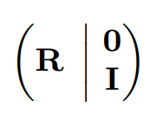
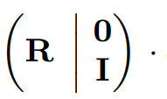
Enable Re-Encryption
Multiply $ct^{\left(i\right)}$with a small norm matrix
, we obtain a result that is close to an encryption.
Original message
Re-encryption key
A new noise $e′$
Can we replace this part with another public key $A^{\left(j\right)}$ ?
Notes:
To convert ct-i to another ciphertext ct-j of user j. We multiply ct-I with a small norm matrix (R zero I) and obtain an equation shown in the slides.
If we can replace the star part with public key A-j of user j, then it becomes a ciphertext of j.

Slide 18
Enable Re-Encryption
With the trapdoor of ${\overline{A}}^{\left(i\right)}$, pre-image sampling algorithm [GPV08, STOC] can help us find a small-norm matrix $R$ such that
LWE instance
message
Ciphertext under public key of j
Notes:
To this end, we use the pre-image sampling algorithm proposed in GPV08 to sample a special matrix R such that the star parts equals A-j, using the trapdoor of A-i. .
In this way, we can transform ct-I to a ciphertext of user j encrypting m.
And the special matrix R is set as the rekey.

Slide 19
To Achieve CPA security
≈
CPA security
ciphertext
random
LWE assumption
No trapdoor of $A^{\left(i\right)}$
Hard to generate re-keys
Public keys
?
Find a way to simulate re-keys
×
This equation can be verified publicly !
Notes:
To achieve CPA security, we try to use LWE assumption to ensure the pseudorandomness of the ciphertext, but then we cannot obtain the trapdoor of A-i when reducing to LWE and it is hard to generate re-keys for the adversary.
So we need to find a way to simulate the rekeys without using the trapdoor of A-i.
However, this is very hard since the adversary can test whether R is a real rekey by checking the equation publicly. (comic)

Slide 20
To Achieve CPA security
To prevent an adversary from verifying the validity of the re-encryption key, we introduce randomness to the generation of re-encryption keys.
The new re-encrypted ciphertext is
replace
LWE
≈ $
? ?
Hidden to adversary
A new s$′$
A bigger noise $e′′$
Notes:
To solve this problem, we adjust our scheme by introducing randomness to the generation of rekeys.
More precisely, when generating the rekey R, we replace A-j with an LWE instance A-j S+E.
Now the term is pseudorandom and the adversary can no longer check the equation.
At the same time, this adjustment doesn’t affect the ciphertext re-encryption since it only introduces a little new noise.

Slide 21
To Achieve Single-Hop
The above scheme is not a single hop scheme.
$${rk}_{A→B}^{f}$$
$${rk}_{B→C}^{f}$$
Alice
Bob
Charlie
Generate
Generate
$$pk^{\left(A\right)}$$
$$pk^{\left(B\right)}$$
trapdoor of $pk^{\left(B\right)}$
$$pk^{\left(C\right)}$$
trapdoor of $pk^{\left(C\right)}$
trapdoor of $pk^{\left(A\right)}$
Notes:
Up to now, we obtain a CPA-secure PRE, however, it is not a single hop scheme.
As we can see, Alice can generate rekey from A to B with the trapdoor of her public key.
And, Bob can do the same thing, for example, he can generates rekey from B to C.
As a result, ciphertext of Alice can be transformed to Bob’s, and further to Charlie’s.

Slide 22
To Achieve Single-Hop
To achieve single-hop, we modify the structure of the public/secret key.
Now the public key of each user is consist of two parts.
$${rk}_{A→B}^{f}$$
No trapdoor and no re-key !
Thus second level ciphertext cannot be further re-encrypted.
Alice
Bob
First-level
trapdoor of $pk_{1}^{\left(A\right)}$
$$pk_{1}^{\left(A\right)}$$
Re-Encrypt
$$pk_{1}^{\left(B\right)}$$
trapdoor of $pk_{1}^{\left(B\right)}$
$$pk_{2}^{\left(A\right)}$$
Second-level
$$pk_{2}^{\left(B\right)}$$
$$sk_{2}$$
$$sk_{2}$$
Notes:
It is desirable to achieve single-hop since it can prevent the proxy from spreading ciphertexts without permission.
To this end, we prepare two pairs of pk,sk for each user.
The first secret key is the trapdoor which can be used to decrypt and generate rekey.
The second secret key can only be used to decrypt.
In this way，we cut the chain of re-encryption and achieve single-hop.

Slide 23
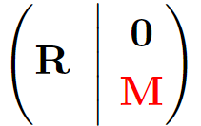
To Achieve Fine-Grained Re-Encryption
In the re-encryption algorithm, message is multiplied by an identity matrix. Note that if we replace this with a matrix $M$, the message will become $Mm$.
$$m$$
$$Mm$$
Fine-Grained Re-Encryption
Notes:
Up to now, we obtain a CPA-secure single-hop PRE.
To Achieve Fine-Grained Re-Encryption
We observe that in our scheme, the message is multiplied by an identity matrix.
Thus, we can replace this with a matrix big M, the message becomes big M times m, which is a function of the message.

Slide 24
To Achieve Adaptive Security
Two level ciphertext also plays an important role in realizing adaptive security.
Note that one level ciphertext is hard to achieve adaptive security:
$${rk}_{A→B}^{f}$$
$${rk}_{B→C}^{f}$$
Alice
Bob
Charlie
×
Generate
$$pk^{\left(A\right)}$$
$$pk^{\left(B\right)}$$
trapdoor of $pk^{\left(B\right)}$
$$pk^{\left(C\right)}$$
trapdoor of $pk^{\left(C\right)}$
trapdoor of $pk^{\left(A\right)}$
To simulate rekey, we will embed LWE problem on $pk^{\left(B\right)}$, and this causes that the trapdoor is unknown to us !
Adversary might then query re-key from Bob to Charlie and it is hard to reply without the trapdoor of Bob!
Notes:
See ppt.

Slide 25
To Achieve Adaptive Security
$${rk}_{A→B}^{f}$$
$${rk}_{B→C}^{f}$$
Alice
Bob
√
Charlie
Challenge user
Honest user
Generate
Honest user or
Corrupted user
But we still have the trapdoor and
it is easy to generate re-encryption keys for the adversary.
$$pk_{1}^{\left(A\right)}$$
Re-Encrypt
trapdoor of $pk_{1}^{\left(A\right)}$
$$pk_{1}^{\left(B\right)}$$
trapdoor of $pk_{1}^{\left(B\right)}$
×
$$sk_{2}$$
$$pk_{2}^{\left(A\right)}$$
$$pk_{2}^{\left(B\right)}$$
This design helps us achieve adaptive security with a small tolerable loss of poly(n).
$$sk_{2}$$
Now the simulation of re-key ${rk}_{A→B}^{f}$ causes $sk_{2}$ is unknown to us !
Notes:
In the two-level settings, embedding LWE problem will cause that sk2 is not known to us.
But it doesn’t matter since we still have the trapdoor and it is easy to generate re-encryption keys for the adversary.
This design helps us achieve adaptive security with a small tolerable loss of poly(n).

Slide 26
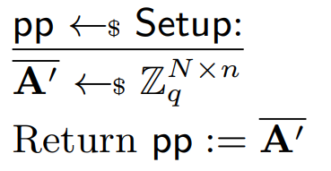
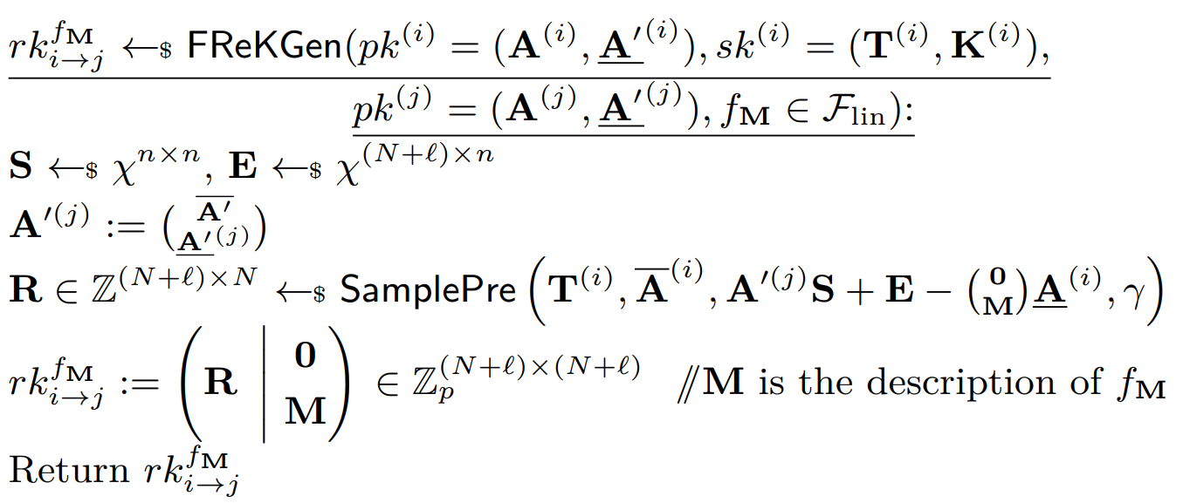
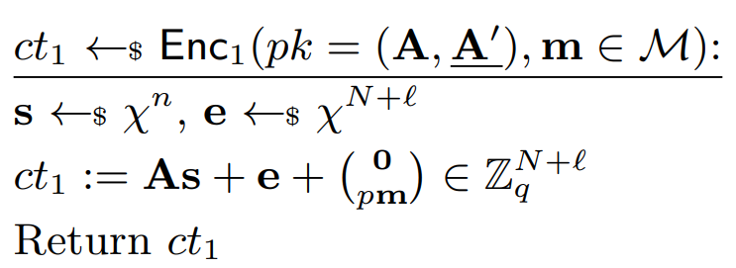
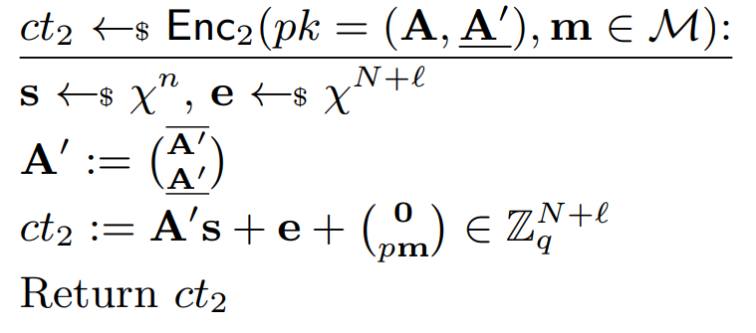
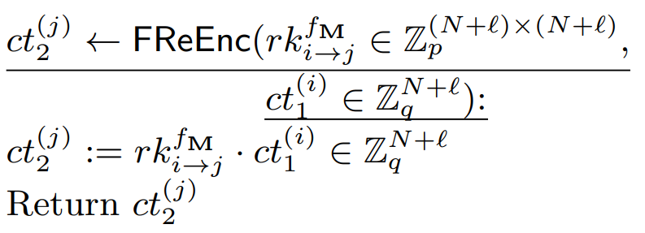
FPRE for Bounded Linear Function
Setup
Re-Encryption Key Generation
First-level encryption
Bounded linear function
Second-level encryption
Re-Encryption
Notes:
Combining all above ideas, we finally obtain our single-hop, adaptively CPA-secure FPRE for bounded linear function, namely, the big M times the message m.
Now we show our full construction. In the Setup, we pick a random matrix A bar prime with no trapdoor.
For the two level encryption algorithm, we can see that ciphertexts in both level has the similar shape, an LWE instance plus the message.
Next is the fine-grained re-encryption key generation algorithm. The key part of the rekey is R, which is generated by the samplePre.
M in red box is the bounded linear function.
The last one is the re-encryption algorithm, the proxy simply performs a simple multiplication.

Slide 27
FPRE for Deletion Function
I am on vacation
There also exists works not for her
I will handle it
--
Forward the work
Re-encryption
--
Boss
Work File
Proxy
Work File
Secretary
$${rk}_{B→S}^{M}$$
-
-
$$1$$
$0$
$$1$$
$$0$$
$$1$$
$m_{1} m_{2} m_{3} m_{4} m_{5}$
$$=$$
$m_{1} 0 { m}_{3} 0 m_{5}$
$1 0 0 0 0$
$$0 0 0 0 0$$
$$0 0 1 0 0$$
$$0 0 0 0 0$$
$$0 0 0 0 1$$
.
$$M=$$
.
Notes:
Now with our FPRE, the boss can set big M as a diagonal matrix and set positions need to be deleted to zero and other positions to 1.
And finally, the only thing the boss should do is forward the encrypted file to her proxy, and the deletion is done along with the re-encryption.
I believe now she will have a nice vacation.

Slide 28
FPRE Scheme: Summary
Post quantum
CPA security
Fine-Grained
re-encryption
Adaptive security
Single-Hop
Pseudorandom
re-encryption key
Well-designed
re-encryption key
Re-encryption between different pk/sk pair
Two level ciphertexts
LWE assumption
Good linear properties of lattice-based cryptography
Various useful tools of
lattice-based cryptography
Different decryption methods for ciphertexts with similar format
Overall, we construct an FPRE scheme from LWE assumption for bounded linear function which supports deletion functions.
Notes:
Finally let’s make a summary about our scheme.
The top layer is the properties of our FPRE scheme, like post quantum CPA security and so on.
The medium layer is our design, different designs brings different properties.
The bottom layer is the cryptographic tools that support our design, like LWE assumption, SamplePre algorithm.
The LWE assumption helps us obtain a Pseudorandom re-encryption key and further brings post quantum CPA security.
Next, Good linear properties of lattice-based cryptography and our well-designed rekey helps to obtain fine-grained re-encryption.
Moreover, the adaptive security is derived from Various useful tools of lattice-based cryptography
Finally, Different decryption methods for ciphertexts with similar format help us obtain a single hop scheme.

Slide 29
Contents
1
Fine-Grained Proxy Re-Encryption: Definitions
2
Technical Overview: Constructions from LWE
3
Comparison
Notes:
And finally, we compare our FPRE with existing single-hop unidirectional PRE schemes.

Slide 30
FPRE Scheme: Comparison
Comparison of single-hop unidirectional PRE schemes.
Scheme | Standard Model ? | Adaptive corruption? | Security | UNID | NTR | CUL | CS | Assumption | Post Quantum? | Fine- Grained?
SC09 | × | √ | CCA | √ | √ | - | √ | DDH | × | ×
CWYD10 | × | × | CCA | √ | √ | - | √ | CDH | × | ×
CDL11 | × | √ | CCA | √ | √ | - | √ | CDH | × | ×
Shao12 | × | √ | CCA | √ | √ | - | √ | DBDH | × | ×
SPR17 | × | × | CCA | √ | √ | - | √ | DCDH | × | ×
AFGH05 | √ | × | weak-CPA | √ | - | - | √ | DBDH | × | ×
LV08 | √ | × | CCA | √ | √ | - | √ | 3-QDBDH | × | ×
Kir14 | √ | × | weak-CCA1 | √ | - | - | - | LWE | √ | ×
FL19 | √ | × | tbCCA | √ | √ | - | - | LWE | √ | ×
SDDR21 | √ | × | HRA | √ | √ | - | - | LWE | √ | ×
LWYYJW21 | √ | × | CPA | √ | - | - | - | LWE | √ | ×
This work | √ | √ | CPA | √ | √ | √ | √ | LWE | √ | √
Notes:
Our scheme achieves adaptive security and all other security notions in the standard model and is the first scheme that supports fine-grained re-encryption.

Slide 31
Conclusion
Definition of a new primitive Fine-Grained PRE.
Formalize the security properties like CPA, CUL, UNID, NTR, CS for FPRE and show relations among them.
First achieve adaptive CPA security in the standard model.
Construction of FPRE for Bounded Linear Functions from LWE.
Construction of FPRE for Deletion Function from LWE.
Thanks! Questions?
ePrint: ia.cr/2023/1324
Notes:
This is the end of this talk, thank you.

