Slide 1
Machine-Checked Security for XMSS as in RFC 8391 and SPHINCS⁺
Manuel Barbosa / François Dupressoir / Benjamin Grégoire / Andreas Hülsing / Matthias Meijers / Pierre-Yves Strub

Slide 2
Context

Slide 3
XMSS (eXtended Merkle Signature Scheme)
Stateful hash-based digital signature scheme
Fixed length → Building block (SPHINCS⁺)
Arbitrary length → Standalone (RFC 8391)
First standardized post-quantum signature scheme (NIST SP 800-208)
Mistake in security proof for SPHINCS⁺, also affects XMSS
4 years until discovery
Fix for SPHINCS⁺, not for XMSS

Slide 4
Computer-Aided Cryptography
Cryptographic constructions and proofs are complex
Broken designs, proofs, and implementations
Alleviate through computers
Reduce complexity
Enforce rigor
Shift “trust”
EasyCrypt

Slide 5
Purpose and Contribution
Increase confidence in security of XMSS and SPHINCS⁺
Fix and verify security proof for XMSS
Verify fix and setup verification of security proof for SPHINCS⁺
Facilitate future formal verification of cryptography
Digital signature schemes
Hash functions
Hash-then-sign paradigm
Merkle trees

Slide 6
Process

Slide 7
Objectives
Fix and verify security proof for XMSS
EUF-CMA
Hash function properties
Verify fix and setup verification of security proof for SPHINCS⁺

Slide 8
Approach
Devise Proof
Formalize Context and Proof Steps
Formally Verify Proof
= Without Tool
= With Tool

Slide 9
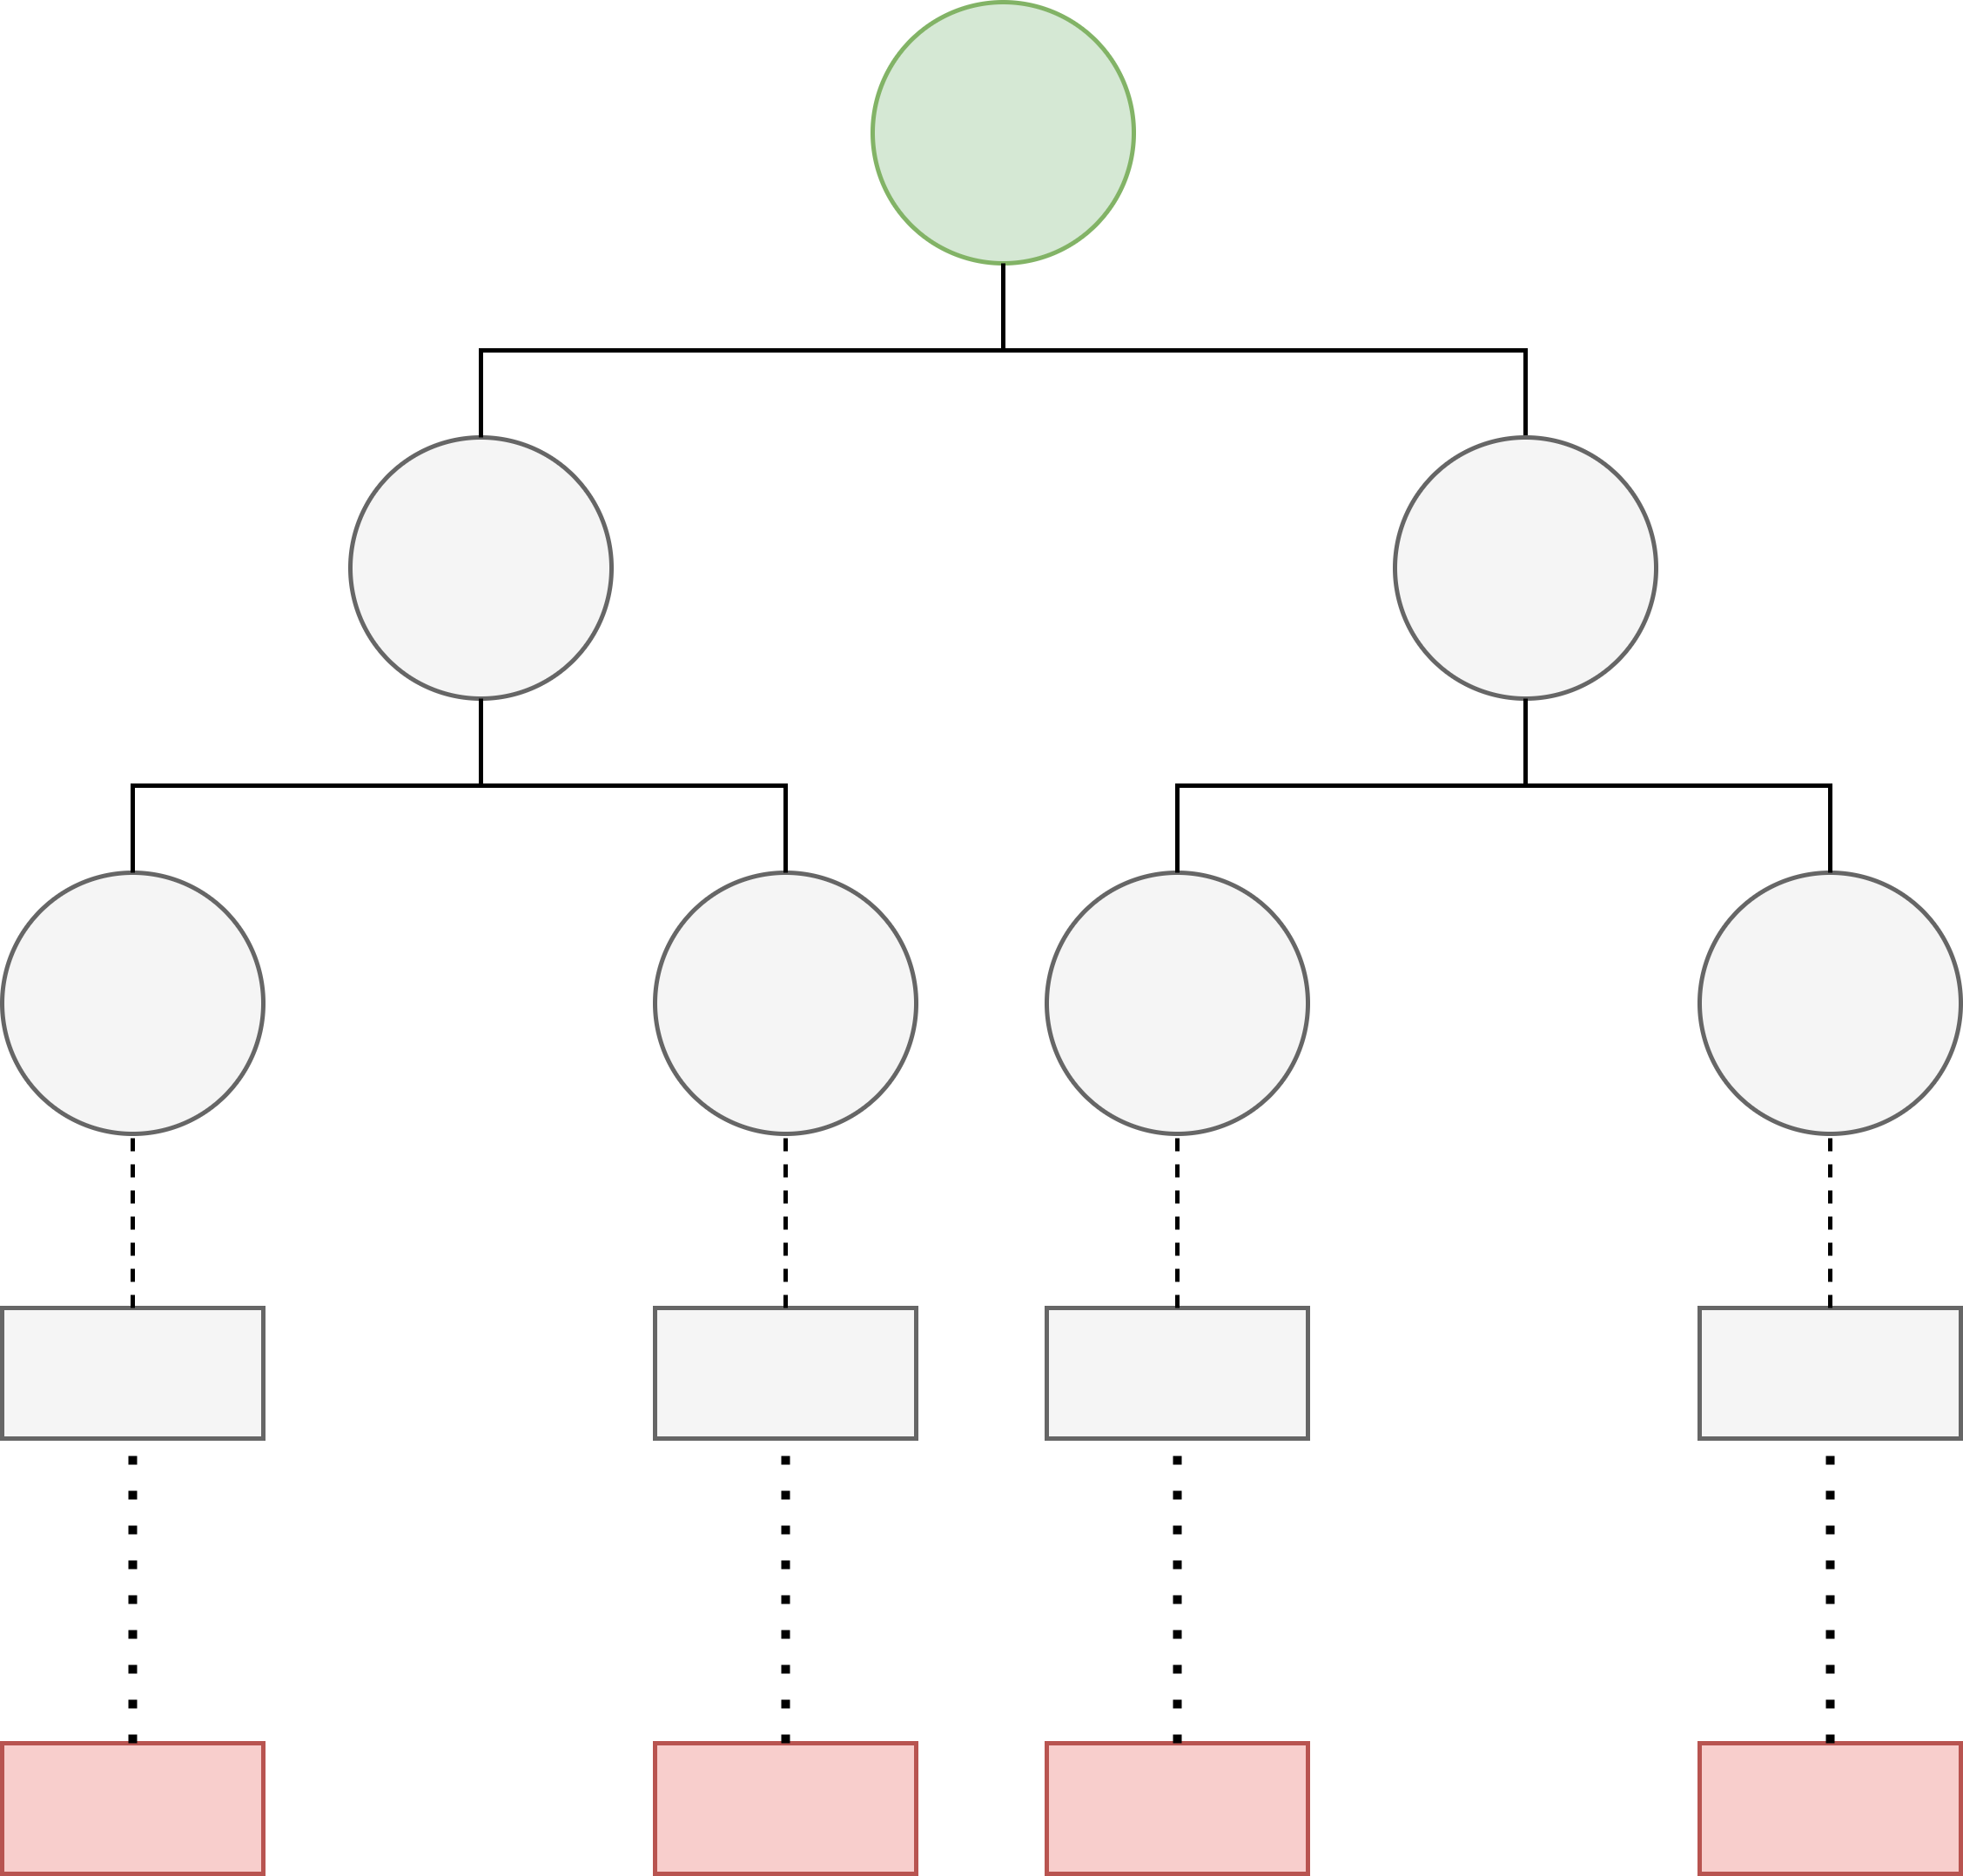
Devise Proof – Scheme (Key Generation)
Combine OTS and Merkle tree
Public key =
Secret key =
State = 0
Combine and Hash
Key Compression
WOTS Public Key
Hash Chains
WOTS Secret Key

Slide 10
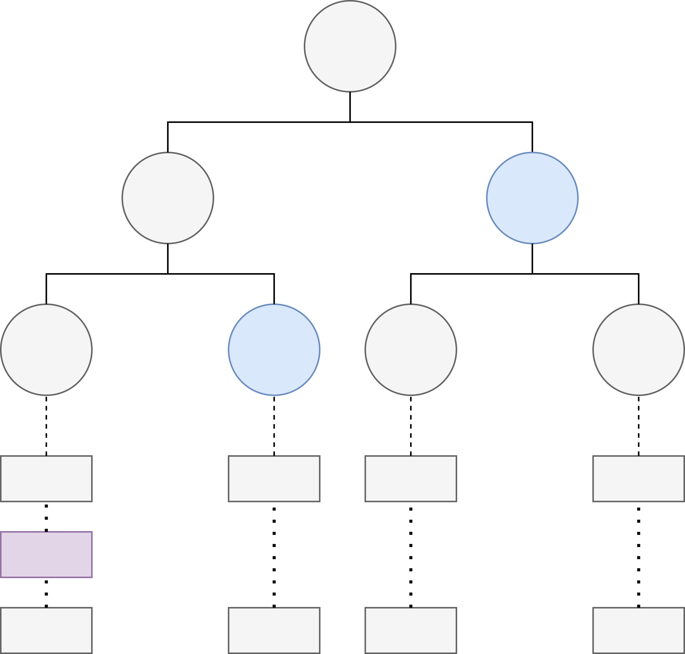
Devise Proof – Scheme (Signing and Verification)
Message compression
Sig = (state, , )
Increment state
Verification by reconstruction and comparison of public key
Authentication Path
WOTS Signature

Slide 11
Devise Proof – Proof Structure
Setup SPHINCS⁺
Fix SPHINCS⁺
Fixed-length XMSS EUF-RMA
WOTS M-EUF-GCMA
Chain Hash UD
Chain Hash PRE
XMSS EUF-CMA
Tree Hash TCR
Message Compression CR
Chain Hash TCR
Nonce Generation PRF
Key Compression TCR
ROM

Slide 12
Formalize Context and Proof Steps
Context
Parameters
Types, functions, and distributions (Merkle trees)
Schemes (hash-then-sign)
Proof steps (and corresponding artifacts)
Security notions (digital signatures) and hardness properties (hash functions)
Adversary classes and reduction adversaries
Games
Proof steps

Slide 13
Formally Verify Proof
M-EUF-GCMA of WOTS
Hybrid argument
EUF-RMA of fixed-length XMSS
Authentication path collision
EUF-CMA of XMSS
Hash-then-sign
Random oracle reprogramming
Fixed-length XMSS EUF-RMA
WOTS M-EUF-GCMA
Chain Hash UD
Chain Hash PRE
XMSS EUF-CMA
Tree Hash TCR
Message Compression CR
Chain Hash TCR
Nonce Generation PRF
Key Compression TCR

Slide 14
Future Work and Summary

Slide 15
Future Work
Quantum-accessible Random Oracle Model (QROM)
SPHINCS⁺
Hash function instantiations/properties
Formally verified implementations
EasyCrypt (Formosa Crypto project*)
*For more information, see formosa-crypto.org

Slide 16
Summary and Statistics
Fix and verify security proof for XMSS
Verify fix and setup verification of security proof for SPHINCS⁺
New EasyCrypt libraries
Effort
1 intermediate (developing), 5 advanced (guiding), part-time, for 1 year
Output
~19000 lines of EasyCrypt code

Slide 17
Questions?

