Slide 1
Cloning Games: A General Framework for Unclonable Primitives
CRYPTO 2023
Prabhanjan Ananth Fatih Kaleoglu Qipeng Liu
UCSB UCSB
Simons
Institute

Slide 2
No-Cloning Theorem
X

Slide 3
No Partial Cloning
X
file.quantum
file1.quantum
file2.quantum
Stronger than No-Cloning
Output.txt
Output.txt
Output.txt

Slide 4
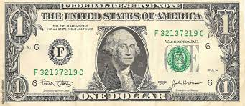
Unclonable Cryptography
Classically Impossible
New technologies
Unconditional Quantum Advantage
Algorithmic Advantage
(conditional on assumptions)
$$| ⟩$$

Slide 5
Unclonable Primitives
MAJOR OPEN PROBLEM
Unclonable Functionality ----------- Primitive
Ciphertext ----------------------------- Unclonable Encryption
(Gottesman ‘02, BL ’20, AK ’21, AKLLZ ’22, …)
Decryption Key ----------------------- Unclonable Decryption Keys
(GZ ’20, CLLZ ‘21, SW ‘22, …)
Function Evaluation ----------------- Copy-Protection
(Aaronson ‘09, CMP ’20, CLLZ ‘21, AK ’21, SW ’22, …)
Passing Public Verification --------- Public-Key Quantum Money
(Aaronson ‘09, FGHLS ‘10, AC ‘12, Zhandry ‘17, LMZ ’22, …)
…
(Focus of this work)
MAJOR OPEN PROBLEM

Slide 6
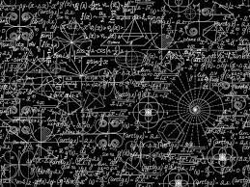
How to Improve Prior Work?
Similar Techniques
Used
Complicated
Proofs
Limited Work
On Implications
Need a more systematic study!
Impagliazzo’s
5 worlds

Slide 7
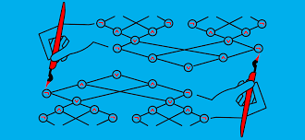
Why Study the Relationship between Unclonable Primitives? (1)
Minimal Computational Assumptions
Impagliazzo’s
5 worlds
Black-Box Separations

Slide 8
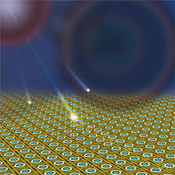
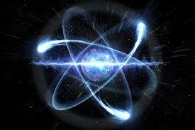
Why Study the Relationship between Unclonable Primitives? (2)
Types of States
Wiesner (BB84) states – near term
Coset states – long term
Prepare & Measure
Fault-Tolerant
Quantum Computing
Notes:
Constructions using another primitive can uncover new types of states that can be used for the primitive.

Slide 9
Why Study the Relationship between Unclonable Primitives? (3)
Using existing classical techniques
Hybrid method
Goldreich-Levin
$$≈$$
$$≈$$
Extraction
Simultaneous
Extraction

Slide 10
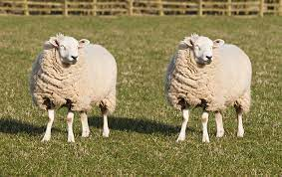
Contributions (Conceptual)
New framework:
Cloning Games

Slide 11
Contributions (Results) – 1
Unconditionally secure Unclonable Decryption Keys in the plain model
Prior Work:
Public-key constructions from heavy assumptions (GZ ‘20, CLLZ ‘21)
Relationship to Unclonable Encryption and Copy-Protection (GZ ’20, SW ‘22)
Notes:
post-quantum IO

Slide 12
Contributions (Results) – 2
Unclonable Encryption with random oracle from Wiesner (BB84) states (*)
Copy-Protection for single-bit point functions with random oracle from Wiesner (BB84) states (*)
Prior Work:
Same result from coset states (AKLLZ ‘22)
Different security notions (BL ‘20, AK ‘21, KT ‘22)
Impossibility of Copy-Protection (AL ’20, AK ‘22)
(*) Simplified security proof

Slide 13
Contributions (Results) – 3
Relate different security notions for unclonable decryption keys and copy-protection
No such prior work known.
Notes:
Mention that we will discuss this later.

Slide 14
Contributions (Results) – 4
New construction of Encryption with Certified Deletion. (*)
Security proof based on Monogamy of Entanglement (TFKW ‘13)
Prior Work:
Unconditionally secure construction (BI ‘20)
Security proof based on entropic bounds.
Other primitives with certified deletion (BK ‘22)
(*) Simplified security proof

Slide 15
Cloning Games (Idea)
Verifiable
Quantum Token
Unclonable

Slide 16
Cloning Games (1 - Setup Phase)
Setup() sk
TokenGen(sk)

Slide 17
Cloning Games (2 - Splitting Phase)
Setup() sk
TokenGen(sk)
Entanglement
Allowed
Notes:
No communication between Bob & Charlie

Slide 18
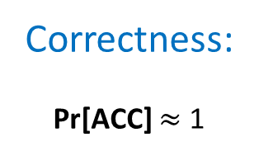
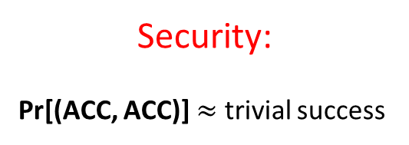
Cloning Games (3 - Verification Phase)
ChallengeGen(sk)
(ch, ch’)
Ver(sk, ch, ans)
ACC/REJ
Ver(sk, ch’, ans’)
ACC/REJ
ch
ch’
ans
ans’
Security:
Pr[(ACC, ACC)] $≈$ trivial success
Correctness:
Pr[ACC] $≈$ 1

Slide 19
Cloning Games (Correctness)
ch
ans
ACCEPTs with probability $≈$ 1
Notes:
There exists such Alice.

Slide 20
Cloning Games (Security)
ACCEPTs both with probability
$≤ ≈$ trivial success
ch
ch’
ans
ans’
(Verification Phase)

Slide 21
Trivial Cloning Attack
Alice treats as a black-box.
$$⊥$$
$≈0$: search
trivial success
$≈1/2$: decision

Slide 22
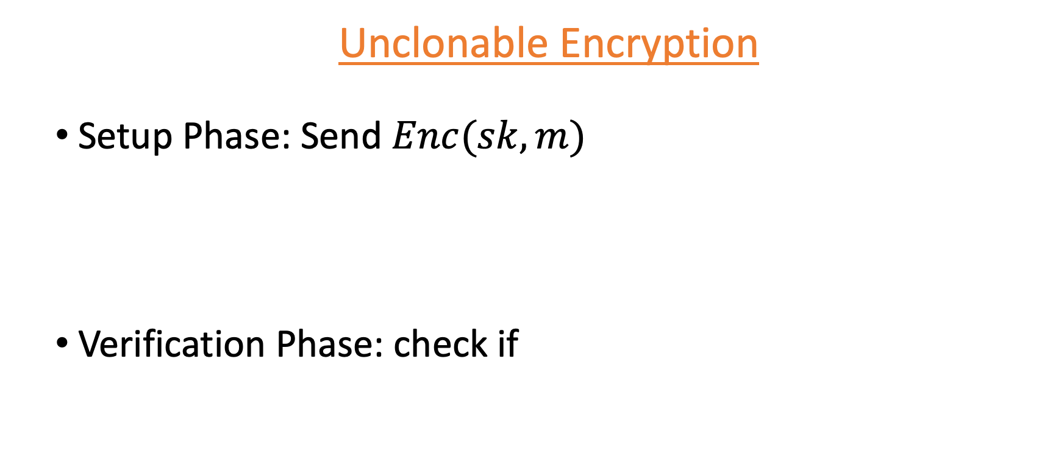
Unclonable Primitives as Cloning Games
Unclonable Encryption
Setup Phase: Send $Enc(sk, m)$
Verification Phase: check if
$$sk$$
$$m$$

Slide 23

Unclonable Primitives as Cloning Games
Copy-Protection
Setup Phase: Send copy-protection of $f$
Verification Phase:
Captures almost all primitives:
Single-Decryptor Encryption
Quantum Money
Tokenized Signatures
Certified Deletion
…
$$x$$
$$f(x)$$

Slide 24
Cloning Games (Challenge Distributions)
Correlation of (ch, ch’) determines:
Independent-Challenge Mode
Identical-Challenge Mode
ch
ch’
ans
ans’

Slide 25
Relationship Between Challenge Distributions (Result 3)
Theorem: A class of cloning game secure against independent-challenges is also secure against identical-challenges. (E.g. CP with multi-bit output, SDE with multi-bit message)
Notes:
The converse is known to be false as pointed out by a reviewer. In fact, it is secure against arbitrarily correlated challenges.

Slide 26
TECHNIQUES
Search Solver
Goal: Relate search & decision games
Non-Local Setting
Decision Solver
(Golreich-Levin)
Search Solver
Search Solver
Decision Solver
Decision Solver
(Simultaneous
Golreich-Levin)

Slide 27
APPROACH 1 (single query)
Customized non-local reductions
Challenge: One register affects the other
AKLLZ ’21
Query extraction in the random oracle model
Project onto states with “good” eigenvalues
(both Bob & Charlie succeed in the cloning game)
Good states

Slide 28
How to avoid bad states?
Reduce to strong (augmented) unclonable search security
Known previously for coset states
This work: any weakly (search) unclonable states (including BB84)

Slide 29
Search Game
Bob and Charlie need to output a high min-entropy answer $m$
Setup() sk, $m$
TokenGen(sk, $m$)
ChallengeGen(sk)
(ch, ch’)
ch
ch’
$$m$$
$$m$$
Notes:
Includes weakly secure UE

Slide 30
Augmented Security
ch
$$P_{m}$$
ch’
$$P_{m}\left(m\right)=1 \\ P_{m}\left(m^{′}\right)=0, ∀m≠m′$$
$$m$$
$$m$$
Notes:
Quantum query-access to the oracle.

Slide 31
Why do we need augmented security?
AKLLZ ’22:
Strong monogamy game for cosets (CLLZ ‘21)
Identical challenge to independent challenge reduction via program testing (Zhandry ’20)
This work:
Weak unclonable security of Wiesner states (BL ‘20)
Augmented security of Wiesner states
Identical challenge to independent challenge reduction via program testing (Zhandry ’20)
Reduction requires access to the verification oracle $P_{m}(⋅)$
Notes:
Instead of coset states, use Wiesner states (or any states with weak-UE security) Cleaner implementation of the AKLLZ procedure (not specific to coset states.)

Slide 32
APPROACH 2 (multi-query)
Lift Classical Reductions
Challenge: Running an adversary can destroy its internal state.
BBK ‘22:
This Work:
Classical Black-Box
Non-Adaptive Reduction
Quantum Black-Box Non-Adaptive Reduction
Classical Non-Local Black-Box Non-Adaptive Reduction
Quantum Non-Local Black-Box Non-Adaptive Reduction

Slide 33
Key Step
Prior Work (BBK ’22):
This Work:
(Quantum) Solver
Non-Local Solver
No Communication
Persistent Non-Local Solver
Persistent Solver

Slide 34
Prior Work (BBK ’22):
This Work:
Persistence Theorem:
Non-Local Persistence Theorem:
Run
Non-Local Solver
Run
Solver
Repair (CMSZ ‘21)
Repair (CMSZ ‘21)
to recover success probability
Run
Repair (CMSZ ‘21)

Slide 35
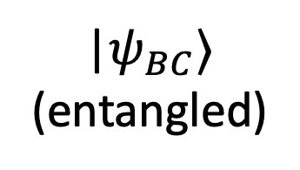
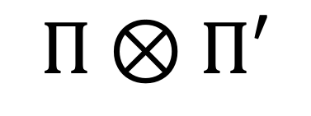
Jordan Subspaces
$$Π⊗Π′$$
|$ψ_{BC}⟩$
(entangled)
Perform Jordan subspace measurement
Commutes with the repair procedure
Unentangles the state
$$\left(Π⊗Π^{′}\right)\left|ψ_{BC}\right\rangle$$
(unentangled)

Slide 36
Jordan Subspaces
Local repair sufficient for independent challenges (convexity)
$$\left(Π⊗Π^{′}\right)\left|ψ_{BC}\right\rangle$$
(unentangled)

Slide 37
Non-Local Lifting - Summary
Locally repair both Bob’s and Charlie’s states.
Works in the independent challenge setting.
Proof by looking at the Jordan decompositions.
Notes:
Talk about jordan subspace measurement for the technical audience.

Slide 38
Non-Local Lifting - Corollaries
One-time unclonable decryption keys in the plain model (result #1)
Independent vs. identical challenge security (result #3)

Slide 39
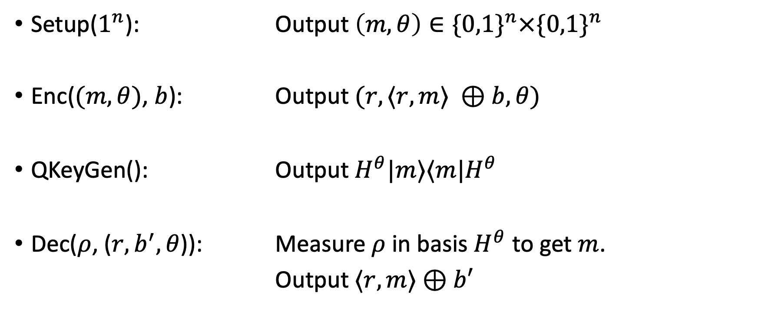
Construction of Unclonable Decryption Keys
Setup($1^{n}$): Output $\left(m, θ\right)∈\{0,1\}^{n}×\{0,1\}^{n}$
Enc($(m, θ)$, $b$): Output $(r,⟨r,m⟩ ⊕b, θ)$
QKeyGen(): Output $H^{θ}|m⟩⟨m|H^{θ}$
Dec($ρ$, ($r,b^{′},θ$)): Measure $ρ$ in basis $H^{θ}$ to get $m$.
Output $⟨r,m⟩⊕b′$
Notes:
Maybe say a sentence or two about security. Mention simultaneous GL.

Slide 40
Open Problems
Relating challenge distributions for non-evasive cloning games
Achieving Unclonable Encryption and Copy-Protection for point functions in the plain model
Removing Black-Box/Non-Adaptive restrictions from the Non-Local Lifting Theorem
Notes:
(2) Remove the QRO from the constructions.

Slide 41
Thank You!
Q & A

